Slide 1
Chapters 12 and 13 A Display Model and Graphics Classes
John Keyser’s
Modifications of Slides by
Bjarne Stroustrup
www.stroustrup.com/Programming

Slide 2
Goal of this
Graphics library allows us to explore some core object-oriented concepts.
Interesting language features
What you see is what you get
Direct relation between concepts, code, output
Graphics can be both fun and useful
Lets you make more interesting output, potentially
Warning: this is not a “real” graphics course!

Slide 3
Display model
Shape
Display
Engine
attach()
draw()
“window”
Square
attach()
Objects (such as graphs) are “attached to” a window.
The “display engine” invokes display commands (such as “draw line from x to y”) for the objects in a window
Objects such as Square contain vectors of lines, text, etc. for the window to draw

Slide 4
Display model
An example illustrating the display model
int main()
{
using namespace Graph_lib; // use our graphics interface library
Point tl(100,200); // a point (obviously)
Simple_window win(tl,600,400,"Canvas"); // make a simple window
Polygon poly; // make a shape (a polygon, obviously)
poly.add(Point(300,200)); // add three points to the polygon
poly.add(Point(350,100));
poly.add(Point(400,200));
poly.set_color(Color::red); // make the polygon red (obviously)
win.attach(poly); // connect poly to the window
win.wait_for_button(); // give control to the display engine
}

Slide 5
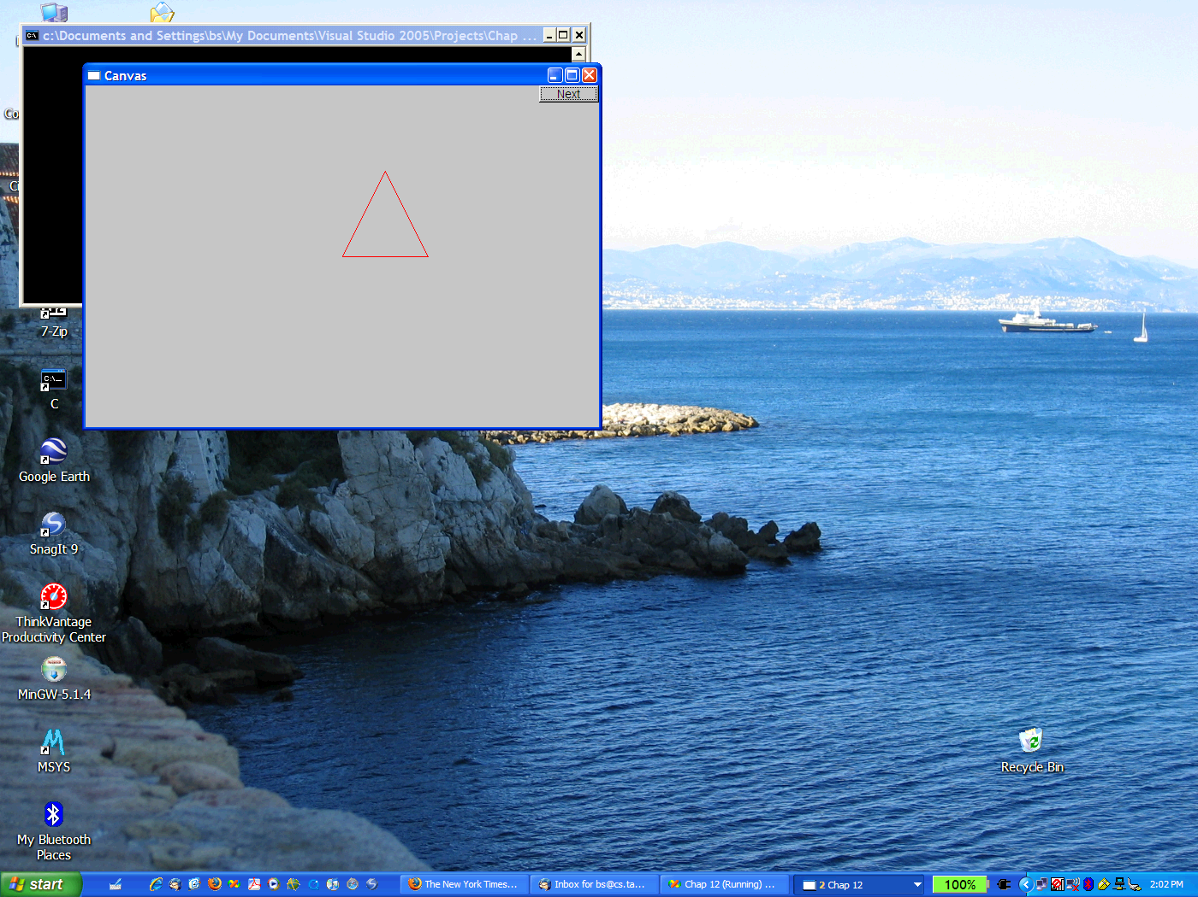
The resulting screen

Slide 6
Graphics/GUI libraries
You’ll be using a few interface classes we wrote
Interfacing to a popular GUI toolkit
GUI == Graphical User Interface
FLTK: www.fltk.org // Fast Light Tool Kit
Installation, etc.
See Appendix D and ask instructor/friend
FLTK
GUI and graphics classes developed for this course
Project settings
This model is far simpler than common toolkit interfaces
The FLTK (very terse) documentation is 370 pages
Our interface library is <20 classes and <500 lines of code
You can write a lot of code with these classes
And you can build more classes on them

Slide 7
Graphics/GUI libraries (cont.)
The code is portable
Windows, Unix, Mac, etc.
This model extends to most common graphics and GUI uses
The general ideas can be used with any popular GUI toolkit
Once you understand the graphics classes you can easily learn any GUI/graphics library
Well, relatively easily – these libraries are huge

Slide 8
Graphics/GUI libraries
Our code
Our interface library
A graphics/GUI library (here FLTK)
The operating system (e.g. Windows or Linux)
Our screen
Often called “a layered architecture”

Slide 9
Interface classes
Line_style
Window
Color
Shape
Point
Simple_window
Line
Lines
Polygon
…
Rectangle
Text
An arrow means “is a kind of”
Color, Line_style, and Point are “utility classes” used by the other classes
Window is our interface to the GUI library (which is our interface to the screen)

Slide 10
Interface classes
Current
Color, Line_style, Font, Point,
Window, Simple_window
Shape, Text, Polygon, Line, Lines, Rectangle, …
Axis
Easy to add (for some definition of “easy”)
Grid, Block_chart, Pie_chart, etc.
Later, GUI
Button, In_box, Out_box, …

Slide 11
Coordinates
0,0
199,0
50,50
0,99
199,99
Oddly, y-coordinates “grow downwards” // right, down
Coordinates identify pixels in the window on the screen
You can resize a window (changing x_max() and y_max())

Slide 12
Demo code 1
// Getting access to the graphics system (don’t forget to install):
#include "Simple_window.h" // stuff to deal with your system’s windows
#include "Graph.h" // graphical shapes
using namespace Graph_lib; // make names available
// in main():
Simple_window win(Point(100,100),600,400,"Canvas");
// screen coordinate (100,100) is top left corner of window
// window size(600 pixels wide by 400 pixels high)
// title: Canvas
win.wait_for_button(); // Display!

Slide 13

A “blank canvas”

Slide 14
Demo code 2
Axis xa(Axis::x, Point(20,300), 280, 10, "x axis");
// make an Axis
// an axis is a kind of Shape
// Axis::x means horizontal
// starting at (20,300)
// 280 pixels long
// 10 “notches” (“tick marks”)
// text “x axis”
win.set_label("Canvas #2");
win.attach(xa); // attach axis xa to the window
win.wait_for_button();

Slide 15
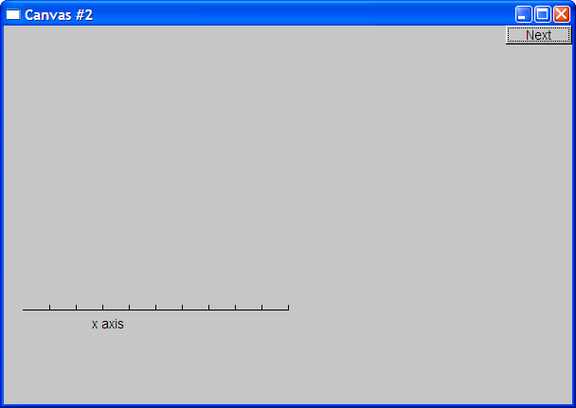
Add an X-axis

Slide 16
Demo code 3
win.set_label("Canvas #3");
Axis ya(Axis::y, Point(20,300), 280, 10, "y axis");
ya.set_color(Color::cyan); // choose a color for the axis
ya.label.set_color(Color::dark_red); // choose a color for the text
win.attach(ya);
win.wait_for_button();

Slide 17
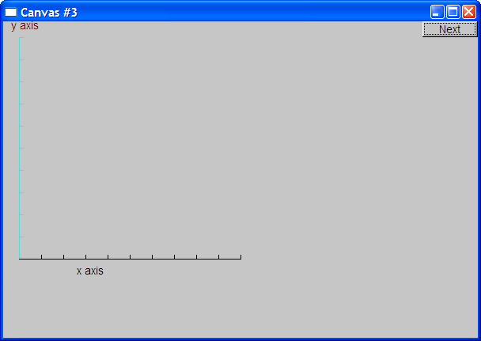
Add a Y-axis (colored)
Yes, it’s ugly, but this is a programming course, not a graphics design course

Slide 18
Demo code 4
win.set_label("Canvas #4");
Function sine(sin,0,100,Point(20,150),1000,50,50); // sine curve
// plot sin() in the range [0:100)
// with (0,0) at (20,150)
// using 1000 points
// scale x values *50, scale y values *50
win.attach(sine);
win.wait_for_button();

Slide 19
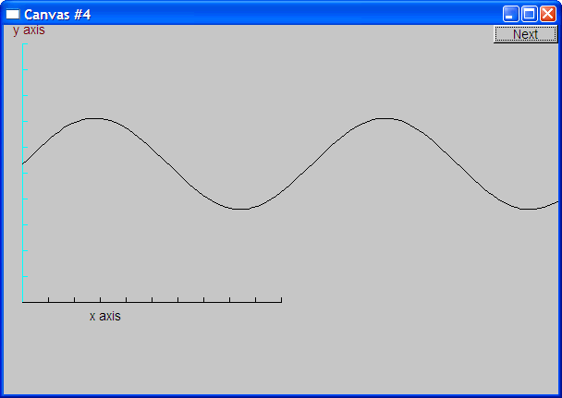
Add a sine curve

Slide 20
Demo code 5
win.set_label("Canvas #5");
sine.set_color(Color::blue); // I changed my mind about sine’s color
Polygon poly; // make a polygon (a kind of Shape)
poly.add(Point(300,200)); // three points make a triangle
poly.add(Point(350,100));
poly.add(Point(400,200));
poly.set_color(Color::red); // change the color
poly.set_style(Line_style::dash); // change the line style
win.attach(poly);
win.wait_for_button();

Slide 21
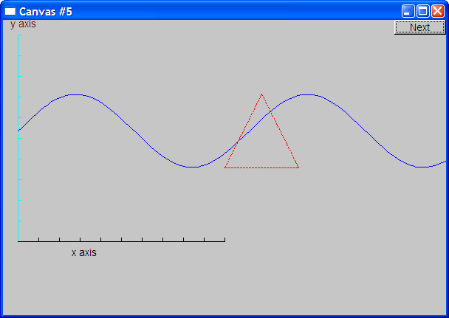
Add a triangle (and color the curve)

Slide 22
Demo code 6
win.set_label("Canvas #6");
Rectangle r(Point(200,200), 100, 50); // top left point, width, height
win.attach(r);
win.wait_for_button();

Slide 23
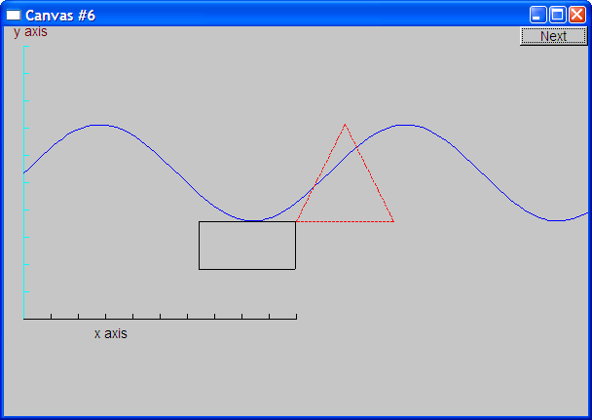
Add a rectangle

Slide 24
Demo code 6.1
Add a shape that looks like a rectangle
Closed_polyline poly_rect;
poly_rect.add(Point(100,50));
poly_rect.add(Point(200,50));
poly_rect.add(Point(200,100));
poly_rect.add(Point(100,100));
win.set_label("Canvas #6.1");

Slide 25
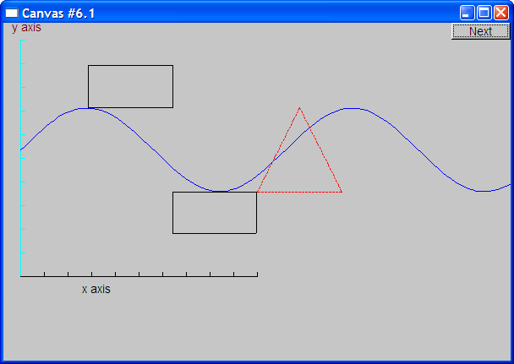
Add a shape that looks like a rectangle
But is it a rectangle?

Slide 26
Demo code 6.2
We can add a point
poly_rect.add(Point(50,75); // now poly_rect has 5 points
win.set_label("Canvas #6.2");
“looking like” is not the same as “is”

Slide 27
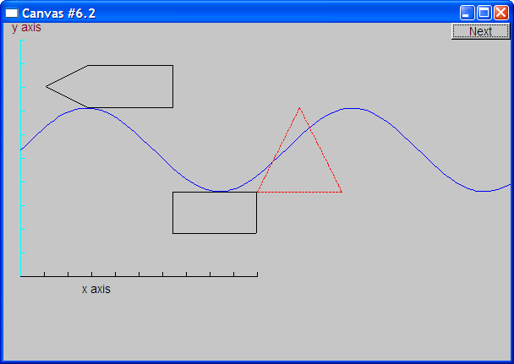
Obviously a polygon

Slide 28
Add fill
r.set_fill_color(Color::yellow); // color the inside of the rectangle
poly.set_style(Line_style(Line_style::dash,4)); // make the triangle fat
poly_rect.set_fill_color(Color::green);
poly_rect.set_style(Line_style(Line_style::dash,2));
win.set_label("Canvas #7");

Slide 29
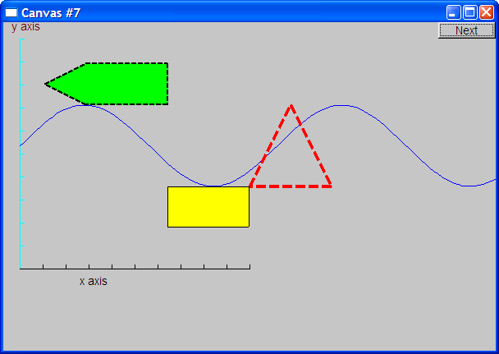
Add fill

Slide 30
Demo Code 8
Text t(Point(100,100),"Hello, graphical world!"); // add text
// point is lower left corner on the baseline
win.set_label("Canvas #8");

Slide 31

Add text

Slide 32
Demo Code 9
Modify text font and size
t.set_font(Font::times_bold);
t.set_font_size(20); // height in pixels

Slide 33
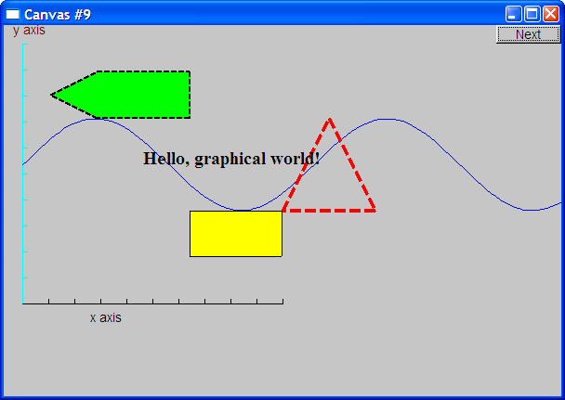
Text font and size

Slide 34
Add an image
Image ii(Point(100,50),"image.jpg"); // open an image file
win.attach(ii);
win.set_label("Canvas #10");

Slide 35
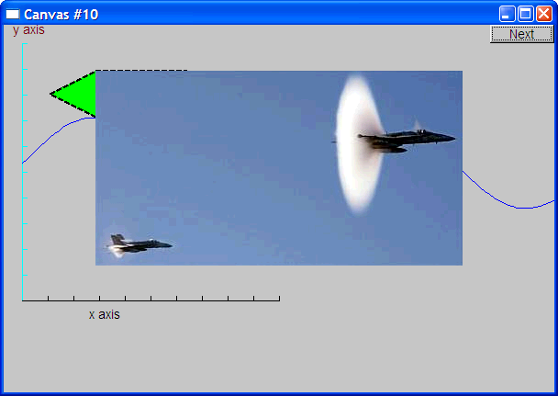
Add an image

Slide 36
Oops!
The image obscures the other shapes
Move it a bit out of the way
ii.move(100,200); // move 100 pixels to the right (-100 moves left)
// move 200 pixels down (-200 moves up)
win.set_label("Canvas #11");
win.wait_for_button();

Slide 37
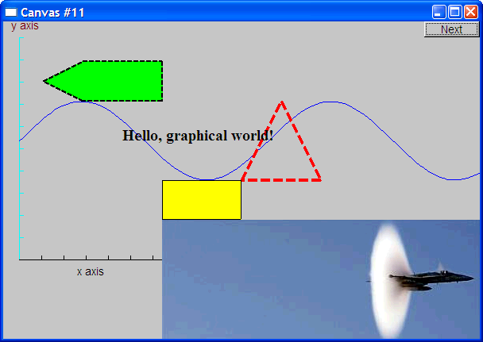
Move the image
Note how the parts of a shape that don’t fit in the window are “clipped” away

Slide 38
Demo Code 12
Circle c(Point(100,200),50); // center, radius
Ellipse e(Point(100,200), 75,25); // center, horizontal radius, vertical radius
e.set_color(Color::dark_red);
Mark m(Point(100,200),'x');
ostringstream oss;
oss << "screen size: " << x_max() << "*" << y_max()
<< "; window size: " << win.x_max() << "*" << win.y_max();
Text sizes(Point(100,20),oss.str());
Image cal(Point(225,225), "snow_cpp.gif"); // 320*240 pixel gif
cal.set_mask(Point(40,40),200,150); // display center of image
win.set_label("Canvas #12");
win.wait_for_button();

Slide 39
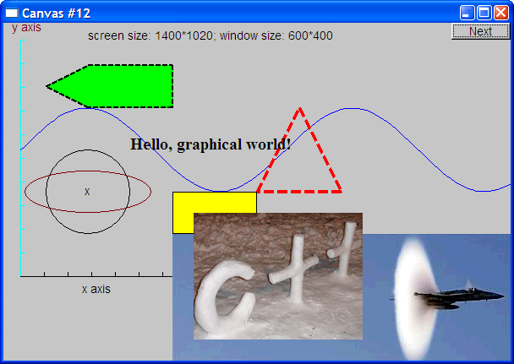
Add shapes, more text

Slide 40
Boiler plate
#include "Graph.h" // header for graphs
#include “Simple_window.h" // header containing window interface
int main ()
try
{
// the main part of your code
}
catch(exception& e) {
cerr << "exception: " << e.what() << '\n';
return 1;
}
catch (...) {
cerr << "Some exception\n";
return 2;
}

Slide 41
Primitives and algorithms
The demo shows the use of library primitives
Just the primitives
Just the use
Typically what we display is the result of
an algorithm
reading data
Now we will look a bit more at how some of this is implemented.

Slide 42
Display model
Open_polyline
draw()
Display
Engine
attach()
draw()
“window”
attach()
Rectangle
draw()
Objects (such as graphs) are “attached to” (“placed in”) a window.
The “display engine” invokes display commands (such as “draw line from x to y”) for the objects in a window
Objects such as Rectangle add vectors of lines to the window to draw

Slide 43
Code organization
FLTK headers
Point.h:
struct Point { … };
FLTK code
Graph.h:
Window.h:
GUI.h:
// Graphing interface:
struct Shape { … };
…
// window interface:
class Window {…};
…
// GUI interface:
struct In_box { … };
…
Graph.cpp:
Window.cpp:
Graph code
Window code
chapter12.cpp:
#include "Graph.h"
#include "Window.h"
int main() { … }
GUI.cpp:
GUI code

Slide 44
Source files
Header
File that contains interface information (declarations)
#include in user and implementer
.cpp (“code file” / “implementation file”)
File that contains code implementing interfaces defined in headers and/or uses such interfaces
#includes headers
Read the Graph.h header
And later the Graph.cpp implementation file
Don’t read the Window.h header or the Window.cpp implementation file
Naturally, some of you will take a peek
Beware: heavy use of yet unexplained C++ features

Slide 45
Design note
The ideal of program design is to represent concepts directly in code
We take this ideal very seriously
For example:
Window – a window as we see it on the screen
Will look different on different operating systems (not our business)
Line – a line as you see it in a window on the screen
Point – a coordinate point
Shape – what’s common to shapes
(imperfectly explained for now; all details in Chapter 14)
Color – as you see it on the screen

Slide 46
Point
namespace Graph_lib // our graphics interface is in Graph_lib
{
struct Point // a Point is simply a pair of ints (the coordinates)
{
int x, y;
Point(int xx, int yy) : x(xx), y(yy) { }
}; // Note the ';'
}

Slide 47
Line
struct Shape {
// hold lines represented as pairs of points
// knows how to display lines
};
struct Line : Shape // a Line is a Shape defined by just two Points
{
Line(Point p1, Point p2);
};
Line::Line(Point p1, Point p2) // construct a line from p1 to p2
{
add(p1); // add p1 to this shape (add() is provided by Shape)
add(p2); // add p2 to this shape
}

Slide 48
Line example
// draw two lines:
using namespace Graph_lib;
Simple_window win(Point(100,100),600,400,"Canvas"); // make a window
Line horizontal(Point(100,100),Point(200,100)); // make a horizontal line
Line vertical(Point(150,50),Point(150,150)); // make a vertical line
win.attach(horizontal); // attach the lines to the window
win.attach(vertical);
win.wait_for_button(); // Display!

Slide 49

Line example

Slide 50
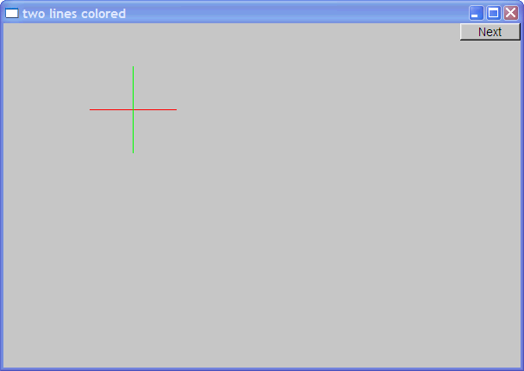
Line example
Individual lines are independent
horizontal.set_color(Color::red);
vertical.set_color(Color::green);

Slide 51
Lines
struct Lines : Shape { // a Lines object is a set of lines
// We use Lines when we want to manipulate
// all the lines as one shape, e.g. move them all
// together with one move statement
void add(Point p1, Point p2); // add line from p1 to p2
void draw_lines() const; // to be called by Window to draw Lines
};
Terminology:
Lines “is derived from” Shape
Lines “inherits from” Shape
Lines “is a kind of” Shape
Shape “is the base” of Lines
This is the key to what is called “object-oriented programming”
We’ll get back to this in Chapter 14

Slide 52
Lines Example
Lines x;
x.add(Point(100,100), Point(200,100)); // horizontal line
x.add(Point(150,50), Point(150,150)); // vertical line
win.attach(x); // attach Lines object x to Window win
win.wait_for_button(); // Draw!

Slide 53
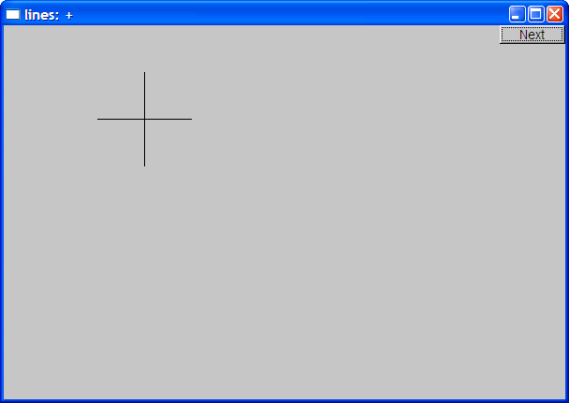
Lines example
Looks exactly like the two Lines example

Slide 54
Implementation: Lines
void Lines::add(Point p1, Point p2) // use Shape’s add()
{
Shape::add(p1);
Shape::add(p2);
}
void Lines::draw_lines() const // to somehow be called from Shape
{
for (int i=1; i<number_of_points(); i+=2)
fl_line(point(i-1).x, point(i-1).y, point(i).x, point(i).y);
}
Note
fl_line is a basic line drawing function from FLTK
FLTK is used in the implementation, not in the interface to our classes
We could replace FLTK with another graphics library

Slide 55
Draw Grid (Why bother with Lines when we have Line?)
// A Lines object may hold many related lines
// Here we construct a grid:
int x_size = win.x_max();
int y_size = win.y_max();
int x_grid = 80; // make cells 80 pixels wide
int y_grid = 40; // make cells 40 pixels high
Lines grid;
for (int x=x_grid; x<x_size; x+=x_grid) // veritcal lines
grid.add(Point(x,0),Point(x,y_size));
for (int y = y_grid; y<y_size; y+=y_grid) // horizontal lines
grid.add(Point(0,y),Point(x_size,y));
win.attach(grid); // attach our grid to our window (note grid is one object)

Slide 56
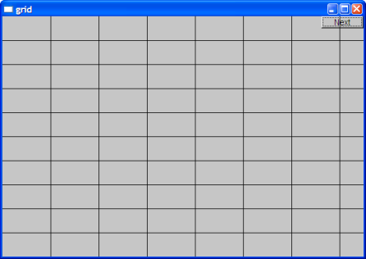
Grid
Oops! Last column is narrow, there's a grid line on top of the Next button, etc.—tweaking required (as usual)

Slide 57
Color
struct Color { // Map FLTK colors and scope them;
// deal with visibility/transparency
enum Color_type { red=FL_RED, blue=FL_BLUE, /* … */ };
enum Transparency { invisible=0, visible=255 }; // also called Alpha
Color(Color_type cc) :c(Fl_Color(cc)), v(visible) { }
Color(int cc) :c(Fl_Color(cc)), v(visible) { }
Color(Color_type cc, Transparency t) :c(Fl_Color(cc)), v(t) { }
int as_int() const { return c; }
Transparency visibility() { return v; }
void set_visibility(Transparency t) { v = t; }
private:
Fl_Color c;
char v;
};

Slide 58
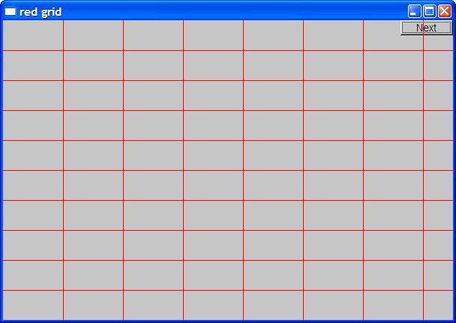
Draw red grid
grid.set_color(Color::red);

Slide 59
Line_style
struct Line_style {
enum Line_style_type {
solid=FL_SOLID, // -------
dash=FL_DASH, // - - - -
dot=FL_DOT, // .......
dashdot=FL_DASHDOT, // - . - .
dashdotdot=FL_DASHDOTDOT, // -..-..
};
Line_style(Line_style_type ss) :s(ss), w(0) { }
Line_style(Line_style_type lst, int ww) :s(lst), w(ww) { }
Line_style(int ss) :s(ss), w(0) { }
int width() const { return w; }
int style() const { return s; }
private:
int s;
int w;
};

Slide 60
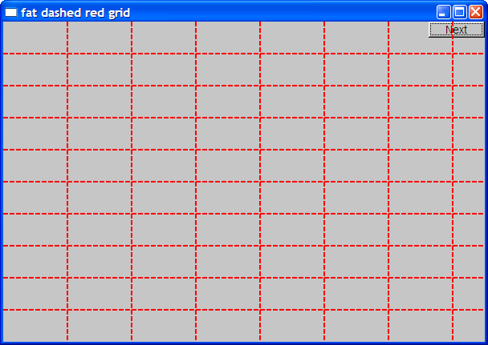
Example: colored fat dash grid
grid.set_style(Line_style(Line_style::dash,2));

Slide 61
Polylines
struct Open_polyline : Shape { // open sequence of lines
void add(Point p) { Shape::add(p); }
};
struct Closed_polyline : Open_polyline { // closed sequence of lines
void draw_lines() const
{
Open_polyline::draw_lines(); // draw lines (except the closing one)
// draw the closing line:
fl_line( point(number_of_points()-1).x,
point(number_of_points()-1).y,
point(0).x,
point(0).y
);
}
void add(Point p) { Shape::add(p); } // not needed (why?)
};

Slide 62
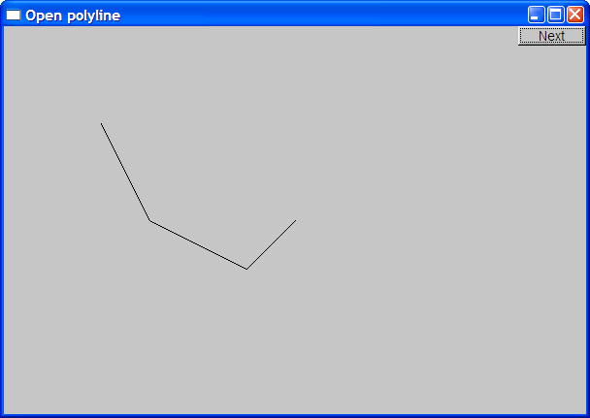
Open_polyline
Open_polyline opl;
opl.add(Point(100,100));
opl.add(Point(150,200));
opl.add(Point(250,250));
opl.add(Point(300,200));

Slide 63

Closed_polyline
Closed_polyline cpl;
cpl.add(Point(100,100));
cpl.add(Point(150,200));
cpl.add(Point(250,250));
cpl.add(Point(300,200));

Slide 64
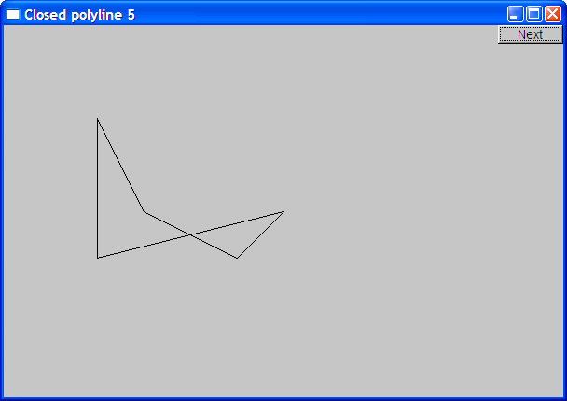
Closed_polyline
cpl.add(Point(100,250));
A Closed_polyline is not a polygon
some closed_polylines look like polygons
A Polygon is a Closed_polyline where no lines cross
A Polygon has a stronger invariant than a Closed_polyline

Slide 65
Text
struct Text : Shape {
Text(Point x, const string& s) // x is the bottom left of the first letter
: lab(s),
fnt(fl_font()), // default character font
fnt_sz(fl_size()) // default character size
{ add(x); } // store x in the Shape part of the Text object
void draw_lines() const;
// … the usual “getter and setter” member functions …
private:
string lab; // label
Font fnt; // character font of label
int fnt_sz; // size of characters in pixels
};

Slide 66
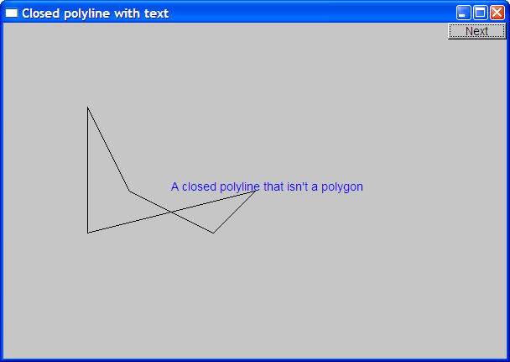
Add text
Text t(Point(200,200), "A closed polyline that isn’t a polygon");
t.set_color(Color::blue);

Slide 67
Implementation: Text
void Text::draw_lines() const
{
fl_draw(lab.c_str(), point(0).x, point(0).y);
}
// fl_draw() is a basic text drawing function from FLTK

Slide 68
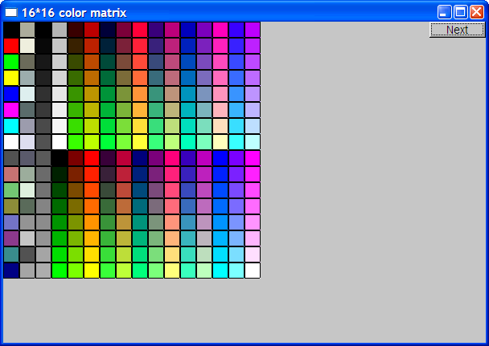
Color matrix
Let’s draw a color matrix
To see some of the colors we have to work with
To see how messy two-dimensional addressing can be
See Chapter 24 for real matrices
To see how to avoid inventing names for hundreds of objects

Slide 69
Color Matrix (16*16)
Simple_window win20(pt,600,400,"16*16 color matrix");
Vector_ref<Rectangle> vr; // use like vector
// but imagine that it holds references to objects
for (int i = 0; i<16; ++i) { // i is the horizontal coordinate
for (int j = 0; j<16; ++j) { // j is the vertical coordinate
vr.push_back(new Rectangle(Point(i*20,j*20),20,20));
vr[vr.size()-1].set_fill_color(i*16+j);
win20.attach(vr[vr.size()-1]);
}
// new makes an object that you can give to a Vector_ref to hold
// Vector_ref is built using std::vector, but is not in the standard library

Slide 70
Color matrix (16*16)
More examples and graphics classes in the book (chapter 13)

Slide 71
Next lecture
What is class Shape?
Introduction to object-oriented programming

