Slide 1
Chapter 15 Functions and graphing
John Keyser’s
Modification of Slides by
Bjarne Stroustrup
www.stroustrup.com/Programming

Slide 2
Abstract
Here we present ways of graphing functions and data and some of the programming techniques needed to do so, notably scaling.

Slide 3
Note
This course is about programming
The examples – such as graphics – are simply examples of
Useful programming techniques
Useful tools for constructing real programs
Look for the way the examples are constructed
How are “big problems” broken down into little ones and solved separately?
How are classes defined and used?
Do they have sensible data members?
Do they have useful member functions?
Use of variables
Are there too few?
Too many?
How would you have named them better?

Slide 4
Graphing functions
Start with something really simple
Always remember “Hello, World!”
We graph functions of one argument yielding one value
Plot (x, f(x)) for values of x in some range [r1,r2)
Let’s graph three simple functions:
double one(double x) { return 1; } // y==1
double slope(double x) { return x/2; } // y==x/2
double square(double x) { return x*x; } // y==x*x

Slide 5
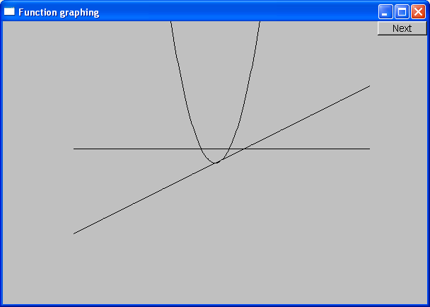
Functions
double one(double x) { return 1; } // y==1
double slope(double x) { return x/2; } // y==x/2
double square(double x) { return x*x; } // y==x*x

Slide 6
How do we write code to do this?
Function to be graphed
Simple_window win0(Point(100,100),xmax,ymax,"Function graphing");
Function s(one, -10,11, orig, n_points,x_scale,y_scale);
Function s2(slope, -10,11, orig, n_points,x_scale,y_scale);
Function s3(square, -10,11, orig, n_points,x_scale,y_scale);
win0.attach(s);
win0.attach(s2);
win0.attach(s3);
win0.wait_for_button( );
First point
“stuff” to make the graph fit into the window
Range in which to graph [x0:xN)

Slide 7
We need some Constants
const int xmax = win0.x_max(); // window size (600 by 400)
const int ymax = win0.y_max();
const int x_orig = xmax/2;
const int y_orig = ymax/2;
const Point orig(x_orig, y_orig); // position of Cartesian (0,0) in window
const int r_min = -10; // range [-10:11) == [-10:10] of x
const int r_max = 11;
const int n_points = 400; // number of points used in range
const int x_scale = 20; // scaling factors
const int y_scale = 20;
// Choosing a center (0,0), scales, and number of points can be fiddly
// The range usually comes from the definition of what you are doing

Slide 8
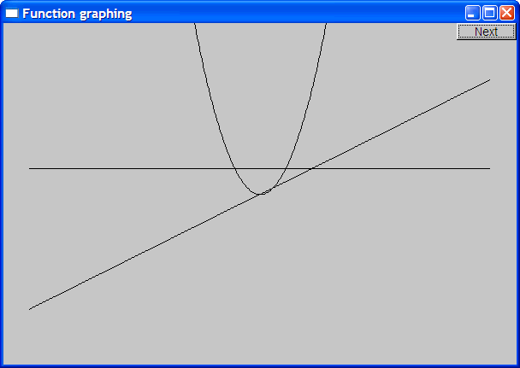
Functions – but what does it mean?
What’s wrong with this?
No axes (no scale)
No labels

Slide 9
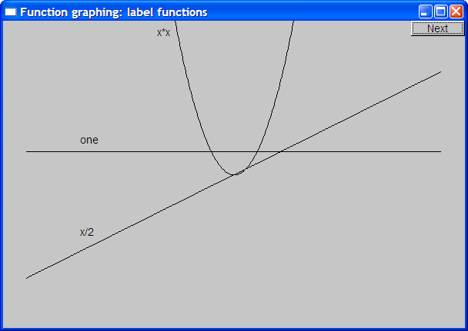
Label the functions
Text ts(Point(100,y_orig-30),"one");
Text ts2(Point(100,y_orig+y_orig/2-10),"x/2");
Text ts3(Point(x_orig-90,20),"x*x");

Slide 10
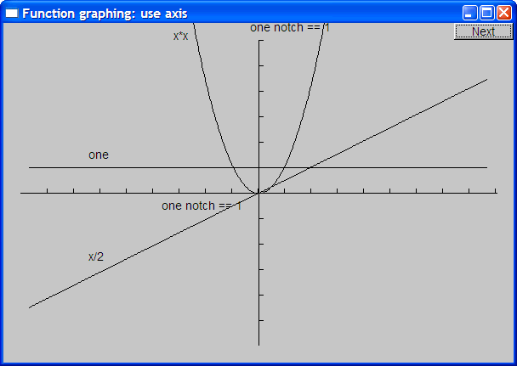
Add x-axis and y-axis
We can use axes to show (0,0) and the scale
Axis x(Axis::x, Point(20,y_orig), xlength/x_scale, "one notch == 1 ");
Axis y(Axis::y, Point(x_orig, ylength+20, ylength/y_scale, "one notch == 1");

Slide 11
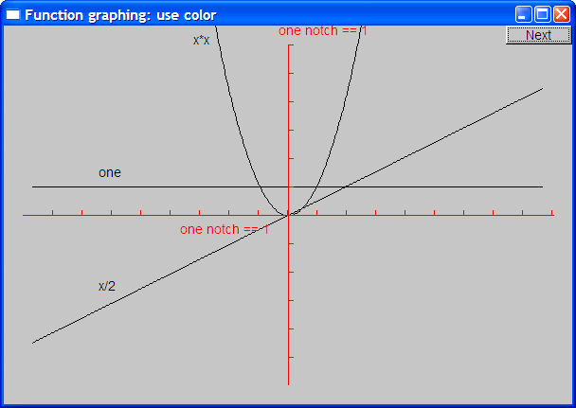
Use color (in moderation)
x.set_color(Color::red);
y.set_color(Color::red);

Slide 12
The implementation of Function
We need a type for the argument specifying the function to graph
typedef can be used to declare a new name for a type
typedef int Count; // now Count means int
Define the type of our desired argument, Fct
typedef double Fct(double); // now Fct means function // taking a double argument // and returning a double
Examples of functions of type Fct:
double one(double x) { return 1; } // y==1
double slope(double x) { return x/2; } // y==x/2
double square(double x) { return x*x; } // y==x*x

Slide 13
Now Define “Function”
struct Function : Shape // Function is derived from Shape
{
// all it needs is a constructor:
Function(
Fct f, // f is a Fct (takes a double, returns a double)
double r1, // the range of x values (arguments to f) [r1:r2)
double r2,
Point orig, // the screen location of Cartesian (0,0)
Count count, // number of points used to draw the function
// (number of line segments used is count-1)
double xscale , // the location (x,f(x)) is (xscale*x, -yscale*f(x)),
double yscale // relative to orig (why minus?)
);
};

Slide 14
Implementation of Function
Function::Function( Fct f,
double r1, double r2, // range
Point xy,
Count count,
double xscale, double yscale )
{
if (r2-r1<=0) error("bad graphing range");
if (count<=0) error("non-positive graphing count");
double dist = (r2-r1)/count;
double r = r1;
for (int i = 0; i<count; ++i) {
add(Point(xy.x+int(r*xscale), xy.y-int(f(r)*yscale)));
r += dist;
}
}

Slide 15
Default arguments
Seven arguments are too many!
Many too many
We’re just asking for confusion and errors
Provide defaults for some (trailing) arguments
Default arguments are often useful for constructors
struct Function : Shape {
Function(Fct f, double r1, double r2, Point xy,
Count count = 100, double xscale = 25, double yscale=25 );
};
Function f1(sqrt, 0, 11, orig, 100, 25, 25 ); // ok (obviously)
Function f2(sqrt, 0, 11, orig, 100, 25); // ok: exactly the same as f1
Function f3(sqrt, 0, 11, orig, 100); // ok: exactly the same as f1
Function f4(sqrt, 0, 11, orig); // ok: exactly the same as f1

Slide 16
Function
Is Function a “pretty class”?
No
Why not?
What could you do with all of those position and scaling arguments?
See 15.6.3 for one minor idea
If you can’t do something genuinely clever, do something simple, so that the user can do anything needed
Such as adding parameters so that the caller can control precision

Slide 17
Some more functions
#include<cmath> // standard mathematical functions
// You can combine functions (e.g., by addition):
double sloping_cos(double x) { return cos(x)+slope(x); }
Function s4(cos,-10,11,orig,400,20,20);
s4.set_color(Color::blue);
Function s5(sloping_cos,-10,11,orig,400,20,20);

Slide 18
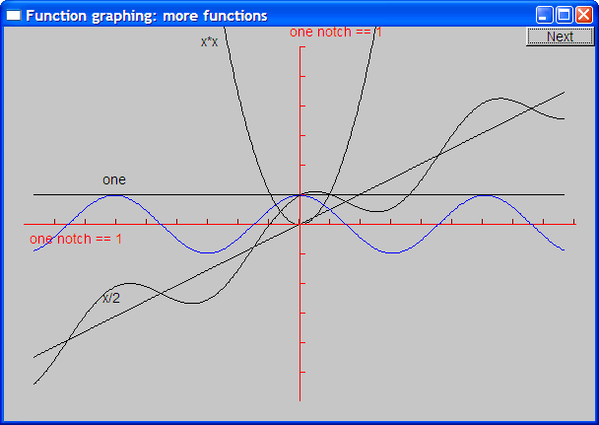
Cos and sloping-cos

Slide 19
Standard mathematical functions (<cmath>)
double abs(double); // absolute value
double ceil(double d); // smallest integer >= d
double floor(double d); // largest integer <= d
double sqrt(double d); // d must be non-negative
double cos(double);
double sin(double);
double tan(double);
double acos(double); // result is non-negative; “a” for “arc”
double asin(double); // result nearest to 0 returned
double atan(double);
double sinh(double); // “h” for “hyperbolic”
double cosh(double);
double tanh(double);

Slide 20
Standard mathematical functions (<cmath>)
double exp(double); // base e
double log(double d); // natural logarithm (base e) ; d must be positive
double log10(double); // base 10 logarithm
double pow(double x, double y); // x to the power of y
double pow(double x, int y); // x to the power of y
double atan2(double y, double x); // atan(y/x)
double fmod(double d, double m); // floating-point remainder // same sign as d%m
double ldexp(double d, int i); // d*pow(2,i)

Slide 21
Why graphing?
Because you can see things in a graph that are not obvious from a set of numbers
How would you understand a sine curve if you couldn’t (ever) see one?
Visualization
Is key to understanding in many fields
Is used in most research and business areas
Science, medicine, business, telecommunications, control of large systems
Can communicate large amounts of data simply

Slide 22
An example: e^{x}
e^{x} == 1
+ x
+ x²/2!
+ x³/3!
+ x⁴/4!
+ x⁵/5!
+ x⁶/6!
+ x⁷/7!
+ …
Where ! means factorial (e.g. 4!==4*3*2*1)
(This is the Taylor series expansion about x==0)

Slide 23
Simple algorithm to approximate e^{x}
double fac(int n) { /* … */ } // factorial
double term(double x, int n) // x^{n}/n!
{
return pow(x,n)/fac(n);
}
double expe(double x, int n) // sum of n terms of Taylor series for e^{x}
{
double sum = 0;
for (int i = 0; i<n; ++i) sum+=term(x,i);
return sum;
}

Slide 24
Simple algorithm to approximate e^{x}
But we can only graph functions of one argument, so how can we get graph expe(x,n) for various n?
int expN_number_of_terms = 6; // nasty sneaky argument to expN
double expN(double x) // sum of expN_number_of_terms terms of x
{
return expe(x,expN_number_of_terms);
}

Slide 25
“Animate” approximations to e^{x}
Simple_window win(Point(100,100),xmax,ymax,"");
// the real exponential :
Function real_exp(exp,r_min,r_max,orig,200,x_scale,y_scale);
real_exp.set_color(Color::blue);
win.attach(real_exp);
const int xlength = xmax-40;
const int ylength = ymax-40;
Axis x(Axis::x, Point(20,y_orig),
xlength, xlength/x_scale, "one notch == 1");
Axis y(Axis::y, Point(x_orig,ylength+20),
ylength, ylength/y_scale, "one notch == 1");
win.attach(x);
win.attach(y);
x.set_color(Color::red);
y.set_color(Color::red);

Slide 26
“Animate” approximations to e^{x}
for (int n = 0; n<50; ++n) {
ostringstream ss;
ss << "exp approximation; n==" << n ;
win.set_label(ss.str().c_str());
expN_number_of_terms = n; // nasty sneaky argument to expN
// next approximation:
Function e(expN,r_min,r_max,orig,200,x_scale,y_scale);
win.attach(e);
win.wait_for_button(); // give the user time to look
win.detach(e);
}

Slide 27
Demo
The following screenshots are of the successive approximations of exp(x) using expe(x,n)

Slide 28
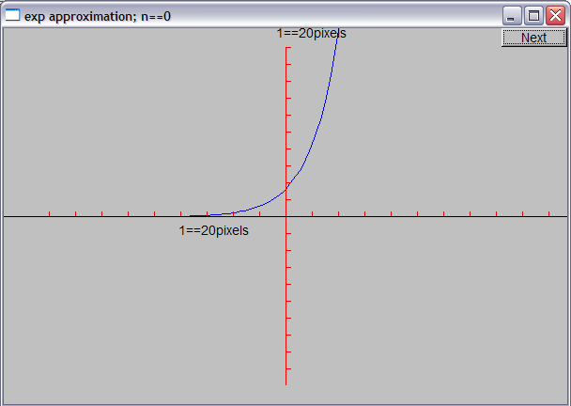
Demo n = 0

Slide 29
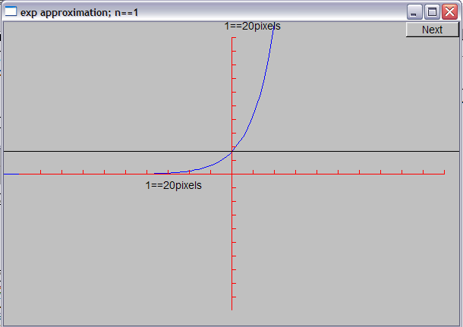
Demo n = 1

Slide 30
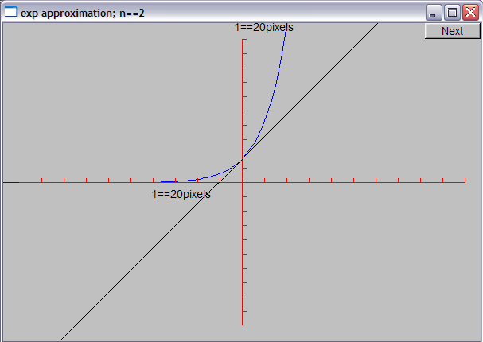
Demo n = 2

Slide 31
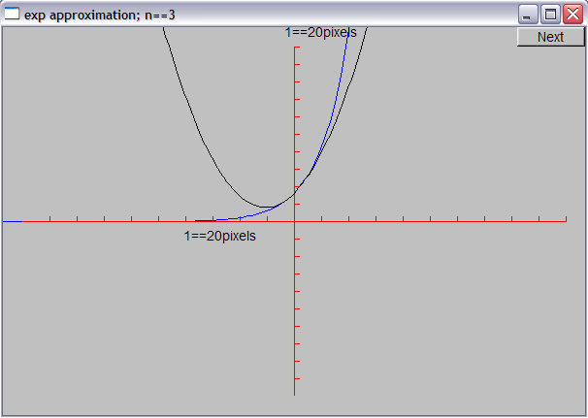
Demo n = 3

Slide 32
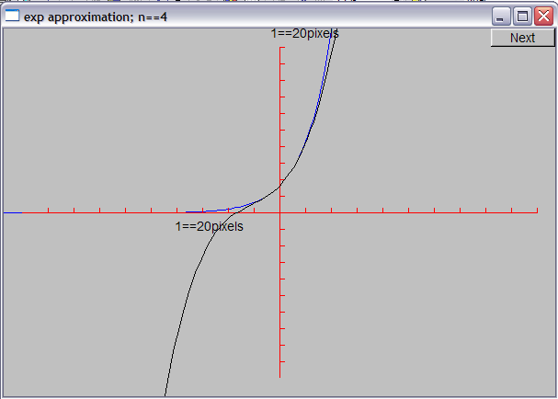
Demo n = 4

Slide 33
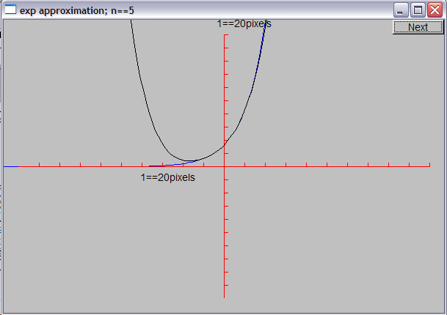
Demo n = 5

Slide 34
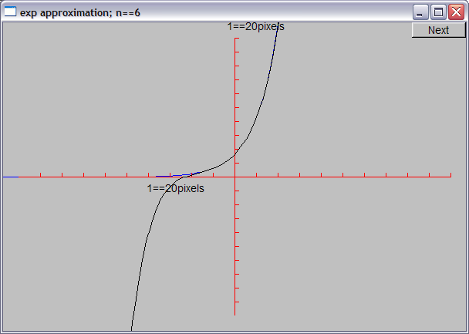
Demo n = 6

Slide 35
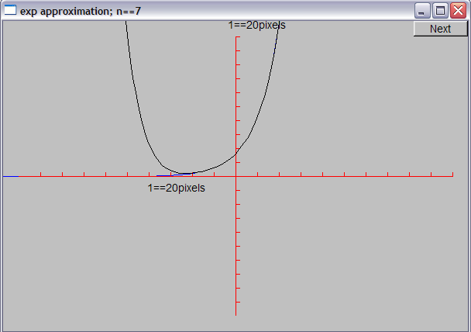
Demo n = 7

Slide 36
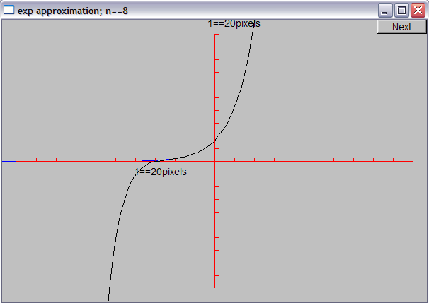
Demo n = 8

Slide 37
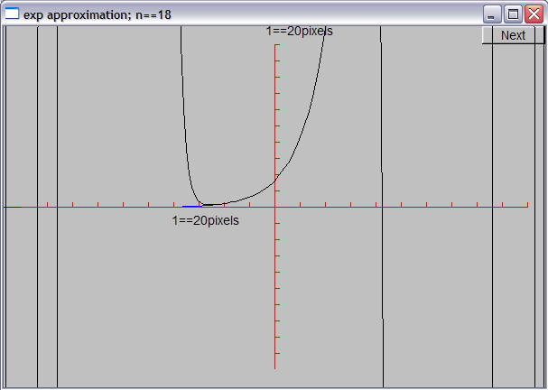
Demo n = 18

Slide 38
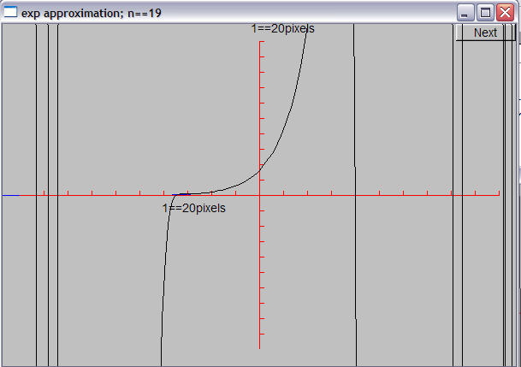
Demo n = 19

Slide 39
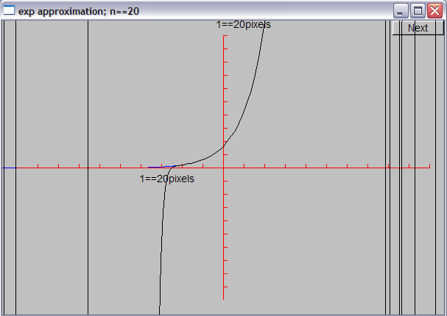
Demo n = 20

Slide 40
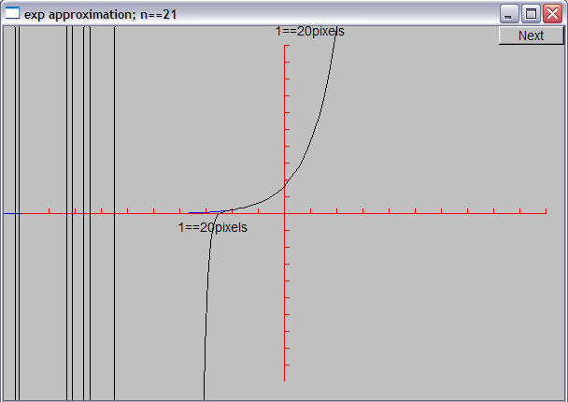
Demo n = 21

Slide 41
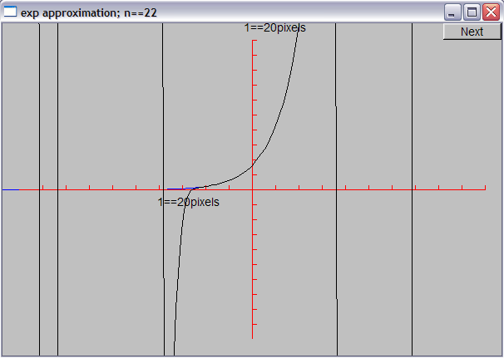
Demo n = 22

Slide 42
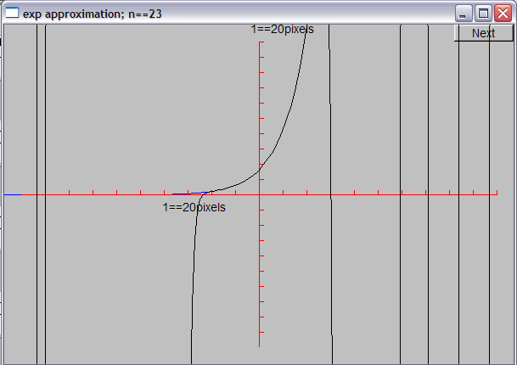
Demo n = 23

Slide 43
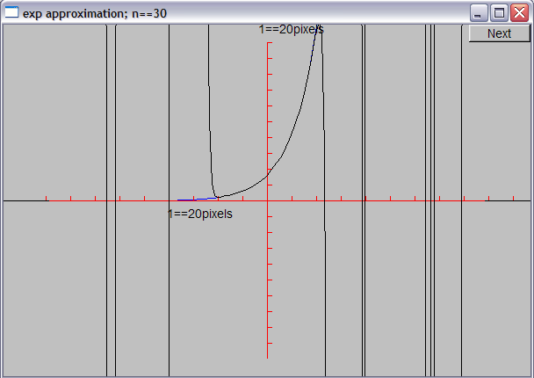
Demo n = 30

Slide 44
Why did the graph “go wild”?
Floating-point numbers are an approximations of real numbers
Just approximations
Real numbers can be arbitrarily large and arbitrarily small
Floating-point numbers are of a fixed size and can’t hold all real numbers
Also, sometimes the approximation is not good enough for what you do
Small inaccuracies (rounding errors) can build up into huge errors
Always
be suspicious about calculations
check your results
hope that your errors are obvious
You want your code to break early – before anyone else gets to use it

Slide 45
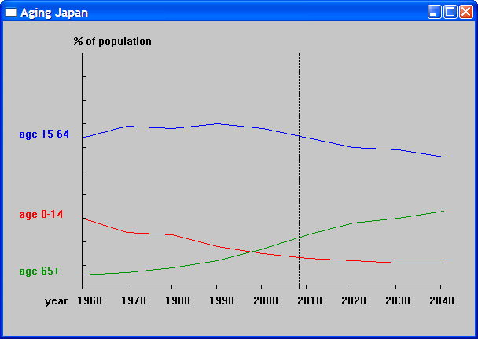
Graphing data
Often, what we want to graph is data, not a well-defined mathematical function
Here, we used three Open_polylines

Slide 46
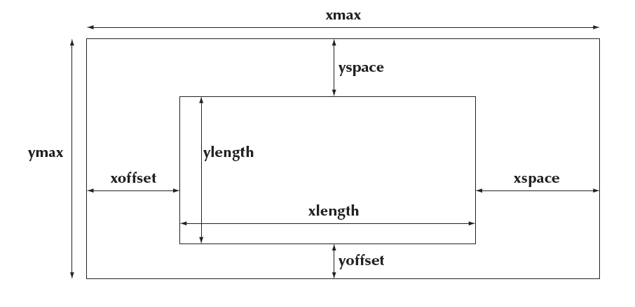
Graphing data
Carefully design your screen layout

Slide 47
Code for Axis
struct Axis : Shape {
enum Orientation { x, y, z };
Axis(Orientation d, Point xy, int length,
int number_of_notches=0, // default: no notches
string label = "" // default : no label
);
void draw_lines() const;
void move(int dx, int dy);
void set_color(Color); // in case we want to change the color of all parts at once
// line stored in Shape
// orientation not stored (can be deduced from line)
Text label;
Lines notches;
};

Slide 48
Axis::Axis(Orientation d, Point xy, int length, int n, string lab)
:label(Point(0,0),lab)
{
if (length<0) error("bad axis length");
switch (d){
case Axis::x:
{ Shape::add(xy); // axis line begin
Shape::add(Point(xy.x+length,xy.y)); // axis line end
if (1<n) {
int dist = length/n;
int x = xy.x+dist;
for (int i = 0; i<n; ++i) {
notches.add(Point(x,xy.y),Point(x,xy.y-5));
x += dist;
}
}
label.move(length/3,xy.y+20); // put label under the line
break;
}
// …
}

Slide 49
Axis implementation
void Axis::draw_lines() const
{
Shape::draw_lines(); // the line
notches.draw_lines(); // the notches may have a different color from the line
label.draw(); // the label may have a different color from the line
}
void Axis::move(int dx, int dy)
{
Shape::move(dx,dy); // the line
notches.move(dx,dy);
label.move(dx,dy);
}
void Axis::set_color(Color c)
{
// … the obvious three lines …
}

Slide 50
Next Lecture
Graphical user interfaces
Windows and Widgets
Buttons and dialog boxes

