Slide 1
Chapter 16 Graphical User Interfaces
John Keyser’s
Modifications of Slides by
Bjarne Stroustrup
www.stroustrup.com/Programming

Slide 2
Overview
Perspective
I/O alternatives
GUI
Layers of software
GUI example
GUI code
callbacks

Slide 3
I/O alternatives
Use console input and output
A strong contender for technical/professional work
Command line interface
Menu driven interface
Graphic User Interface
Use a GUI Library
To match the “feel” of windows/Mac applications
When you need drag and drop, WYSIWYG
Event driven program design
A web browser – this is a GUI library application
HTML / a scripting language
For remote access (and more)

Slide 4
Common GUI tasks
Titles / Text
Names
Prompts
User instructions
Fields / Dialog boxes
Input
Output
Buttons
Let the user initiate actions
Let the user select among a set of alternatives
e.g. yes/no, blue/green/red, etc.

Slide 5
Common GUI tasks (cont.)
Display results
Shapes
Text and numbers
Make a window “look right”
Style and color
Note: our windows look different (and appropriate) on different systems
More advanced
Tracking the mouse
Dragging and dropping
Free-hand drawing

Slide 6
GUI
From a programming point of view GUI is based on two techniques
Object-oriented programming
For organizing program parts with common interfaces and common actions
Events
For connecting an event (like a mouse click) with a program action

Slide 7
Layers of software
When we build software, we usually build upon existing code
Example of a layer
Provides services
Uses services
Our program
Our GUI/Graphics interface library
FLTK
The operating system Graphics GUI facilities
Device driver layer

Slide 8
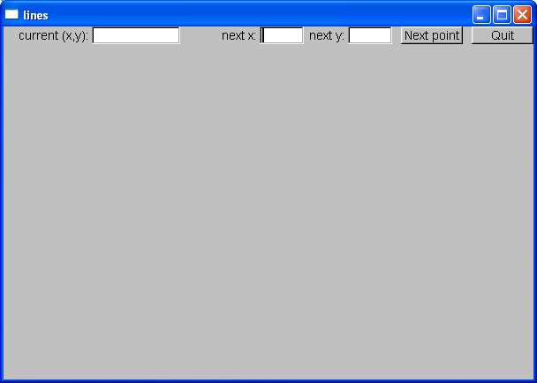
GUI example
Window with
two Buttons, two In_boxes, and an Out_box

Slide 9
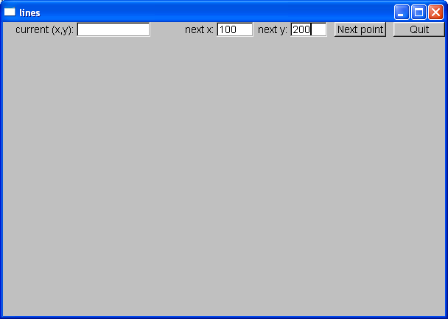
GUI example
Enter a point in the In_boxes

Slide 10

GUI example
When you hit Next point that point becomes the current (x,y) and is displayed in the Out_box

Slide 11

GUI example
Add another point and you have a line

Slide 12

GUI example
Three points give two lines
Obviously, we are building a polyline

Slide 13
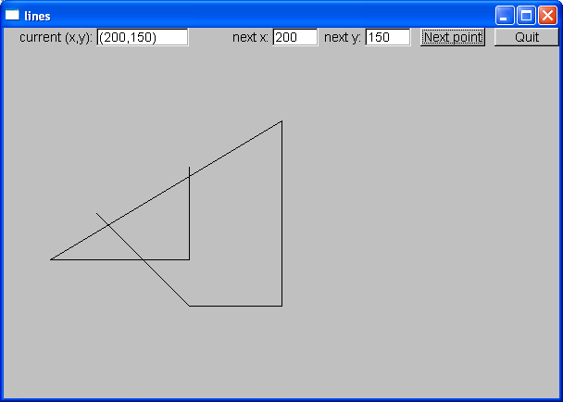
GUI example
And so on, until you hit Quit.

Slide 14
So what? And How?
We saw buttons, input boxes and an outbox in a window
How do we define a window?
How do we define buttons?
How do we define input and output boxes?
Click on a button and something happens
How do we program that action?
How do we connect our code to the button?
You type something into a input box
How do we get that value into our code?
How do we convert from a string to numbers?
We saw output in the output box
How do we get the values there?
Lines appeared in our window
How do we store the lines?
How do we draw them?

Slide 15
How it works
Window
Describe where the button is Describe what the button looks like Register Button’s callback
Attach Button
Our code
FLTK
Call “callback” when Button is pressed

Slide 16
How it works A bit more detail…
Window
Describe where the button is Describe what the button looks like Register Button’s callback
Attach Button
FLTK
Our Code
Window Setup Code
Callback Handling Code
Call “callback” when Button is pressed

Slide 17
Initial Setup/Programming
Program Sets up
Window/Layouts
Program sets up
Callback Functions

Slide 18
System Runs: Startup
WINDOW
Main Program
Executes:
Callbacks are registered
Window is
Created
Program Sets up
Window/Layouts
Program sets up
Callback Functions

Slide 19
System Runs Begin Loop
WINDOW
Main Program:
Infinite Loop
Window/Layouts
Callback Functions

Slide 20
System Runs User Interacts
User Interacts
With Widget in
Window
WINDOW
Main Program:
Infinite Loop
Window/Layouts
Callback Functions

Slide 21
System Runs Callback is Made
User Interacts
With Widget in
Window
WINDOW
Main Program:
Main Program
Calls Appropriate
Callback
Window/Layouts
Callback Functions

Slide 22
System Runs Callback Executes
WINDOW
Main Program:
Main Program
Calls Appropriate
Callback
Callback Function
Executes
Window/Layouts
Callback Functions

Slide 23
System Runs Callback Finishes
WINDOW
Main Program:
Main Program
Calls Appropriate
Callback
Callback Function
Finishes
Window/Layouts
Callback Functions

Slide 24
System Runs See Results
WINDOW
Main Program:
Main Program
Updates
Window
Window/Layouts
Callback Functions

Slide 25
System Runs Return to Loop
WINDOW
Main Program:
Infinite Loop
Window/Layouts
Callback Functions

Slide 26
Mapping
We map our ideas onto the FTLK version of the conventional Graphics/GUI ideas

Slide 27
Define class Lines_window
struct Lines_window : Window // Lines_window inherits from Window
{
Lines_window(Point xy, int w, int h, const string& title); // declare constructor
Open_polyline lines;
private:
Button next_button; // declare some buttons – type Button
Button quit_button;
In_box next_x; // declare some i/o boxes
In_box next_y;
Out_box xy_out;
void next(); // what to do when next_button is pushed
void quit(); // what to do when quit_botton is pushed
static void cb_next(Address, Address window); // callback for next_button
static void cb_quit(Address, Address window); // callback for quit_button
};

Slide 28
GUI example
Window with
two Buttons, two In_boxes, and an Out_box

Slide 29
The Lines_window constructor
Lines_window::Lines_window(Point xy, int w, int h, const string& title)
:Window(xy,w,h,title),
// construct/initialize the parts of the window:
// location size name action
next_button(Point(x_max()-150,0), 70, 20, "Next point", cb_next),
quit_button(Point(x_max()-70,0), 70, 20, "Quit", cb_quit), // quit button
next_x(Point(x_max()-310,0), 50, 20, "next x:"), // io boxes
next_y(Point(x_max()-210,0), 50, 20, "next y:"),
xy_out(Point(100,0), 100, 20, "current (x,y):")
{
attach(next_button); // attach the parts to the window
attach(quit_button);
attach(next_x);
attach(next_y);
attach(xy_out);
attach(lines); // attach the open_polylines to the window
}

Slide 30
Widgets, Buttons, and Callbacks
// A widget is something you see in the window
// which has an action associated with it
// A Button is a Widget that displays as a labeled rectangle on the screen;
// when you click on the button, a Callback is triggered
// A Callback connects the button to some function
struct Button : Widget {
Button(Point xy, int w, int h, const string& s, Callback cb)
:Widget(xy,w,h,s,cb) { }
};

Slide 31
Widgets, Buttons, and Callbacks
A Widget is something you see in the window which has an action associated with it
A Button is a Widget that displays as a labeled
rectangle on the screen, and when you click on the
button, a Callback is triggered
A Callback connects the button to some function or functions (the action to be performed)

Slide 32
GUI example
Add another point and you have a line

Slide 33
Widget
A basic concept in Windows and X windows systems
Basically anything you can see on the screen and do something with is a widget (also called a “control” by Microsoft)
struct Widget {
Widget(Point xy, int w, int h, const string& s, Callback cb)
:loc(xy), width(w), height(h), label(s), do_it(cb)
{ }
// … connection to FLTK …
};

Slide 34
Button
A Button is a Widget that
displays as a labeled rectangle on the screen;
when you click on it, a Callback is triggered
struct Button : Widget {
Button(Point xy, int w, int h, const string& s, Callback cb)
:Widget(xy,w,h,s,cb) { }
};

Slide 35
Callback
Callbacks are part of our interface to “the system”
Connecting functions to widgets is messy in most GUIs
It need not be, but
“the system” does not “know about” C++
the style/mess comes from systems designed in/for C/assembler
Major systems always use many languages; this is one example of how to cross a language barrier
A callback function maps from system conventions back to C++

Slide 36
Callback
Callbacks are part of our interface to “the system”
Connecting functions to widgets is messy in most GUIs
It need not be, but
“the system” does not “know about” C++
the style/mess comes from systems designed in/for C/assembler
Major systems always use many languages; this is one example of how to cross a language barrier
A callback function maps from system conventions back to C++
void Lines_window::cb_quit(Address, Address pw)
// Call Lines_window::quit() for the window located at address pw
{
reference_to<Lines_window>(pw).quit(); // now call our function
}
Map an address into a reference to the type of object residing at that address – to be explained the following chapters

Slide 37
Our “action” code
// The action itself is simple enough to write
void Lines_window::quit()
{
// here we can do just about anything with the Lines_window
hide(); // peculiar FLTK idiom for “get rid of this window”
}

Slide 38
The next point function
// our action for a click (“push”) on the next point button
void Lines_window::next()
{
int x = next_x.get_int();
int y = next_y.get_int();
lines.add(Point(x,y));
// update current position readout:
stringstream ss;
ss << '(' << x << ',' << y << ')';
xy_out.put(ss.str());
redraw(); // now redraw the screen
}

Slide 39
In_box
// An In_box is a widget into which you can type characters
// Its “action” is to receive characters
struct In_box : Widget {
In_box(Point xy, int w, int h, const string& s)
:Widget(xy,w,h,s,0) { }
int get_int();
string get_string();
};
int In_box::get_int()
{
// get a reference to the FLTK FL_Input widget:
Fl_Input& pi = reference_to<Fl_Input>(pw);
// use it:
return atoi(pi.value()); // get the value and convert
// it from characters (alpha) to int
}

Slide 40
Control Inversion
But where is the program?
Our code just responds to the user clicking on our widgets
No loops? No if-then-else?
“The program” is simply
int main ()
{
Lines_window win(Point(100,100),600,400,”lines”);
return gui_main(); // an “infinite loop”
}

Slide 41
Control Inversion
Application
call
Input function
prompt
User responds
Application
callback
System
click
User “action”

Slide 42
Summary
We have seen
Action on buttons
Interactive I/O
Text input
Text output
Graphical output
Missing
Menu (See Section 16.7)
Window and Widget (see Appendix E)
Anything to do with tracking the mouse
Dragging
Hovering
Free-hand drawing
What we haven’t shown, you can pick up if you need it

Slide 43
Next lecture
The next three lectures will show how the standard vector is implemented using basic low-level language facilities.
This is where we really get down to the hardware and work our way back up to a more comfortable and productive level of programming.

