Slide 1


ANAND INSTITUTE OF HIGHER TECHNOLOGY (An Autonomous Institution)
DEPARTMENT OF COMPUTER SCIENCE AND ENGINEERING
AI-DRIVEN CKD AND CVD PREDICTION AND
HOSPITAL RECOMMENDATION
GUIDE NAME
DR. JANCY DAISY SICKORY .M.E.(Ph.D).,
(Associate Professor)
TEAM MEMEBERS
1. KAMAL RAJ D (310121104302)
2. RICHARD NICHOLES M (310121104085)

Slide 2

AGENDA
DOMAIN INTRODUCTION
EXISTING STATEMENT
PROBLEM STATEMENT
PROPOSED STATEMENT
OBJECTIVE AND SCOPE
ARCHITECTURAL DIAGRAM
MODULES
OUTPUT SCREENSHOTS
CONCLUSION
FUTURE ENHANCEMENTS
PUBLICATION
PATENTS
INTERNSHIP CERTIFICATES

Slide 3



DOMAIN INTRODUCTION
This project operates within the domains of Health Informatics, Machine Learning in Healthcare, and Telemedicine, bringing together advanced technologies to enhance early diagnosis, accessibility, and patient care. It leverages predictive analytics to analyze user input and assess the risk of two major health conditions—Chronic Kidney Disease (CKD) and Cardiovascular Disease (CVD)—enabling early intervention and proactive healthcare. By incorporating machine learning algorithms, the system can identify potential health risks, helping users understand their medical status before symptoms become severe. Additionally, the platform integrates IP-based geolocation to recommend nearby hospitals and healthcare facilities, making it easier for users to find and access appropriate care quickly.
The system also includes a convenient appointment booking feature, allowing patients to schedule medical consultations directly through the platform, thus reducing delays and waiting times. To ensure privacy and protect sensitive medical data, the platform employs SHA-256 encryption, a robust security standard, safeguarding personal health information in compliance with data protection regulations. Designed with usability in mind, the platform provides a user-friendly interface that bridges the gap between patients and healthcare providers, facilitating seamless communication and improving the overall healthcare experience. By combining predictive modeling, geolocation services, and secure data management, this digital healthcare assistant aims to revolutionize the way individuals manage their health and access timely medical care.

Slide 4
EXISTING STATEMENT
Inaccurate Predictions: Many systems struggle with providing reliable predictions due to poor data quality or incomplete datasets.
Lack of Personalization: Existing platforms often offer generic advice, neglecting individual factors like lifestyle or genetic markers..
Inefficient Access to Healthcare: Systems may not integrate well with healthcare providers, leading to delays in finding hospitals or booking appointments.
Poor User Experience: Complex interfaces or poor design can make it hard for patients, especially the elderly, to use the system effectively.
Data Security Issues: Many platforms fail to adequately protect sensitive medical data, risking breaches or unauthorized access.

Slide 5
PROBLEM STATEMENT
Many patients discover Chronic Kidney Disease (CKD) or Cardiovascular Disease (CVD) at advanced stages due to lack of early screening tools.
Rural and underserved areas often lack immediate access to healthcare facilities and specialists.
Existing platforms don't provide an end-to-end solution—from risk prediction to hospital recommendations and appointment booking.
Handling sensitive medical information without robust encryption poses risks to patient confidentiality.

Slide 6
PROPOSED STATEMENT
Early Disease Prediction: Utilize the machine learning algorithms to accurately predict the risk of CKD and CVD based on user input data.
User-Friendly Interface: Design an intuitive web-based platform accessible to users of all backgrounds for easy health assessment.
Location Based Recommendations: Integrate IP-based geolocation to suggest nearby hospitals and clinics for timely medical support.
Secure Data Handling: Implement SHA-256 encryption to ensure the privacy and integrity of users’ medical information.
Appointment Booking System: Enable users to seamlessly schedule medical appointments through the platform to reduce delays in treatment.

Slide 7
OBJECTIVE AND SCOPE
Early Disease Prediction: Utilize advanced machine learning algorithms to predict the risk of Chronic Kidney Disease (CKD) and Cardiovascular Disease (CVD) based on user input, enabling early diagnosis and proactive healthcare.
Healthcare Accessibility: Integrate IP-based geolocation to suggest nearby hospitals and healthcare facilities, helping users quickly find and access timely care.
User-Friendly Interface: Create an intuitive, easy-to-use platform for both mobile and desktop, ensuring accessibility for all users.
Appointment Booking: Enable users to book doctor appointments directly through the platform, reducing delays and improving access to healthcare services.
Data Security and Privacy: Implement SHA-256 encryption to ensure the protection of sensitive medical data and ensure compliance with global privacy regulations like HIPAA and GDPR.
User-Friendly Interface: Create an intuitive, easy-to-use platform for both mobile and desktop, ensuring accessibility for all users.

Slide 8
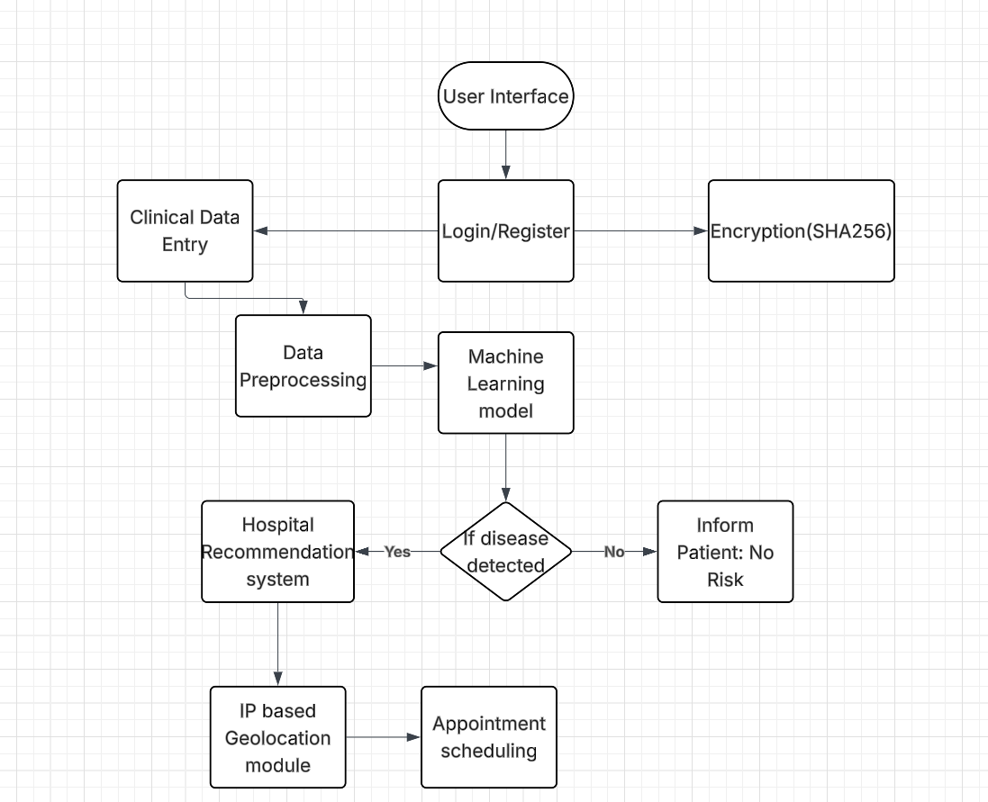
ARCHITECTURAL DIAGRAM

Slide 9
MODULES
Data Encryption and Security Module - Implements SHA-256 encryption for secure data storage and communication and protects user privacy by ensuring the confidentiality and integrity of sensitive health information.
Geolocation-Based Hospital Recommendation Module - Uses IP-based geolocation to suggest nearby hospitals and clinics based on the user’s location and helps users quickly find and access medical facilities close to them for immediate care.
Disease Prediction Module - Uses machine learning to predict CKD and CVD risk based on user data, offering early warning signs for proactive healthcare.
Appointment Booking Module - Allows users to browse available hospital appointment slots and book consultations directly through the platform.
Data Encryption and Security Module - Implements SHA-256 encryption for secure data storage and communication and protects user privacy by ensuring the confidentiality and integrity of sensitive health information.

Slide 10
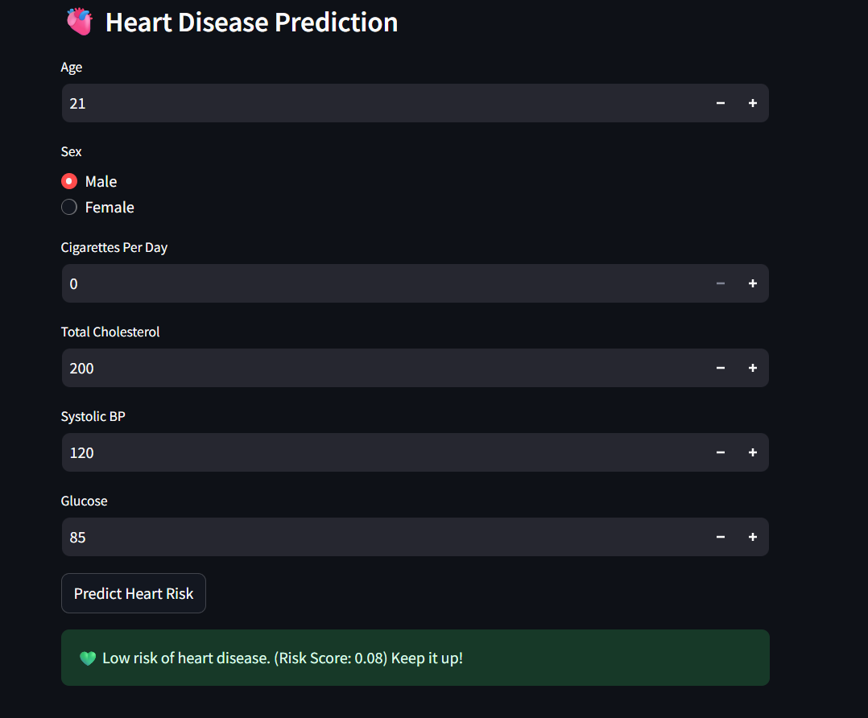
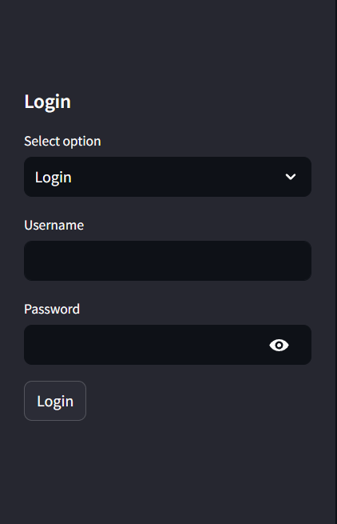
OUTPUT SCREENSHOTS
LOGIN PAGE
HEART PREDICTION

Slide 11
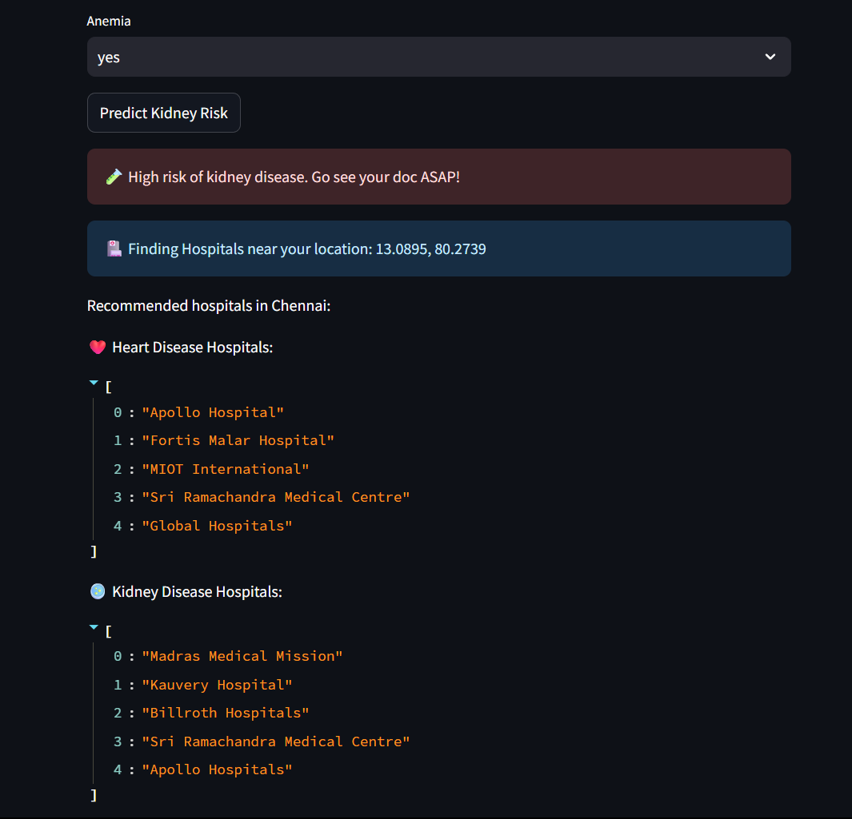
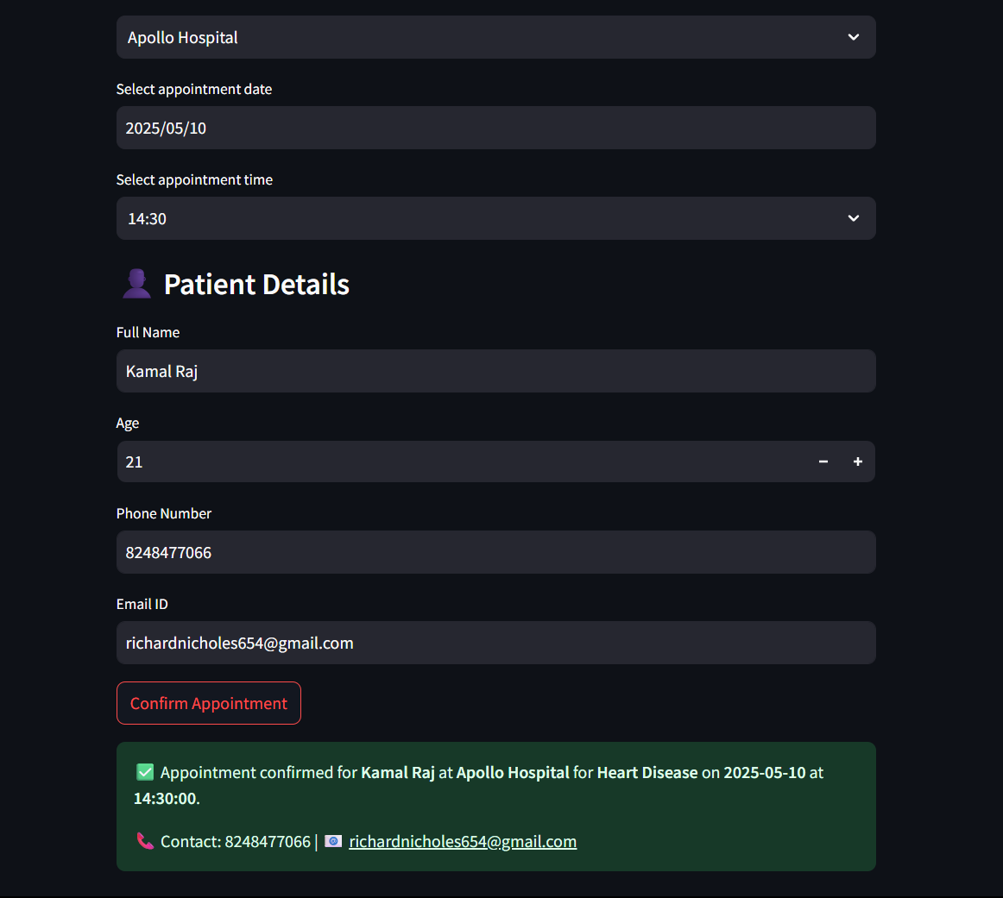
OUTPUT SCREENSHOTS

Slide 12
CONCLUSION
In conclusion, this intelligent healthcare assistant aims to revolutionize the way individuals manage their health by providing early predictions for Chronic Kidney Disease (CKD) and Cardiovascular Disease (CVD) through advanced machine learning. By offering personalized health recommendations, geolocation-based hospital suggestions, and a streamlined appointment booking system, the platform enhances accessibility and timely care. With a strong focus on data security through SHA-256 encryption and an intuitive, user-friendly interface, it ensures privacy and ease of use for patients of all technical backgrounds. Ultimately, this system empowers users to take control of their health while fostering seamless communication between patients and healthcare providers.

Slide 13
FUTURE ENHANCEMENTS
SMTP Integration: Add SMTP functionality to send automated emails to hospitals for appointment confirmations and health updates.
Mobile App Development: Develop a dedicated mobile app for easier access and enhanced user experience on smartphones.
Report Generation: Enable users to generate downloadable health reports in PDF format for easy sharing with healthcare providers.
Multi-Language Support: Introduce multi-language capabilities to cater to a global audience and enhance accessibility.
Integration with Wearables: Incorporate data from wearables (e.g., fitness trackers) to provide real-time health monitoring and more accurate predictions.
Telemedicine Integration: Add a telemedicine feature for virtual consultations, allowing users to connect directly with healthcare professionals.

Slide 14


INTERNSHIP CERTIFICATES

Slide 15
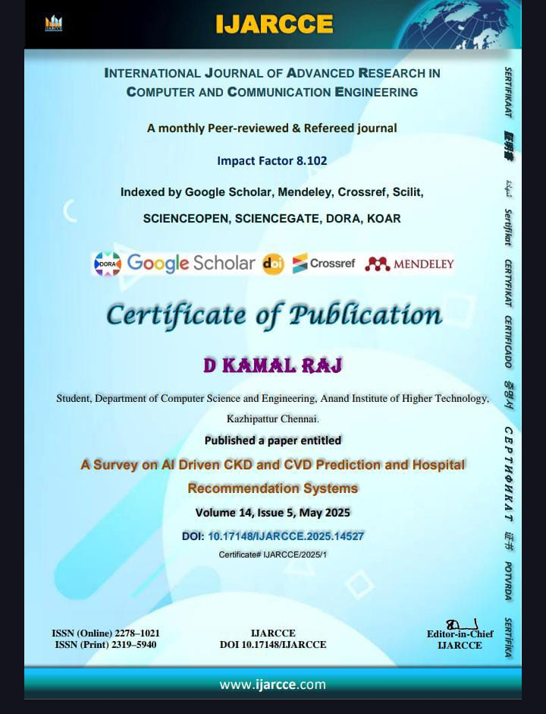
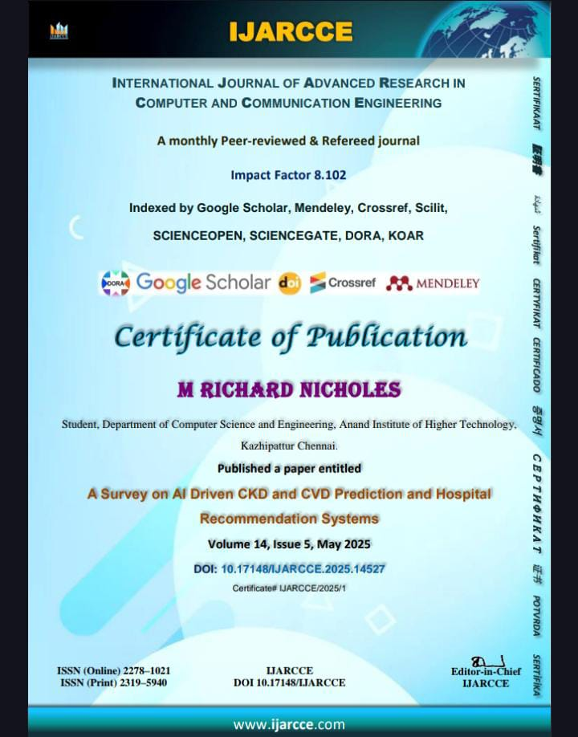
INTERNSHIP CERTIFICATES

Slide 16
THANK
YOU

