Slide 1
Regression Overview
Linear and Logistic regression discussion

Slide 2
Linear versus Logistic Regression
Linear Regression
Continuous function output
E.g.: How much will this cost
Output based on a derived formula
Formula MUST be linear
When there is only feature it is called Uni-variate Linear Regression
If there are multiple features, it is called Multiple Linear Regression.
Logistic Regression
Discrete function output
E.g.: What class / Over or under a certain price
Formula MAY be linear (but can vary)
Output usually sigmoid (yes/no, a/b)… multiple values allowed, but rare
Linear function based on one or more predictive factors

Slide 3
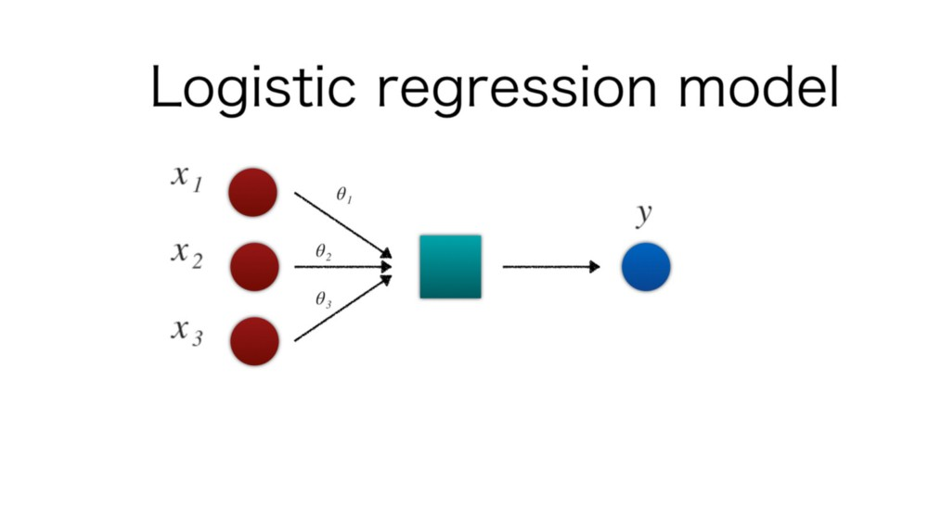
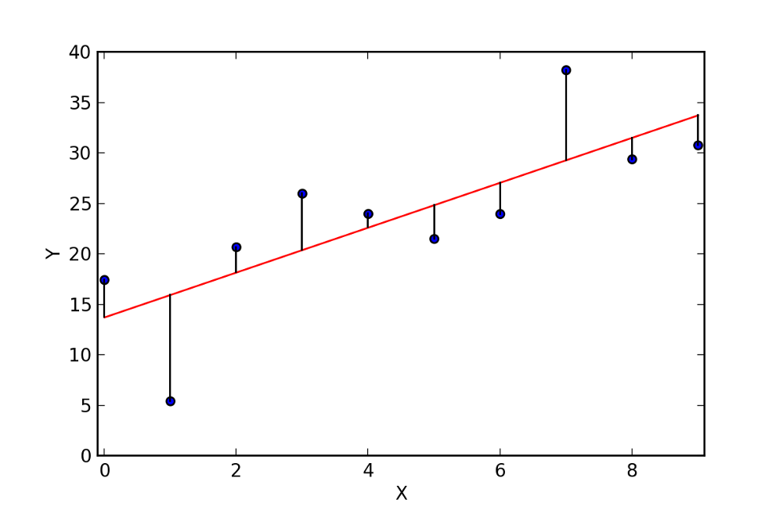
Visual: Linear versus Logistic
Linear Regression: Cost vs data
Image Credit : toshistats.net
https://towardsdatascience.com/simple-and-multiple-linear-regression-in-python-c928425168f9
https://towardsdatascience.com/machine-learning-part-3-logistics-regression-9d890928680f

Slide 4
Logistic Regression versus K nearest neighbors
Logistic Regression
Some training required (to find the line)
Uses linear distance (error squared of y distance) to plot the line
Line ends up 2-dimensional
Prediction is probability of classifier, sigmoid output
K nearest neighbors
No training required
Uses distance formula from boundary
Separation can be n-dimensional, so linear across multiple dimensions (hyperplane)
Better with more data/classifier
Prediction is value of classifier

Slide 5
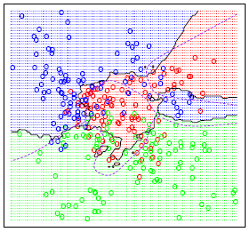
Visual: Logistic versus KNN
k-Nearest-Neighbors
Image Credit : toshistats.net
https://towardsdatascience.com/machine-learning-part-3-logistics-regression-9d890928680f
https://towardsdatascience.com/introduction-to-k-nearest-neighbors-3b534bb11d26

