Slide 1
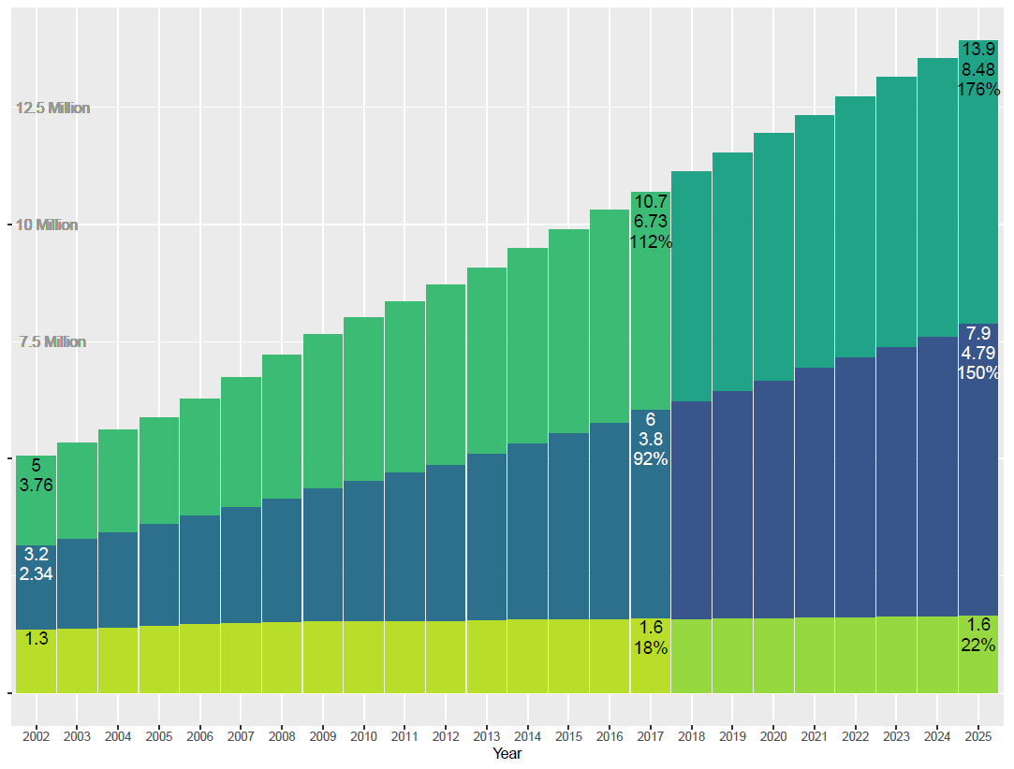

Slide 2
Intro Script
As high school scholars quickly learn when preparing and submitting their US college applications, the process lacks clarity and transparency.
My name is Rich Paterson, and I am going to bring some light to the process whereby college applications are converted to admissions and finally converted to enrolments when the students show up to start their studies.
I will also suggest what I think can be done to bring some transparency to this process, as well as what can be done to remove false hopes from prospective students.

Slide 3
Script – applications!
To start, I will describe the problem. What you will see is actual and predicted changes in total applications, admissions and enrolments over time. Together with this, you will see the difference in growth rates between these three set of numbers. So lets go…
This first bar shows the total number of applications submitted by prospective students for the 2002/2003 school year – 5 million applications were submitted in total which equated to 3.76 applications submitted per prospective student. As we see, the numbers increase over time until we get to the last set of actuals data that we have which is for the 2017/2018 school year, where we see that 10.7 million applications were submitted at a rate of 6.73 applications per student; a growth of 112% since 2002.
Using the Bayesian based Forecasting Routine from Facebook, called Prophet, we then predicted applications by prospective students thru 2025. this shows that we can expect to see 13.9 million applications in 2025, at an average rate of 8.49 applications per student, an increase of 176% since 2002!
It is obvious this is an increasing trend.

Slide 4
Script – admittances!
Moving on to admissions, this new bar shows the total number of students admitted to colleges in 2002 – 3.2 million prospective students admitted at a rate of 2.34 admittances per student. Remember, this admitted number is that of colleges saying that a prospective students application has been accepted and they can attend the college, if they so choose. Again we see the numbers increase over time until we get to 2017, where we see that 6 million students were admitted at a rate of 3.8 admittances per student; a growth of almost 92% since 2002.
Again we predicted admittances by colleges thru 2025 which shows that we can expect to see 7.9 million admittances, at a rate of 4.79 admittances per student, and an increase of 150% since 2002!
This is also an increasing trend.

Slide 5
Script – enrolments!
Lastly, we look at enrolments. This new bar at bottom left shows the total number of students that showed up to one of the colleges they were admitted to in 2002 – 1.3 million students. And, over time, we see that the enrolments number increase but ever so slightly until we get to 2017 where we see that 1.6 million students actually showed up and enrolled. This reflects a growth rate of about 18%.
Again we predicted enrolments numbers thru 2025 which shows an increase of about 22% since 2002!

Slide 6
Conclusion
To conclude, I think there are three things that can be done about the ever increasing applications count:
Firstly, before colleges even accept an application (and the money for it), they should pre-qualify the student applicants.
Secondly, there should be a cap on the number of applications a college can accept.
Third, the colleges that have outsized application pools (those that are more competitive) should self-regulate who they allow to apply.
Lastly, if you have any questions regarding this analysis, or my suggestions, please reach out to me.

