Slide 1










Is it REAL or FAKE NEWS?
Presented by
Richard Dzidzornu
Richard Paterson
Michael Znidarsic
12/4/2019

Slide 2
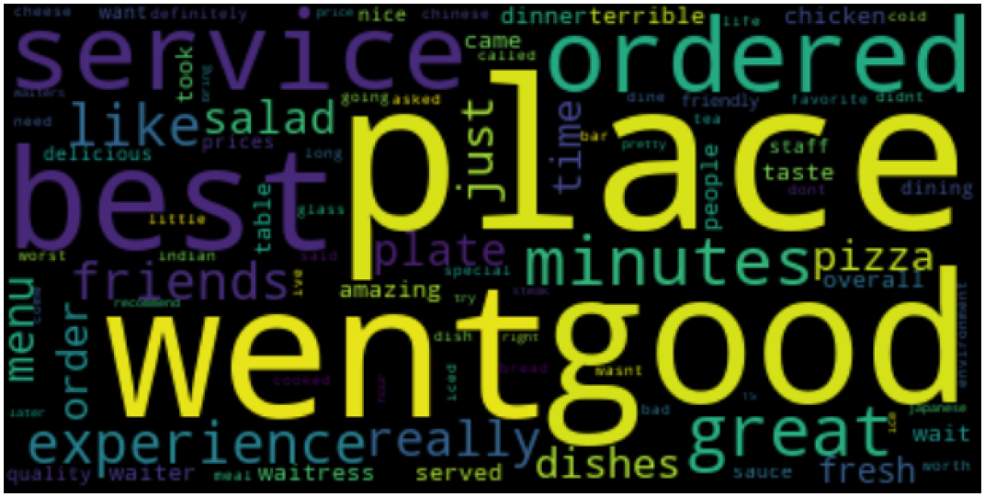
Final Project Proposal
Objective
The objective of our project is to train a model that can predict whether news articles are real or fake news.
Identify Fake News Sites
Obtain Documents; Classify as Fake or Real
Use Fake + Real News Documents to Train our Model
Obtain Documents for Testing
Test Documents
Classify, Topic, Categorize,
Rank, Sentiment
Refine and Confirm Model is Defensible
Verify Accuracy of Tests

Slide 3
“Is It Real News”?
Our intention is to put individual documents through our “Is It Real News” Engine (which consists of a number of trained models), and the Engine will give back an “Is It Real News” Score/Prediction.
As an example, we tested /Infowars Monday Quarterbacking Political Review containing 800 words, 3 paragraphs, author = unknown). Model results are:
Model | Prediction | Model Accuracy | Precision | Recall | F1 Score | Weighted Score
Classification | True | .8908 | .87 | .79 | .83 | .508165
Prediction | Mostly False | .9168 | .88 | .97 | .92 | .719974
Sentiment | True
Author Type | Maybe | .7455 | .67 | .92 | .78 | .358430
Document Complexity | -- | -- | -- | -- | --
Topic / Category | -- | -- | -- | -- | --

Slide 4
Composite Model

Slide 5
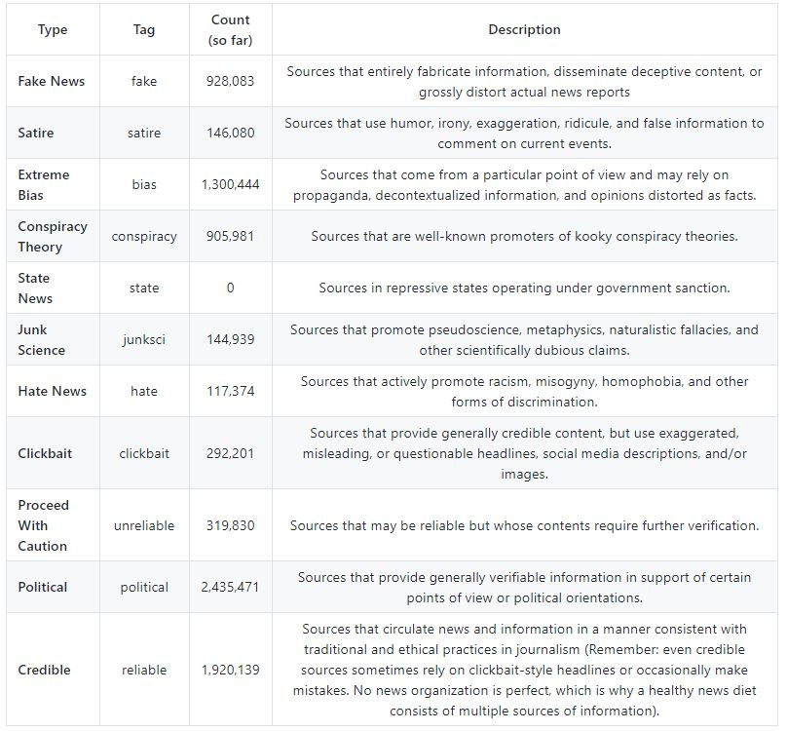
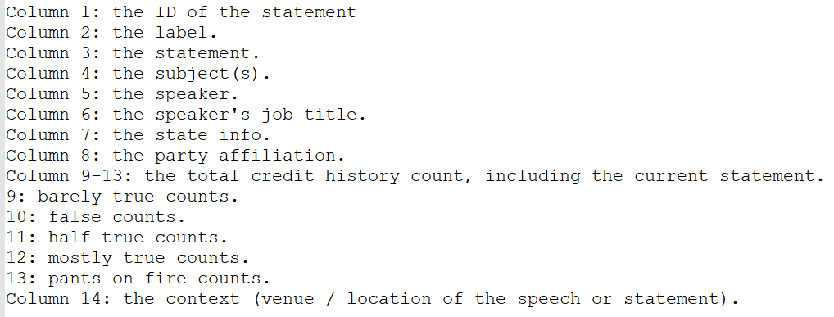
The Source Data
Several27’s FakeNewsCorpus Dataset
AllTheNews Dataset
False
Filtering
Mostly False
Cleaning
Usable Data
Label
Text
Author
Transformation
Mostly True
Synthesis
True
Liar Liar … Pants On Fire (Politifact) Dataset

Slide 6
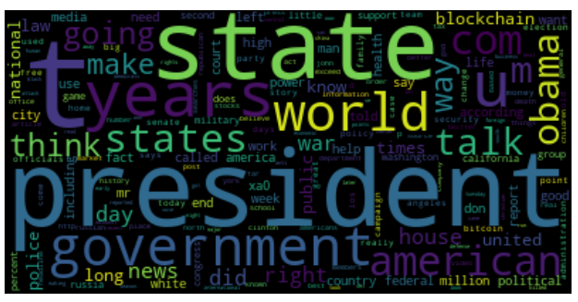
Vectorization

Slide 7
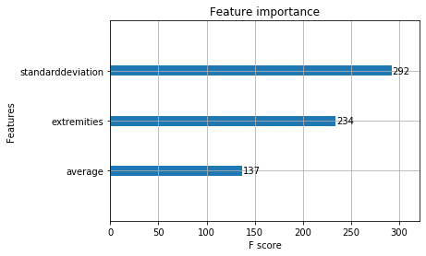
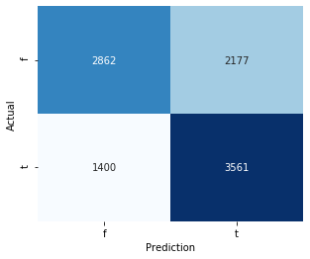
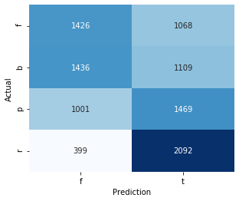
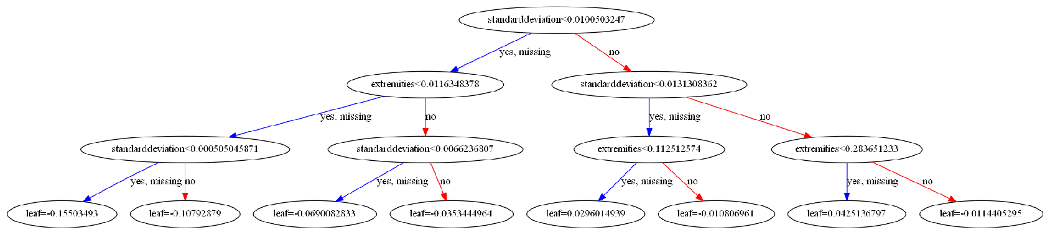
Sentiment-Based Classifier
Used AFINN lexicon; assigns word sentiment -5 to 5
XGBoost outperformed RandomForest and SVM
77% accuracy classifying very fake vs. very reliable
64.23% accuracy classifying nuanced data (four labels included equally, binary discretized: Fake and Bias as FALSE, Political and Reliable as TRUE)

Slide 8
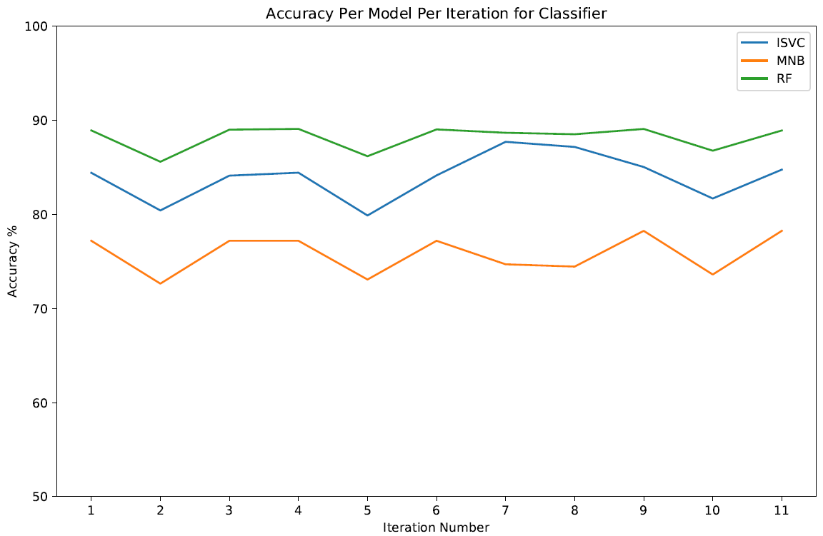
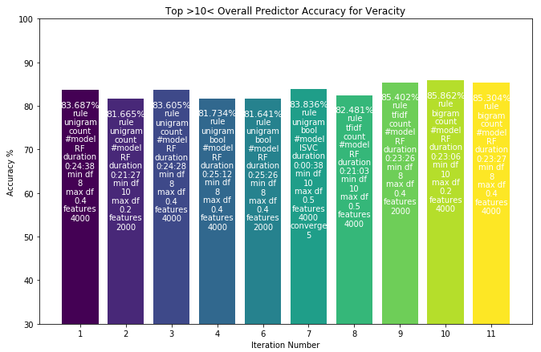
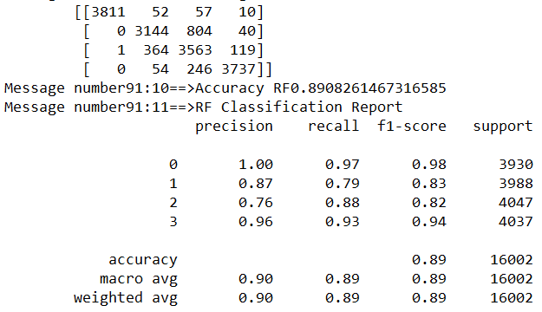
Veracity Classifier
Classify documents by Veracity: False, Mostly False, Mostly True, True
11 Rules-based iterations of the Vectorizer process were run using the input documents as described. For each Vectorized set, 3 classifiers were trained and applied to 3 test sets:
Multinomial NB
Linear SVC
Random Forest
The fourth model, SVC with rbf kernel was too slow)
Model chosen is the one with the highest accuracy
Confusion Matrix and Classification
20191203 21:47:32

Slide 9
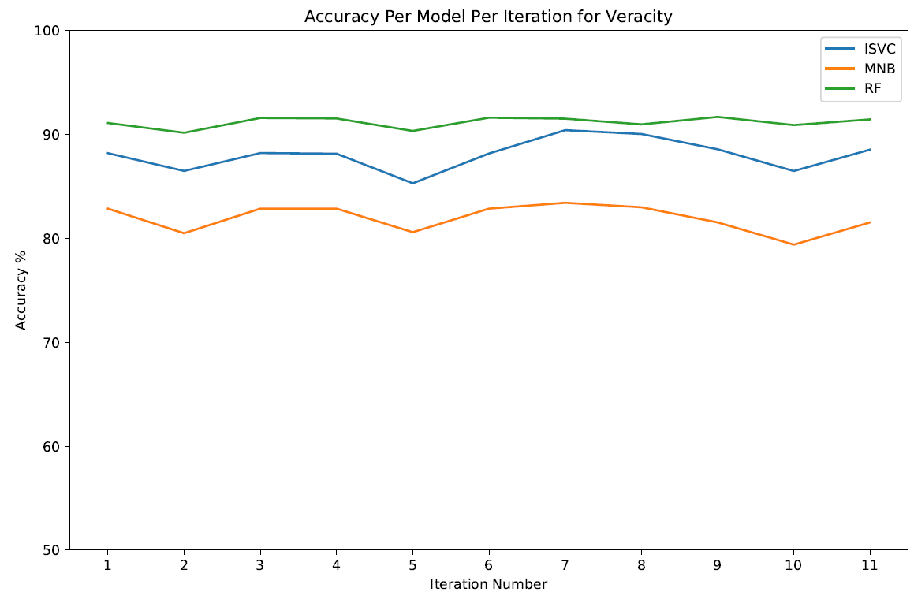
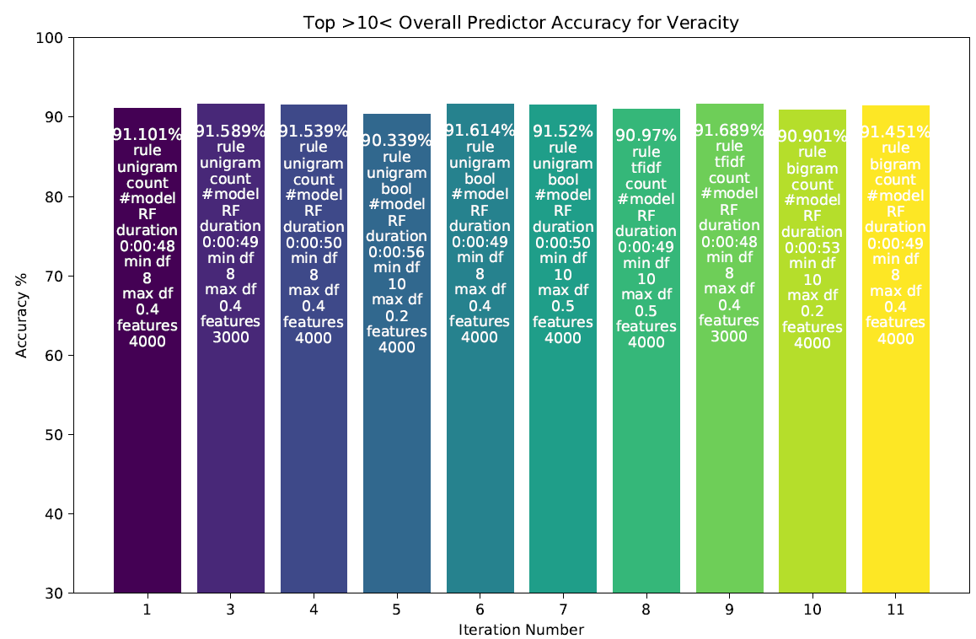
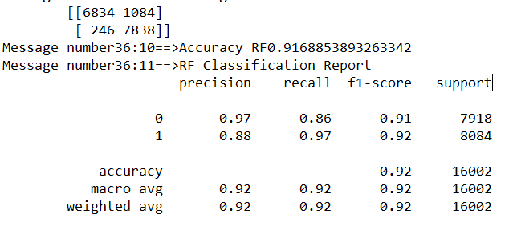
Binary Classifier
Label documents by Binary Veracity: True or False. Veracity was derived from classification scheme where True was set for documents that were either True or Mostly True and False was set for documents that were False or Mostly False.
11 Rules-based iterations of the Vectorizer process were run using the input documents as described. 3 prediction models were run using the vectorized set
Multinomial NB
Linear SVC
Random Forest
Model accurate model chosen is the iteration 9 RF.
Confusion Matrix and Classification
20191203 18:58:34

Slide 10
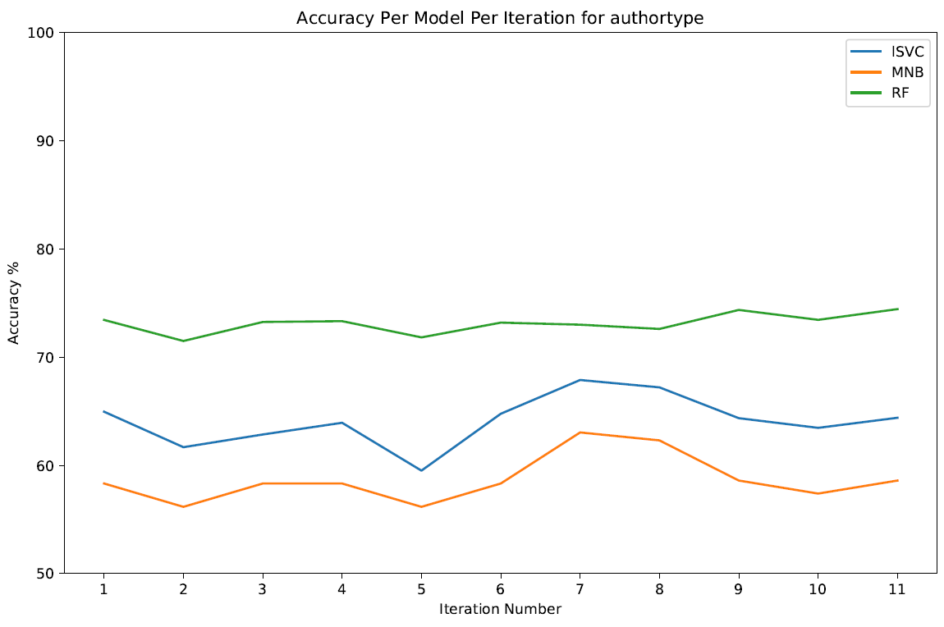
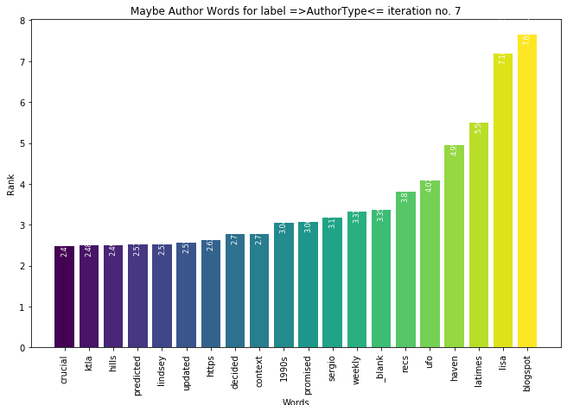
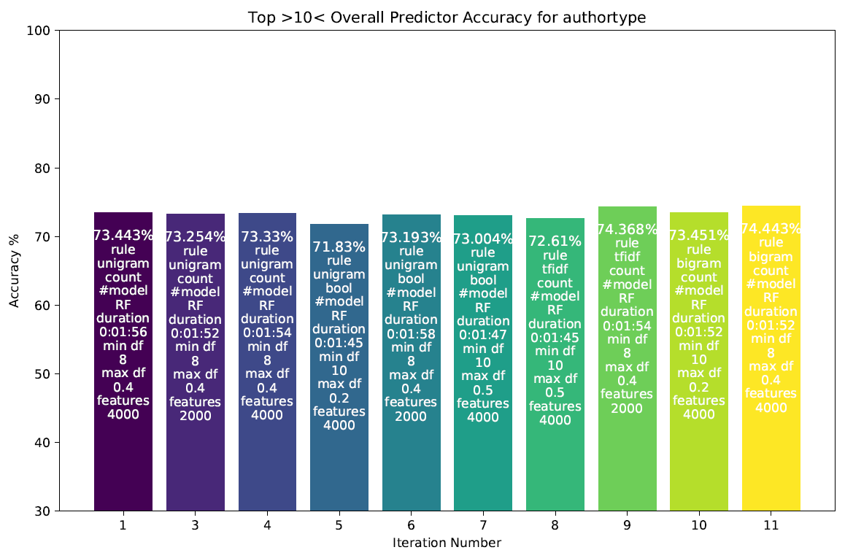
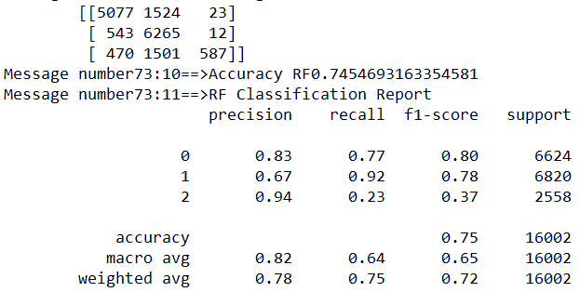
Author Type
Label documents by Author Type: Author Known, Author Maybe Known, Author Unknown. Author Type was derived from NLTK Entity Tagging routine, based on document author provided.
11 Rules-based iterations of the Vectorizer process were run using the input documents as described. 3 prediction models were run using the vectorized set
Multinomial NB
Linear SVC
Random Forest
Model chosen is the one is iteration 9 RF.
Confusion Matrix and Classification
20191203 21:00:54

Slide 11
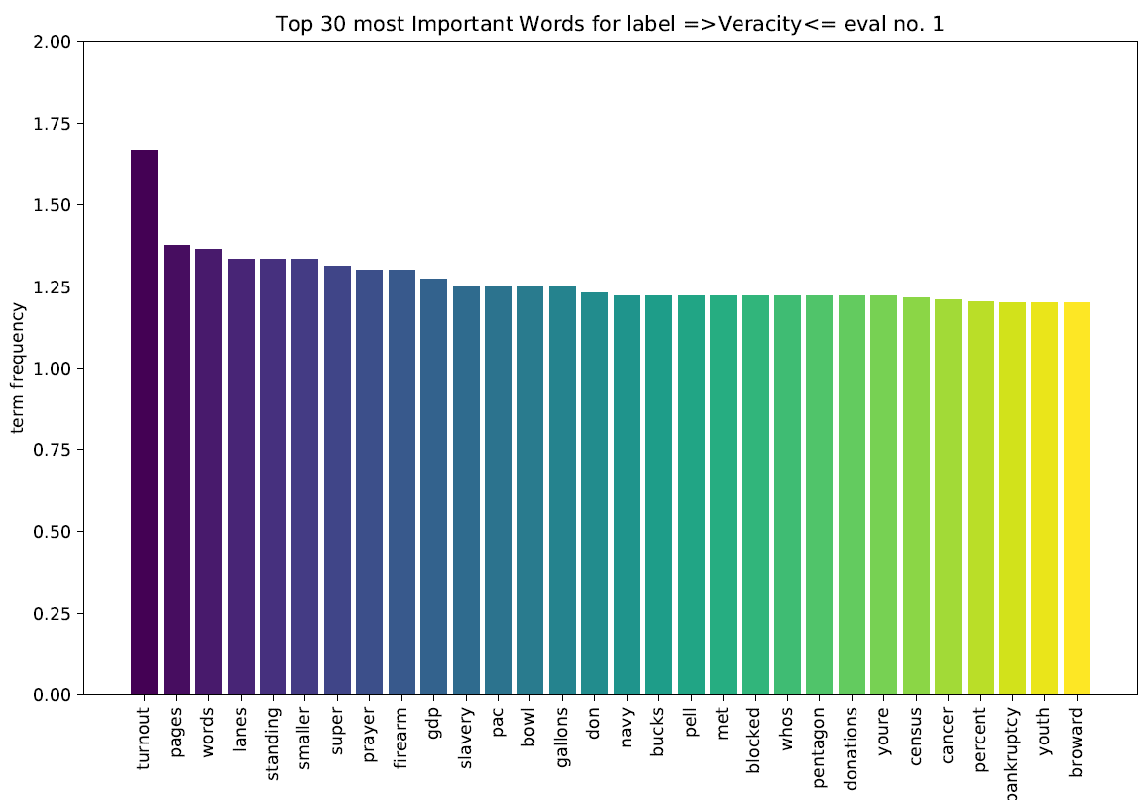
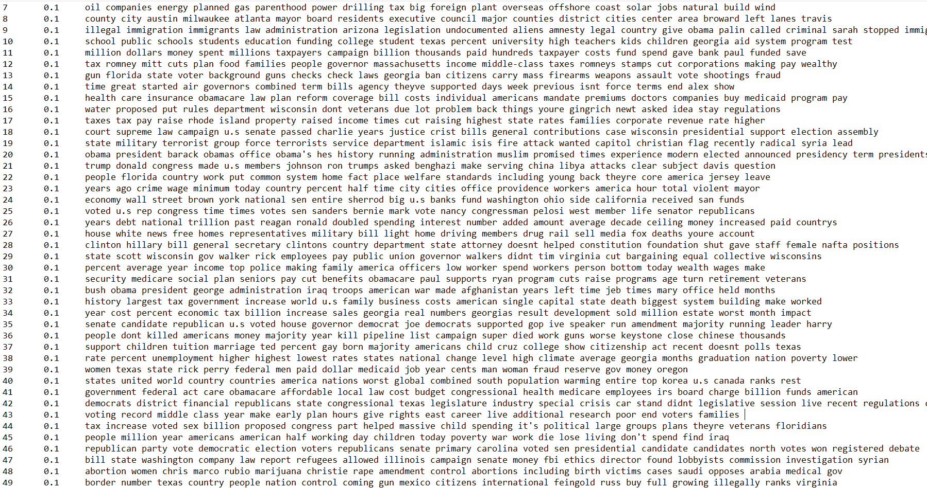
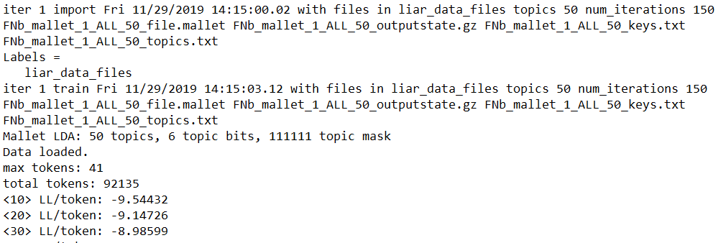
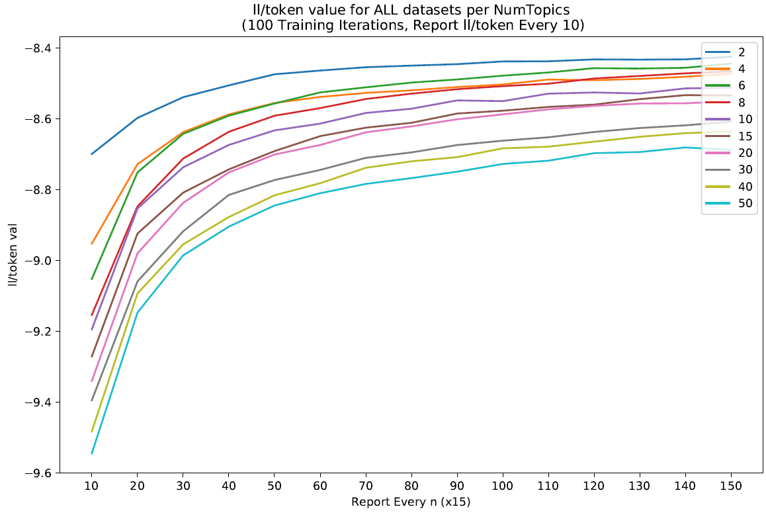
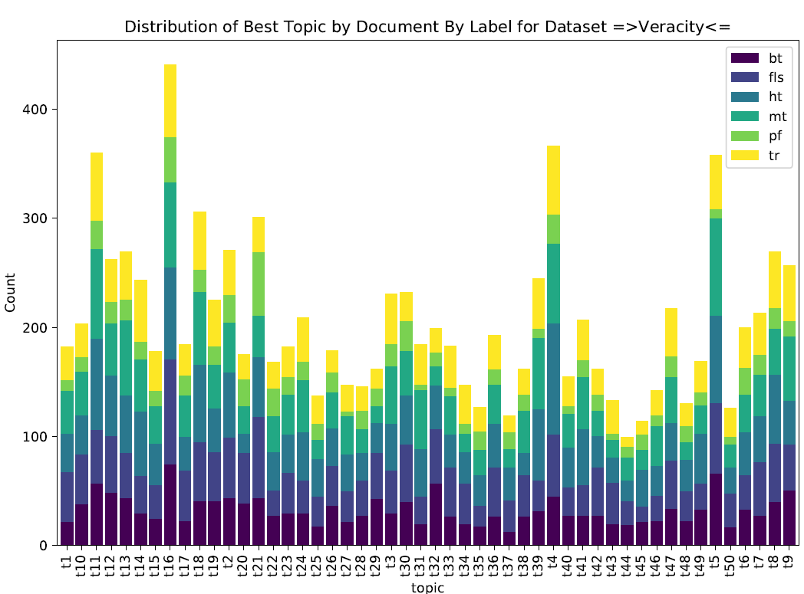
Topic Model
Sample of Mallet Topic Modeling Output

Slide 12
What’s Next…
Improve Accuracy of Models
Improve Composite Model Mechanism
Automate Process
Questions. . . .

