Slide 1










Is it REAL or FAKE NEWS?

Slide 2
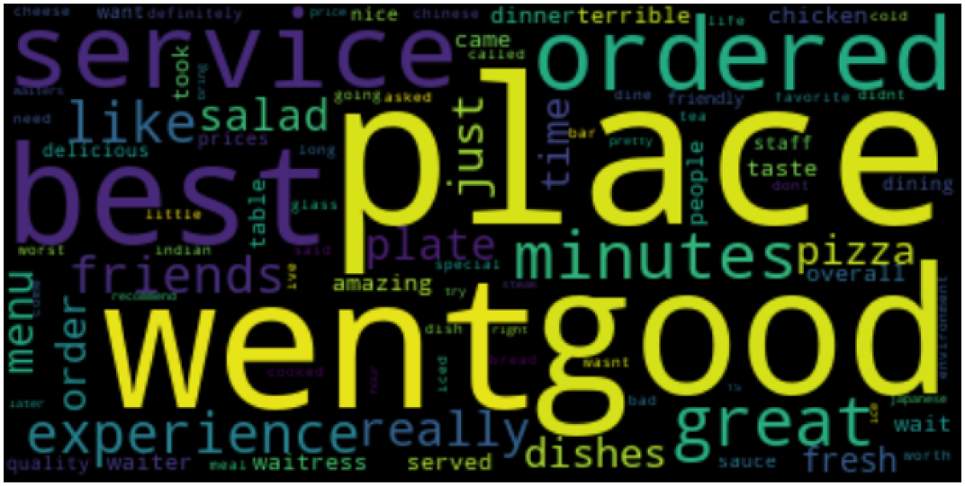
Final Project Proposal
Objective
The objective of our project is to train a model that can predict whether news articles are real or fake news.
Talking points are : Where we started with this project and what we are looking to do
Identify Fake News Sites
Obtain Documents; Classify as Fake or Real
Use Fake + Real News Documents to Train our Model
Obtain Documents for Testing
Test Documents
Classify, Topic, Categorize,
Rank, Sentiment
Refine and Confirm Model is Defensible
Verify Accuracy of Tests

Slide 3
“Is It Real News”? Score
Objective is to put a document through our Real News Engine (which consists of a number of trained models, and the Engine will give back a Real News Score.
Document Name: Bob’s Monday Qback Political Review
Document Characteristics: 800 words, 3 paragraphs, author = unknown
Model | Prediction | Model Accuracy | Precision | Recall | F1 Score | Weighted Score
Prediction | Maybe False | .85 |  |  |  | .27
Classification | True | .9169 | .88 | .97 | .92
Sentiment | True | .76 |  |  |  | .45
Author Type | Maybe
Document Complexity |  | -- | -- | -- | --
Topic / Category
Talking points are : Models we have built and scores that are recorded
Overall Score
57.54%
Rich draft

Slide 4
Decision Tree
Talking points are : Decision tree for final scoring / labeling
Michael draft

Slide 5
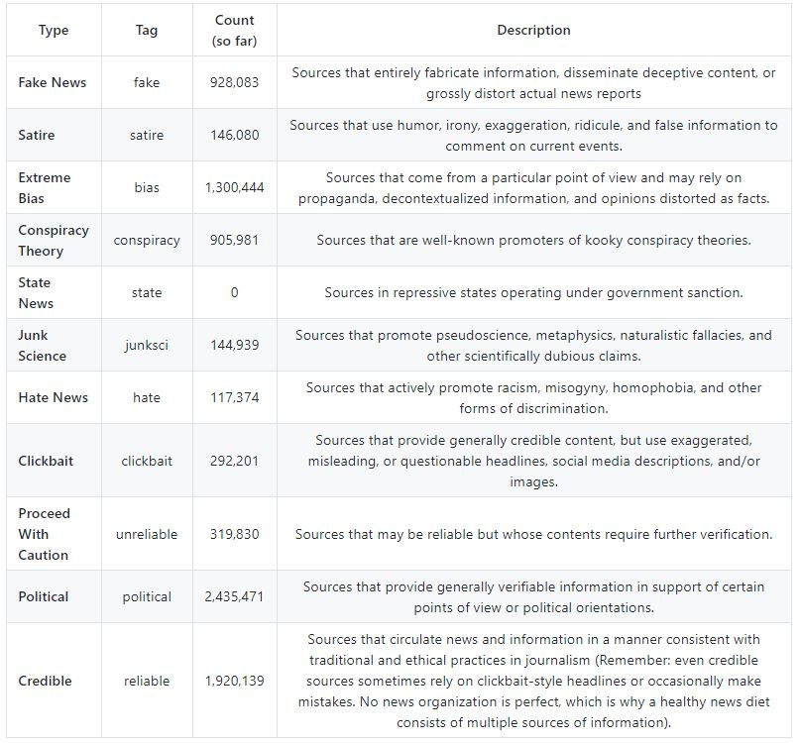
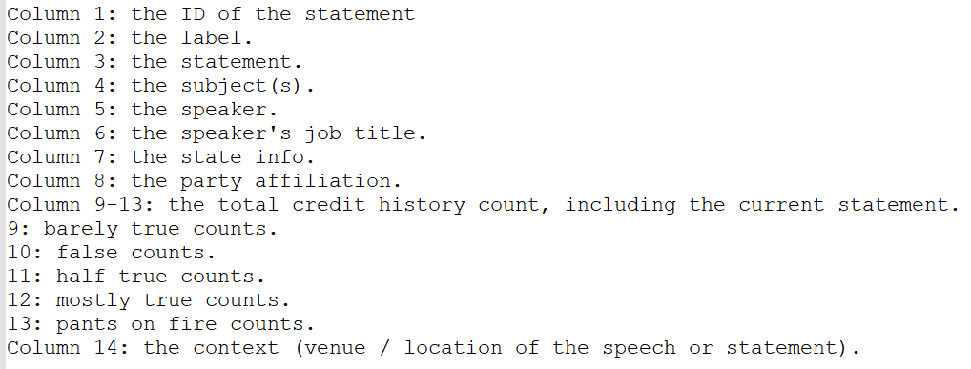
The Source Data
Github several27/FakeNewsCorpus
AllTheNews.db
Filtering
Usable Data
Text
Label
False
Mostly false
Mostly True
True
Cleaning
Talking points are : What data we looked at and where we eventually got
Transformation
Synthesis
Liar Liar … Pants On Fire

Slide 6
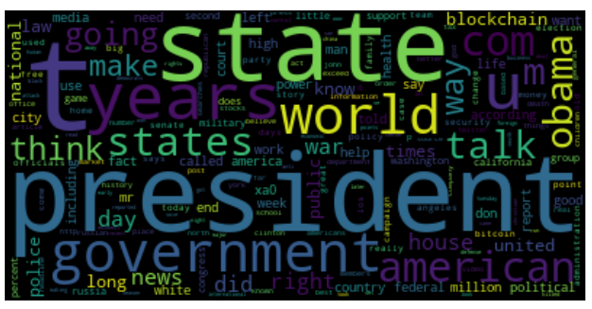
Vectorization
Talking points are : General discussion about vectorization permutations
Rich draft

Slide 7
Sentiment
Michael: You need to describe what you have been doing and put charts etc here
Michael draft

Slide 8
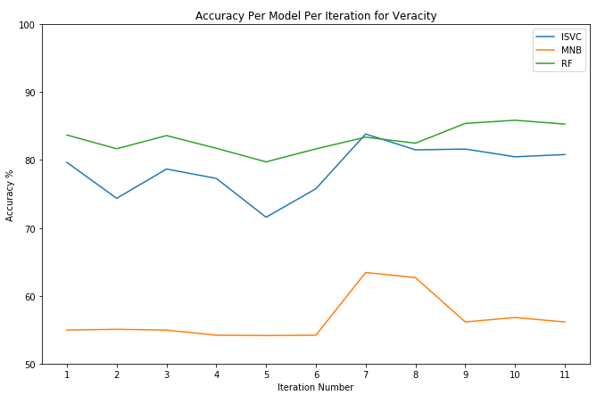
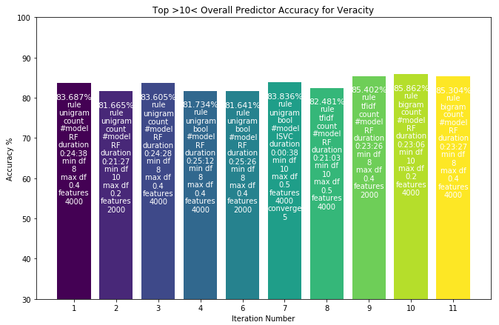
Veracity Classification
Classify documents by Veracity: False, Mostly False, Mostly True, True
11 Rules-based iterations of the Vectorizer process were run using the input documents as described. For each Vectorized set, 3 classifiers were trained and applied to 3 test sets:
Multinomial NB
Linear SVC
Random Forest
The fourth model, SVC with rbf kernel was too slow)
Model chosen is the one with the highest accuracy
Talking points are : multiple models run for classification
For Vectorization iteration 10, with model RF, accuracy is 89%
Confusion Matrix is:
Confidence Matrix is:
Accuracy is
Rich draft
20191203 21:47:32

Slide 9
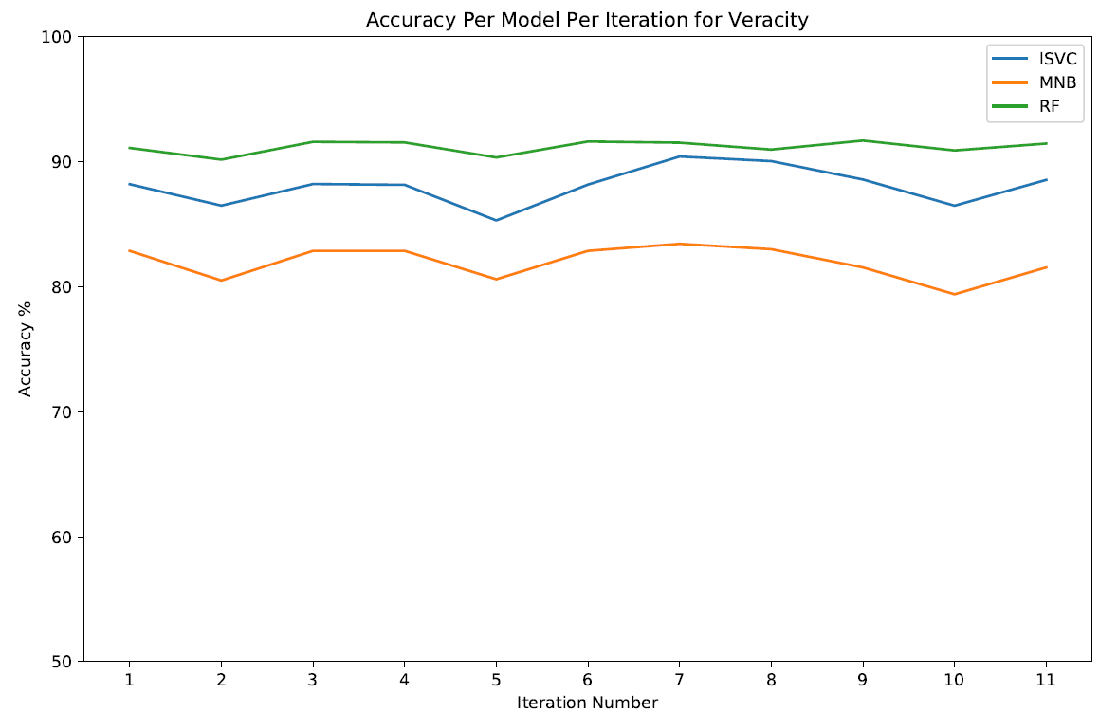
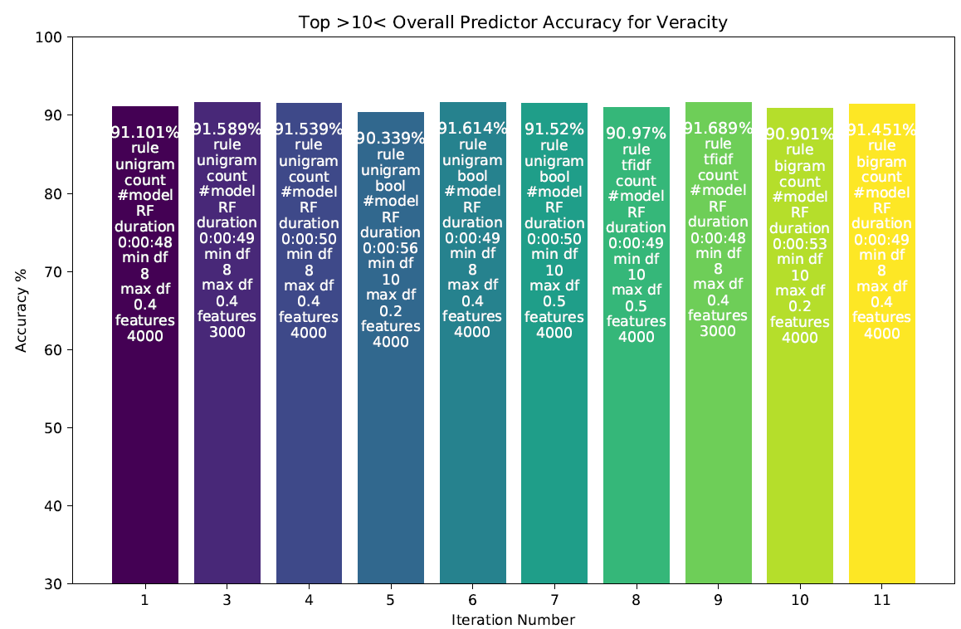
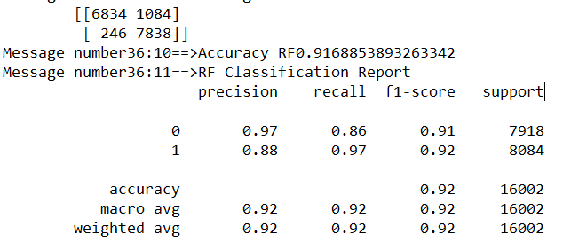
True or False Prediction
Label documents by Binary Veracity: True or False. Veracity was derived from classification scheme where True was set for documents that were either True or Mostly True and False was set for documents that were False or Mostly False.
11 Rules-based iterations of the Vectorizer process were run using the input documents as described. 3 prediction models were run using the vectorized set
Multinomial NB
Linear SVC
Random Forest
Model accurate model chosen is the iteration 9 RF.
Talking points are : multiple models run for classification
Confusion Matrix and Classification
Rich draft
20191203 18:58:34

Slide 10
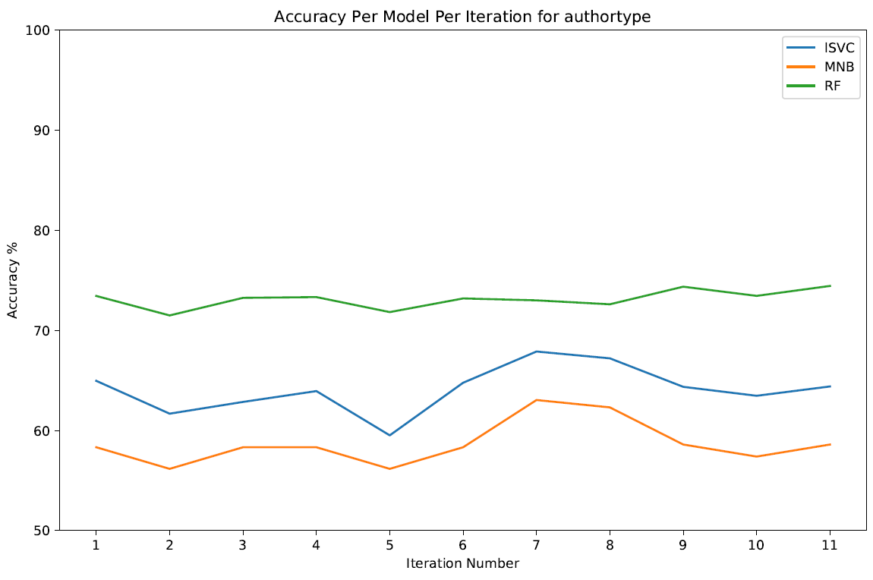
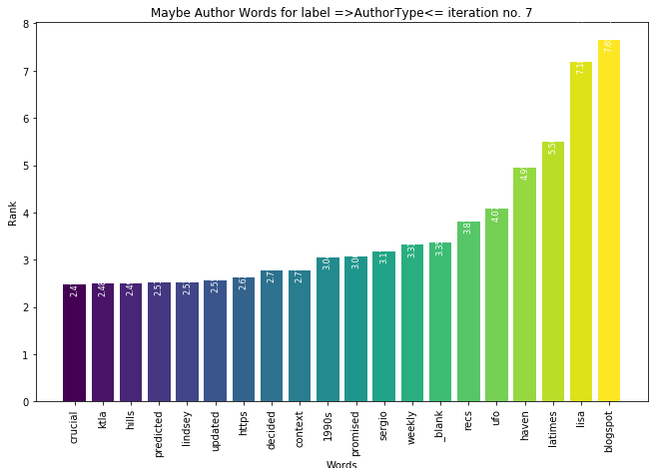
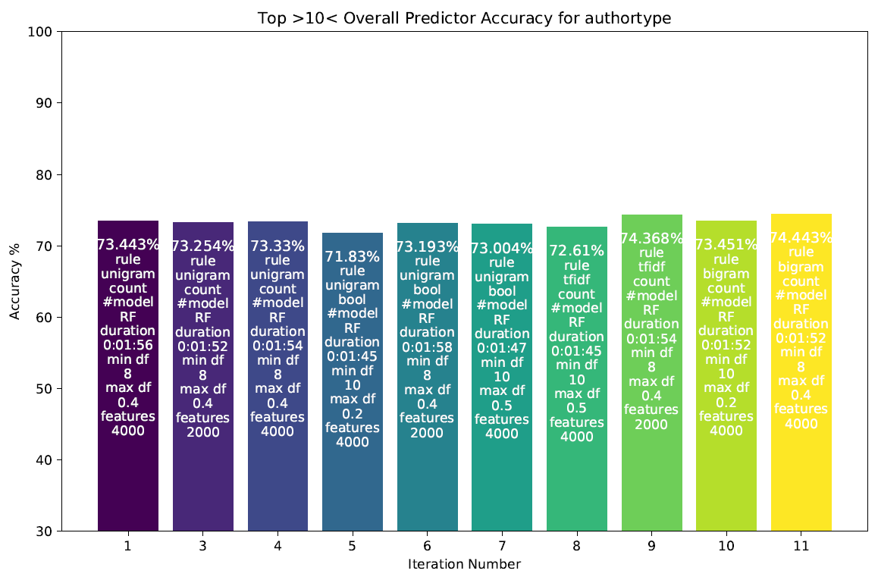
Author Type
Label documents by Author Type: Author Known, Author Maybe Known, Author Unknown. Author Type was derived from NLTK Entity Tagging routine, based on document author provided.
11 Rules-based iterations of the Vectorizer process were run using the input documents as described. 3 prediction models were run using the vectorized set
Multinomial NB
Linear SVC
Random Forest
Model chosen is the one is iteration 9 RF.
Talking points are : multiple models run for classification
Confusion Matrix and Classification
Accuracy 74.367%
Rich draft
20191203 21:00:54

Slide 11
Topic
Rich P (I have Mallet on Liar) or Michael (If you did LDA)…
??? draft

Slide 12
What’s Next…
Improve Accuracy of Models
Improve Scoring Mechanism
Automate Process
Questions. . . .
Talking points are: Things to do AND Close…

Slide 13
Appendix

Slide 14
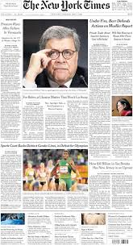
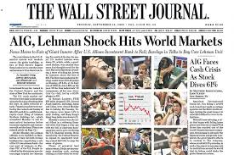
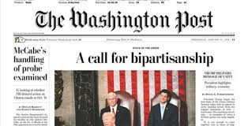
Questions we hope to answer
For training, how do we know an article is fake vs real?
/training articles must be really, really fake/
Can we confirm that bias does not misguide the training set?
/training articles must be inclusive of different political polarities/
Can we tell whether an article is intended to deceive?
Can we tell if an article was written by human or by machine?
Can we build a Real News likelihood score?
(base this on fit to model, sentiment, human author, category/

