Slide 1










Is it REAL or FAKE NEWS?

Slide 2
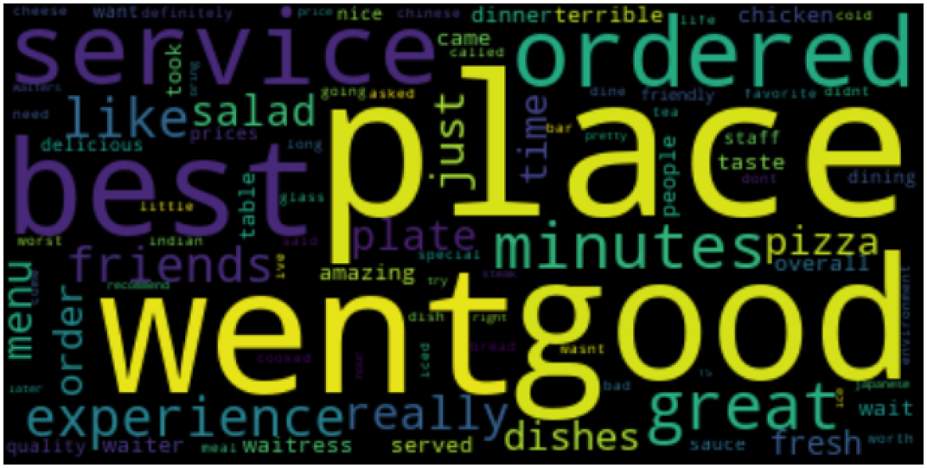
Final Project
Objective
The objective of our project is to train a model that can predict whether news articles are real or fake news.
Identify Fake News Sites
Obtain Documents; Classify as Fake or Real
Use Fake + Real News Documents to Train our Model
Obtain Documents for Testing
Test Documents
Classify, Topic, Categorize,
Rank, Sentiment
Refine and Confirm Model is Defensible
Verify Accuracy of Tests

Slide 3
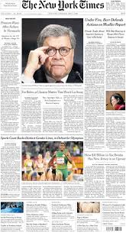
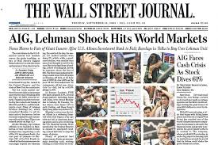
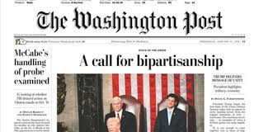
Questions we hope to answer
For training, how do we know an article is fake vs real?
/training articles must be really, really fake/
Can we confirm that bias does not misguide the training set?
/training articles must be inclusive of different political polarities/
Can we tell whether an article is intended to deceive?
Can we tell if an article was written by human or by machine?
Can we build a Real News likelihood score?
(base this on fit to model, sentiment, human author, category/

Slide 4
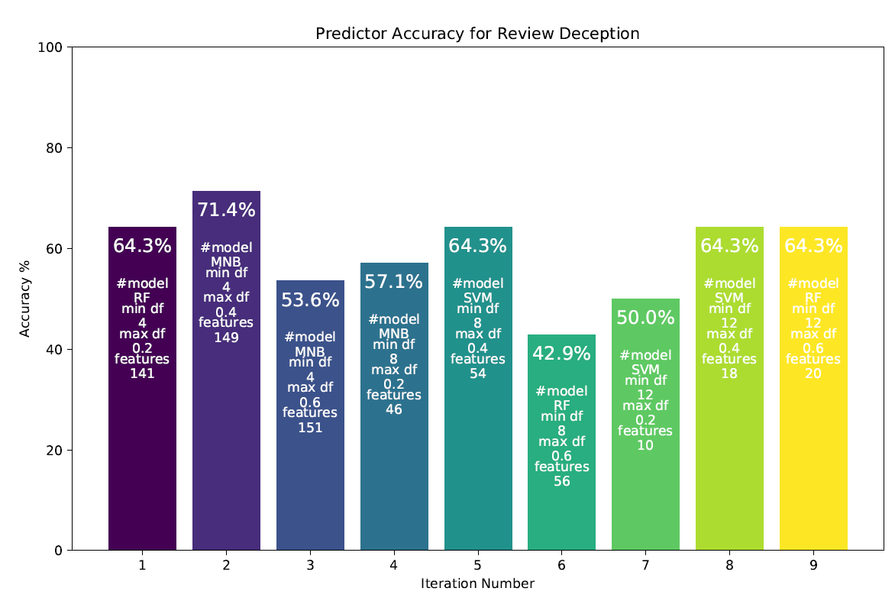
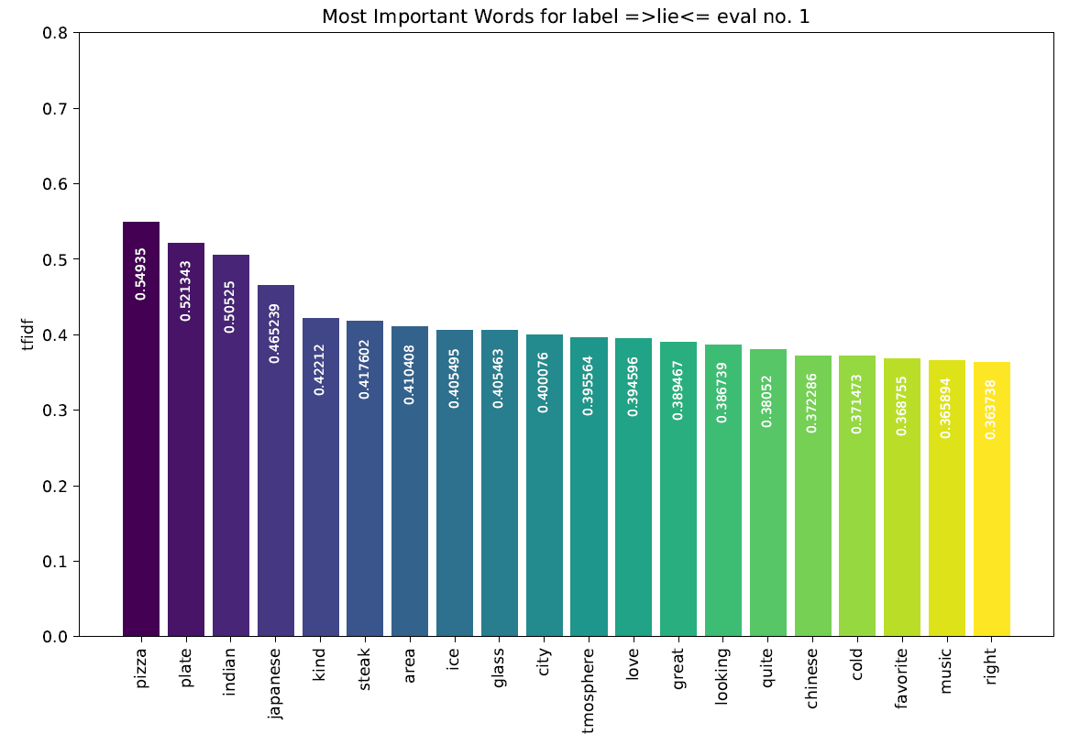
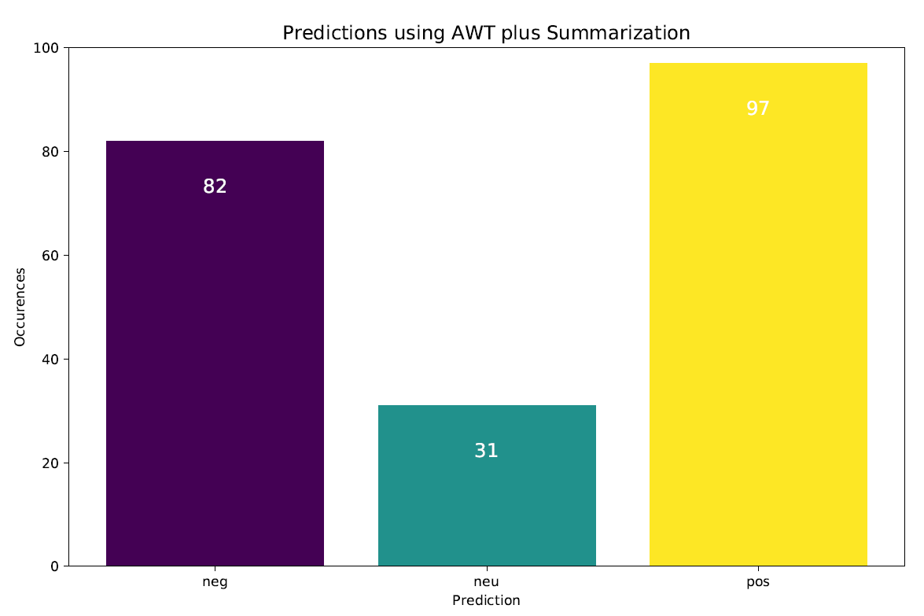
Data/News Sources

Slide 5
Modeling and Viz
Vectorization
Predictions - Multinomial NB, SVM, RF
Decision Tree
Feature Ranking – Gain Ratio
Wordcloud
Sentiment Analysis
Topic Model
Categorization - Classification
Authorship *maybe*

