Slide 1
III. Ground-Water Management Problem Used for the Exercises
Notes:
III. GW Management Problem, Steady State Forward Run, Compare Simulated & Observed Values

Slide 2
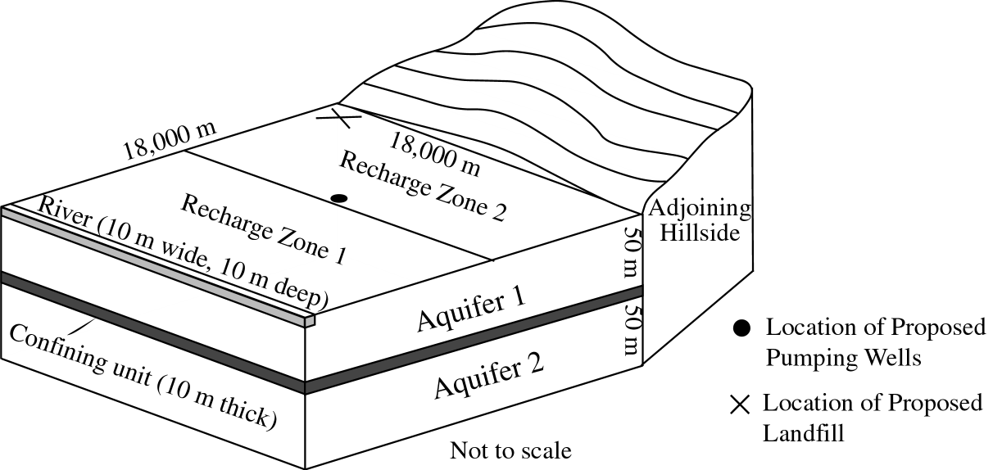
Ground-Water Flow System
The flow system is comprised of two confined aquifers separated by a confining unit.
Inflow occurs primarily as areal recharge; there is also a very small amount of inflow across the boundary with the hillside.
At steady-state, outflow occurs only as discharge to the river.
Notes:
III. GW Management Problem, Steady State Forward Run, Compare Simulated & Observed Values

Slide 3
Management Issues
Ground-water management issues related to this flow system:
  Pumping wells for water supply are being completed in aquifers 1 and 2. The effect of pumping on:
    Drawdown at local domestic wells
    Head in the well
    Stream depletion, affecting minimum flow requirements
We are developing a flow model to help evaluate these concerns, which relate to SGMA undesirable results
Notes:
III. GW Management Problem, Steady State Forward Run, Compare Simulated & Observed Values

Slide 4
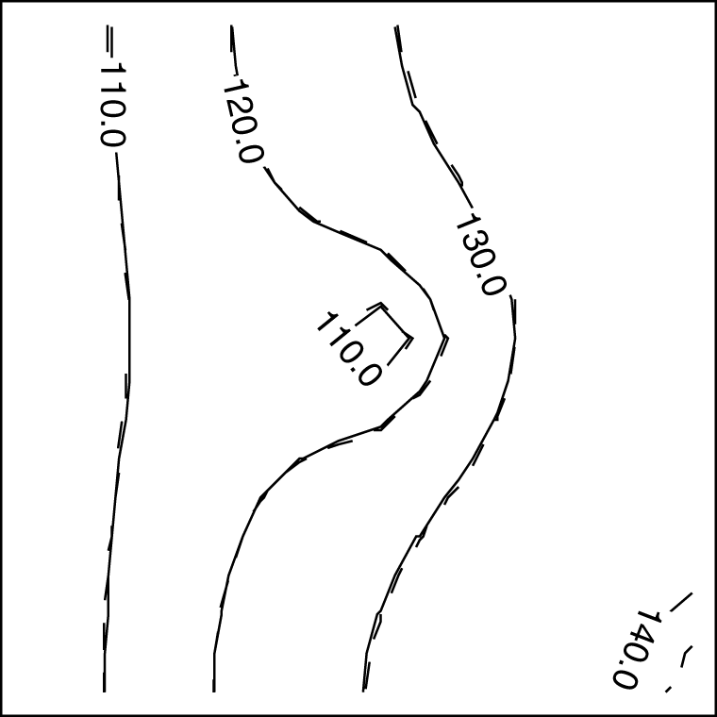
Predictions of Interest Related to Proposed Pumping
Predictions related to SGMA undesirable results and minimum thresholds
Will the drawdown in the south east corner near local water supply wells be more than 20 m?
Will the head at the pumping well decline to less than 80 m?
?
?
Will the pumping rate cause the stream leakage to be less than 4.0 m³/s, which is the minimum flow requirement
?
Notes:
III. GW Management Problem, Steady State Forward Run, Compare Simulated & Observed Values

Slide 5
Ground-Water Flow Model
First, steady-state model without pumping will be developed and calibrated using available measurements of hydraulic-heads and discharge to the river, and will be used for preliminary evaluation of the issues.
Then, pumping wells will be installed, a long-term aquifer test will be conducted using the wells, and a transient model of the system will be recalibrated using the steady-state measurements as well as the additional drawdown and river discharge data collected during the test.
See flow model setup in Figure 2-1b (page 32) of Hill and Tiedeman.
See model parameter definition and starting values in Table 3-1 (page 38).
See true simulated conditions in Figures 2-1c and 2-1d (page 22-23).
Notes:
III. GW Management Problem, Steady State Forward Run, Compare Simulated & Observed Values

Slide 6
MODFLOW Packages Used
Basic (BAS) and the Discretization input file
  Define model grid, including rows, columns, and layers
  Define types of model layer (confined; convertible)
Layer Property Flow (LPF)
  Define hydraulic properties – K, S_{s}, S_{y}, Anisotropy
Recharge (RCH)
  Define distribution of areal recharge
River (RIV)
General-Head Boundary (GHB)
Well (WEL)
  Define pumpage
  Used in steady state model for prediction runs only
Notes:
III. GW Management Problem, Steady State Forward Run, Compare Simulated & Observed Values

Slide 7
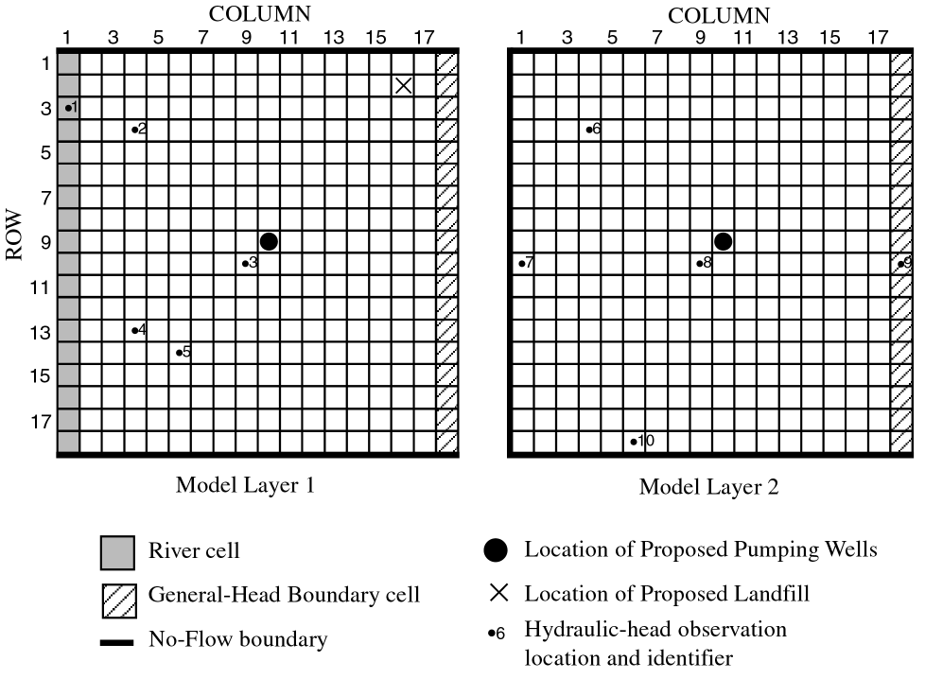
Spatial Discretization -- Ground-Water Flow Model Grid
Figure 2-1b of Hill and Tiedeman (page 22)
Notes:
III. GW Management Problem, Steady State Forward Run, Compare Simulated & Observed Values

Slide 8
Layer-Property Flow Package
Define hydraulic properties – K, Ss, Sy, Anisotropy
Figure 2-1a of Hill and Tiedeman (page 34)
Model layer 1 is homogeneous
Model layer 2 has K that increases linearly from beneath the river to the hillside
Notes:
III. GW Management Problem, Steady State Forward Run, Compare Simulated & Observed Values

Slide 9
Recharge Package
Recharge varies spatially – one value applies on the portion of the model closest to near the river, and one value applies on the portion closest to the hillside.
Can apply recharge to model layer 1 or top active cell at each row, column location
Input a flow rate (L/T). The program multiplies by area to get volume per time.
Parameters are used to define the recharge rate.
Notes:
III. GW Management Problem, Steady State Forward Run, Compare Simulated & Observed Values

Slide 10
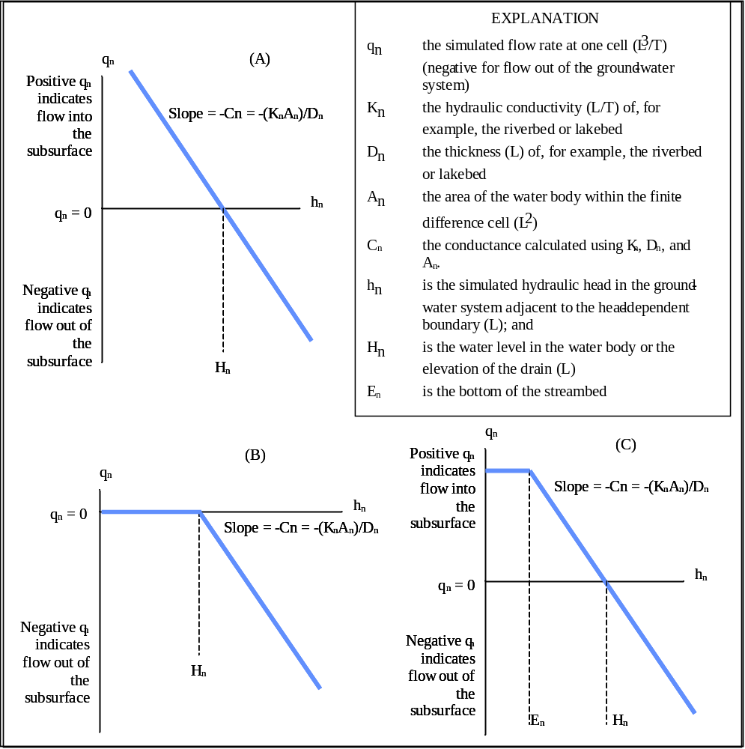
The
River (RIV) and
General-Head Boundary (GHB)
Packages are used
GHB
DRN
RIV
Both define head-dependent boundaries: q=C(H-h)
Notes:
III. GW Management Problem, Steady State Forward Run, Compare Simulated & Observed Values

Slide 11
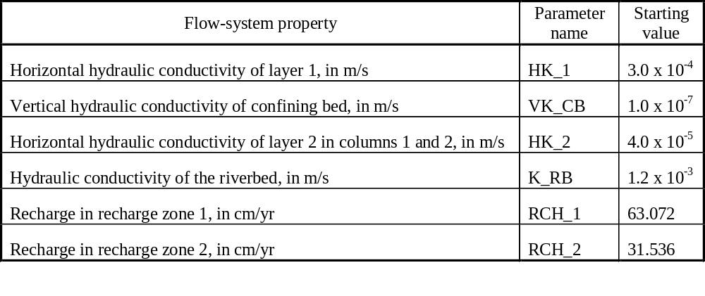
Parameters and Starting Values
Table 3-1 of Hill and Tiedeman (page 38)
Notes:
III. GW Management Problem, Steady State Forward Run, Compare Simulated & Observed Values

Slide 12
Notes:
III. GW Management Problem, Steady State Forward Run, Compare Simulated & Observed Values

Slide 13
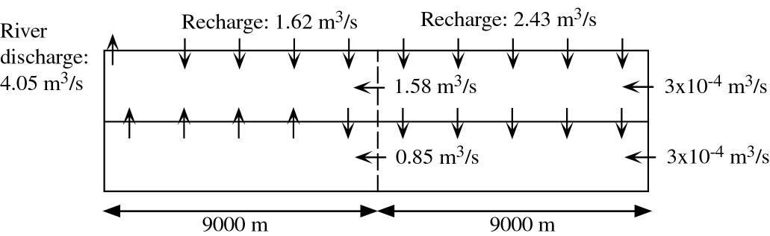
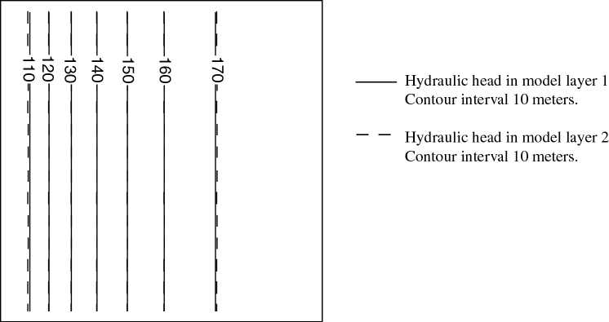
True Simulated Conditions
Figure 2-1 c and 2d of Hill and Tiedeman (page 22-23)
Notes:
III. GW Management Problem, Steady State Forward Run, Compare Simulated & Observed Values

Slide 14
Observations
10 head observations, 5 in each model layer.
Observed values shown in Table 3-2 (page 38) of Hill and Tiedeman.
1 steady-state flow observation: ground-water discharge to the river of –4.4 m³/sec.
Notes:
III. GW Management Problem, Steady State Forward Run, Compare Simulated & Observed Values

Slide 15
Head Observations
Well identifier
Observation name
Layer
Row
Col
Observed head (m)
Variance of well elevation measurement error (m²)
Variance of water-level measurement error (m²)
Variance of the observation (m²)
1
1.ss
1
3
1
101.804
1.00
0.0025
1.0025
2
2.ss
1
4
4
128.117
1.00
0.0025
1.0025
3
3.ss
1
10
9
156.678
1.00
0.0025
1.0025
4
4.ss
1
13
4
124.893
1.00
0.0025
1.0025
5
5.ss
1
14
6
140.961
1.00
0.0025
1.0025
6
6.ss
2
4
4
126.537
1.00
0.0025
1.0025
7
7.ss
2
10
1
101.112
1.00
0.0025
1.0025
8
8.ss
2
10
9
158.135
1.00
0.0025
1.0025
9
9.ss
2
10
18
176.374
1.00
0.0025
1.0025
10
10.ss
2
18
6
142.020
1.00
0.0025
1.0025
Table 3-2 of Hill and Tiedeman (page 38)
Notes:
III. GW Management Problem, Steady State Forward Run, Compare Simulated & Observed Values

