Slide 1
What is UCODE_2014?
Steffen Mehl
USGS and CSU Chico
Many of the slides created by
Mary Hill and Claire Tiedeman (USGS)
Notes:
II. Introduction to UCODE_2005

Slide 2

Model Calibration
Trial and Error
Data
Model Design
Boundary conditions
Geometry
Transmissivity
Recharge
Model Output
Compare
“Intelligent” mechanism
for model adjustment
UCODE_2014
Modified Gauss Newton

Slide 3
How UCODE Works
Model Input Files
creates model input files
Template
File
Model executes
UCODE_2014
executes the model
Instruction
File
Model Output Files
reads model output files

Slide 4
How UCODE Works: 1.adjust input
Model Input Files
creates model input files
Template file
Template
File
Model executes
UCODE_2014
executes the model
Instruction
File
Model Output Files
reads model output files

Slide 5

Communicating with the model:
Creating input using Template files
model input file
  5.1 2.7 50.
  .0100417696 2.723437E-4
  9
  5.
  10.
  15.
  20.
  25.
  30.
  35.
  40.
  45.
Template file
  jtf !
  5.1 2.7 50.
  !K ! !w !
  9
  5.
  10.
  15.
  20.
  25.
  30.
  35.
  40.
  45.
! indicates the delimiter
Parameters we want to adjust
Same as in PEST, via John Doherty’s involvement in the JUPITER API
Notes:
II. Introduction to UCODE_2005

Slide 6
Notes about Template Files
Search and Replace is your friend!
Choose a unique delimiter
  [a-z], [A-Z], and [0-9] are not valid
  The delimiter cannot appear anywhere else in the file except for indicating parameter substitution
  ! and @ are good choices

Slide 7
How UCODE Works: 2.run model
Model Input Files
creates model input files
Template
File
Model executes
UCODE_2014
executes the model
Instruction
File
Model Output Files
reads model output files

Slide 8
Running the model:
A process model command is specified in the main UCODE_2014 input file.
For example:
Command =
".\..\bin\mf2005.exe ex3.3.nam“
  You do not need to run via a batch file, but often convenient to do so

Slide 9
How UCODE Works: 3. get output
Model Input Files
creates model input files
Template
File
Model executes
UCODE_2014
executes the model
Instruction
File
Model Output Files
reads model output files
Instruction file

Slide 10
Some Instruction File Options
Primary and Secondary “markers”
  Primary markers are used to find a line in the file
  Secondary markers are used to navigate within a line
Line advance
  l# (lower case L followed by the # of lines to advance)

Slide 11

Extraction: values compared to obsname
Fixed Extraction [obsname] a:b
  Extracts values from columns a – b
Semi-Fixed Extraction (obsname) a:b
  Starting at column a, searches between columns a – b to find a number. Then reads in entire value (can read beyond a and/or b)
    Values must be separated by a blank space
Non-Fixed Extraction !obsname!
  Starting at cursor position (as a result of previous search or line advance read first value (free format)

Slide 12
Communicating with the model:
Extract output using Instruction files
Instruction file
  jif @
  @ x head@
  l1 [h1]17:37
  l2 [h2]17:37
  l2 [h3]17:37
  l2 [h4]17:37
  l2 [h5]17:37
  @ q at x=zero@
  l1 [qleft]1:25
  @ q at x=width@
  l1 [qright]1:25
Process model output file
  Hleft Hright Width
  5.10000 2.70000 50.00000
  K RechargeRate
  0.01004 0.00027
  x head
  5.00000 5.49911
  10.00000 5.75451
  15.00000 5.88494
  20.00000 5.89870
  25.00000 5.79661
  30.00000 5.57231
  35.00000 5.21005
  40.00000 4.67787
  45.00000 3.90695
  q at x=zero
  -0.00493
  q at x=width
  0.00869
@ indicates search delimiter
Primary marker
Same as in PEST, plus Standard File for values in a continuous column
Notes:
II. Introduction to UCODE_2005
Cannot use ! for a delimeter because this takes on a special role. Also cannot use :, &, ), (, ], [
Note – non fixed extraction would not work unless we somehow got the cursor beyond the x values. Semi fixed would work though.

Slide 13
Input block: table example
This is one of the input blocks that serve purpose
3: Define observations and predictions
  BEGIN OBSERVATION_DATA TABLE
  NROW=7 NCOL=5 COLUMNLABELS
  obsname obsvalue statistic statflag groupname
  h1 5.505 5.0e-4 sd head
  h2 5.897 5.0e-4 sd head
  h3 5.812 5.0e-4 sd head
  h4 5.223 5.0e-4 sd head
  h5 3.915 5.0e-4 sd head
  qleft -0.005 1.0e-8 var flow
  qright 0.0088 6.4e-7 var flow
  END OBSERVATION_DATA TABLE
Notes:
II. Introduction to UCODE_2005
We will revisit this slide later when discussing input blocks. Here just used to show how observation names and values are defined in a table.

Slide 14
Standard File Example
By far the easiest way to extract
Process model output file
  Hleft Hright Width
  5.10000 2.70000 50.00000
  K RechargeRate
  0.01004 0.00027
  x head
  5.00000 5.49911
  10.00000 5.75451
  15.00000 5.88494
  20.00000 5.89870
  25.00000 5.79661
  30.00000 5.57231
  35.00000 5.21005
  40.00000 4.67787
  45.00000 3.90695
Instruction file
  jif @
  StandardFile 6 2 9
  h1
  h2
  h3
  h4
  h5
  h6
  h7
  h8
  h9
Skip 6 lines
Read 2nd col
Read 9 values
Notes:
In this case, the standard file works because we want all the heads as compared to the previous case where we extracted every other head.
II. Introduction to UCODE_2005

Slide 15
Some Instruction File Options
Primary and Secondary “markers”
  Primary markers are used to find a line in the file
  Secondary markers are used to navigate within a line
Line advance
  l# (lower case L followed by the # of lines to advance)
Standard File
  Ideal for output data written as columns of values

Slide 16
Standard File Example
By far the easiest way to extract
Process model output file
  Hleft Hright Width
  5.10000 2.70000 50.00000
  K RechargeRate
  0.01004 0.00027
  x head
  5.00000 5.49911
  10.00000 5.75451
  15.00000 5.88494
  20.00000 5.89870
  25.00000 5.79661
  30.00000 5.57231
  35.00000 5.21005
  40.00000 4.67787
  45.00000 3.90695
Instruction file
  jif @
  StandardFile 6 2 9
  h1
  h2
  h3
  h4
  h5
  h6
  h7
  h8
  h9
Skip 6 lines
Read 2nd col
Read 9 values
Notes:
In this case, the standard file works because we want all the heads as compared to the previous case where we extracted every other head.
II. Introduction to UCODE_2005

Slide 17
Controlling What UCODE does
Input blocks
  UCODE_2014 input files can have many input blocks. See Appendix F of UCODE_2005
  The input blocks serve 7 purposes
    Control UCODE_2014 operation
    Define parameters
    Define observations and predictions
    Include measurements of parameter values
    Define weight matrices
    Interact with process model
    Parallel execution
Notes:
II. Introduction to UCODE_2005

Slide 18

Input block structure
The input block can be constructed using one of the three possible block formats
    Keywords (a list of keywords)
    Table (a table of input data)
    File (a file from which data is read)
Notes:
II. Introduction to UCODE_2005

Slide 19
Input block: Keywords example
This is one of the input blocks that serve purpose
1: Control UCODE_2014 operation
  BEGIN UCODE_CONTROL_DATA KEYWORDS
  ModelName=Dupuit_Simple.1
  ModelLengthUnits=meters
  ModelTimeUnits=days
  sensitivities=yes
  optimize=yes
  DataExchange=yes
  END UCODE_CONTROL_DATA

Slide 20
Input block: table example
This is one of the input blocks that serve purpose
3: Define observations and predictions
  BEGIN OBSERVATION_DATA TABLE
  NROW=7 NCOL=5 COLUMNLABELS
  obsname obsvalue statistic statflag groupname
  h1 5.505 5.0e-4 sd head
  h2 5.897 5.0e-4 sd head
  h3 5.812 5.0e-4 sd head
  h4 5.223 5.0e-4 sd head
  h5 3.915 5.0e-4 sd head
  qleft -0.005 1.0e-8 var flow
  qright 0.0088 6.4e-7 var flow
  END OBSERVATION_DATA TABLE
Notes:
II. Introduction to UCODE_2005

Slide 21
Input blocks: example file list
  BEGIN OBSERVATION_DATA FILES
  ..\ex1a-files\hed.obs
  ..\ex1a-files\flo.obs
  END OBSERVATION_DATA
The files would use either Keywords or Table to define the format of the input block
Why use this feature?
  Keep main input file smaller; compartmentalize inputs
Notes:
II. Introduction to UCODE_2005

Slide 22
Troubleshooting Ucode_2014:
What to check for when things go wrong
Check CSS or DSS
  Are values 0 when they should not be?
  Are values not zero when they should be
    Porosity parameters showing sensitivity to head observations
Check substitutions and extractions
    Verify with a forward run that substitutions are correct
    Keep a backup copy of your files
      Ucode will clobber your originals!

Slide 23
Input
Defaults available for many things. No input is needed to use the defaults.
Unknown keywords are IGNORED!!
Be careful!
In the Options input block use Verbose=5 to check what UCODE_2014 is seeing
Notes:
II. Introduction to UCODE_2005

Slide 24
UCODE_2014 Modes
Use UCODE_Control_Data input block
Modes run Independently. Typically proceed in this order
Forward
Sensitivity-analysis
Parameter-estimation
Modes that need to follow a successful parameter estimation run
Test-model-linearity (modified Beale’s measure)
Prediction
Modes that need to be coordinated with runs of other modes
Advanced-test-model-linearity
Nonlinear-uncertainty
Mode run independently
Investigate-objective-function (ModelViewer. Winston, Hsieh)
Notes:
II. Introduction to UCODE_2005

Slide 25
Data-Exchange Files
There are lots of data-exchange files. Alphabetically listed in appendix B of UCODE_2005 documentation. Listed by topic in tables of Chapters 14-17.
Use for post-processing
  GW_CHART (Richard Winston)
Notes:
II. Introduction to UCODE_2005

Slide 26
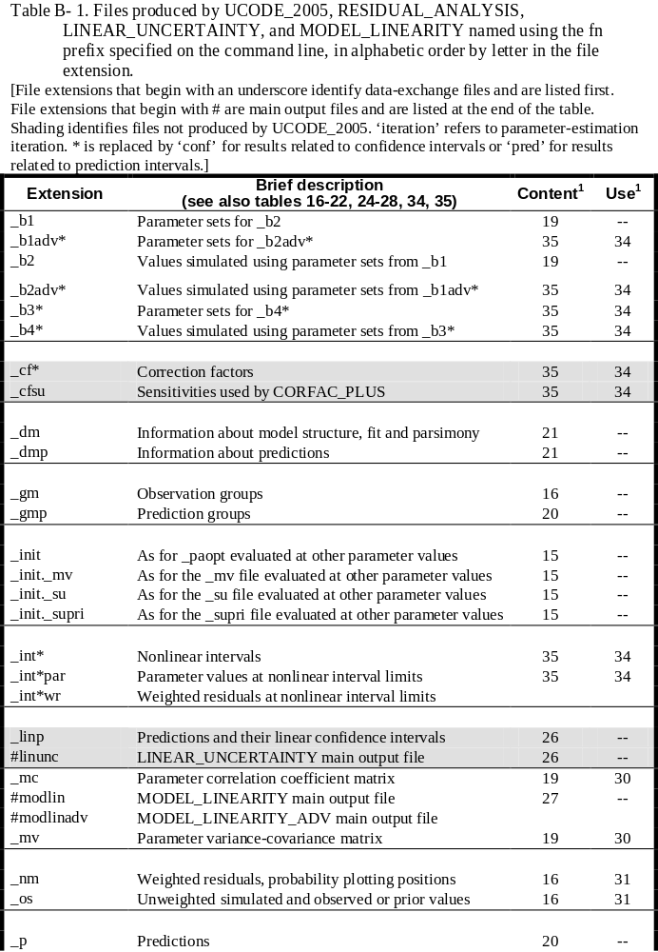
UCODE_2005 documentation,
Appendix B, p. 231-233

Slide 27
Troubleshooting Ucode_2014:
What to do about regression problems
Inverse model options
  Eliminate insensitive parameters
  Add prior (but carefully)
Algorithm options
  Log transforming
  Lower MAXCHANGE
  Try the trustregion methods
Forward model options
  Different solver (“noisy” solvers can be bad)
  Different formulation of BC’s or representation of observations

Slide 28
UCODE_2014 Capabilities
UCODE_2014 has many capabilities not discussed in class.
See the documentation.
Here we go over those needed for class

Slide 29
Weighting
Weights have to make contributions to the objective function dimensionless
  Observations with different units can be combined
Weights can be used to emphasize reliable observations compared to less reliable ones
  Can use standard deviations or coefficients of variation (cv) to define the weight.
Notes:
II. Introduction to UCODE_2005

Slide 30
Beyond estimating parameters
How good is our fit, our parameters, our data, our predictions?
6 other programs included in UCODE_2014
  Updates of capabilities available with MODFLOWP, UCODE, AND MODFLOW-2000
    RESIDUAL_ANALYSIS (was RESAN…)
    MODEL_LINEARITY (was BEALE…)
    LINEAR_UNCERTAINTY (was YCINT…)
  Associated with nonlinear confidence intervals and new measures on linearity
    RESIDUAL_ANALYSIS_ADV
    CORFAC_PLUS
    MODEL_LINEARITY_ADV
Notes:
II. Introduction to UCODE_2005

Slide 31
SA/PE/UA
Sensitivity Analysis, Parameter Estimation, and Uncertainty Analysis
  Insight into how data and models interact
  Use quantification provided to communicate data importance and needs to decision makers
  Provides measure of uncertainty

Slide 32
Common questions that can be addressed by careful use of SA/EA/PE
How much and what model complexity can the observations support?
Are any of the estimated parameter values dominated by a single observation?
What model parameters are important to the things I need to predict?
What data should be collected to improve the predictions?
Which conceptual model of the system is likely to produce better predictions?
How certain are the predictions?
Notes:
II. Introduction to UCODE_2005

Slide 33
Documentation
Poeter, Hill, Banta, Mehl, and Christensen USGS TM6-A11
  Source and executable available at:
  http://www.mines.edu/igwmc/freeware/ucode/
Hill and Tiedeman 2007, Methods and guidelines for effective groundwater model calibration. Wiley.
Christensen and Cooley (2005) Documentation for the UNC Process of MODFLOW
Cooley (2004) USGS
Notes:
II. Introduction to UCODE_2005

Slide 34
Prepare Exercises
Download ‘software.zip’ from the link provided
  Extract to a folder that does not contain spaces in the name
    ‘my documents’ will not work!
    ‘downloads’ will work.
  You should see a folder structure that looks like: xxx\software\ucode_2014_1.004_and_more\ucode_2014_1.004\test-win
Download the file ‘Exercises from Hill and Tiedeman 2007_for_GRA.zip’
  Extract it in the folder listed above: xxx\software\ucode_2014_1.004_and_more\ucode_2014_1.004\test-win
We will run everything from the folder: Exercises from Hill and Tiedeman 2007_for_GRA
Notes:
II. Introduction to UCODE_2005

