Slide 1
IV. Sensitivity Analysis for
Initial Model
1. Sensitivities and how are they calculated
2. Fit-independent sensitivity-analysis statistics
3. Scaled sensitivities DSS, CSS
4. Parameter correlation coefficients
5. Scaled sensitivities 1SS
6. Leverage
Notes:
IV. Sensitivity analysis for the Initial Model

Slide 2
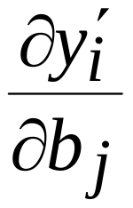
Sensitivities
Sensitivities are derivatives of dependent variables with respect to model parameters. The sensitivity of a simulated value y_{i}’ to parameter b_{j} is expressed as:
Sensitivities are needed by nonlinear regression to estimate parameters.
When appropriately scaled, they are also very useful by themselves. Scaling is needed because different y_{i}’ and b_{j} can have different units, so different values of ∂y_{i}’/ ∂b_{j} can’t always be meaningfully compared.
Can assess scaled sensitivities before performing regression, and use them to help guide the regression. “Fit-independent statistics”
Notes:
IV. Sensitivity analysis for the Initial Model

Slide 3
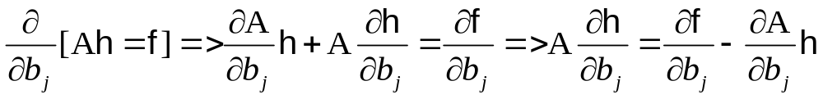
Calculating sensitivities:
Sensitivity-equation sensitivities
Matrix equation for heads solved by MODFLOW:
Ah=f
A is an n x n matrix that contains hydraulic conductivities.
n = number of nodes in the grid
h is an n x 1 vector of heads for each node in the grid
f is an n x 1 vector of known quantities. Includes pumping,
recharge, part of head-dependent boundary calculation, etc
Take derivative with respect to parameter b_{j}:
Calculate observation sensitivities from these grid sensitivities
Notes:
IV. Sensitivity analysis for the Initial Model

Slide 4
Calculating sensitivities:
Perturbation sensitivities
forward differences or central differences
y’_{i}(b_{j}+Δb_{j})- y’_{i}(b_{j}) y’ _{i}(b_{j}+Δb_{j})- y’ _{i}(b_{j} –Δb_{j})
Δb_{j} 2 Δb_{j}
Sensitivities calculated using perturbation method usually are less accurate.
Refs: Yager, R.M. 2004; Hill & Østerby, 2003. Effects of model sensitivity and nonlinearity on parameter correlation and parameter estimation. GW flow.
UCODE and PEST: It is worth spending some time making sure the sensitivities are accurate. Work with (1) perturbation used and (2) accuracy and stability of the model. JACTEST utility in PEST for inspecting perturbation dynamics.
For (2), consider solver convergence criteria and anything automatically calculated to improve solution accuracy, like time-step size for transport models. Set values the same for all runs used to calculate sensitivities.
Notes:
IV. Sensitivity analysis for the Initial Model

Slide 5
Perturbation Sensitivities: forward difference
Evaluation at current parameter value
y’_{i}
Evaluation at increased parameter value
b_{j}

Slide 6
Perturbation Sensitivities: central difference
Evaluation at current parameter value
y’_{i}
Evaluation at increased parameter value
Evaluation at decreased parameter value
b_{j}

Slide 7
A closer look at perturbation size
In theory, derivative is obtained in the limit as Δb → 0
  Therefore, the smaller the perturbation size, the better you will approximate the true derivative
In practice, round off errors and cancellation degrade accuracy
  Therefore, the smaller the perturbation size, the worse you will approximate the true derivative
Choose a perturbation size that balances this tradeoff

Slide 8
A closer look at perturbation size
A guideline for perturbation
  Ex., first 6 digits are good, last 3 are numerical garbage
  123.456789
  Base value: 526.337548
  perturbed value: 526.331026
  000.006522
  Of our 6 good digits, 5 cancelled, only 1 good digit remains
  Perturbation should affect the back half of the good digits
  123.456789
  Base value: 526.337548
  perturbed value: 526.205343
  000.132205
Notes:
IV. Sensitivity analysis for the Initial Model
For forward differences, perturb back half of the good digits
For centered differences, perturb back two-thirds of good digits (ie, in example above, perturbation should affect 3rd digit
How do you know how many digits are good? 1) run same model on different hardware (Mac vs PC vs Sun, etc. and note differences in solution). 2) Change solver criteria and see where changes in the solution show up.

Slide 9
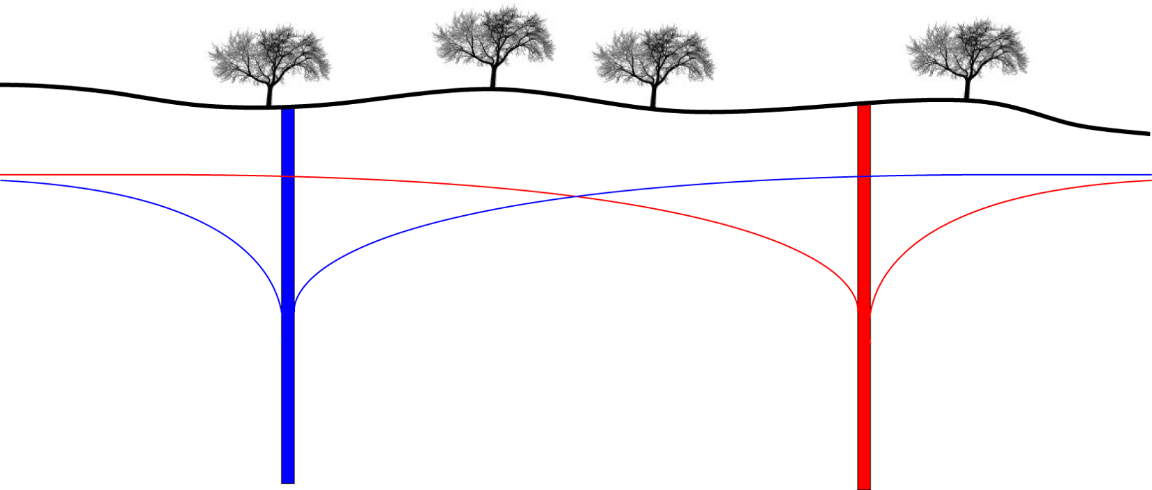
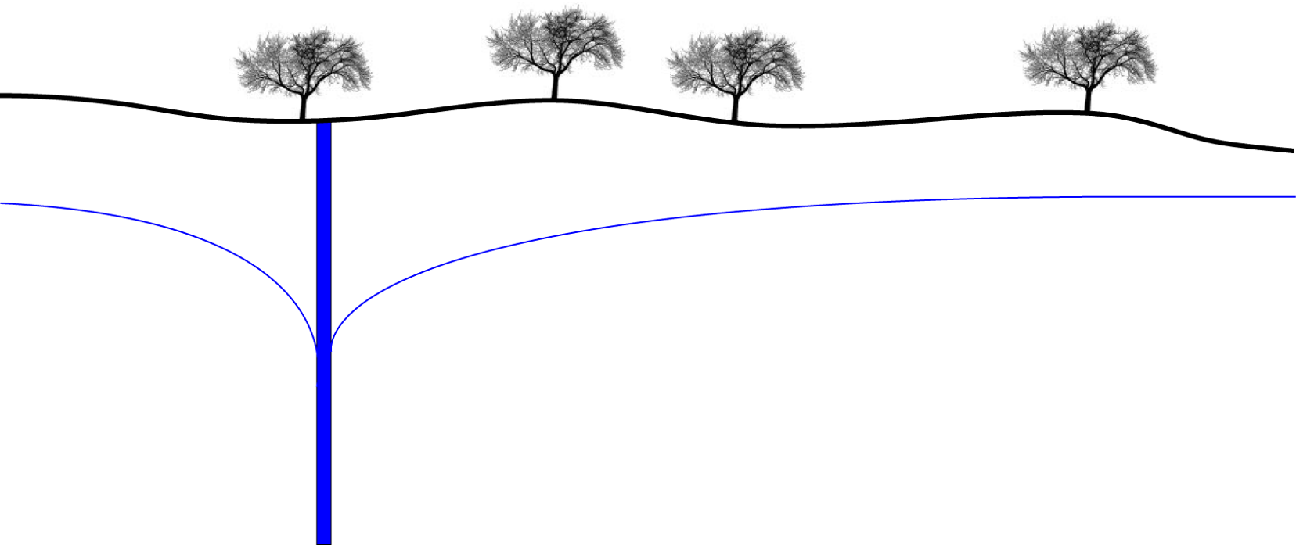
Calculating sensitivities:
Adjoint State:
Reciprocity of flow equations
Effect is running the model once per observation
More accurate than perturbations and very efficient for highly- parameterized inversions
Reference: Clemo and Hill, in prep… for MF2005 and MT3D
Notes:
IV. Sensitivity analysis for the Initial Model

Slide 10
Fit-Independent Statistics
Fit-independent statistics do not use the residual (observed minus simulated value) in the calculation of the statistic
Use sensitivities, weights, and parameter values to calculate the statistics.
Not usually presented in statistics books. They usually focus on statistics calculated after regression is complete. But when a model has a long execution time it is advantageous to do some evaluation before any regressions when the model fit may be quite poor. This is where fit-independent statistics come in.

Slide 11
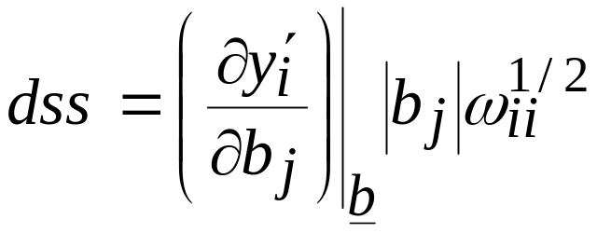
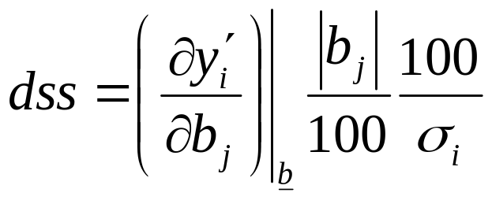
Dimensionless Scaled Sensitivities
Dimensionless scaled sensitivity (Book, p. 48):
Indicates the amount the simulated value would change given a one-percent change in the parameter value, expressed as a percent of the observation error standard deviation (p. 49)
Can be used to compare importance of:
  different observations to estimation of a single parameter.
  different parameters to simulation of a single dependent variable.
Larger |dss| indicates greater importance of the observation relative to its error.
Can be used to detect errors in model input files (0 or non zero values)
Notes:
IV. Sensitivity analysis for the Initial Model
swm: added note about detecting errors. DSS=0 when they shouldn’t or DSS not = 0 when they should be 0 indicate something is wrong!

Slide 12
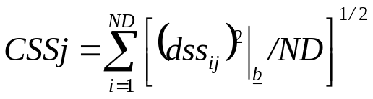
Composite Scaled Sensitivities
Composite scaled sensitivity (Book, p. 50):
CSS indicate importance of observations as a whole to a single parameter, compared with the accuracy on the observation
Can use CSS to help choose which parameters to estimate by regression.
Generally, if CSS_{j} is more than about 2 orders of magnitude smaller than the largest CSS, it will be difficult to estimate parameter b_{j}, and the regression may have trouble converging.
Notes:
IV. Sensitivity analysis for the Initial Model

Slide 13
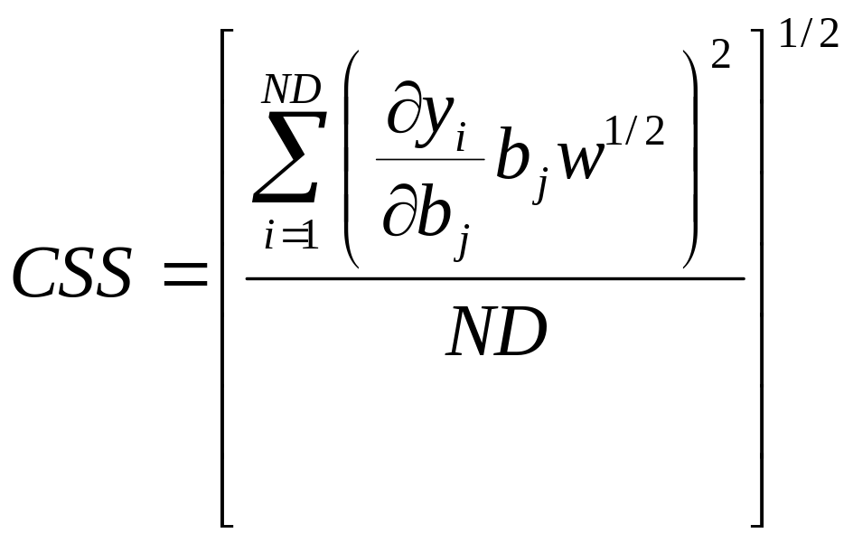
1. Composite Scaled Sensitivities (p. 50)
Dimensionless scaled sensitivity
y_{i} = simulated observation value
b_{j} = estimated parameter value
ω = weight of observation
s = std dev of measurement error
CSS indicate importance of observations as a whole to a single parameter, compared with the accuracy on the observation
Can use CSS to help choose which parameters to estimate by regression.
Generally, if CSS_{j} is more than about 2 orders of magnitude smaller than the largest CSS, it will be difficult to estimate parameter b_{j}, and the regression may have trouble converging.
CSS values less than 1.0 indicate that the sensitivity contribution is less than the effect of observation error.
Notes:
IV. Sensitivity analysis for the Initial Model

Slide 14
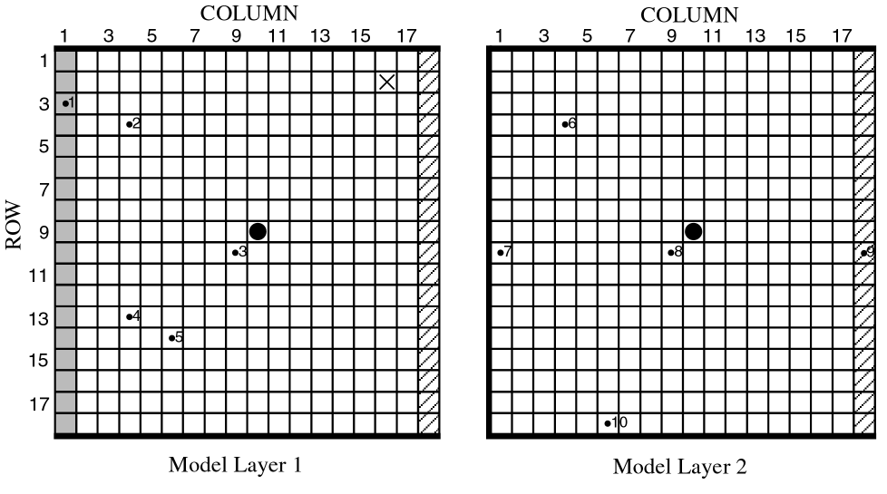
Exercise 4.1b
DO EXERCISE 4.1b: Use dimensionless, composite, and one-percent scaled sensitivities to evaluate observations and defined parameters.
Dimensionless scaled sensitivities for the initial steady-state model are given in Table 4-1 of Hill and Tiedeman (p. 61).
Composite scaled sensitivities are given in Table 4-1 and Figure
4-3. Can be plotted with GW_Chart.
Notes:
IV. Sensitivity analysis for the Initial Model

Slide 15
DSS and CSS for Initial Steady-State Model
Parameter
Observation Number
ID
HK_1
K_RB
VK_CB
HK_2
RCH_1
RCH_2
1
1.ss
0.11E-04
-0.225
0.105E-06
0.383E-05
0.150
0.749E-01
2
2. ss
-33.3
-0.225
-0.284
-5.47
24.0
15.3
3
3. ss
-57.9
-0.225
-0.493
-15.7
38.3
35.9
4
4. ss
-33.3
-0.225
-0.284
-5.47
24.0
15.3
5
5. ss
-46.5
-0.225
-0.394
-9.95
32.9
24.1
6
6. ss
-33.4
-0.225
-0.635
-5.35
24.0
15.6
7
7. ss
-2.34
-0.225
-2.38
2.08
1.82
1.04
8
8. ss
-57.5
-0.225
-0.133
-16.0
37.8
36.1
9
9. ss
-66.6
-0.225
-0.580E-01
-23.3
38.1
52.1
10
10. ss
-46.3
-0.225
-0.330
-10.1
32.6
24.4
11
flow.ss
-0.547E-03
-0.663E-04
-0.260E-05
-0.190E-03
-7.36
-3.68
Composite Scaled Sensitivity
41.3
0.214
0.783
11.0
27.4
25.6
Table 4-1 of Hill and Tiedeman (p. 61)
Display graphically and investigate values in following slides
Notes:
IV. Sensitivity analysis for the Initial Model
swm: RCH1 and RCH2 most important for flow obs. Makes sense because RCH is the dominant source of water in this system. Note the negative sign – this is because Modflow is defining this as a leakage leaving the aquifer, so the observation itself is negative. As RCH increases, we see a corresponding increase in leakage (defined as negative) from the aquifer->river.
Head 1 and 7 have little sensitivity because of the proximity to the river, which is a head dependent boundary, which controls the head elevation at the river.

Slide 16
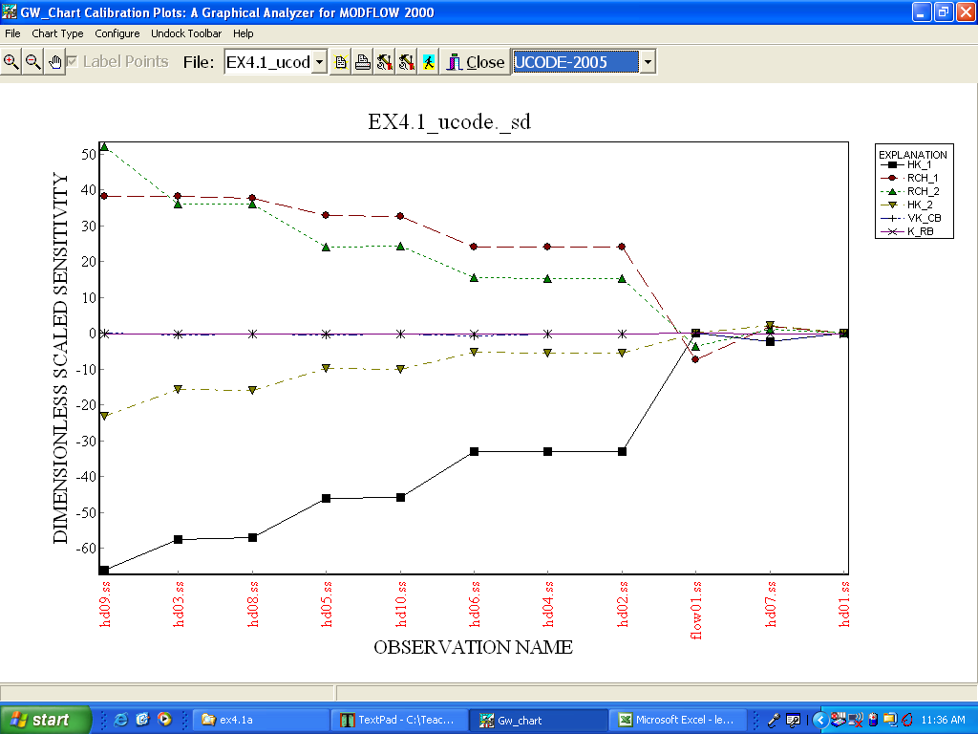

Slide 17
Why are the dss small for …
flow01.ss
hd07.ss
hd01.ss
hd01.ss
flow01.ss
hd07.ss

Slide 18
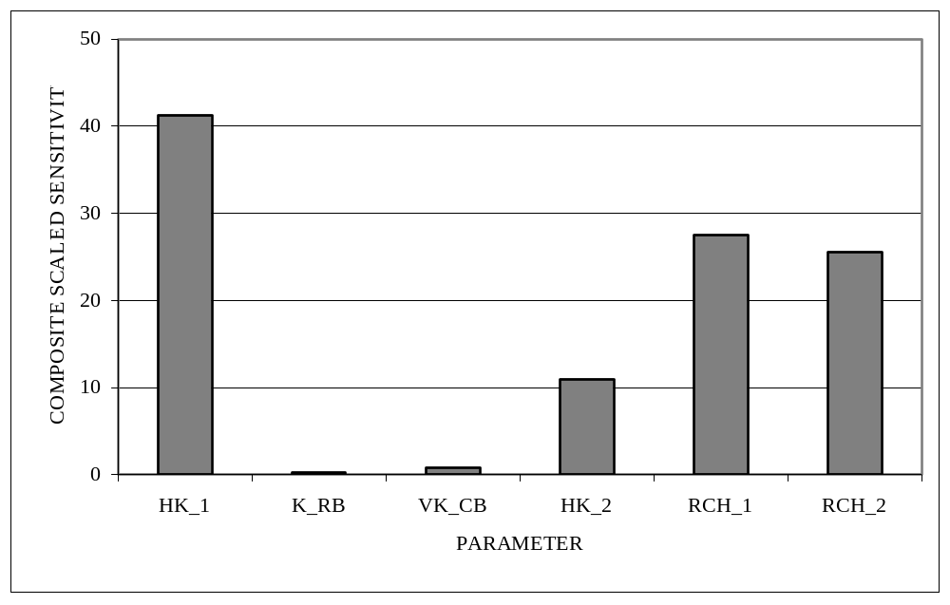
CSS for Initial Steady-State Model
Figure 4-3 of Hill and Tiedeman (p. 62)
Notes:
IV. Sensitivity analysis for the Initial Model
Based on the 2 orders of magnitude rule-of-thumb, looks like K_RB and VK_CB could be problematic to estimate.

Slide 19
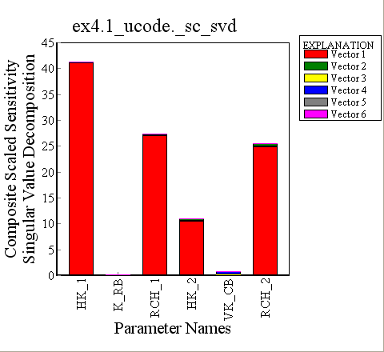
SVD on CSS for Initial Steady-State Model
Singular Value Decomposition of the sensitivity matrix is an alternative way to seek out sensitivity and correlation.
Less sensitive to derivative accuracy.
Combines information about which parameters are sensitive to which part of the estimation process.
We’ll talk more about SVD later, and details on this application are in Hill and Østerby (2006).
Notes:
IV. Sensitivity analysis for the Initial Model

Slide 20
IV. Sensitivity Analysis for
Initial Model
1. Sensitivities
derivative of output y_{i} with respect to parameter b_{j}.
2. Ways to use the observation sensitivities
3. Scaled sensitivities (DSS, CSS)
4. Parameter correlation coefficients
5. Scaled sensitivities 1SS
6. Leverage
Notes:
IV. Sensitivity analysis for the Initial Model

Slide 21
Parameter Correlation Coefficients
a measure of whether or not the calibration data can be used to estimate independently each of a pair of parameters.
important part of sensitivity analysis of the initial model.
assessed intuitively here
  more rigorous explanation later in the course.
Notes:
IV. Sensitivity analysis for the Initial Model

Slide 22
Parameter Correlation Coefficients
DO EXERCISE 4.1c: Use parameter correlation coefficients to assess parameter uniqueness.
The parameter correlation coefficient matrix for the starting parameter values for the steady-state problem, calculated using the hydraulic-head and flow observations, is shown in Table 4-2 of Hill and Tiedeman (p. 62). The parameter correlation coefficient matrix calculated using only the hydraulic-head data is shown in Table 4-3 (p. 63).
Notes:
IV. Sensitivity analysis for the Initial Model

Slide 23
Parameter Correlation Coefficients
Calculated by MODFLOW-2000, using head and flow data.
HK_1
K_RB
VK_CB
HK_2
RCH_1
RCH_2
HK_1
1.00
-0.37
-0.57
-0.76
0.95
-0.63
K_RB
1.00
-0.11
0.31
-0.22
0.25
VK_CB
1.00
0.82
-0.68
0.81
HK_2
symmetric
1.00
-0.83
0.98
RCH_1
1.00
-0.76
RCH_2
1.00
Table 4-2A of Hill and Tiedeman (p. 62)
Notes:
IV. Sensitivity analysis for the Initial Model
Note – if comparing to class, some values are slightly different due to perturbation sensitivities.

Slide 24
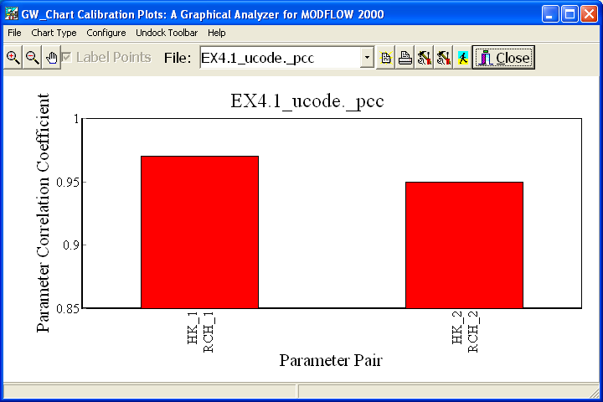
Using GW_Chart and UCODE_2005

Slide 25
Parameter Correlation Coefficients
Calculated by MODFLOW-2000, using only head data.
HK_1
K_RB
VK_CB
HK_2
RCH_1
RCH_2
HK_1
1.00
1.00
1.00
1.00
1.00
1.00
K_RB
1.00
1.00
1.00
1.00
1.00
VK_CB
1.00
1.00
1.00
1.00
HK_2
symmetric
1.00
1.00
1.00
RCH_1
1.00
1.00
RCH_2
1.00
Table 4-3A of Hill and Tiedeman (p. 73)
Notes:
IV. Sensitivity analysis for the Initial Model
Must have Q and K to constrain model.

Slide 26
Parameter Correlation Coefficients
Calculated by UCODE_2005, using only head data.
HK_1
K_RB
VK_CB
HK_2
RCH_1
RCH_2
HK_1
1.00
0.97
1.00
1.00
1.00
1.00
K_RB
1.00
0.97
0.97
0.97
0.97
VK_CB
1.00
1.00
1.00
1.00
HK_2
symmetric
1.00
1.00
1.00
RCH_1
1.00
1.00
RCH_2
1.00
Table 4-3B of Hill and Tiedeman (p. 63)
Notes:
IV. Sensitivity analysis for the Initial Model
Round off error in the finite difference sensitivities combined with poor conditioning of the matrix when perfectly correlated makes it difficult to produce 1.0 everywhere when perfectly correlated.

Slide 27
IV. Sensitivity Analysis for
Initial Model
1. Sensitivities
derivative of output y_{i} with respect to parameter b_{j}.
2. Ways to use the observation sensitivities
3. Scaled sensitivities (DSS, CSS)
4. Parameter correlation coefficients
5. Scaled sensitivities 1SS
6. Leverage
Notes:
IV. Sensitivity analysis for the Initial Model

Slide 28
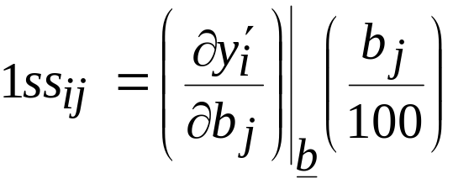
One-Percent Scaled Sensitivities
formula (Book, p.54)
In units of the observations; can be thought of as change in simulated value due to 1% increase in parameter value.
1% is used because for nonlinear models, sensitivities change with parameter value. The values calculated here are likely to hold for small parameter value changes, like 1 %
Can be used to create contour maps of one-percent scaled sensitivities for hydraulic heads in a given model layer.
    now think of y_{i} as head in cell i
Notes:
IV. Sensitivity analysis for the Initial Model

Slide 29
One-Percent Sensitivity Maps For Initial Model
1% sensitivity maps of hydraulic head to a model parameter can provide useful information about a simulated flow system.
For the simple steady-state model used in these exercises, the one-percent sensitivity maps can be explained using Darcy’s Law and the simulated fluxes of the simple flow system.
Useful for detecting model input errors
Once input errors are out, not generally useful for optimization because there are too many maps that usually each identify different important areas. Other statistics are more useful.
Useful for designing data collection strategies, (but there are better methods, such as OPR)
Notes:
IV. Sensitivity analysis for the Initial Model
swm: added note about data collection. However, common sense needs to be used here. Collecting a lot of data in insensitive areas is usually a bad idea, however collecting lots of data in sensitive area can also backfire in that it might be redundant. This is where OPR can help because once you include an obs, the picture changes on where the next obs should be located. That is, it will account for all existing obs.

Slide 30
One-Percent Sensitivity Maps For Initial Model
DO EXERCISE 4.1d: Evaluate contour maps of one-percent sensitivities for the steady-state flow system.
These maps are shown in Figure 4-4 of Hill and Tiedeman (p. 64).
Notes:
IV. Sensitivity analysis for the Initial Model

Slide 31
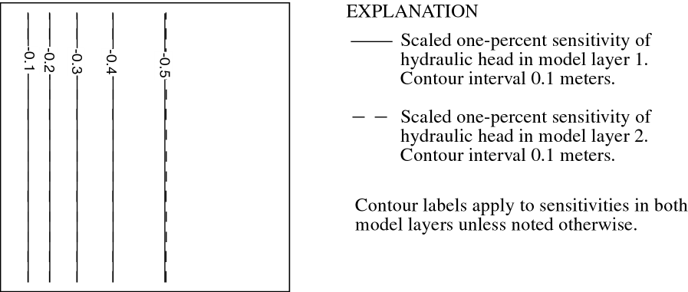
One-Percent Sensitivities for HK_1
Figure 4-4A of Hill and Tiedeman
Zero at river. Why?
Negative away from river. Why?
Contours closer near the river. Why?
Values in layers 1 and 2 similar. Why?
Notes:
IV. Sensitivity analysis for the Initial Model

Slide 32
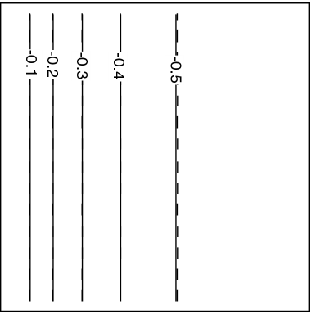
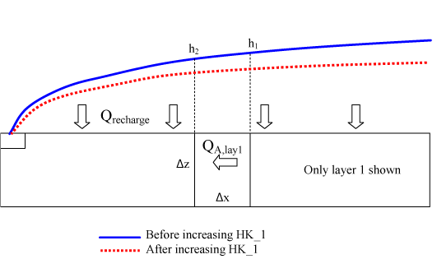
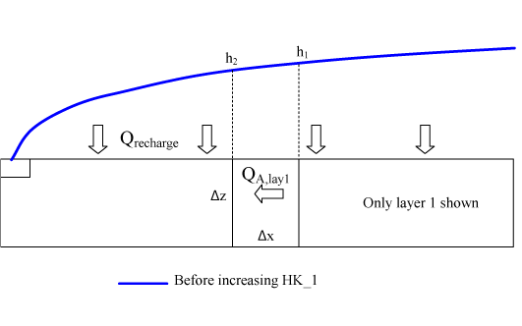
One-Percent Sensitivities for HK_1
Zero at river. Why?
Negative away from river. Why?
Contours closer near the river. Why?
Values in layers 1 and 2 similar. Why?
Notes:
IV. Sensitivity analysis for the Initial Model

Slide 33
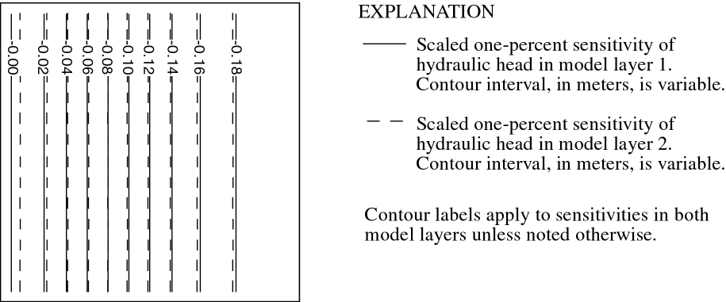
One-Percent Sensitivities for HK_2
Figure 4-4B of Hill and Tiedeman
Zero at river. Why?
Negative away from river. Why?
Smaller values than for layer 1. Why?
Notes:
IV. Sensitivity analysis for the Initial Model

Slide 34
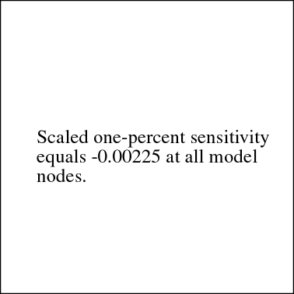
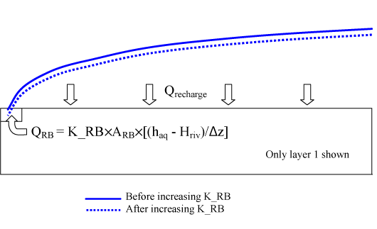
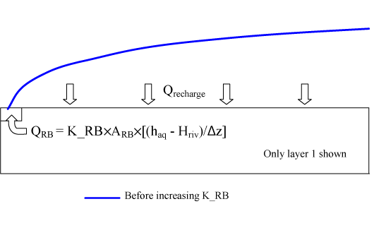
One-Percent Sensitivities for K_RB
Figure 4-4C of Hill and Tiedeman
Constant over the whole system. Why?
Notes:
IV. Sensitivity analysis for the Initial Model

Slide 35
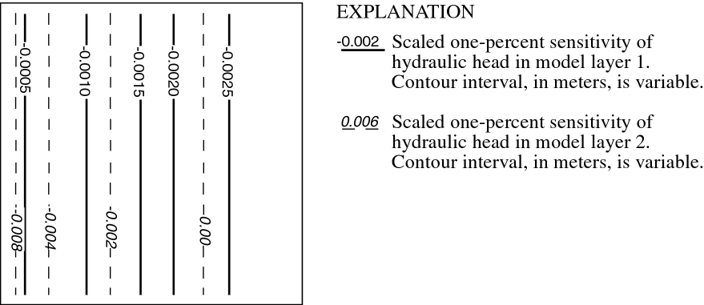
One-Percent Sensitivities for VK_CB
Figure 4-4D of Hill and Tiedeman
Different for layers 1 and 2. Why?
Notes:
IV. Sensitivity analysis for the Initial Model

Slide 36
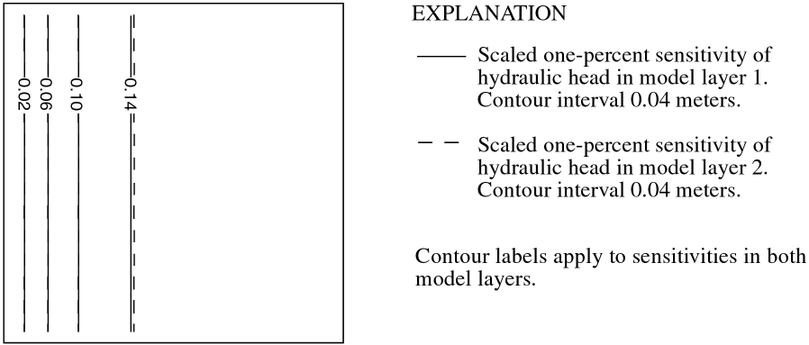
One-Percent Sensitivities for RCH_1
RCH_1
RCH_2
Figure 4-4E of Hill and Tiedeman
Constant on right side of system. Why?
Notes:
IV. Sensitivity analysis for the Initial Model

Slide 37
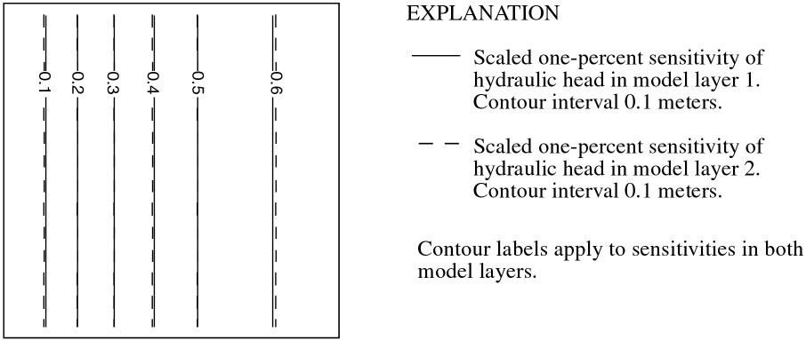
One-Percent Sensitivities for RCH_2
RCH_1
RCH_2
Figure 4-4F of Hill and Tiedeman
Contours equally spaced on left side of system. Why?
Notes:
IV. Sensitivity analysis for the Initial Model

Slide 38
IV. Sensitivity Analysis for
Initial Model
1. Sensitivities
derivative of output y_{i} with respect to parameter b_{j}.
2. Ways to use the observation sensitivities
3. Scaled sensitivities (DSS, CSS)
4. Parameter correlation coefficients
5. Scaled sensitivities 1SS
6. Leverage
Notes:
IV. Sensitivity analysis for the Initial Model

Slide 39
Leverage
Leverage
  Calculated from sensitivities in a way that accounts for parameter correlation, as measured by pcc.
    Use to identify observations important to estimating unique parameter values (unlike dss and 1ss)
  Measures the potential for an observation to make a difference based on the observation sensitivities
    In contrast, influence statistics measure the actual difference; more on that later
Exercise 4.1e

Slide 40
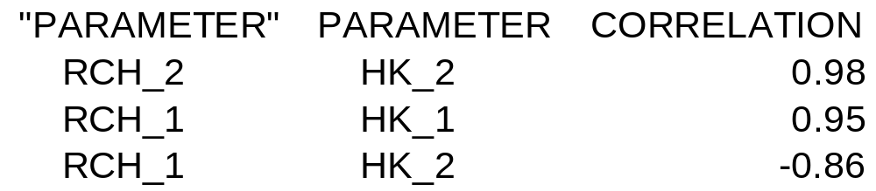

Slide 41
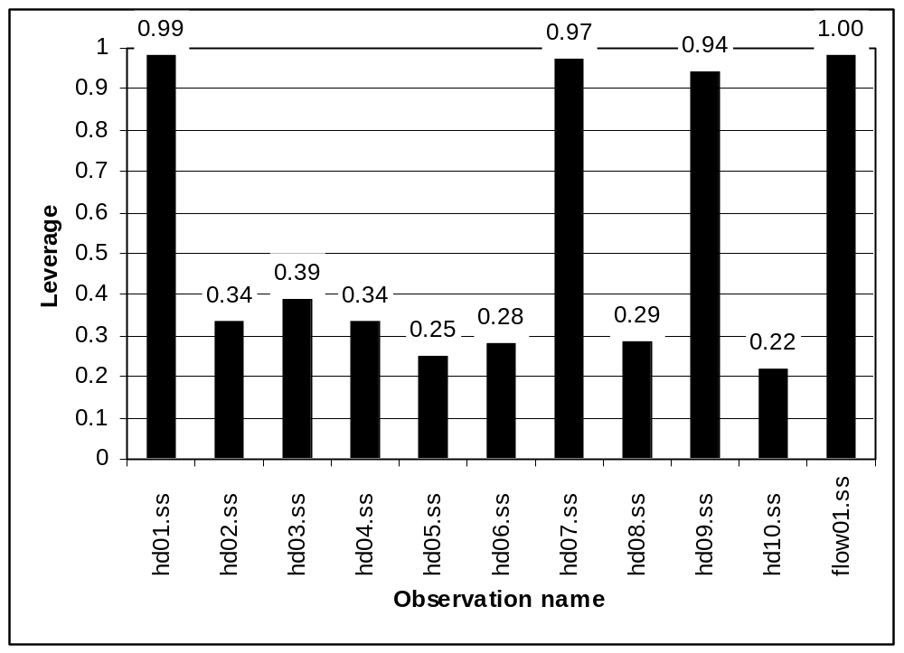
Notes:
IV. Sensitivity analysis for the Initial Model
Due to high correlation or high sensitivity.

Slide 42
hd01, hd07, flow01 important because their effects of parameter correlation.
Hd09.ss important because of high sensitivities.

Slide 43
IV. Sensitivity Analysis for
Initial Model
1. Sensitivities
derivative of output y_{i} with respect to parameter b_{j}.
2. Ways to use the observation sensitivities
3. Scaled sensitivities (DSS, CSS)
4. Parameter correlation coefficients
5. Scaled sensitivities 1SS
6. Leverage
Notes:
IV. Sensitivity analysis for the Initial Model

