Slide 1
V. Nonlinear Regression
Objective-Function Surfaces
Thus far, we have:
Parameterized the forward model
Obtained head and flow observations and their weights
  More on weights later
Calculated and evaluated sensitivities of the simulated observations to each parameter
  More on sensitivities later
Now the parameter-estimation process can be used to get “best set” of parameter values → optimization problem
Before we get into the mathematics behind parameter estimation we first graphically examine this process
Notes:
V. Nonlinear regression objective function surfaces

Slide 2
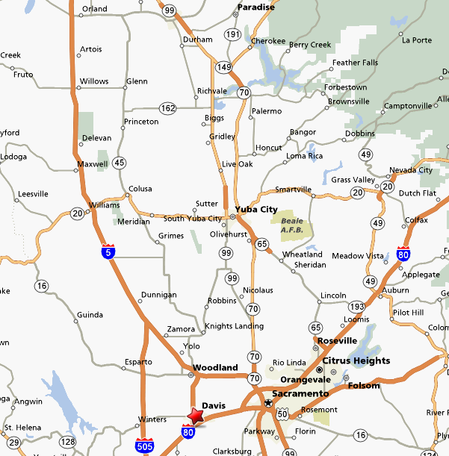
Chico

Slide 3
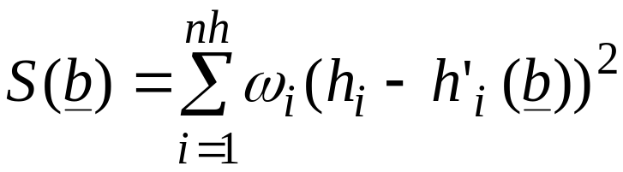
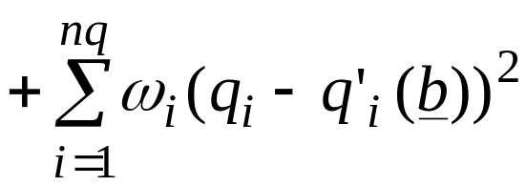
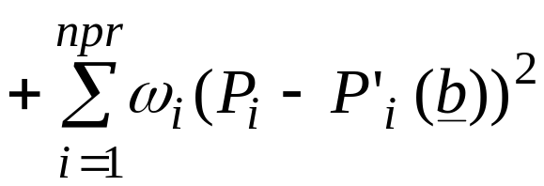
V. Nonlinear Regression
Objective-Function Surfaces
Sum of squared weighted residuals objective function:
HEADS
FLOWS
PRIOR
Goal of nonlinear regression is to find the set of model parameters b that minimizes S(b)
Notes:
V. Nonlinear regression objective function surfaces

Slide 4
Objective-Function Surfaces - continued
Weighted squared errors are dimensionless, so quantities with different units can be summed in the objective function.
Increasing the weight on an observation increases the contribution of that observation to S(b) .

Slide 5
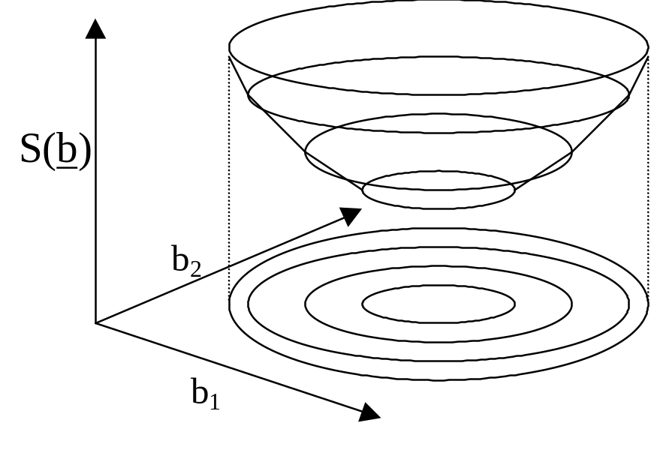
Objective-Function Surfaces - continued
Objective function has as many dimensions as there are model parameters. For a 2-parameter problem, the objective function can be calculated for many pairs of parameter values, and the resulting objective-function surface can be contoured

Slide 6
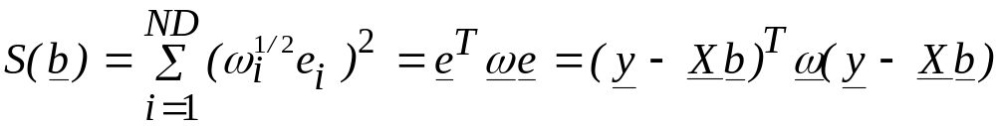
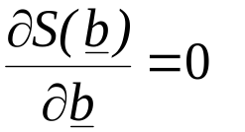


Linear Regression with Weighting
When using weights, we minimize the sum of squared weighted residuals:
We again set the derivative of the objective function to zero:
This leads to the normal equations:
Solving for b’:
Notes:
V. Nonlinear regression objective function surfaces
Obj func written as (w^(1/2) e )^2 assumes using a DIAGONAL weight matrix and that the different observations are uncorrelated.
Writing as (eT w e) allows for a full weight matrix, with terms on the off-diagonals. This allows for a weighting scheme to account for correlations among different observations.
Example: streamflow measured at 3 points. The gain/loss over the 2 reaches are correlated because each is calculated using the middle point measurement.
One study in gw lieterature that has incorporated the off diagonal terms found that including correlations among the observations didn’t matter in terms of the regression results.
In mf2k, can have full weight matrix on flows, adv, prior.

Slide 7

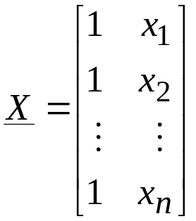
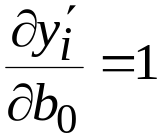
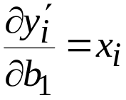
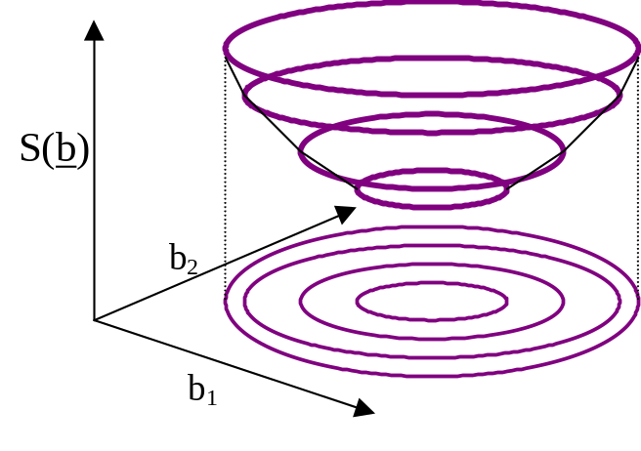
Linear versus Nonlinear Models
Linear models: Sensitivities of matrix X are not a function of the model parameters:
and
; recall
Linear models have elliptical objective function surfaces. With two parameters:
One step to get to the minimum.
Notes:
V. Nonlinear regression objective function surfaces
First eqn: Simulated values for a 2-parameter linear model
Terms of X are independent of values of b0 and b1.
These are sensitivities: derivative of a simulated value w/r/t a model parameter. Same quantities you worked with in ex. 6.
dS/db = f (dy/db), and dy/db are constant for linear model; therefore dS/db is constant no matter what the values of b are.
swm: dS/db is not constant. By definition the minimum is where it is zero, so it has to change. As above, dS/db = f(dy/db), but this a quadratic function (ie, we square residuals), so S is a paraboloid. (second derivative is constant, not first derivative)
Obj func surface shown: Nice shape – well defined global minimum, no local minima.
For linear problems, get to minimum of this surface (to optimal values of b0,b1) in just 1 step of solving normal equations.

Slide 8
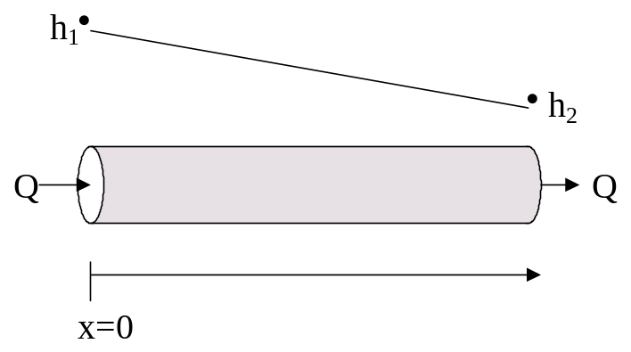
Linear versus Nonlinear Models
Nonlinear models: Sensitivities of matrix X are a function of the model parameters.
Ground-water models are commonly nonlinear. This nonlinearity comes from Darcy’s Law:
  Q = -KA (∂h/∂x)
  h = h₁ – x (Q/KA)
Derivatives:
  ∂h/∂x = -Q/KA Not a function of x. Linear in x.
  ∂h/∂Q = -x/KA Function of K. Linear in Q, but nonlinear in K.
  ∂h/∂K = xQ/K²A Function of K and Q. Nonlinear in both K and Q.
Notes:
V. Nonlinear regression objective function surfaces
Used Darcy’s Law before for illustrating parameter correlations, by solving for h.
Now, use to illustrate model nonlinearity, by taking derivatives w/r/t terms of the equations.
dh/dQ result – Q doesn’t appear in RHS.

Slide 9
Nonlinear Regression
An iterative form of linear regression, with some modifications to the normal equations to make them work in practice. General procedure:
  Linearize the model around the current parameter values. This results in a linearized objective-function surface.
  Using the normal equations, calculate new parameter values that are closer to the minimum of the linearized objective-function surface, and therefore, hopefully closer to the minimum of the nonlinear objective-function surface.
  Repeat from step 1.
Notes:
V. Nonlinear regression objective function surfaces
Now sensitivities are different for different parameter values. Thus objective function surface is different. Not just value of S being different for different parameters, but whole surface in all of parameter space.
swm: I think this should be restated that the *linearized* objective function surface is different.

Slide 10
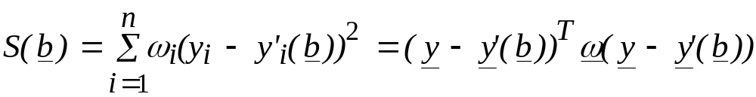
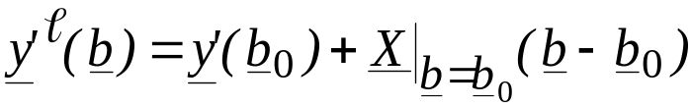
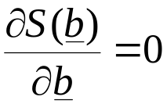
Nonlinear Regression
Objective function for nonlinear model:
y’(b) is nonlinear function of b.
To minimize S, we first substitute the linearized approximation of y’(b) into S. The linear approximation written in terms of sensitivity matrix X:
Substituting this into S, and setting
leads once again to
The NORMAL EQUATIONS!!!
(X^{T} ω X) d = X^{T} ω (y - y′ )
Notes:
V. Nonlinear regression objective function surfaces
In S(b) eqn, we write y’(b) because Xb is not constant.
b0 are starting values for first iteration, then are updated values in subsequent iterations.
In these normal equations: y is vector of obs. y’ is calculated at vector b=b0.
This shouldn’t look too mysterious!

Slide 11
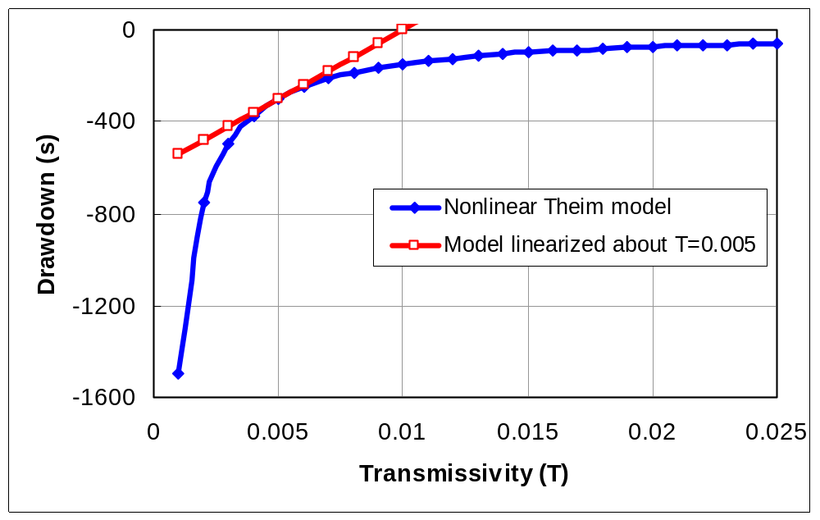
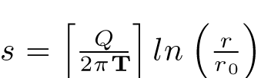

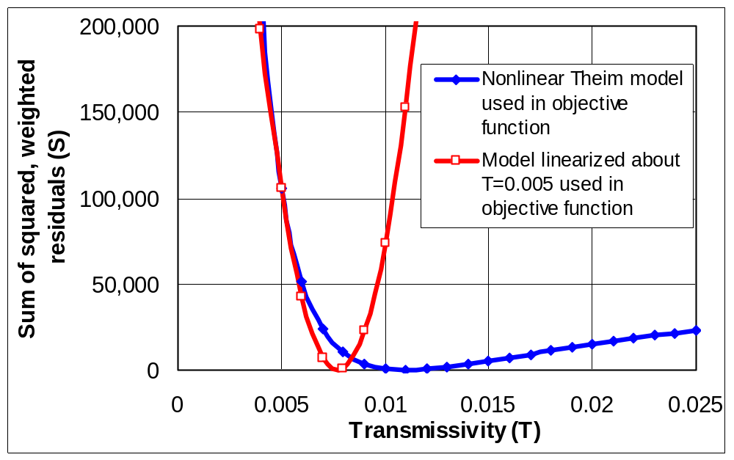

Nonlinear Regression
One-parameter model example: The Theim equation (pg 70).
drawdown:
Calculated drawdown for models at r=1.
Nonlinear and Linearized
Objective function=
Objective function values with observations at r=1, 2, 4, 6, 10, 40, 80, 120, 200, 300, 600.
No noise was added to the observations.
Nonlinear and Linearized
Notes:
V. Nonlinear regression objective function surfaces
Theim model: steady flow to pumped will in confined aquifer.
h=f(T), recall from Darcy’s law that h = nonlinear function of K, or T here. Thus, nonlinear model.
Upper graph, black curve: drawdown (head) plotted against T. See how is nonlinear.
Red curve: linearized model. Gives exact value at T=.005, deviates more & more from exact model as we get further and further from T=.005
Lower graph: Assumed some drawdown data, to construct an objective function.
Red curve: is exact at T=.005, deviates significantly away from T=.005.
As move closer from T=.005 to minimum of linearized objective function, we are also moving closer to minimum of nonlinear function. But, bad to move too far!.

Slide 12
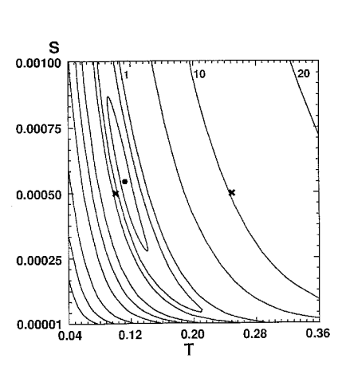
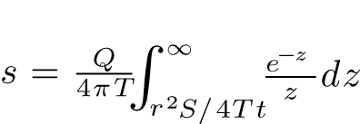
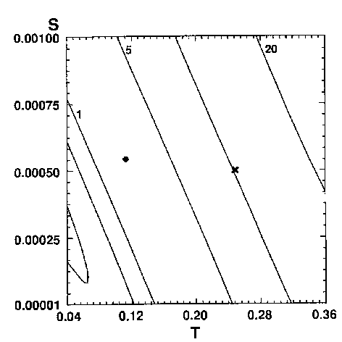
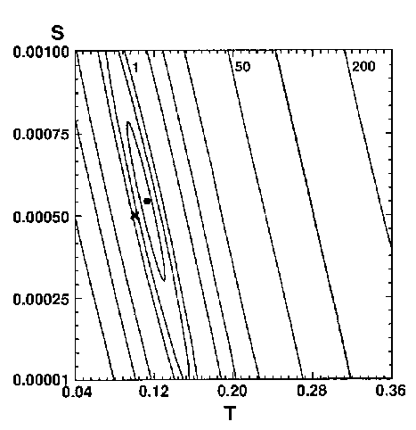
Nonlinear Regression
(A)
Time, in seconds Drawdown, in feet
480 1.71
1020 2.23
1500 2.54
2040 2.77
2700 3.04
3720 3.25
4920 3.56
Pumpage = 1.16 ft³/s
Distance from pumping to observation well = 175 ft
Nonlinear objective-function surface
Two-parameter model example: The Theis equation (pg 75).
Objective-function surface linearized about a point far from minimum of nonlinear objective-function surface
Objective-function surface linearized about a point close to minimum of nonlinear objective-function surface
True minimum
Points about which the surface is linearized
Notes:
V. Nonlinear regression objective function surfaces
Dot is true minimum.
X’s are points we will linearize around.
Lower left figure: We would overshoot if we went all the way to the minimum of the linearized surface.

Slide 13





Why aren’t the objective functions symmetric about the minimum? (the trough when correlated)
Parameter Nonlinearity of Darcy’s Law
(Hill and Tiedeman, 2007, p. 12-13)
Darcy’s Law
Linear in X
Nonlinearity makes it much harder to estimate parameter values.
Linear in Q
Nonlinear in K
Notes:
V. Nonlinear regression objective function surfaces
swm: linear wrt to Q. Hence we can use superposition!

Slide 14
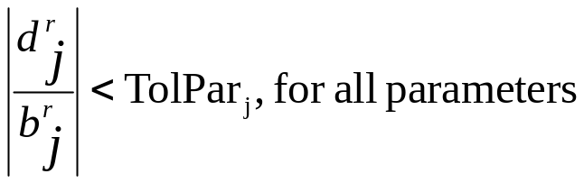
Stopping Criteria: TolPar and TolSOSC
Gauss-Newton process is iterative – so, when do you stop iterating?
Need a convergence criteria.
Two convergence criteria in MODFLOW-2000 and UCODE: TolPar and TolSOSC.
TolPar (Tolerance fro Parameters): The largest fractional change in a parameter value. For regression to converge:
TolPar should ideally be ≤ 0.01; larger values may be needed in initial regression runs or for insensitive parameters
TolSOSC: Convergence criterion for the sum of squared weighted residuals objective function. This criterion stops regression when the model fit isn’t changing much.
In the final regression runs, the TolPar convergence criterion should be met.
Notes:
V. Nonlinear regression objective function surfaces
Small fractional change: means we are at or very close to the minimum of the linearized objective function – Regression ‘sees’ a flat spot.
Note – TolPar can different for different parameters. Helpful when 1 or 2 parameters tend to bounce around more than the others

Slide 15
Steady-State Problem as a Two-Parameter Problem
Original six-parameter model is re-posed so that the six defined parameters are combined to form two parameters: KMult and RchMult.
When KMult = 1.0:
  Like when HK_1, HK_2, VK_CB, and K_RB equal their starting values in the six-parameter model.
When Rch_Mult = 1.0:
  Like when RCH_1 and RCH_2 equal their starting values in the six-parameter model.

Slide 16
Steady-State Problem as a Two-Parameter Problem
With the problem posed in terms of KMult and RchMult:
  Use UCODE in Evaluate Objective Function mode to calculate S(b) using many sets of values for KMult and RchMult
    Values of KMult and RchMult range from 0.1 to 10
    Use many values for each within this range. If 100, would have 100x100=10,000 sets of parameter values
  Plot values of S(b) for each set of parameter values
  Contour the resulting objective-function surface
  Examine how the objective-function surface changes given different observation types and weights.

Slide 17
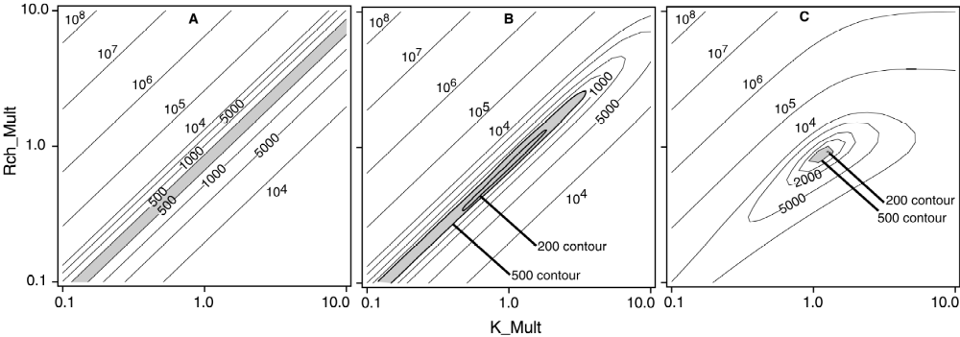
Steady-State Problem as a Two-Parameter Problem
Objective function surfaces (Book, Fig. 5-4, p. 82)
(contours of objective function calculated for combinations of 2 parameters)
Heads only
With flow
weighted using a
coefficient of
variation of 10%
With flow
weighted using a
coefficient of
variation of 1%

Slide 18
DO EXERCISE 5.1a: Assess relation of
objective-function surfaces to parameter
correlation coefficients.

Slide 19
Steady-State Problem as a Two-Parameter Problem
Objective function surfaces (Book, Fig. 5-4, p. 82)
(contours of objective function calculated for combinations of 2 parameters)
Heads only
With flow
weighted using a
coefficient of
variation of 10%
With flow
weighted using a
coefficient of
variation of 1%

Slide 20
Exercise 5.1a - questions
Use Darcy’s Law to explain why all the parameters are completely correlated when only hydraulic-head observations are used.
Why does adding a single flow measurement make such a difference in the objective-function surface?
Given that addition of one observation prevents the parameters from being completely correlated, what effect do you expect any error in the flow measurement to have on the regression results?
Notes:
swm: also means that artificially upweighting or downweighting the error in the flow measurement will artificially increase or decrease the resulting confidence intervals (see Tiedeman & Hill)
V. Nonlinear regression objective function surfaces

Slide 21
Introduction to the Performance of the Gauss-Newton Method: Effect of MAX-CHANGE
Goal of the modified Gauss-Newton (MGN) method: find the minimum value of the objective function.
MGN iterates. Each iteration moves toward the minimum of an approximate objective function. Approximation: linearize the model about the current set of parameter values.
If the approximate and true objective functions are very different, the minimum of the approximate objective-function may be far from the true minimum.
Often advantageous to restrict the method: for any one iteration the parameter values are not allowed to change too much. Use damping.
MAX-CHANGE: User-specified value partly controls the damping. MAX-CHANGE = the maximum fractional change allowed in one regression iteration.
If MAX-CHANGE=2 and the parameter value=1.1, the new value is allowed to be between 1.1±(2x1.1), or between -1.1 and 3.3.

Slide 22
DO EXERCISE 5.1b: Examine the performance of
the modified Gauss-Newton method for the
two-parameter lumped problem.

Slide 23
Exercise 5.1b – questions in first bullet
Do the regression runs converge to optimal parameter values?
How do the estimated parameter values compare among the different regression runs?
Explain the difference in the progression of parameter values during these regression runs.
Notes:
V. Nonlinear regression objective function surfaces

Slide 24
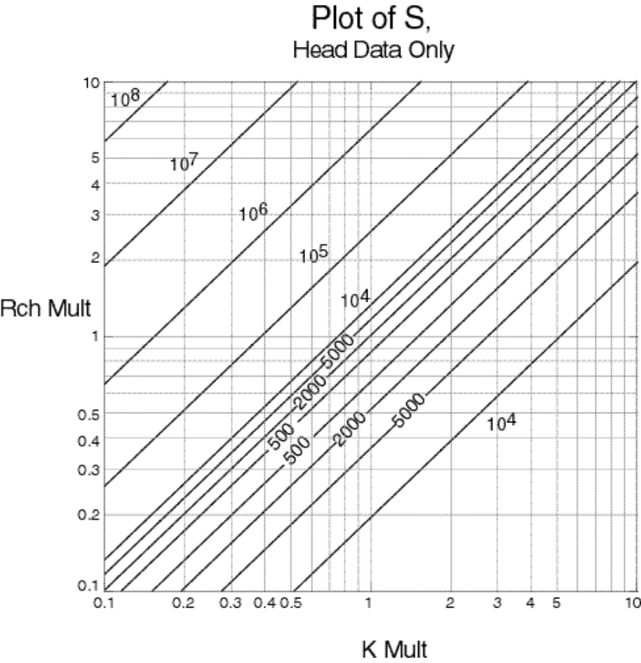
Exercise: Plot regression results on objective function surface for model calibrated with ONLY HEAD DATA
4 regression runs with different starting values or different maximum step sizes:
  Run 1: Start near trough
  Run 2: Start far away, let regression take big steps
  Runs 3 & 4: Start far away, force small steps
 | Run 1 MaxChange= 10,000 |  | Run 2 MaxChange= 10,000 |  | Run 3 MaxChange= 0.5 |  | Run 4 MaxChange =0.5
Iter. | K | Rch | K | Rch | K | Rch | K | Rch
1 | 1.0 | 1.0 | 9.0 | 0.20 | 9.0 | 0.20 | 1.0 | 9.0
2 | 1.9 | 0.86 | 1×10⁻¹⁴ | -12 | 4.5 | 0.11 | 0.74 | 4.5
3 | 1.1 | 0.81 | 1×10⁻¹⁴ | -7.8 | 2.4 | 0.056 | 0.51 | 2.25
4 | 1.1 | 0.81 | 2×10⁻¹⁴ | -5.1 | 1.2 | 0.079 | 0.76 | 1.3
5 | Converged |  | 3×10⁻¹⁴ | -3.3 | 0.60 | 0.12 | 0.99 | 0.94
6 |  |  | 4×10⁻¹⁴ | -2.2 | 0.32 | 0.18 | 1.06 | 0.82
7 |  |  | 6×10⁻¹⁴ | -1.4 | 0.26 | 0.21 | 1.03 | 0.76
8 |  |  | 8×10⁻¹⁴ | -0.92 | 0.26 | 0.20 | 1.02 | 0.78
9 |  |  | 1×10⁻¹³ | -0.60 | 0.26 | 0.20 | Converged
10 |  |  | 2×10⁻¹³ | -0.25 | Converged
The regression converged in 3 of the runs!
Are those parameter estimates unique?
Notes:
V. Nonlinear regression objective function surfaces

Slide 25
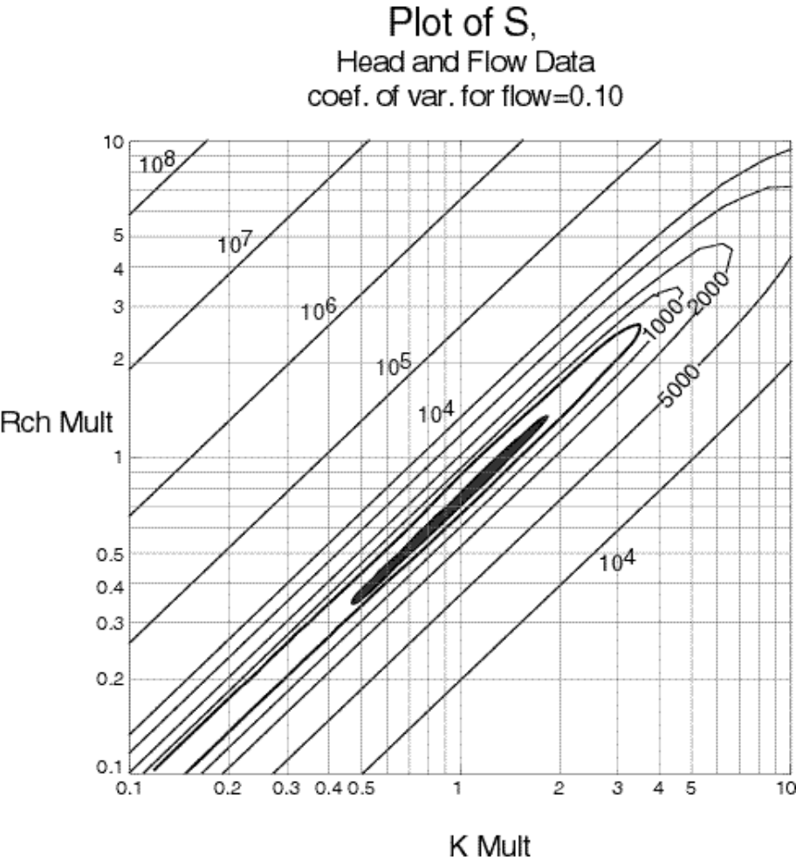
Exercise: Plot regression results on objective function surface for model calibrated with HEAD AND FLOW DATA
Same starting values and maximum step sizes as in previous exercise.
 | Run 1 MaxChange =10,000 |  | Run 2 MaxChang e=10,000 |  | Run 3 MaxChange =0.5 |  | Run 4 MaxChange =0.5
Iter. | K | Rch | K | Rch | K | Rch | K | Rch
1 | 1.0 | 1.0 | 9.0 | 0.20 | 9.0 | 0.20 | 1.0 | 9.0
2 | 1.1 | 0.9 | 8×10⁻¹³ | 0.89 | 4.5 | 0.22 | 1.0 | 4.5
3 | 1.2 | 0.9 | 1×10⁻¹² | 0.58 | 2.25 | 0.26 | 1.0 | 2.25
4 | 1.2 | 0.9 | 2×10⁻¹² | 0.38 | 1.2 | 0.38 | 1.1 | 0.89
5 | Converged |  | 2×10⁻¹² | 0.25 | 1.2 | 0.57 | 1.2 | 0.89
6 |  |  | 3×10⁻¹² | 0.16 | 1.2 | 0.86 | 1.2 | 0.89
7 |  |  | 5×10⁻¹² | 0.10 | 1.2 | 0.89 | Converged
8 |  |  | 7×10⁻¹² | 0.068 | 1.2 | 0.89
9 |  |  | 9×10⁻¹² | 0.045 | Converged
10 |  |  | 2×10⁻¹¹ | 0.019
The regression again converged in 3 of the runs.
Now do we have a calibrated model with unique parameter estimates?
Notes:
V. Nonlinear regression objective function surfaces

Slide 26
Effects of Correlation and Insensitivity
b₂
Linear objective function:
No correlation, b₁ less sensitive
minimum
~Var(b₂)
b₁
~Var(b₁)

Slide 27
Effects of Correlation and Insensitivity
b₂
Linear objective function
Strong, negative correlation
minimum
b₁

Slide 28
Effects of Correlation and Insensitivity
objective function value
Minimum is not
well defined
Parameter values along section

Slide 29
Effects of Correlation and Insensitivity
b₂
Linear objective function
Strong, negative correlation
minimum
~Var(b₂)
b₁
~Var(b₁)

Slide 30
Effects of Correlation and Insensitivity
b₂
Linear objective function:
No correlation, b₁ less sensitive
minimum
~Var(b₂)
b₁
~Var(b₁)

Slide 31
Effects of Correlation and Insensitivity
Insensitivity
  Stretches the contours in the direction of the insensitive parameter.
    very insensitive = very uncertain
Correlations
  Rotate the contours away from the parameter axis
    Uncertainty from one parameter can be passed into another parameter!
  Create parameter combinations that give equivalent results
    Increases the non-uniqueness

