Slide 1
V. Nonlinear Regression By Modified Gauss-Newton Method: Theory
Method to calculate model parameter estimates that result in the best fit, in a least squares sense, to the calibration data.
Implemented as an iterative form of linear regression
Chapter 5 and Appendix A (Hill and Tiedeman, 2007)
Notes:
V. Nonlinear Regression - Gauss Newton

Slide 2
Outline
Nonlinear regression and normal equations
Modifications that make the nonlinear regression normal equations work in practice
Limits on estimated parameters
Log transformed parameters
Exercises 5.2a and 5.2b
Addition of prior information
Exercise 5.2c
Notes:
V. Nonlinear Regression - Gauss Newton

Slide 3
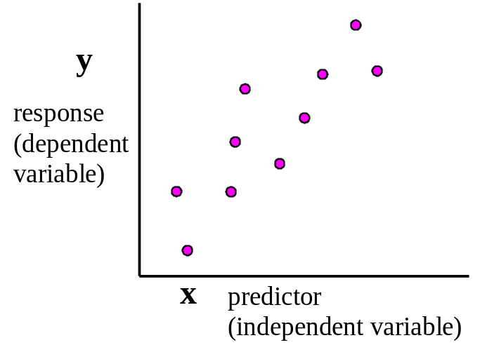

Simple Linear Regression
Suppose we collect some data and want to determine the relation between the observed values, y, and the independent variable, x:
If we think the relation between y and x is linear, we can model the data using a linear model:
observed
response
true,
unknown
intercept
true,
unknown
slope
true,
unknown
random error
β₀ and β₁ are the true parameters of this linear model.
Notes:
V. Nonlinear Regression - Gauss Newton

Slide 4



Simple Linear Regression
Don’t know the true values of the parameters.
Estimate them using the assumed model and the observations, by expressing the linear model in terms of estimated parameter values:
simulated values, y_{i}′
observed
response
estimate of β₀
estimate of β₁
residual
Estimate b₀ and b₁ to obtain the best fit of the simulated values to the observations.
One method: Minimize sum of squared errors, or residuals.
Notes:
V. Nonlinear Regression - Gauss Newton

Slide 5
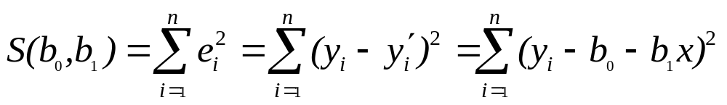
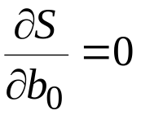
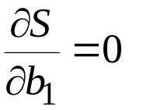
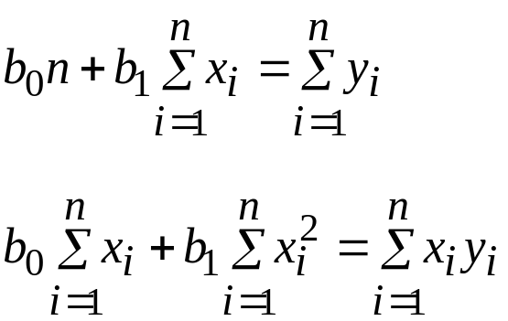
Simple Linear Regression
Sum of squared residuals:
To minimize:
Set
and
This results in the normal equations:
Solve these equations to obtain expressions for b₀ and b₁, the parameter estimates that give the best fit of the simulated and observed values.
If have more than 2 parameters, need to replace summations with matrix notation. First, look at using 2 parameters and matrix notation.
Notes:
V. Nonlinear Regression - Gauss Newton
Remember from calculus: How do we find the minimum of a function?
Reason for ‘normal’ terminology: At the least squares estimates b’, vectors y’=Xb’ and e=y-Xb’ are ORTHOGONAL, or ‘normal’ to eachother.
Normal equations: 2 unknowns (b0,b1) and 2 equations. Thus, can solve by hand for b0 and b1 just using a calculator and some algebra.

Slide 6

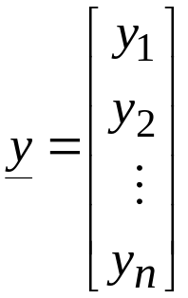
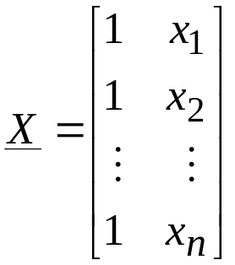
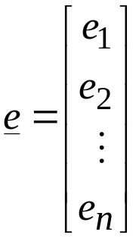
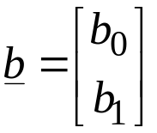


Linear Regression in Matrix Form
Linear regression model: , i=1 to n ➔
vector of
observed
values
matrix of
coefficients
vector of
parameters
vector of
residuals
In general, X is of dimension ND x NP, and b is of dimension NP,
where ND is the number of observations and NP is the number of parameters.
The normal equations (b’ is the vector of least-squares estimates of b):
Using matrix notation:
Using summa-tions
  ➔
Notes:
V. Nonlinear Regression - Gauss Newton
Now we will generalize the previous discussion of linear regression.
Y=Xb+e: more general form of linear model.
Definitions of y,X,etc: just writing out equation for many values of i, using vectors and matrices. Vectors are of length ND = # obs.
If we calculate the sum of squared residuals using the expression y=Xb+e, and minimize it, we get the normal equations and their solution shown here.
Show what Transpose is.

Slide 7
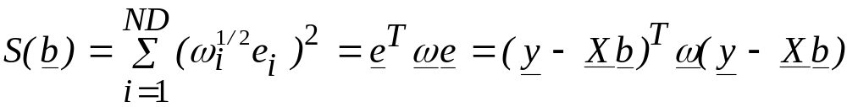
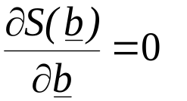
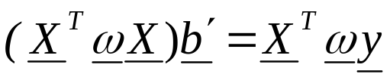

Linear Regression with Weighting
When using weights, we minimize the sum of squared weighted residuals:
We again set the derivative of the objective function to zero:
This leads to the normal equations:
Solving for b’:
Notes:
V. Nonlinear Regression - Gauss Newton
Obj func written as (w^(1/2) e )^2 assumes using a DIAGONAL weight matrix and that the different observations are uncorrelated.
Writing as (eT w e) allows for a full weight matrix, with terms on the off-diagonals. This allows for a weighting scheme to account for correlations among different observations.
Example: streamflow measured at 3 points. The gain/loss over the 2 reaches are correlated because each is calculated using the middle point measurement.
One study in gw literature that has incorporated the off diagonal terms found that including correlations among the observations didn’t matter in terms of the regression results.
In mf2k, can have full weight matrix on flows, adv, prior.

Slide 8

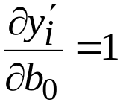
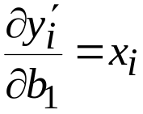
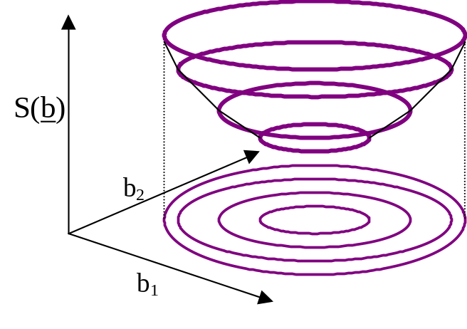
Linear versus Nonlinear Models
Linear models: Sensitivities of matrix X are not a function of the model parameters:
and
; recall
Linear models have elliptical objective function surfaces. With two parameters:
One step to get to the minimum.
Notes:
V. Nonlinear Regression - Gauss Newton
First eqn: Simulated values for a 2-parameter linear model
Terms of X are independent of values of b0 and b1.
These are sensitivities: derivative of a simulated value w/r/t a model parameter. Same quantities you worked with in ex. 6.
dS/db = f (dy/db), and dy/db are constant for linear model; therefore dS/db is constant no matter what the values of b are.
swm: dS/db is not constant. By definition the minimum is where it is zero, so it has to change. As above, dS/db = f(dy/db), but this a quadratic function (ie, we square residuals), so S is a paraboloid.
Obj func surface shown: Nice shape – well defined global minimum, no local minima.
For linear problems, get to minimum of this surface (to optimal values of b0,b1) in just 1 step of solving normal equations.

Slide 9





Linear versus Nonlinear Models
Nonlinear models: Sensitivities of matrix X are a function of the model parameters.
Ground-water models are commonly nonlinear. This nonlinearity comes from Darcy’s Law:
h
0
•
•
h
2
Q
Q
x=0
Derivatives:
  Not a function of x. Linear in x.
  Function of K. Linear in Q, but nonlinear in K.
  Function of K and Q. Nonlinear in both K and Q.
Notes:
V. Nonlinear Regression - Gauss Newton
Used Darcy’s Law before for illustrating parameter correlations, by solving for h.
Now, use to illustrate model nonlinearity, by taking derivatives w/r/t terms of the equations.
dh/dQ result – Q doesn’t appear in RHS.

Slide 10
Nonlinear Regression
An iterative form of linear regression, with some modifications to the normal equations to make them work in practice. General procedure:
  Linearize the model around the current parameter values. This results in a linearized objective-function surface.
  Using the normal equations, calculate new parameter values that are closer to the minimum of the linearized objective-function surface, and therefore, hopefully closer to the minimum of the nonlinear objective-function surface.
  Repeat from step 1.
Notes:
V. Nonlinear Regression - Gauss Newton
Now sensitivities are different for different parameter values. Thus objective function surface is different. Not just value of S being different for different parameters, but whole surface in all of parameter space.

Slide 11

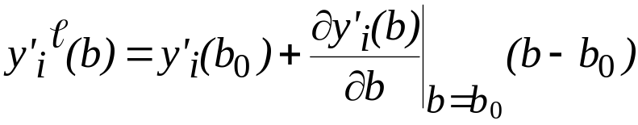
Nonlinear Regression
Nonlinear model:
y’(b) is nonlinear function of b.
To linearize y’(b), we use a Taylor Series expansion about the current values of b – noted as b₀.
For a one-parameter model:
Notes:
V. Nonlinear Regression - Gauss Newton
Can’t write in terms of X anymore because X changes with b.
Superscript l: linearized.
This equation calculates the linearized value of y’i at b, by linearizing the function y’ about b0.
First term on RHS: actual simulated value at b0
Second term: is delta-y – [ (delta y)/(delta b) ] (delta b)

Slide 12
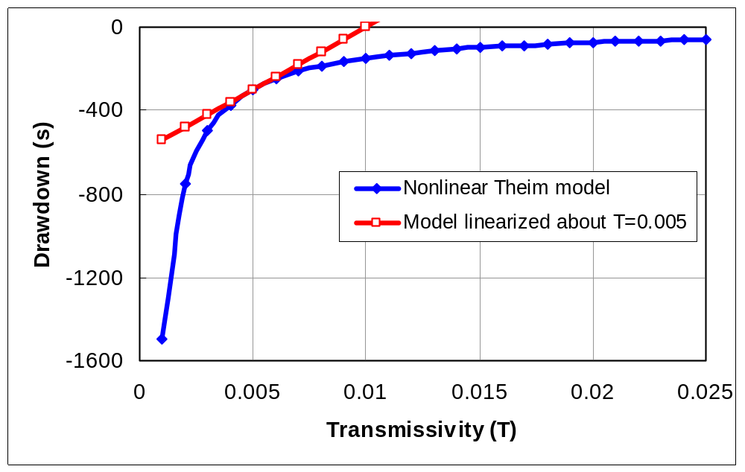
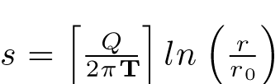

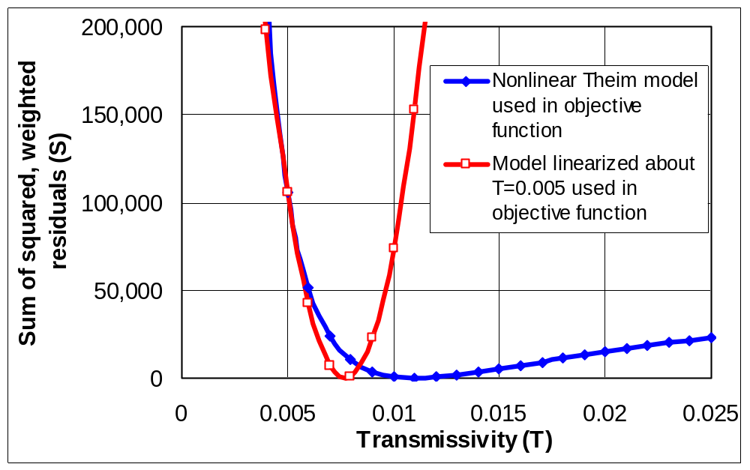

Nonlinear Regression
One-parameter model example: The Theim equation (pg 70).
drawdown:
Calculated drawdown for models for at r=1.
Nonlinear and Linearized
Objective function=
Objective function values with observations at r=1, 2, 4, 6, 10, 40, 80, 120, 200, 300, 600.
No noise was added to the observations.
Nonlinear and Linearized
Notes:
V. Nonlinear Regression - Gauss Newton
Theim model: steady flow to pumped will in confined aquifer.
h=f(T), recall from Darcy’s law that h = nonlinear function of K, or T here. Thus, nonlinear model.
Upper graph, black curve: drawdown (head) plotted against T. See how is nonlinear.
Red curve: linearized model. Gives exact value at T=.005, deviates more & more from exact model as we get further and further from T=.005
Lower graph: Assumed some drawdown data, to construct an objective function.
Red curve: is exact at T=.005, deviates significantly away from T=.005.
As move closer from T=.005 to minimum of linearized objective function, we are also moving closer to minimum of nonlinear function. But, bad to move too far!.

Slide 13
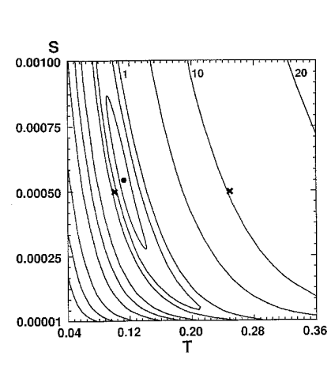
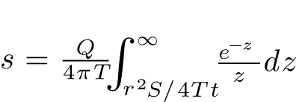
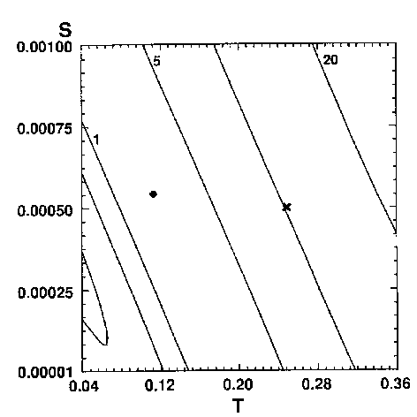
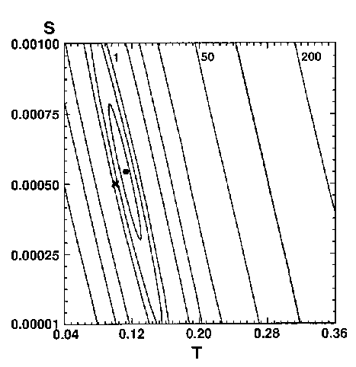
Nonlinear Regression
(A)
Time, in seconds Drawdown, in feet
480 1.71
1020 2.23
1500 2.54
2040 2.77
2700 3.04
3720 3.25
4920 3.56
Pumpage = 1.16 ft³/s
Distance from pumping to observation well = 175 ft
Nonlinear objective-function surface
Two-parameter model example: The Theis equation (pg 75).
Objective-function surface linearized about a point far from minimum of nonlinear objective-function surface
Objective-function surface linearized about a point close to minimum of nonlinear objective-function surface
True minimum
Points about which the surface is linearized
Notes:
V. Nonlinear Regression - Gauss Newton
Dot is true minimum.
X’s are points we will linearize around.
Lower left figure: We would overshoot if we went all the way to the minimum of the linearized surface.

Slide 14
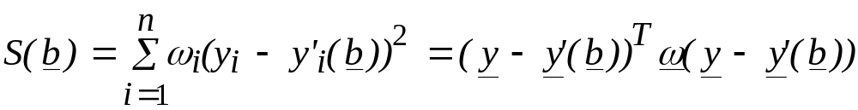
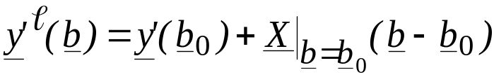
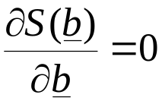
Nonlinear Regression
Objective function for nonlinear model:
To minimize S, we first substitute the linearized approximation of y’(b) into S. The linear approximation written in terms of sensitivity matrix X:
Substituting this into S, and setting
leads once again to
The NORMAL EQUATIONS!!!
(X^{T} ω X) d = X^{T} ω (y - y′ )
Notes:
V. Nonlinear Regression - Gauss Newton
In S(b) eqn, we write y’(b) because Xb is not constant.
b0 are starting values for first iteration, then are updated values in subsequent iterations.
In these normal equations: y is vector of obs. y’ is calculated at vector b=b0.
This shouldn’t look too mysterious!

Slide 15
Nonlinear Regression
The NORMAL EQUATIONS:
(X^{T} ω X) d = X^{T} ω (y - y′ )
d = (X^{T} ω X)⁻¹ X^{T} ω (y - y′ )
Same form as the normal equations for linear regression, except:
  d replaces b′
  y - y′ replaces y
These differences are because of the iterative process used to solve the nonlinear regression.
d is the parameter change vector: b_{r+1} = b_{r} + d.
Solve normal equations for d, then calculate b_{r+1}, which are the parameter values at the next iteration, r+1.
X is the matrix of sensitivities calculated at b_{r}.
Derived independently by Gauss and Newton in the early 1800’s.
Performed poorly; unstable
Notes:
V. Nonlinear Regression - Gauss Newton
As written, this is the Gauss-Newton method. Both Gauss and Newton independently came up with method of linearizing & iterating to solve nonlinear regression problems.

Slide 16
Geometry of the Normal Equations
(X^{T}ω X)
d
=
X^{T} ω (y-y′)
Alters d to be different than straight down gradient: points toward linearized minimum
Parameter change vector
Proportional to the gradient of the objective function, ∂S/∂b. Points downhill. Steepest descent direction.
Contours of S(b)
b₂
b₁
These normal equations were developed in the early 1800’s. However, in the form presented above, they typically have convergence problems. Modifications are needed to make them work well.
Notes:
V. Nonlinear Regression - Gauss Newton
First term: alters d to point to minimum of linearized obj function.
Took until 1960’s to get equations to work well, to solve problems such as overshoot.

Slide 17

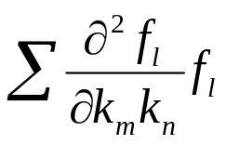

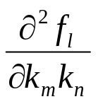
Why Plain Gauss-Newton Needs Help
Gauss-Newton method often needs modifications to work well in practice.
  We want the minimum of a quadratic function (sum of squared residuals), but we used a linear approximation (first order Taylor Series) and squared it.
    The true Hessian is: X^{T}ωX +(y-y’)^{T} , but we only use the first term
    Neglecting second derivative of quadratic function:
  2 cases where the second term is negligible:
    Model is linear, =0; =0
    Residuals are small, (y-y’)^{T} ≈0; f_{l} ≈0 (near the minimum)
      In these cases, we get quadratic convergence!
Modifications needed to improve stability
  Modified Gauss Newton (Levenberg-Marquardt)
Yikes!
Notes:
V. Nonlinear Regression - Gauss Newton
Quasi-Newton methods attempt to approximate the second term.

Slide 18
Making the Normal Equations Work: Scaling
(C^{T} X^{T}ω X C)
C⁻¹ d
=
C^{T} X^{T} ω (y-y′)
Define C so the diagonal terms of this scaled matrix equal 1.0
C terms added here to maintain equality in the equation.
C_{ii} = [X^{T}ω X]_{ii}^(-1/2)
Scaling is needed when the parameter values are very different in magnitude, so that sensitivities are also very different. Improves accuracy of the calculated change vector, d.
Scaling does NOT change the magnitude or direction of the parameter change vector, d.
  For trust region methods, scaling CAN affect magnitude and direction of the parameter change vector, d.
Notes:
V. Nonlinear Regression - Gauss Newton
Cii = [(XTwX)ii]^(-1/2)
Scaling is conceptually very simple

Slide 19
Making the Normal Equations Work:
The Marquardt Parameter (1950’s)
(C^{T} X^{T}ω X C + I m_{r}
C⁻¹ d
=
C^{T} X^{T} ω (y-y′)
)
Marquardt
term.
Scaled d vector
Steepest descent direction
Direction change is needed when the scaled parameter change vector, d, is in a direction that is not likely to help.
Addition of the Marquardt term results in a change vector, d, that points in a direction that is closer to the steepest descent direction.
b₂
b₁
Notes:
V. Nonlinear Regression - Gauss Newton
Diagonals of blue term are all 1.0. So, mr is a small number added to each of the diagonals to make them slightly different from 1.0

Slide 20
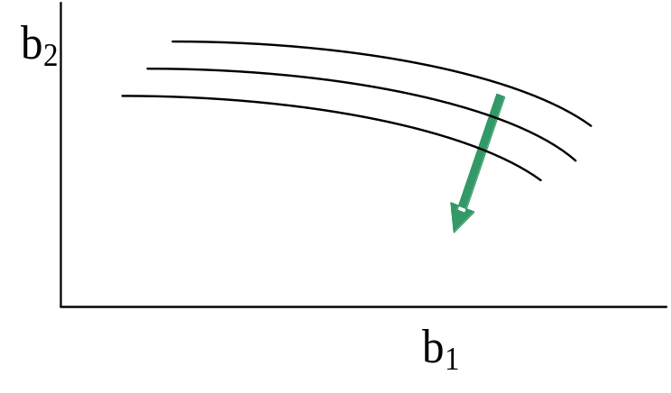
Calculating the Marquardt Parameter
Marquardt parameter used to improve regression performance for ill posed problems. Initially m_{r} =0 for all iterations.
If d is too close to being orthogonal to steepest descent direction, then Marquardt parameter is used:
Criterion for implementing Marquardt parameter suggested by Cooley and Naff (1990): If cosine of angle is <0.08 (angle > ~85°), then m_{r,new}= a x m_{r,old} + b
Cooley and Naff (1990) suggest a=1.5 and b=0.001.
In UCODE_2014, user can specify cosine, a, and b.
PEST tries different values of the Marquardt parameter (lambda) (+/-) and then selects the best value
Notes:
V. Nonlinear Regression - Gauss Newton
In this example, marquardt parameter used because minimum of linearized obj. func. Is way off to the left.
Blue arrow: direction that d points.
Green arrow: steepest descent direction.
Use of Marquardt parameter causes blue arrow to become closer to the green arrow.
There have been cases where changing a & b helped, but usually this is not necessary.

Slide 21
Making the Normal Equations Work: Damping
Damping – allow the parameter values to change less than indicated by d.
Damping helps remedy overshoot problems.
Implemented by inclusion of damping factor ρ_{r} in calculation of b_{r+1}:
b_{r+1} = ρ_{r} d + b_{r}.
Changes the magnitude but not the direction of d.
The value of ρ_{r} is calculated internally by UCODE_2014.
The value calculated equals the damping required so that no parameter changes by more than user-specified factor MaxChange. A common value is 2.0.
Notes:
V. Nonlinear Regression - Gauss Newton
Obtain d from solution of normal equations.
Pr is a scalar that scales values of d for ALL parameters.

Slide 22
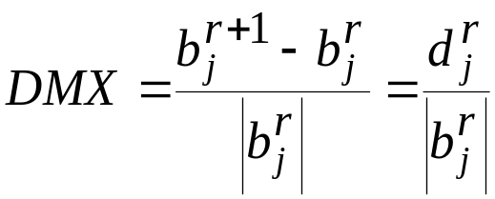

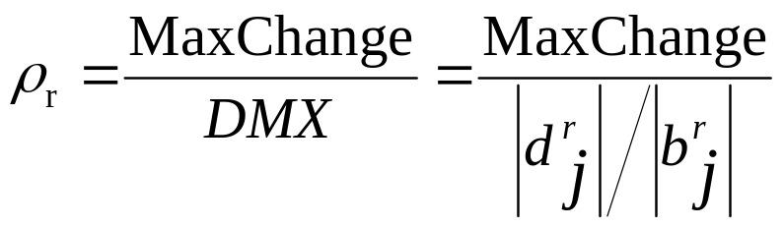
Making the Normal Equations Work: Damping
The factor by which the regression ‘wants’ to change the jth parameter is:
where
Is calculated with ρ_{r} = 1.0.
If DMX is greater than user-specified MaxChange, then ρ_{r} is calculated as:
Example: Suppose MaxChange = 2.0, and DMX = 10.0:
  ρ_{r} = 2.0 / 10.0 = 0.2
  In this example, each model parameter will be actually changed by only 0.2 times the value of DMX calculated by the regression for that parameter.
UCODE_2014 allows a different MaxChange values to be defined for each parameter.
Notes:
V. Nonlinear Regression - Gauss Newton
djr: What the regression calculates when solving the normal equations.

Slide 23
Trust Region Approach
How far do you trust your linear model?
The methods listed previously try to prevent overshoot
  However, they are based mostly on parameter change and do not consider model fit
Trust Region Methods
  At each iteration, check how well the linearized objective function surface approximates the nonlinear objective function surface.
    If the agreement is good, increase the trust region
    If the agreement is okay, keep trust region the same
    If the agreement is poor, decrease the trust region

Slide 24
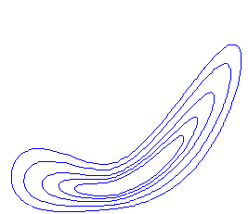
Trust Region Approach
How far do you trust your linear model?
For each iteration, evaluate accuracy of the linear model
Linear model of sum of squared residuals surface
Nonlinear sum of squared residuals surface
Compare predicted reduction in residuals (based on the linear model)
to actual reduction in residuals (nonlinear model)

Slide 25
Double-Dogleg Trust Region Approach
How far do you trust your linear model?
Steepest
Descent
Step
Linear model
Gauss-Newton Step

Slide 26
Double-Dogleg Trust Region Approach
How far do you trust your linear model?
Steepest descent > Trust region
Take a step in the steepest descent direction
Trust region
Linear model

Slide 27
Double-Dogleg Trust Region Approach
How far do you trust your linear model?
Trust region > Gauss-Newton
Take the Gauss-Newton step
Linear model

Slide 28
Double-Dogleg Trust Region Approach
How far do you trust your linear model?
Steepest descent < Trust region < Gauss-Newton
Take the double-dogleg step
Linear model

Slide 29
Hookstep Trust Region Approach
How far do you trust your linear model?
Hookstep
  Finds the value of the Marquardt parameter such that the step length equals the radius of the trust region
Linear model

Slide 30
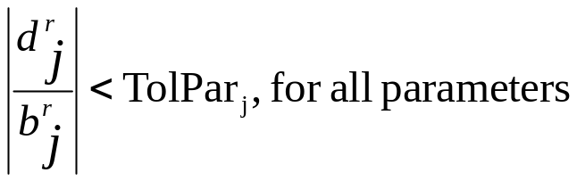
Stopping Criteria: TolPar and TolSOSC
Gauss-Newton process is iterative – so, when do you stop iterating?
Need convergence criteria.
Two convergence criteria in MODFLOW-2000 and UCODE_2005: TolPar and TolSOSC.
TolPar (Tolerance for Parameters): The largest fractional change in a parameter value. For regression to converge:
TolPar should ideally be ≤ 0.01; larger values may be needed in initial regression runs or for insensitive parameters
TolSOSC: Convergence criterion for the sum of squared weighted residuals objective function. This criterion stops regression when the model fit isn’t changing much.
In the final regression runs, the TolPar convergence criterion should be met.
Notes:
V. Nonlinear Regression - Gauss Newton
Small fractional change: means we are at or very close to the minimum of the linearized objective function – Regression ‘sees’ a flat spot.

Slide 31
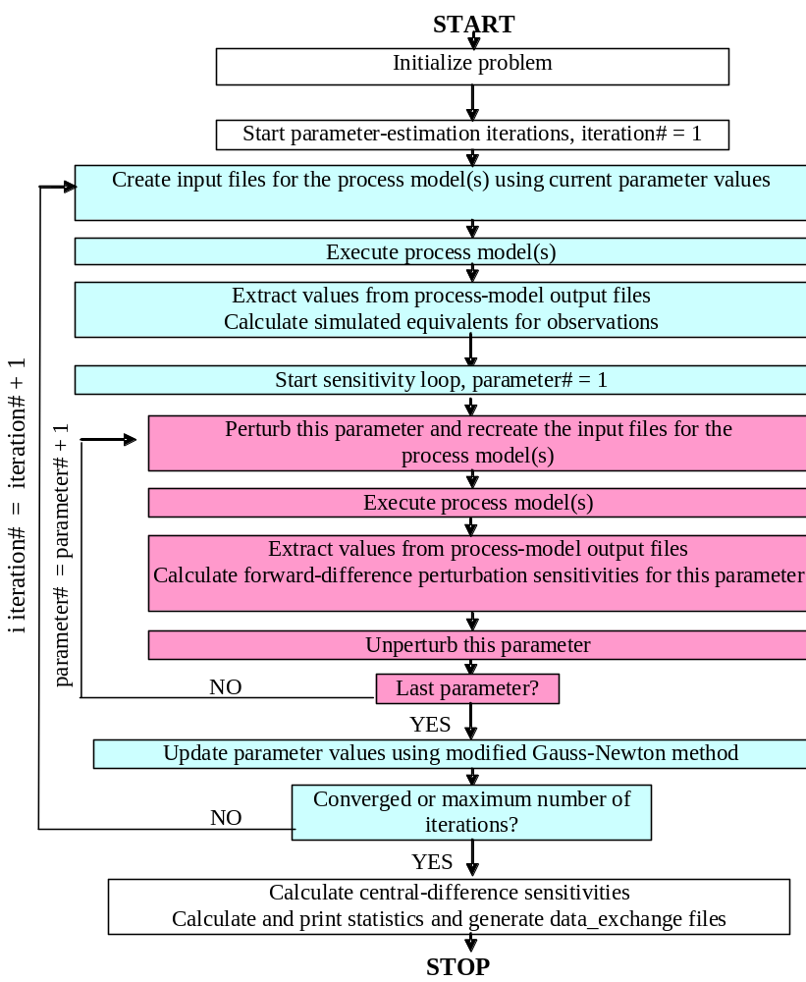
UCODE_2005 Flow Chart
Flowchart showing the major steps of UCODE_2005. (Figure 1 of Poeter, Hill, Banta, Mehl, and Christensen, 2005) .

Slide 32
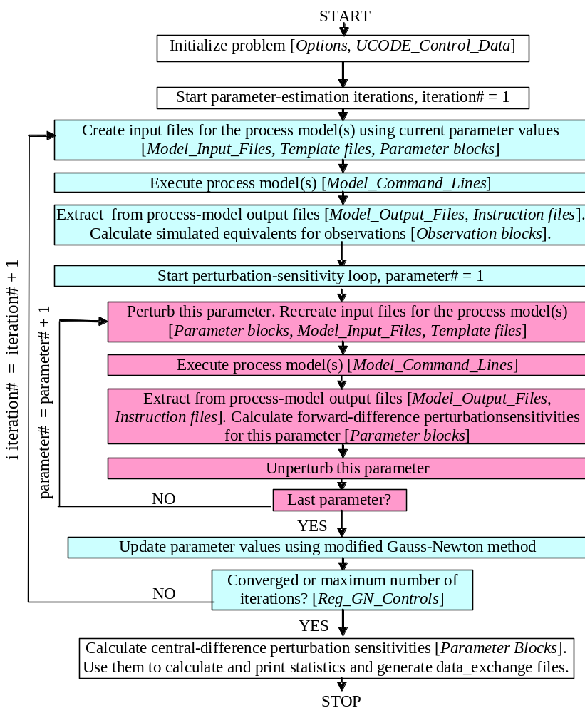
UCODE Flow Chart
Flowchart showing the major steps of UCODE_2005. (Figure 1 of Poeter, Hill, Banta, Mehl, and Christensen, 2005)
Lists the input that control each major step.

Slide 33
Use of Limits on Estimated Parameter Values
Often used to constrain estimated parameter values to avoid unrealistic values. But unrealistic values can be a valuable indicator of model error!!
But what about insensitive parameters?
  Applying limits results in the estimated parameter being at the edge of reasonable range of values.
  Using prior information instead results in parameter values that are in the middle of the range of reasonable parameter values.
  Applying limits results in difficulties in propagating uncertainty in limited parameters to uncertainty in predictions.
  Using prior information provides a clear framework for propagating uncertainty in the parameters to uncertainty in the predictions.
Limits are allowed in UCODE, because it is applicable to ANY model, and limits may be needed to maintain parameter values for which solutions can be obtained. See the Parameter_Data input block, documentation p. 70.
In MODFLOW-2000, this is achieved internally by, for example, not letting hydraulic conductivity parameters be negative unless the user says otherwise.
Notes:
V. Nonlinear Regression - Gauss Newton
If a K or S parameter goes negative, mf2K sets it to a value 2 orders of magnitude < starting value.

Slide 34
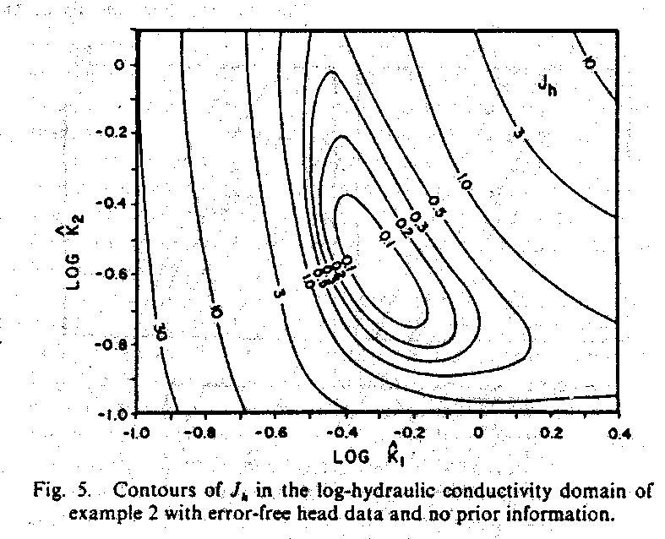
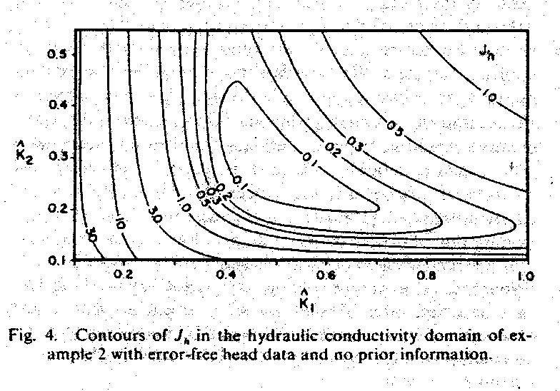
Log-Transformed Parameters
Log-transforming parameters can sometimes make a nonlinear regression problem behave more linearly:
From Carrera and Neuman, WRR, 1986, 22(2), p. 211-227
Log-transforming also prevents the regression from calculating negative values for the parameters in their native space:
Normal distribution
Log-normal distribution
In MODFLOW-2000 and UCODE, user generally sees values in native space, even when log-transforming is used. Parameter estimates and statistics are printed in the output files as native and log10 transformed values. (Codes do calculations in natural log space).

Slide 35
Exercises 5.2a and 5.2b
DO EXERCISE 5.2a: Define range of reasonable parameter values.
DO EXERCISE 5.2b: First attempt at regression.
  First, use native parameter values
  Second, try log transforming the K-related parameters
Notes:
V. Nonlinear Regression - Gauss Newton
Reasonable values are in input files. These do not enter into any regression calculations – are just so parameter values can be compared to them in output files.
8b: with native parameter values FAILS – no converge in 10 iters, some K’s go negative.
With log trans, still fails – crashes because an exponent gets too large.
Let’s now look at output.

Slide 36
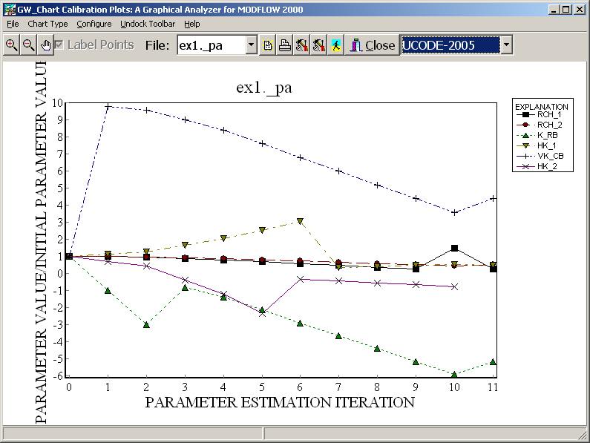
Exercise 5.2b – No log transform

Slide 37
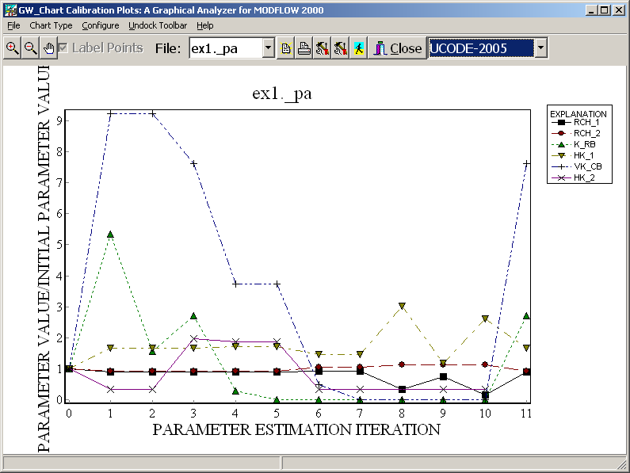
Exercise 5.2b – K’s log transformed

Slide 38
Analysis of non convergence
Several K parameters being changed to orders of magnitude smaller than start values.
What might we do now? Regression did not work with or without log transforming.
Recall CSS – indicated might not be able to estimate all parameters.
Should we fix some parameters? Another option: Add prior.
  If so, which parameters?
Notes:
V. Nonlinear Regression - Gauss Newton
Weiss & Smith (GW, 1998) have a nice discussion of which parameters should have prior. Generally, if a parameter is sensitive, it doesn’t need prior. If a parameter is insensitive, it does. Also, errors in sensitive parameters can strongly affect simulated results, while error errors in insensitive parameters have less impact. Therefore, generally prior should be applied to insensitive parameters.

Slide 39
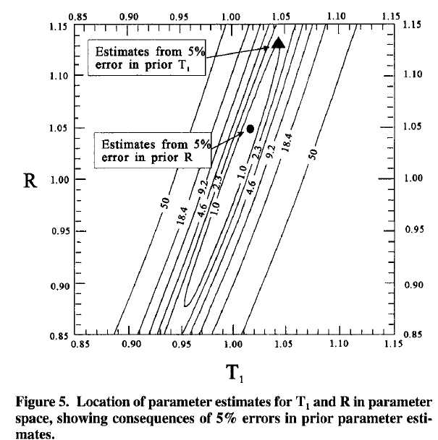
Effects of Error in Prior Information
Based on analysis of Weiss & Smith (1998)
  Sensitive parameters have larger affects on regression. Therefore, errors in prior will propagate further.

Slide 40
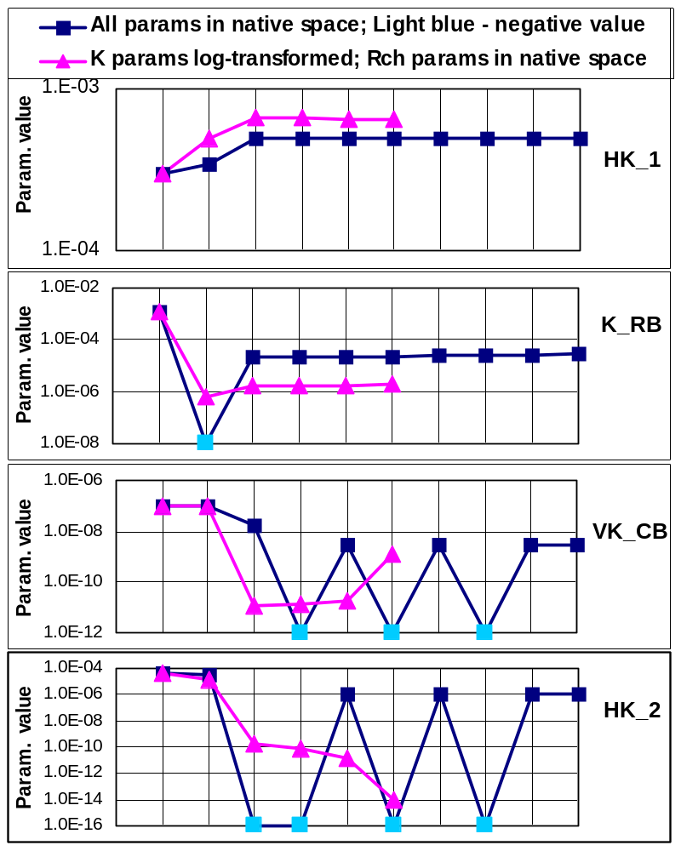
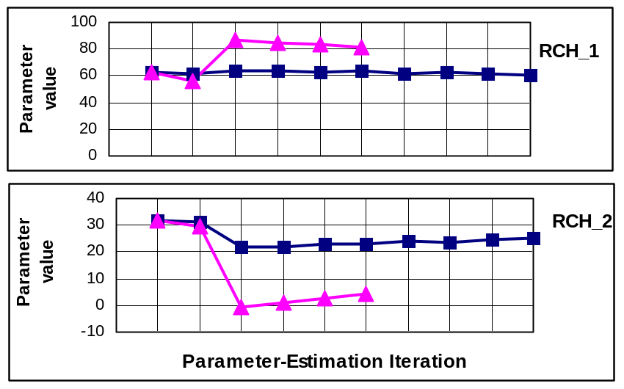
Regression Runs of Exercise 5.2b
Exercise 5.2b parameter value changes over 10 parameter-estimation iterations when LN=0 for all parameters, and over 6 parameter-estimation iterations when LN=1 for all K parameters.
Notes:
V. Nonlinear Regression - Gauss Newton
Several K parameters being changed to orders of magnitude smaller than start values.
What might we do now? Regression did not work with or without log transforming.
Recall CSS – indicated might not be able to estimate all parameters.
Should we fix some parameters? Another option: Add prior.

Slide 41
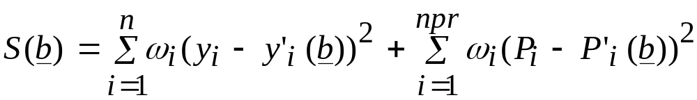
Prior Information
Allows direct, independent measurements of model input values to be included in the regression:
Observations Prior
Use prior carefully. Before adding prior, first try performing regression without prior, and assess how much information the dependent observations alone provide towards estimating the model parameters.
Using prior instead of fixing the value of a parameter allows uncertainty in the parameter to be included in the calculated measures of parameter and prediction uncertainty.
When model execution times are long, can fix parameter value initially, then use prior information for final regression runs and(or) to evaluate uncertainty
Notes:
V. Nonlinear Regression - Gauss Newton
2nd bullet: this is what we’ve done already in exercise 8b.
Prior information is like a penalty function. The sum of squared residuals is increased as the parameters depart from our prior information.

Slide 42
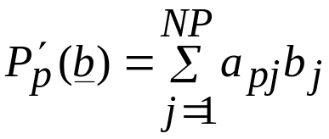
Prior Information
In MODFLOW-2000 and UCODE, the simulated values related to the prior information are of the form:
where b_{j} is a parameter value and a_{pj} is a coefficient
Commonly, the prior information relates to a single parameter value.
  Example: prior information is the field estimate of K from a large-scale aquifer test. Pp is the field estimate, and P’p is the regression estimate of the K parameter.
Prior information can also relate to more than one parameter.
  Example: prior information is an annual recharge estimate, but we estimate seasonal recharge in the model. Pp is the annual recharge estimate, and P’p is the sum of the regression estimates of seasonal recharges.

Slide 43
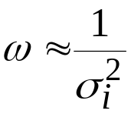
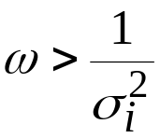
Weighting Prior Information
If the weight reflects the actual uncertainty in the value specified, that is,
then this is truly prior information, as used in Bayesian theory.
If the weight is larger than is consistent with the actual uncertainty, that is,
so that the value of STATISTIC is less than that which would accurately reflect the uncertainty, then what is called prior information needs to be classified instead as regularization.

Slide 44
Weighting Prior Information
It is sometimes necessary to use regularization to make the problem tractable, but the result is that measures of uncertainty produced by the model will not be correct.
One approach to this problem is to calibrate the model with the regularization needed to produce a tractable problem, and then change the weighting when calculating prediction uncertainty.
Notes:
V. Nonlinear Regression - Gauss Newton
Can obtain weights on prior in same way as was discussed for observations. Say 95% confident that prior for K of a unit is good to +/- 1 order of magnitude. If pose this way:
1e-5 +/- order of magnitude: 1e-4 to 1e-6
In log10 space: -4 to -6
Std dev in log10 space: [-4 – (-6)] / [2(1.96)] =~ 0.5

Slide 45
Entering Prior Equations in UCODE
Prior equation in UCODE_2014: Linear_prior_information using the format table:
In UCODE, if the parameter is log-transformed,
  the value is in native space
  the STATISTIC must relate to the log-transformed value of the prior estimate. STATFLAG identifies what STAT is (variance, standard deviation, or coefficient of variation).
  The equation needs to include the log10 of the parameter. e.g. the equation must be linear.
BEGIN LINEAR_PRIOR_INFORMATION TABLE
nrow=2 ncol=5 columnlabels groupname=prior
priorname equation PriorInfoValue Statistic StatFlag
PRIOR_VK_CB VK_CB 1.0E-7 0.3 CV
Eqn_Rch_Ann 0.5*Rch1+0.5*Rch2 37.0 4.0 VAR
END LINEAR_PRIOR_INFORMATION

Slide 46
Exercise 5.2c
DO EXERCISE 5.2c: Assign prior information on parameters, and re-run the regression.
Do not log transform
Add prior
  Which parameters should we add prior to?
  Use the starting values as prior value with a coefficient of variation of 0.3
PROBLEM: Compare ex5.2c.#uout (from 5.2c) and to ex5.2.#uout (from 5.2b)

Slide 47
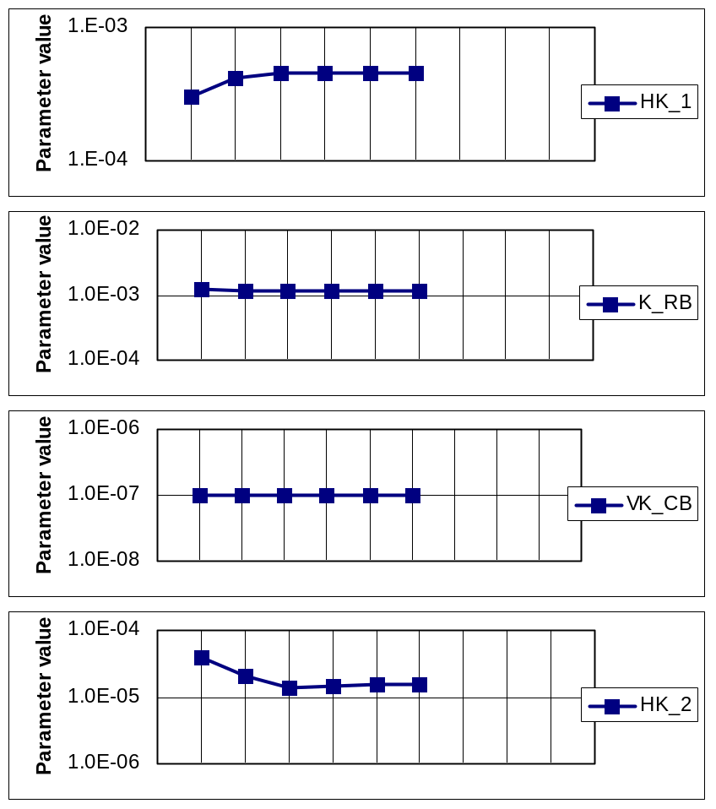
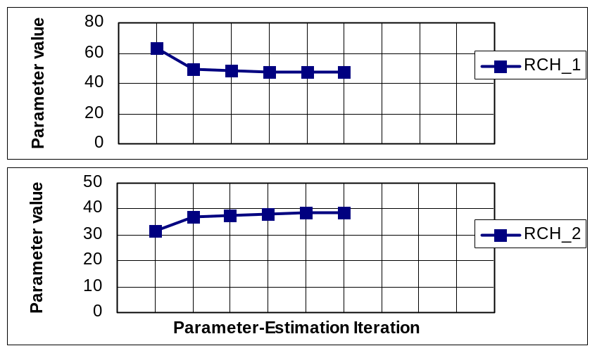
Regression Run of Exercise 5.2c
Exercise 5.2c parameter value changes over the 6 parameter-estimation iterations.

Slide 48
Prior Information Summary
Prior information
  Can help stabilize and improve the inversion procedure.
    But use realistic weights when analyzing uncertainties
  Can be thought of as:
    Additional observations, or
    A penalty function
  Is a way for the modeler to incorporate their own judgment about the parameter values.
  Set initial values the same as prior information values.
  Use carefully! (see Weiss & Smith, GW 1998)
    Apply to insensitive parameters, not sensitive parameters.

