Slide 1
VII. Observation-Parameter Statistics
Composite scaled sensitivities for parameters
Leverage and Influence
Parameter variances and covariances
Correlation coefficients
Uniqueness
Standard deviations and coefficients of variation
Confidence intervals
Optimized values versus reasonable ranges
Notes:
VII. Parameter Statistics

Slide 2
Composite Scaled Sensitivities (CSS) (Book, p. 124-125)
Indicates information provided by all observations on a parameter.
Used initially to decide which parameters to optimize.
Parameters with larger CSS generally can be estimated more reliably.
CSS changes with parameter values
  occasionally recalculate CSS for all parameters
  other parameters may have to be included in optimization
Notes:
VII. Parameter Statistics
Because the regression is nonlinear, sensitivities, can change as parameters change, and therefore CSS’s can change. For CSS, the statistic is scaled by the parameter value, so if there is a large change in the parameter value, there could be a large change in the CSS. Therefore, it is important to reevaluate the CSS (and other measures based on sensitivity).
In the case presented, there is little change in the CSS for the parameters with prior, and the CSS is still much smaller than the other parameters. Therefore, the results indicate that the regression should not be attempted w/o prior. The fact that the parameter values are very near the prior values (as seen by the small weighted residuals) indicates that this is the dominating information for these parameters.

Slide 3
Composite Scaled Sensitivities Exercise
DO EXERCISE 7.1a (p. 145)
  What is the difference between initial and final CSS values?
  Effect of model nonlinearity and scaling?
  Use CSS to explain small weighted residuals for prior information.
Notes:
VII. Parameter Statistics
Because the regression is nonlinear, sensitivities, can change as parameters change, and therefore CSS’s can change. For CSS, the statistic is scaled by the parameter value, so if there is a large change in the parameter value, there could be a large change in the CSS. Therefore, it is important to reevaluate the CSS (and other measures based on sensitivity).
In the case presented, there is little change in the CSS for the parameters with prior, and the CSS is still much smaller than the other parameters. Therefore, the results indicate that the regression should not be attempted w/o prior. The fact that the parameter values are very near the prior values (as seen by the small weighted residuals) indicates that this is the dominating information for these parameters.

Slide 4
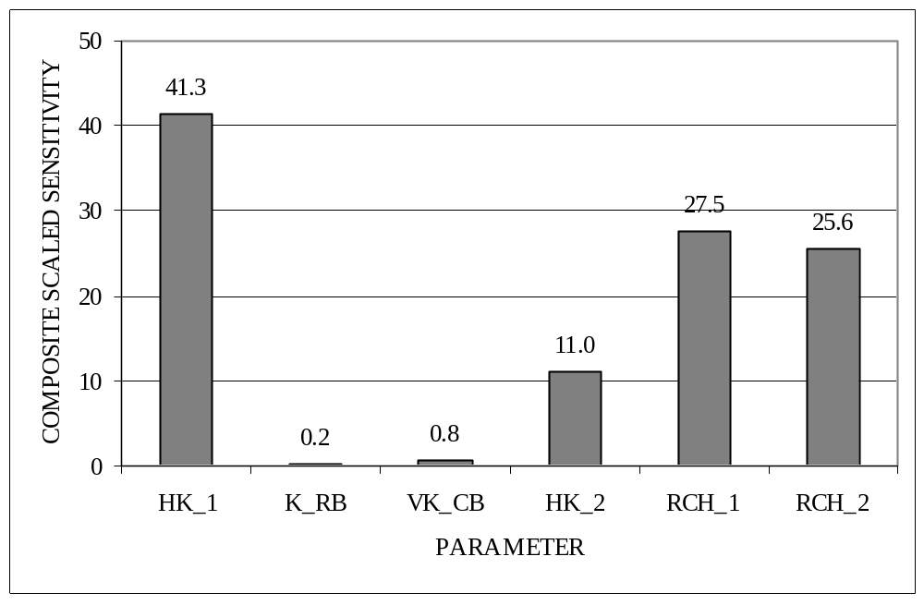
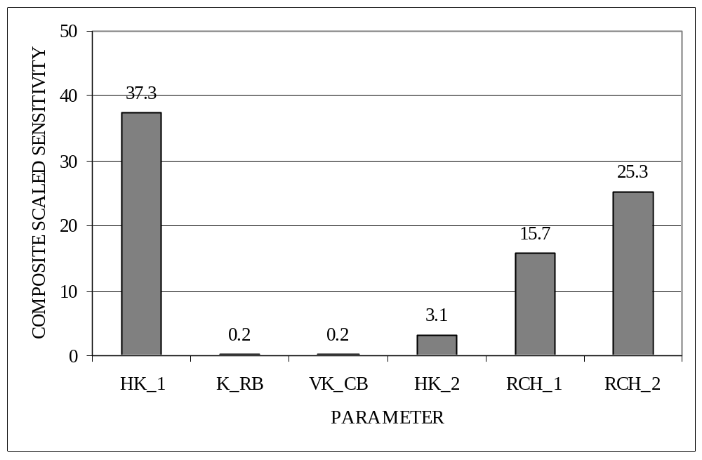
Composite scaled sensitivities
from the starting steady-state model
Values have changed but conclusions about parameter importance similar.
Fit-dependent alternative:
Parameter coefficients of variation (item 6), but also reflect prior.
Composite scaled sensitivities from the final steady-state model
(Book, Fig. 7-5a, p. 146)

Slide 5
Leverage and Influence
Use to identify important observations
  Estimates can be largely determined by very few observations
  Desirable to have optimization really use information from many observations
Leverage
  depends on observation type, location, time
Influence
  depends also on the observed value

Slide 6
Leverage (p. 134)
Identifies observations for which observed values potentially have a big effect on regression results ( ._so file)
  High leverage
    Inconsistent with other observations → observation will cause large changes in parameter values in optimization
    Consistent with other observations → little effect in optimization
  Low leverage
    little effect on parameter values in optimization.
Leverage of ith observation
(
)
h
=
x
T
X
T
ω
X
−
1
x
i
i
i
h
is
leverage of ith observation
i
x
is a vector with weighted sensitivities of the ith observation
i
X
is a matrix with all parameter-observation sensitivities
ω
is a matrix with observation weights
Notes:
x_{i}^{T} is the same as the i^{th} row vector of the weighted sensitivity matrix (w^{1/2} X).
VII. Parameter Statistics

Slide 7
Leverage for linear regression
The matrix equation is hard to understand. Consider the equation for leverage from linear regression
Leverage = (1/n) + [(x_{i}-(Σx/n))²]/SS_{x}
  Large when the x_{i} for an observation is far from the mean of the X’s (Σx/n).
The x values of linear regression are equivalent to our sensitivities.
The idea that high leverage parameters are those for which the sensitivities are somehow different carries over to multiple, nonlinear regression.

Slide 8
Influence: Cook’s D and DFBETAS
Influence Statistics indicate the actual effect of the observation in the regression
  Cook’s D (eq. 7.8 p. 135) is determined from effect of leaving out one measurement in the optimization
    compare to critical value 4/(ND+NPR)
    ND = number of obs., NPR = number of prior info. values
  DFBETAS (eq. 7.9 p. 136) is determined from change of single parameter when 1 observation is left out
    critical value: 2/(ND+NPR)^{1/2}
Cook’s D and DFBETAS are based on linearization
  Calculation takes little time
  Separate program residual_analysis.exe produces UCODE data-exchange files ._rc and ._rb

Slide 9
Example: regression lines
10
19
10
High leverage
Low influence
9
9
8
8
7
7
6
6
5
5
4
4
18
3
3
2
2
High leverage
High influence
1
1
0
0
5
10
15
20
25
30
0
0
5
10
15
20
25
30
Obs in black only
with 19
with 18

Slide 10
Exercises
USE GW_CHART to analyze these files
EXERCISE 7.1b: Evaluate leverage statistics (p. 146)
  Statistics needed are in ex5.2c_ucode._so
  Values > ~0.9 have high leverage (Table 7.2)
EXERCISE 7.1c: Evaluate observation importance using influence statistics (produced in exercise 6.2e using residual_analysis.exe)
  DFBETAS are in file ex5.2c_ucode._rb
  Cook’s D are in file ex5.2c_ucode._rc
  Compare the values in the graphs to the critical values to identify influential observations.
    Cook’s D critical value: 4/(ND+NPR)
    DFBETAS critical value: 2/(ND+NPR)^{1/2}
    ND = number of obs., NPR = number of prior info. values
Notes:
Flow observation is very important. We know this because of the correlation. Prior info also very important because it provides independent info and helps with correlation. Harder to see, but hd07 is also important (it is above critical value). It controls the flow to the river and DFBETAS shows how it influences HK1,HK2, RCH1, RCH2, which we know are correlated.
VII. Parameter Statistics

Slide 11
VII. Observation-Parameter Statistics
Composite scaled sensitivities for parameters
Leverage and Influence
Parameter variances and covariances
Correlation coefficients
Uniqueness
Standard deviations and coefficients of variation
Confidence intervals
Optimized values versus reasonable ranges
Notes:
VII. Parameter Statistics

Slide 12
Parameter Variances and Covariances
The variance-covariance matrix for the parameters
(Hill and Tiedeman, 2007, p. 125, eq 7.1)
Cov(b)=s²(X^{T}ω X) ⁻¹
b vector of parameter values
s² calculated error variance (measure of model fit)
X sensitivities matrix, calculated at b’
ω weight matrix
Remark: (X^{T}ωX)⁻¹ also is part of the formula for Leverage

Slide 13
(Co)variance Matrix (book p. 126)
Diagonal elements: parameter variances
off-diagonal elements: parameter covariances.
For a 3 parameter problem, the matrix is:
Var (1) Cov(1,2) Cov(1,3)
Cov (2,1) Var (2) Cov (2,3)
Cov (3,1) Cov (3,2) Var (3)
Remark: Cov(1,1) = Var(1)
Remark: Var(1) = StDev²(1)

Slide 14
Usefulness of Parameter (Co)variance matrix
Variance (square of standard deviation) is measure for reliability of the parameter
Covariance contains information on correlation of parameters

Slide 15
Parameter variance-covariance matrix
Cov(b)=s²(X^{T}ω X)⁻¹ can be used in different ways:
  With optimized parameter values from acceptable model.
  With optimized parameter values + the other parameter values
    s² is known from parameter optimization for versions a. and b.
  With preliminary parameter values
  Alternate observation sets – observations omitted or added
  With predictions
    s² is not meaningful
    information can not be used directly – first divide out s²
For now we will work with version a..

Slide 16
Correlation Matrix
Covariance Matrix
StDev²(1) Cov(1,2) Cov(1,3)
Cov (2,1) StDev²(2) Cov (2,3)
Cov (3,1) Cov (3,2) StDev²(3)
Correlation Matrix:
1 cor(1,2) cor 1,3)
cor(2,1) 1 cor(2,3)
cor (3,1) cor (3,2) 1
where cor(i,j) = Cov(i,j)/StDev(i)/StDev(j)

Slide 17
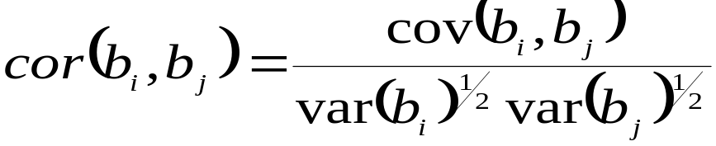
Parameter Correlation Coefficients (Book, p. 127)
Equation:
  Independent of model fit
    (s² cancels out in calculation; it is both in Var and Cov)
Introduced yesterday already
  Main diagonal value +1
  Off-diagonal values from -1 to +1
  0 → no correlation; abs(cor)=1 → fully correlated
  UCODE lists abs(cor) ≥ 0.85 in ._pcc; full matrix in ._mc file.

Slide 18
Parameter Correlation Coefficients
Used when selecting parameters for optimization
  High correlations may cause optimization to fail
    Leave out a parameter or add different measurements
Used when evaluating optimized model
  High correlations may cause uncertainty of parameters
  Absolute values close to 1 can indicate nonunique parameters.
  If nonuniqueness is suspected, restart the regression with different initial parameter values and check whether the regression converges to the same estimates
    If not, redo optimization with fewer params. or extra measurements
DO EXERCISE 7.1d (p. 148)
  Evaluate correlations of optimized parameters (._mc and ._pcc files)

Slide 19
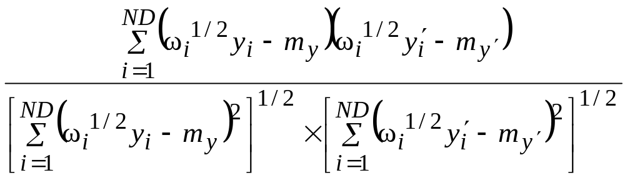
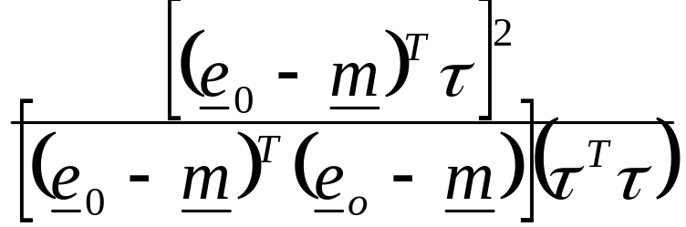
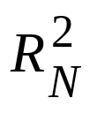
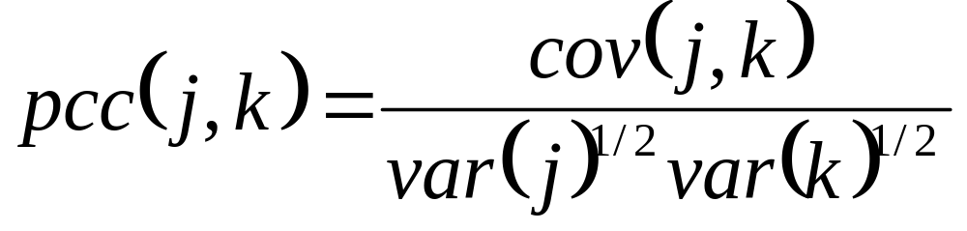
Parameter Correlation Coefficients
EXERCISE 7.2: Consider the three different correlation coefficients presented in class (p. 155)
R = (6.11a)
= (6.18)
(7.5)

Slide 20
Further tests for nonunique parameters
While useful, for a variety for reasons parameter correlation coefficients can fail to detect nonunique solutions.
  E.g. Correlations for insensitive parameters are calculated inaccurately
Further investigation can be done with:
  regression from alternative starting values of the parameters
  global sensitivity analysis and regression methods.
    Cf. the determination of the objection function surfaces in Ch.5
Notes:
VII. Parameter Statistics
Restart using an order of magnitude different values

Slide 21
Causes of non-uniqueness
Physical
  e.g. k and thickness correlated for flow problems which are governed by transmissivity (product k and thickness)
Lack of measurements
  e.g. example problem without the flow measurement
Parameterization
  e.g. semi-confined flow with head measurements only
Single aquitard resistance insensitive
Two aquitard resistances both sensitive

Slide 22
Exercises
EXERCISE 7.1e: Test nonuniqueness
  See exercise instructions, p. 33. Summary:
  Part 1: Use results in book, p. 150, and do Problem
  Part 2: Do computer simulations using ModelMate, and do Problem on p. 151.

Slide 23
Exercise 7.1e. Detecting non-unique parameter estimates – instructions for MFI2005
First, perform a regression run without flow observation and prior information:
In MFI2005, save the ex5.2c dataset as dataset ex7.1e1 and use the ex7.1e dataset in this exercise
In “Parameter values”, constrain the four hydraulic conductivity parameters using the default values.
In “UCODE” remove prior information.
Proceed with the exercise instructions
Next, include the flow observation and prior information, and start the regression from different initial values:
Go back to the ex5.2c files and save them as dataset ex7.1e2
Proceed with the exercise instructions

Slide 24
VII. Observation-Parameter Statistics
Composite scaled sensitivities for parameters
Leverage and Influence
Parameter variances and covariances
Correlation coefficients
Uniqueness
Standard deviations and coefficients of variation
Confidence intervals
Optimized values versus reasonable ranges
Notes:
VII. Parameter Statistics

Slide 25

Standard Deviation and Coefficient of Variation (Book, p. 127)
The parameter standard deviation (σ) for parameter b_{j} is the square root of the parameter variance (j^{th} diagonal element of covariance matrix):
  Same units as the parameter value (unlike variance).
The parameter coefficient of variation is:
  Dimensionless (use to compare the relative precision of parameters)
Outputted in .#uout file – GW_Chart -> ._pc file

Slide 26
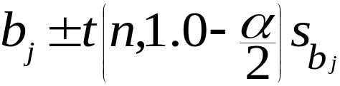
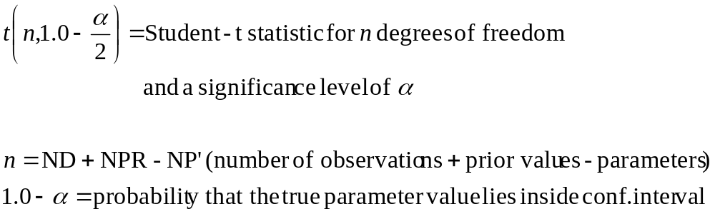
Individual Linear Confidence Intervals (Book, p. 138)
Linear individual confidence interval is calculated as:
  where
  the parameter is assumed to have a normal distribution

Slide 27
Student-t probability distribution
adaptation of normal distribution accounting for smaller sample sizes.
approaches the normal distribution as n becomes large
n t(n,0.05) N(0.05)
5 2.57 1.96
10 2.23 1.96
20 2.09 1.96
60 2.00 1.96
120 1.98 1.96
Infinity 1.96 1.96

Slide 28
Individual Linear Confidence Intervals
Important assumptions in derivation:
  The model is correct
    These confidence intervals do not account for model error
  The parameter estimates are normally distributed
    log-transformation appropriate for conductivities
    parameter estimates are normally distributed if
      the true observation errors are normally distributed
  The model is linear near the optimal values
    parameter sensitivities are assumed to be constant for the range of the parameter values within the confidence intervals
Outputted in ._pc file

Slide 29
Individual Linear Confidence Intervals
For a linear model, the parameter estimates are normally distributed if the true observation errors are normally distributed.
However, because the true errors are unknown, we analyze the weighted residuals instead:
  Construct a normal probability plot and evaluate R_{N}².
Evaluate model linearity with the modified Beale’s measure (exercise 7.3)
DO EXERCISE 7.1f (p. 151): Evaluate precision by examining standard deviations, linear confidence intervals, and coefficients of variation

Slide 30
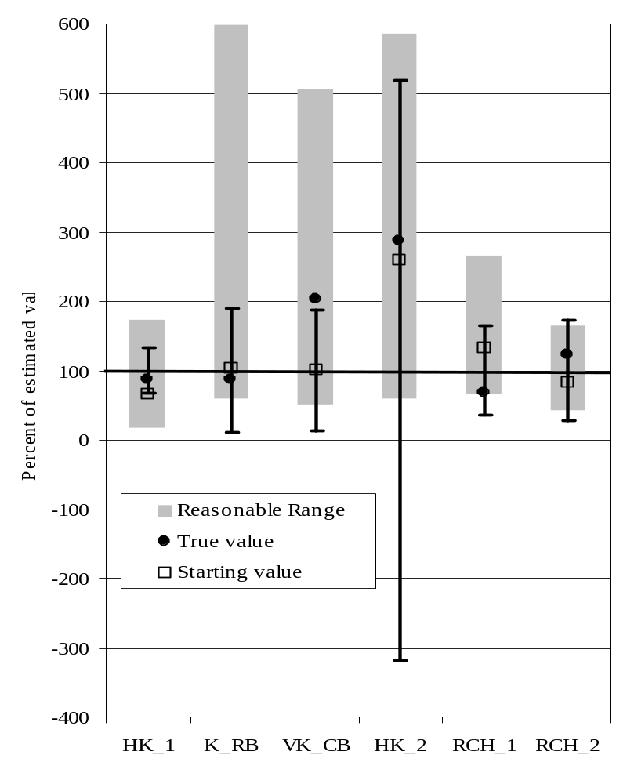
Linear 95% Confidence Intervals on Estimated Parameter Values
If the model and weighting are correct and the mean of the true errors is zero,
there is a 95% chance that the true parameter values fall within the calculated intervals.
Plots similar to this can be produced using GW_Chart and the _pc file.
Fig. 7.7, p. 153

Slide 31
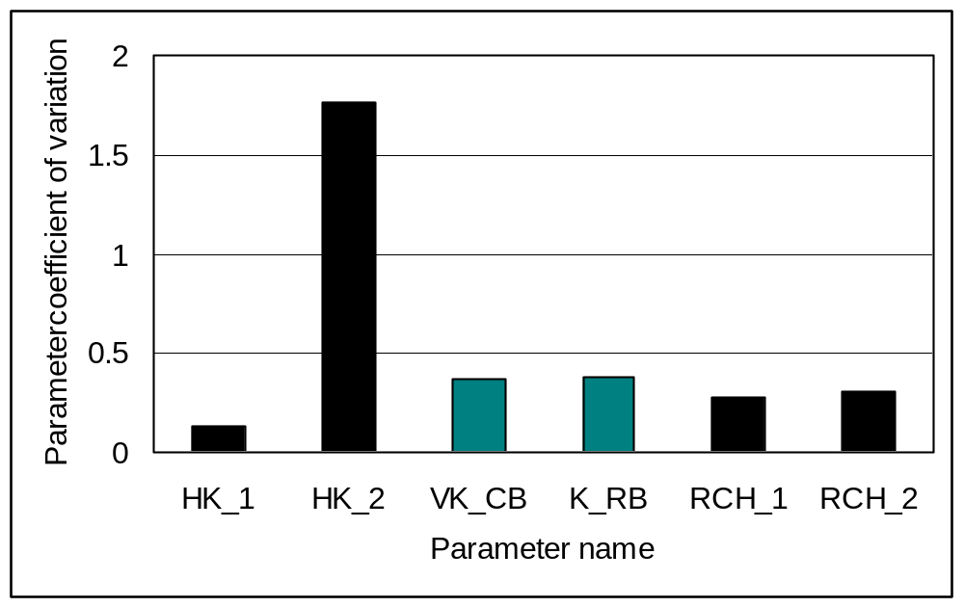
Parameter coefficients of variation
Prior information on VK_CB and K_R with CV=0.3.
Standard error of the regression = 1.23.
Values here are close to 0.3*1.23=0.37, as expected.

Slide 32
VII. Observation-Parameter Statistics
Composite scaled sensitivities for parameters
Leverage and Influence
Parameter variances and covariances
Correlation coefficients
Uniqueness
Standard deviations and coefficients of variation
Confidence intervals
Optimized values versus reasonable ranges
Notes:
VII. Parameter Statistics

Slide 33
Estimated Parameter Values compared with Reasonable Ranges (Book, p. 140)
common situations:
  parameter estimate and most of confidence interval within reasonable range
  estimate and confidence interval outside reasonable range
  parameter estimate outside but part of confidence interval inside
reasonable
range
parameter
estimate
confidence
interval
Parameter
Value
1
2
3
Situation

Slide 34
Situation 1
Range of
Reasonable
Values
Parameter
Value
1
2
3
parameter estimate and most of confidence interval within reasonable range
enough information to estimate the parameter precisely
estimate is consistent with independent information
we have learned something: the probable range is smaller than what we thought originally

Slide 35
Situation 2
Range of
Reasonable
Values
Parameter
Value
1
2
3
estimate and confidence interval outside reasonable range
enough information to estimate the parameter precisely
estimate is not consistent with independent information
we are about to learn something: why does the outcome contradict our expectations?
  Reconsider the model, choice of parameters, measurements …

Slide 36
Situation 3
Range of
Reasonable
Values
Parameter
Value
1
2
3
parameter estimate outside but part of confidence interval inside range of reasonable values
enough information to estimate the parameter, but without much precision
estimate does not contradict independent information
we have learned nothing new

Slide 37
Comparing Estimated Parameter Values with Reasonable Ranges
Range of
Reasonable
Values
Parameter
Value
1
2
3
Situation
Situation 2 Example: Perhaps the reasonable range is determined from aquifer test data in only one part of a large K zone, and there are head data throughout the K zone. The head data in the part of the zone away from the aquifer test might be influencing the K estimate that is unreasonable. This may mean that K needs to be represented by 2 separate zones.
X: aquifer test data
X
O
O
X
O
O
X
X
X
O
O
X
O
O
O: head data
X
X
O
O
O
O
O
O
K1
K1
K2

Slide 38
Estimated Parameter Values & Reasonable Range
Situation 3: Think about (a) additional data to provide more information towards estimating the parameter, and (b) improve-ments to the conceptual model of the system.
Situations 2: Adding prior does not address the fundamental problem. There is enough information for the regression to converge to a particular parameter value. The modeler needs to think about what is causing the unreasonable estimates.
Range of
Reasonable
Values
Parameter
Value
1
2
3
Situation

Slide 39
Estimated Parameter Values & Reasonable Range
DO EXERCISE 7.1g (p. 153)
  Compare estimated values with reasonable ranges
  view file ._pc in GW_chart

Slide 40
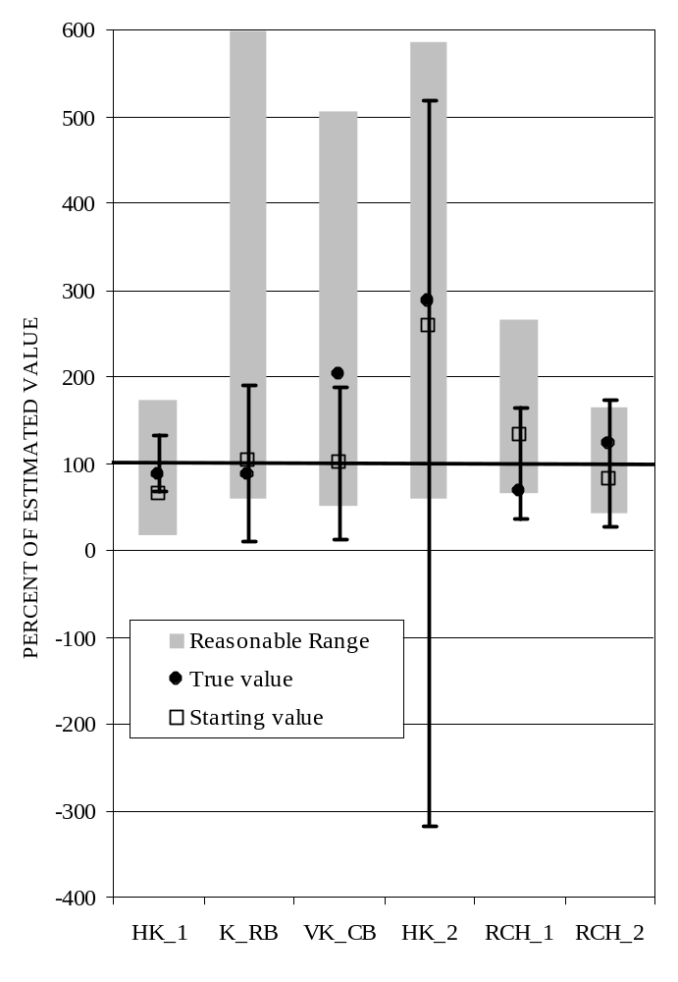
Confidence intervals, starting, final, and true values, compared to reasonable ranges
(Book, Figure 7-7, p.153)
_pc
Notes:
VII. Parameter Statistics

Slide 41
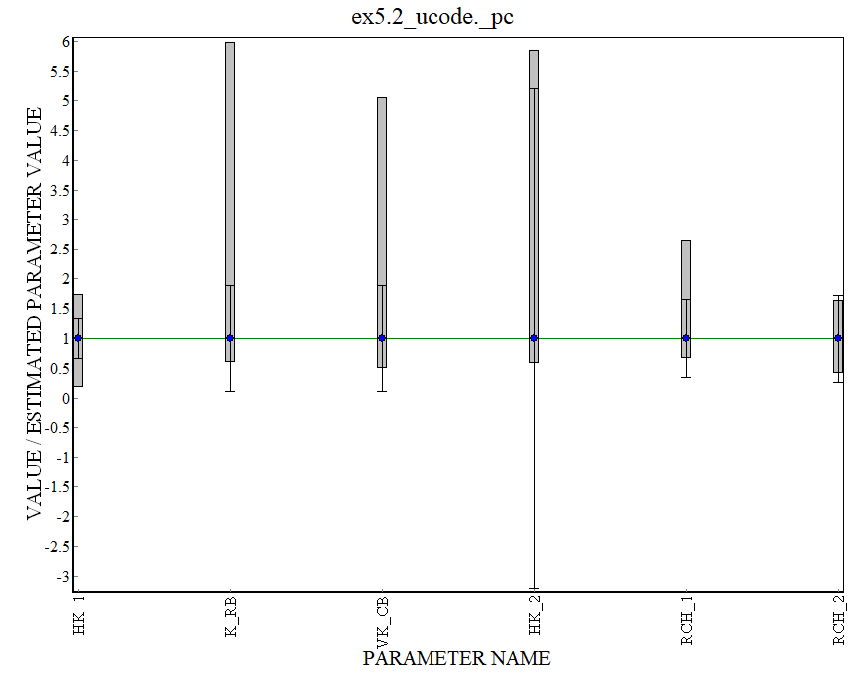
Confidence intervals, starting, final, and true values, compared to reasonable ranges
(Book, Figure 7-7, p.153)
_pc
Notes:
HK1 – like situation 1.
K_RB & VK_CB. CI are smaller than reasonable range – this is because the prior is too tight – it’s more like regularization.
HK2 – estimate is at the low end of the range, but CI’s are much larger indicating much more uncertainty than we thought. Like situation 3
RCH1 – is a bit like situation 2, but not as bad. Precision is good, but estimate is on the edge of reasonable range, but most of CI lies within reasonable range
RCH2 – uncertainty is larger than we expected.
CAVEAT – these are based on Linear CI.
VII. Parameter Statistics

Slide 42
VII. Observation-Parameter Statistics
Composite scaled sensitivities for parameters
Leverage and Influence
Parameter variances and covariances
Correlation coefficients
Uniqueness
Standard deviations and coefficients of variation
Confidence intervals*
Optimized values versus reasonable ranges*
* NOTE assumption of normal distribution and model linearity
Notes:
VII. Parameter Statistics

