Slide 1
Using models to make predictions
Key aspect for SGMA
Need to provide accurate predictions and clear guidance for future planning
Making predictions accurate enough for management and planning is challenging, but models provide a unique toolbox to test ideas, highlight data gaps, understand processes
--> Use the model to increase transparency (understanding what features in the system are likely to be important or unimportant - identifying dominant parameters, important observations and controlling processes.)

Slide 2
Define predictive quantity
We typically make predictions to assess the state of the simulated system at a future time.
  Often, predictions occur under different conditions than those under which the model was calibrated – addition of pumping, change in boundary conditions, etc.
  The predictive quantity might differ from the types of quantities used as observations.
  You as the modeler need to help define what model-calculated values are best to use as predictions in the problem of concern
The predictions available can depend on the software used
  MODFLOW-2005: any quantity that can be an observation can also be a prediction. Heads, temporal changes in head, some flows, advective transport.
  UCODE_2014 or PEST: any quantity that can be calculated using values in the application model output files.
Notes:
VIII. Predictions -- Calculation and sensitivity analysis, Exercises 8.1a & 8.1b

Slide 3

Key questions to be answered with the model (and how this applies to SGMA)
Will the drawdown at the southeast corner of the domain decline by more than 20 meters (m)? With 20 m of drawdown, local domestic wells will start to go dry and the local municipality will need to consider the expensive proposition of extending city water supplies to the area.

Slide 4
Will the head at the pumping well decline to less than 80m? At this level the saturated thickness of aquifer 1 would be only 30 m at the well screen; less is considered to be problematic.

Slide 5
Will the 2.2 m3/s pumping rate cause groundwater flow to the stream to be less than 4.0 m3/s, which is the minimum required flow?

Slide 6
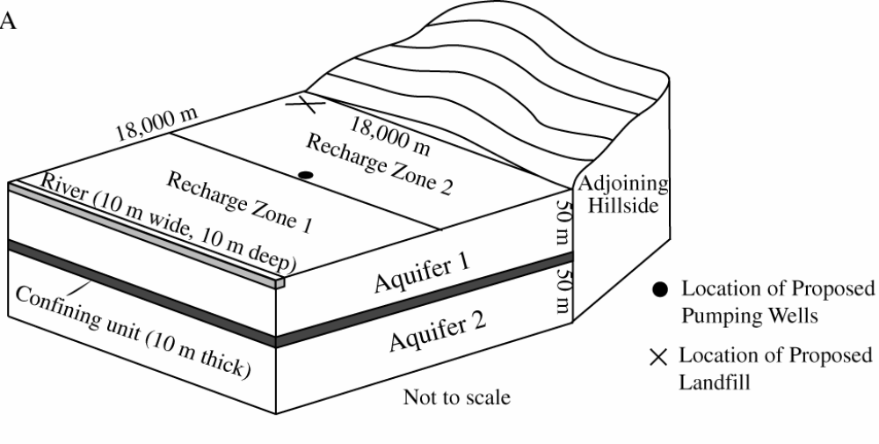
Problem
GOAL: The model will be steady state reflecting conditions with no pumpage and predictions conditions after pumping
Notes:
VIII. Predictions -- Calculation and sensitivity analysis, Exercises 8.1a & 8.1b

Slide 7
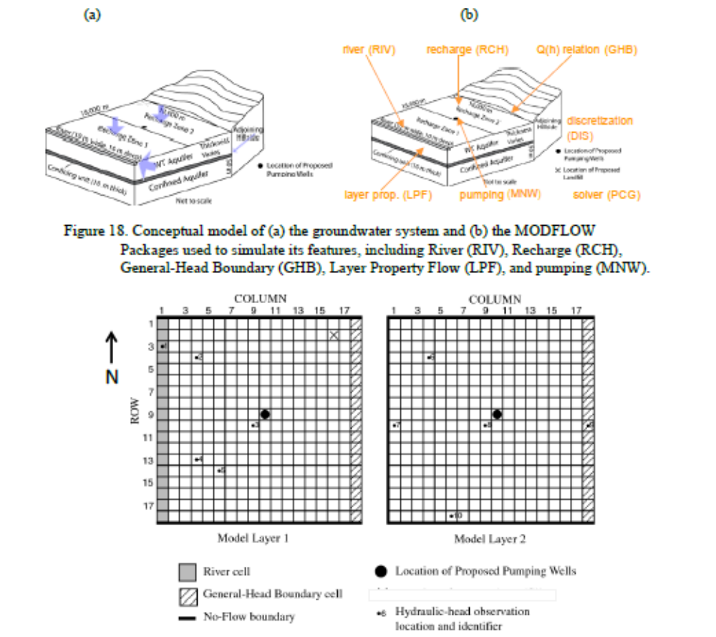

Slide 8
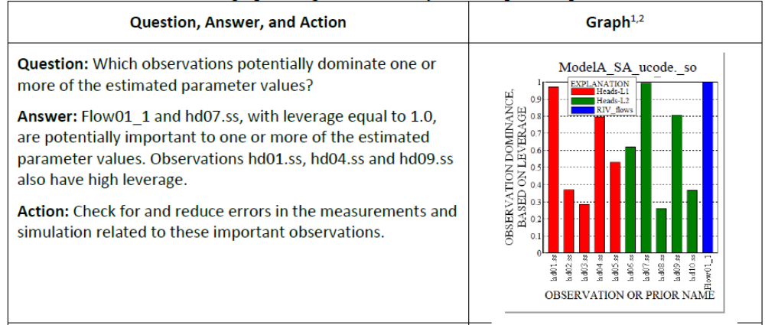
Initial Sensitivity

Slide 9
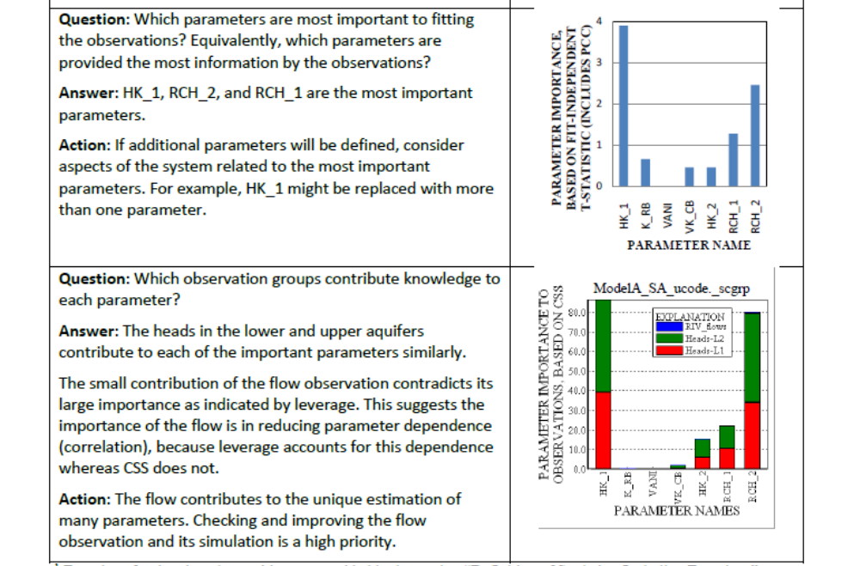

Slide 10
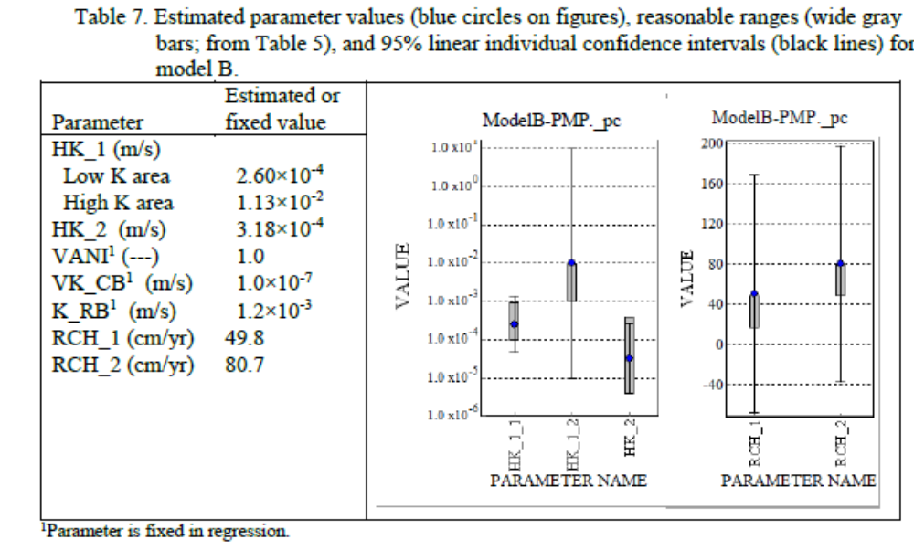
Run calibration

Slide 11
How can we answer to the questions posed at the beginning of the exercise?
Stakeholders claim the model is inadequate for two reasons:
  Model was calibrated using heads and flows and no pumping, but is being used to predict heads and flows under pumping conditions.
  Need for prior suggests the observations are inadequate
Our response based on sensitivity analysis
  Indeed, the model is inadequate.
  The calibration data does not provide information on some parameters important to predictions
Also, we stress that we need to consider the results of an uncertainty analysis

Slide 12
How can we answer to the questions posed at the beginning of the exercise?
Stakeholders claim the model is inadequate for two reasons:
  Model was calibrated using heads and flows and no pumping, but is being used to predict heads and flows under pumping conditions.
  Need for prior suggests the observations are inadequate
We stress that we need to consider the results of an uncertainty analysis

Slide 13

Do the predictions meet the management criteria? How does the uncertainty propagate into the predictions?
→ Need to calculate prediction uncertainty caused by parameter uncertainty
Run _05-RunUcode-Prediction.bat
  Runs Ucode in prediction mode with predictions defined like observations. Calculates sensitivities to predicted quantities
  Then runs linear_uncertainty to propagate parameter uncertainty to predictions
Use GW Chart to examine:
ex3-pred_ucode._linp

Slide 14
Which parameters are important to predictions. Are they precisely and uniquely estimated?
  Scaled sensitivities and PCC.
  Prediction and composite scaled sensitivities and parameter correlation coefficients (pss, css, pcc). (Ex. 8.1b).
  PPR statistic. (Ex. 8.1c)
Notes:
VIII. Predictions -- Calculation and sensitivity analysis, Exercises 8.1a & 8.1b

Slide 15
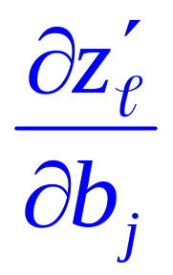

Prediction sensitivities: (Book, p. 159)
What is z for this problem?
  Head or streamflow
  Perturbation sensitivities: change in each coordiante divided by change in one parameter.
  Calculate as Δhead/Δb_{i} Δdrawdown/Δb_{i} Δflow/Δb_{i}
Notes:
VIII. Predictions -- Calculation and sensitivity analysis, Exercises 8.1a & 8.1b
Analagous to observation sensitivity
Sz: combines prediction sensitivities with parameter uncertainty.
Recall parameter std dev is sqrt of V(b)
Eqn assumes a linear model – that prediction sensitivities constant with parameter value

Slide 16
Prediction scaled sensitivities (pss)
(Book, p. 160-161)
Four possible scalings:
1. pss is percent change in prediction caused by a 1-percent change in the parameter value b_{j} (in _sppp file of UCODE_2005):
pss_{j} = (∂z′/∂b_{j}) (b_{j}/100) (100/z′)
2. pss is percent change in prediction caused by a change in b_{j} equal to 1 percent of its standard deviation s_{bj} (in _spsp file):
pss_{j} = (∂z′/∂b_{j}) (s_{bj}/100) (100/z′)
3,4. For both these scalings, (100/z′) can be replaced by (100/a′), where a’ is some other meaningful quantity. On p. 161, using a reference value is suggested. (in _sppr and _spsr file of UCODE_2005)
In _sp** , third letter identifies parameter value or standard deviation on the parameter; fourth letter identifies prediction or reference value)
Notes:
VIII. Predictions -- Calculation and sensitivity analysis, Exercises 8.1a & 8.1b

Slide 17
In _sp** , third letter identifies parameter value or standard deviation on the parameter; fourth letter identifies prediction or reference value)
Third letter: parameter value or std dev
  If use the parameter value, need something else to indicate how well the parameter is estimated. Use CSS? (Book Fig. 8.8)
  If use the parameter standard deviation, nothing else is needed.
Fourth letter: prediction or reference value
  In this case, heads or streamflows
  For example, for advective travel, prediction is x, y, or z relative to the origins of the grid coordinate system. If data changes, measure changes.

Slide 18
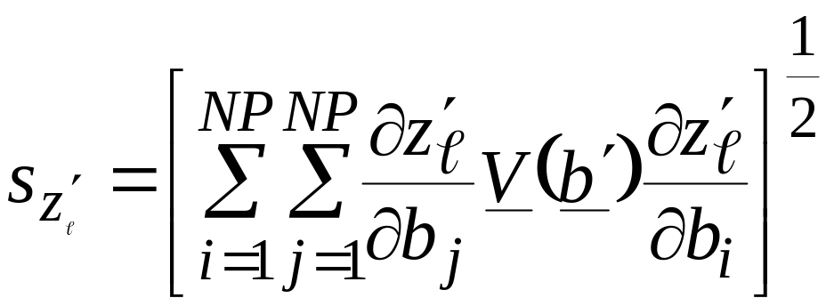
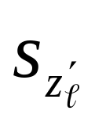
Quantify prediction uncertainty(Book, p. 174-189)
Prediction standard deviations (Book, p. 180):
  A measure of prediction uncertainty
  Calculated by translating parameter uncertainty through to the predictions:
Activate all parameters when calculating !!!
  Calculate parameter var-cov matrix with all parameters
  Calculate prediction sensitivities for all parameters
Notes:
VIII. Predictions -- Uncertainty

Slide 19
What we will do
Run the exercise
Use GW_chart to check the results and discuss them
We will look at parameter value sensitivity to predictions (_sppp), parameter standard deviation (_pc)

Slide 20
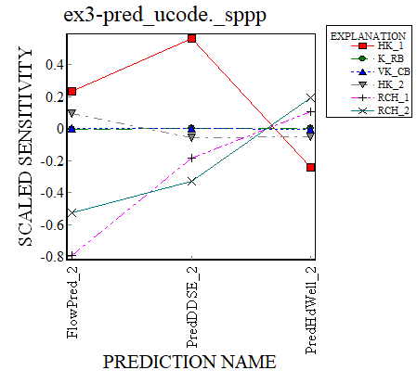
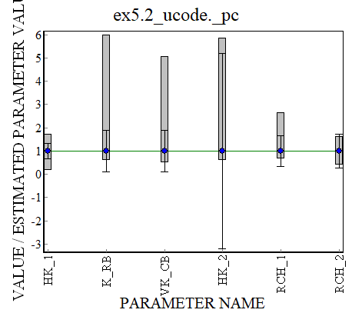

Which parameters are important to predictions? Are they precisely and uniquely estimated?
Notes:
HK is important, and precisely estimated. Recall that K_RB and VK_CB required prior, but fortunately that are not very important to the prediction. HK2 is not well estimated and it somewhat important to the Flow prediction. RCH1 was at the edge of its reasonable range, but confidence intervals say it is pretty well estimated, but it is very important for the flow prediction. This might be a cause for concern.
VIII. Predictions -- Calculation and sensitivity analysis, Exercises 8.1a & 8.1b

Slide 21
Determine problematic parameters using pcc
Compare two sets of parameter correlation coefficients:
  pcc calculated using only calibration observations
  pcc calculated with calibration observations AND predictions.
  Compare parameter correlation coefficients in
  directory files
  ex8.1b.1-sen&pcc-obs ex8.1b. _pcc
  ex8.1b.2-pcc-obs-pred ex8.1b. _pcc
Notes:
VIII. Predictions -- Calculation and sensitivity analysis, Exercises 8.1a & 8.1b

Slide 22
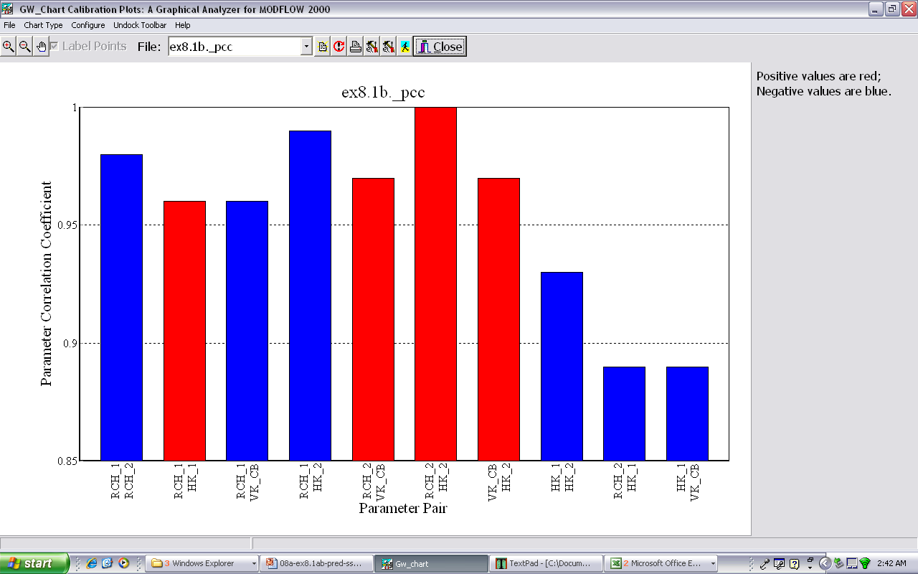
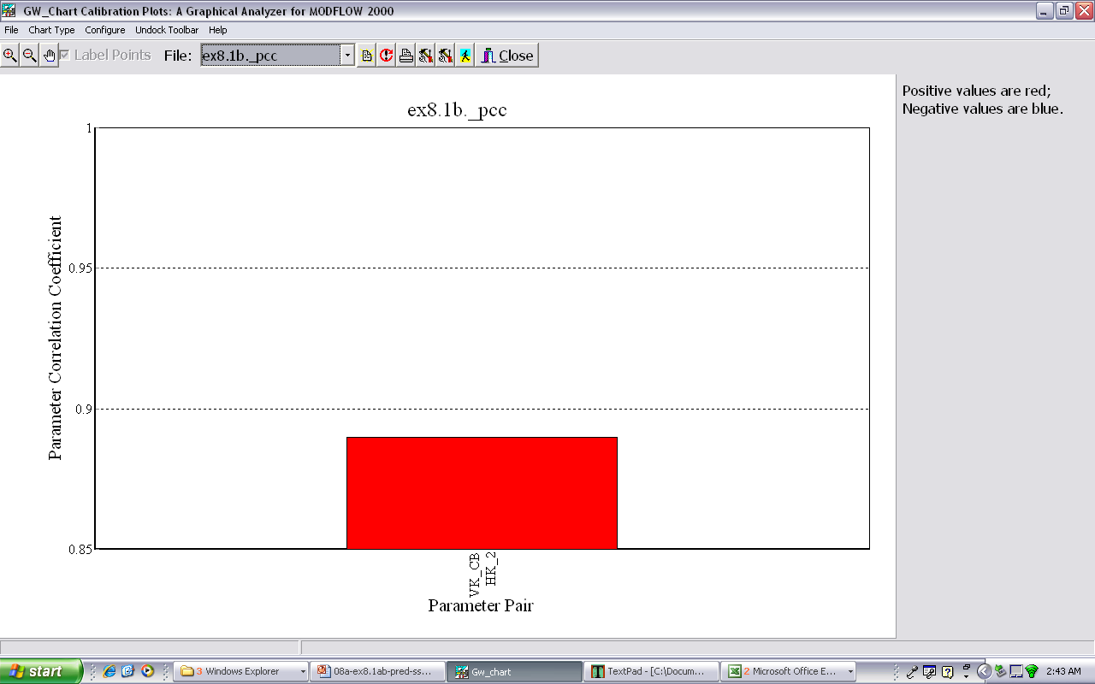
With Observations: lots of extremely correlated parameters
With Obs and preds: one correlated pair of parameters
Book tables 8.4 & 8.5, p. 199

Slide 23
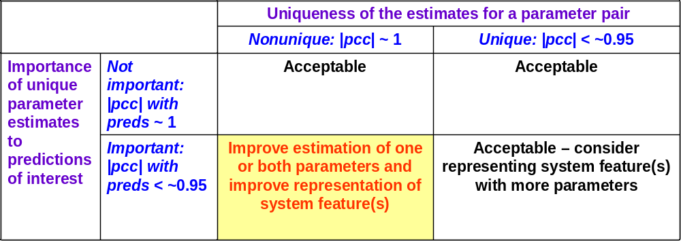
Use pcc to identify uniqueness problems
Are non-unique parameter estimates important to the predictions?
(from Hill & Tiedeman, Figure 8.2b, p. 166)
Notes:
VIII. Predictions -- Calculation and sensitivity analysis, Exercises 8.1a & 8.1b

Slide 24
Prediction weights needed for
pcc with predictions
Weights are needed to calculate parameter correlation coefficients.
Weights for the advective travel predictions are calculated from specified standard deviations, in meters (Table 8.3, p. 198).
Weights in this analysis can reflect desired prediction precision.
 | Time of advective travel
Direction | 10 years | 50 years | 100 years
X | 200 m | 600 m | 1000 m
Y | 200 m | 600 m | 1000 m
Z | 10 m | 15 m | 25 m
Notes:
VIII. Predictions -- Calculation and sensitivity analysis, Exercises 8.1a & 8.1b

Slide 25
Is there a statistic that can integrate correlation better?
Parameter-Prediction (PPR) Statistic

Slide 26
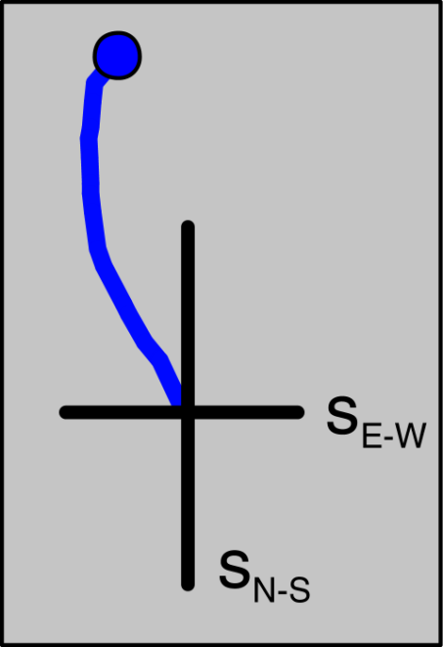
Brief explanation of PPR
Standard Deviation
Measure of uncertainty
The black bell curve presents the standard deviation in the context of a normal distribution, which may or not be the appropriate distribution for this uncertainty.
Advective path
Normal distribution
Notes:
VIII. Predictions -- Calculation and sensitivity analysis, Exercises 8.1a & 8.1b

Slide 27
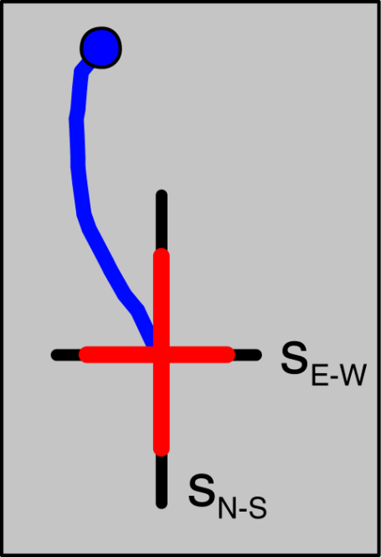
Brief explanation of PPR
Standard Deviation
Reduce predictive standard deviation with
  more information on parameters or
  added observations
Red bars illustrates ‘new’ predictive standard deviation
The change in standard deviation makes the probability distribution more narrow.
Use the difference between the red and the black bars to measure the worth of the additional data.
  PPR
  OPR
Advective path
Normal distribution
Normal distribution
Notes:
VIII. Predictions -- Calculation and sensitivity analysis, Exercises 8.1a & 8.1b

Slide 28

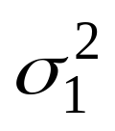
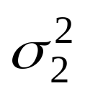
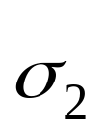
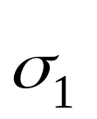
Equations
[ ]_{i} = h^{T}V(b)h [ ]_{i} = h^{T}V(b)’h
υ=1-{[ ]_{i} / [ ]_{i}} or υ=100(1-{[ ]_{i} / [ ]_{i} })
eq 4a eq 4b

Slide 29
Name of υ (the final statistic) | Type of quantity identified by i: | Contents of vector h (h contains one element for each parameter) | [V(b)]´ is calculated as for V(b) except add or omit information for one or more: | Use equation 4a or 4b
¹V(b) calculated in one of two options presented by Doherty (2008). Part of PEST
Relative error reduction statistic | parameter | Zeros except for a value of 1 in position i | ²observations | 4a
Predvar2, 5 Predunc2, 5 | predictions | Sensitivities of the prediction with respect to each parameter | Parameters (perfect values) | 4a
Predvar1, 3, 4 Predunc1, 3, 4 | prediction | Sensitivities of the prediction with respect to each parameter | observations | 4a
³V(b) calculated using classical equation s²[X^{T}ωX]^{-1.} Part of UCODE_2005
Observation-Parameter statistic (OPA) | parameter | Zeros except for a value of 1 in position i | observations | 4b
Parameter-Prediction statistic (PPR) | prediction | Sensitivities of the prediction with respect to each parameter | Parameters (reduced variance) | 4b
Observation-Prediction statistic (OPR) | prediction | Sensitivities of the prediction with respect to each parameter | observations | 4b

Slide 30
References
  PPR Statistic:
  Tiedeman, C.R., Hill, M.C., D’Agnese, F.A., and Faunt, C.C., WRR, 2003
  (The PPR statistic is the same as what is called the VOII statistic in this paper)
  OPR Statistic:
  Tiedeman, C.R., D.M. Ely, M.C. Hill, and G.M. O'Brien, WRR, 2004
  OPR-PPR Software:
  Tonkin, M.J., Tiedeman C.R., Ely, D.M., and Hill M.C., (2007), Documentation of OPR-PPR, a Computer Program for Assessing Data Importance to Model Predictions Using Linear Statistics
  U.S. Geological Survey Techniques and Methods Report TM E6-2
  PredVar/PredUnc
  Dausman, A., Doherty, J., Langevin, C., Soukup, M.C., 2008, Quantifying Data Contributions toward Reducing Predictive Uncertainty in a Variable-Density Flow and Solute/Heat Transport Model: Proceedings of MODFLOW and More 2008.
  Doherty,
Notes:
VIII. Predictions -- Calculation and sensitivity analysis, Exercises 8.1a & 8.1b

Slide 31
Quantify prediction uncertainty(Book, p. 174-189)
Prediction standard deviations (Book, p. 180):
  A measure of prediction uncertainty
  Calculated by translating parameter uncertainty through to the predictions:
Activate all parameters when calculating !!!
  Calculate parameter var-cov matrix with all parameters
  Calculate prediction sensitivities for all parameters
Notes:
VIII. Predictions -- Uncertainty

Slide 32
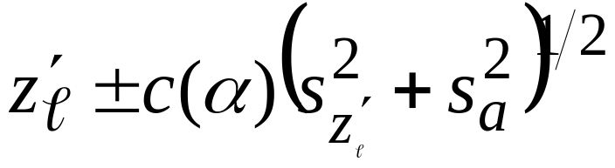
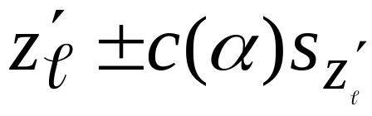
Quantify prediction uncertainty
Linear confidence and prediction intervals (p. 176-177)
  Intervals can be individual or simultaneous
  Form: confidence interval prediction interval
  Prediction intervals account for ‘measurement’ error. Use to compare simulated results to field measurements.
  α is the significance level, c(α) is the critical value and is different for different types of intervals (Table 8.1, p. 176).

Slide 33
Individual vs. Simultaneous Intervals
Individual linear intervals
  Defined as an interval that has a specified probability of containing the true predicted value.
  Exact for correct, linear models with normally distributed residuals.
  The more these requirements are violated, the less accurate the intervals become.
Simultaneous linear intervals
  On two or more predictions, each has a specified probability of containing the true value.
  Always ≥ linear intervals, because of greater difficulty in defining intervals that simultaneously include true values of two or more predictions. Largest intervals are for case where # of predictions
  = # of parameters
  Common types: Bonferoni & Sheffé

Slide 34
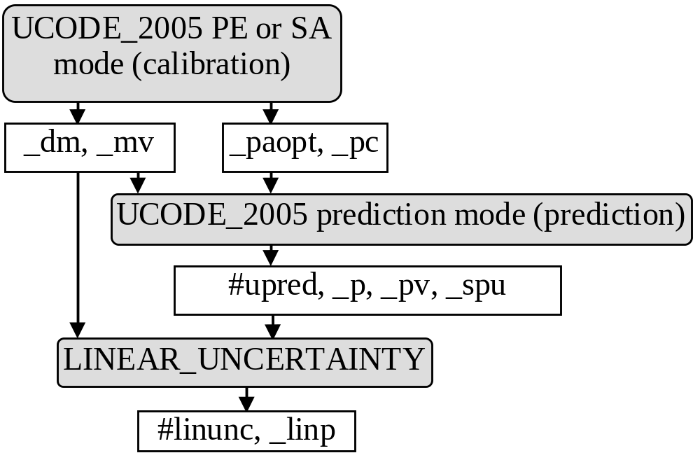
Calculating linear intervals with UCODE_2005.
From Poeter +, 2005, p. 158)

Slide 35
Linear Intervals to help understanding the uncertainty in the predictions

Slide 36
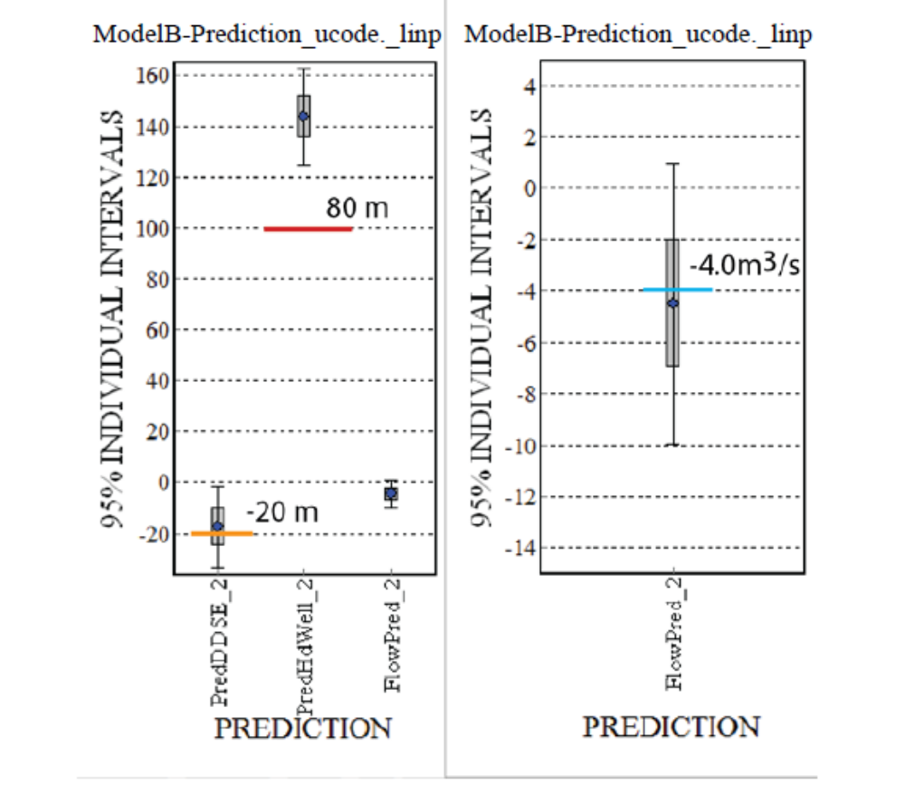

Slide 37
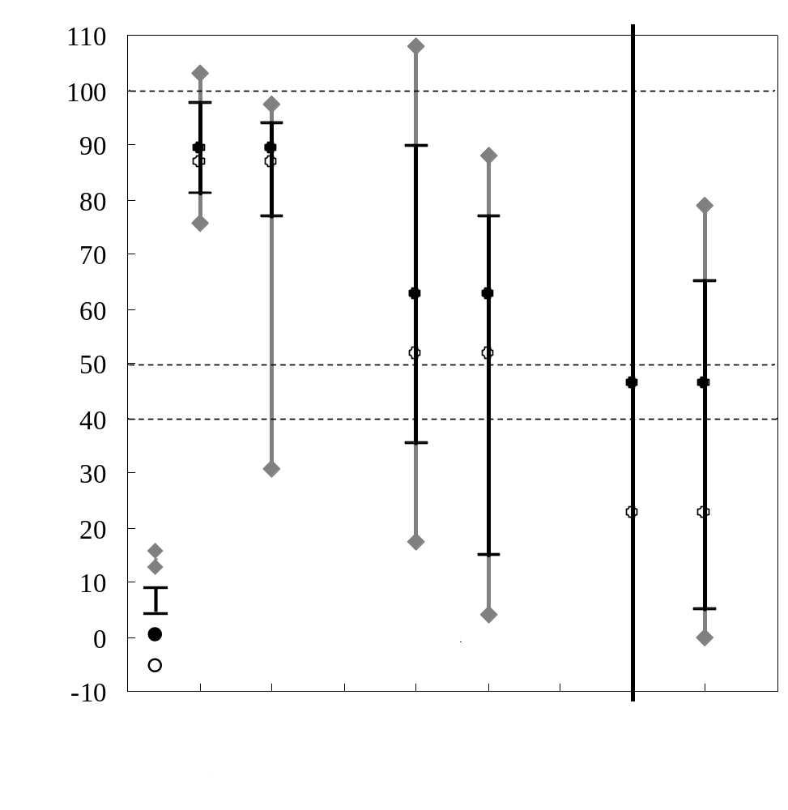
Results of Exercise 8.2a
(continued)
Linear Confidence Intervals for Question 5: What is the prediction uncertainty?
Figure 8.16, p. 211

Slide 38
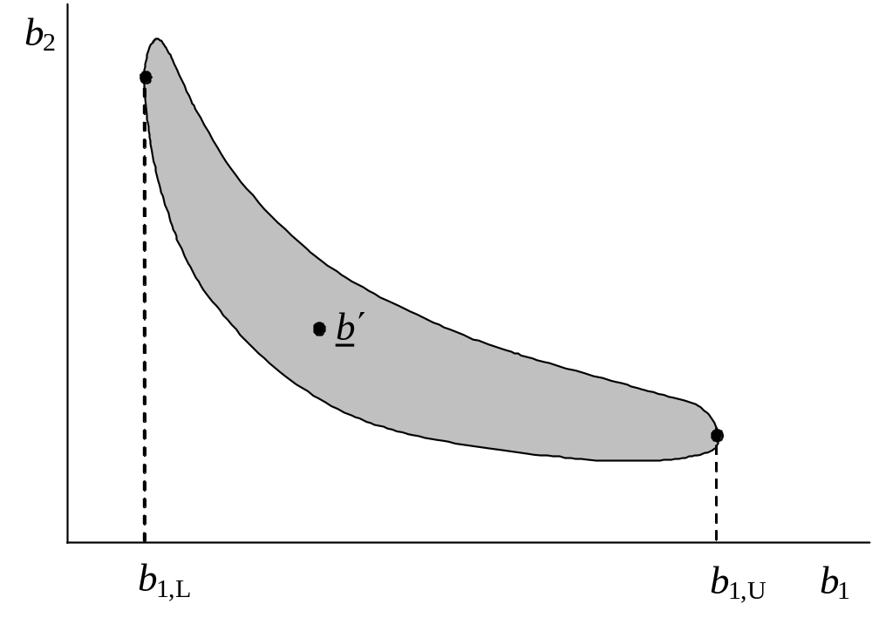
Nonlinear Intervals
Method involves finding the minimum and maximum predicted value on a confidence region for the parameters, which is defined as (book, p. 178)
S(b) < S(b’) + (s² x crit) + a
crit=critical value
Maximum prediction
Minimum prediction
Developed by Vecchia and Cooley (1987, WRR)
In PEST as the Prediction Analyzer.
Each limit of each interval requires a regression run that is often more difficult than the regression runs used for calibration.

Slide 39
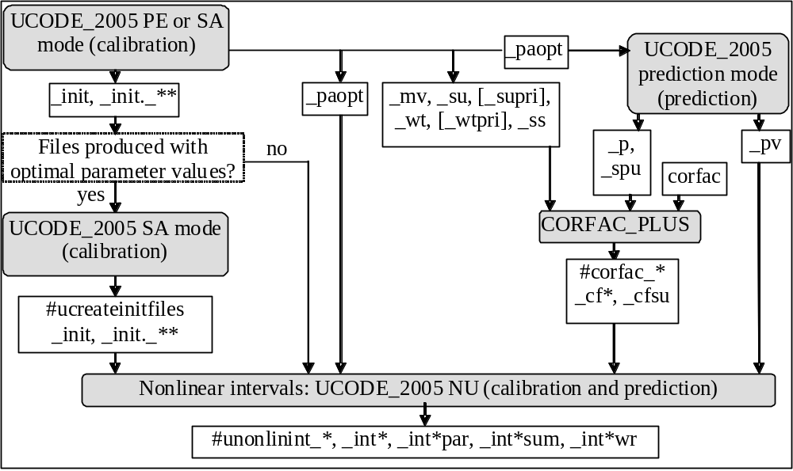
Calculating nonlinear intervals with UCODE_2005.
Modified from Poeter +, 2005, p. 193)

Slide 40
Our Final Analysis and the County Decision
Our Analysis
  Though it looks likely that the particle goes to the well, results are not conclusive.
  Consider using parameter values for which the particle goes to the river in an advective-dispersive model to analyze concentrations at the well. If concentrations high, results become more conclusive.
County decision
  No additional modeling right now
  Wait for the new data and use it to recalibrate

Slide 41
Can confidence intervals replace traditional sensitivity analysis? (p. 184-185)
Traditional sensitivity analysis
  quantify uncertainty in the calibrated model caused by uncertainty in the estimated parameter values
  change hydraulic conductivity, storage, recharge and boundary conditions systematically within previously established plausible range
Weaknesses of traditional method
  Plausible range does not reflect significant information provided through model calibration. Results exaggerate uncertainty.
  Suggested method to account for parameter correlation exacerbates this exaggeration.

Slide 42
Can confidence intervals replace traditional sensitivity analysis?
Weaknesses of both methods
  Only consider uncertainty in the parameter values.
  Uncertainty in model construction generally neglected entirely
  Use MMA!
Advantages of confidence intervals
  Account for information provided through the modeling process.

Slide 43
Use this analysis to assess the potential importance of adding new data
→ This translates into SGMA language as development of the ideal monitoring network during GSP development

Slide 44
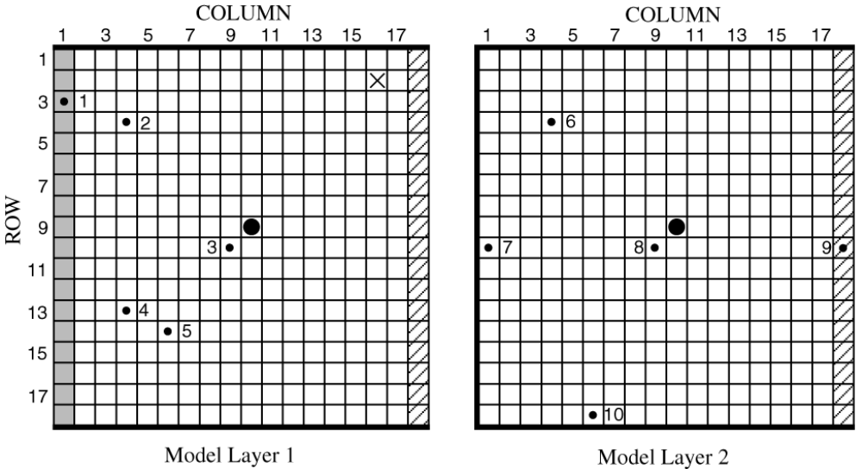
Exercise 8.1e: Assess the likely importance of potential new data to the predictions using dss, css, and pcc (Book, p. 204-205)
Two potential new observations to be collected under pumping conditions
River gain or loss along entire reach
Hydraulic head in layer 1, row 9, column 18
Notes:
VIII. Predictions -- Exercise 8.1e

Slide 45
Exercise 8.1e: Assess the likely importance of potential new data to the predictions
Calculate dimensionless scaled sensitivities (dss) for the two potential observations and calculate parameter correlations (pcc) that include these observations.
Use the dss and pcc to evaluate potential improvement in precision and uniqueness of the parameter estimates under pumping conditions.
Do Exercise 8.1e (p. 204) and the Problem, including answering
Question 3: Is it worth waiting for new data under pumping conditions?
Notes:
VIII. Predictions -- Exercise 8.1e

Slide 46
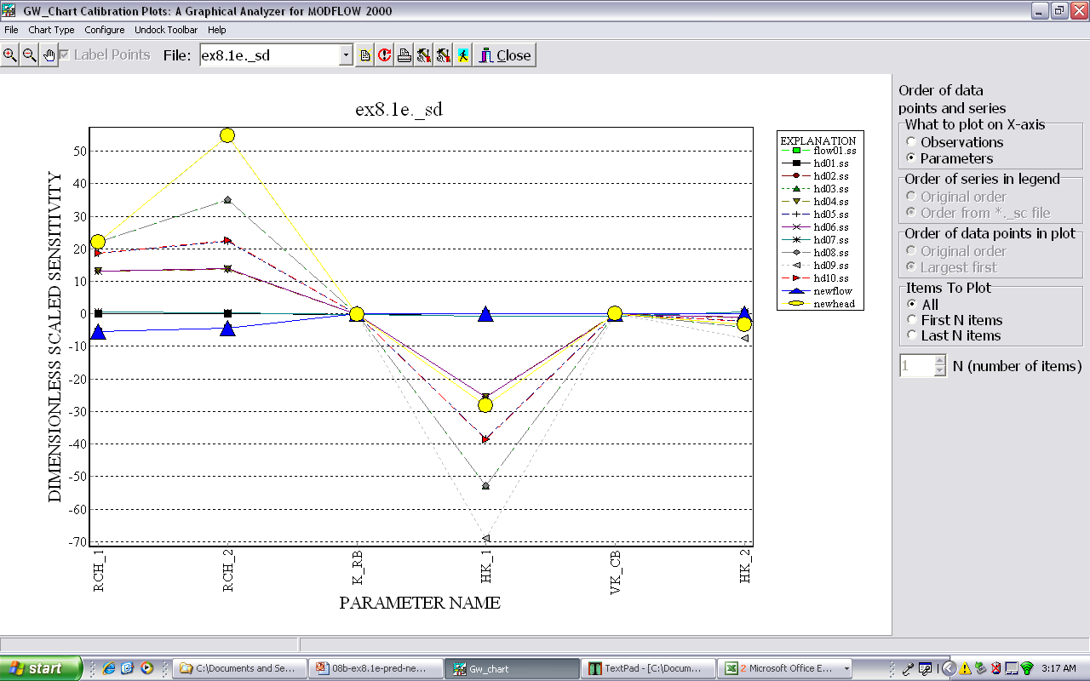
From DSS, not clear that the new data will be useful, but what about correlation?

Slide 47
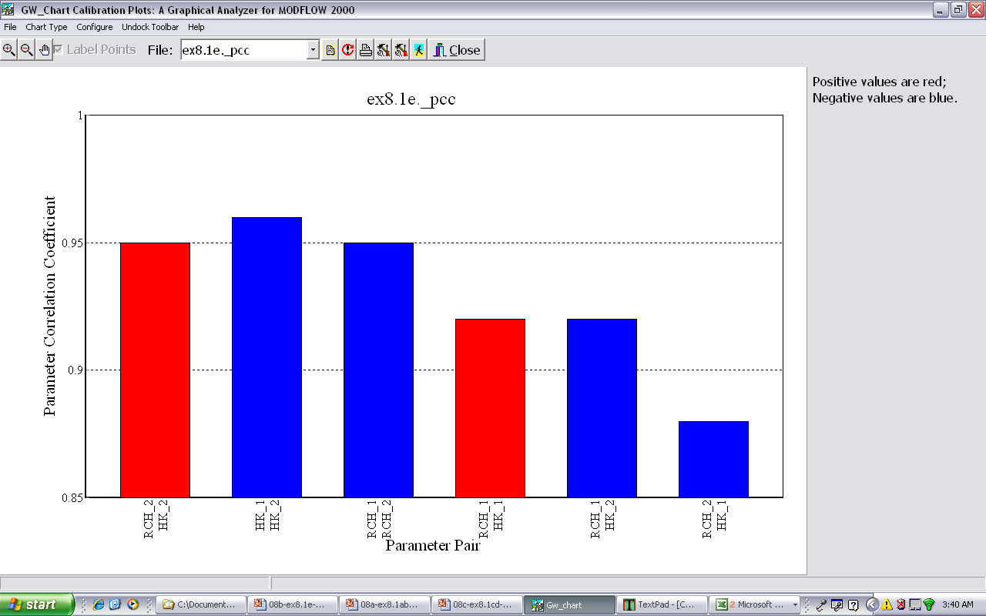
With Observations: lots of extremely correlated parameters
With Obs and new obs: less parameter correlation

Slide 48
With Observations: lots of extremely correlated parameters
With Obs and preds: one correlated pair of parameters
Book tables 8.4 & 8.5, p. 199

Slide 49
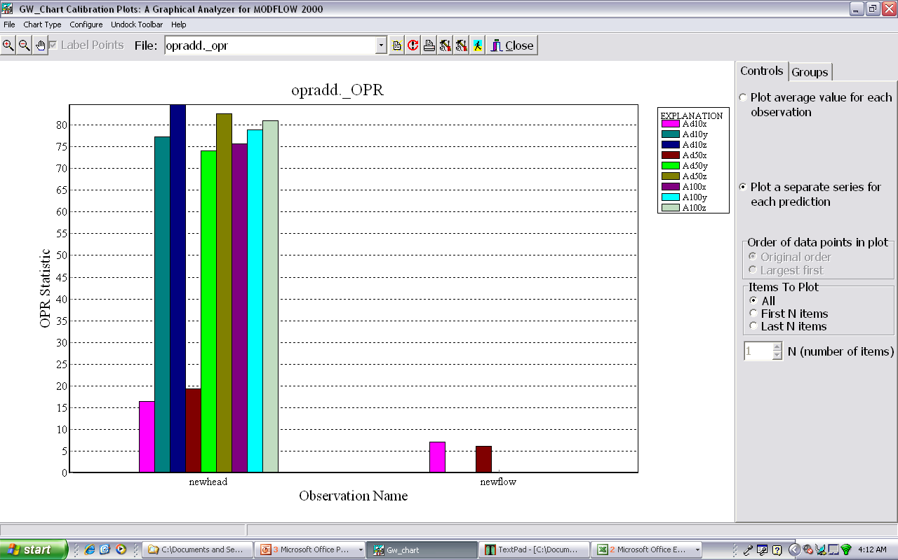
Exercise 8.1f
Figure 8.12, p. 207

Slide 50
Exercise 8.1f : OPR-ADD Results
By the OPR analysis, are the potential observations important to the predictions?
Yes!, Especially the new head!
Are there other new head locations we should consider?
Notes:
VIII. Predictions -- Exercise 8.1e

Slide 51
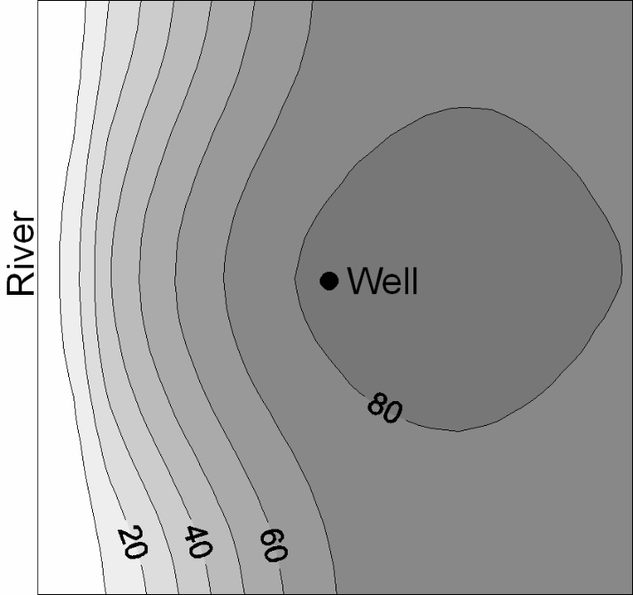
Exercise 8.1f: OPR-ADDNODE Results
Average OPR statistic at 100 years (averaged over x, y, z transport directions):
Percent reduction in prediction standard deviation caused by adding one new head observation at a model node in layer 1.
Figure 8.12, p. 207
Proposed new head location
Where are the best locations for collecting additional head data?
Notes:
VIII. Predictions -- Exercise 8.1e
(a), (b), and (c) correspond to x, y, and z prediction standard deviations

Slide 52
Is the new data worth waiting for?
Our analysis clearly shows that with the new data we are likely to be able to estimate more uniquely parameters important to predictions.
The government officials want to see the results of the uncertainty analysis before they decide

