Slide 1
Demonstrate use of error-based weighting, local sensitivity analysis, and single-objective function
Rainfall runoff model

Slide 2
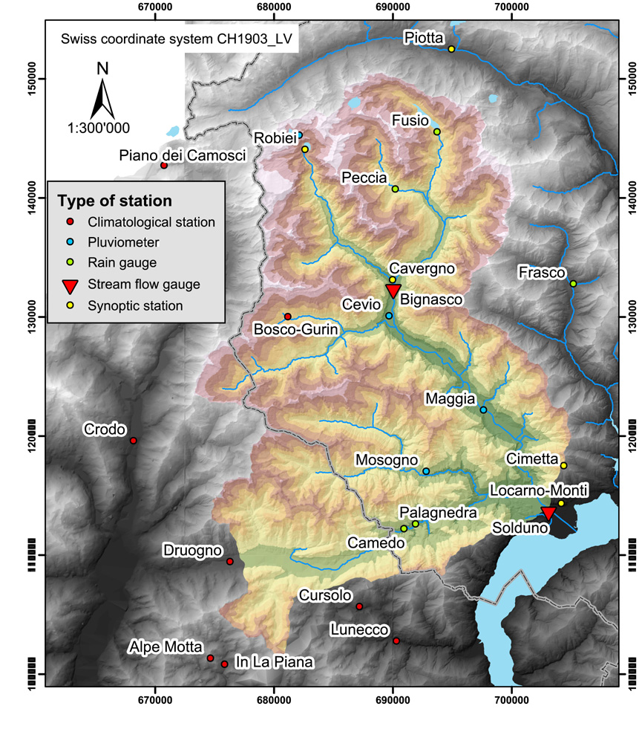
Streamflow observation locations
Bignasco
Lodano
Solduno

Slide 3
Defined parameters
For 6
soil types
Total: 35 defined parameters.
Sensitivity analysis using central difference perturbation sensitivities requires 71 model runs.

Slide 4
Choose observations using PEST utility.
Use sequentially numbered obs in graphs.
Error-based weighting.
Streamflow error coefficients of variation:
10% at Solduno and some other flows;
40% otherwise.

Slide 5
Goal: Design regression to estimate parameters. Identify parameters important to observations.
Composite scaled sensitivities (CSS)
High values➔important to observations
Parameter Correlation Coefficients (PCC)
|PCC| ➔1
➔ nonunique parameters

Slide 6
Goal: Design regression to estimate parameters. Identify parameters important to observations.
Composite scaled sensitivities (CSS)
High values➔important to observations
Parameter Correlation Coefficients (PCC)
|PCC| ➔1
➔ nonunique parameters

Slide 7
Goal: Design regression to estimate parameters. Identify parameters important to observations.
Composite scaled sensitivities (CSS)
High values➔important to observations
Only a few parameters have enough sensitivity to be estimated. Some of those are too correlated to estimate uniquely.
Regression results supported the local sensitivity analysis results.
Parameter Correlation Coefficients (PCC)
|PCC| ➔1
➔ nonunique parameters

Slide 8
Both graphs: Model fit. Bottom graph: Leverage and Cook’s D to identify observations important to parameters.

Slide 9
Both graphs: Model fit. Bottom graph: Leverage and Cook’s D to identify observations important to parameters.
Leverage and Cook’s D mostly identify the same important obs.
Downstream station (Solduno) most important.
Important obs related to large peak expected.
PROBLEM: Low flows more important than expected. Consider resampling obs for low flows for any further analysis.

Slide 10
Choose observations using PEST utilities.
Use sequentially numbered obs in graphs.
Weighting: use coefficients of variation. 10% at Solduno and some other flows; 40% otherwise. UCODE_2005 converts to variances.

Slide 11
Potential Danger
Model nonlinearity can incorrectly identify important parameters and observations.
Easy to detect: Conduct linear sensitivity analysis at various sets of parameter values. If different parameters and observations are identified as important, use global methods.
Mild consequences: May spend 200 runs that are not helpful before going to global methods that use 2,000+ runs. So, modest potential wasted effort.
Note: I have not yet worked with a model for which the linear methods did not provide useful insights.

Slide 12
Conclusions: part 1
Insights attained using 71 parallelizable model runs here would require more than a thousand runs using procedures such as GLUE or MCMC. MCMC runs generally are not parallelizable.
Foglia et al., WRR, 2009

Slide 13
And now?
Results of this first calibration have been used to improve the understanding of the model and of the system used

Slide 14
Motivation
computationally frugal vs expensive analyses
simple vs complex models
how do we use these in model development?
The Maggia Valley example
increasing model complexity to represent multiple processes and guide integration of multiple data types/obs.
Conclusion and outlook

Slide 15
Frugal Methods
Model development, sensitivity analysis and calibration (UCODE_2005; Poeter +, 2005)
Error-based weighting of observations and prior info
Error based weighting has a unique theoretical foundation in that under ideal conditions it produces model parameters with the smallest variance.
Local sensitivity analysis
Single-objective function nonlinear regression
→ Theoretical assumptions:
Model linearity or smoothness
Gaussian error behavior
And/or single minimum within the plausible parameter value range
In practice? Explore non ideal problems!

Slide 16
Cross validation: Computationally demanding method
Start with model calibrated with optimization
Here, nonlinear regression by modified Gauss-Newton=Levenberg-Marquardt
Remove one (or more) observations
Perform regression
Save results
Calculate normalized change in estimated parameters and calculated predictions
Repeat

Slide 17
Models: simple to complex
GROUNDWATER: MODFLOW-2000 (Harbaugh+, 2000; Hill+,2000)
Two confined aquifers, water table approximated
River Package (simple and fast) and SFR package
25m grid resolution to match DEM
Steady state, Short execution time – few minutes
HYDROLOGICAL MODEL: TOPKAPI
TOPographic Kinematic APproximation and Integration physically based distributed rainfall-runoff model based on non linear kinematic wave model [Todini & Ciarapica, 2002, Liu & Todini, 2002].
INTEGRATED MODEL: TOPKAPI+MODFLOW
TOPKAPI output → distributed recharge into MODFLOW
Increasing Complexity

Slide 18
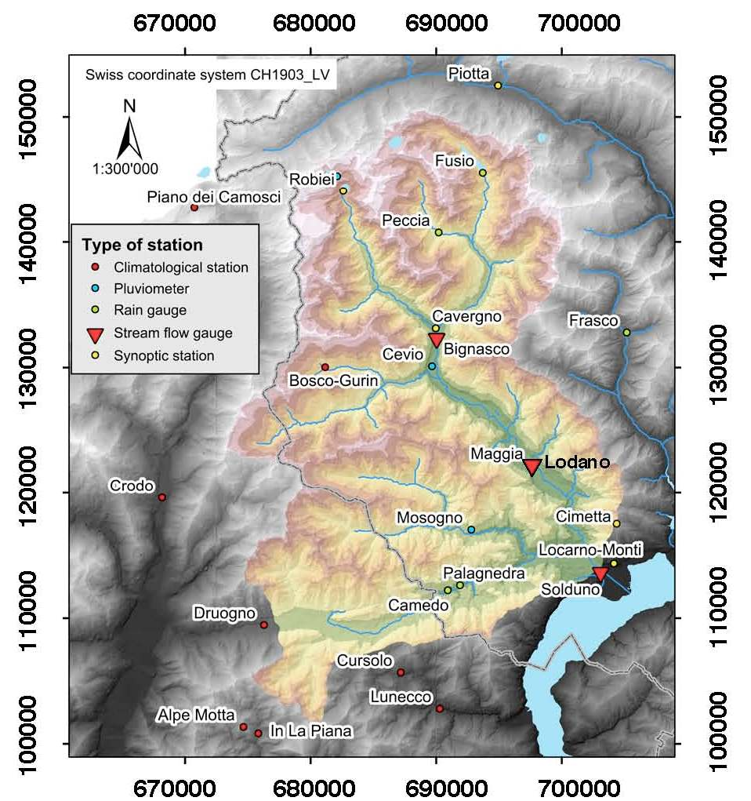
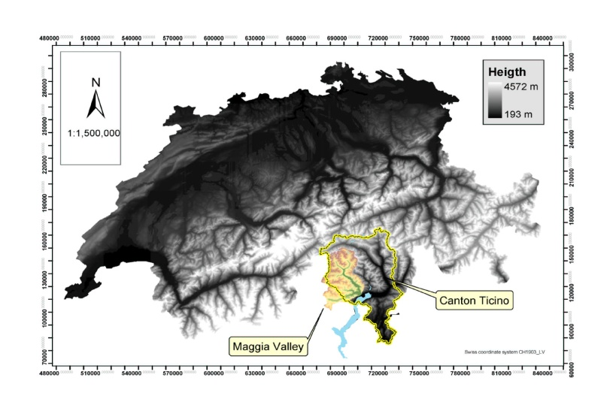
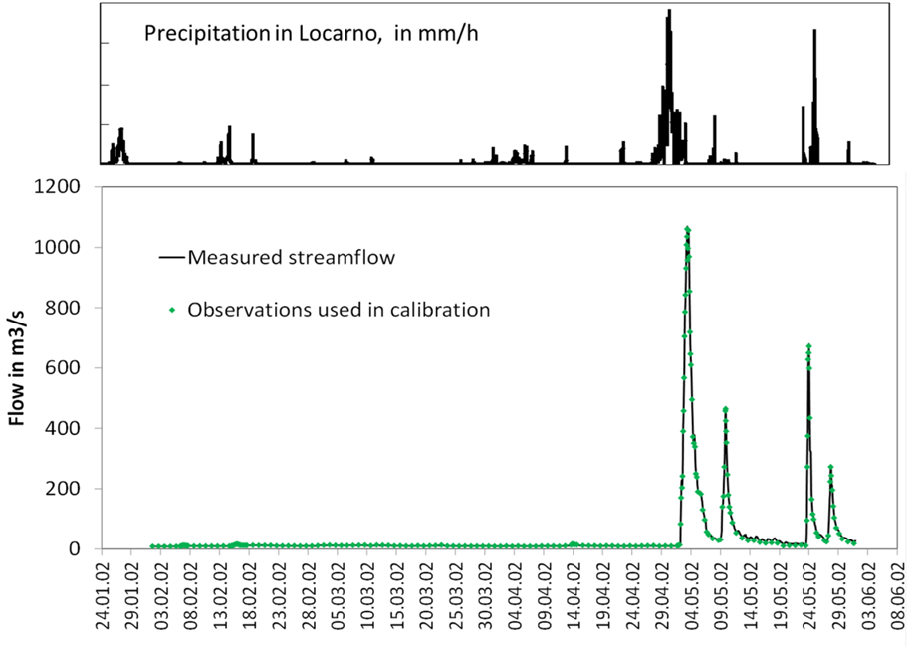
TOPKAPI hydrological model outline and Obs Locations
206 obs in each station

Slide 19
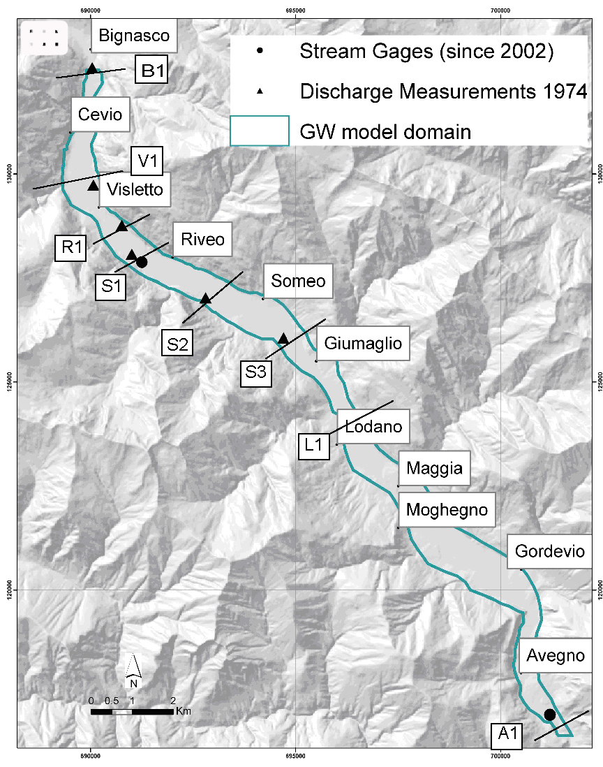
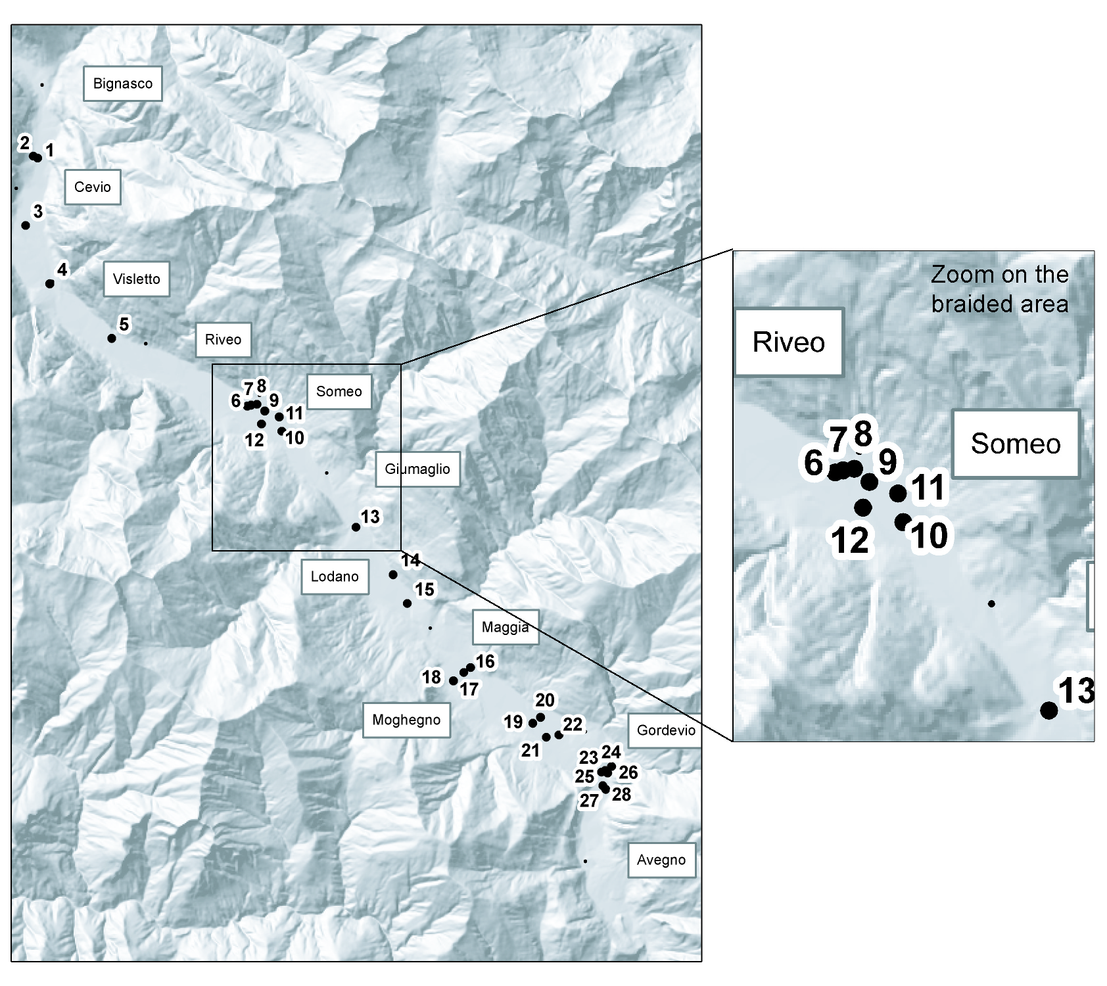
GW Model outline and Obs Locations
Flow data (use gains/losses)
Head data
19

Slide 20
Increasing complexity
Groundwater model development and calibration using frugal methods and crossvalidation
→ frugal methods provide 70% of the insights with 2% of the model runs (results not presented here, GW, 2007)
Hydrological model calibration using frugal methods: low flow observations more important than expected
→ resampling of the observations to better capture all parts of the hydrograph
INTEGRATED MODEL:
NEW PROCESSES + NEW OBSERVATIONS

Slide 21
New obs., processes, & parameters
New Obs. - based on findings of WRR 2009 paper:
Increase obs from ~ 40 to 206 at all three stations
Improve representation of all parts of the hydrograph (low flows, flood peaks, and the rising and falling limbs).
New Processes - Hydrological model coupled to the GW model
3D GW flow + stream/aquifer interaction processes
New Parameters (Summary)
36 Rainfall/Runoff parameters
– ET, soil depth, conductivity, water content, Manning’s n
6 GW parameters
Recharge, aquifer and streambed conductivities

Slide 23
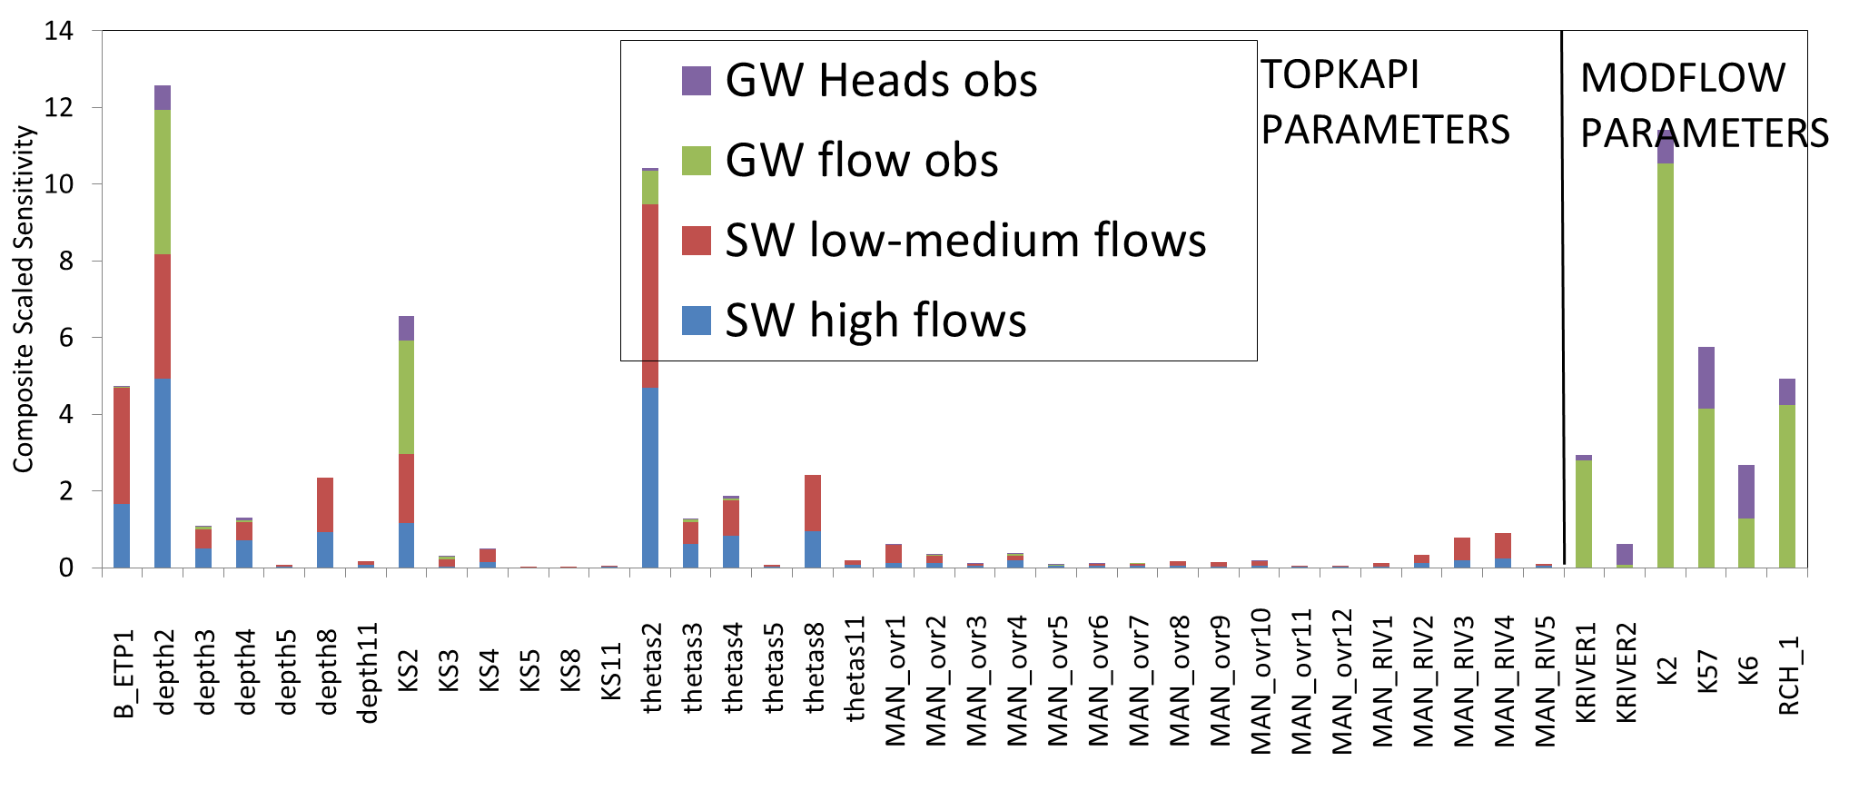
Parameter importance for the integrated model (with CSS)
Make text bigger
ADD NOTE ABOUT CORRELATIONS
→ New obs likely to have huge impact on calibration results
Foglia et al., Parameter and Observation Importance in Modeling Integrated Surface-Water/Groundwater Systems , in prep.

Slide 24
Results
Parameters with biggest change are depth2 (0.96 to 0.18) and thetas2 (0.75 to 2.92)
CSS showed both are sensitive to low flows
Depth2, thetas2, and KS2 are strongly correlated
Parameter correlations not presented here significantly affect model calibration. Mainly the surface water parameters

Slide 25
Conclusion
Coupling the GW and RR models provides significant insight for estimation of critical parameters like depth2
Increased model complexity can benefit model calibration through inclusion of supporting & complementary data

Slide 26
Future work
These preliminary results provide important directions for the future work:
Why some parameters are significantly more affected by the new observations than others?
More detailed analyses of the processes to create a better relation between parameters, observations, and processes.
How can we improve the fit of the low flows?
Tests with exaggerated weights assigned to the low flows
How can we improve the fit to the peaks after the major flood?

