Slide 1
DILDEX EXPLAINER
“Helping you lose money more easily you silly twat”™

Slide 2
Basics: PRB
Am using PRB as a basis for how we look at historical results
Example here of 9 horses in a race
Top horse = beat 8/8 rivals = 1
5th placed horse = beat 4/8 rivals = 0.5
Also, example here of a 5-horse race

Slide 3
Using PRB
So, for any racing variables, we can look at the prior PRB and work out how it stacks up for that variable
This could be
simply the horse’s prior average PRB
the average PRB for the history of the Jockey/Trainer that is riding/training this specific horse
the Jockey’s average PRB on that Course
Basic Dildex = average PRB for all the variables that have been used
However: I am also using weightings for each variable to see what is the optimal weighting such that the it produces the greatest improvement in the % of wins for the horse with the top Dildex compared to the average % of wins for horses
Will eventually look at profitability

Slide 4
Which Variables?
Horse
Trainer + Jockey
Jockey + Course
Jockey + Race Length (grouped)
Trainer + Race Length
Trainer + Course
This is just a first pass
Chart below shows how the elements of the Dildex are weighed to maximum “Top Dildex Win Percentage”
Aim is to tinker with variables to increase the yellow Win Uplift / Place Uplift
Currently the data is taking the whole horse / trainer / jockey history: ability also to just limit this to last 30/60/90/365 days etc.

Slide 5
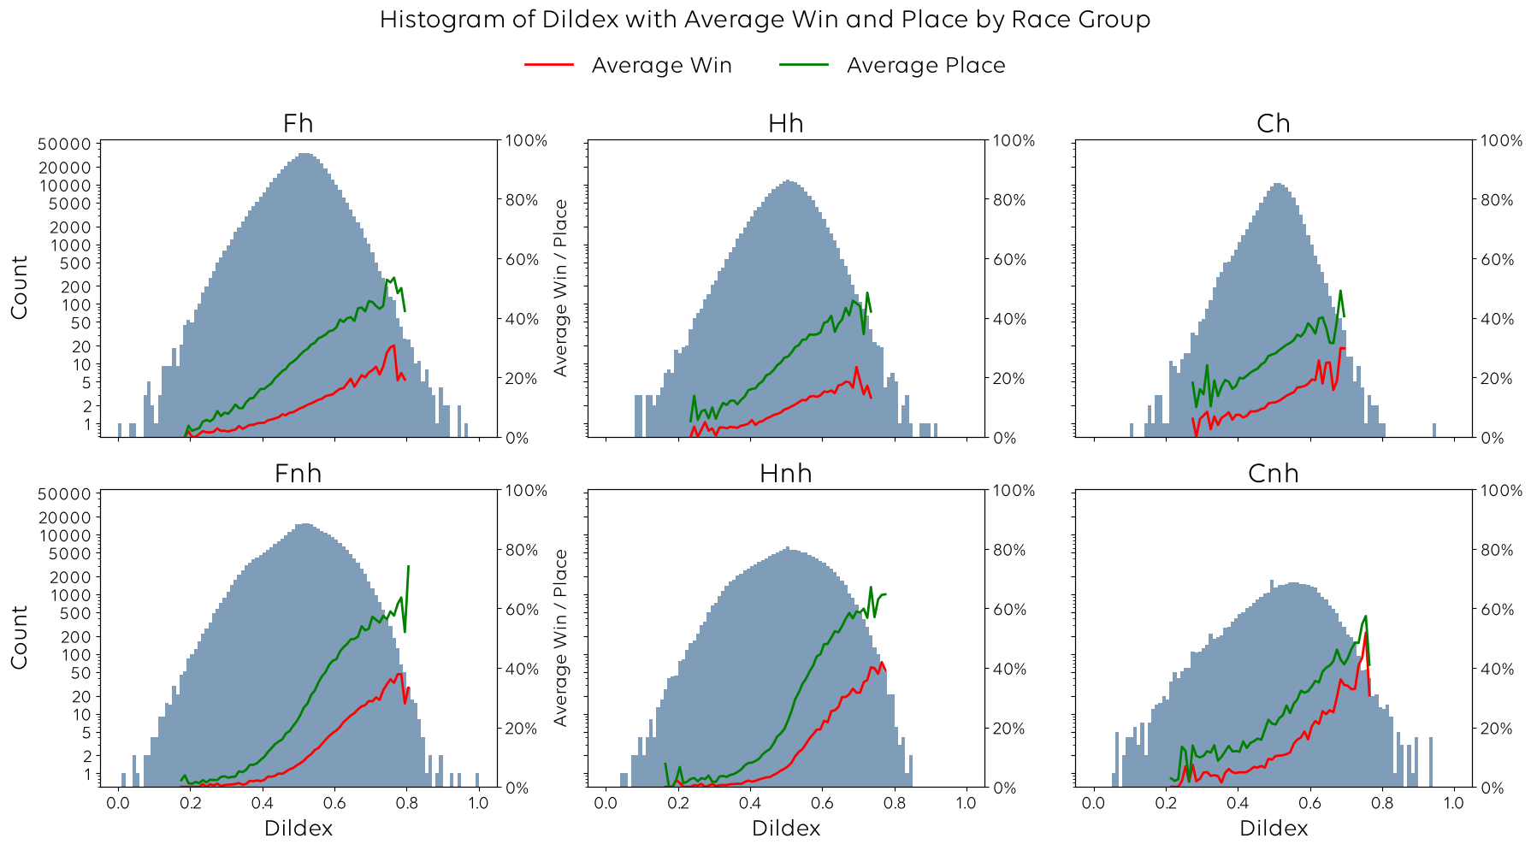
Dildex Score: Currently Between 0 and 1
Can see how the % of places / wins increases with Dildex value

Slide 6
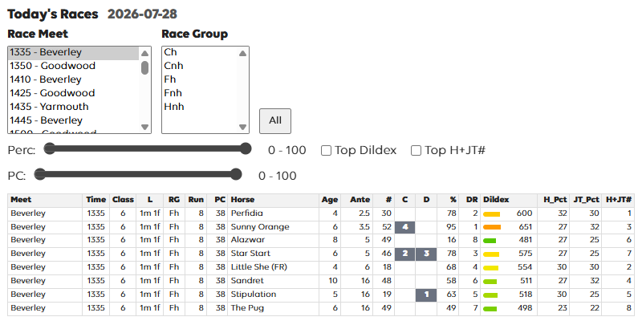
Dildex Racecard: https://richsdixon.github.io/horses/dildex.html#card
First-pass Dildex example
The % column is the percentile value of the Dildex for that horse’s ante-post price
Higher values = rare high values for that horse’s ante-post price
Will also add to this with some more subjective standard detail
Form (more recent races count)
Course/Distance prior wins
Days since last race
PC – place chance (Places/Runners)
# - race count,
C = Course Win, D=Dist win,
% = Dildex percentile for price,
DR = Dildex Rank

Slide 7
Dildex Racecard: https://richsdixon.github.io/horses/dildex.html#card
These data are using the average PRB and count of races to predict the chance of a place using
The horse
The jockey/trainer combo
Just another additional data point to sit alongside the Dildex
Needs a lot of work though
Racecard has ability to filter on the Dildex percentile for that race class (i.e. find those with some decent historical stats for that horse / jockey / course etc.)
Can also filter on “Place Chance”
Also, a check-box to pick out the highest Dildex ranked horse

