Slide 1
Rockbuster Stealth data analysis
Rich Seiler

Slide 2
LUXURY CINEMA THEATER INFOGRAPHICS
Here is where your presentation begins

Slide 3
LUXURY CINEMA THEATER INFOGRAPHICS
This template contains an assortment of complementary infographic resources for the Luxury Cinema Theater Pitch Deck presentation.
These infographics are adapted to the style of the before mentioned presentation, so you can insert them easily and have the completely integrated at once. You just need to do the following:
Select the element that you want to copy
Right-click and choose “Copy”
Go to the slide where you want the element to appear
Right-click and choose “Paste”

Slide 4
LUXURY CINEMA THEATER INFOGRAPHICS
NEPTUNE
A
B
SUN
Neptune is the farthest planet from the Sun
The Sun is the star at the center of the Solar System
1997

Slide 5
LUXURY CINEMA THEATER INFOGRAPHICS
MERCURY - 47%
Mercury is the smallest planet
VENUS - 13%
Venus has a beautiful name
EARTH - 75%
Earth is the planet with life

Slide 6
LUXURY CINEMA THEATER INFOGRAPHICS
MERCURY
EARTH
Mercury is the smallest planet in the Solar System
JUPITER
Earth is the third planet from the Sun and has life
MARS
Jupiter is the biggest planet in the Solar System
Despite being red, Mars is actually a cold place
01
02
03
04

Slide 7
LUXURY CINEMA THEATER INFOGRAPHICS
MERCURY
JUPITER
Mercury is the smallest planet in the Solar System
Jupiter is the biggest planet in the Solar System
Earth is the planet with life
Despite being red, Mars is actually a cold place
Neptune is the farthest planet from the Sun
Venus has a beautiful name

Slide 8
LUXURY CINEMA THEATER INFOGRAPHICS
JUPITER
SATURN
Jupiter is the biggest planet of them all
It’s a gas giant and has several rings
MARS
NEPTUNE
Despite being red, Mars is actually cold
It’s the farthest planet from the Sun
EARTH
MERCURY
Earth is the third planet from the Sun
It’s the closest planet to the Sun
PRODUCT OVERVIEW

Slide 9
LUXURY CINEMA THEATER INFOGRAPHICS
JUPITER
SATURN
It’s the biggest planet of them all
It’s a gas giant and has several rings
MARS
NEPTUNE
Despite being red, Mars is cold
It’s the farthest planet from the Sun
EARTH
It’s the third planet from the Sun
MERCURY
It’s the closest planet to the Sun

Slide 10
LUXURY CINEMA THEATER INFOGRAPHICS
COMPETITOR A
COMPETITOR B
Saturn is a gas giant with several rings
SATURN
EARTH
Earth is the third planet from the Sun
Jupiter is the biggest planet
JUPITER
MARS
Despite being red, Mars is a cold place
Pluto is considered a dwarf planet
PLUTO
VENUS
Venus has a beautiful name
Mercury is the smallest planet
MERCURY
THE SUN
The Sun is the star that we all orbit

Slide 11
LUXURY CINEMA THEATER INFOGRAPHICS
80%
70%
60%
30%
MERCURY
JUPITER
EARTH
MARS
Mercury is the smallest planet in the Solar System
Jupiter is the biggest planet in the Solar System
Earth is the third planet from the Sun and has life
Despite being red, Mars is actually a cold place

Slide 12
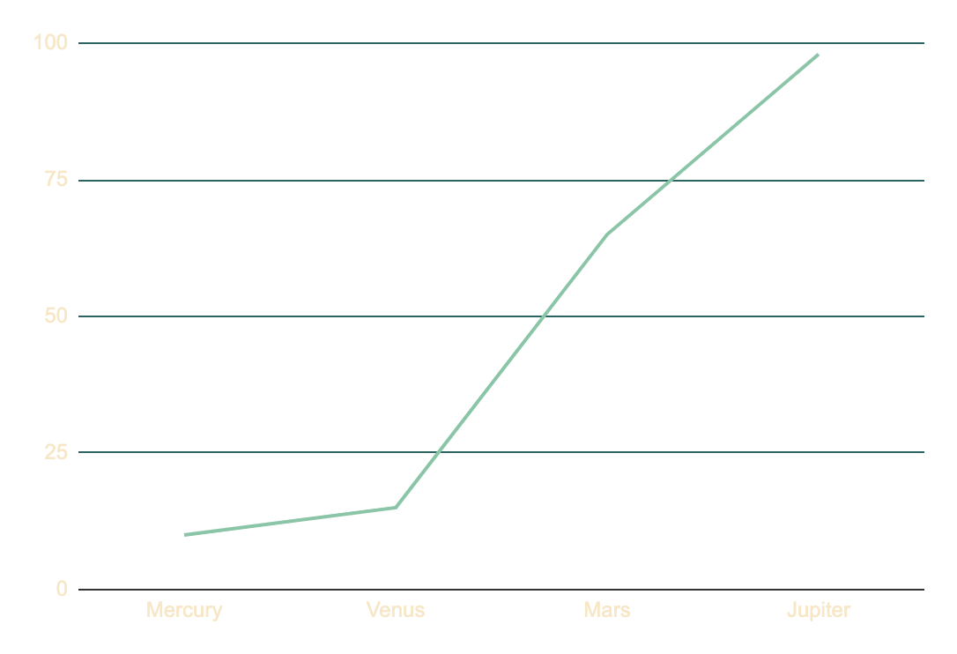
LUXURY CINEMA THEATER INFOGRAPHICS
MERCURY
VENUS
Mercury is the smallest planet in the Solar System
Venus is the second planet from the Sun
10%
15%
MARS
JUPITER
Despite being red, Mars is actually cold
Jupiter is the biggest planet in the Solar System
Follow the link in the graph to modify its data and then paste the new one here. For more info, click here
65%
98%

Slide 13
LUXURY CINEMA THEATER INFOGRAPHICS
JUPITER
MARS
Jupiter is the biggest planet in the Solar System
Despite being red, Mars is actually a cold place
MERCURY
EARTH
Mercury is the smallest planet in the Solar System
Earth is the third planet from the Sun and has life

Slide 14
LUXURY CINEMA THEATER INFOGRAPHICS
S
W
O
T
STRENGTHS
WEAKNESSES
OPPORTUNITIES
THREATS
Mercury is the smallest planet in the Solar System
Jupiter is the biggest planet in the Solar System
Earth is the third planet from the Sun and has life
Despite being red, Mars is actually a cold place

Slide 15
LUXURY CINEMA THEATER INFOGRAPHICS
VENUS
MARS
80%
30%
Venus has a beautiful name
Despite being red, Mars is cold
SATURN
MERCURY
60%
70%
Saturn is a gas giant with rings
Mercury is the smallest planet
JUPITER
NEPTUNE
40%
90%
It’s the biggest planet of them all
Neptune is far away from Earth

Slide 16
LUXURY CINEMA THEATER INFOGRAPHICS
STRENGTHS
WEAKNESSES
S
W
Neptune is the farthest planet from the Sun
Earth is the third planet from the Sun
Despite being red, Mars is a cold place
The Sun is a huge and big star
OPPORTUNITIES
THREATS
O
T
Saturn is a gas giant with several rings
Jupiter is the biggest planet of them all
Mercury is the smallest planet of them all
Pluto is now considered a dwarf planet

Slide 17
LUXURY CINEMA THEATER INFOGRAPHICS
VENUS
SATURN
MARS
MERCURY
PRODUCT OVERVIEW
Venus has a beautiful name
Saturn is a gas giant with rings
Despite being red, Mars is cold
Mercury is the smallest planet

Slide 18
LUXURY CINEMA THEATER INFOGRAPHICS
THE SUN
8/10
The Sun is the star at the center of the Solar System
NEPTUNE
6/10
Neptune is the farthest planet from the Sun
PLUTO
7/10
Pluto is now considered a dwarf planet

Slide 19
LUXURY CINEMA THEATER INFOGRAPHICS
MARS
Despite being red, Mars is actually a cold place
JUPITER
Jupiter is a gas giant and the fourth planet from the Sun
SATURN
Saturn is a gas giant made of hydrogen and helium
NEPTUNE
Neptune is the farthest planet from the Sun
VENUS
Venus is the second planet from the Sun

Slide 20
LUXURY CINEMA THEATER INFOGRAPHICS
THEM
US
Mercury is the smallest planet in the Solar System
Earth is the third planet from the Sun and it harbors life
Saturn is mostly composed of hydrogen and helium
Venus is the second planet from the Sun
Jupiter is a gas giant and the biggest planet of them all
Despite being red, Mars is actually a cold place

Slide 21
LUXURY CINEMA THEATER INFOGRAPHICS
BUSINESS MODEL
80%
20%
NEPTUNE
THE SUN
Neptune is the farthest planet from the Sun
The Sun is the star at the center of the Solar System

Slide 22
LUXURY CINEMA THEATER INFOGRAPHICS
DAY 01
DAY 02
DAY 03
DAY 04
Mercury is the smallest planet in the Solar System
Jupiter is the biggest planet in the Solar System
Earth is the third planet from the Sun and has life
Despite being red, Mars is actually a cold place

Slide 23
LUXURY CINEMA THEATER INFOGRAPHICS
MERCURY
Mercury is the closest planet to the Sun
VENUS
Venus is the second planet from the Sun
MARS
Despite being red, Mars is a cold place
JUPITER
Jupiter is the biggest planet of them all
SATURN
It is composed of hydrogen and helium

Slide 24
LUXURY CINEMA THEATER INFOGRAPHICS
VENUS | MARS | JUPITER
Venus has a beautiful name and is the second planet from the Sun | Despite being red, Mars is actually a cold place. It’s full of iron oxide dust | Jupiter is a gas giant and the fourth-brightest object in the night sky
Venus is very hot It has a toxic atmosphere | Mars is very cold Mars is made of basalt | Jupiter is big Jupiter is very bright

Slide 25
LUXURY CINEMA THEATER INFOGRAPHICS
AWARD #1
Mercury is the smallest planet in the Solar System
AWARD #2
Jupiter is the biggest planet in the Solar System
AWARD #3
Earth is the third planet from the Sun and has life

Slide 26
LUXURY CINEMA THEATER INFOGRAPHICS
THEM
US
Mercury is the smallest planet in the Solar System
01
Earth is the third planet from the Sun and it harbors life
Saturn is mostly composed of hydrogen and helium
02
Venus is the second planet from the Sun
Jupiter is a gas giant and the biggest planet of them all
03
Despite being red, Mars is actually a cold place

Slide 27
LUXURY CINEMA THEATER INFOGRAPHICS
Despite being red, Mars is really cold
Venus is the second planet from the Sun
MARS
VENUS
JUPITER
Jupiter is a gas giant and the biggest planet in the Solar System
Gas giant made of hydrogen and helium
Neptune is the farthest planet from the Sun
SATURN
NEPTUNE

Slide 28
LUXURY CINEMA THEATER INFOGRAPHICS
01
MERCURY
Mercury is the closest planet to the Sun
02
VENUS
Venus is the second planet from the Sun
03
MARS
Despite being red, Mars is a cold place
04
JUPITER
Jupiter is the biggest planet of them all
05
SATURN
It is composed of hydrogen and helium

Slide 29
LUXURY CINEMA THEATER INFOGRAPHICS
Mercury is the closest planet to the Sun and the smallest one in the Solar System
Venus is the second planet from the Sun
01
Despite being red, Mars is a cold place
02
Jupiter is the biggest planet of them all
03

Slide 30
LUXURY CINEMA THEATER INFOGRAPHICS
MARS
SATURN
JUPITER
Earth is the third planet from the Sun. It’s where we all live
Neptune is the farthest planet from the Sun
Mercury is the closest planet to the Sun and the smallest one
Pluto is now considered a dwarf planet
Saturn is a gas giant with several rings. Named after a Roman god
Jupiter is the biggest planet of them all

Slide 31
LUXURY CINEMA THEATER INFOGRAPHICS
THEM
US
Mercury is the smallest planet in the Solar System
Earth is the third planet from the Sun and it harbors life
Saturn is mostly composed of hydrogen and helium
Venus is the second planet from the Sun
Jupiter is a gas giant and the biggest planet of them all
Despite being red, Mars is actually a cold place

Slide 32
LUXURY CINEMA THEATER INFOGRAPHICS
20%
80%
90%
10%
60%
40%
50%
50%
THE SUN
The Sun is the star at the center of the Solar System
NEPTUNE
Neptune is the farthest planet from the Sun
VENUS
MARS
JUPITER
SATURN

Slide 33
LUXURY CINEMA THEATER INFOGRAPHICS
NEPTUNE
60%
Mercury is the smallest planet in the Solar System
Venus is the second planet from the Sun
40%
THE SUN
50%
Saturn is composed of hydrogen and helium
Earth is the beautiful planet where we live
50%

Slide 34
Instructions for use
In order to use this template, you must credit Slidesgo in your final presentation.
You are allowed to:
- Modify this template.
- Use it for both personal and commercial projects.
You are not allowed to:
- Sublicense, sell or rent any of Slidesgo Content (or a modified version of Slidesgo Content).
- Distribute Slidesgo Content unless it has been expressly authorized by Slidesgo.
- Include Slidesgo Content in an online or offline database or file.
- Offer Slidesgo templates (or modified versions of Slidesgo templates) for download.
- Acquire the copyright of Slidesgo Content.
For more information about editing slides, please read our FAQs or visit Slidesgo School:
https://slidesgo.com/faqs and https://slidesgo.com/slidesgo-school

Slide 35
Instructions for use (premium users)
As a Premium user, you can use this template without attributing Slidesgo or keeping the "Thanks" slide.
You are allowed to:
Modify this template.
Use it for both personal and commercial purposes.
Hide or delete the “Thanks” slide and the mention to Slidesgo in the credits.
Share this template in an editable format with people who are not part of your team.
You are not allowed to:
Sublicense, sell or rent this Slidesgo Template (or a modified version of this Slidesgo Template).
Distribute this Slidesgo Template (or a modified version of this Slidesgo Template) or include it in a database or in any other product or service that offers downloadable images, icons or presentations that may be subject to distribution or resale.
Use any of the elements that are part of this Slidesgo Template in an isolated and separated way from this Template.
Register any of the elements that are part of this template as a trademark or logo, or register it as a work in an intellectual property registry or similar.
For more information about editing slides, please read our FAQs or visit Slidesgo School:
https://slidesgo.com/faqs and https://slidesgo.com/slidesgo-school

Slide 36
Infographics
You can add and edit some infographics to your presentation to present your data in a visual way.
Choose your favourite infographic and insert it in your presentation using Ctrl C + Ctrl V or Cmd C + Cmd V in Mac.
Select one of the parts and ungroup it by right-clicking and choosing “Ungroup”.
Change the color by clicking on the paint bucket.
Then resize the element by clicking and dragging one of the square-shaped points of its bounding box (the cursor should look like a double-headed arrow). Remember to hold Shift while dragging to keep the proportions.
Group the elements again by selecting them, right-clicking and choosing “Group”.
Repeat the steps above with the other parts and when you’re done editing, copy the end result and paste it into your presentation.
Remember to choose the “Keep source formatting” option so that it keeps the design. For more info, please visit Slidesgo School.

