Slide 1
Principle of Communications
--- The Wireless Channel
Speaker Teacher：Dr. Xiang Cheng
（程 翔）
Research Center of Wireless Communications and Signal Processing
Institute of Modern Communications
School of Electronics Engineering and Computing Sciences

Slide 2
Teaching Contents
Why Study Wireless Channels?
What Are Wireless Channels?
Three Phenomena in Wireless Channels
Multipath Fading
Summary

Slide 3



I. Why Study Wireless Channels?
System
Design
Any wireless communication system basically includes three parts:
Tx and Rx can be designed to make the system present better tradeoff between reliability and efficiency.
Wireless channels cannot be engineered!
Transmitter
(Tx)
Receiver
(Rx)
Wireless
Channel
Knowledge of Wireless Channels
The concept of tradeoff appears ubiquitously in the investigation of wireless communications！
Enabling foundation for successful analysis and design of any wireless system!

Slide 4
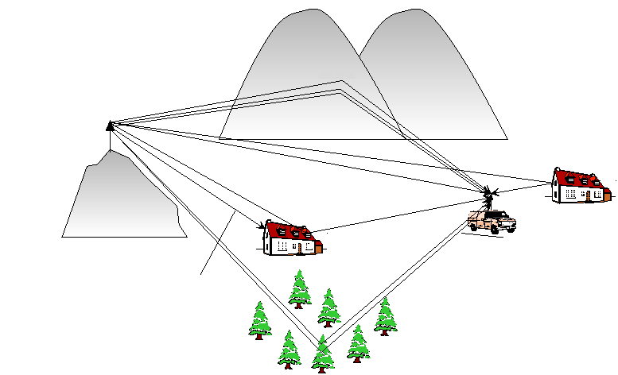
II. What Are Wireless Channels?
Wireless channels are the real environments in which the Tx and Rx are operating.
Scattering（散射）
Base station
Reflection（反射）
Line-of-sight path {LOS}
Diffraction
（衍射）
Mobile station
Shadowing
（阴影效应）
Scattering
（散射）

Slide 5

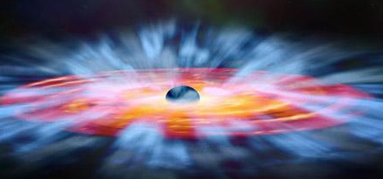
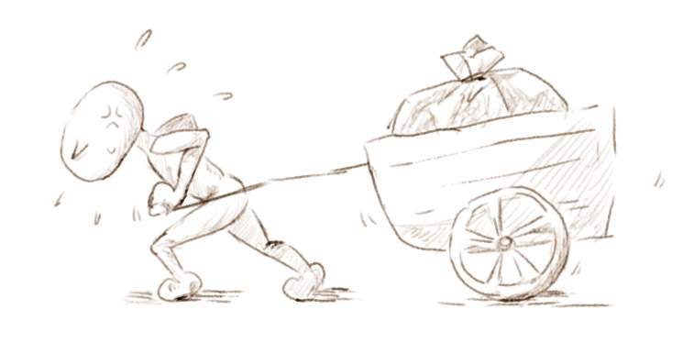
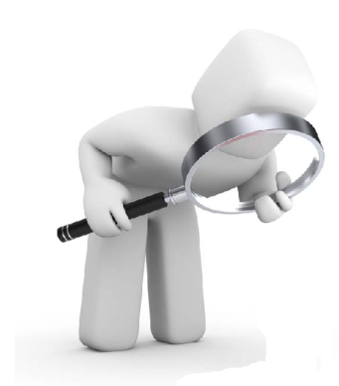


Common Problems
Space Selectivity
Path Loss
Small Scale Fading
Shadowing
Delay dispersion
Delay Spread
Coherent Bandwidth
Channel Impulse Response
Fast Fading Channel
Narrowband Channel
Coherent Time
Angle Dispersion
Doppler Dispersion
Draw a trolley without raising head to look the road.
Slow Fading Channel
Time Selectivity
Frequency Selectivity
Wideband Channel
Fail to see the forest for the trees.
Provide a unified and conceptually simple explanation of a morass of concepts for wireless channels！

Slide 6
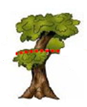
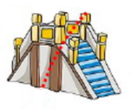
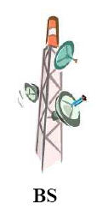

III. Three Phenomena in Wireless Channels
Fading: variation of the received signal power due to the environment, multipaths, and mobility.
Path Loss, P
Shadowing, S
Multipath Fading, h
Environment
Scattering（散射）
Power
Large Scale Fading
Small Scale Fading
Base station
Distance between the Tx and Rx
Multipaths
Reflection（反射）
Line-of-sight path {LOS}
Mobility
Diffraction
（衍射）
Mobile station
Shadowing
（阴影效应）
Scattering
（散射）

Slide 7
IV. Multipath Fading
Transmitter
(Tx)
Receiver
(Rx)
Wireless
Channel
Wireless Channel
Signal System
Wireless System
(Linear TV system)
c_{n}: amplitude of the nth propagation path.
time delay of the nth propagation.
phase of the nth propagation.
TV: time-varying
TV channel impulse response
(system function):
Time-invariant

Slide 8
Channel Impulse Response
Assumption: The distance between the BS and the MS is sufficiently large so that the radio propagation environment can be modeled as two-dimensional (2-D).
Scatterers
Tx
Rx
Rx
Moved Rx:
Fixed Rx:
(multiple antennas)
c : speed of light
Multipath
Motion of the Rx
Maximum Doppler frequency
Multiple antennas

Slide 9

Duality of Wireless Channels
Duality: to express the same phenomena in different domains.
Time domain,
Doppler domain,
Frequency domain,
8 system functions
Delay domain,
Space domain,
Angle domain,
Properly utilize the concept of duality may help understand some puzzles！
Fourier Transform

Slide 10
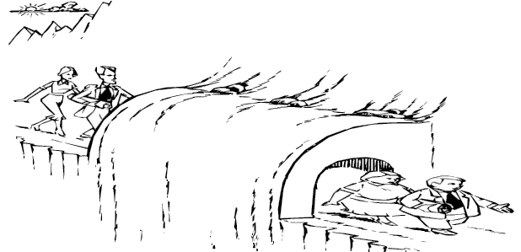
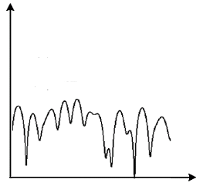
Dispersion and Seclectivity of Wireless Channels
Dispersion: spread effect of wireless channels, which means that wireless channels spread the transmitted signal in a certain domain.
Selectivity: wireless channel changes over a certain domain.
Time domain,
Doppler domain,
Frequency domain,
Delay domain,
Space domain,
Angle domain,
Duality
Dispersion
Selectivity
Fourier Transform

Slide 11
Delay Dispersion
Symbol duration, T_{s}
Scatterers
Symbol duration
Symbol duration
Tx
Rx
Delay spread
Delay dispersion: multipaths with different time delays lead to the spread of the transmitted signal.
Measured by delay spread, De_{s}, .
Impulse response:
T_{s} > De_{s}
No inter-symbol interference (ISI)
Narrowband (frequency non-selective) channels
T_{s} <= De_{s}
Inter-symbol interference (ISI)
Wideband (frequency selective) channels

Slide 12

Frequency Seclectivity
Fourier transform
Impulse response
Transfer function
Frequency selectivity: channel changes over frequency.
Measured by coherence bandwidth, C_{B} : the bandwidth over which channels express similar characteristic.
Symbol duration, T_{s}
C_{B}
B_{s}
C_{B}
B_{s} < C_{B}
Narrowband (flat fading/frequency non-selective) channels
B_{s} >= C_{B}
Wideband (frequency selective) channels

Slide 13

Delay Dispersion-Frequency Selectivy Duality
Transfer function
C_{B}
FD
Fluctuation
FD: frequency domain
DD: Delay domain
DD
FD
Reciprocal
De_{s}
C_{B}
A wireless channel with higher De_{s} (lower C_{B}) is easier to be a wideband channel.
A wireless system with higher transmission rate (higher signal wideband) is easier to incur wideband channels.
De_{s}

Slide 14

Time Selectivity
Symbol duration, T_{s}
Scatterers
Time domain,
Doppler domain,
Tx
Rx
Rx
Frequency domain,
Delay domain,
Space domain,
Time selectivity: channel changes over time.
Measured by coherence time, C_{T} : the time period over which channels express similar characteristic.
Angle domain,
Duality
C_{T}
Selectivity
Dispersion
Time variant function:
Fourier Transform
T_{s} < C_{T}
Slow fading channels
T_{s} >= C_{T}
Fast fading (time-selective) channels

Slide 15
Doppler Dispersion
Scatterers
Rx
Doppler spread
B_{s}
Tx
Doppler dispersion: the motion of the Rx results in a broadening of the transmitted signal spectrum.
Measured by Doppler spread, D_{s} , .
Inverse Fourier transform
B_{s} > D_{s}
Slow fading channels
B_{s} <= D_{s}
Fast fading (time-selective) channels

Slide 16

Doppler Dispersion-Time Selectivy Duality
Time variant function
C_{T}
TD
Fluctuation
TD: time domain
DD: Doppler domain
DD
TD
Reciprocal
D_{s}
C_{T}
A wireless channel with higher D_{s} (lower C_{T}) is easier to be a fast fading channel.
A wireless system with higher transmission rate (higher signal wideband) is easier to incur slow fading channels.
D_{s}

Slide 17

Space Selectivity
Scatterers
Tx
Time domain,
Rx
Doppler domain,
Frequency domain,
Delay domain,
Space selectivity: channel changes over locations.
Measured by coherence distance, C_{S} : the distance over which channels express similar characteristic.
Space domain,
Angle domain,
C_{S}
Duality
Dispersion
Selectivity
Space variant function:
Fourier Transform
Space separation between any two antennas in a multiple antenna array: S_{s}
S_{s} < C_{S}
Spatial correlated channels
S_{s} >= C_{S}
Spatial uncorrelated channels

Slide 18
Angle Dispersion
Scatterers
angle spread
Tx
Angle dispersion: multiple antennas lead to the spread of the transmitted signal in angle domain.
Measured by angle spread, A_{s} , .
Angle dispersion also relates to the pattern of multiple antenna arrays!
Inverse Fourier transform

Slide 19
Angle Dispersion-Distance Selectivy Duality
Time variant function
C_{S}
SD
Fluctuation
SD: space domain
AD: Angle domain
AD
SD
Reciprocal
A_{s}
C_{S}
A wireless channel with higher A_{s} (lower C_{S}) is easier to be a spatial uncorrelated channel.
A multiple antenna wireless system with larger antenna spacing is easier to incur spatial uncorrelated channels.
A_{s}

Slide 20
V. Main Plot
Delay domain
Frequency domain
Path loss
Doppler domain
Time domain
Fading
Large-scale fading
(cell-cite plan)
Angle domain
Space domain
Shadowing
8 system functions
Small-scale fading
(system design)
Dispersion
Duality
Selectivity
Delay dispersion
Duality
Frequency selectivity
Doppler dispersion
Duality
Time selectivity
Angle dispersion
Duality
Space selectivity
Reciprocal
Reciprocal
Reciprocal
De_{s}
C_{B}
D_{s}
C_{T}
A_{s}
C_{S}
Reciprocal
Reciprocal
T_{s}
B_{s}
B_{s}
T_{s}
S_{s}
Narrowband channel
Slow fading channel
Spatial uncorrelated channel
Wideband channel
Fast fading channel
Spatial correlated channel

Slide 21
Thank you for your attention!

