Slide 1
DN / RESEARCH
BIOLOGICAL FORESIGHT
SOURCE → STATE → EXPERIMENT → REVIEW
Autonomous research
for biological
foresight
PAPERS
CLAIM GRAPH
Biological breakthroughs can create
unilateral power before defenses adapt.
AGENT SESSIONS
REVIEW
CODE + DATA
We connect the literature to executable
experiments and inspectable evidence.
Persistent evidence + bounded compute
DNHACKS 2026 / WORKING PRESENTATION
01
Notes:
TENTATIVE SCRIPT · 30 seconds
Biology is an underappreciated source of future unilateral power: a discovery can give one actor capabilities others have not anticipated. Reactive measures are inadequate when the capability itself is new. The national biotechnology commission describes the United States repeatedly playing catch-up. Our thesis is that scientists need systems that continuously connect published claims, formulate hypotheses and execute computational experiments. We are building that research engine, with a record of how every result was produced.
EVIDENCE / STATUS
Strategic thesis and product ambition. Native editable rendering shows papers, claim graph, recursive sessions, executable experiments and review feedback. It is a conceptual system diagram, not a measured run. No operational threat prediction or biological prevention result is claimed.
BEFORE PRESENTING / NEXT EDIT
Working product name; edit freely. The rest of this deck puts technical mechanisms and measurements in the main argument. Preserve future-direction status where the complete capability has not been demonstrated.
JUDGING CRITERIA
Problem & Real-World Impact (25); DTX strategic relevance
SOURCES
NSCEB final report, 2025, §1.3: https://www.biotech.senate.gov/final-report/chapters/chapter-1/section-3/ (accessed 2026-09-06)
NSCEB final report, 2025, §3.3: https://www.biotech.senate.gov/final-report/chapters/chapter-3/section-3/ (accessed 2026-09-06)
DTX Ventures · Vision: https://www.dtxventures.com/vision (accessed 2026-09-06)
Repository: ARCHITECTURE.md at da551e0cccfc1833830c71eabb52b78bfb100db5

Slide 2
DN / RESEARCH
EXPERIMENTAL FRAMING / WHY ANTICIPATORY RESEARCH
AI is accelerating biology. Defense needs a head start.
CAPABILITY
SAFEGUARDS
Up to 60%
198,000
above PhD baselines on selected
biology / chemistry questions
adversarial attempts still exposed
one high-risk vulnerability
AISI · open-ended QA benchmarks
Anthropic · Constitutional Classifiers++
“The United States tends to play catch-up after critical
technologies have already become mainstream.”
NSCEB
2025 · §1.3
DNHACKS 2026 / WORKING PRESENTATION
02
Notes:
TENTATIVE SCRIPT · 35 seconds
Biology is becoming more accessible as AI learns to reason about it and execute longer tasks. AISI reports models scoring up to sixty percent above expert baselines on selected biology and chemistry questions. Safeguards are improving, but extensive adversarial testing still uncovers vulnerabilities. That does not show that a novice can build a weapon; it shows why safeguards alone are an incomplete preparedness strategy. Our proposed role is anticipatory research: test consequential scientific questions and assemble traceable evidence before an emerging capability becomes a crisis.
EVIDENCE / STATUS
AISI report covers models released through October2025. Relative QA score improvement, not a 60-percentage-point gain, whole-scientist competence or measured weapons feasibility. Private biology/chemistry sets each contain over280 open-ended questions; expert absolute scores roughly40–50%. Anthropic reports over1700 cumulative red-team hours and198000 attempts, one high-risk vulnerability, no universal jailbreak discovered in that evaluation. It is not a misuse probability. NSCEB §3.3 calls for emerging-biotechnology foresight and early detection/characterization. The proposed project contribution is an investment/product thesis, not validated threat prediction. No operational threat generation or jailbreak method is included.
BEFORE PRESENTING / NEXT EDIT
Experimental second slide requested by the user. Keep benchmark and red-team scope in the spoken explanation. The current system supports scientific investigation; the anticipatory-defense use case still needs domain-led evaluation.
JUDGING CRITERIA
Problem & Real-World Impact (25); DTX relevance; Feasibility (25)
SOURCES
UK AISI, Frontier AI Trends Report; models through October 2025: https://www.aisi.gov.uk/frontier-ai-trends-report (accessed 2026-09-06)
Anthropic, Constitutional Classifiers++: https://www.anthropic.com/research/next-generation-constitutional-classifiers (accessed 2026-09-06)
NSCEB final report, 2025, §1.3: https://www.biotech.senate.gov/final-report/chapters/chapter-1/section-3/ (accessed 2026-09-06)
NSCEB final report, 2025, §3.3: https://www.biotech.senate.gov/final-report/chapters/chapter-3/section-3/ (accessed 2026-09-06)

Slide 3
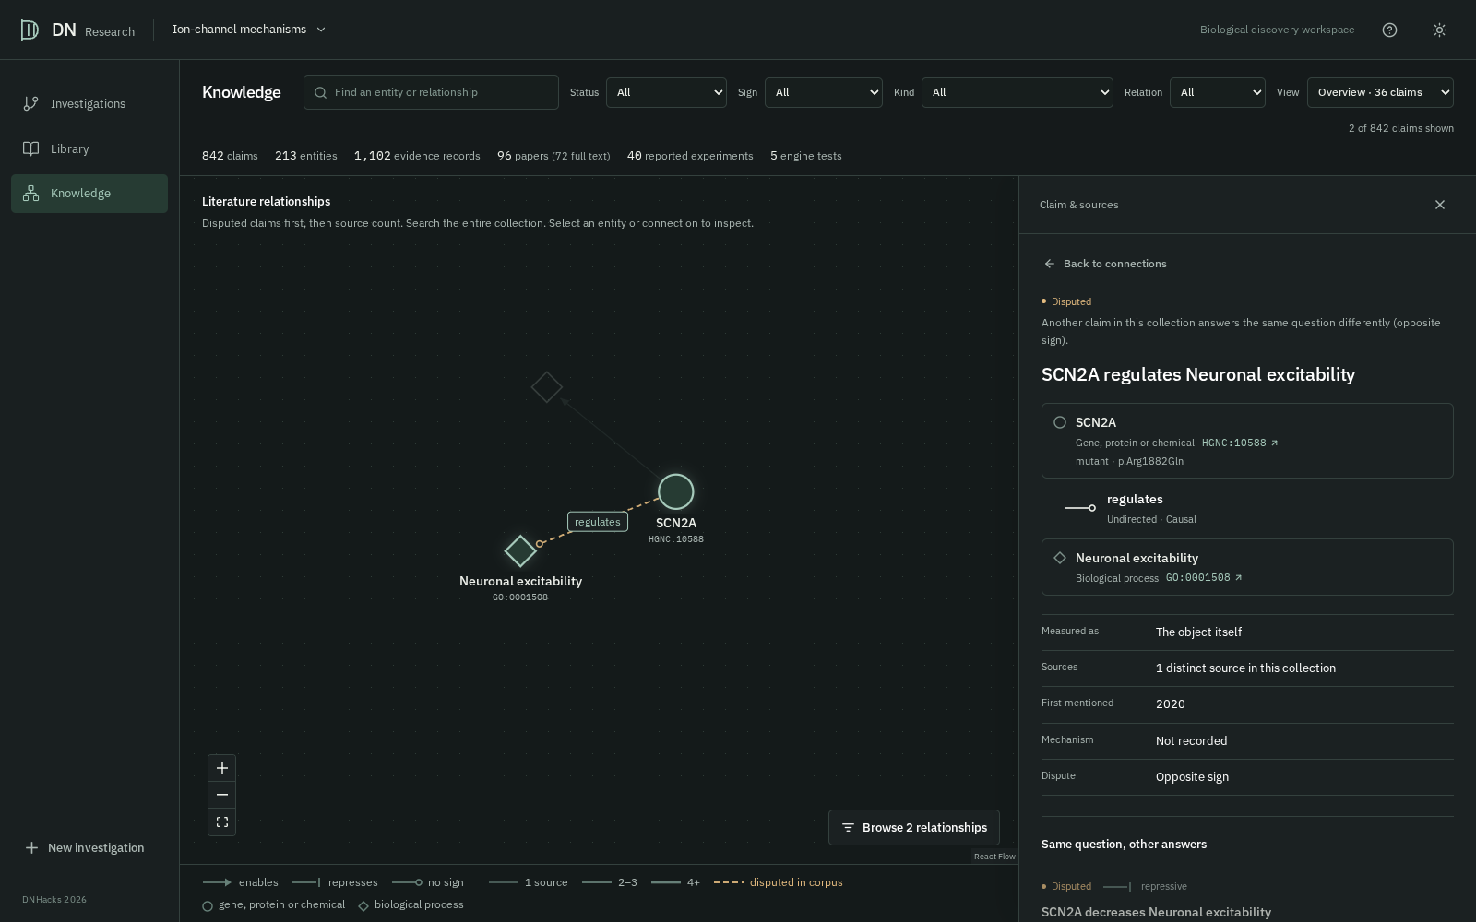
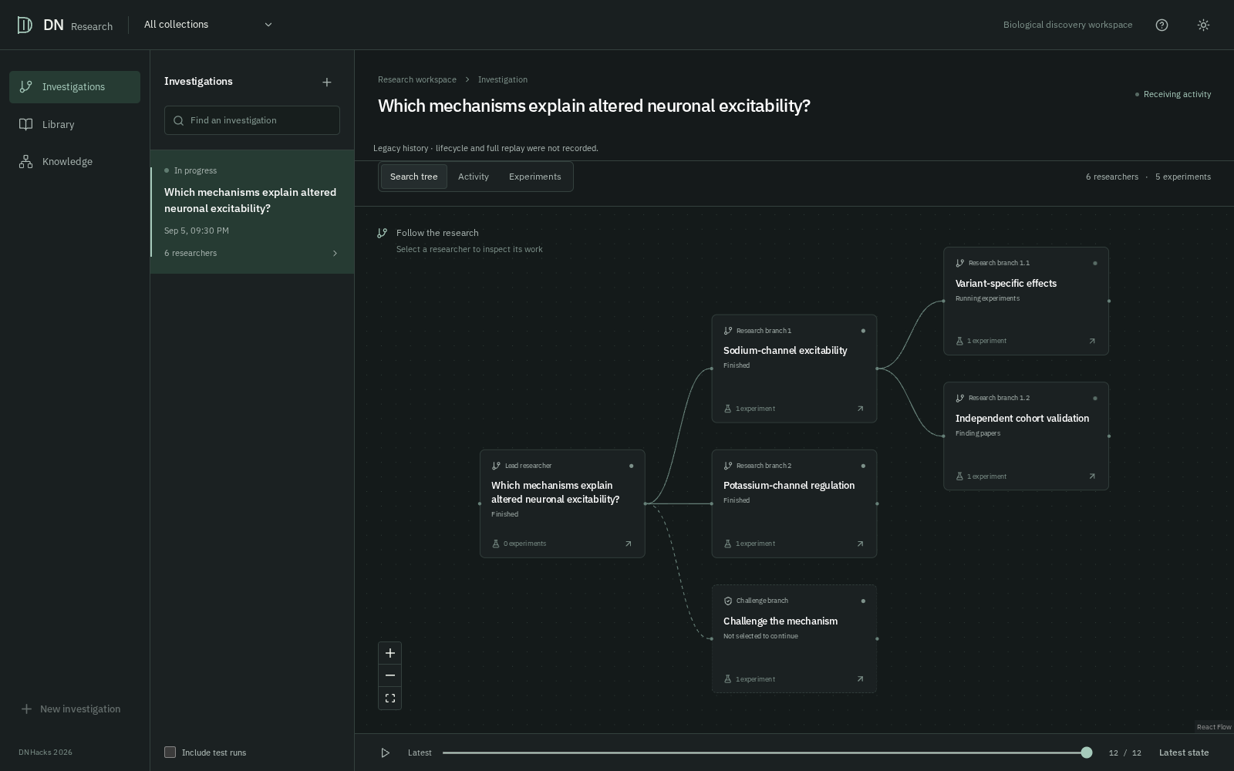
DN / RESEARCH
SOURCE-GROUNDED RECURSIVE RESEARCH
A claim graph drives a persistent tree of experiments.
Ingest → grounded graph
→
Recursive agent sessions
→
Acceptance + review
HGNC / ChEBI / MONDO → canonical IDs
One action → execution → observation
Typed checks / artifacts / human decision
WORKING WEBSITE · SAMPLE DATA
Knowledge: canonical identity, context and source inspection
Investigation: branches, activity and experiment replay
18 actions / checkpoint · 2,880 actions / shared tree · atomic grants survive restart
DNHACKS 2026 / WORKING PRESENTATION
03
Notes:
TENTATIVE SCRIPT · 40 seconds
The graph stores typed biological claims, resolved entity identifiers, context and source quotations. A resumable agent searches that graph and its papers, proposes hypotheses, writes analysis code and observes the result. It can fork a question into child sessions. Every eighteen research actions it reports to a parent controller, which continues, forks or prunes the branch. All descendants share a frozen budget; transactional grants and recorded decisions survive restart. The scientist sees the same provenance chain in the website, from a literature relationship to the branch and its experimental artifacts.
EVIDENCE / STATUS
Implemented extraction, grounding, claim/evidence storage, recursive sessions, controller and runtime journal. The two images are actual current React UI captures at a054f1b with synthetic test data, not a measured six-agent investigation. Claim confidence counts distinct source papers, not independently deduplicated experiments. The controller has no measured equal-budget discovery advantage. Ordinary falsifier screens reported fields/flags, not an independent rerun of arbitrary code; human review records a decision.
BEFORE PRESENTING / NEXT EDIT
Replace both screenshots with the final corpus and selected investigation. Current sample data is marked on slide. For deeper questions: Opus extraction, separate Sonnet direction/repair sessions, closed-vocabulary grounding, DuckDB evidence and SQLite controller; the current executor uses host Python subprocesses, recorded submitted/executed code, scoped working paths and owned-process cancellation. This is not OS isolation; separate-account security remains deployment work.
JUDGING CRITERIA
Technical Execution (50); AI Novelty (25); AI Sophistication (50); UX (40); Understanding User (30)
SOURCES
Repository: ARCHITECTURE.md at da551e0cccfc1833830c71eabb52b78bfb100db5
Repository: docs/claim-repair.md at da551e0cccfc1833830c71eabb52b78bfb100db5
Repository: docs/runtime.md at da551e0cccfc1833830c71eabb52b78bfb100db5
Repository: src/dnhacksbio/explorer/control.py at da551e0cccfc1833830c71eabb52b78bfb100db5
Repository: presentation/assets/revision/manifest.json at da551e0cccfc1833830c71eabb52b78bfb100db5

Slide 4
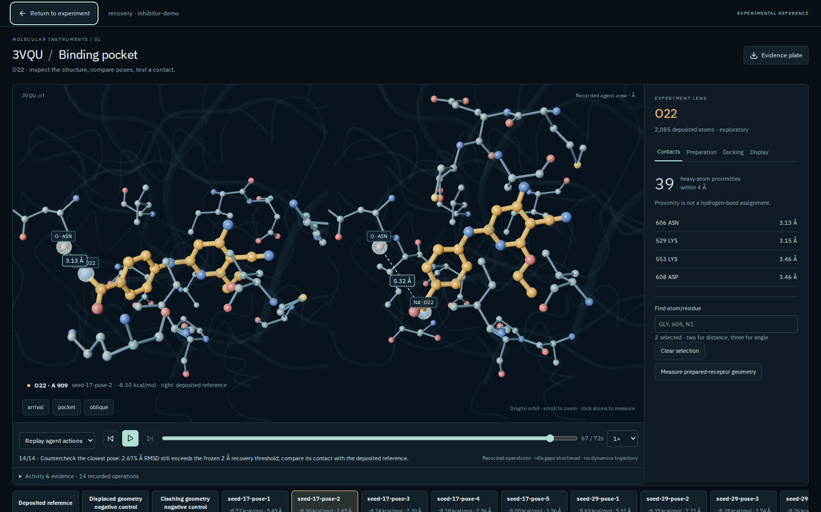
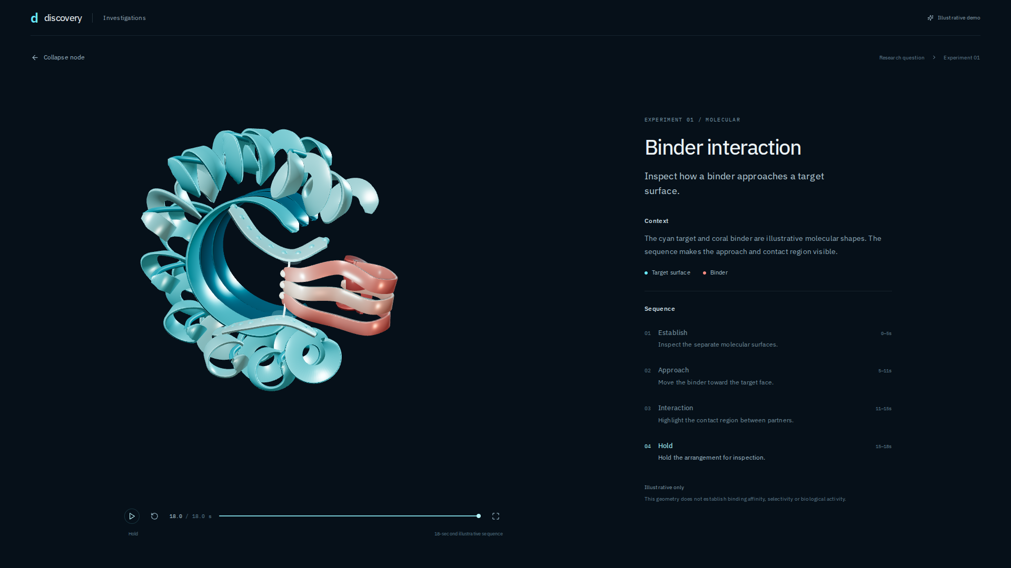
DN / RESEARCH
EXECUTABLE SCIENTIFIC INSTRUMENTS / GROUNDING
Images become evidence when checked against coordinates.
RECORDED TOOL RUN
▶ OPEN VIDEO
23 seconds
Auto-plays in Slide Show · MP4 in delivery folder
Binder cinematic: illustrative geometry
MEASURED CONTROL
Docking → image review → coordinate countercheck
2.675 Å RMSD / required ≤2 Å
DNHACKS 2026 / WORKING PRESENTATION
04
Notes:
TENTATIVE SCRIPT · 45 seconds
These are scientific instruments the agent can operate, not just images returned by a chatbot. We ran three docking seeds. The agent inspected the paired molecular images and counterchecked the same contact using canonical coordinates. The selected contact was 3.132 versus 5.324 angstroms, but the whole-pose recovery error was 2.675 against a two-angstrom requirement. That control failed, and the failure stays in the record. The toolkit also includes PhysiCell and BioFVM tissue simulation, Cytosim spindle mechanics and binder-interface inspection. The short binder movie illustrates the website interaction; it is not a new molecular result.
EVIDENCE / STATUS
Actual 3VQU/O22 workbench and recorded agent countercheck. Three-seed recovery criterion is RMSD ≤2 Å; proximity does not establish efficacy. The 23.44-second H.264 movie is the authored binder node-reveal browser capture with illustrative geometry. Tissue and spindle are conditional, uncalibrated simulations. Binder interface exists; no BindCraft inference pilot is claimed. Native movie start condition is delay=0; PowerPoint playback still needs local rehearsal.
BEFORE PRESENTING / NEXT EDIT
Play the deck in Slide Show mode: this movie is configured to start when the slide opens. The green button opens the adjacent binder-reveal.mp4 in the extracted delivery folder; the same clip was sent separately to Telegram. A PDF or Telegram document preview cannot play embedded PowerPoint media. Swap the cinematic for a final recorded real investigation when available.
JUDGING CRITERIA
Technical Execution (50); AI Sophistication (50); Design Craft (30); Usability (40); AI Reliability (25)
SOURCES
Repository: docs/inhibitor-review/README.md at da551e0cccfc1833830c71eabb52b78bfb100db5
Repository: docs/inhibitor-review/agent-countercheck.json at da551e0cccfc1833830c71eabb52b78bfb100db5
Repository: docs/tumor-stroma.md at da551e0cccfc1833830c71eabb52b78bfb100db5
Repository: docs/spindle-simulator.md at da551e0cccfc1833830c71eabb52b78bfb100db5
Repository: docs/binder-design.md at da551e0cccfc1833830c71eabb52b78bfb100db5
Repository: docs/demo-cinematics.md at da551e0cccfc1833830c71eabb52b78bfb100db5

Slide 5
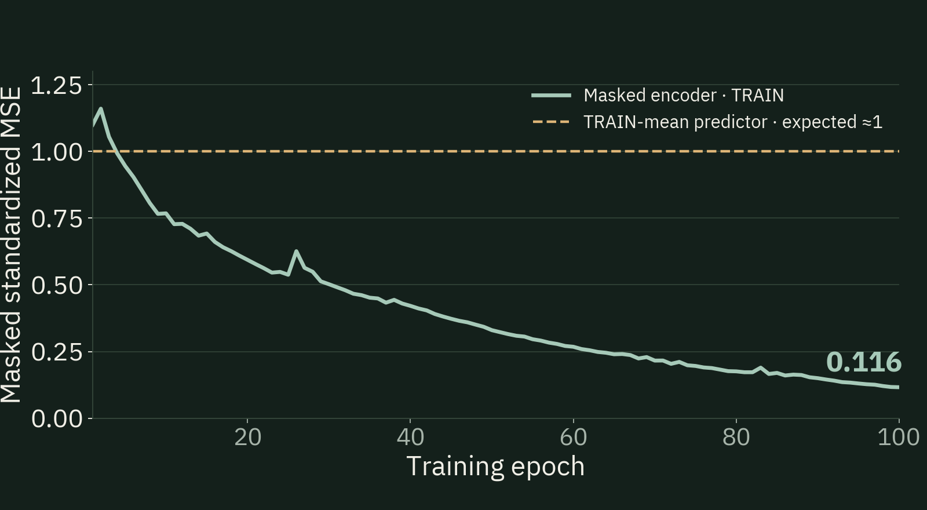
DN / RESEARCH
TRAINING OBJECTIVE / MEASURED GPU WORK
Learn structure by reconstructing genes we deliberately hide.
19,000 genes → 512 hidden → 128 latent features
Denoising objective: Vincent et al. · JMLR 2010 / GSE212041 cohort
THE OBJECTIVE
L = mean (x̂ᵢ − xᵢ)², i ∈ masked genes
Hide 15% of inputs; score only their reconstruction.
The encoder must use relationships among genes.
149 TRAIN / 74 DEV / 151 EVAL
L40S · 100 epochs · 3.41s fit
TRAIN loss 0.116 vs ≈1 for the mean predictor. Generalization is tested on the next slide.
DNHACKS 2026 / WORKING PRESENTATION
05
Notes:
TENTATIVE SCRIPT · 40 seconds
We train a representation before collecting evidence. Each gene is standardized using training donors only. We hide fifteen percent of the inputs and minimize squared error on those hidden entries, so simply copying the input cannot solve the task. This is the denoising-autoencoder principle. A predictor that always returns the training mean has expected standardized error around one; the recorded training loss ends at point-one-one-six. This is a fit diagnostic, not proof of generalization. We froze that encoder and evaluated it on fresh donors. The recorded hundred-epoch fit ran on an L40S GPU in three-point-four-one seconds.
EVIDENCE / STATUS
Implemented loss in expr_encoder.py: (decoder(encoder(damaged))-target)[mask].square().mean(). Each nonconstant gene has TRAIN empirical variance1 after log1p(TPM) standardization. Returning its TRAIN mean corresponds to zero and gives expected uniformly masked MSE approximately1. This analytically defined reference is not a new empirical baseline run, held-out score or random-network measurement. Final recorded TRAIN masked MSE0.1161042408. A changing random mask and minibatch weight updates are part of the logged curve. No per-epoch held-out loss exists. MSE is appropriate to standardized continuous reconstruction; low TRAIN MSE does not establish biological usefulness. Denoising rationale follows Vincent et al.2010; this architecture is our small cohort-specific implementation, not their benchmark replication. GPU metadata: L40S/CUDA12.8/Torch2.10.0, float32, fixed seed20260905,100epochs,Adam.001, batch64. Timing covers the fit call plus CUDA synchronization; excludes file serialization, data loading/download and provisioning; it is not a discovery runtime or CPU speedup. The small float64 bettor device check actually ran faster on CPU than CUDA. No GPU rediscovery run is attributed to these records.
BEFORE PRESENTING / NEXT EDIT
Keep the TRAIN label and analytical-baseline label. Data source: GSE212041 observational D0 cohort,374donors. Fixed149/74/151split; top19000variance genes, means/scales and representation fitted onTRAIN only. Training is distinct from branch-monitor fitting, which remains future work.
JUDGING CRITERIA
AI Technical Sophistication (50); Technical Execution (50); AI Reliability (25)
SOURCES
Vincent et al., Stacked Denoising Autoencoders, JMLR 2010: https://www.jmlr.org/papers/v11/vincent10a.html (accessed 2026-09-06)
Repository: src/dnhacksbio/expr_encoder.py at da551e0cccfc1833830c71eabb52b78bfb100db5
Repository: research/learned-evalue-validation/real-expression/training.json at da551e0cccfc1833830c71eabb52b78bfb100db5
Repository: research/learned-evalue-validation/real-expression/device-benchmark.json at da551e0cccfc1833830c71eabb52b78bfb100db5
Repository: presentation/assets/revision/plots/manifest.json at da551e0cccfc1833830c71eabb52b78bfb100db5

Slide 6
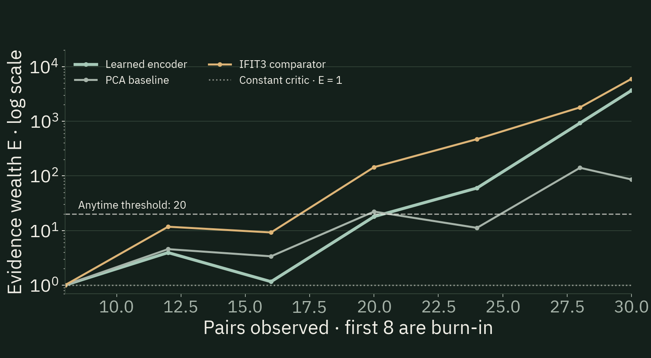
DN / RESEARCH
TECHNICAL PROOF / LEARNED BIOLOGICAL EVIDENCE
Evidence must grow on data the model has never seen.
Train on the past → bet on a fresh pair → accumulate evidence
Pandeva et al. · AISTATS 2024 / DAVT adaptation
Lbet = −mean log q q = 1 + tanh(d)
FINAL E: LEARNED 3,653 / PCA 86 / IFIT3 5,964
d = clip(g(x) − g(y), −4, 4)
Eₜ = Eₜ₋₁ × qₜ
Under the registered null, swapping x and y
makes the bet fair. Arbitrary scores cannot
claim that guarantee.
112 / 10,000 null runs ever crossed E ≥ 20 · 5% anytime error budget under stated assumptions
DNHACKS 2026 / WORKING PRESENTATION
06
Notes:
TENTATIVE SCRIPT · 50 seconds
We do not ask an LLM to invent a confidence score. The network minimizes negative log payoff on past pairs, then bets on a fresh pair. Under the registered null, swapping the two inputs changes the sign and makes the bet conditionally fair. That gives a five-percent bound on ever crossing twenty, even if we inspect every batch. A constant critic stays at one: no information, no evidence growth. Our learned representation finished at 3,653 against PCA's 86; the stronger single-gene comparator stays in the plot. A separate synthetic audit had 112 crossings in 10,000 runs. Better prediction can increase power; the sampling contract and arithmetic determine validity.
EVIDENCE / STATUS
IMPLEMENTED, MEASURED COMPONENT DIAGNOSTIC; not a verified biological discovery.
METHOD / ATTRIBUTION: Pandeva et al., Deep anytime-valid hypothesis testing, AISTATS 2024, https://proceedings.mlr.press/v238/pandeva24a.html. This is an adapted two-sample DAVT diagnostic with a frozen expression representation; it is not our new theorem and not the research-trajectory E-valuator method or native four-term association kernel. For pair t, d_t = clip(f_t(x_t)-f_t(y_t), -4,4), q_t = 1+tanh(d_t), E_t = product of scored q_i. f_t is trained/selected using past pairs only. Under equal independent group distributions and a predictable learner, exchangeability makes the conditional factor expectation one. At alpha=.05 the anytime threshold is 20. Code computes log(2)-softplus(-2d), adds log factors, and returns final wealth; a running maximum is a separate diagnostic, not the returned e-value.
DATA / TRAINING: GSE212041 neutrophil TPM, COVID-positive versus symptomatic negative, one D0 sample per donor; healthy controls and later/event-driven draws excluded. 374 donors: TRAIN149 (119+/30-), DEV74, EVAL151 (121+/30-). Fixed stratified split. Top19,000 genes selected by TRAIN-only log1p(TPM) variance; frozen TRAIN means/scales. Masked autoencoder19,000→512→128 with mirrored decoder, 15% masking, Adam lr=.001, 100 epochs, seed20260905, NVIDIA L40S float32. DEV was available for device timing, not model/feature/epoch selection. Slide 5 shows the committed TRAIN masked reconstruction MSE series; no per-epoch held-out validation curve was recorded. PCA uses64 components, so the representations do not have matched dimensionality.
FRESH-PAIR SCORING: Primary predeclared seed20260906 uses30 selected disjoint pairs; 91 positive EVAL donors are unused. These are group-comparison pairs, not clinically matched patients. Batch size4: first8 pairs are unscored training/validation burn-in; 22 pairs are scored in six batches, last partial. The64/64 ReLU bettor fits older batches, validates on the latest past batch, and scores unseen rows before reuse; Adam lr=.0005, weight_decay=.01, max100 epochs/update, patience10. Representation and preprocessing never train on DEV/EVAL. Final e-values3652.81 learned,85.76 PCA,5964.41 predeclared IFIT3 scalar; calibrated permutation final e99 (p=.0001), not shown in this figure. IFIT3 is stronger here. These are evidence statistics, not accuracy, effect size, clinical utility or power. Ten order/subsample sensitivities reuse donors; they are not independent power trials. Observational recruitment, severity, treatment and cell composition can explain a distribution difference; no causal or PDAC therapeutic inference is claimed.
NULL AUDIT:112/10,000 ever-crossings =1.12%, pointwise95% Wilson CI0.93–1.35%; 20/10,000 final rejections =.20%. This is the separately trained small synthetic autoencoder benchmark,96 pairs/run, not the19,000-gene RNA encoder, product-wide error rate or branch-monitor calibration. Regression tests separately enumerate all64 orientations of six fixed unordered pairs and audit fit/score separation.
ADDITIONAL TRAINED TOOL / PROTEIN: donor-disjoint CPTAC TRAIN219, LUAD VAL110, PDAC DEV105; 2,000-protein panel; masked denoiser4,000→256→32→2,000 with20% masking. Held-out reconstruction MSE: training mean2.9318, PCA1.8243, denoiser2.1067. These are final reconstruction metrics; no epoch curve was retained. External Fudan 224 graded tumors: primary rank-PCA AUROC.55249, secondary rank-kernel.69376, not independent sequential confirmation. The frozen rank kernel did not meet the modeled targeted-effect power requirement; fixed-module simulation results are separate. Actual protein plots remain at presentation/assets/v2/plots/protein.png and external_protein.png for manual slide editing.
ADDITIONAL INTERNAL EVIDENCE CORE: native association scoring uses a distinct four-term matched/crossed two-donor factor, 1+stake*(c11+c22-c12-c21)/4, with bounded critic scores and frozen stake. Under its registered independent sampling null, the factor has conditional expectation one. The private ledger atomically commits donor consumption, factor, cursor and critic state; exact retries cannot accrue evidence twice. Adapters still require audited sampling/access/measurement and prospective power. This is not the RNA DAVT construction pictured above.
STATUS: Biological two-sample diagnostic and its public-input replay guards are implemented. Branch-monitor prefix scoring/grouped calibration infrastructure exists; real research-trajectory fitting and calibration remain pending. This slide does not claim a validated branch-stopping policy, private clinical confirmation, independent falsifier recomputation, or completed literature-to-discovery recovery.
BEFORE PRESENTING / NEXT EDIT
Preserve every predeclared representation comparator. The constant critic g=0 is an analytical no-information baseline with E=1, not an empirical random-number experiment. Never equate an e-value with accuracy, clinical utility or probability that a claim is true. The 112/10,000 crossing audit uses the separate small synthetic encoder. Unlike a fixed confidence number, this score has a conditional expectation bound; arbitrary LLM numbers do not. Better fitting cannot rescue dependence, leakage or a wrong null. Do not transfer the diagnostic to branch-monitor calibration, which remains pending.
JUDGING CRITERIA
Main Technical Execution (50); AI Technical Sophistication (50); AI Reliability/Evaluation/Trustworthiness (25); AI Importance (25)
SOURCES
Repository: src/dnhacksbio/learned_evalue.py at da551e0cccfc1833830c71eabb52b78bfb100db5
Repository: src/dnhacksbio/expr_encoder.py at da551e0cccfc1833830c71eabb52b78bfb100db5
Repository: docs/learned-evalue-process.md at da551e0cccfc1833830c71eabb52b78bfb100db5
Repository: research/learned-evalue-validation/real-expression/training.json at da551e0cccfc1833830c71eabb52b78bfb100db5
Repository: research/learned-evalue-validation/real-expression/evaluation.json at da551e0cccfc1833830c71eabb52b78bfb100db5
Repository: research/learned-evalue-validation/real-expression/manifest.json at da551e0cccfc1833830c71eabb52b78bfb100db5
Repository: research/learned-evalue-validation/expanded-null.json at da551e0cccfc1833830c71eabb52b78bfb100db5
Repository: tests/test_learned_evalue.py at da551e0cccfc1833830c71eabb52b78bfb100db5
Repository: docs/branch-monitoring.md at da551e0cccfc1833830c71eabb52b78bfb100db5
Repository: docs/native-evidence.md at da551e0cccfc1833830c71eabb52b78bfb100db5
Repository: docs/protein-training.md at da551e0cccfc1833830c71eabb52b78bfb100db5
Repository: docs/protein-external.md at da551e0cccfc1833830c71eabb52b78bfb100db5
Repository: docs/protein-model-power.md at da551e0cccfc1833830c71eabb52b78bfb100db5
Repository: presentation/assets/v2/plots/manifest.json at da551e0cccfc1833830c71eabb52b78bfb100db5

Slide 7
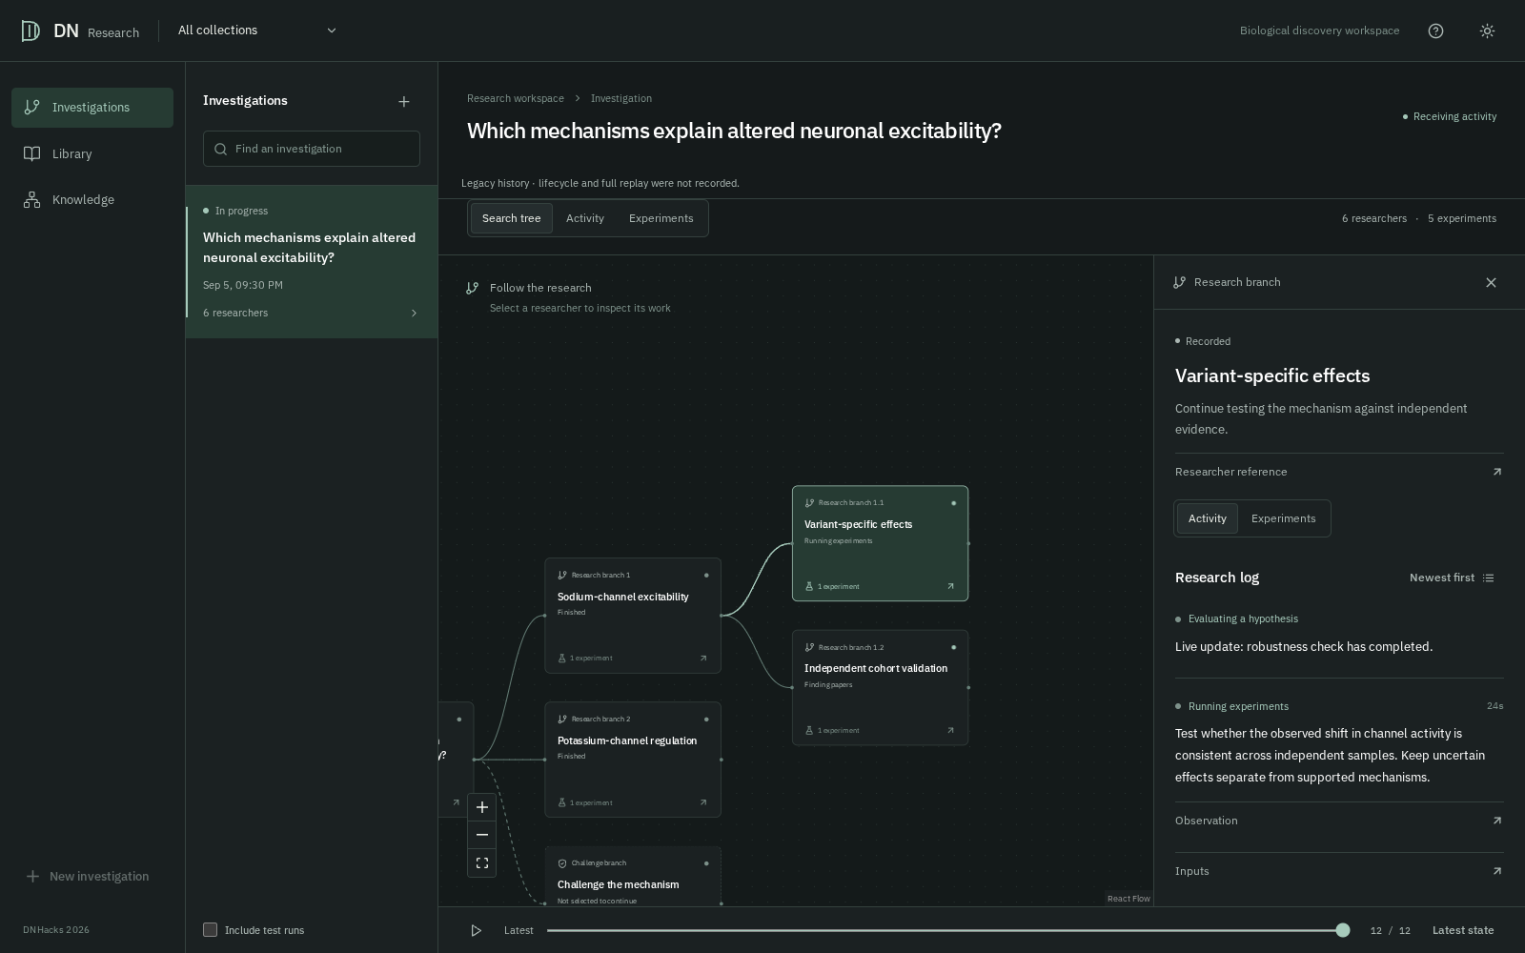
DN / RESEARCH
DISCOVERY DEMONSTRATION / EDITABLE SEQUENCE
Trace an investigation, then reveal the later discovery.
Source claim → untested bridge → executable analysis → result → checks → human review
WEBSITE PLACEHOLDER · SAMPLE RUN
RESEARCH ARTICLE / LATER PUBLICATION
[Paper title matching
this recovered finding]
[Publication date · DOI]
MATCHED FINDING
[The specific result shared with the candidate]
[Proposed → passed → reviewed] · [candidate + result]
DNHACKS 2026 / WORKING PRESENTATION
07
Notes:
TENTATIVE SCRIPT · 35 seconds
[Fill the bracketed run details before presenting.] Start with the source relationship in the website. Show the agent turning a gap into a question, then open its saved analysis and raw output. Show what the automatic checks accepted and the scientist reviewed. Of [proposed] candidates, [passed] reached review. Now click to reveal the later paper: this candidate matches [the exact finding]. Explain the shared result, not just overlapping keywords. The audience has seen the working loop first; on the next slide, show how its accessible evidence was frozen.
EVIDENCE / STATUS
User confirms demonstration records are on a teammate machine and authorizes inferred structure with placeholders. Counts, candidate, paper identity and exact match are not locally verified. The white paper mockup is native editable text/shapes, not an invented publication. Current left image is actual website UI with synthetic test data. The paper group has an800ms on-click fade; it is visible in PDF final state.
BEFORE PRESENTING / NEXT EDIT
Replace the left panel with a video or snapshots from the same selected run, and fill the actual survivors and paper. Show the full loop, then survivors, then click the paper reveal. Advance directly to slide 8. The user will manually edit this working deck.
JUDGING CRITERIA
Technical Originality/Execution (50); Problem & Impact (25); Reliability/Trustworthiness (25)
SOURCES
Repository: plans/PLAN-demo-slides.md at da551e0cccfc1833830c71eabb52b78bfb100db5
Repository: presentation/assets/revision/manifest.json at da551e0cccfc1833830c71eabb52b78bfb100db5

Slide 8
DN / RESEARCH
FROZEN EVIDENCE / IMMEDIATELY AFTER REVEAL
Backtest discovery against a recorded evidence cutoff.
CAPTURE PLACEHOLDER
FREEZE BEFORE EXECUTION
Library + source reader
[Run ID · cutoff · corpus / data hashes]
[Capture the actual accessible corpus]
[Open the source claim and quotation]
[Keep the excluded paper outside this view]
EXCLUDE AND AUDIT
Target paper withheld; retain retrieval and tool logs
RECORD COMPUTATION
[GPU task · device · time] + saved code / outputs
Next proof: sealed post-cutoff data and equal-budget comparisons against retrieval-only and unguided agents.
DNHACKS 2026 / WORKING PRESENTATION
08
Notes:
TENTATIVE SCRIPT · 35 seconds
Here is the backtest behind the reveal. Freeze the papers, data and access policy before starting, with the matching later paper held out. Run the ordinary research workflow and retain source references, submitted code, outputs and retrieval logs. Then compare the exact candidate finding with the held-out publication. GPU use belongs to a particular recorded model fit or scientific computation; fill that task and timing from the teammate run. Our locally documented L40S work trained the expression representation. The next stronger test uses sealed post-cutoff data and the same compute budget for a retrieval-only or unguided agent.
EVIDENCE / STATUS
Inferred demo structure authorized by the user; teammate records supply the placeholders. Curated local PDAC collection:100papers dated2007–2025 with inclusive2026-01-25curation boundary; this is not itself a run-access boundary. No actual Library/reader image or teammate recovery records are local. The independent L40S expression fit is supported by training.json; it must not be relabeled GPU-powered recovery. A frozen retrieval corpus cannot rule out pretrained model knowledge. A later matching paper does not by itself establish causality, novelty, or equal-budget discovery advantage. A real audit must check external retrieval and exact available data, including locally cached artifacts.
BEFORE PRESENTING / NEXT EDIT
Keep immediately after the paper-reveal slide. Fill every bracketed field from the selected run and exclusion audit. Replace the left native panel with an actual Library/source-reader screenshot. Do not turn a curation date into a claim about model memory or unrestricted retrieval.
JUDGING CRITERIA
AI Reliability/Evaluation (25); Technical Originality (50); UX/Understanding User (40/30)
SOURCES
Repository: demo/pdac/README.md at da551e0cccfc1833830c71eabb52b78bfb100db5
Repository: demo/pdac/papers.json at da551e0cccfc1833830c71eabb52b78bfb100db5
Repository: plans/PLAN-demo-slides.md at da551e0cccfc1833830c71eabb52b78bfb100db5

Slide 9
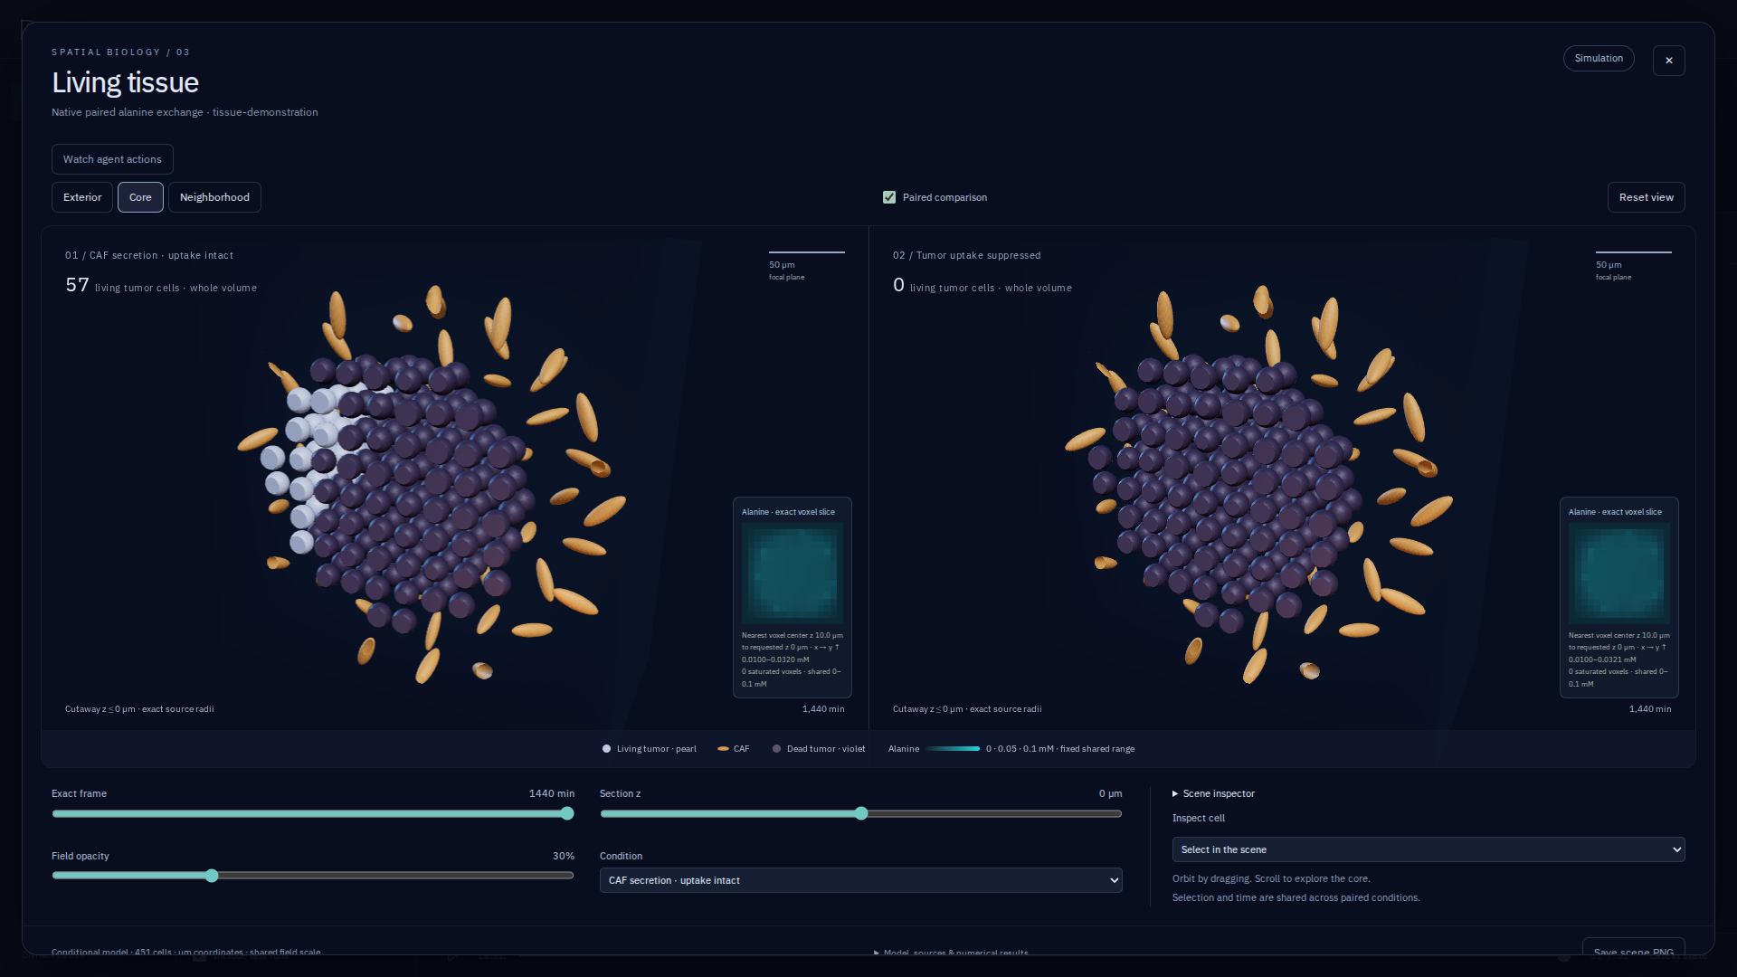
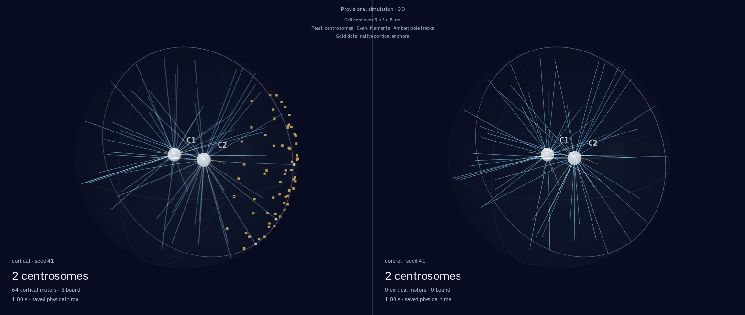
DN / RESEARCH
DEPLOYMENT / COMMERCIAL PROOF
Deploy first inside a computational research team.
USER
A research lead deciding what to test
with limited compute and reviewer time.
First integration
Approved corpus, data permissions, owned tool execution
Tissue: PhysiCell / BioFVM conditional simulation
Unit economics
All model + tool + review cost per rerunnable useful result
Adoption test
Review time, repeat use and paid expansion within the team
Spindle: Cytosim mechanics / corrected motor export
DNHACKS 2026 / WORKING PRESENTATION
09
Notes:
TENTATIVE SCRIPT · 30 seconds
The first customer is a computational research lead who already has questions, data and a limited experimental budget. Start in one private workspace and integrate with that team’s literature and analysis workflow. Measure independently rerunnable useful findings, total model and tool cost, and reviewer time. A subscription plus metered compute is a business model to test. The longer-term direction is an autonomous research organization: allocating experiments across scientific instruments, accumulating evidence and helping scientists anticipate consequential biological capabilities before they become widespread.
EVIDENCE / STATUS
Buyer and commercial model are hypotheses; no traction or pricing validation is claimed. Existing runtime records action/operation time and SDK usage; cost per useful discovery has not been measured. Research branch monitoring has prefix models/grouped calibration code but real-trajectory fitting remains pending. Separate-account deployment, execution permissions, data rights, privacy and security review remain deployment work. The tissue and spindle panels are actual conditional software outputs; biological calibration is not established.
BEFORE PRESENTING / NEXT EDIT
Add the team’s final ask and any measured pilot cost/user feedback. Future direction may be presented boldly; do not invent customers or effectiveness. Medical/clinical use would require additional validation and regulatory work. The active ecosystem/pharmacotype research routes were cancelled; these distinct 3D tools are not those routes.
JUDGING CRITERIA
Feasibility & Deployment (25); Understanding User (30); Design Craft (30); Problem & Impact (25)
SOURCES
Repository: docs/deployment.md at da551e0cccfc1833830c71eabb52b78bfb100db5
Repository: docs/runtime.md at da551e0cccfc1833830c71eabb52b78bfb100db5
Repository: docs/branch-monitoring.md at da551e0cccfc1833830c71eabb52b78bfb100db5
Repository: docs/tumor-stroma.md at da551e0cccfc1833830c71eabb52b78bfb100db5
Repository: docs/spindle-motors.md at da551e0cccfc1833830c71eabb52b78bfb100db5
DTX Ventures · Vision: https://www.dtxventures.com/vision (accessed 2026-09-06)

Slide 10
DN / RESEARCH
THREE-YEAR DIRECTION / INVESTMENT THESIS
Stronger models should produce more science per research budget.
YEAR 1 / 2027
YEAR 2 / 2028
YEAR 3 / 2029
A repeatable workflow
Allocation that learns
Continuous programs
Connect one team’s sources and tools.
Establish equal-budget baselines.
Train on completed trajectories.
Calibrate on independent episodes.
Coordinate supervised portfolios
as models and instruments improve.
Prove: rerunnable findings,
review time, cost and repeat use.
Prove: discovery yield under
a fixed budget; paid expansion.
Prove: retained customers,
useful output and scalable margins.
DNHACKS 2026 / WORKING PRESENTATION
10
Notes:
TENTATIVE SCRIPT · 35 seconds
Our three-year thesis is that model progress expands this system’s useful workload. Better extraction fills the grounded graph; better coding and instrument use expand what an investigation can execute. We keep the experimental records and evaluation contracts while changing the model. First prove a repeatable team workflow. Then train allocation on completed trajectories and demonstrate better results at the same budget. By year three, the optimistic product is continuous, supervised research programs. The company must earn its position through trusted integrations, accumulated evidence and customer retention, as stronger models become widely available.
EVIDENCE / STATUS
Explicit prospective milestones, not forecasts or delivered capabilities. Real branch-monitor fitting, calibration and operational statistical stopping are pending. Prospective independent episodes and careful handling of censored/pruned branches are required; related children are not independent calibration units. Better models can improve power or productivity but do not guarantee discovery yield. Permissioned sources, instrument integrations and accepted research histories are potential durable assets only if customers value them. No pricing, margin, revenue, retention or pilot uplift is fabricated. Three-year horizons are relative to the2026hackathon.
BEFORE PRESENTING / NEXT EDIT
Replace goals with measured pilot metrics as they become available. A useful VC dashboard records all-in cost per independently rerunnable useful result, expert review minutes, return usage, paid expansion, retention and integration time. Compare models/workflows at equal budgets and retain negative outcomes.
JUDGING CRITERIA
Feasibility & Deployment (25); Technical Originality (50); Problem & Impact (25)
SOURCES
Repository: docs/branch-monitoring.md at da551e0cccfc1833830c71eabb52b78bfb100db5
Repository: docs/deployment.md at da551e0cccfc1833830c71eabb52b78bfb100db5
Repository: docs/runtime.md at da551e0cccfc1833830c71eabb52b78bfb100db5
DTX Ventures · Vision: https://www.dtxventures.com/vision (accessed 2026-09-06)

