Slide 1

Advanced Workshop 2:
U-nets and ML pipelines

Slide 2
OVERVIEW
Computer Vision
U-Nets
Segmentation and Loss functions
Pipeline
A coded example

Slide 3
1. Computer vision: definition
“Computer vision is a field of artificial intelligence (AI) that enables computers and systems to derive meaningful information from digital images, videos and other visual inputs — and take actions or make recommendations based on that information.” – ibm.com

Slide 4
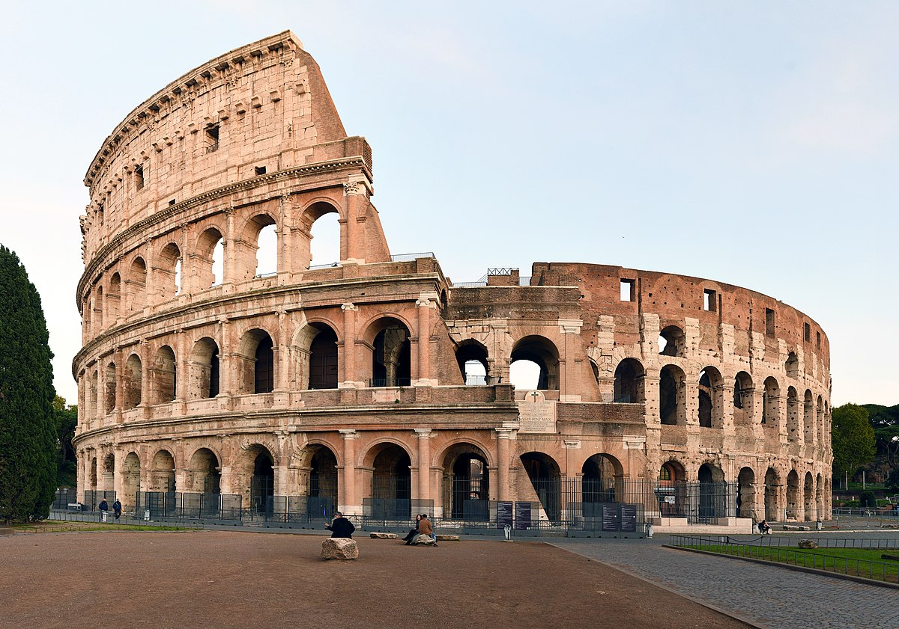
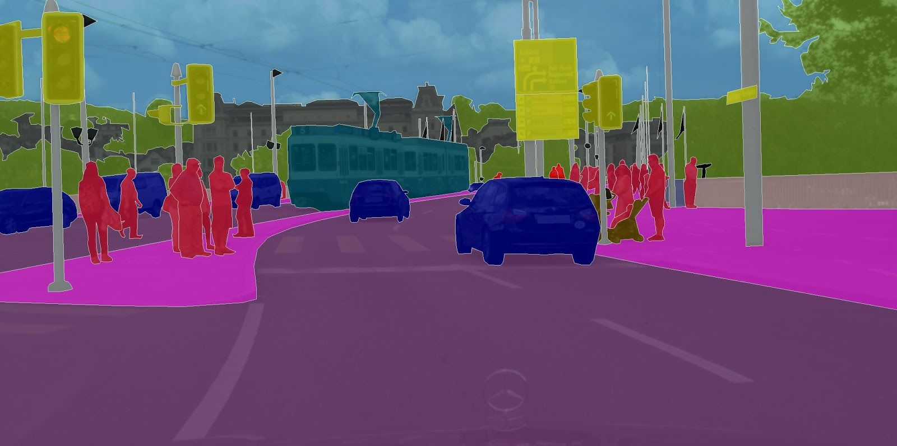
1. Computer vision: tasks
Discrete recognition (after feeding in an image)
Tell to which class a certain image belongs to
…
Semantic segmentation
Tell to which class (multiple) objects in an image belong to
Rome!

Slide 5
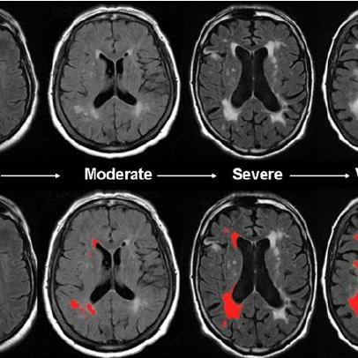
1. Computer vision: segmentation
Widely used in biomedical imaging
Case study:
Segmenting microlesions in the brain (White Matter Hyperintensities) through MRI images and U-nets
(my research topic last summer ☺)

Slide 6
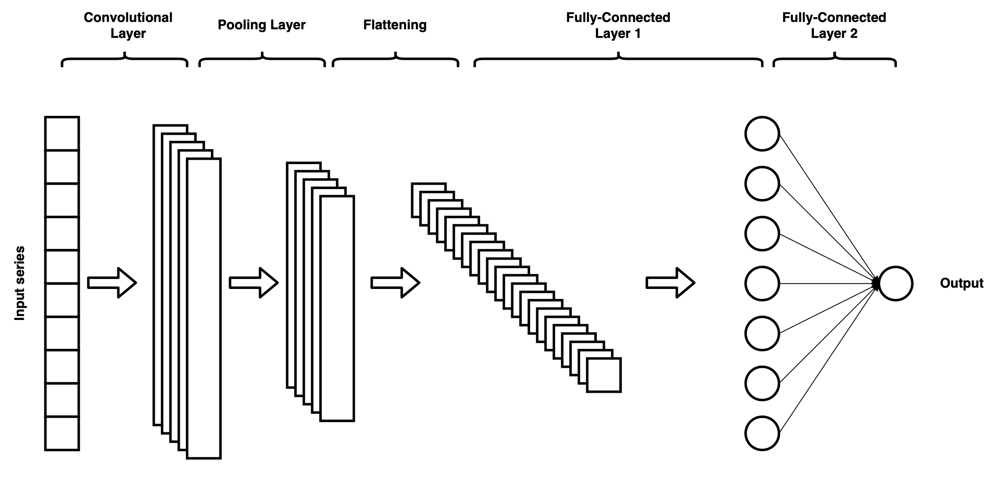
1. Computer vision: why not cnn?
CNNs extract information from the original image and reduce the feature space to make calculations feasible
Spatial information gets lost
Other structures to preserve both classification and localization?

Slide 7
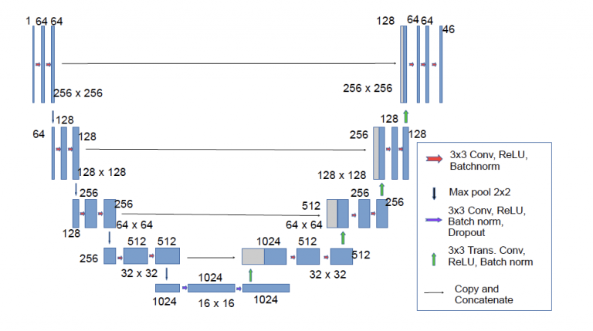
2. U-nets: architecture
filters
Img size
Valid convolutions
or upsampling

Slide 8
2. U-nets: architecture
What
- CNNs
- Donwsampling
Where -Input copying
-Upsampling

Slide 9
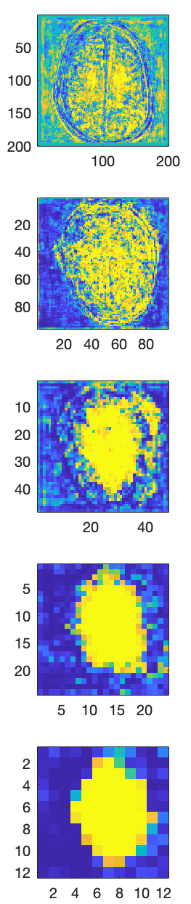
2. U-nets intermediate levels
Very early stages of the training
Highest level
Lowest level

Slide 10
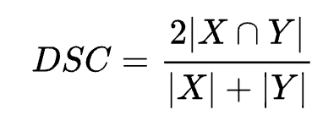
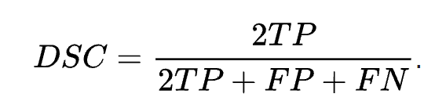
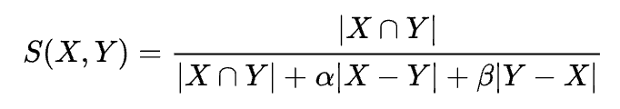
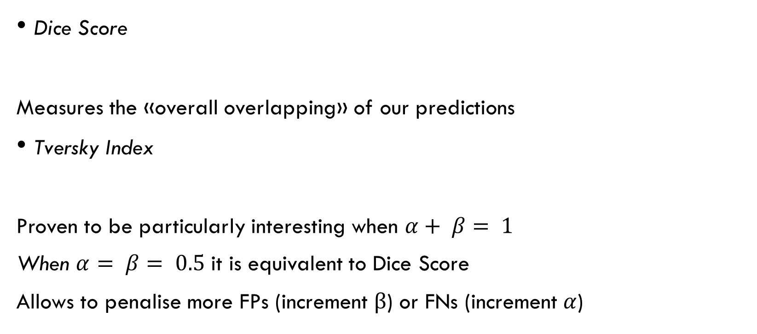
3. Segmentation and loss functions
Dice Score
Measures the «overall overlapping» of our predictions
Tversky Index
Proven to be particularly interesting when $α+ β= 1$
When $α= β= 0.5$ it is equivalent to Dice Score
Allows to penalise more FPs (increment $β$) or FNs (increment $α$)

Slide 11
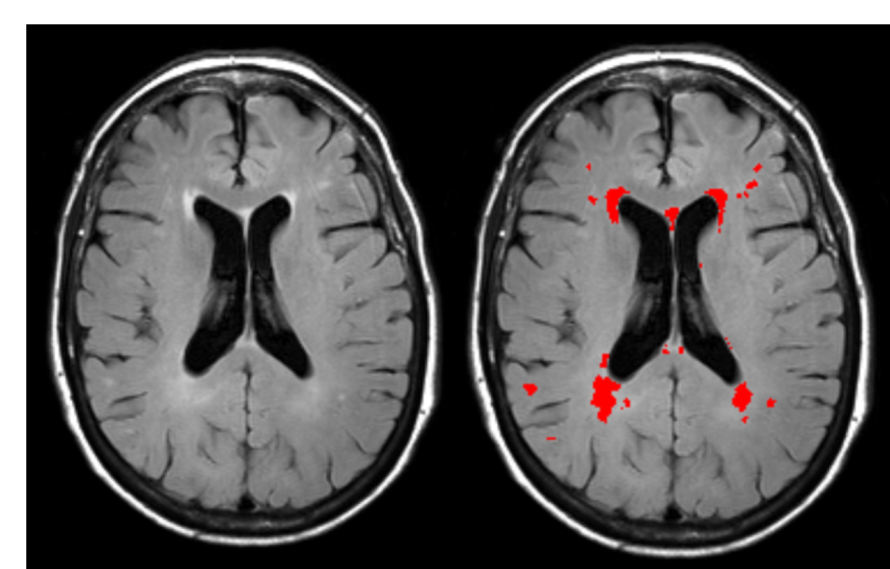
3. Segmentation and loss functions
A closer look into how training with DSC as loss function works:
Define the loss to be 1 – DSC (we want to minimise it)
Example: microlesion segmentation. Each image has a boolean mask, where a pixel is 0 if it is healthy, 1 if diseased. We try to predict the mask
Image and mask on top of it
Mask is just 1s on the red regions and rest 0, not an «image»
Image

Slide 12
3. Segmentation and loss functions
DSC compares our predicted mask with the actual one (the ground truth).
It measures how many positive pixels overlap (TPs)
It then divides this number by the number of wrong predictions made (FP and FN) and the right predictions made (so it stays between 0 and 1)

Slide 13
4. Pipeline: overall structure
1: Data acquisition
2: Data storage
3: Data augmentation
4: Training
5: Inference
6: Evaluation

Slide 14
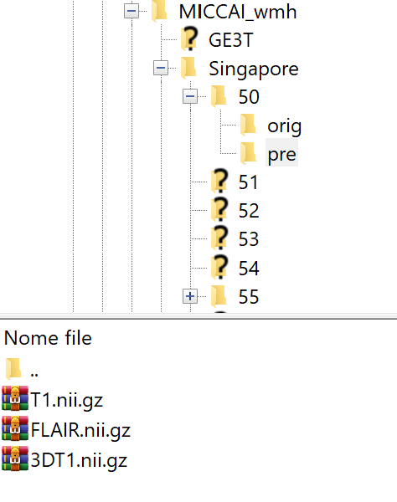
4.1 Pipeline: data acquisition
Data usually comes organised in folders
We want to select the files we are actually interested in and annotate their path in a csv file so that we can further manipulate them later

Slide 15
4.2 Pipeline: data storage
Now that we know each file location, we can:
Open the file and load it in every time we need it (computationally expensive)
Create a file with the relevant data stored in (hdf5 file)
We can add some processing to the data
Normalise the values
Extract patches if we’re doing a patch based approach
Perform data augmentation

Slide 16
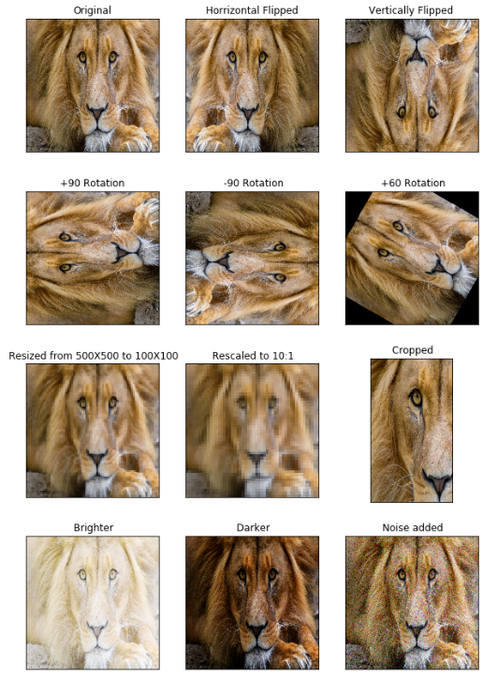
4.3 pipeline: data augmentation
Data augmentation is the process of creating additional synthetic data to:
Enlarge our data set
Make the model translational resistent
Make the model rotational resistent
Not all of them are useful in each task

Slide 17
4.3 pipeline: data augmentation
Data augmentation can be:
Static:
Apply augmentation and save the augmented data with the original data (like in hdf5 file)
Problem: data set too large and data set’s length is now fixed
On-the-fly:
Apply augmentation on the batches just before they get passed through the network for training
Augmented data gets discarded after use and always use different (randomly chosen) parameters for the augmentation (e.g. angle of rotation)
In Keras it’s usually done by creating a «Data Generator» (built-in) and overriding its __get_data method

Slide 18
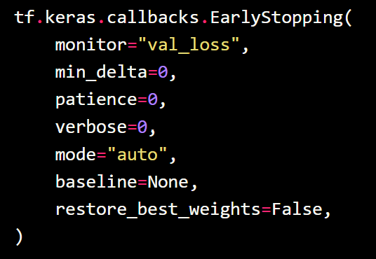
4.4 Pipeline: Training
But how do we know when to stop the training?
We use Early Stoppings
Easy to use and often built-in in most ML libraries as a callback
It stops the training when a certain indicator (monitor) stop decreasing or increasing after a certain number of epochs (patience)

Slide 19
4.5 Pipeline: Inference
Common techniques to improve the quality of the inference:
Assembled n-voting:
Train n unets and then make them inference all on the same image (they try to predict the lesion mask). Then, for each pixel, average the predictions.
Example: assembled 3-voting. You train 3 unets and for the pixel (2,3), they predict 1, 0.3 and 0. The resulting vote is then (1+0.3+0)/3
Thresholding
It seems natural to threshold the predictions at 0.5, i.e. if the predicted value for a pixel is above 0.5 we consider it positive, else negative. But we might achieve better results with different thresholds

Slide 20
4.6 pipeline: evaluation
To evaluate the quality of our prediction, we can use:
DSC
Volume Difference
Balanced accuracy (takes care of TN and FN proportion)
… a lot
gts = #gt positives
preds = #pred positives
VD = abs(gts-preds)

Slide 21
5. A coded example
https://github.com/zhixuhao/unet/blob/master/model.py

