Slide 1


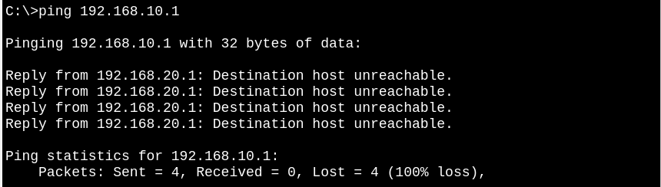
Both business and client vlan can access the internet
Client vlan cannot communicate with business vlan

