Slide 1
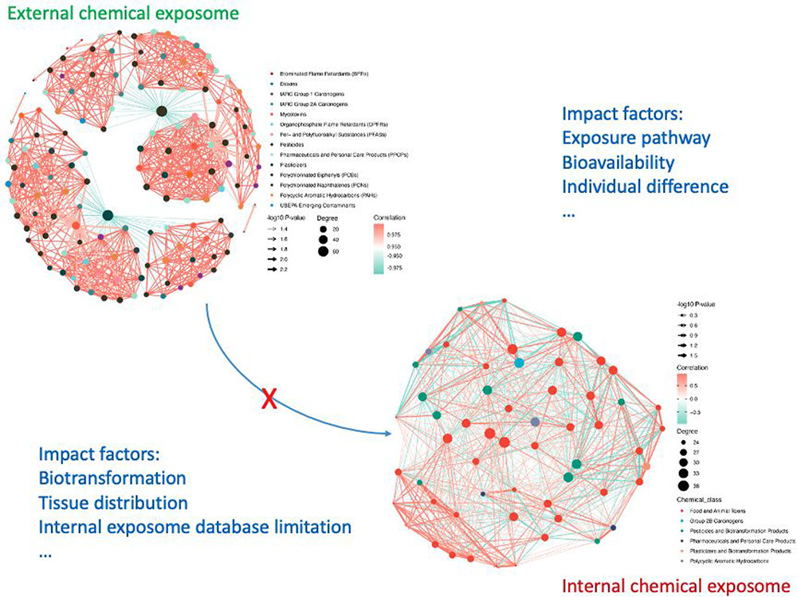
External exposome may not reflect the internal exposome inside organisms regarding constitutions, concentrations, and interactions due to several potential impact factors.
DOI: (10.1021/acs.est.0c07033)

