Slide 1

Thank You
This PowerPoint document contains the images that you requested.
Copyright Notice
All materials on this Site are protected by United States copyright law and may not be reproduced, distributed, transmitted, displayed, or otherwise published without the prior written permission of Wolters Kluwer. You may not alter or remove any trademark, copyright or other notice.
However, provided that you maintain all copyright, trademark and other notices contained therein, you may download material (one machine readable copy and one print copy per page) for your personal, non-commercial use only. Please refer to this link for further information on how to apply for permission for re-use
Any information posted to discussion forums (moderated and un-moderated) is for informational purposes only. We are not responsible for the information or the result of its practice.

Slide 2
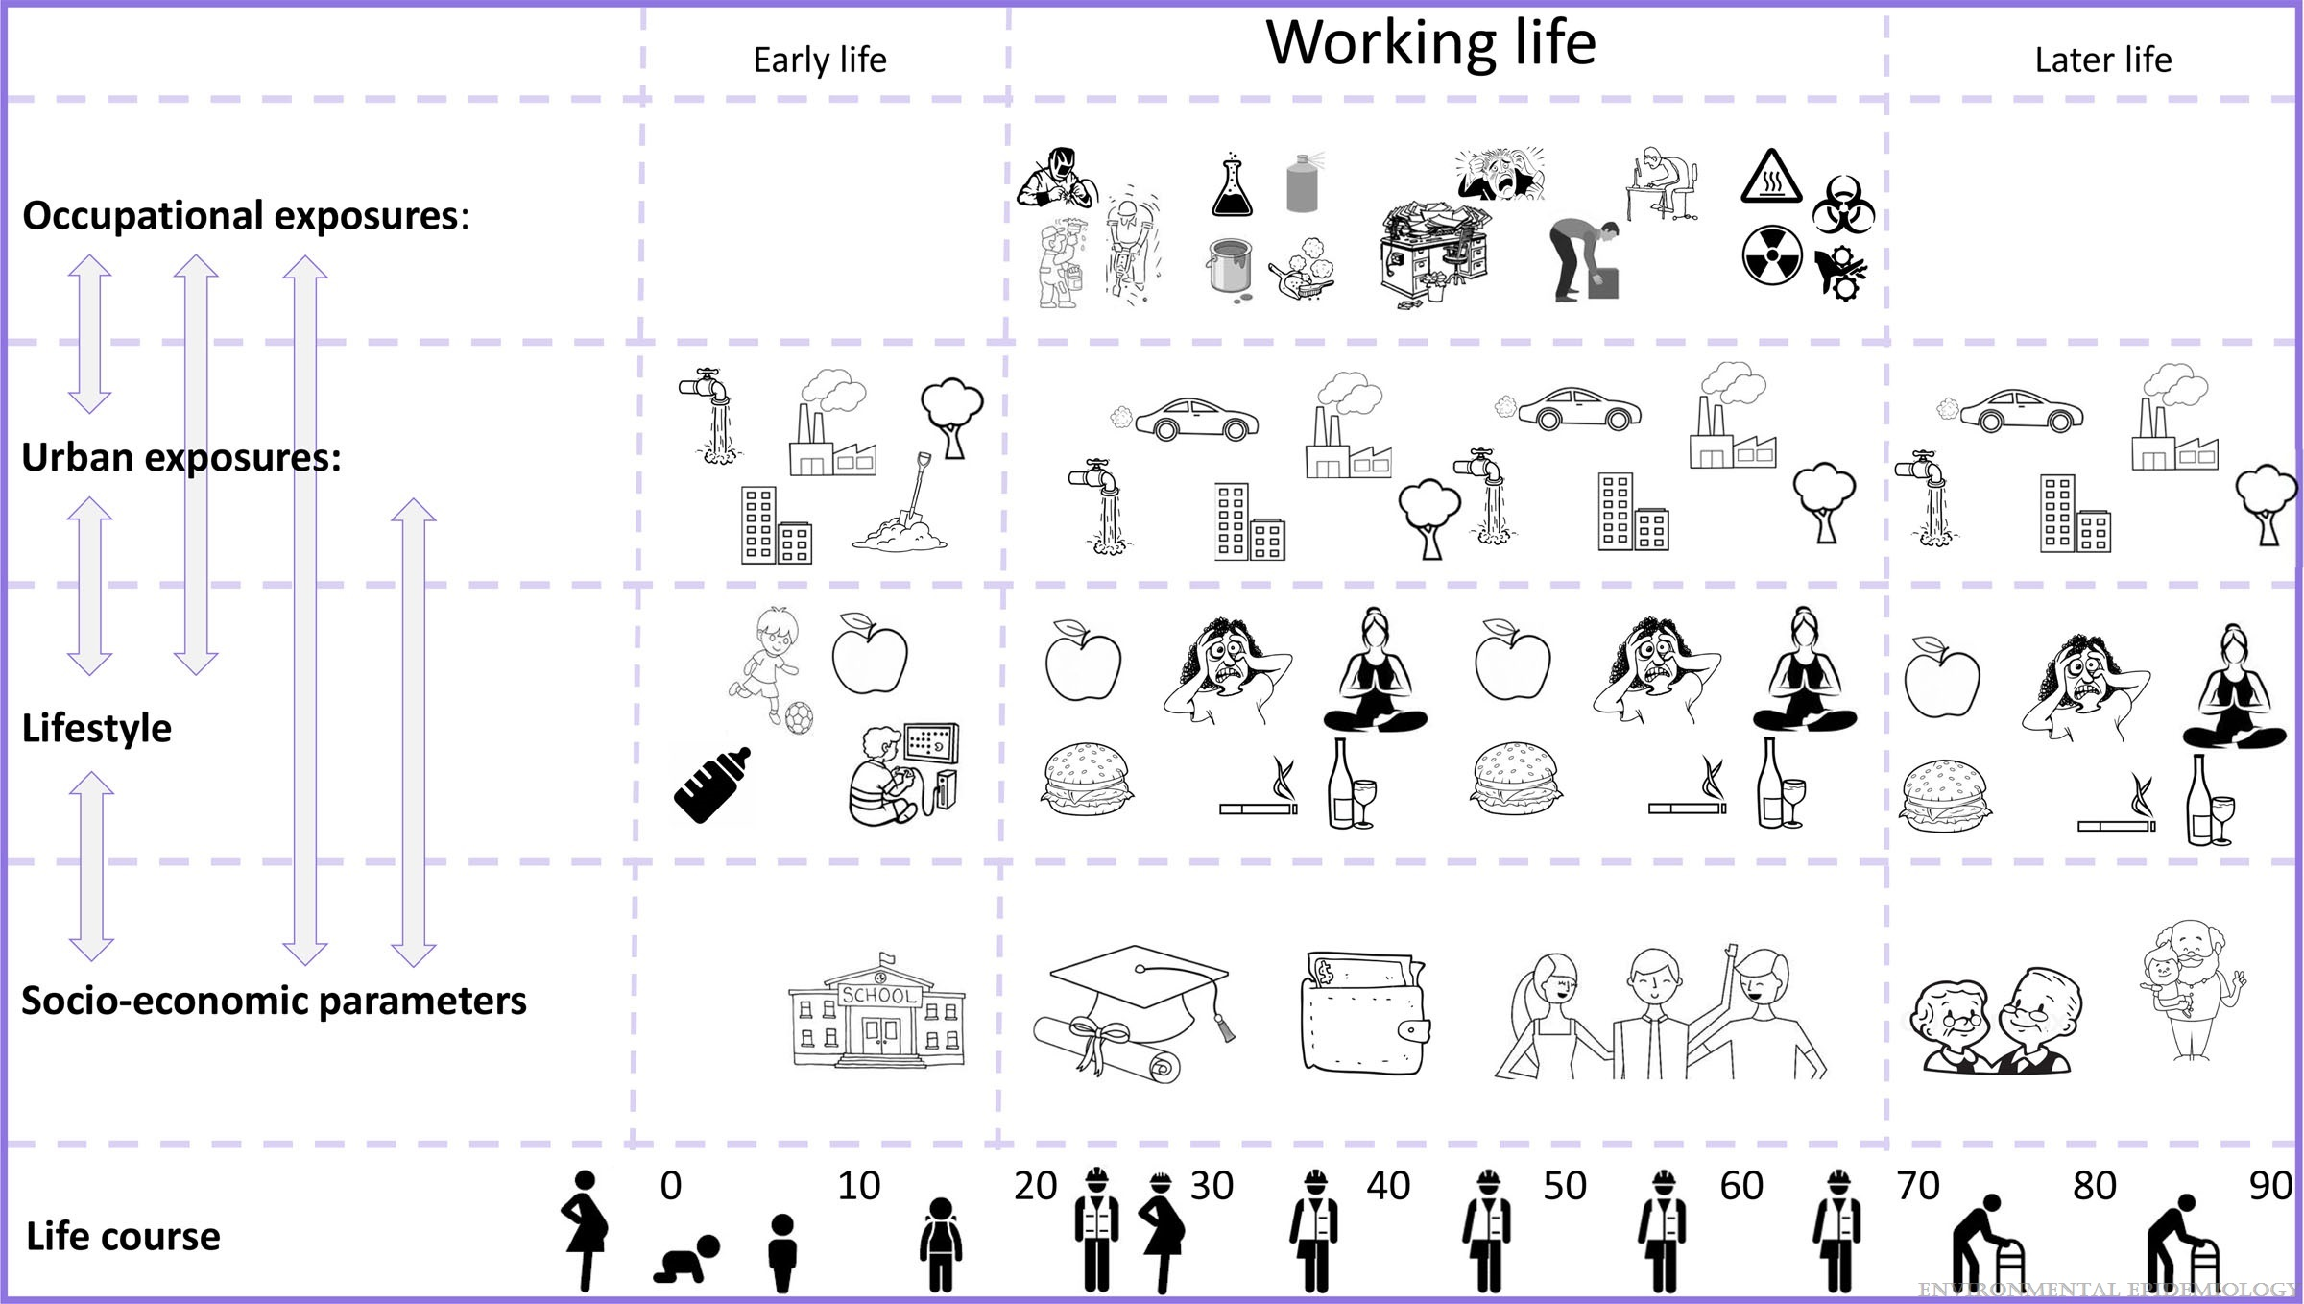
Figure 1.
Applying the exposome concept to working life health: The EU EPHOR project
Pronk, Anjoeka; Loh, Miranda; Kuijpers, Eelco; Albin, Maria; Selander, Jenny; Godderis, Lode; Ghosh, Manosij; Vermeulen, Roel; Peters, Susan; Mehlum, Ingrid Sivesind; Turner, Michelle C.; Schlünssen, Vivi; Goldberg, Marcel; Kogevinas, Manolis; Harding, Barbara N.; Solovieva, Svetlana; Garani-Papadatos, Tina; van Tongeren, Martie; The EPHOR Consortium; Stierum, Rob
Environmental Epidemiology6(2):e185, April 2022.
doi: 10.1097/EE9.0000000000000185
Working life exposures in the exposome context.

Slide 3
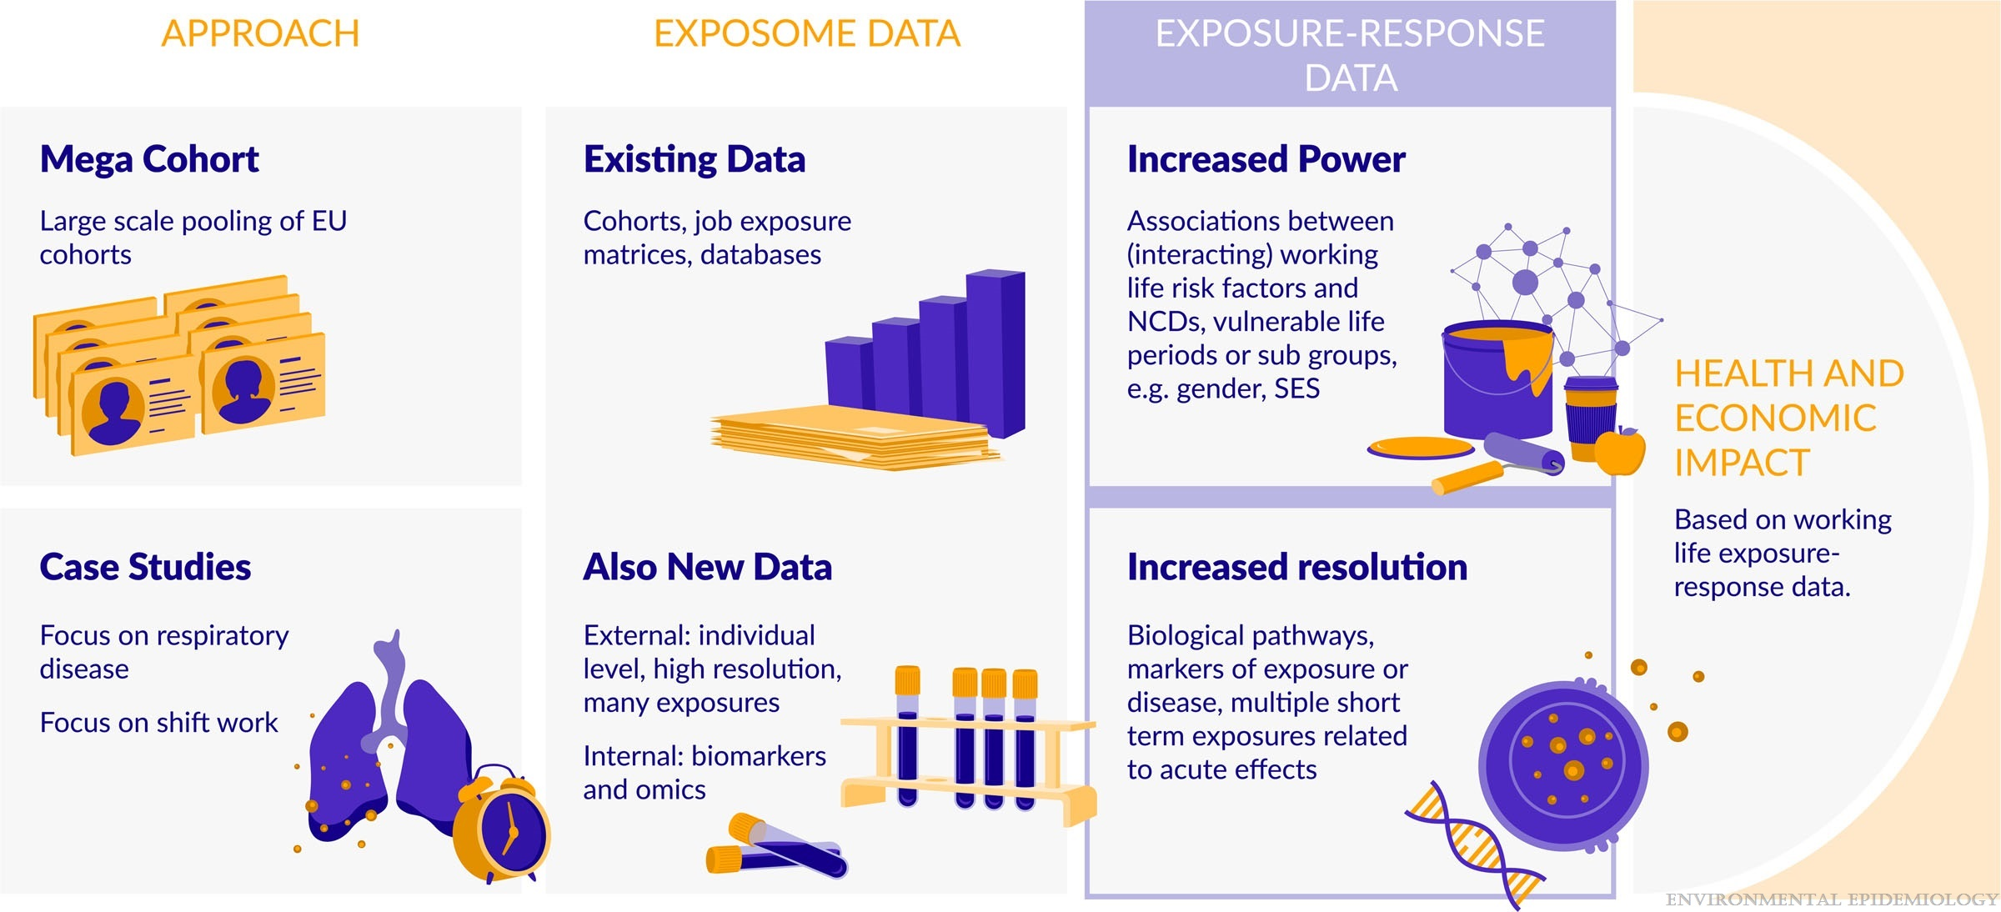
Figure 2.
Applying the exposome concept to working life health: The EU EPHOR project
Pronk, Anjoeka; Loh, Miranda; Kuijpers, Eelco; Albin, Maria; Selander, Jenny; Godderis, Lode; Ghosh, Manosij; Vermeulen, Roel; Peters, Susan; Mehlum, Ingrid Sivesind; Turner, Michelle C.; Schlünssen, Vivi; Goldberg, Marcel; Kogevinas, Manolis; Harding, Barbara N.; Solovieva, Svetlana; Garani-Papadatos, Tina; van Tongeren, Martie; The EPHOR Consortium; Stierum, Rob
Environmental Epidemiology6(2):e185, April 2022.
doi: 10.1097/EE9.0000000000000185
EPHOR approach combining the EPHOR mega cohort and focused case studies.

Slide 4
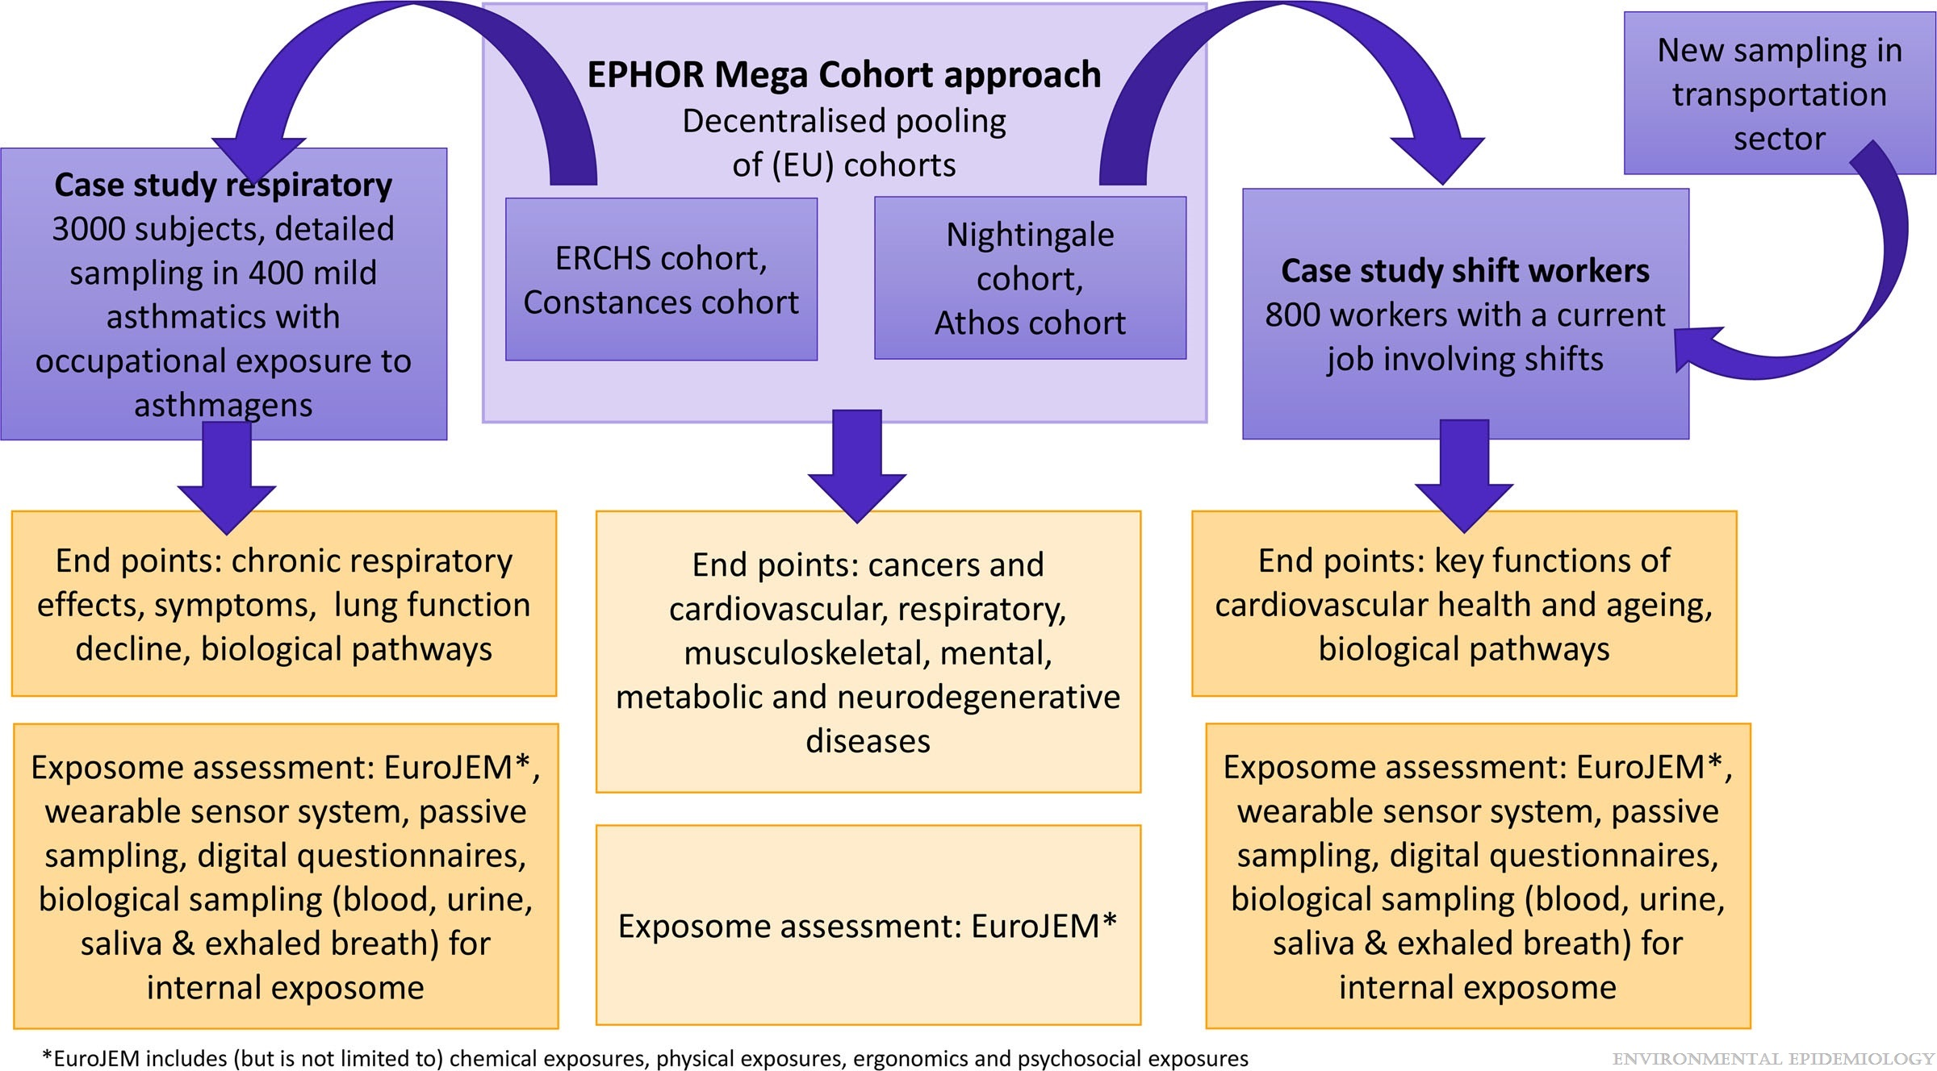
Figure 3.
Applying the exposome concept to working life health: The EU EPHOR project
Pronk, Anjoeka; Loh, Miranda; Kuijpers, Eelco; Albin, Maria; Selander, Jenny; Godderis, Lode; Ghosh, Manosij; Vermeulen, Roel; Peters, Susan; Mehlum, Ingrid Sivesind; Turner, Michelle C.; Schlünssen, Vivi; Goldberg, Marcel; Kogevinas, Manolis; Harding, Barbara N.; Solovieva, Svetlana; Garani-Papadatos, Tina; van Tongeren, Martie; The EPHOR Consortium; Stierum, Rob
Environmental Epidemiology6(2):e185, April 2022.
doi: 10.1097/EE9.0000000000000185
Study populations and design.

Slide 5
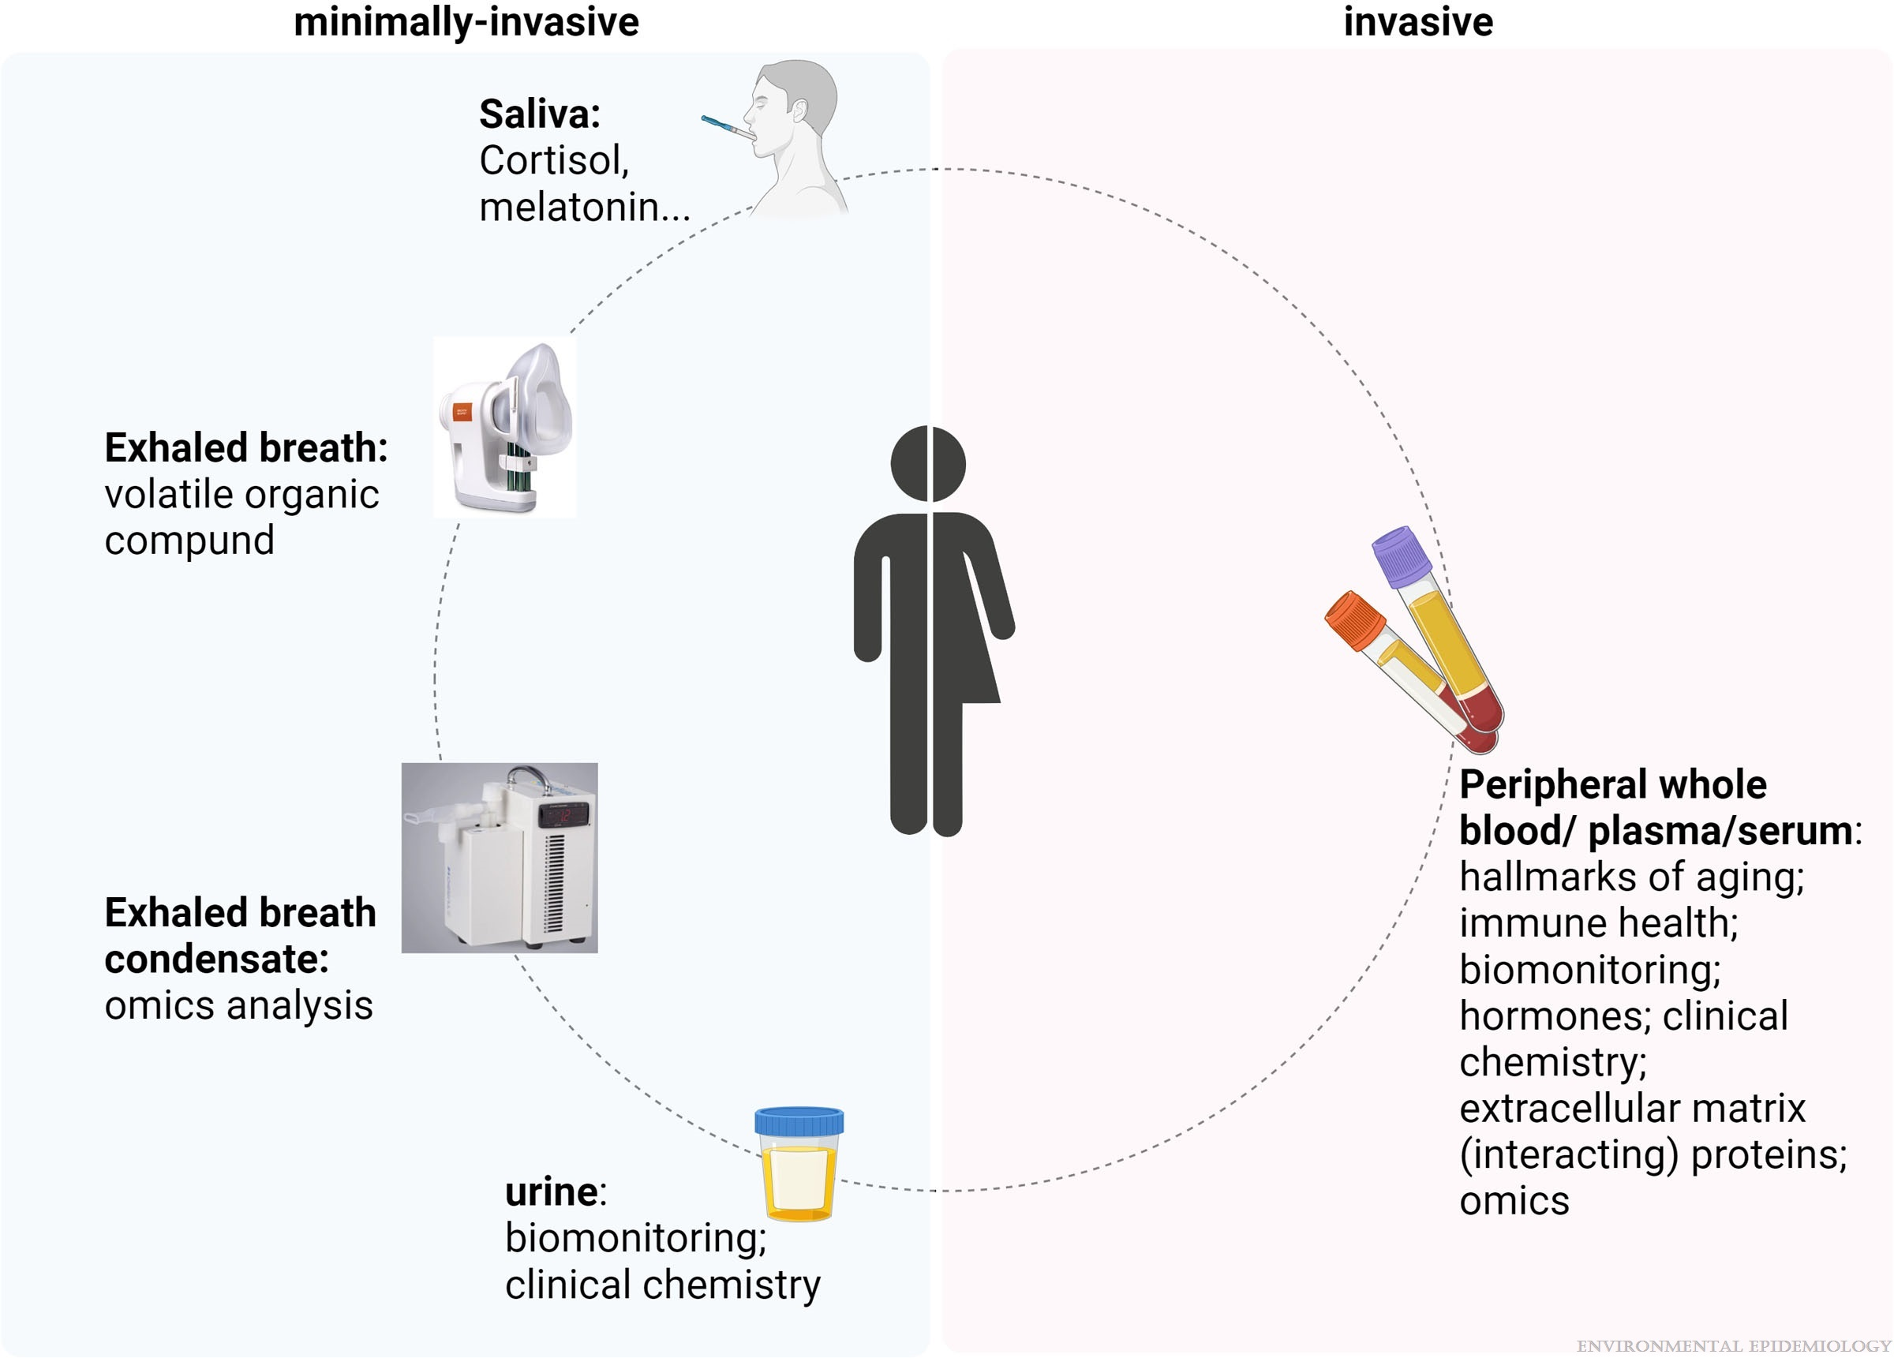
Figure 4.
Applying the exposome concept to working life health: The EU EPHOR project
Pronk, Anjoeka; Loh, Miranda; Kuijpers, Eelco; Albin, Maria; Selander, Jenny; Godderis, Lode; Ghosh, Manosij; Vermeulen, Roel; Peters, Susan; Mehlum, Ingrid Sivesind; Turner, Michelle C.; Schlünssen, Vivi; Goldberg, Marcel; Kogevinas, Manolis; Harding, Barbara N.; Solovieva, Svetlana; Garani-Papadatos, Tina; van Tongeren, Martie; The EPHOR Consortium; Stierum, Rob
Environmental Epidemiology6(2):e185, April 2022.
doi: 10.1097/EE9.0000000000000185
Overview of minimally invasive and invasive sampling and analyses in EPHOR case studies.

Slide 6
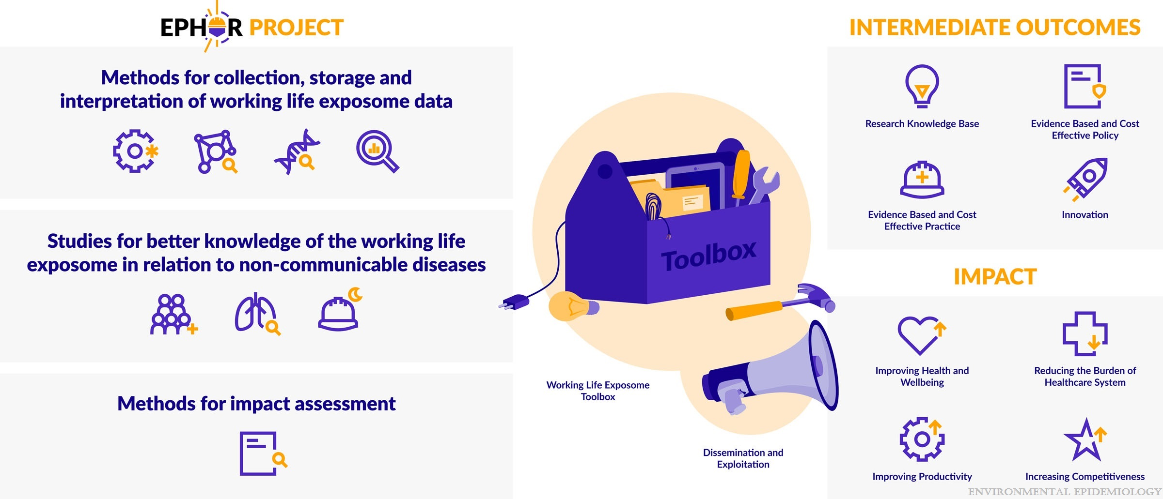
Figure 5.
Applying the exposome concept to working life health: The EU EPHOR project
Pronk, Anjoeka; Loh, Miranda; Kuijpers, Eelco; Albin, Maria; Selander, Jenny; Godderis, Lode; Ghosh, Manosij; Vermeulen, Roel; Peters, Susan; Mehlum, Ingrid Sivesind; Turner, Michelle C.; Schlünssen, Vivi; Goldberg, Marcel; Kogevinas, Manolis; Harding, Barbara N.; Solovieva, Svetlana; Garani-Papadatos, Tina; van Tongeren, Martie; The EPHOR Consortium; Stierum, Rob
Environmental Epidemiology6(2):e185, April 2022.
doi: 10.1097/EE9.0000000000000185
Overview of EPHOR and its expected intermediate outcomes and impact.

