Slide 1
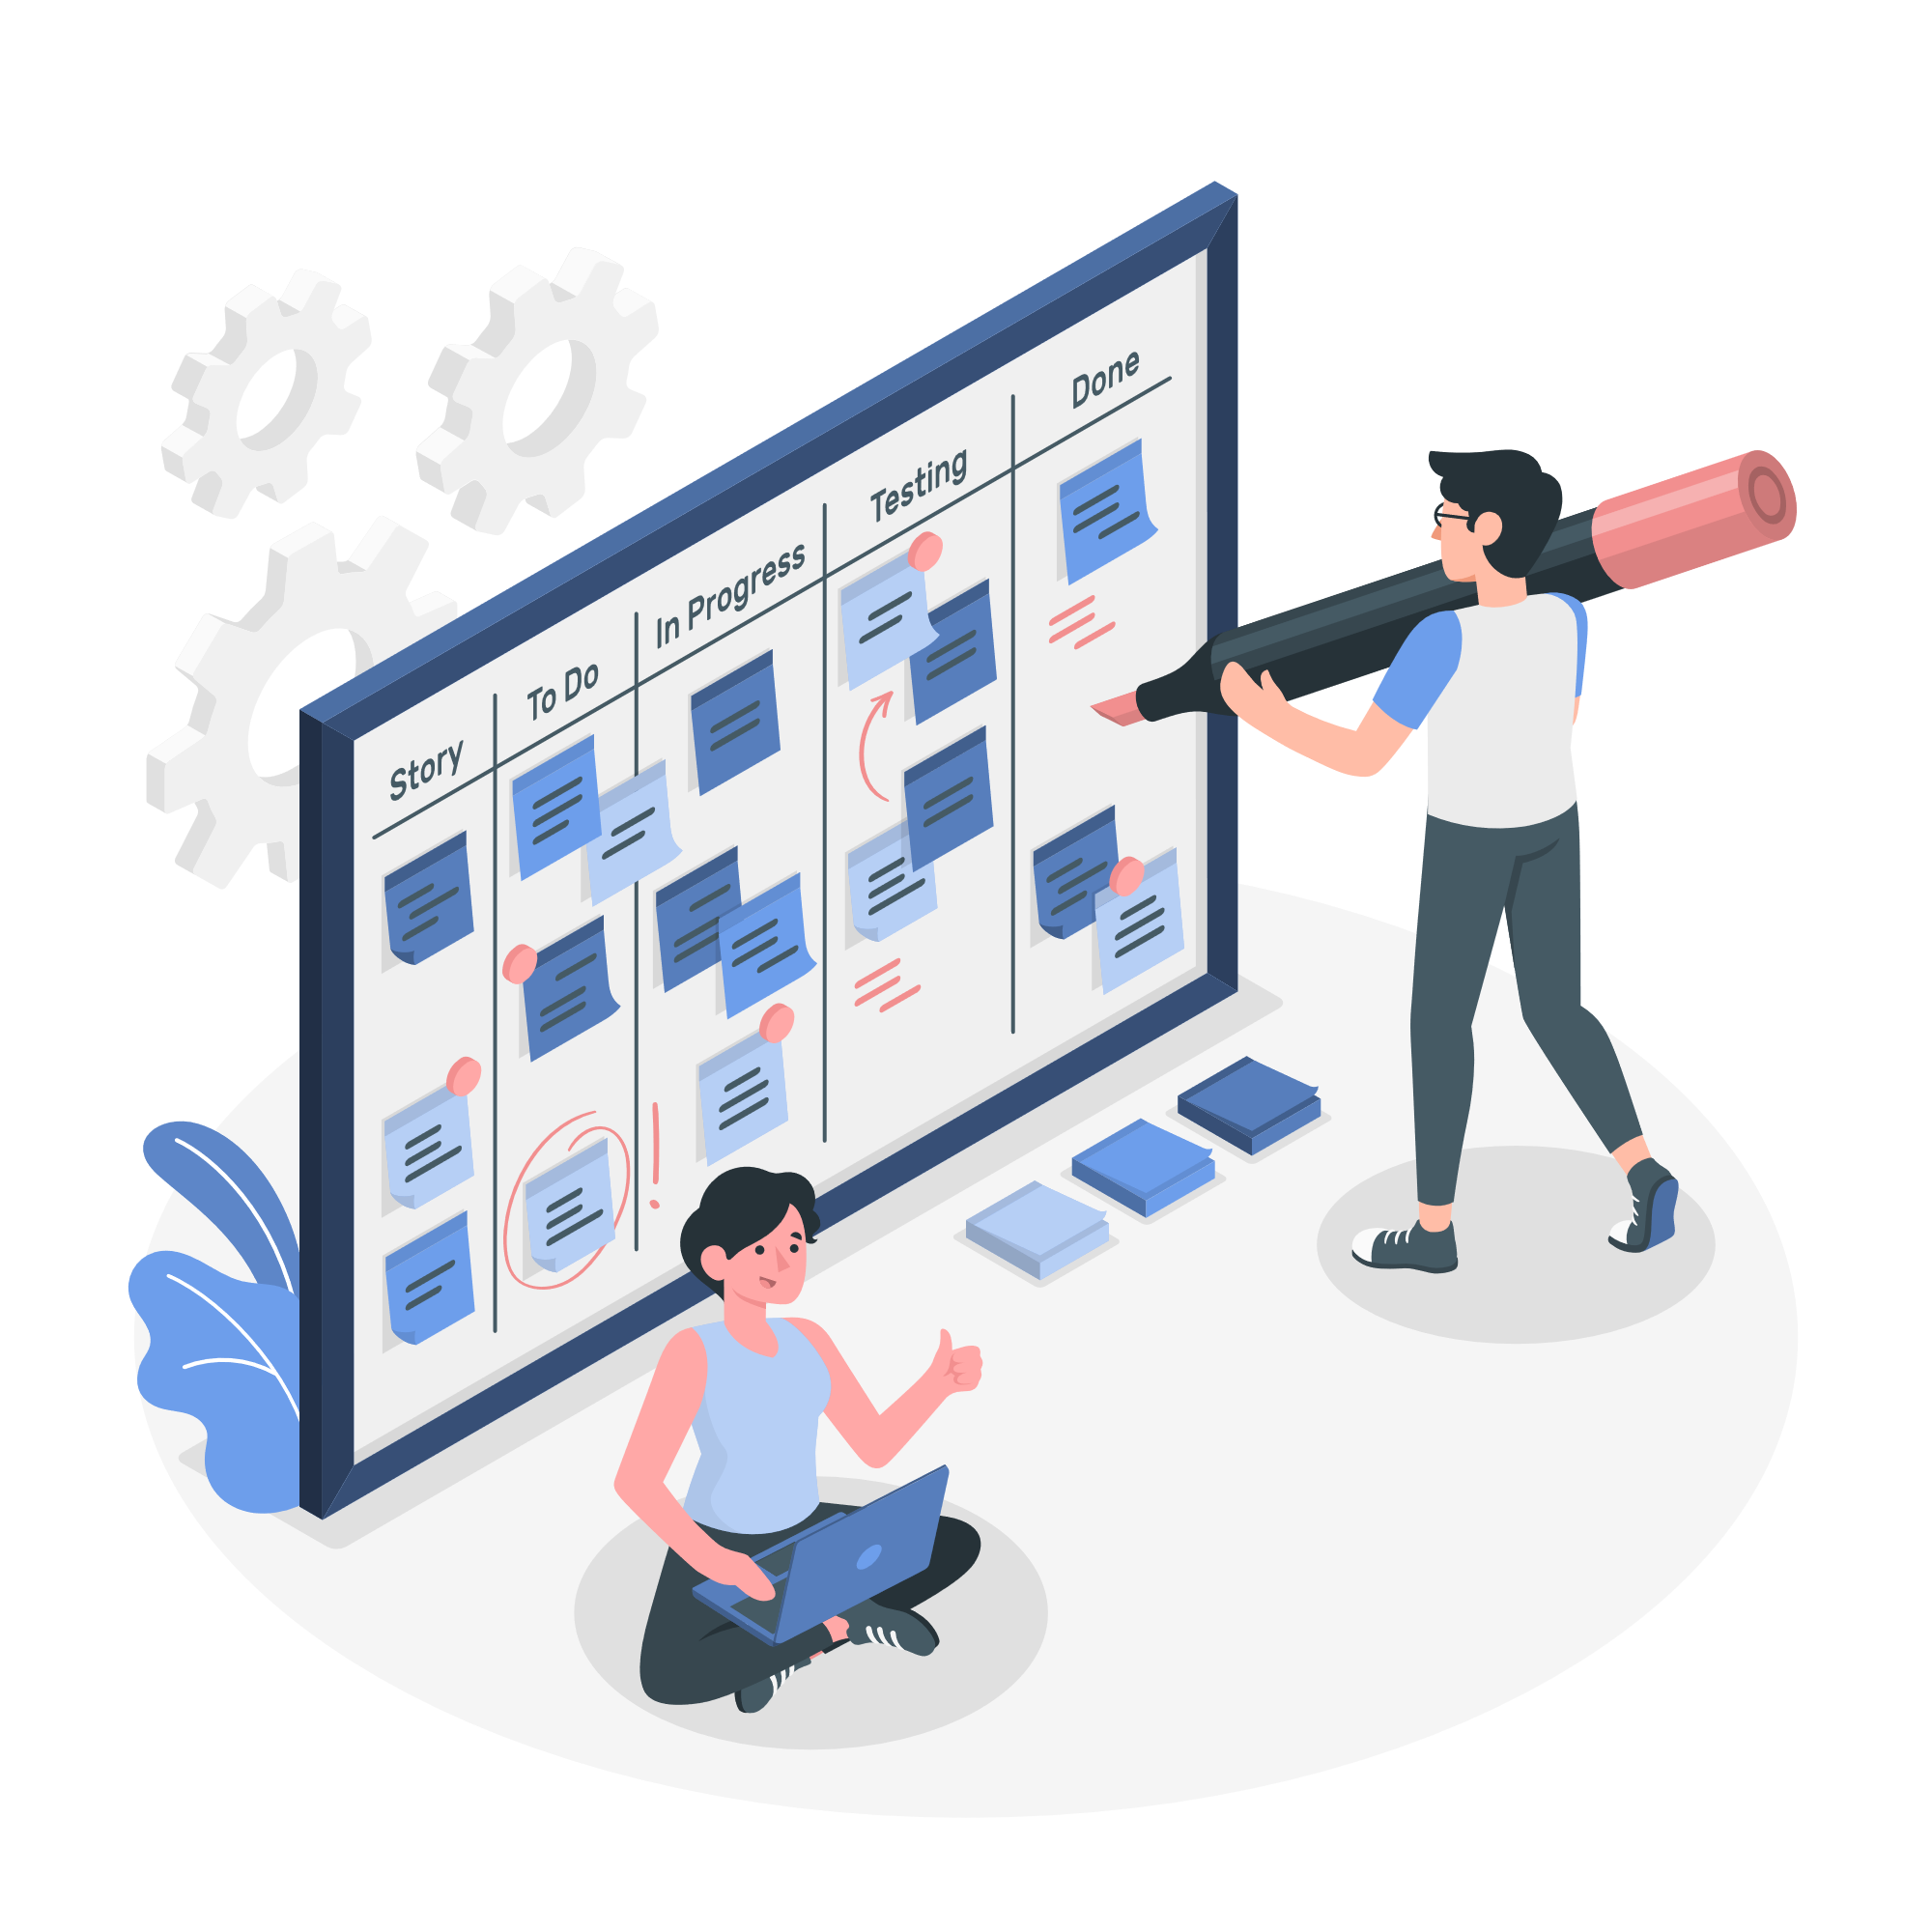
timeKeep
Schedule your day
Project by Andrea Caiulo, Riccardo Caiulo, Giorgia Rita Di Ruggiero

Slide 2
Summary
A short presentation
architectural choices
We introduce ourselves briefly, with the help of infographics.
We go over the programming languages, frameworks, APIs and tools used to work on the product.
Project structure
Product reviews
We list some features of the main components of our system, enunciate the algorithmical choices, go over the database structure (ER Diagram) and workflow diagrams.
We demo every component of the system, showing every feature and capability of the app, website, and algorithm. We also explain how a user would utilize our product.

Slide 3

A Brief Presentation
We are three students from the University of Pavia, Northern Italy, passionate about product design and programming, and keen to demonstrate our capabilities.
Giorgia Di Ruggiero is a graduate engineering student, currently pursuing a Master of Science in Biomedical Engineering.
Riccardo Caiulo is a student of the Electronics and Informatics Engineering bachelor program.
Andrea Caiulo, the team leader, is a graduated engineering student, pursuing a Master of Science in Electronics Engineering.

Slide 4
Architectural choices
In order to accomplish the tasks provided by the challenge, we had to utilize different languages and IDEs:
The Android app has been developed in Kotlin and XML, using Android Studio.
The Website is written in Html and JavaScript, using the React.js and Node.js frameworks in Visual Studio Code.
The Application System, providing the scheduling service, is a Python algorithm, developed with Visual Studio Code.
The Database example is written in XML, using Windows Access.
The following choices were made during the development:
To assure a correct workflow and a smooth collaboration inside the team, the project was consistently updated in a private GitHub repository, accessible under request.
All images present in the app, website and presentation where either created by ourselves or under a free license. In the presentation, the icons were provided by Flavicon and the infographics by Freepik, both under a free license.
Due to the unavailability of a web server, the website pages are hosted standalone. This means we couldn’t host the backend of the website and app concurrently on a database, so we built a mock database with sample entries.
The number of API calls is very limited. Both the website and the Android app use Google APIs only for the Google Maps service. The website uses it for registering a shop’s location and the app uses it to find shops in the proximity of the client.

Slide 5
Project structure
For the Website:
Basic static pages and animations have been developed. Every owner can access and register an account to the website. Inside their personal homepage, an owner can insert information for multiple premises including name, category, coordinates, phone number of the shop, floor area, maximum number of personnel working at the same time and a description.
The maximum number of people allowed in the shop is automatically obtained by the Application System using the floor area of the shop, the number of personnel and the relation between people and floor area. This information is taken from an Italian “Decreto del Presidente del Consiglio dei ministri”.
A page for associating a duration to every TimeZone (see the Application System section) is yet to be implemented.
The website also has machine learning algorithms that provide owners with data analysis tools, some algorithms which we have implemented are k-nearest neighbours, logistical regression, linear regression and least squares method.
For the Android App:
With the Android App a user can access and register an account, view nearby stores using both an individual page and a Google Map API, reserve a timeslot for any specific shop or store, and outline any specific requirements he might have.
The user, with the app, can view the distance and shortest path to nearby shops, view the reserved timeslots and automatically set alarms for those dates, view any products that the store has listed with the website and reserve those products when they book a timeslot.
The app can read and generate QR Codes, which paired with a functioning server and backend will provide the assurance that the users actually went to the shop itself.

Slide 6
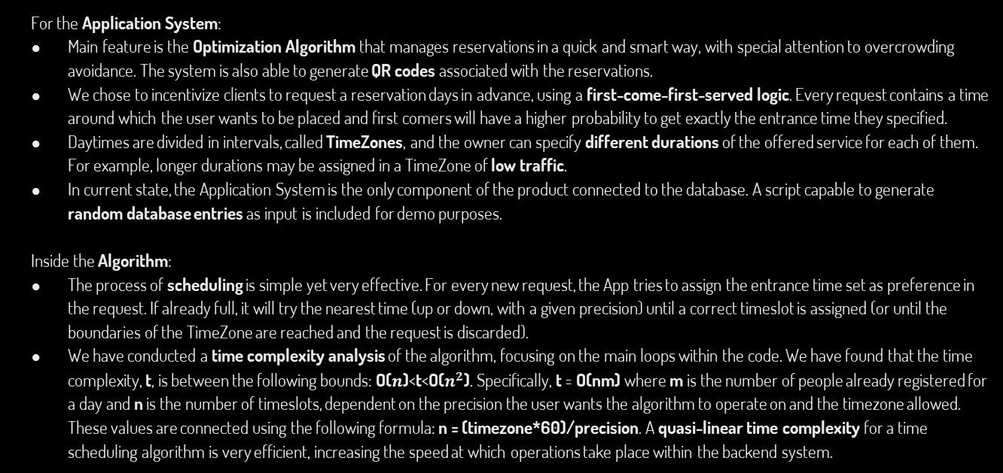
Project structure
For the Application System:
Main feature is the Optimization Algorithm that manages reservations in a quick and smart way, with special attention to overcrowding avoidance. The system is also able to generate QR codes associated with the reservations.
We chose to incentivize clients to request a reservation days in advance, using a first-come-first-served logic. Every request contains a time around which the user wants to be placed and first comers will have a higher probability to get exactly the entrance time they specified.
Daytimes are divided in intervals, called TimeZones, and the owner can specify different durations of the offered service for each of them. For example, longer durations may be assigned in a TimeZone of low traffic.
In current state, the Application System is the only component of the product connected to the database. A script capable to generate random database entries as input is included for demo purposes.
Inside the Algorithm:
The process of scheduling is simple yet very effective. For every new request, the App tries to assign the entrance time set as preference in the request. If already full, it will try the nearest time (up or down, with a given precision) until a correct timeslot is assigned (or until the boundaries of the TimeZone are reached and the request is discarded).
We have conducted a time complexity analysis of the algorithm, focusing on the main loops within the code. We have found that the time complexity, t, is between the following bounds: O($n$)<t<O($n^{2}$). Specifically, t = O(nm) where m is the number of people already registered for a day and n is the number of timeslots, dependent on the precision the user wants the algorithm to operate on and the timezone allowed. These values are connected using the following formula: n = (timezone*60)/precision. A quasi-linear time complexity for a time scheduling algorithm is very efficient, increasing the speed at which operations take place within the backend system.

Slide 7
ER diagram explanation
The entity–relationship model (ER model) has been chosen as the data model that defines the data and information structure in the database of our product.
In the ER model, an entity is defined as an object characterized by independent existence and that can be uniquely identified. Entities are inserted in boxes and must have a minimal set of uniquely identifying attributes which may be used as a unique/primary keys.
A relationship captures how entities are related to one another, linking them together. Relationships are inserted in diamonds. In this ER model there is a main entity PEOPLE with two “sons”: USER and OWNER. In fact, the system should be accessible by two different kind of users with different characteristics and actions.
The user can book a service at a gym, shop, restaurant or any other desired place and they will receive an e-mail to confirm the reservation. The owner should have at least one registered premise. Every request sent by the user is for a specific shop.
We use these rules considering only the maximum value of cardinalities:
If cardinalities (1,1) – (1, 1) → one table is generated with the attributes of entities and relationships
If cardinalities (1,1) – (1, N) →two tables: one for the first entity and relationship and one for the second one.
If cardinalities (1,N) – (1, M) → three tables: two for entities and one for the relationship.

Slide 8
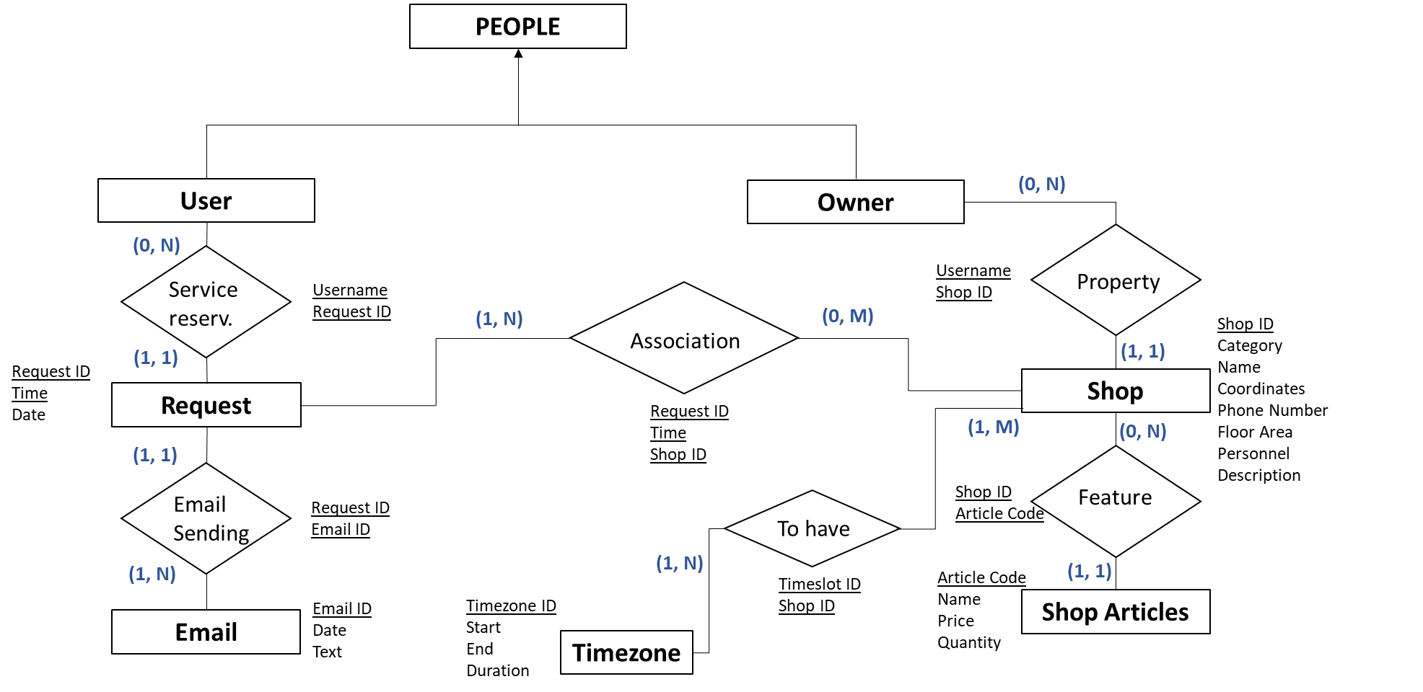
ER diagram

Slide 9
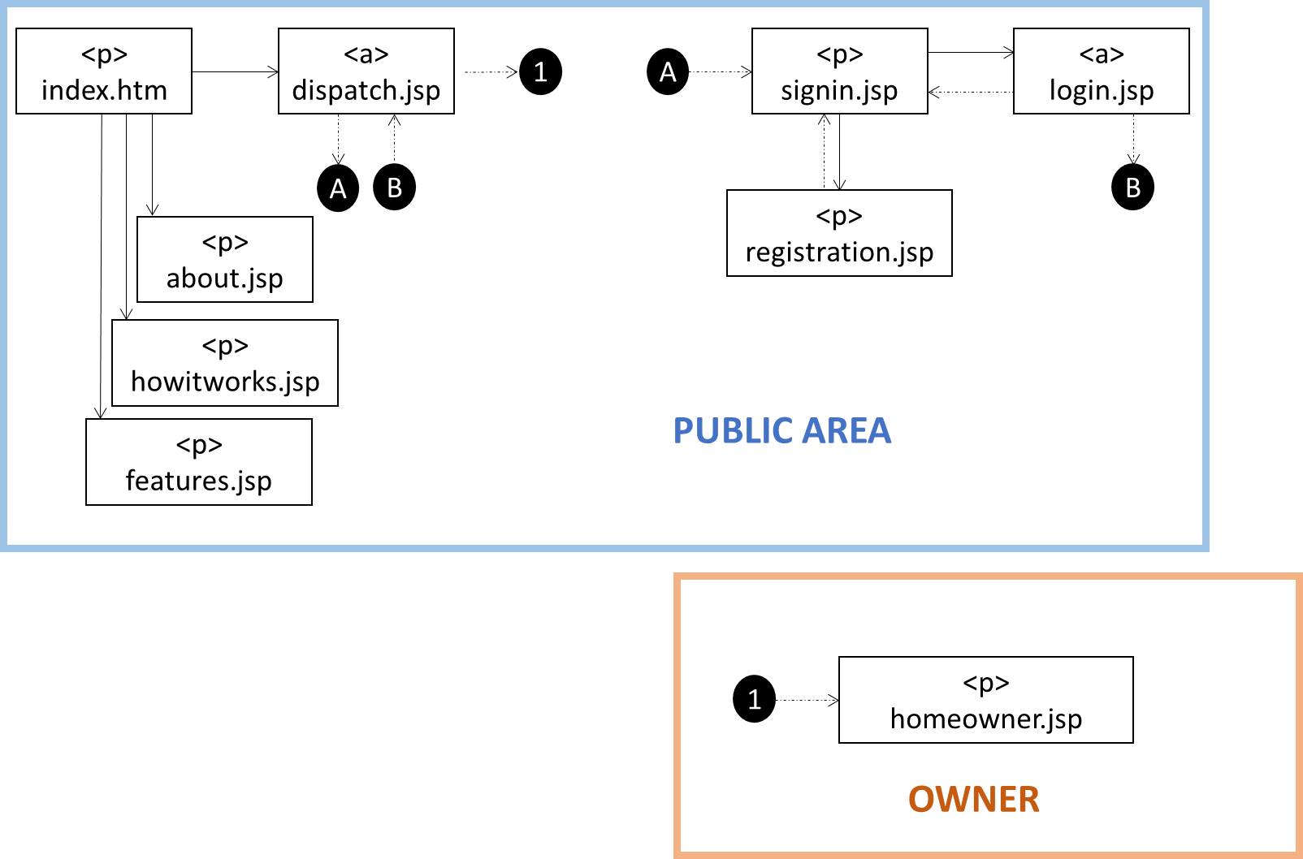
WEBSITE NAVIGATION DIAGRAM

Slide 10
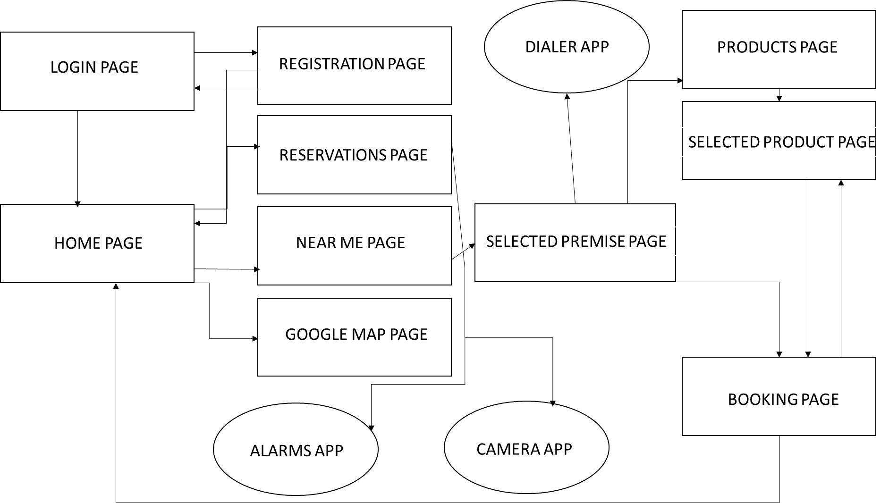
ANDROID APP NAVIGATION DIAGRAM

Slide 11
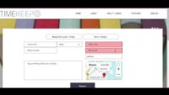
Product review
WEBSITE Presentation

Slide 12
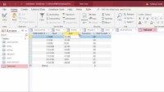
Product review
Database Presentation

Slide 13
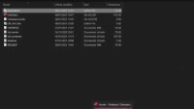
Product review
Algorithm Presentation

Slide 14

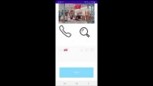
Product review
Android app Presentation

Slide 15

Customers flow
Let’s suppose we have a Barber shop, working with four clients at the same time in timeslots of thirty minutes each. Let’s also suppose that the shop is working at full capacity for a whole day, from 9 AM to 7 PM, stopping between 1 PM and 3 PM.
In this case, the expected number of clients the system should be able to withstand is around sixty.
If considering a completely different kind of service, as the reservation of a changing room, the request would be much higher.
Our service enables owners to set preferences as the duration of every timeslot in different TimeZones of every day.

Slide 16
Decentralization
We have written a smart contract in Solidity that sends the information that would be sent to a remote database to the Ethereum blockchain, essentially decentralizing the application and removing the need for a database.
The smart contract is ready to be deployed, but is not yet connected to the website. If connected, it would convert the necessary data into a text file, which would then be stored on the website temporarily and then uploaded to the Ethereum blockchain using web3js to parse the file and connect to the Blockchain.
This idea still needs work to be fully implemented, but might become a significant improvement to the usual centralized model that apps are built upon.

Slide 17
“Thank you for your attention. Deloitte gave us the possibility to put ourselves to the test, and we hope that our effort will be appreciated.”
—THE TIMEKEEP TEAM

