Slide 1
LAW 21474 Financial Accounting
Session 1: Introduction

Slide 2
Instructor
Rick Antle
William S. Beinecke Professor of Accounting
Been at Yale since 1985, before that served as Associate Professor at the University of Chicago
Ph.D. in Business from Stanford, 1981
Co-founder of:
Ross, Jeffrey & Antle, LLC (Now RJA Asset Management LLC)
Compensation Valuation, Inc.
33 Whitney Associates, LLC
Sole member of 217 Canner Associates, LLC, trustee of Greenwich Sentry and Greenwich Sentry Partners Liquidation Trusts, two BLMIS feeder funds.
Current professional interests
Teaching the first accounting course

Slide 3
Course details
Item | Part of Grade | Due
Homework | 10% | Each class session
Problem Set | 70% | October 14 6 pm
Final Exam or Project | 20% | Self-scheduled
Total | 100%

Slide 4
Accounting
It is all about capturing, processing and communicating financial INFORMATION and there are three components:
Aspirations: Show value and how it changes. Noble. Lofty purpose. Big help in creating/maintaining a civilized society.
Accounting Conventions: Aspirations meet real world, need conventions. Don’t get your hopes up too high!
Institutional Context: Aspirations meet real world, accounting is done by people in a social/economic/political context. Watch out!
Three steps in doing accounting:
Recognition (do we record anything?)
Classification (if so, what accounts are affected?)
Valuation (what numbers do we use?)
All within a formal, double entry system that involves recording two views of every transaction or event, requiring them to agree, and then tying them all together.

Slide 5
Most Important Figure
Balance sheet
Balance sheet
Balance sheet
Financial Value
Creation/Consumption
time
Income statement
Cash flow statement
St. Changes in SE
Income statement
Cash flow statement
St. Changes in SE
Cash Generation/
Consumption
Redistribution

Slide 6
Uncle pennybags' generosity
How financial statements work together to convey information

Slide 7

Your uncle, Mr. Pennybags, was a bit
of a risk taker with a propensity to start
new businesses. He started 4 on Jan 1, 2020
and has decided to give them to you and your
3 siblings. He drew your name out of his hat,
so you get first choice.
You are aware that, in addition to his generosity,
Mr. Pennybags, is a bit annoying. He never
passes up an opportunity to teach you what
he considers to be the most important
lessons that he had to learn “the hard way.”
The lesson accompanying this gift, he tells you,
is about financial statements.
Source: https://www.cleanpng.com/png-computer-icons-rich-uncle-pennybags-blog-clip-art-5688280/download-png.html

Slide 12
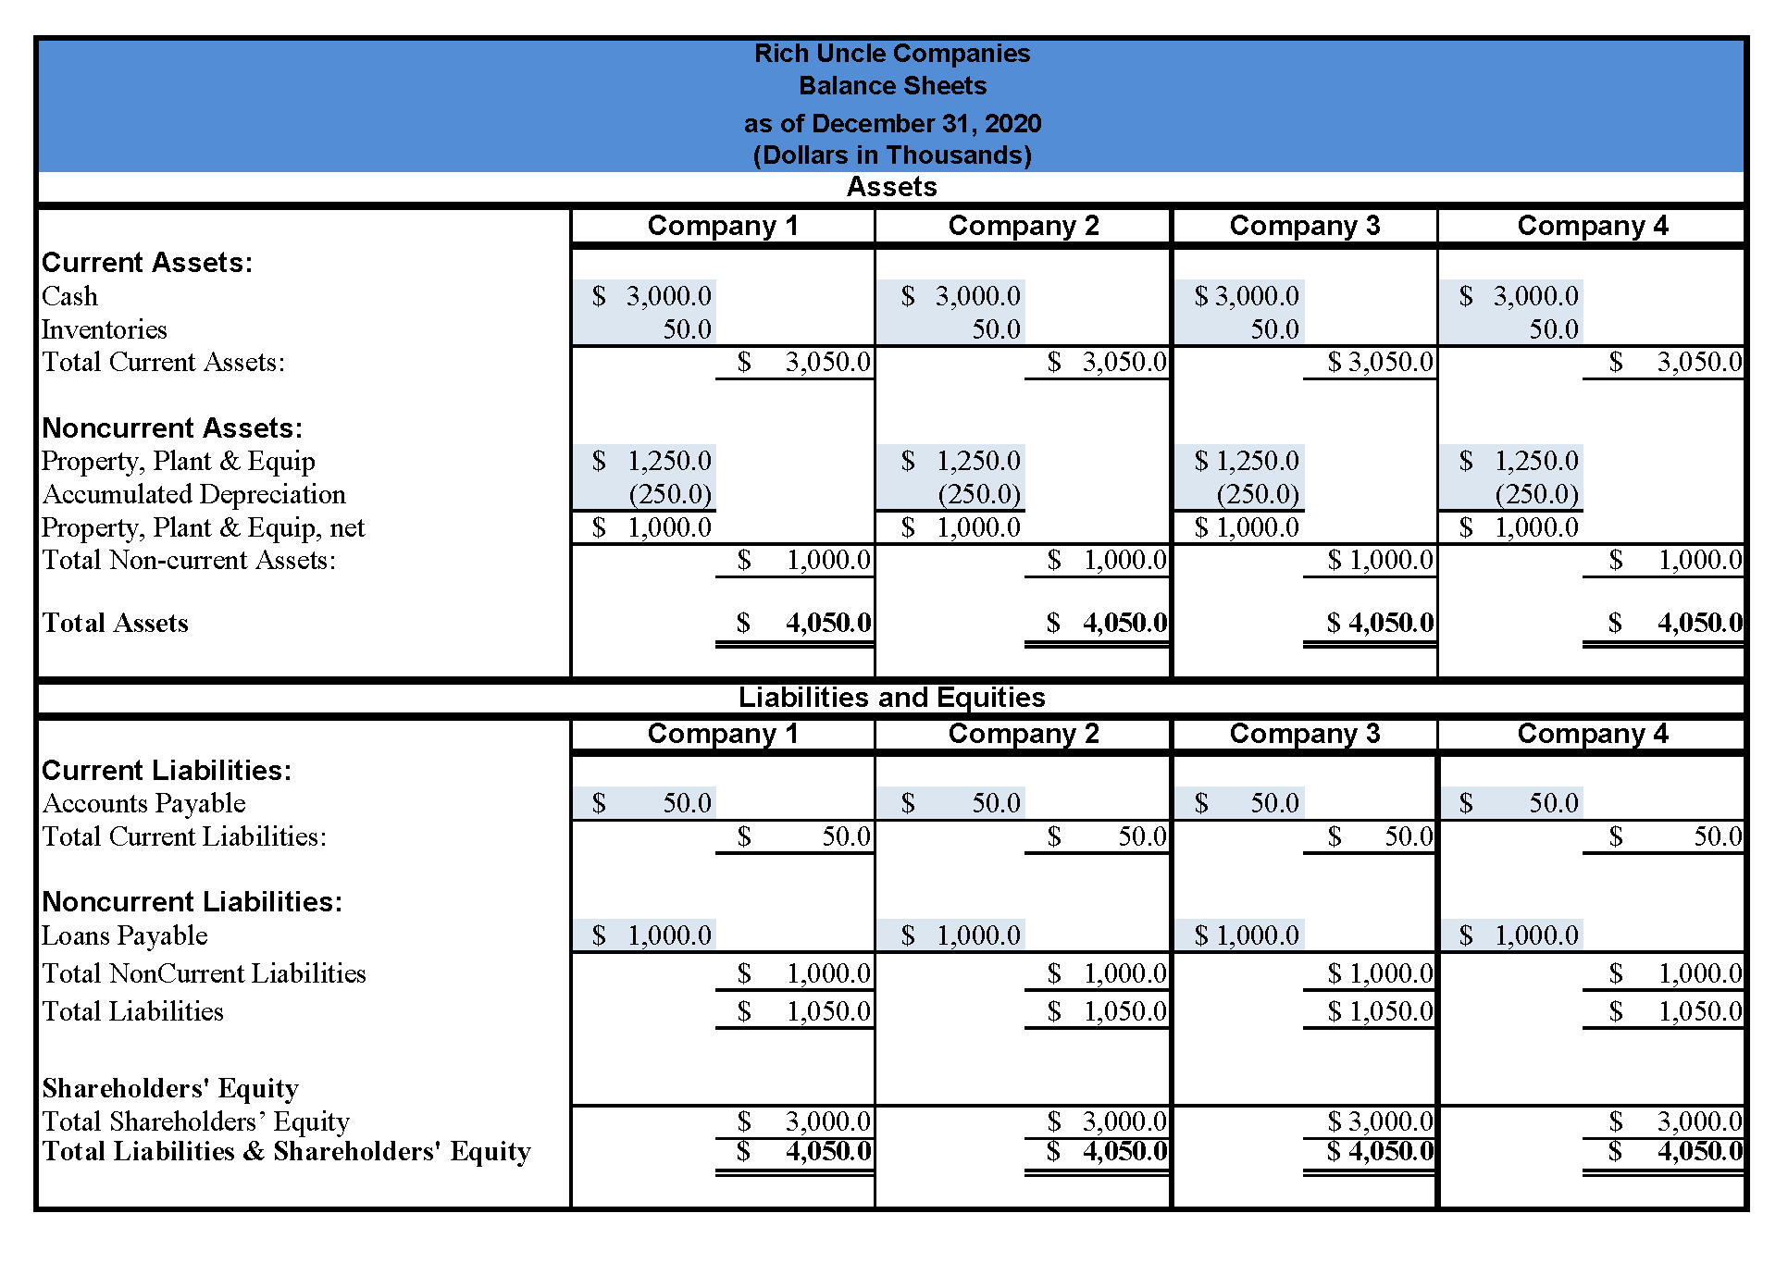

Slide 18
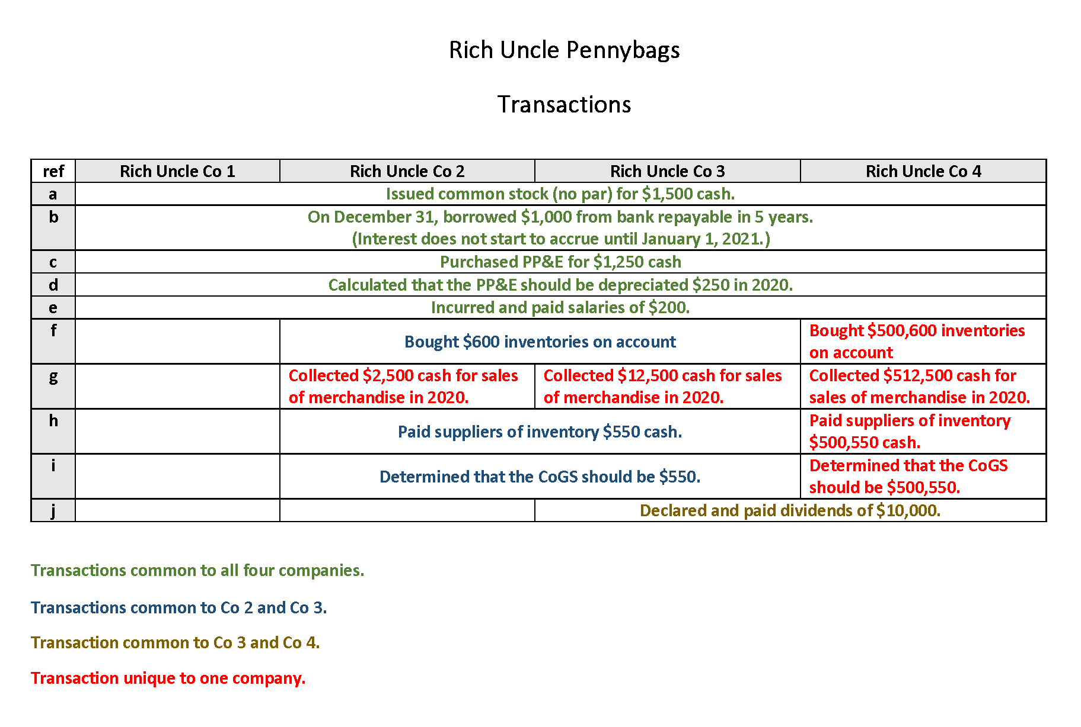

Slide 19
Government Bailouts 101
AIG
GM

Slide 20
Merck
Product liability: Vioxx

Slide 21
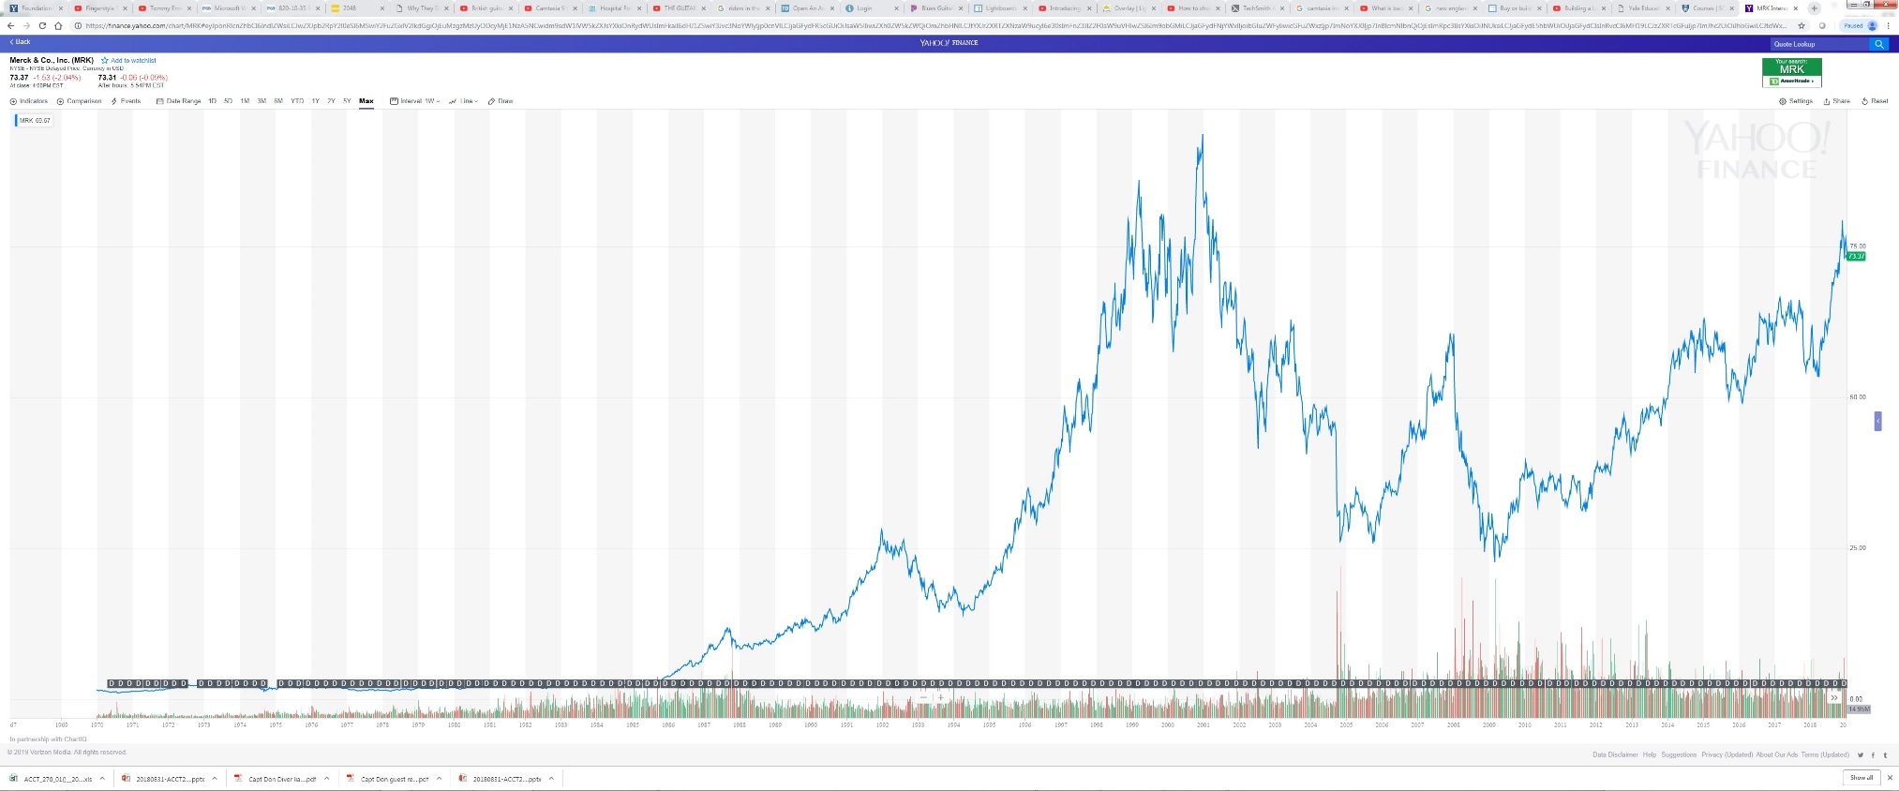

Slide 22
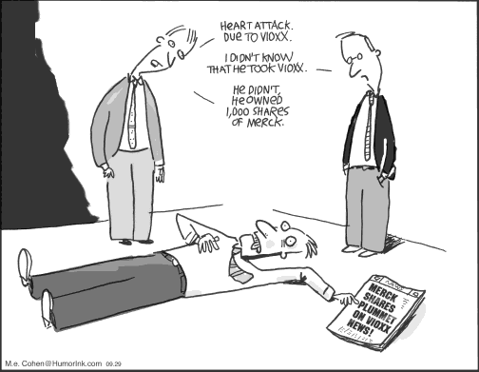

Slide 23
Merck & Co., Inc.
7. From Note 11: “The Company records accruals for contingencies when it is probable that a liability has been incurred and the amount can be reasonably estimated.”
8. From Note 11: “Legal defense costs expected to be incurred in connection with a loss contingency are accrued when probable and reasonably estimable.”

Slide 24
Merck & Co., Inc.
20. “In view of the inherent difficulty of predicting the outcome of litigation, particularly where there are many claimants and the claimants seek indeterminate damages, the Company is unable to predict the outcome of these matters, and at this time cannot reasonably estimate the possible loss or range of loss with respect to the Vioxx Lawsuits. The Company has not established any reserves for any potential liability relating to the Vioxx Lawsuits or the Vioxx Investigations (collectively the “Vioxx Litigation”). The Company has established a reserve of $675 million solely for its future legal defense costs related to the Vioxx Litigation. This reserve is based on certain assumptions and is the minimum amount that the Company believes at this time it can reasonably estimate will be spent over a multi-year period.”

Slide 25
Next Time
Start learning accounting at the MOST basic level
Bookkeeping mechanics and financial statement structure that form the basis for all accounting systems (US GAAP, IFRS, US Income Tax accounting)
Excel environment that I have designed. Works best with Office 365 and a subscription.
Very different from other YLS courses but DO IT ANYWAY!!

