Slide 1
Investment Game
LAW 21474 Spring 2026

Slide 2
Investment Game
I chose 11 of you to participate.
Each will have an endowment (that’s what we call what you start with in economics) of (pretend) Bitcoin.
Each will make investments with a promised rate of return of 100% per period.
Some of you will withdrawal funds from their accounts.

Slide 3
Investors
Name | ₿ | Accnt#
Alejandro Escamilla | 5 | 1
Kevin Xiao | 5 | 2
Negar Saatchi | 5 | 3
Emma Li | 5 | 4
Ruth Tomlin | 10 | 5
Amanda Chen | 10 | 6
Brian Fydenkevez | 10 | 7
Luis Bravo Lumbreras | 10 | 8
Jane Lord-Krause | 40 | 9
Christian Aviles | 40 | 10
Keegan Vacanti | 40 | 11

Slide 4
Investment Company and Rules
Ricky Lee Antle Investment Securities, LLC (hereafter, RLAIS)
Beginning endowment: ₿20
Stated rate of return on RLAIS strategy: 100%
RLAIS fees: 0%
Minimum investment: ₿5
Deposits at the beginning of the period, withdrawals at the end of the period.
Just so we understand the stakes: Bitcoin-Dollar

Slide 5
₿10
₿10
₿10
₿10
RLAIS
₿5
₿20
₿40
₿5
₿40
₿5
₿40
₿5
Total wealth of the group: ₿200

Slide 6
Round 1

Slide 7
Period 1: Beginning
Deposits occur at the beginning of the period.
₿10
₿10
₿10
₿10
RLAIS
₿5
₿20
₿40
₿5
₿40
₿5
₿40
₿5

Slide 8
Period 1: Beginning
Deposits occur at the beginning of the period.
₿10
₿10
₿10
RLAIS
₿10
₿0
₿40
₿40
₿0
₿40
₿0
₿40
₿0
Total wealth of the group: ₿200

Slide 9
Period 1: During
Earnings occur during the period.
₿10
₿10
₿10
RLAIS
₿10
₿80
₿40
₿40
₿40
₿40
Total reported wealth of the group: ₿240

Slide 10
BIG SECRET…
RLAIS has no operations and it earns nothing.
I.e., RLAIS’s actual rate of return is 0%.

Slide 11
Period 1: During
The actual state before withdrawals is:
₿10
₿10
₿10
RLAIS
₿10
₿0
₿40
₿40
₿0
₿40
₿0
₿40
₿0
Total actual wealth of the group: ₿200

Slide 12
Period 1: End
Withdrawals occur at the end of the period.
₿10
₿10
₿10
RLAIS
₿10
₿5
₿10
₿40
₿25
₿40
₿40
Total wealth of the group: ₿200

Slide 13
TOTALS
RICK

Slide 14
Round 2

Slide 15
Period 2: Beginning
Deposits occur at the beginning of the period.
₿10
₿10
₿10
RLAIS
₿10
₿65
₿40
₿25
₿40
₿5
₿40
₿10
Total wealth of the group: ₿200

Slide 16
Period 2: During
Earnings occur during the period.
RLAIS
₿40
₿65
₿40
₿5
₿10
₿40
Total wealth of the group: ₿200

Slide 17
Period 2: End
Withdrawals occur at the end of the period.
RLAIS
₿10
₿10
₿40
₿10
₿65
₿40
₿5
₿40
₿10
Total wealth of the group: ₿200

Slide 18
Period 2: End
Withdrawals occur at the end of the period.
₿10
RLAIS
₿35
₿40
₿10
₿40
₿15
₿40
₿10
Total wealth of the group: ₿200

Slide 20
TOTALS
RICK

Slide 21
Round 3

Slide 22
Period 3: Beginning
Deposits occur at the beginning of the period.
₿10
RLAIS
₿40
₿155
₿10
₿40
₿15
₿40
₿10
Total wealth of the group: ₿200

Slide 24
Criminal | Beg | From “Investors” | To “Investors” | End
Rick | 20 | 180 | (45) | 155

Slide 25
Overall Results for RJAIS, LLC
Took in ₿180
Distributed ₿45
Stole ₿135

Slide 26
How Much Did the Investors Lose?
What they thought they had at the time the loss was discovered?
Lost cash plus opportunity cost?
Just the cash?
What the legal system dictates/allows
Laws
Precedents

Slide 27
Compensation for the Loss?
How can we compensate the investors for the loss?
Rick took the ₿135, so begin by getting as much of that back as we can.
Rick also had an endowment of ₿20, so we could get what is left of that
Anything else?
The experience was not uniform across the investor group.
Many lost, but some won (i.e., withdrew more than they deposited).

Slide 29
20

Slide 30

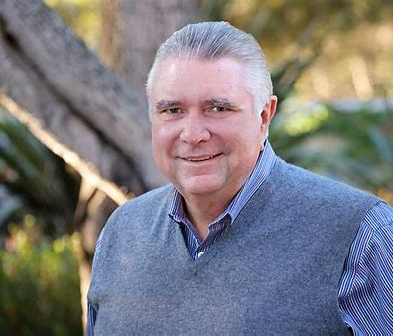
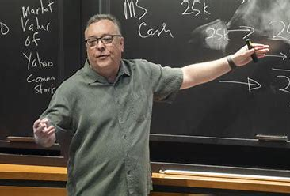
What do we do with Rick?
Rick Antle of
Tanamura & Antle
Oops, wrong Rick!!

Slide 31
Ponzi Schemes
Work by inviting/encouraging/inducing people to make a key mistake:
Confuse creation of wealth with the redistribution of wealth.
Accounting words: confusing income (or profit) generating activities with financing, or capital raising (and returning) activities.

