Slide 1
Financial Accounting LAW 21474
Session 3: Analyzing and Recording Transactions, Adjusting and Closing

Slide 2
Today
Do Rick and Stan’s Business
Transactions
Adjustments
Depreciation Expense
Rent Expense
Interest Expense
Closing
Journal entries, post to T-accounts, prepare financial statements
First, Debits and Credits: What, Why and How

Slide 3
Debits and credits

Slide 4
Rick and stan’s business

Slide 5
Here’s What We Will Do
Record all the transactions that took place from Oct 1 to Dec 31 with journal entries
Make adjustments to the accounts to bring them up-to-date as of Dec 31.
Close the books on Dec 31.
Prepare financial statements.

Slide 6
Along the Way, We Will:
Use temporary accounts to record the revenues and expenses
Post the transactions to the T-accounts
Post the adjustments to the T-accounts

Slide 7
Depreciation
Oct 1, 20X5
Sept 30, 20Y0
Dec 31, 20X5
Dec 31, 20Y0
3 months
of depreciation
One year of depreciation
9 months
of depreciation

Slide 8
Calculation of depreciation
$60k
=
$12k per year
5 years
3
Depreciation
for Oct 1 to
Dec 31
x
$12k
=
$3k
12
Can you make the entry?

Slide 9
Prepaid Rent
Sept 30, 20X6
Oct 1, 20X5
Dec 31, 20X5
Dec 31, 20X6
9 months of rent
3 months
of rent

Slide 10
Calculation of rent
$3k
=
$250 per month
12 months
3
Rent
for Oct 1 to
Dec 31
x
$250
=
$750
12
Can you make the entry?

Slide 11
Calculation of interest
3
12%
$20,000
*
1 +
- $20,000
= $606.02
12
Interest cost
for Oct 1 to
Dec 31
Can you make the entry?

Slide 12
Next Steps
Post journal entries
Reorganizes the information
Close temporary accounts
Make up financial statements

Slide 13
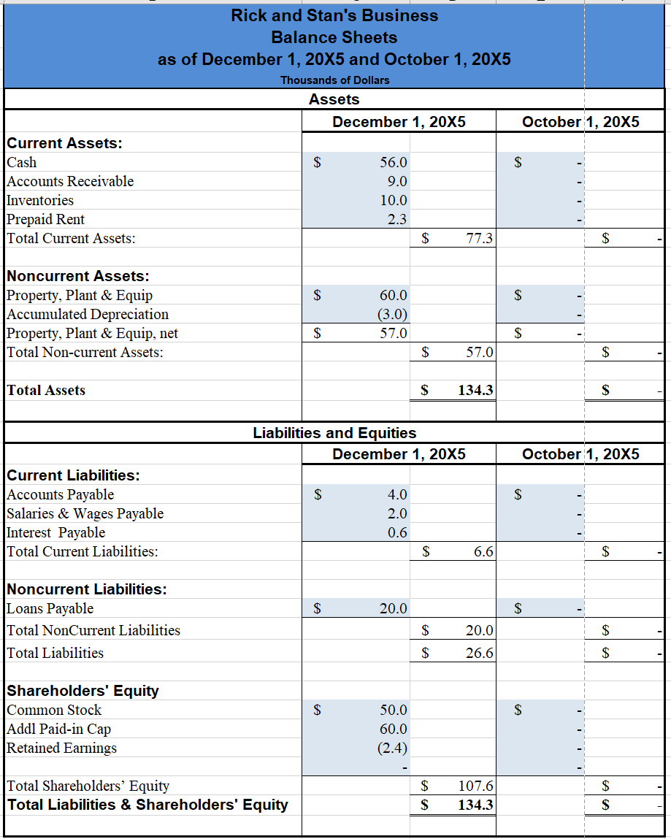

Slide 14
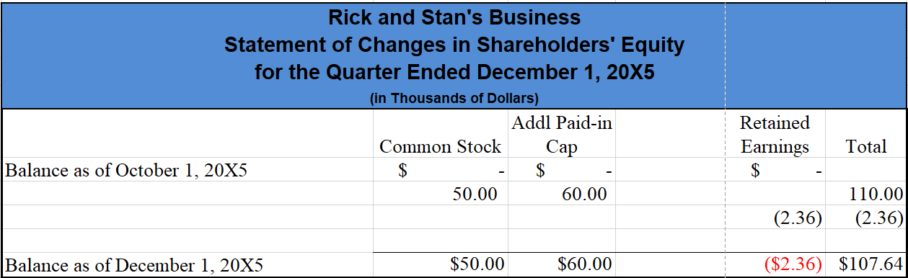

Slide 15
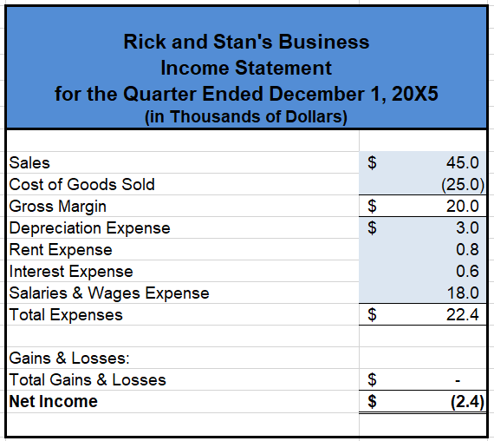

Slide 16
Observations
Which notation is better?
Equations
T-accounts
Temporary accounts handle changes in Retained earnings resulting from operations

Slide 17
Next Time
More practice

