Slide 1
Financial Accounting LAW 21474
Session 4: Income Statements

Slide 2
Today
RetailBiz, Inc.
Start Rick and Stan’s Business
Journal Entries
Adjustments
Depreciation Expense
Rent Expense
Interest Expense
Closing
Prepare balance sheet, statement of shareholders’ equity, and income statement

Slide 3
Retailbiz, inc.

Slide 4
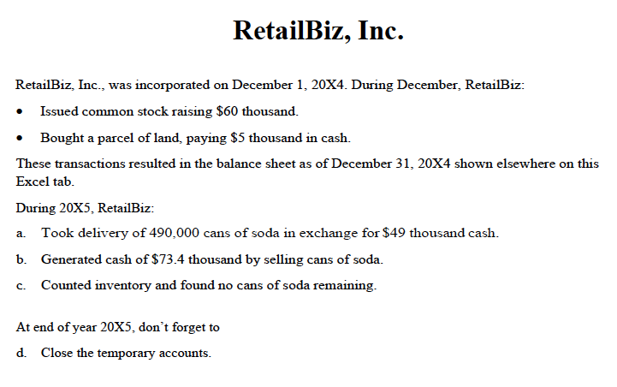

Slide 5
RetailBiz, Inc.
Step 1: Prepare starting point
Enter beginning Balance Sheet
Enter beginning balances in Statement of Shareholders’ Equity
Step 2: Record transactions and events
Step 3: Make adjustments
Step 4: Close temporary accounts
Step 5: Prepare financial statements

Slide 6
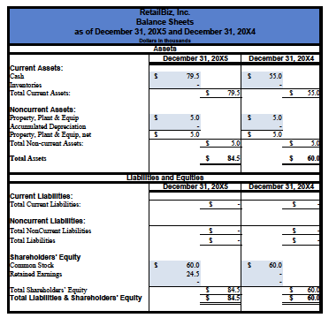

Slide 7
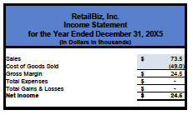

Slide 8
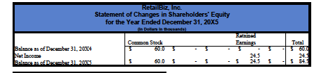

Slide 9
Rick and stan’s business

Slide 10
Rick and Stan’s Business
Step 1: Prepare starting point
Enter beginning Balance Sheet
Enter beginning balances in Statement of Shareholders’ Equity
Step 2: Record transactions and events
Step 3: Make adjustments
Step 4: Close temporary accounts
Step 5: Prepare financial statements

Slide 11
Adjustments
Go to T-accounts
Are we comfortable preparing financial statements from:
Balance Sheet: Ending balances
Income Statement: Totals from the temporary accounts
Statement of Shareholders’ Equity: Ending balances and totals from temporary accounts?
Yes
Close temporary accounts
Prepare financial statements
No
Make adjusting entries
Close temporary accounts
Prepare financial statements

Slide 12
Depreciation
Oct 1, 2005
Sept 30, 2010
Dec 31, 2005
Dec 31, 2010
3 months
of depreciation
One year of depreciation
9 months
of depreciation

Slide 13
Calculation of depreciation
$60k
=
$12k per year
5 years
3
Depreciation
for Oct 1 to
Dec 31
x
$12k
=
$3k
12
Can you make the entry?

Slide 14
Prepaid Rent
Sept 30, 2006
Oct 1, 2005
Dec 31, 2005
Dec 31, 2006
9 months of rent
3 months
of rent

Slide 15
Calculation of rent
$3k
=
$250 per month
12 months
3
Rent
for Oct 1 to
Dec 31
x
$250
=
$750
12
Can you make the entry?

Slide 16
Calculation of interest
3
12%
$20,000
*
1 +
- $20,000
= $606.02
12
Interest cost
for Oct 1 to
Dec 31
Can you make the entry?

Slide 17
Next Steps
Close temporary accounts
Make up financial statements

Slide 18
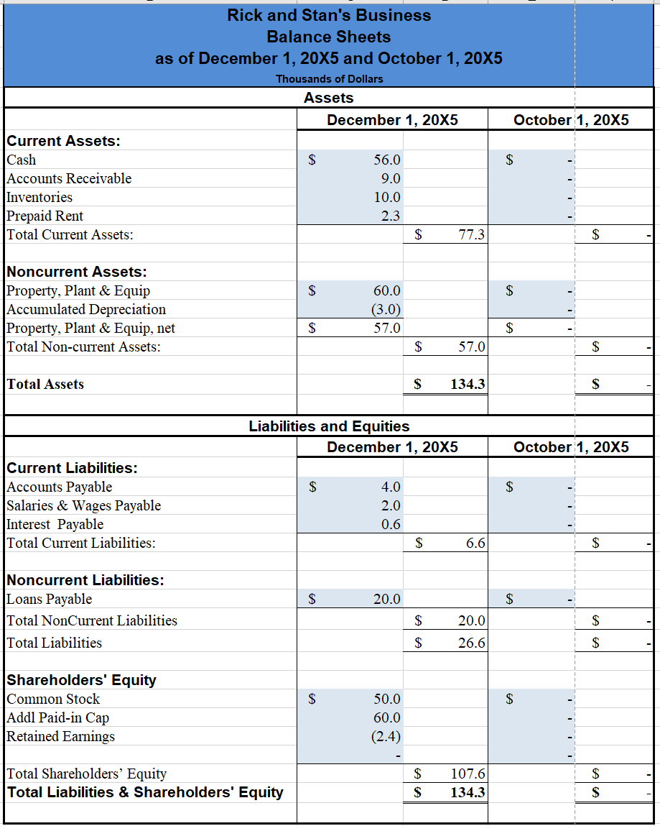

Slide 19
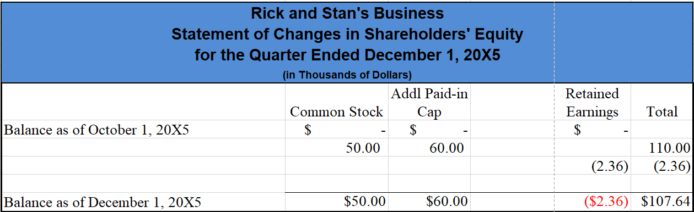

Slide 20
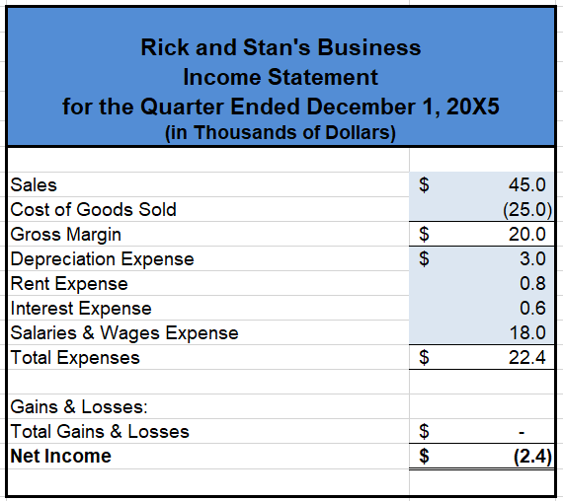

Slide 21
Observations
Are you beginning to see the advantages of:
Journal entry notation:
T-accounts?
Temporary accounts handle changes in Retained earnings resulting from operations

Slide 22
Next Time
More practice

