Slide 1
Financial Accounting LAW 21474
Session 10: Cash Flows and Accruals

Slide 2
Net Income vs Cash Flow from Operations
Definition of cash flows:
The change in cash over a period.
Definition of net income (loss):
Net value generated (consumed) over a period.
Difference is due to our use of accruals, e.g.:
Sales revenue versus cash collected from customers
Cost of goods sold (expense) versus cash paid to suppliers
Wages expense versus wages paid
Rent expense versus rent paid

Slide 3
Total Toy Company: Basics
Only operations
no financing or investment
Buy dolls for $24 each, sell them for $30 each
CGS is the only expense
No rent, labor, taxes, marketing, etc. required
Lasts only 1 year, total sales 14,400 dolls

Slide 4
Economics of Total Toy
$
Total revenue
$ Amount
of Revenue
Recognized
Total cost
Net Income
$ Amount
of cost matched to
revenue
$30/doll
$24/doll
# of dolls
Number of dolls sold

Slide 5
Economics of Total Toy
$
Total revenue
Revenue:
$432,000
Total cost
Profit: $86,400
Expenses:
$345,600
$30/doll
$24/doll
14,400
# of dolls

Slide 6
Operational Details: Demand
Growth phase
Demand starts at 0 units, grows by 600 units per month
Steady state
Demand constant at 1,800 units per month
Decline phase
Demand decreases by 600 units per month until it hits zero

Slide 7
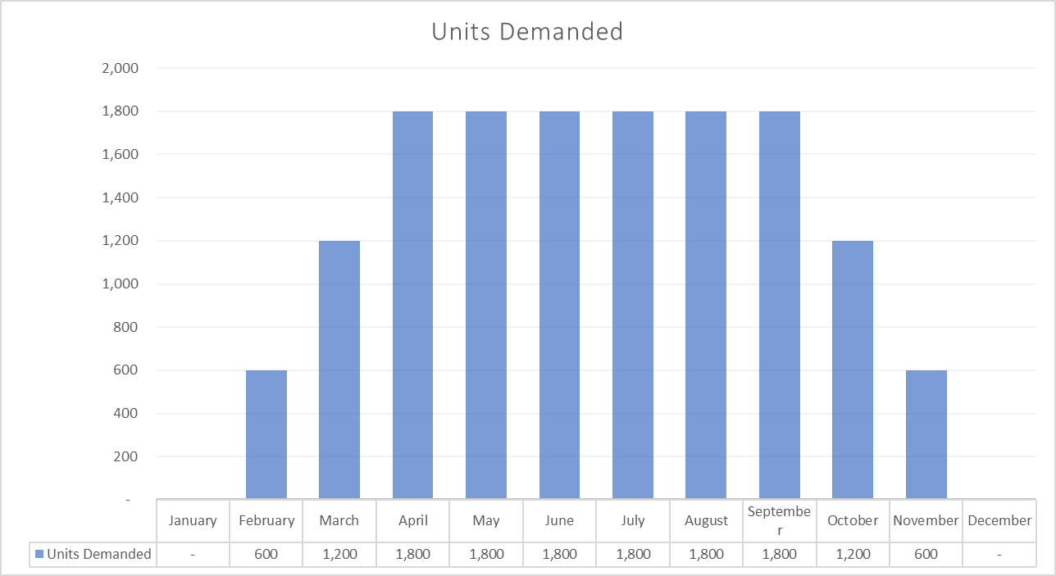
Demand for Dolls
Steady State
Growth
Decline

Slide 8
Operational Details: Inventory, Receivables & Cash Flow
Need: inventory = next month’s sales
Pay suppliers immediately
Inventory sits for 30 days
Customers pay with a 30-day lag

Slide 9

Timeline
$24
$30
January
February
March

Slide 10
The graphs that follow are illustrative
Exact graphs are in the Appendix to this presentation. To explore the relationships, use the Excel workbook: Total_Toy_NI_CFO_Phases

Slide 11
Cash Flows During Growth
$
Pay for more than you collect on in a growing business.
Revenues $36k
Income $7.2k
Cash outflow
Receipts
Disbursements
Expenses $28.8k
February
600
March
1,200
April
1,800
# of dolls

Slide 12
Cash Flows During Steady State
$
NI = Cash Flow in
Steady State
Revenues $54k
Receipts $54k
Income $10.8k
Cash inflow $10.8
Disbursements $43.3k
Expenses $43.2k
August
1,800
June
1,800
July
1,800
# of dolls

Slide 13
Cash Flows During Decline
$
Collect on more than you buy in a declining business.
Receipts $54
Revenues $36k
Income $7.2k
Cash inflow $39.6k
Expenses $28.8k
Disbursements $14.4k
November
600
October
1,200
September
1,800
# of dolls

Slide 14
What We Can Learn from Total Toy
In theory, cash flows and financial values are connected (at least over the long run), but the connection is complicated.
In practice, we must pay close attention to the timing of cash flows to make sure we can operate the entity.
The relation between Net Income and Cash Flows tells us more than the amount of either.

Slide 15
Exact graphs for total toy
Appendix 1

Slide 16
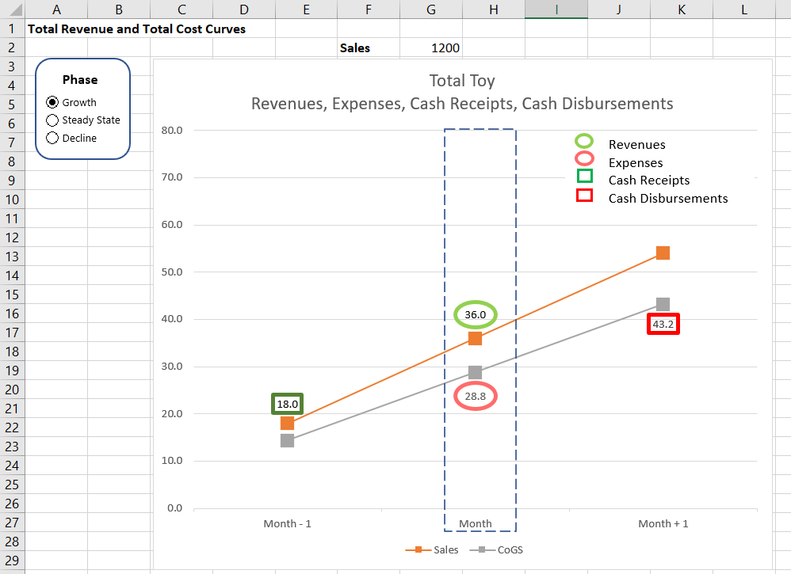

Slide 17
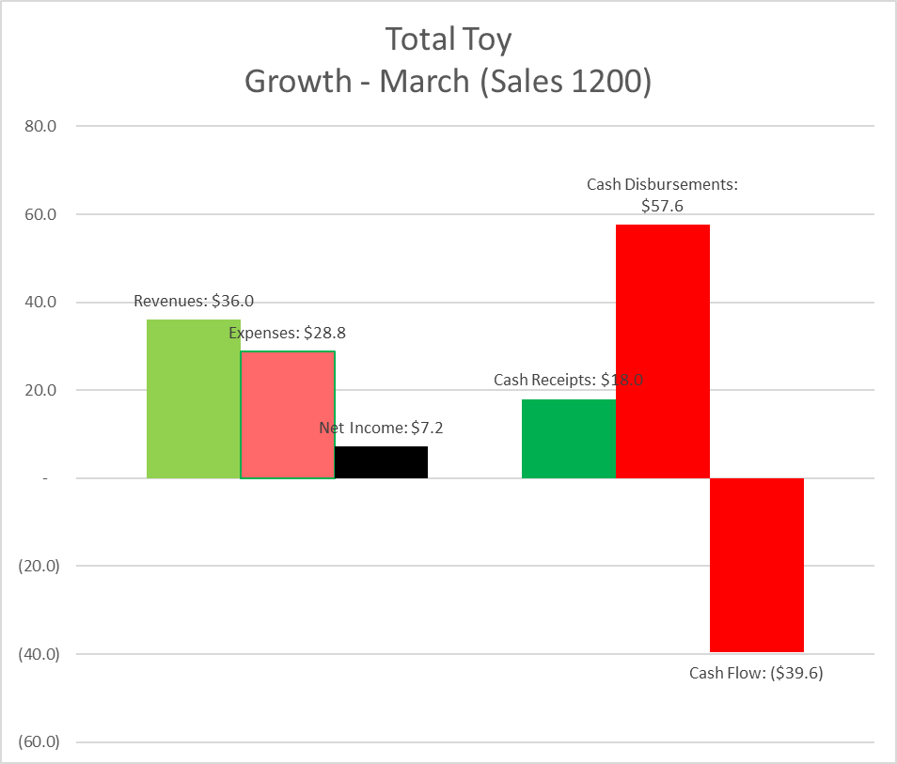

Slide 18
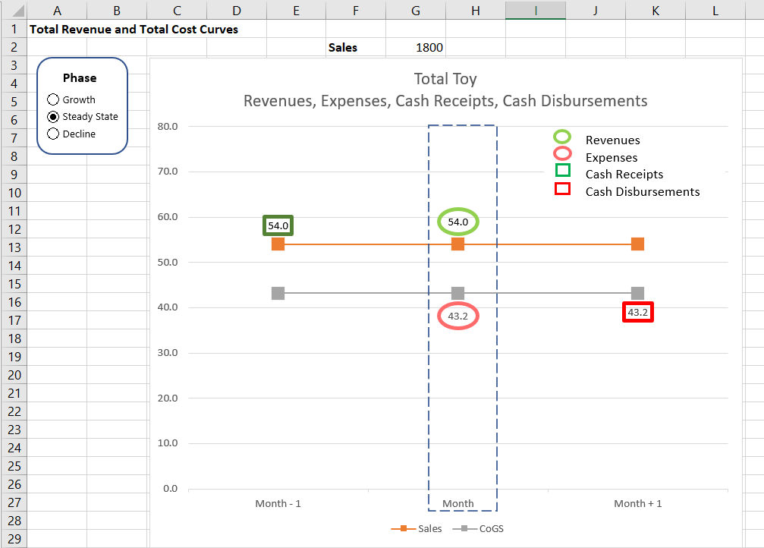

Slide 19
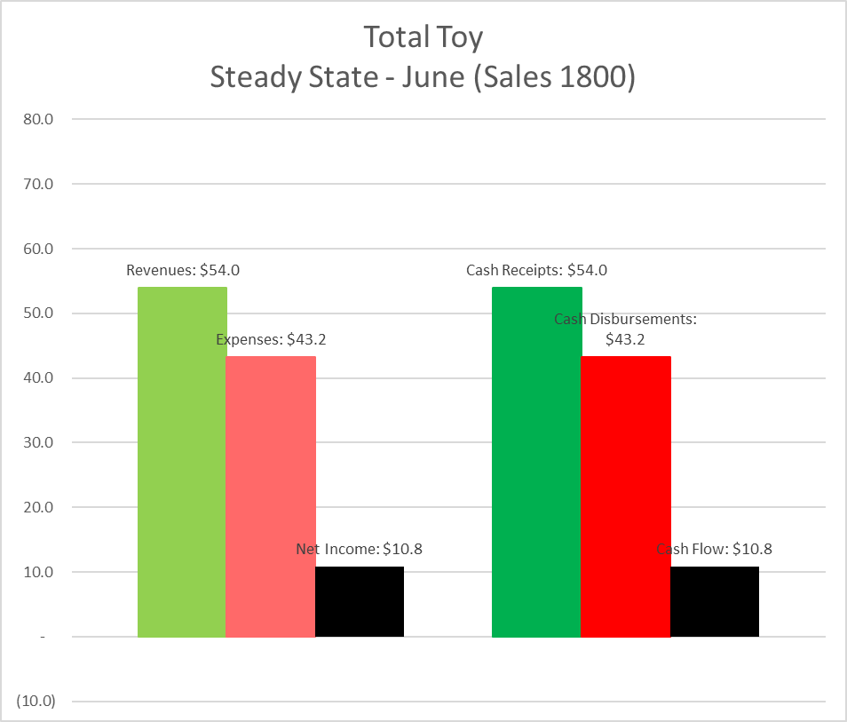

Slide 20
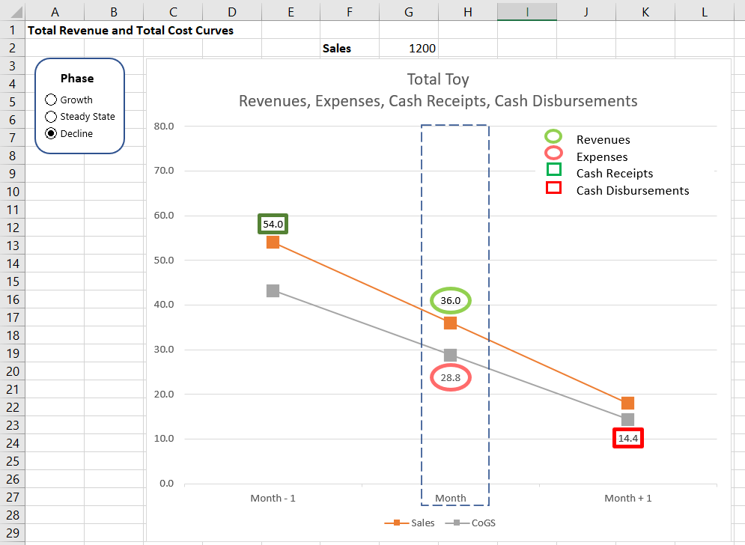

Slide 21
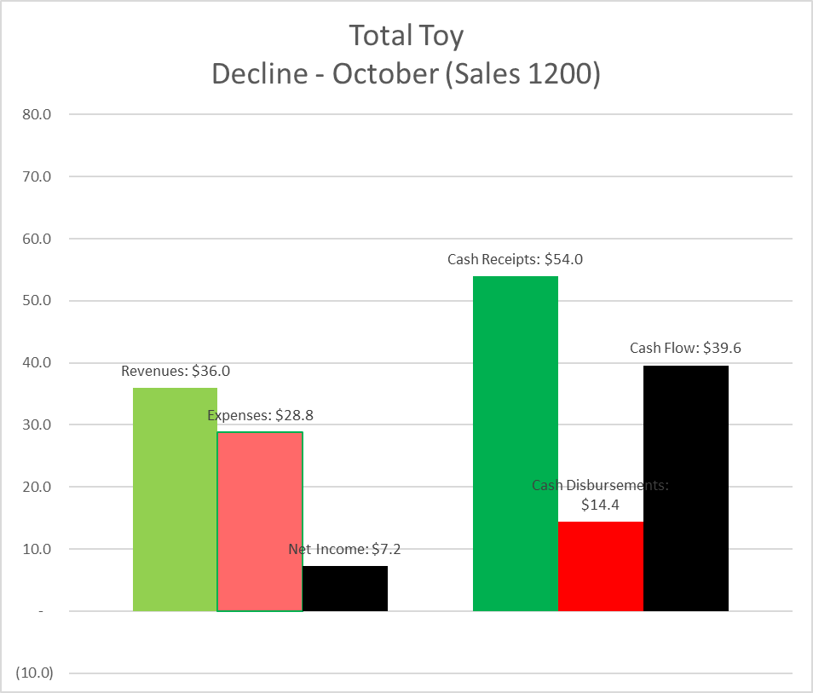

Slide 22
Cash flows & accruals
Appendix 2

Slide 23
Suppose Value is Created
If all the value has been received in cash in the past
HERE
If all the value is received in cash in the future
If all the value is received in cash in the current period
Must have a liability
Just count the cash
Must have an asset
HERE
HERE
HERE
Period in which Revenue is recognized

Slide 24
Suppose Value is Consumed
HERE
If all the value is paid for with current cash disbursements, just count the cash flow
If all the value is to be paid for in cash in the future, must create a liability
If all the value has paid for in cash in the past, must create an asset
HERE
HERE
HERE
Period in which Expense is recognized

