Slide 1
LAW 21474 Financial Accounting
Session 16: Accounts Receivable

Slide 2
Four Goals of Accounting for Accounts Receivable
Keep track of who owes what
Recognize the creation of the AR asset in the proper period
This is the balance sheet equivalent of revenue recognition
Have balance sheet reflect economic value of accounts receivable
Match bad debts against revenues in the proper period (have the income statement reflect economic reality of the transactions)

Slide 3
How GAAP Works
Record accounts at amounts owed in Accounts Receivable
Set up a contra-asset: Allowance for doubtful accounts
Write-offs reduce Accounts Receivable and the Allowance for Doubtful Accounts
Estimated bad debts are treated as an expense: Bad Debts Expense

Slide 4
Use of Contra Account
Accounts Receivable
Allowance for Doubtful Accounts
Beginning Balance
Beginning Balance
Collections
Sales
Bad Debts Expense
Write-offs
Write-offs
Obtained in business acquisitions
Sold in business dispositions
Sold in business dispositions
Obtained in business acquisitions
Ending Balance
Ending Balance

Slide 5
Balance Sheet Presentation
 | Ending Balance Sheet | Beginning Balance Sheet
Accounts Receivable | 100 | 90
Allowance for Doubtful Accounts | (2) | (3)
Accounts Receivable, net | 98 | 87

Slide 6
MGM Mirage - Balance Sheet (000s)
 | December 31,
 | 2004 | 2003
ASSETS
Current assets
Cash and cash equivalents | 435,128 | 279,606
Accounts receivable, net | 204,151 | 139,475
Inventories | 70,333 | 65,189
Income tax receivable |  | 9,901
Deferred income taxes | 28,928 | 49,286
Prepaid expenses and other | 81,662 | 89,641
Assets held for sale |  | 226,082
Total current assets | 820,202 | 859,180
Property and equipment, net | 8,914,142 | 8,681,339
Other assets
Investments in unconsolidated affiliates | 842,640 | 756,012
Goodwill and other intangible assets, net | 233,335 | 267,668
Deposits and other assets, net | 304,710 | 247,070
Total other assets | 1,380,685 | 1,270,750
 | 11,115,029 | 10,811,269

Slide 7
Two basic approaches to accounting for bad debts
% of sales method
Does matching very well
Balance sheet valuation of A/R might not be perfectly accurate
Analysis of outstanding receivables, e.g. aging method individual account analysis
Driven by analysis of the balance sheet (i.e, the balance in A/R), good balance sheet valuation results
May not match well

Slide 8
% of Sales
Estimate this
Accounts Receivable
Allowance for Doubtful Accounts
Bad
Debts
Exp.
Sales
Ending BS AR
Ending BS ADA

Slide 9
% Sales Method
Use historical data to estimate the relation between sales and bad debts.
Period | Sales | Eventually collected | %uncollected
Year 1 | $100 | $92 | 8.0%
Year 2 | $110 | $101 | 8.2%
Year 3 | $115 | $106 | 7.8%
Year 4 | $105 | $96 | 8.6%
Year 5 | $120 | $111 | 7.5%
Average: 8%

Slide 10
Analysis of Outstanding Accounts Receivable
Accounts Receivable
Allowance for Doubtful Accounts
Bad
Debts
Exp.
Sales
Ending BS AR
Ending BS ADA
Estimate this

Slide 11
Aging of Receivables
Tabulate receivables by how long they have remained uncollected.
The older they are, the more likely they will be uncollectible
An example: suppose
0 to 30 days, 0.5% uncollectible
30 to 60 days, 2% uncollectible
more than 60 days, 100% uncollectible

Slide 12
Example
Sales | $100
Collections | $60
Write-offs | $3
%Sales | Estimated bad debts = 8% Sales
Beginning AR and ADA | $0
Aging | Estimated ending ADA = $8

Slide 13
Journal Entries - %Sales Method
Accounts Receivable 100 Sales Revenue 100
Bad debt Expense 8 Allowance for Uncollectibles 8
Cash 60 Accts Receivable 60
Allowance for Uncollectibles 3 Accts Receivable 3

Slide 14
% of Sales
Accounts Receivable
Allowance for Uncollectibles
Sales*8%
0
0
Bad
Debts
Exp.
Sales
100
60
8
3
3
37
5

Slide 15
% Sales
Balance sheet: Accounts Receivable, net $32
Income statement: Bad Debts Expense $8
Cash flow statement:
Direct method: Collections from customers $60
Indirect method: ChAR due to ops $32
(or BD Expense $8 and ChAR due to ops $40)

Slide 16
Journal Entries - Aging Method
Accounts Receivable 100 Sales Revenue 100
Cash 60 Accts Receivable 60
Allowance for Uncollectibles 3 Accts Receivable 3
Do T accounts before we do this

Slide 17
Account Analysis: Aging
Accounts Receivable
Allowance for Uncollectibles
0
0
Bad
Debts
Exp.
Sales
100
60
11
3
3
37
8

Slide 18
Journal Entries - Aging Method
Accounts Receivable 100 Sales Revenue 100
Cash 60 Accts Receivable 60
Allowance for Uncollectibles 3 Accts Receivable 3
Bad debt Expense 11 Allowance for Uncollectibles 11

Slide 19
Aging
Balance sheet: Accounts Receivable, net $29
Income statement: Bad Debts Expense $11
Cash flow statement:
Direct method: Collections from customers $60
Indirect method: ChAR due to ops $29
(or BD Expense $11 and ChAR due to ops $40)

Slide 20
Yale’s Accounts Receivable
Can have a
contra to show at
present value if
time to collect is
long.

Slide 21
MGM Mirage Income Statement (000s)
 | Year Ended December 31,
 | 2004 | 2003 | 2002
Revenues
Casino | 2,223,965 | 2,037,514 | 2,012,840
Rooms | 911,259 | 833,272 | 796,861
Food and beverage | 841,147 | 757,278 | 706,153
Entertainment | 270,799 | 255,995 | 251,488
Retail | 184,438 | 180,935 | 170,537
Other | 240,880 | 210,772 | 215,600
 | 4,672,488 | 4,275,766 | 4,153,479
Less: Promotional allowances | (434,384) | (413,023) | (396,551)
 | 4,238,104 | 3,862,743 | 3,756,928
Expenses
Casino | 1,106,142 | 1,040,948 | 1,007,968
Rooms | 247,387 | 234,693 | 211,401
Food and beverage | 482,417 | 436,754 | 393,166
Entertainment | 192,390 | 183,012 | 181,403
Retail | 118,413 | 115,123 | 108,325
Other | 146,146 | 130,698 | 114,431
Provision for doubtful accounts | (3,629) | 12,570 | 27,675
General and administrative | 612,615 | 583,599 | 560,909
Corporate expense | 77,910 | 61,541 | 43,856
Preopening and start-up expenses | 10,276 | 29,266 | 14,141
Restructuring costs (credit) | 5,625 | 6,597 | (17,021)
Property transactions, net | 8,665 | (18,941) | 14,712
Depreciation and amortization | 402,545 | 400,766 | 381,785
 | 3,406,902 | 3,216,626 | 3,042,751
Income from unconsolidated affil’s | 119,658 | 53,612 | 32,361
Operating income | 950,860 | 699,729 | 746,538
NOTE: this income statement does not stop here – there are other items

Slide 24
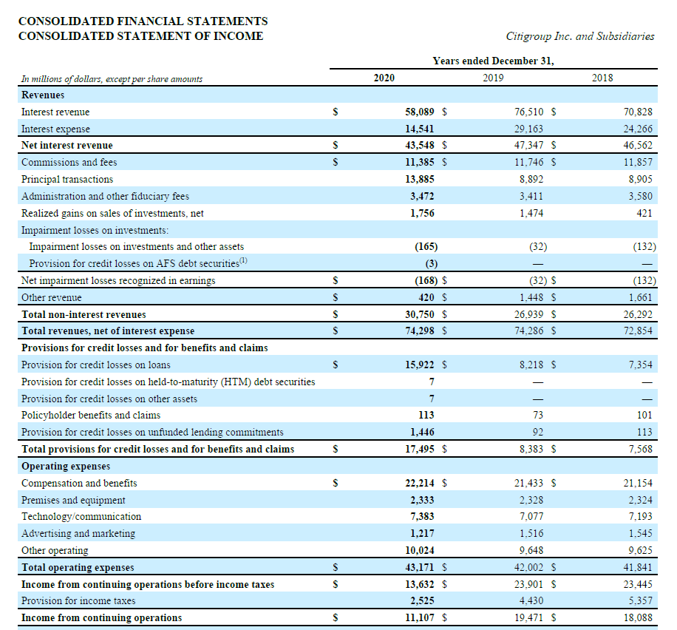

Slide 25
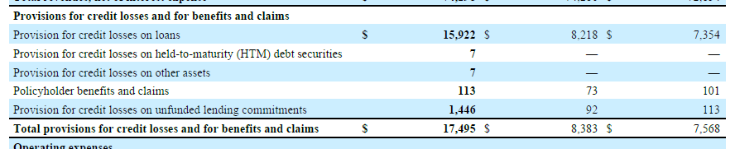

Slide 33
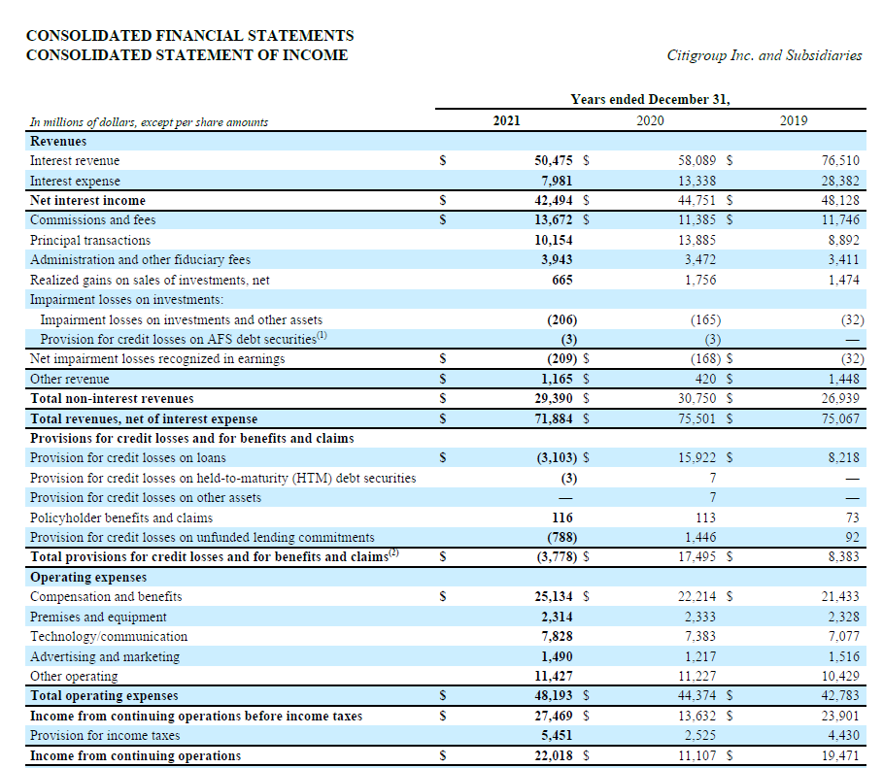

Slide 34
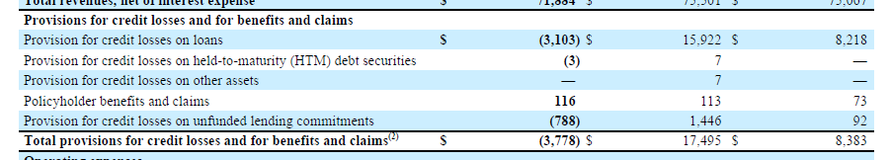

Slide 35
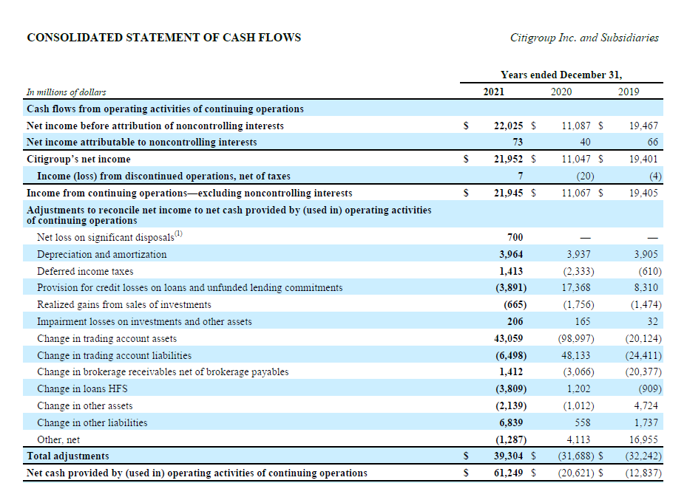
Same story
as MGM Mirage

Slide 36
Next time
Marketable Securities

