Slide 1
LAW 21474 Financial Accounting
Session 17: Marketable Securities

Slide 2
Agenda
Define marketable securities
GAAP for marketable securities
Berkshire Hathaway case

Slide 3
Definition
Marketable securities are the debt and equity securities of other entities that a company holds as a passive investment.
A passive investment is one for which there is no ability to influence the operations of the investee.
Debt securities are bonds, notes receivable, etc.
Equity securities are shares of stock.

Slide 4
T-Account After Recording All Transactions of the Period
Marketable Securities
Beginning Balance
Market value?
Purchases
Cost of MS Sold
Ending Balance

Slide 5
Mark-to-Market (Fair Value)
Marketable Securities
Beginning Balance
Purchases
Cost of MS Sold
Unrealized Holding Gain
Unrealized Holding Loss
Ending Balance

Slide 6
Mark-to-Market, Net Income & AOCI
Suppose there is an unrealized holding loss:
Accnt to Dr | Accnt to Cr | Accnt to Cr | Dr Amt | Cr Amt
Unrealized Holding Loss on Marketable Securities |  |  | X
 | Marketable Securities |  |  | X
Temporary Account that should be closed?
MAYBE:
Ask your Mother!

Slide 7
Accumulated Other Comprehensive Income
Holds cumulative gains and losses that have not been closed. I.e., they have not been put into Retained Earnings through closing.
Example, Berkshire Hathaway Inc. from 2018, the year of a change in US GAAP accounting rules on marketable securities.

Slide 8
Equity Securities
With a readily determinable fair value
Valued at fair value at each balance sheet date
Gains or losses reflected in net income
Without a readily determinable fair value
Qualifies for the practical expedient to estimate fair value
Investments in entities that calculate a net asset value per share (or equivalent, such as membership units)
Use the net asset value per share
Does not qualify for the practical expedient, entity may elect
Cost minus impairment

Slide 9
Definition
Equity securities must have a readily determinable fair value. I.e., if it meets any of:
…[S]ales prices or bid-and-asked quotations are currently available on a securities exchange registered with the U.S. Securities and Exchange Commission (SEC) or in the over-the-counter market, provided that those prices or quotations for the over-the-counter market are publicly reported by the National Association of Securities Dealers Automated Quotations systems or by OTC Markets Group Inc. Restricted stock meets that definition if the restriction terminates within one year.
…[It is]traded only in a foreign market … of a breadth and scope comparable to one of the U.S. markets referred to above.
…[A]n investment in a mutual fund or in a structure similar to a mutual fund … if the fair value per share (unit) is determined and published and is the basis for current transactions. https://asc.fasb.org/glossarysection&trid=2196938&id=SL2285215-111558 accessed March 30, 2020 15:04 EDT

Slide 10
Debt Securities: Three Categories
Trading
Those debt or equity securities on which the company intends to make profits by trading (i.e. buying & selling)
Available-for-sale
Not trading or held-to-maturity.
Held-to-maturity
Those debt securities that the company intends to hold to maturity.

Slide 11
GAAP – Trading Securities
Marked-to-market
Any holding gains or losses reflected as part of net income

Slide 12
GAAP – Available-for-sale Securities
Marked-to-market
Holding gains and losses
Not counted in net income: Direct-to-equity entry
Realized gains and losses
Always counted in net income

Slide 13
Available-for-sale Equity Accounts
Using “fair values” for the available-for-sale securities without recognizing the holding gains and losses as affecting net income requires creating another equity account.
Usually, we call this equity account Accumulated Other Comprehensive Income.

Slide 14
Another Income Calculation
GAAP net income no longer reflects the increase in net assets produced (i.e., not raised from owners) over a period.
Add another accounting statement called the Statement of Comprehensive Income.
There are policy-making reasons for this, not economic or managerial ones.

Slide 15
GAAP – Held-to-maturity Securities
Accounted for at amortized cost – cost plus accrued interest
Interest rate is rate in effect for the security on the date it was purchased
No adjustment for unexpected changes in value.

Slide 16
Berkshire hathaway
Investments in 2018: Effects of Change in Accounting Rules

Slide 17
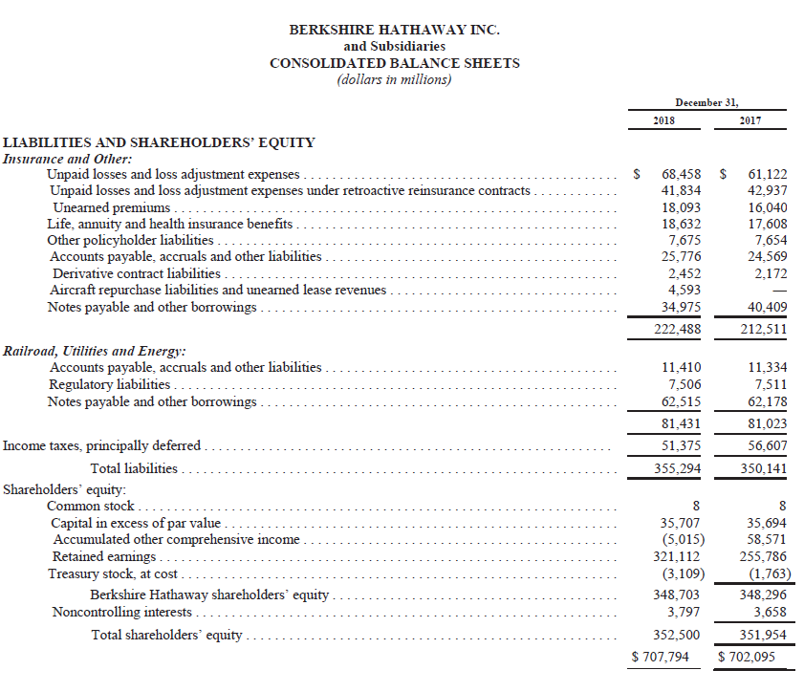

Slide 18
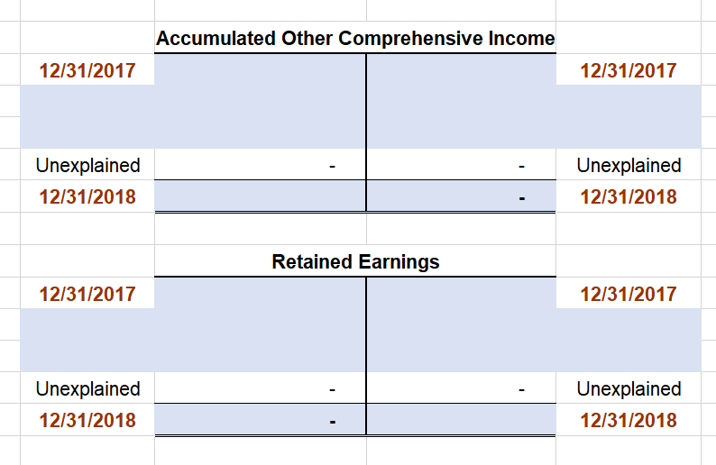

Slide 20
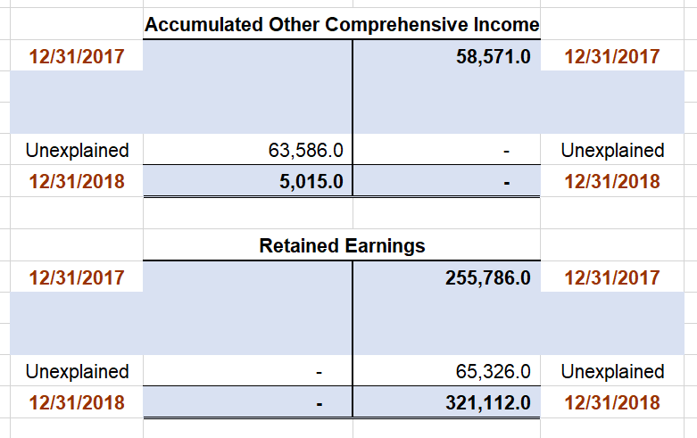

Slide 21
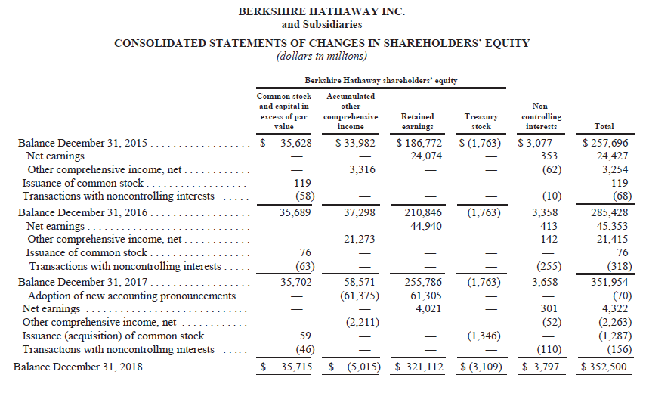

Slide 22
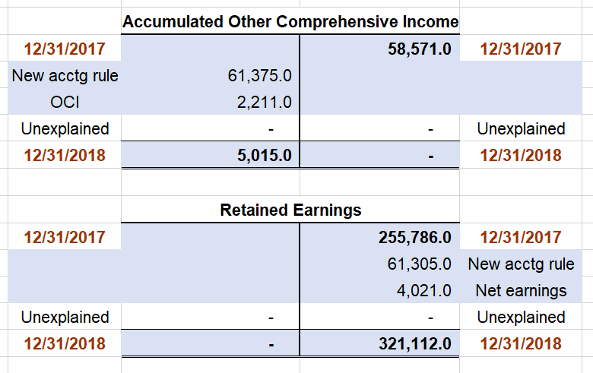

Slide 23
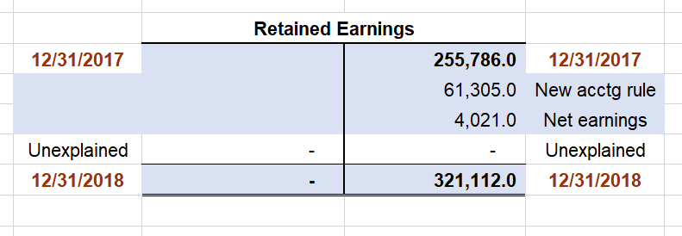
Any Dividends Declared?
No entries here, so
no dividends were declared

Slide 24
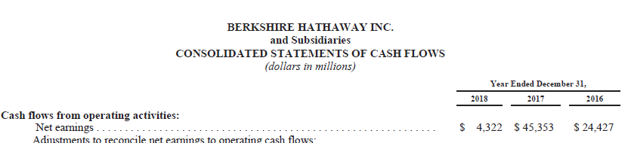
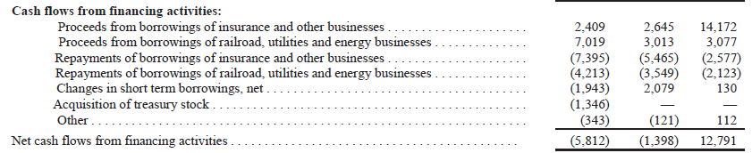
Any Dividends Paid?
No entries here, so
no dividends were paid

Slide 25
Entry to Reclassify AOCI into RE #1

Slide 26
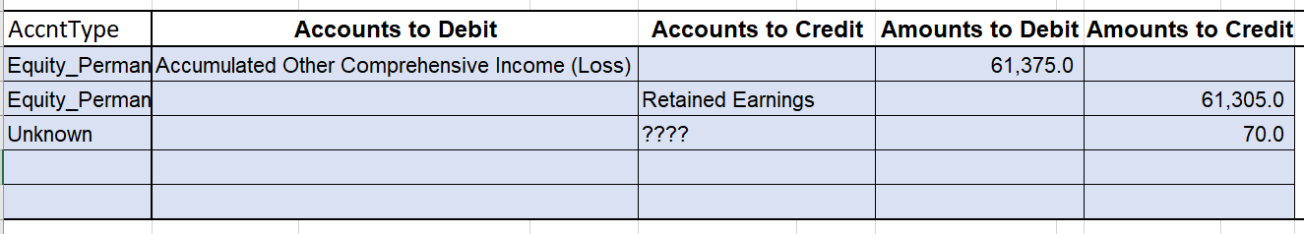

Slide 27
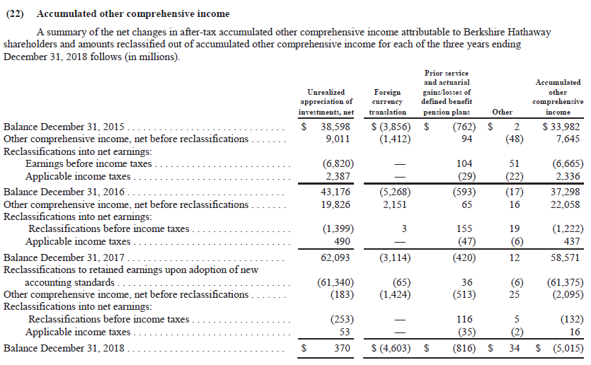
Reclassify AOCI to RE #2

Slide 28
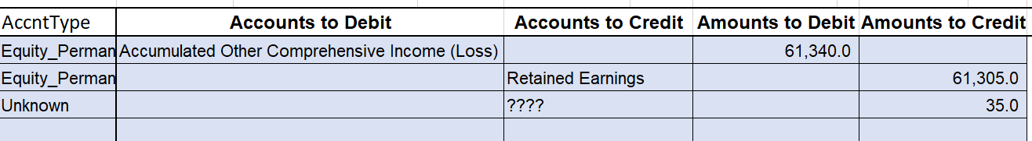

Slide 29
Cash Sales of Investments in Equity Securities

Slide 30
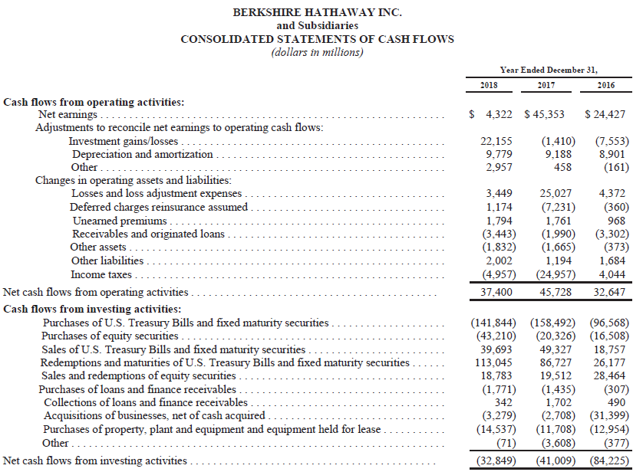

Slide 31
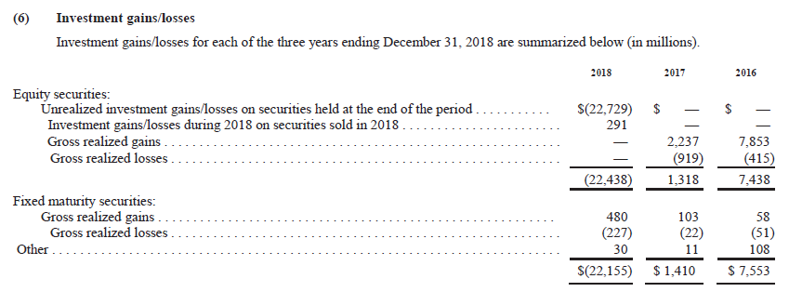

Slide 32
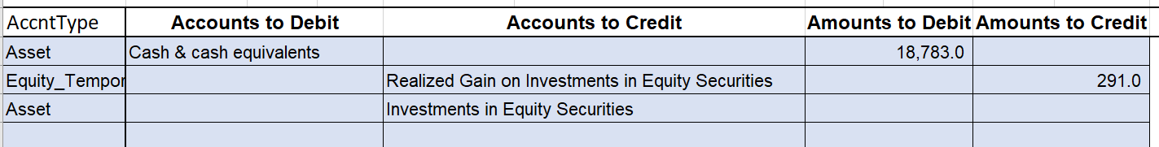
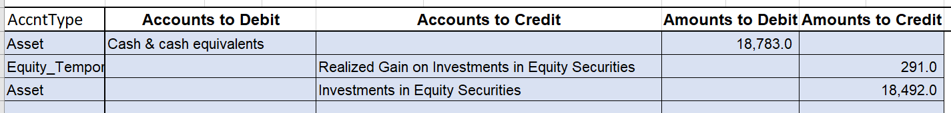

Slide 33
Fair Value Adjustment

Slide 34
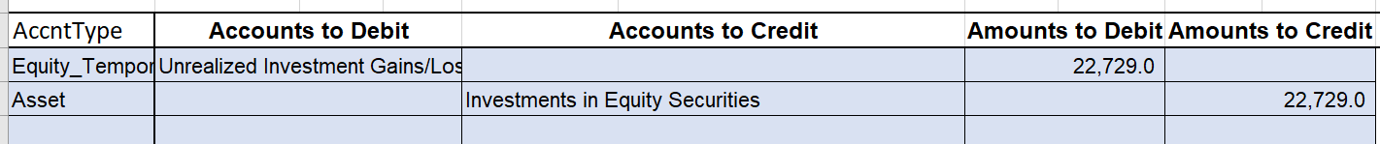

Slide 35
Investments Gains/Losses

Slide 37
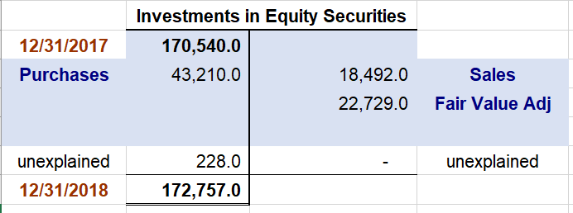

Slide 38
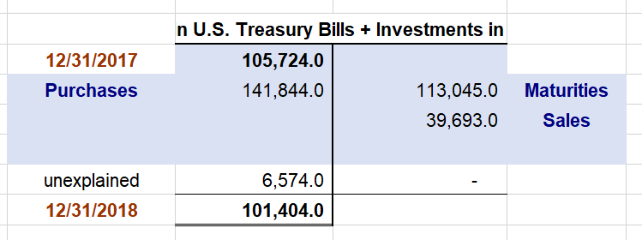

Slide 39
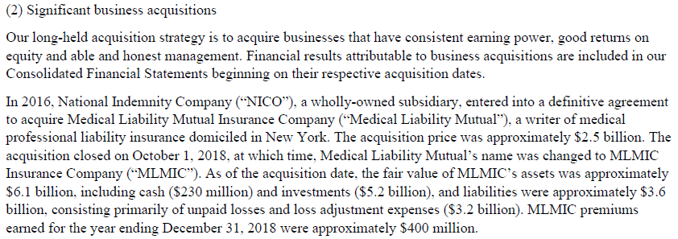

Slide 40
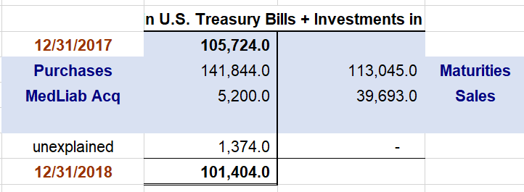

Slide 41
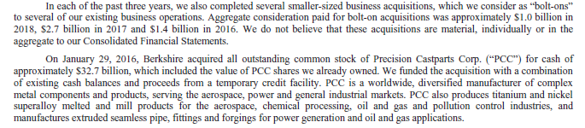
More from Note 2
Gets us part way there, but it is not enough.

Slide 42
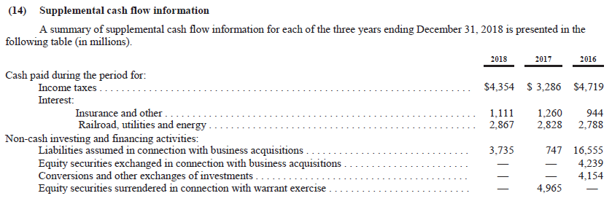
One Last Place to Look
Nothing here seems to help, and I am out of ideas …

Slide 43
One Last Thing
Evaluate Buffett’s arguments against including some gains and losses from the calculation of net income.
Look at what has happened …

Slide 45
Berkshire Case: Conclusion
We could make a lot of progress understanding what went on, but we can’t tie things out exactly.
This example was chosen because Buffett’s letter is worth discussing, not because it was tidy.
But notice how we had some tools to interrogate the financial statements and to assess our progress.

Slide 46
Next Time
Fixed assets
Valuation
Depreciation
Impairment

