Slide 1
Financial Accounting LAW 21474
Session 21: Financial Accounting for Income Taxes – Berkshire Hathaway’s Deferred Taxes in FY 2023

Slide 2
Berkshire Hathaway Inc.
Financial Statement for year ended 12/31/2023 excerpts from 10-K

Slide 3
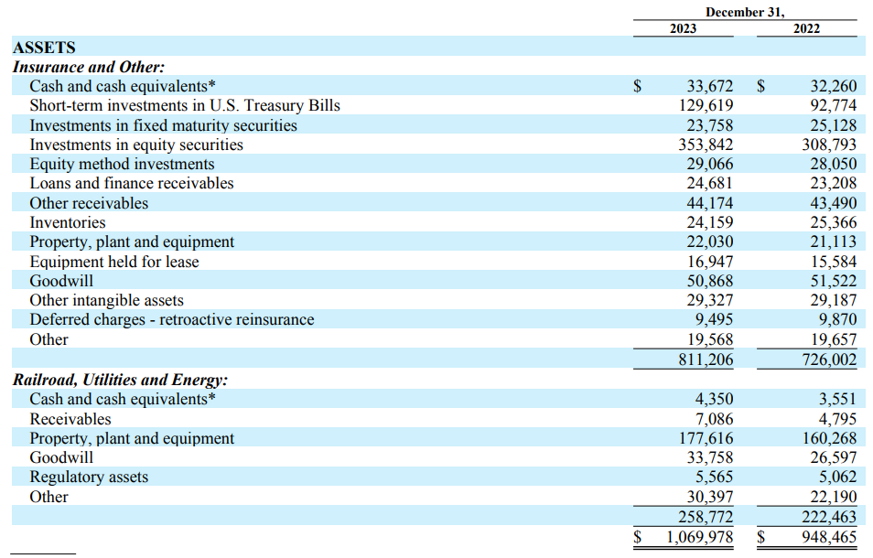

Slide 4
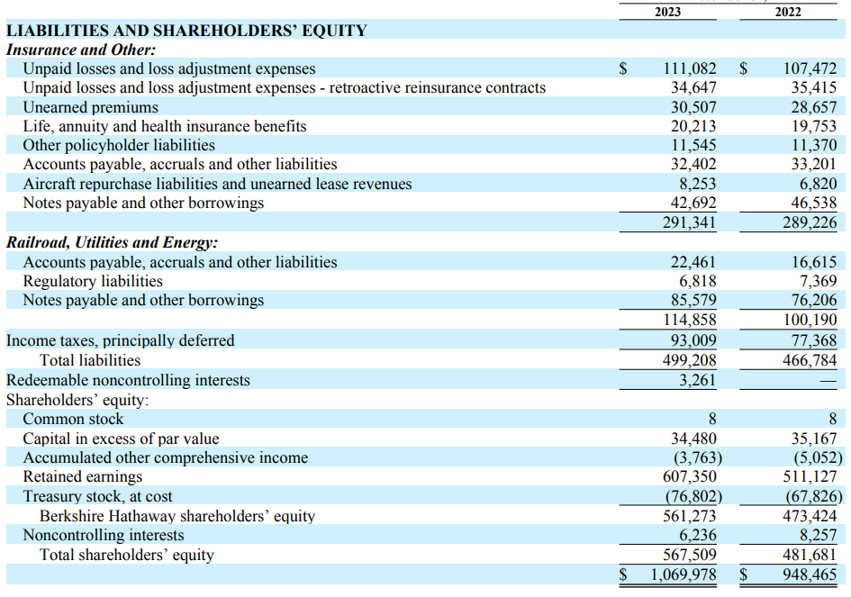

Slide 5
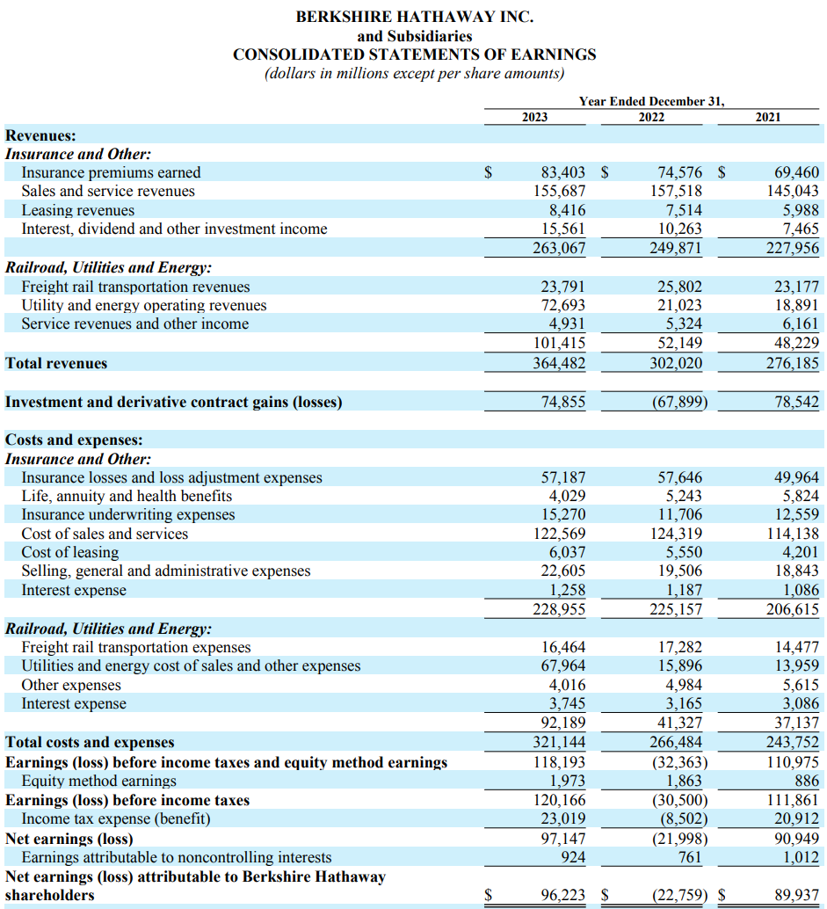

Slide 6
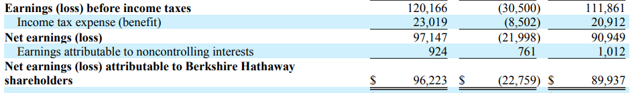

Slide 7
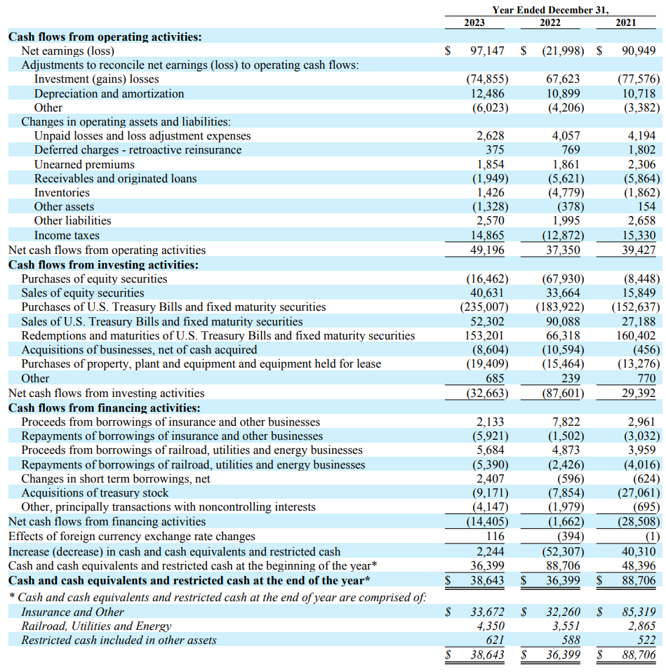

Slide 9
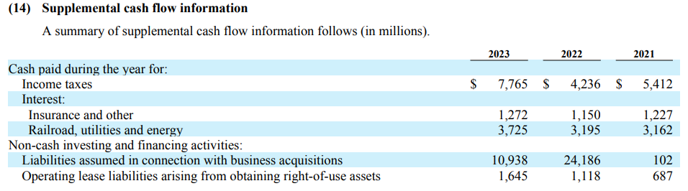

Slide 10
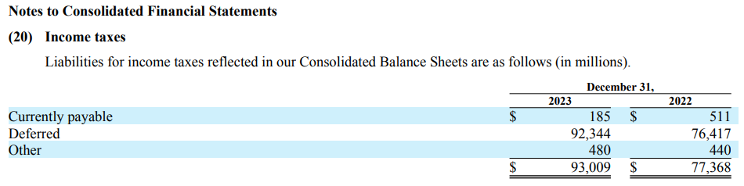

Slide 11
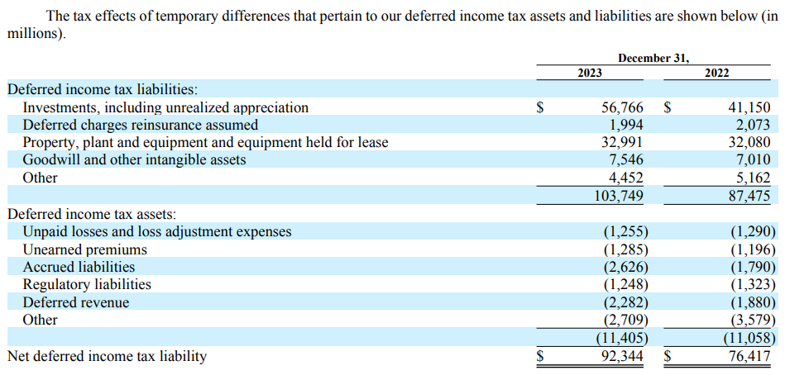

Slide 12
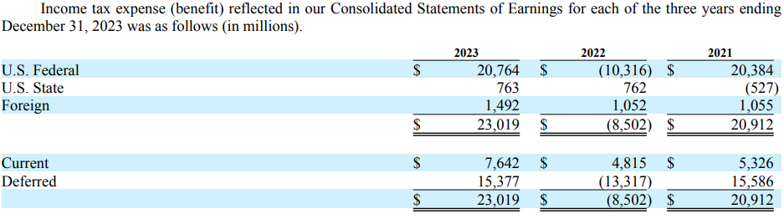

Slide 13
Aggregate Entry
To record Income Tax Expense
Income Tax Expense |  | 23,019
 | Income Taxes Payable |  | 7,642
 | Deferred Income Taxes |  | 15,377

Slide 14
Conclusion
A lot of big numbers for deferred taxes.

