Slide 1
LAW40405 Financial Accounting
Session 25: Perrigo and Review

Slide 2
Grow Corp. and Perrigo Co.
In the early 1990’s I was the expert analyst in a legal case involving a disputed management buyout (MBO)
Steve Ross, former SOM and MIT finance prof and my business partner, was the testifying witness

Slide 3
Parties
Grow Corp.
Manufactured and sold house paint.
Was struggling financially in the period in question.
Was subsequently acquired by ICI (Imperial Chemical Industries) which was itself acquired by AKZO Nobel in 2008.
Perrigo (www.perrigo.com)
Manufacturer of OTC healthcare products.
Store-brand products of familiar brands such as Advil®, Tylenol®, Flonase®, Allegra®, Prilosec® and Nicorette®.
Rx to OTC switches.

Slide 4
Perrigo Story
https://www.youtube.com/watch?v=YHxP1AOW028

Slide 5
Relevant Transactions
Grow
Perrigo
Pre 1986: Separate companies
1986: Grow acquires Perrigo
for $85 million in cash
Perrigo

Slide 6
Relevant Transactions
Grow
Perrigo
(private)
April 1989: Perrigo management
Bought the company from Grow
For $106 million
Perrigo
(public)
Perrigo
Dec 1991: Perrigo
IPO valued it at $1.2 billion

Slide 7
Timeline
About 3 years.
Annualized return: 8%
Less than 3 years.
Annualize return (if 3 years): 124%
Early 1986
April1989
Dec 1991
$85 million
$106 million
$1,200 million
Was this a fair price?
55% growth of $85 million
is $319 million.
About 6 years.
Annualized return: 55%

Slide 8
Timeline
Early 1986
April1989
Dec 1991
$85 million
$106 million
$1,200 million
Get fairness opinion from investment bankers.
Part of required due diligence from Grow management
and board of directors.
Fairness opinion based on three things:
Similar transactions
Multiples of similar companies
Discounted cash flow analysis

Slide 9
Discounted Cash Flow Analysis (DCF)
Based on forecasts of free cash flows: i.e., cash that could be paid to shareholders without damaging the earning power of the company
Here’s how we do it. First, pick a forecast window. In this case it was 10 years.
Forecast sales and expenses
Forecast working capital requirements
Use indirect method cash flow logic to derive prediction of operating cash flow stream
Forecast capital expenditures
Make simple assumption about the value of the company at the end of the forecast window. E.g., company will be worth 4x EBIT.

Slide 10
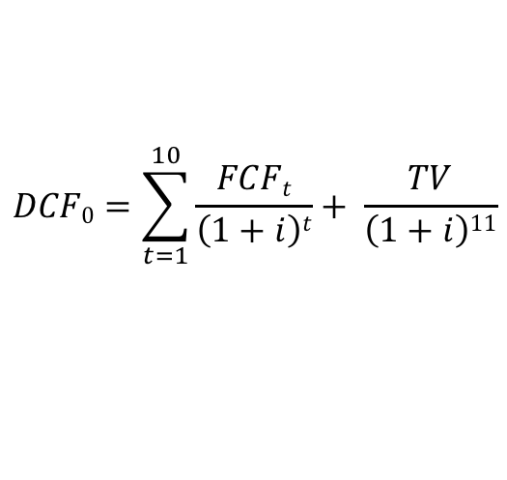
Forecasts
Late 1989
Late 1999
FCF₁
FCF₂
FCF₃
FCF₄
FCF₅
FCF₆
FCF₇
FCF₈
FCF₉
FCF₁₀
Terminal
Value (TV)
CFO_{t}
NI_{t} + Depr ± Necessary Adjustments
- CFI_{t}
- CFI_{t}
= FCF_{t}
= FCF_{t}
$$DCF0=\sum_{t=1}^{10}{\frac{FCFt}{\left(1+i\right)t}+ \frac{TV}{\left(1+i\right)11}}$$
Where do we get the interest rate?
Finance theory helps
Where do we get all the forecasts?
Management

Slide 11
Timeline
Early 1986
April1989
Dec 1991
$85 million
$106 million
$1,200 million
Management doubled its sales and net
Income forecasts here
Two weeks after the buyout closed

Slide 12
Perrigo

Slide 13
Case Facts
Everyone agreed that the right interest rate to use was somewhere between 13.5% and 15.5%
Compare two things:
Range of DCFs using forecasts actually used by investment bankers in arriving at their fairness opinion
Range of DCFs using the forecasts put out by management in May 1989

Slide 14
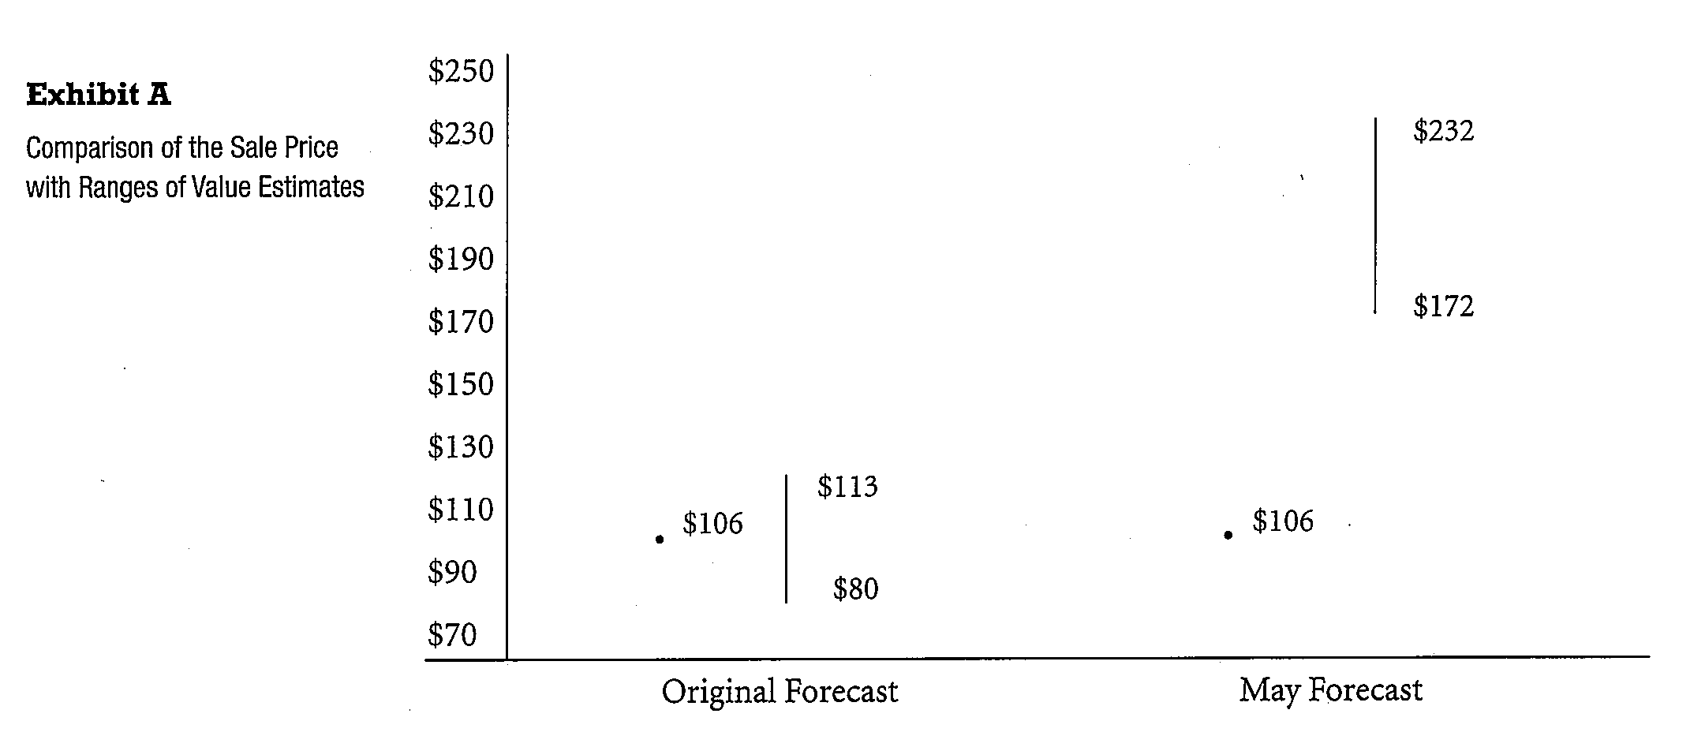
C16-5 Perrigo
Ross testified that,
had the investment
bankers been given
the proper information,
they would not have issued
a fairness opinion at the
$106 million price, and that
he had never seen a case in
which that had been done.

Slide 15
Cross Examining Attorney Puts this Into Evidence
1986 | 1987 | 1988 | 1989 | 1990 | 1991 | 1992 | 1993 | 1994 | 1995
$1,743 | $7,617 | $12,425 | $15,023 | $19,830 | $21,891 | $26,701 | $27,728 | $28,808 | $29,941
At the end of the 10th year, it is estimated that the company could be sold for $184,812.
DCF_{15.5%} = $122 million
DCF_{13.5%} = $130 million
Further, this was represented as being the work behind the 1986 sale of Perrigo to Grow!!

Slide 16
C16-5 Perrigo
I became very highly motivated to examine their analysis.
(Which was done by a national-level economics consulting firm.)
Found immediately that the
discounting calculation was correct. So what is next?? Free Cash Flows
$130
Outside the range!
$122
$85
1986 Sale

Slide 17
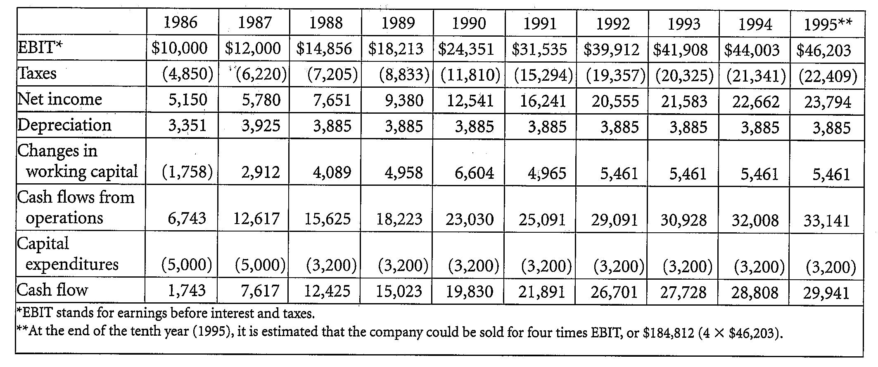
C16-3 Perrigo

Slide 18
C16-3 Perrigo

Slide 19
Oops! Got the Sign Wrong!
Do it right and you get …

Slide 20
Let’s Fix It
1986 | 1987 | 1988 | 1989 | 1990 | 1991 | 1992 | 1993 | 1994 | 1995
$1,743 | $7,617 | $12,425 | $15,023 | $19,830 | $21,891 | $26,701 | $27,728 | $28,808 | $29,941
$1,758 | $(2,912) | $(4,089) | (4,958) | $(6,604) | $ (4,965) | (5,461) | $(5,461) | $(5,461) | $(5,461)
$3,501 | $4,705 | $8,336 | $10,065 | $13,226 | $16,926 | $21,240 | $22,267 | $23,347 | $24,480
We’re not done. This just cancels out the error. Now we have to add it again to get it right.
$1,758 | $(2,912) | $(4,089) | (4,958) | $(6,604) | $ (4,965) | (5,461) | $(5,461) | $(5,461) | $(5,461)
$5,259 | $1,793 | $4,247 | $5,107 | $6,622 | $11,961 | $15,779 | $16,806 | $17,886 | $19,019
At the end of the 10th year, it is estimated that the company could be sold for $184,812.

Slide 21
That’s a Big Mistake
Use the right FCFs and you get …

Slide 22
C16-5 Perrigo
Inside the range!
$90
$86
$85
1986 Sale

Slide 23
Conclusion
I prepared a cross examination for the partner in the consulting firm that was going to present their analysis.
My questions were brutal, as was the sequencing of them. Heads were going to roll.
And what actually happened …

Slide 24
Most Important Figure
Balance sheet
Balance sheet
Balance sheet
time
St of Changes in SE
Income statement
Cash flow statement
St of Changes in SE
Income statement
Cash flow statement

Slide 25
Suppose Value is Created
If all the value has been received in cash in the past
HERE
If all the value is received in cash in the future
If all the value is received in cash in the current period
Must have a liability
Just count the cash
Must have an asset
HERE
HERE
HERE
Period of interest

Slide 26
Suppose Value is Consumed
HERE
If all the value is paid for with current cash disbursements, just count the cash flow
If all the value is to be paid for in cash in the future, must create a liability
If all the value has paid for in cash in the past, must create an asset
HERE
HERE
HERE
Period of interest

Slide 27
Net Income and Other Comprehensive Income
ASSETS = LIABILITIES + EQUITIES
Contributed
+
Earned
Through income
statement
By-pass income
statement

