Slide 1
ACCT270 Foundations of Accounting & Valuation
Session 25: Accounting & Uncertainty: More Adjustments

Slide 2
Adjustments
Accounting starts by recording transactions.
Tracking values and value flows (i.e., accrual accounting) requires more than keeping a record of transactions.
The entries that augment the basic record of transactions are called “Adjustments.”

Slide 3
Adjustments 1
The adjustments that we have covered to this point in the course are aimed at two targets:
Keeping up with the passage of time
Examples: Expiration of prepaid rent, expiration of prepaid insurance, interest accrual on liabilities, depreciation of fixed assets, amortization of intangible assets.
Recording implicit transactions
Example: Recognizing liabilities for wages earned but not paid, cost of goods sold if not recorded continuously.

Slide 4
Either Way, It’s Like This …
Asset Account
Did we miss
something?
Beginning Balance
Additions thru
transactions
Subtractions thru
transactions
Ending Balance

Slide 5
Example: Prepaid Rent
Prepaid Rent
Beginning Balance
Subtractions thru
transactions
Additions thru
transactions
Expirations thru
passage of time:
Rent Expense
Ending Balance

Slide 6
Example: Prepaid Insurance
Prepaid Insurance
Beginning Balance
Subtractions thru
transactions
Additions thru
transactions
Expirations thru
passage of time:
Insurance Expense
Ending Balance

Slide 7
Example: Property, Plant & Equipment
Property, Plant & Equipment
Beginning Balance
Subtractions thru
transactions
Additions thru
transactions
Expirations thru passage of time:
Depreciation Expense
Ending Balance

Slide 8
Wait: We Used a Contra Account
Property, Plant & Equipment
Accumulated Depreciation
Beginning Balance
Beginning Balance
Subtractions thru
transactions
Subtractions thru
transactions
Expirations thru passage of time:
Depreciation Expense
Additions thru
transactions
Ending Balance
Ending Balance

Slide 9
Example: Patents
Patents
Beginning Balance
Subtractions thru
transactions
Additions thru
transactions
Expirations thru passage of time:
Amortization Expense
Ending Balance

Slide 10
What About a Contra Account?
Patents
Accumulated Amortization
Beginning Balance
Beginning Balance
Subtractions thru
transactions
Subtractions thru
transactions
Expirations thru passage of time:
Amortization Expense
Additions thru
transactions
Ending Balance
Ending Balance
Ok, you can do that if you want.

Slide 11
Tesla

Slide 12
Tesla

Slide 13
Example: Goodwill
Goodwill
Beginning Balance
Subtractions thru
transactions
Additions thru
transactions
Not in the U.S. for
fiscal years beginning
after December 25,
2001. (FAS 142.) Goodwill is seen as not having a finite life.
Expirations thru passage of time:
Amortization Expense
Ending Balance

Slide 14
Adjustments 2
The adjustments we will talk about now are different, because they use information beyond that in transactions and the passage of time to:
Decide whether an adjustment should be made (i.e., whether to recognize the implications of this information)
If an adjust is to be made, what the amount of the it should be.

Slide 15
It’s Like This …
Asset Account
Given the information
we have, are we comfortable reporting this number on the balance sheet?
Beginning Balance
Additions thru
transactions
Subtractions thru
transactions
Ending Balance

Slide 16
Example: How GAAP for AR Works
Record accounts at amounts owed in Accounts Receivable
Set up a contra-asset: Allowance for doubtful accounts
Write-offs reduce Accounts Receivable and the Allowance for Doubtful Accounts
Estimated bad debts are treated as an expense: Bad Debts Expense

Slide 17
Use of Contra Account
Accounts Receivable
Allowance for Doubtful Accounts
Beginning Balance
Beginning Balance
Collections
Sales
Bad Debts Expense
Write-offs
Write-offs
Obtained in business acquisitions
Sold in business dispositions
Sold in business dispositions
Obtained in business acquisitions
Ending Balance
Ending Balance

Slide 18
MGM Mirage - Balance Sheet (000s)
 | December 31,
 | 2004 | 2003
ASSETS
Current assets
Cash and cash equivalents | 435,128 | 279,606
Accounts receivable, net | 204,151 | 139,475
Inventories | 70,333 | 65,189
Income tax receivable |  | 9,901
Deferred income taxes | 28,928 | 49,286
Prepaid expenses and other | 81,662 | 89,641
Assets held for sale |  | 226,082
Total current assets | 820,202 | 859,180
Property and equipment, net | 8,914,142 | 8,681,339
Other assets
Investments in unconsolidated affiliates | 842,640 | 756,012
Goodwill and other intangible assets, net | 233,335 | 267,668
Deposits and other assets, net | 304,710 | 247,070
Total other assets | 1,380,685 | 1,270,750
 | 11,115,029 | 10,811,269

Slide 19
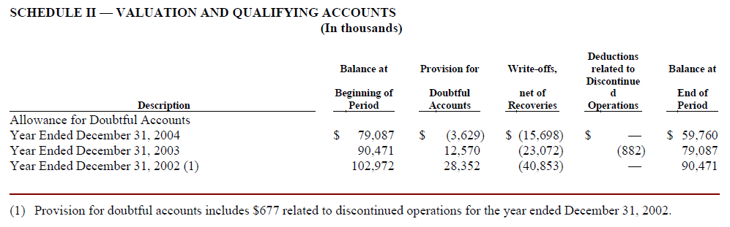

Slide 20
Accounts Receivable, net
Plug (i.e., figure it out)
 | 12/31/2004 | 12/31/2003
Accounts Receivable | 263,911 | 218,562
Allowance for Doubtful Accounts | (59,760) | (79,087)
Accounts Receivable, net | 204,151 | 139,475
Schedule II
Balance Sheets

Slide 21
Estimating the Allowance for Doubtful Accounts
Data analysis/judgment
Account analysis
Aging
Tabulate receivables by how long they have remained uncollected.
The older they are, the more likely they will be uncollectible
Sort by characteristics
Creditworthiness of customer
Past payment history
Consider other factors
History of past uncollectibles
Financial stress in industry
Overall economy
Other?

Slide 22
Account Analysis
Accounts Receivable
Allowance for Doubtful Accounts
218,582
79,087
Bad
Debts
Exp.??
Sales
& Collections
4,238,104
4,177,057
3,629
Write-
offs
15,698
15,698
263,911
59,760

Slide 23
MGM Mirage Income Statement (000s)
 | Year Ended December 31,
 | 2004 | 2003 | 2002
Revenues
Casino | 2,223,965 | 2,037,514 | 2,012,840
Rooms | 911,259 | 833,272 | 796,861
Food and beverage | 841,147 | 757,278 | 706,153
Entertainment | 270,799 | 255,995 | 251,488
Retail | 184,438 | 180,935 | 170,537
Other | 240,880 | 210,772 | 215,600
 | 4,672,488 | 4,275,766 | 4,153,479
Less: Promotional allowances | (434,384) | (413,023) | (396,551)
 | 4,238,104 | 3,862,743 | 3,756,928
Expenses
Casino | 1,106,142 | 1,040,948 | 1,007,968
Rooms | 247,387 | 234,693 | 211,401
Food and beverage | 482,417 | 436,754 | 393,166
Entertainment | 192,390 | 183,012 | 181,403
Retail | 118,413 | 115,123 | 108,325
Other | 146,146 | 130,698 | 114,431
Provision for doubtful accounts | (3,629) | 12,570 | 27,675
General and administrative | 612,615 | 583,599 | 560,909
Corporate expense | 77,910 | 61,541 | 43,856
Preopening and start-up expenses | 10,276 | 29,266 | 14,141
Restructuring costs (credit) | 5,625 | 6,597 | (17,021)
Property transactions, net | 8,665 | (18,941) | 14,712
Depreciation and amortization | 402,545 | 400,766 | 381,785
 | 3,406,902 | 3,216,626 | 3,042,751
Income from unconsolidated affil’s | 119,658 | 53,612 | 32,361
Operating income | 950,860 | 699,729 | 746,538
NOTE: this income statement does not stop here – there are other items

Slide 24
Citigroup 2020
Handling forecast errors

Slide 27
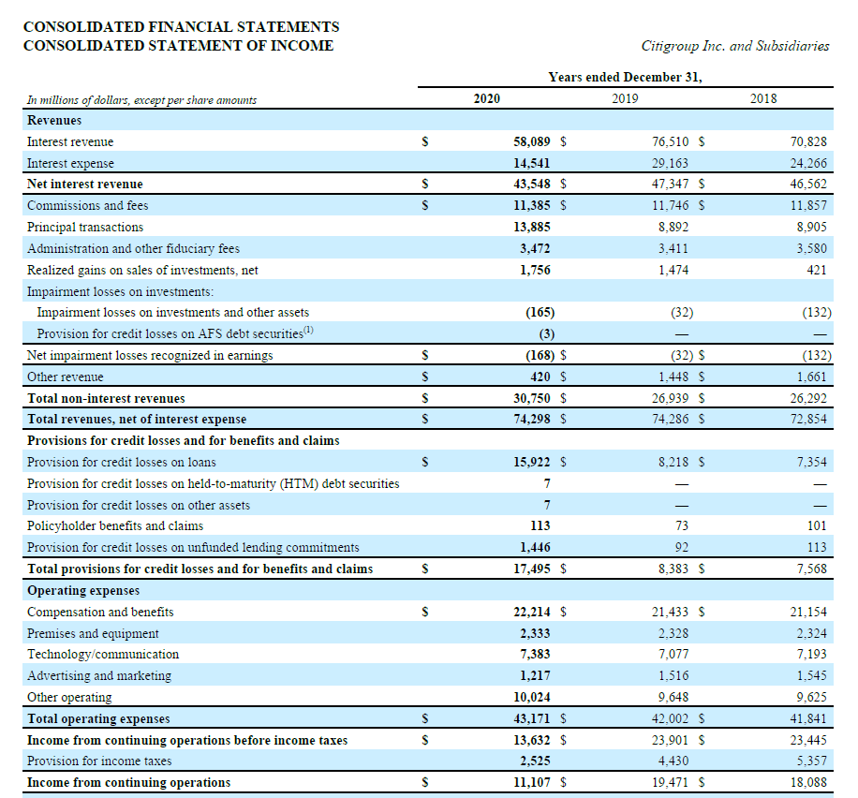

Slide 28
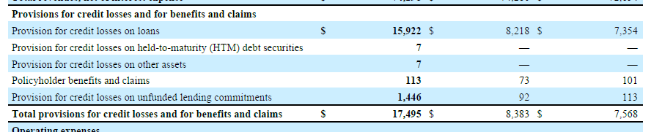

Slide 36
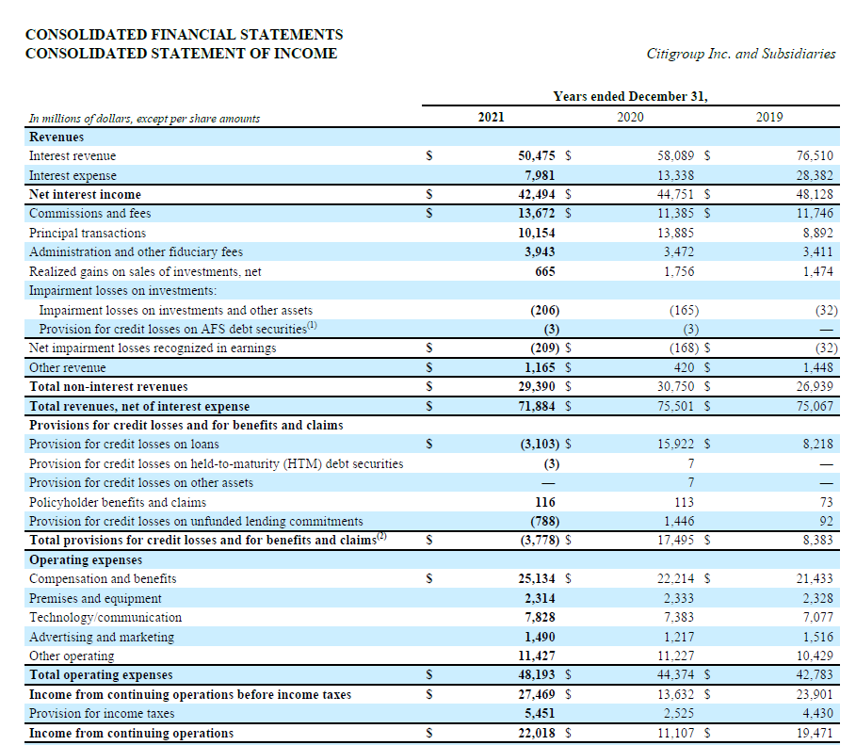

Slide 37
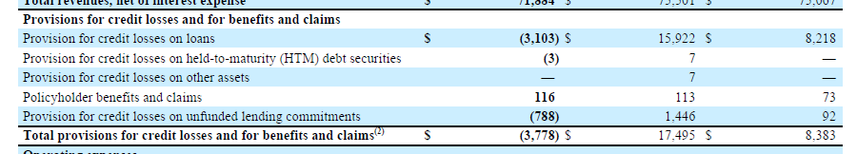

Slide 38
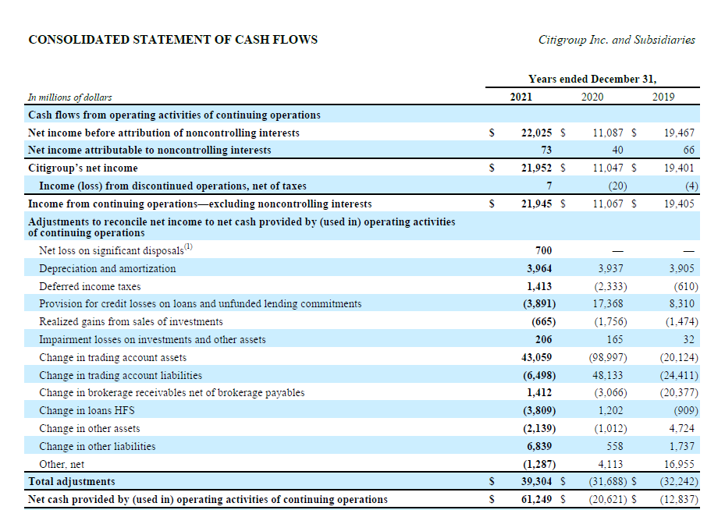
Same story
as MGM Mirage

Slide 39
Example 2: Marketable Securities
Marketable securities are the debt and equity securities of other entities that a company holds as a passive investment.
A passive investment is one for which there is no ability to influence the operations of the investee.
Debt securities are bonds, notes receivable, etc.
Equity securities are shares of stock.

Slide 40
Example: Marketable Securities
Marketable Securities
Beginning Balance
Market value?
Purchases
Cost of MS Sold
Ending Balance

Slide 41
Example: Marketable Securities
Marketable Securities
Beginning Balance
Purchases
Cost of MS Sold
Unrealized Holding Gain
Unrealized Holding Loss
Ending Balance

Slide 42
Mark-to-Market, Net Income & AOCI
Suppose there is an unrealized holding loss:
Accnt to Dr | Accnt to Cr | Accnt to Cr | Dr Amt | Cr Amt
Unrealized Holding Loss on Marketable Securities |  |  | X
 | Marketable Securities |  |  | X
Temporary Account that should be closed?
MAYBE:
Ask your Mother!

Slide 43
Accumulated Other Comprehensive Income
Holds cumulative gains and losses that have not been closed. I.e., they have not been put into Retained Earnings through closing.
Example, Berkshire Hathaway Inc. from 2018, the year of a change in US GAAP accounting rules on marketable securities.

Slide 44
Berkshire hathaway
Investments in 2018: Effects of Change in Accounting Rules

Slide 45
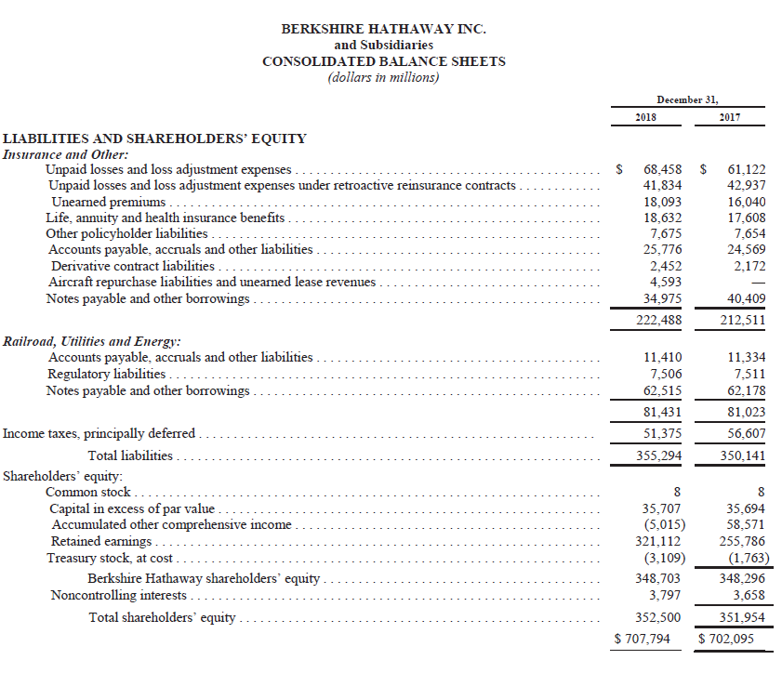

Slide 46
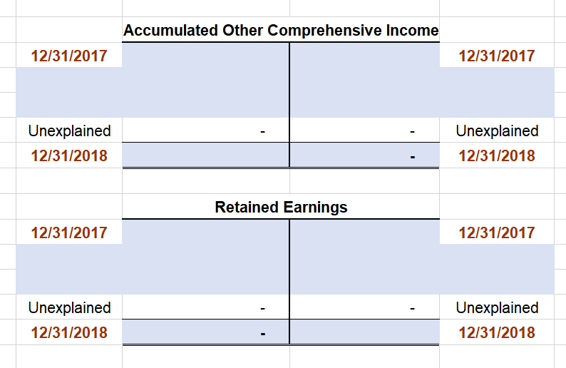

Slide 48
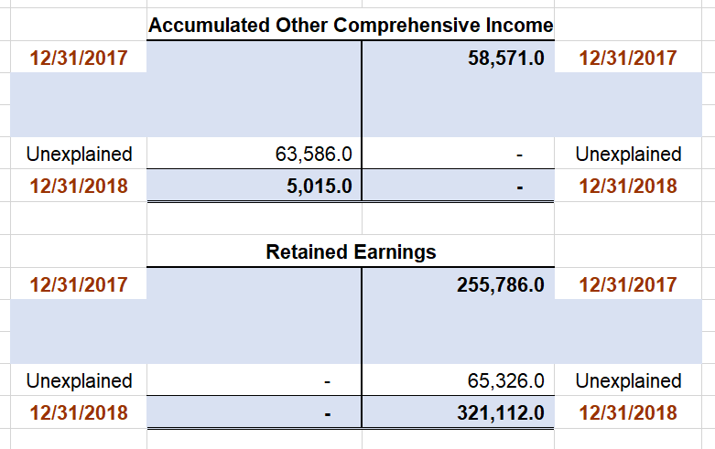

Slide 49
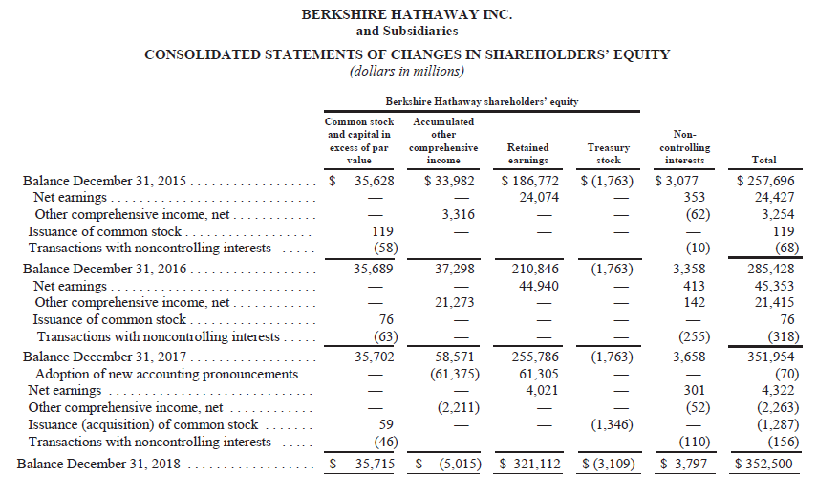

Slide 50
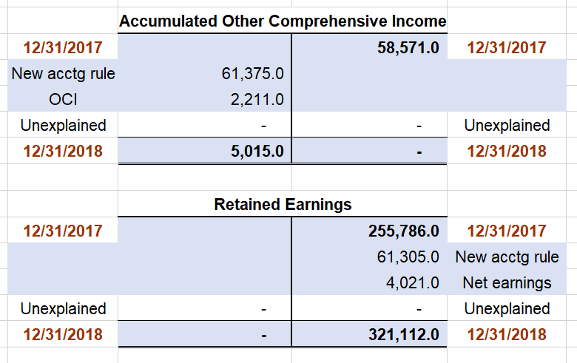

Slide 51
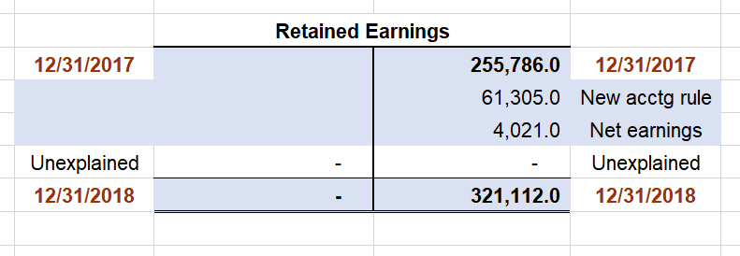
Any Dividends Declared?
No entries here, so
no dividends were declared

Slide 52
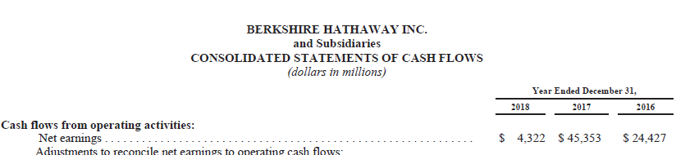
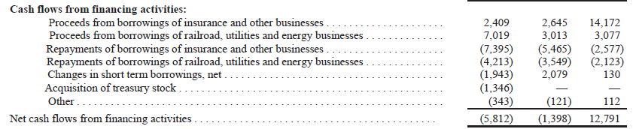
Any Dividends Paid?
No entries here, so
no dividends were paid

Slide 53
Entry to Reclassify AOCI into RE #1

Slide 54
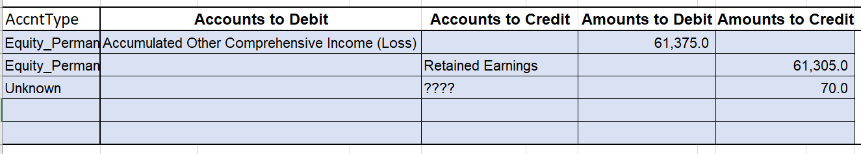

Slide 55
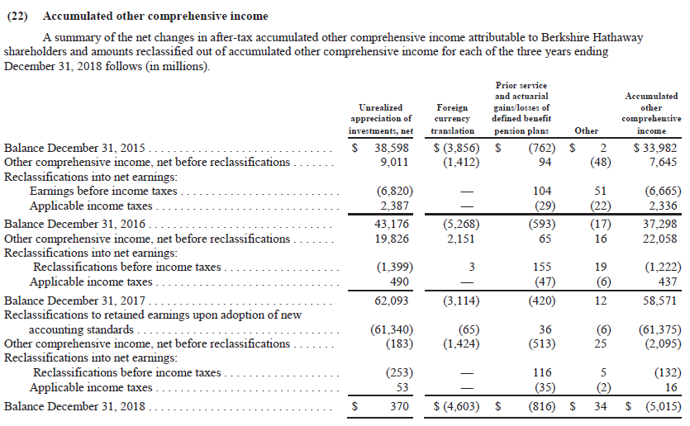
Reclassify AOCI to RE #2

Slide 56
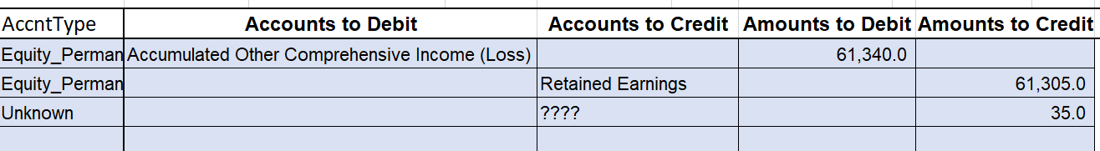

Slide 57
Cash Sales of Investments in Equity Securities

Slide 58
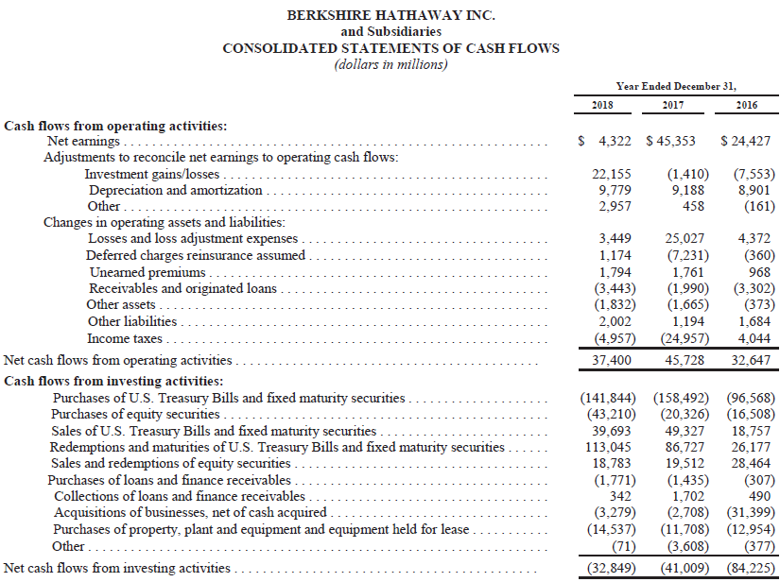

Slide 59
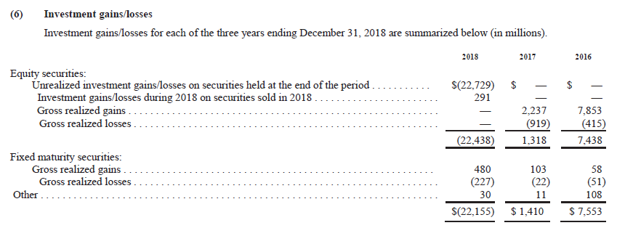

Slide 60
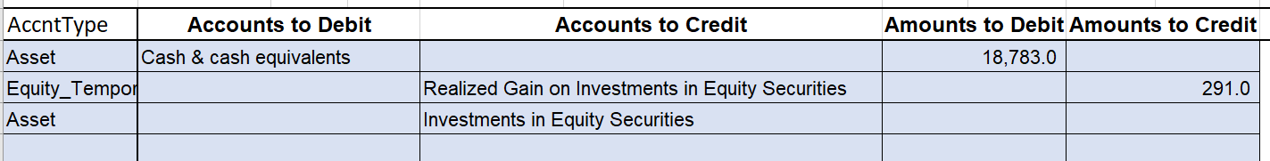
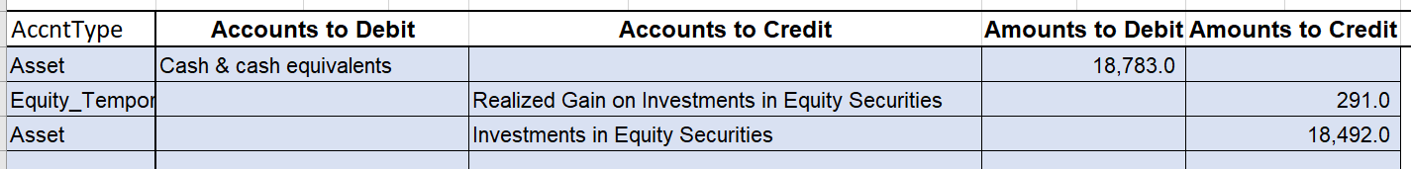

Slide 61
Fair Value Adjustment

Slide 62
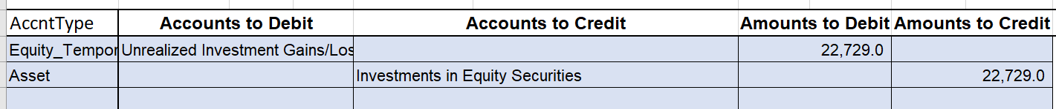

Slide 63
Investments Gains/Losses

Slide 65
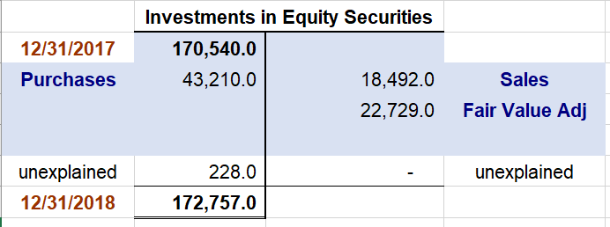

Slide 66
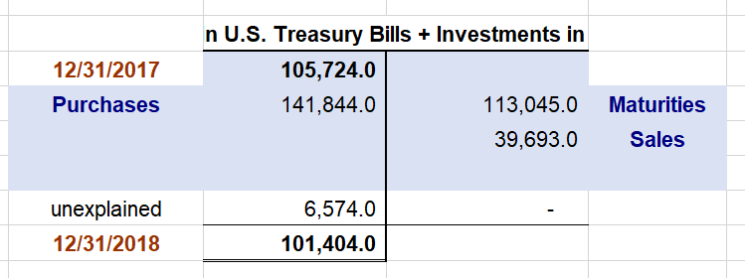

Slide 67
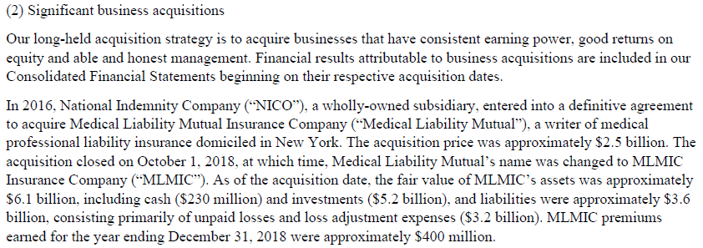

Slide 68
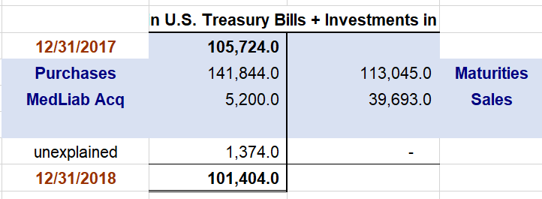

Slide 69
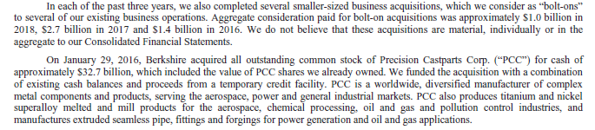
More from Note 2
Gets us part way there, but it is not enough.

Slide 70
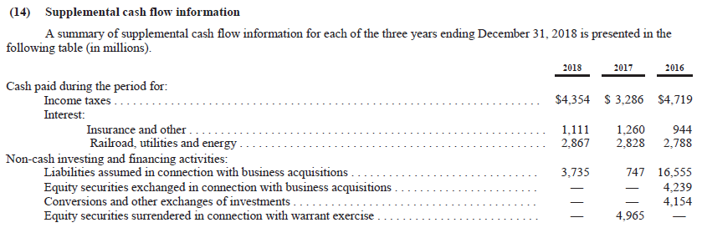
One Last Place to Look
Nothing here seems to help, and I am out of ideas …

Slide 71
One Last Thing
Evaluate Buffett’s arguments against including some gains and losses from the calculation of net income.
Look at what has happened …

Slide 73
Berkshire Case: Conclusion
We could make a lot of progress understanding what went on, but we can’t tie things out exactly.
This example was chosen because Buffett’s letter is worth discussing, not because it was tidy.
But notice how we had some tools to interrogate the financial statements and to assess our progress.

Slide 74
Example 3: Impairments: PP&E
Property, Plant & Equipment
Accumulated Depreciation
Beginning Balance
Beginning Balance
Subtractions thru
transactions
Subtractions thru
transactions
Expirations thru passage of time:
Depreciation Expense
Additions thru
transactions
Impairment Loss
Ending Balance
Ending Balance
What if future cash flows are less than Book Value?

Slide 75
Impairments: Goodwill
Goodwill
Beginning Balance
Subtractions thru
transactions
Additions thru
transactions
Impairment Loss
Ending Balance
What if future cash flows are less than Book Value?

Slide 76
JDS Uniphase

Slide 77
Wow!

Slide 78
Next Time
Wrap up case
Revisit the Grow Company

