Slide 1
Bluebonnet Savings & Loan
A world of confusion

Slide 2
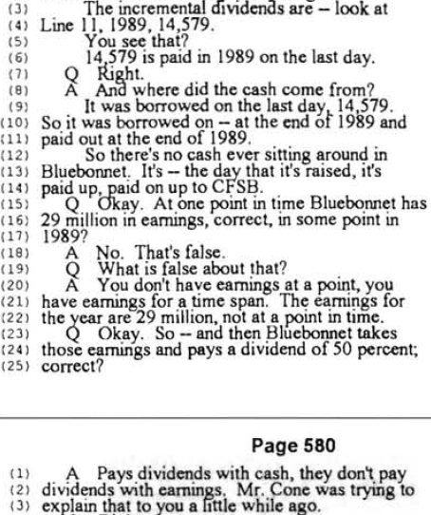
What is going on here?

Slide 3
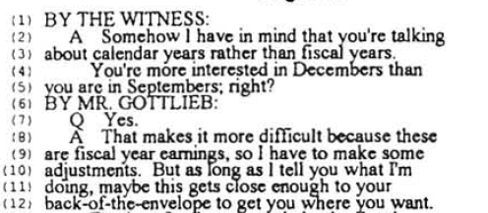
Background Confusion
Time period

Slide 4
For-profit Entity
What if this is the period
of at issue?
Balance sheet
Balance sheet
Balance sheet
time
Income Statement
Income Statement
Cash Flow Statement
Cash Flow Statement
Statement of Changes
in Shareholders’ Equity
Statement of Changes
in Shareholders’ Equity
Notes:
At any point in time, we can construct a balance sheet that shows SOM Corp’s financial resources and obligations at that point in time.
We expect to do this periodically.
Flow statements tell us about why the SOM Corp’s financial position changes over time.
Income statement – value produced and consumed by the SOM Corp’s operations not due to contributions from or distributions to its owners.
Cash flow statement – cash that flowed in and out of the SOM Corp.
Statement of changes in owners’ equity – value flows to and from the SOM Corp’s owners.

Slide 5
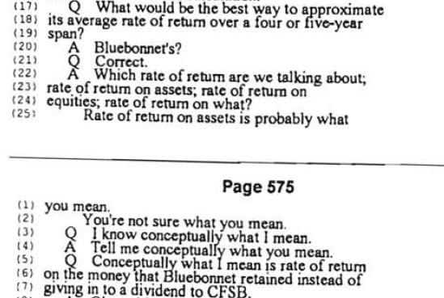
Rates of Return

Slide 6
Suppose you start with $2
Period 1: Lose $1
-1/2 = 50% loss
Period 2: Earn $1
1/1 = 100% gain
Average return: (-50%+100%)/2 = 25%

Slide 7
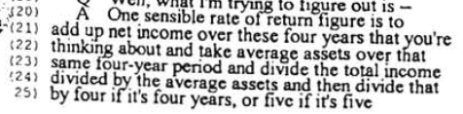
Rates of return are tricky…

Slide 8
Suppose you start with $2
Period 1: Lose $1
Period 2: Earn $1
Roman’s average return: (-$1+$1)/[($2 + $1)/2] = 0%

Slide 9

I’m surprised at Roman’s answer
What does “access to earnings” mean?

Slide 10
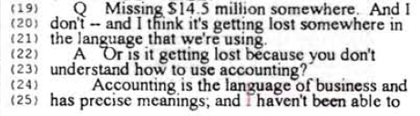
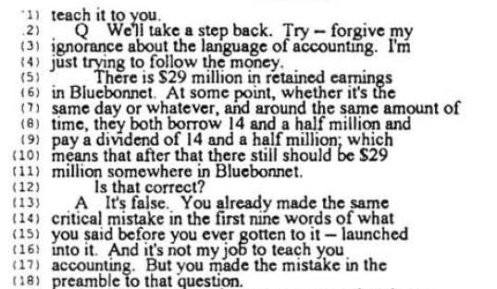
This is pretty uncomfortable ….

