Slide 1
ACCT 2700 Foundations of Accounting & Valuation
Session 1: Introduction

Slide 2
Today
First course in accounting & valuation
I assume you have no background
Course details & expectations
Overview of topics
But FIRST, I have an investment opportunity for you…

Slide 3
Potential Investment - FS
$50,000 minimum investment
Additions can be made monthly
Redemptions can be obtained monthly
Fees: 1% of Assets Under Management (AUM)
Want to invest?

Slide 4
Is there a track record?
First Question:

Slide 5
FS Annual Track Record (Actual)
Year | Percentage Return
1 | 18.58%
2 | 14.67%
3 | 11.68%
4 | 11.49%
5 | 12.95%
6 | 12.99%
7 | 14.00%
8 | 13.40%
9 | 14.18%
10 | 11.55%
11 | 10.68%
12 | 9.33%

Slide 6
FS Performance
$5
$1

Slide 7
What are other opportunities?
Second Question:

Slide 8
$1.72
$1

Slide 9
FS with Comparison to T-Bills
$5
$1.72
$1
$1

Slide 10
$4.89
+ dividends
$1

Slide 12
Decision?
Do you like FS?
What are your criteria for saying that you do or you don’t like it?
Any concerns?

Slide 13
A Little More Due Diligence
As of the date at which the performance information ends, FS had $5.1 billion in assets.
FS is part of a firm that had $8.3 billion in assets.

Slide 14
Even More Information
FS was actually the Fairfield Sentry Fund, headquartered in Greenwich, CT
Time period was from the end of 1990 to the middle of 2004
Their wizardry – invest all the money in another hedge fund, BLMIS, ran by this man…

Slide 15
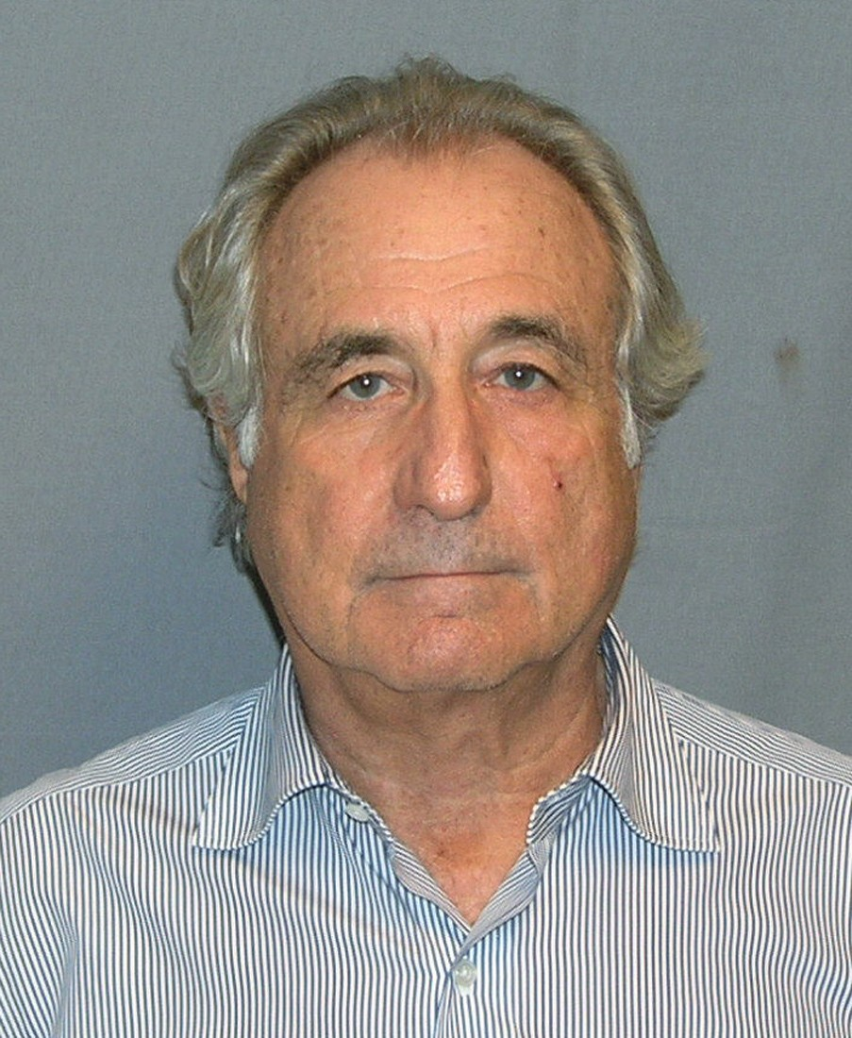
Bernard L. Madoff

Slide 16

Federal Correctional Complex, Butner (FCC Butner) North Carolina
When he was 81, Madoff, who orchestrated the largest Ponzi scheme in history, asked for compassionate release from prison, saying he has less than 18 months to live.
https://www.cnn.com/2020/03/05/business/bernie-madoff-release/index.html
Bernie Madoff should die in prison, US government says
By Jordan Valinsky, CNN Business
Updated 9:48 AM ET, Thu March 5, 2020
New York (CNN Business) - Bernard Madoff should not be released early from his 150-year prison sentence, even though he has terminal kidney failure, federal prosecutors said Wednesday.
He died in prison on April 14,2021.
https://apnews.com/article/bernie-madoff-dead-9d9bd8065708384e0bf0c840bd1ae711
150 years in federal prison and $170 billion in restitution

Slide 17
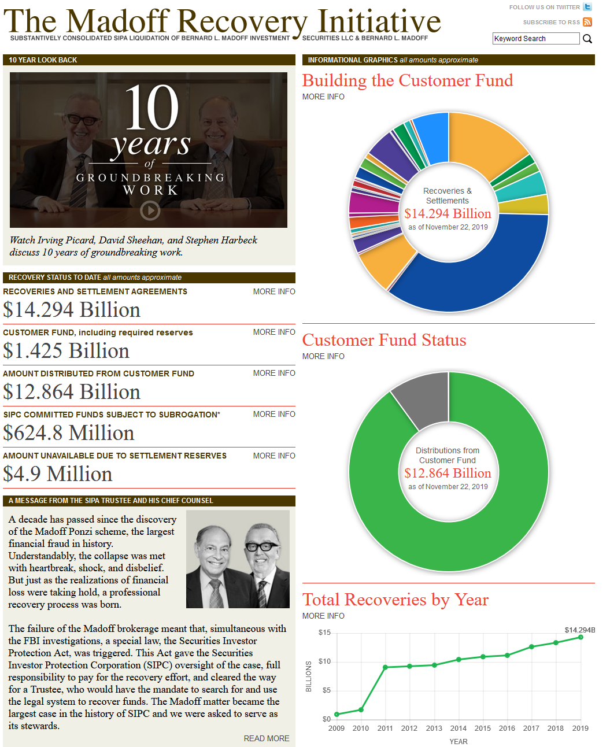
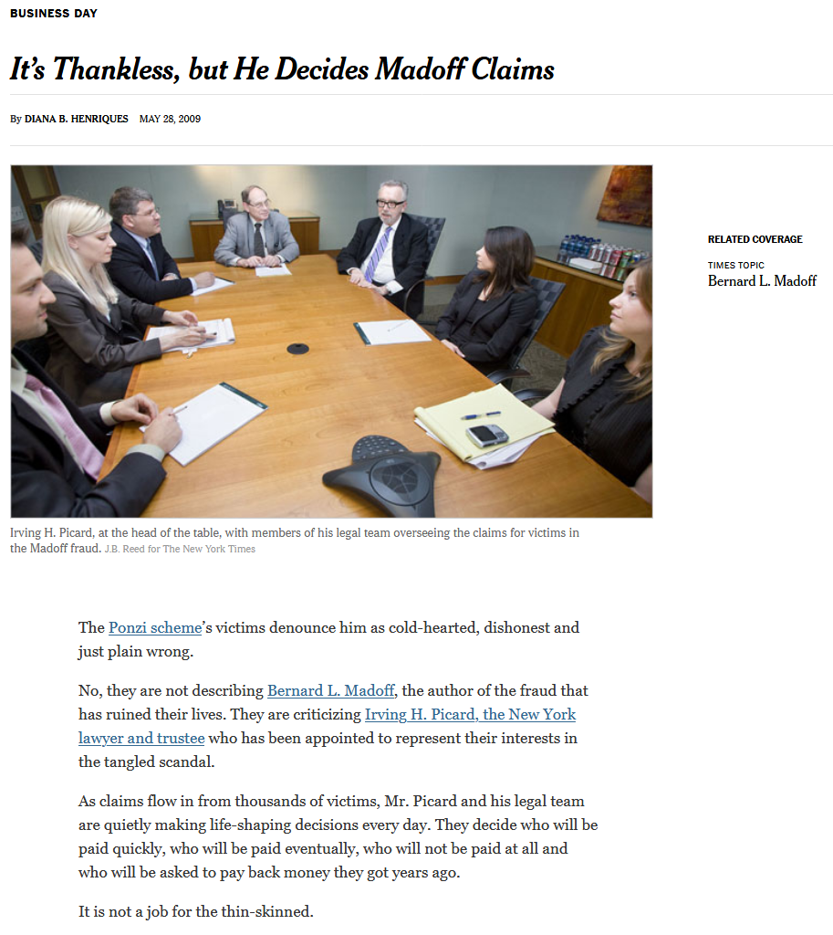
Cleaning Up the Mess
https://www.madofftrustee.com/
https://www.nytimes.com/2009/05/29/business/29claims.html

Slide 18
Costs of Cleaning Up the Mess
“Lawyers tasked with sifting through the fallout of Bernie Madoff’s historic Ponzi scheme on behalf of investors have earned more than $1.4 billion in fees between the unraveling of Madoff’s fraud in 2008 and his death on Wednesday.
By far, the lion’s share of approved fees - $1,250,562,343.08 to be exact - have gone to Baker & Hostetler, which has been the home of Irving Picard, the court-appointed trustee overseeing the liquidation of Bernard L. Madoff Investment Securities LLC, since December 2008.
To read the full story on Westlaw Today, click here: bit.ly/3mOi3cy”
From: https://www.reuters.com/article/madoff-fees/baker-hostetler-fees-pass-1-25-billion-as-madoff-case-lives-on-idUSL1N2M7395

Slide 19
Watch this video…
https://insights.som.yale.edu/insights/where-did-madoffs-money-go

Slide 20
Accounting and Finance
The finance part of this story is that these returns are too good to be true.
Combination of risk and return is suspicious.
By looking at the financial returns on an investment in BLMIS, we can see the symptoms of a flawed wealth-generation process.
The accounting part is more of the “nuts and bolts” i.e., accounting can show us the disease.

Slide 21
Ponzi Schemes
Work by inviting/encouraging/inducing people to make a key mistake:
Confuse creation of wealth with the redistribution of wealth.
Accounting words: confusing income (or profit) generating activities with financing, or capital raising (and returning) activities.

Slide 22
Investment Game

Slide 23
Extent of Damage Caused by Failure to Assess Value and Value Creation
The pyramid scheme phenomenon in Albania is important because its scale relative
to the size of the economy was unprecedented, and because the political and social
consequences of the pyramid schemes were profound.
Jarvis, C., “The Rise and Fall of the Pyramid Schemes in Albania”, IMF Staff Papers Vol. 47, No 1., p. 1.
"In the wake of a nationwide catastrophic collapse of savings that led to losses totaling
about 40% of the Albanian gross domestic product, the authors detected apparent
long-term deleterious health effects of financial loss and downward intergenerational
subjective social mobility."
Burazeri, G., A. Goda, G. Sulo, J. Stefa, and J. D. Kark, "Financial loss in pyramid savings schemes, downward social mobility and acute coronary syndrome in transitional Albania," Journal of Epidemiology and Community Health (1979-), Vol. 62, No. 7 (July 2008) pp. 620-626.
YOUTUBE links you might find interesting – no warranty or endorsement should be inferred!
https://www.youtube.com/watch?v=NuO6dNjNMtU
https://www.youtube.com/watch?v=lMUtU0tOmNE

Slide 24
BLMIS Accounting
Madoff claimed that, before every financial statement date, he converted all the stock and options that he supposedly held into T-bills (basically, cash).
If true, what would a balance sheet look like? Suppose he held $50 billion in T-bills and had no liabilities.
A = L + E or $50b in T-bills = 0 liabs +$50b equity

Slide 25
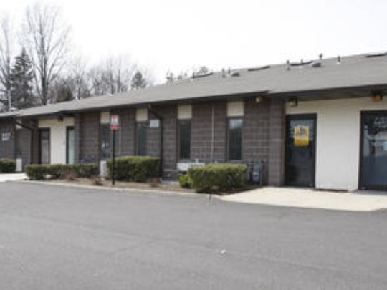
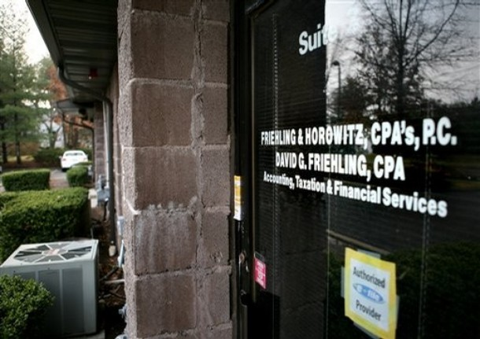
How Could He Have Been Caught?
Good set of financial statements
Give a clear picture of financial position at points in time
Give an indication of how much wealth was created during periods of time
Track flows of money and label redistributions as such
Should be audited
BLMIS’s auditor was a sham:
Friehling & Horowitz, CPAs, P.C.
3-person firm with a shopping center store front office
Did no auditing of BLMIS
All they had to do was verify whether BLMIS did in fact hold the T-bills it claimed to have.

Slide 26
Recap
Started with a high-level, finance view
Got to a nitty-gritty accounting view
That is the idea of this course
Go from the valuation perspective of the money
To the accounting perspective of the creation of value

Slide 27
Course
Two interwoven parts
Valuation: first and last parts of the course
Accounting: middle part
Valuation
Time, money and value
Risk and return
Accounting
Balance sheets, income statements and statements of cash flows
Cash flow statements, in particular, reconcile the value creation story with the cash flow story

Slide 28
Grades, etc
Two problem sets
Homework; AG essential
Two-part final exam
Take home:
Part A: Required, virtually flawless answer required, gets a B for the course
Part B: Optional, virtually flawless answer required, gets a B+ for the course
In class: Optional, hard, A’s only for outstanding performance
Here’s another explanation: Grading System
You need to come to every class and do all the homework to learn this material
It will be a lot of work

Slide 29
Next time
Time and money: Compound growth
Present values, discounting, etc., etc.

