Slide 1
Ponzi Game
ACCT 2700 Spring 2026

Slide 2
Ponzi Schemes
Work by inviting/encouraging/inducing people to make a key mistake:
Confuse creation of wealth with the redistribution of wealth.
Accounting words: confusing income (or profit) generating activities with financing, or capital raising (and returning) activities.

Slide 3
Investment Game
I selected 11 of you at random.
Each will have an endowment (that’s what we call what you start with in economics) of (pretend) Bitcoin.
Each will make investments with a promised rate of return of 100% per period.
Some of you will withdrawal funds from their accounts.

Slide 4
Investors
Name | ₿ | Accnt#
Meena Ambati | 5 | 1
Erin Daniels | 5 | 2
Sydney Mitchell | 5 | 3
Claiborne Tompkins | 5 | 4
Olivia Kim | 10 | 5
Kiley Capstraw | 10 | 6
Isaac Monks | 10 | 7
Ruben Berreby | 10 | 8
Joya Xu | 40 | 9
Emma Lee | 40 | 10
Lucas Szydlowski | 40 | 11

Slide 5
Investment Company and Rules
Ricky Lee Antle Investment Securities, LLC (hereafter, RLAIS)
Beginning endowment: ₿20
Stated rate of return on RLAIS strategy: 100%
RLAIS fees: 0%
Minimum investment: ₿5
Deposits at the beginning of the period, withdrawals at the end of the period.
Just so we understand the stakes: Bitcoin-Dollar

Slide 6
₿10
₿10
₿10
₿10
RLAIS
₿5
₿20
₿40
₿5
₿40
₿5
₿40
₿5
Total wealth of the group: ₿200

Slide 7
Round 1

Slide 8
Period 1: Beginning
Deposits occur at the beginning of the period.
₿10
₿10
₿10
₿10
RLAIS
₿5
₿20
₿40
₿5
₿40
₿5
₿40
₿5
Notes:
Meena Ambati deposits 5
Erin Daniels deposits 5
Sydney Mitchell deposits 5
Claiborne Tompkins deposits 5

Slide 9
Period 1: Beginning
Deposits occur at the beginning of the period.
₿10
₿10
₿10
RLAIS
₿10
₿0
₿40
₿40
₿0
₿40
₿0
₿40
₿0
Total wealth of the group: ₿200

Slide 10
Period 1: During
Earnings occur during the period.
₿10
₿10
₿10
RLAIS
₿10
₿80
₿40
₿40
₿40
₿40
Total reported wealth of the group: ₿240

Slide 11
BIG SECRET…
There is no RLAIS strategy, so it will earn nothing.
I.e., the actual rate of return is 0%.

Slide 12
Period 1: During
The actual state before withdrawals is:
₿10
₿10
₿10
RLAIS
₿10
₿0
₿40
₿40
₿0
₿40
₿0
₿40
₿0
Total actual wealth of the group: ₿200

Slide 13
Period 1: End
Withdrawals occur at the end of the period.
₿10
₿10
₿10
RLAIS
₿10
₿5
₿10
₿40
₿25
₿40
₿40
Total wealth of the group: ₿200
Notes:
Meena Ambati withdraws 10
Erin Daniels withdraws 5

Slide 14
TOTALS
RICK

Slide 15
Round 2

Slide 16
Period 2: Beginning
Deposits occur at the beginning of the period.
₿10
₿10
₿10
RLAIS
₿10
₿65
₿40
₿25
₿40
₿5
₿40
₿10
Total wealth of the group: ₿200
Notes:
Olivia Kim deposits 10
Kiley Capstraw deposits 10
Isaac Monks deposits 10
Ruben Berreby deposits 10

Slide 17
Period 2: During
Earnings occur during the period.
RLAIS
₿40
₿40
₿5
₿40
₿10

Slide 18
Period 2: End
Withdrawals occur at the end of the period.
RLAIS
₿10
₿10
₿40
₿10
₿65
₿35
₿40
₿15
₿5
₿40
₿10
Total wealth of the group: ₿200
Notes:
Erin Daniels withdraws 10
Sydney Mitchell withdraws 10
Kiley Capstraw withdraws 10

Slide 20
TOTALS
RICK

Slide 21
Round 3

Slide 22
Period 3: Beginning
Deposits occur at the beginning of the period.
₿10
RLAIS
₿40
₿155
₿10
₿40
₿15
₿40
₿10
Total wealth of the group: ₿200
Notes:
Joya Xu deposits 40
Emma Lee deposits 40
Lucas Szydlowski deposits 40

Slide 23
How Much Did the Investors Lose?
What they thought they had at the time the loss was discovered?
Lost cash plus opportunity cost?
Just the cash?
What the legal system dictates/allows
Laws
Precedents

Slide 25
Criminal | Beg | From “Investors” | To “Investors” | End
Rick | 20 | 180 | (45) | 155

Slide 26
Overall Results for RJAIS, LLC
Took in ₿180
Distributed ₿45
Stole ₿135

Slide 27
Compensation for the Loss?
How can we compensate the investors for the loss?
Rick stole ₿135, so begin by getting as much of that back as we can.
Rick also had an endowment of ₿20, so we could get what is left of that
Anything else?
The experience was not uniform across the investor group.
Many lost, but some won (i.e., withdrew more than they deposited).

Slide 29
20

Slide 30

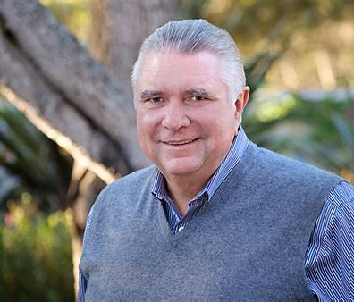
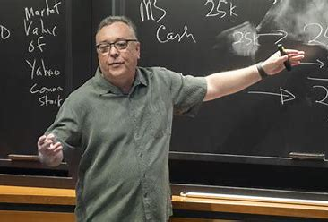
What do we do with Rick?
Rick Antle of
Tanamura & Antle
Oops, wrong Rick!!

