Slide 1
ACCT 2700 Foundations of Accounting & Valuation
Session 2: Compounding & Discounting

Slide 2
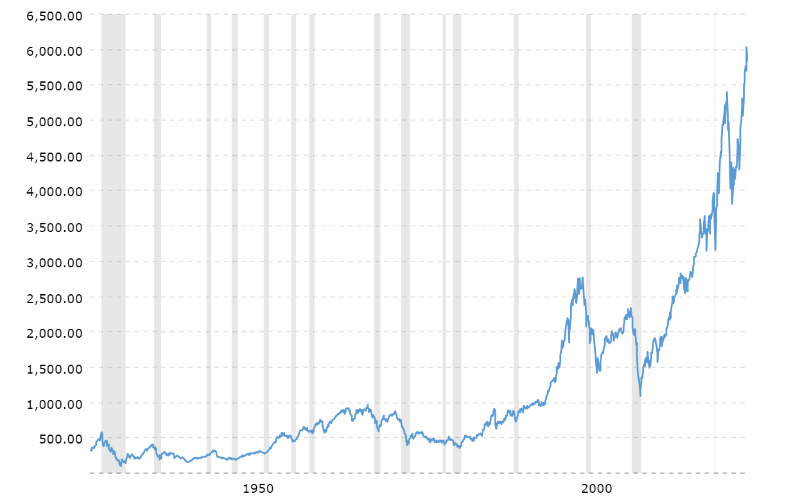
S&P 500 Index Jan 1928 – Dec 2024
5,881.63
Index only:
Dividends not
included
Value of Index
Adjusted for
inflation
320.42
Source: MacroTrends
Year

Slide 3
Inflation-Adjusted
Notes:
Tuan Doan – what’s the most simple kind of function that will give us a curve?
Maybe that’s not a good question:
Straight line – addition
Growth at an increasing rate - multiplication

Slide 4
What’s the Math for It?
Linear
Notes:
Hallie Kennan – MEM – How do trees grow? X inches per year?

Slide 5
What is the Math for It?
Curve
Notes:
Tuan Doan – what’s the most simple kind of function that will give us a curve?
Maybe that’s not a good question:
Straight line – addition
Growth at an increasing rate - multiplication

Slide 6
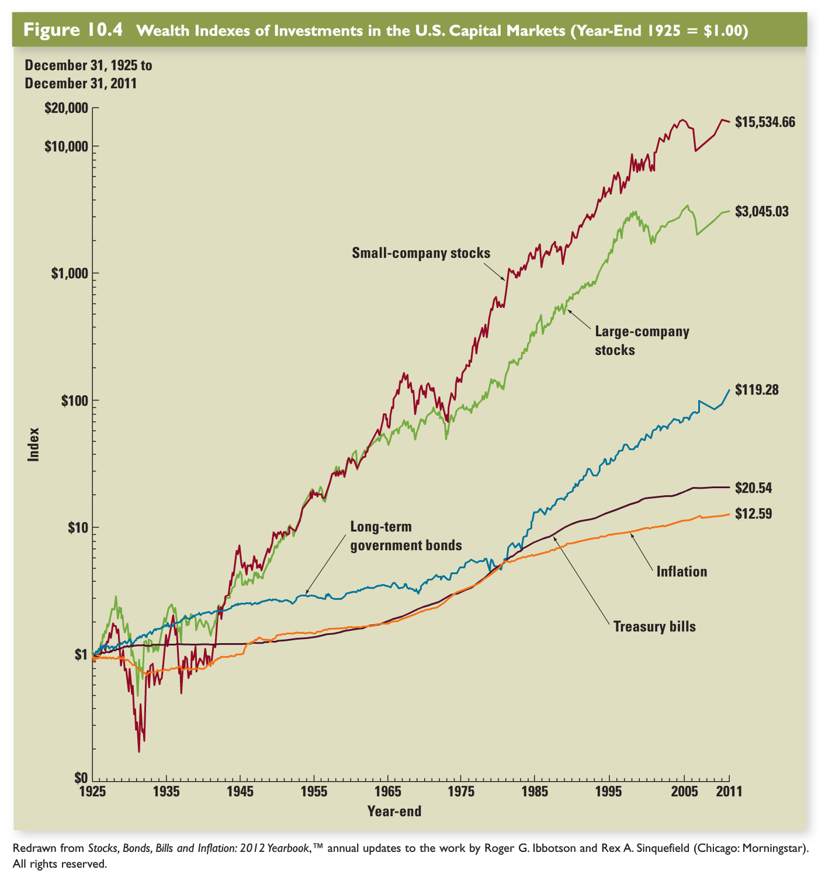
Look carefully at the y-axis!
Move up one unit
(after the first) on the
y-axis and you have
10 times the amount
of the tick below.
It is a log scale.

Slide 7
Cash Flows, Time & Uncertainty
The financial value of an asset is derived from the stream of cash flows you receive from it
Three critical properties of cash flow streams
Amounts
Timing
Uncertainty
Next few sessions, we focus on amounts and timing

Slide 8
One Idea: Compound Interest
Growth by a multiplicative compounding process
Terms: Future value, present value, discounting, discounted value, on and on
But only ONE IDEA!!
You just have to work it forwards and backwards.

Slide 9
Timing of Cash Flows
Assume cash flow streams are certain, but differ in timing
Could be inflows or outflows
Here are two cash flow streams:
Receive $83.96 today
Receive $100.00 three periods hence
Cash flow diagrams …

Slide 10
Two Cash Flow Streams
$83.96
A
0
1
2
3
$100.00
B
0
1
2
3

Slide 11
Which Would You Prefer?
One rule: You have to spend it
within 30 minutes of receiving it.
Notes:
Which one would you rather have?
Charlie Elwes (Political Science)
Cooper Burrill (Economics)
Lauren Kohler (Environmental Studies)
Brian Cashin (Economics)
Michelle Benavidez Frausto (Psychology) – sorry to pick on you again, but you are our only psych major. How should we think about people’s preferences here. Some prefer $83.96 today, others $100 three periods from now.
Need for instant gratification?
Patience?
Other?
Wouldn’t we like to say something about how these two compare without getting into individual psychology?

Slide 12
What Do You Mean “THE” Value?
Suppose you have no access to borrowing and lending opportunities
What if you are 119 years old?
Hint: No one lives to 120
What if you are certain to live for at least four more years?
Upon what factors would your choice depend?
Rational individuals could make different choices
Trying to concoct one number that would “measure” value for everyone is a fool’s errand in this setting!
If we are going to define value independent of individual preferences, we need more structure.
Notes:
Which one would you rather have?
Charlie Elwes (Political Science)
Cooper Burrill (Economics)
Lauren Kohler (Environmental Studies)
Brian Cashin (Economics)
Michelle Benavidez Frausto (Psychology) – sorry to pick on you again, but you are our only psych major. How should we think about people’s preferences here. Some prefer $83.96 today, others $100 three periods from now.
Need for instant gratification?
Patience?
Other?
Wouldn’t we like to say something about how these two compare without getting into individual psychology?

Slide 13
Financial Markets
Suppose you could invest with a guaranteed return of 6% per period
Suppose you could borrow at a guaranteed rate of 6% per period
Suppose you could do either
$83.96 is the present value of $100 to be received 3 periods hence at 6%
Notes:
Big idea – add context. I.e., imbed the problem in a situation with more alternatives than simply take A or B. In a way, we are making the situation more complex. Can that simplify our thinking?
$83.96 now and consume it now
$100 three periods from now and consume it then
$83.96 now and invest it for 3 periods, then consume
$100 three periods from now but borrow and consume now

Slide 14
How About This One?
$50.00
$40.00
$1.42
C
0
1
2
3

Slide 15
Present Value
Either of two cash flow streams with the same present value can be physically transformed into the other by borrowing and lending at the interest rate
But note the idealized context:
Cash flow streams are certain
Borrowing and lending can be done at the same rate
Financial markets are frictionless. I.e., there are no transactions’ costs (e.g., no legal bills, bank fees, wasted time, etc.)

Slide 16
How About This One?
Annuity (in arrears)
$31.41
$31.41
$31.41
D
0
1
2
3
Apartment rent; Auto loan; mortgage; capital lease

Slide 17
Bonds
A coupon bond is a promise to pay out periodic coupon payments and the face value at maturity
E.g., consider a bond with a 6% coupon and a $100 face value. The coupon payment is in each period and the bond matures 3 periods hence.

Slide 18
$100 Face, 3 Period Maturity, 6% per Period Coupon
Coupon Bond
$106.00
$6.00
$6.00
E
0
1
2
3
What is its present value at 6%?

Slide 19
$119.10 Face, 3 Period Maturity, 0% per Period Coupon
Zero Coupon Bond
$119.10
$0.00
$0.00
F
0
1
2
3
What is its present value at 6%?

Slide 20
Modern Technology to Multiply and Divide Repeatedly?
Doing these calculations by hand or with a calculator gets very tedious
Give me a spreadsheet program, e.g., Excel, and I can really go to town on future values, present values, discounting, ….
Next time, Excel techniques.
Hint: Never use the built-in functions for these kinds of calculations.

Slide 21
Next Time
Start doing these calculations in Excel

