Slide 1
ACCT2700 Foundations of Accounting & Valuation
Session 10: Introduction to Accounting

Slide 2
Today
There is a lot of material on the Learning Accounting site assignment for today
Entity and transactions
Framework
Financial statements 101
Make sure you go through this thoroughly, watch all the videos, etc.

Slide 3
Money providers
(shareholders)
Suppliers
Accounting system
keeps track of all
this!!!
Equity
(dividends &
ownership
claims they can
sell)
Money Providers
(bankers, bond market)
$
$
$
$
Governments
Organization (Corporation, LLC, Partnership, Not-for-profit, etc. – the accounting entity)
Goods &
Services
(Expenses)
$
Debt (principal & interest)
$
Taxes
Employees
Labor
Defense, police, courts,
roads, etc. (Public goods)
Revenue
$
$
Salaries & wages
Customers
Management Services
Managers
Goods &
Services
$
Salaries & wages
Source: SOM Professor Shyam Sunder

Slide 4
Framework
Three parts to accounting:
Aspirations: Show value and how it changes. Noble. Lofty purpose. Big help in creating/maintaining a civilized society.
Accounting Conventions: Aspirations meet real world, need conventions. Don’t get your hopes up too high!
Institutional Context: Aspirations meet real world, accounting is done by people in a social/economic/political context. Watch out!

Slide 5
Most Important Figure
Balance sheet
Balance sheet
Balance sheet
time
Income statement
Cash flow statement
Statement of changes
in Shareholders’ Equity
Income statement
Cash flow statement
Statement of changes
in Shareholders’ Equity

Slide 6
Uncle Pennybags’ Generosity
An Exploration of Financial Statements
© 2021 Rick Antle

Slide 7

Your uncle, Mr. Pennybags, was a bit
of a risk taker with a propensity to start
new businesses. He started 4 on Jan 1, 202X
and has decided to give them to you and your
3 siblings. He drew your name out of his hat,
so you get first choice.
You are aware that, in addition to his generosity,
Mr. Pennybags, is a bit annoying. He never
passes up an opportunity to teach you what
he considers to be the most important
lessons that he had to learn “the hard way.”
The lesson accompanying this gift, he tells you,
is about financial statements.
Source: https://www.cleanpng.com/png-computer-icons-rich-uncle-pennybags-blog-clip-art-5688280/download-png.html

Slide 12
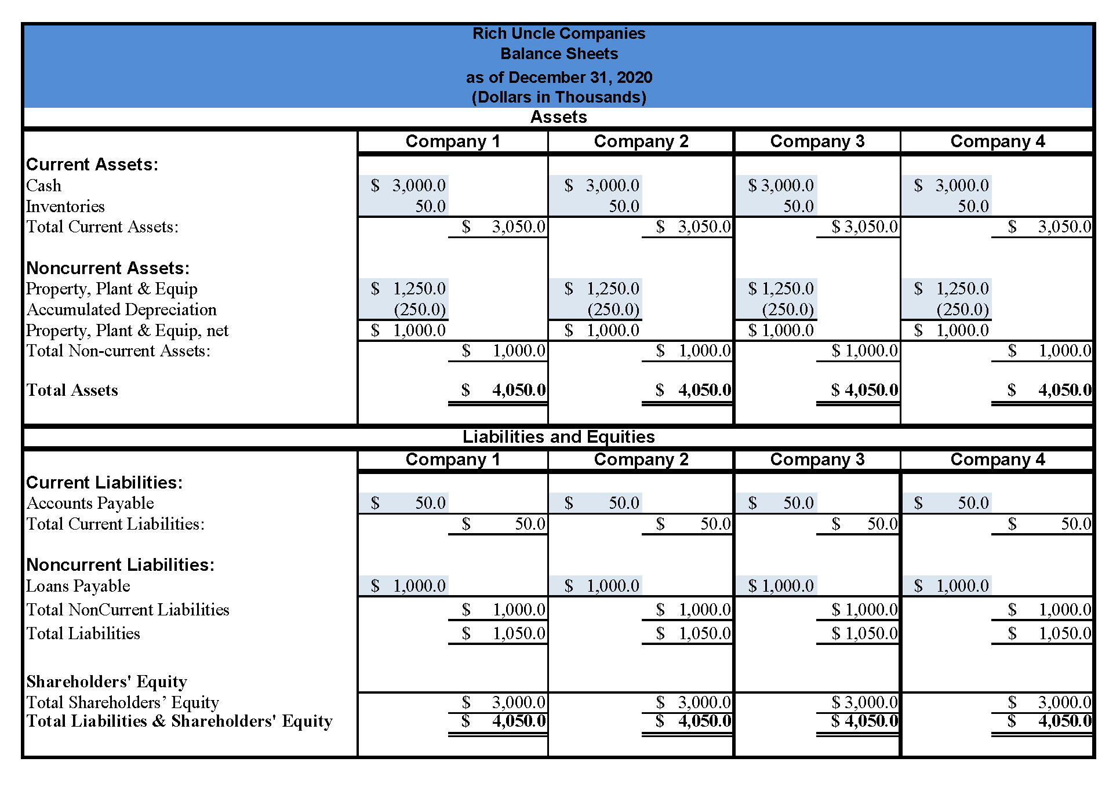

Slide 18
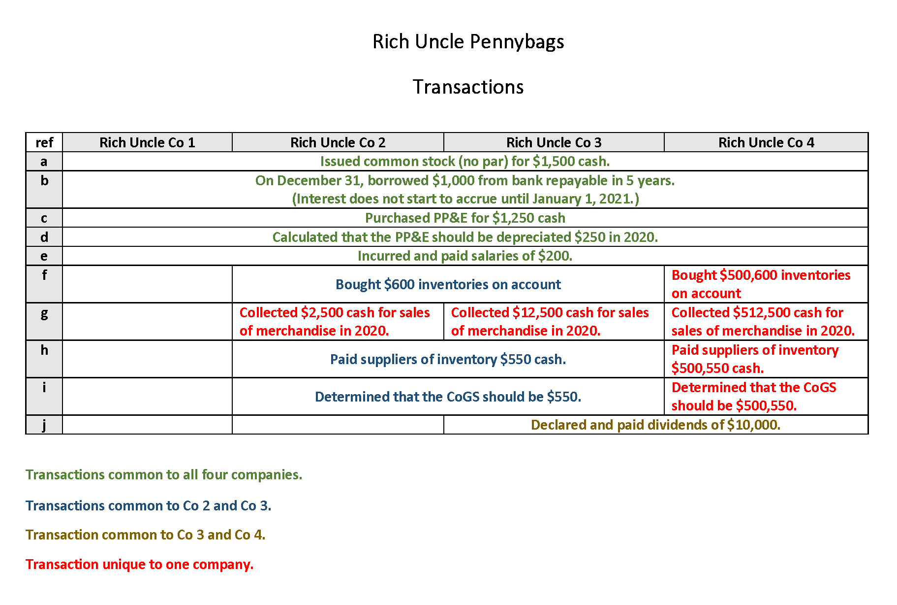

Slide 19
Merck & Vioxx
Accounting recognition rules exclude a lot…

Slide 20
Market Reaction
Source: Yale Case 08-016 Merck and Vioxx (A)

Slide 21
Link to News Coverage
https://www.nytimes.com/2004/09/30/business/merck-pulls-vioxx-painkiller-from-market-and-stock-plunges.html
Reports that Merck’s market capitalization fell by about $25 bn.

Slide 22
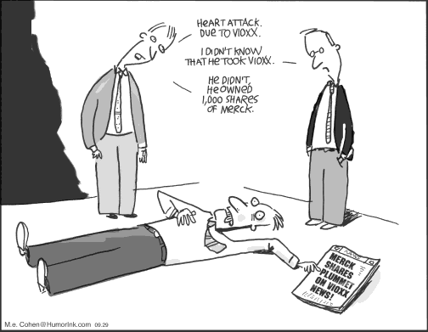

Slide 23
Merck & Co., Inc.
7. From Note 11: “The Company records accruals for contingencies when it is probable that a liability has been incurred and the amount can be reasonably estimated.”
8. From Note 11: “Legal defense costs expected to be incurred in connection with a loss contingency are accrued when probable and reasonably estimable.”

Slide 24
But Seriously …
Suppose Merck did have a good idea about its ultimate losses in litigation – say, $4.85 bn.
Also suppose that accounting conventions required Merck to book the liability.
What would you do the next day in court if you were the plaintiffs’ attorneys?

Slide 25
Accounting Neutrality
Accounting rule makers often hold themselves out to be the passive recorders of events – i.e., that they are just reporting the “facts” and the consequences aren’t their department.
Of course, the world doesn’t work that way. The results we see are impacted by the accounting we do (and by the accounting we expect to be done).
That’s your dose of high-flying, ivory tower stuff. Now let’s get to debits and credits!

Slide 26
A Brief Logic Exercise
Value can be … | Which …
Created | Increases the social ‘pie’
Consumed | Decreases the social ‘pie’
Redistributed | Re-divides the social ‘pie’
The processes which result in value creation, consumption, and redistribution
occur over time.
We have seen that ‘value events’ are not automatically coincident with cash flows.

Slide 27
Possibilities
Cash Flow Occurs | Value Creation | Value Consumption
Before Value Event | Liability | Asset
Coincident with Value Event | Just count the cash | Just count the cash
After the Value Event | Asset | Liability

Slide 28
Suppose Value is Created
If all the value has been received in cash in the past
HERE
If all the value is received in cash in the future
If all the value is received in cash in the current period
Must have a liability
Just count the cash
Must have an asset
HERE
HERE
HERE
Period of interest

Slide 29
Suppose Value is Consumed
HERE
If all the value is paid for with current cash disbursements, just count the cash flow
If all the value is to be paid for in cash in the future, must create a liability
If all the value has paid for in cash in the past, must create an asset
HERE
HERE
HERE
Period of interest

Slide 30
Dig In!
Recording transactions and preserving the accounting identity.
Accounting Identity: Debits and Credits

Slide 31
Next Time
More on financial statements
Balance Sheets (aka) Statements of Financial Position
Income Statements
Debits, credits and how accounting works!

