Slide 1
libcsp
A Binding for CSP
Communication and Synchronisation
in Multithreaded C Programs
Rick Beton
Richard.Beton@roke.co.uk
Roke Manor Research Ltd
Notes:
1
1
A C library is described which exists to support synchronisation and communication in the CSP model, using the Posix Threads API as its basis.
This differs from other notable approaches (e.g. Jim Moores 1999 CCSP - A Portable CSP-Based Run-Time System Supporting C and occam) in that it uses Posix Threads.
Whilst this approach has drawbacks, its main achievement is being easily adopted by people already familiar with Posix Threads and being useful to a wide range of target platforms.
libcsp is open-source, available under the Library Gnu Public License. See http://www.beton.freeserve.co.uk/libcsp/.

Slide 2
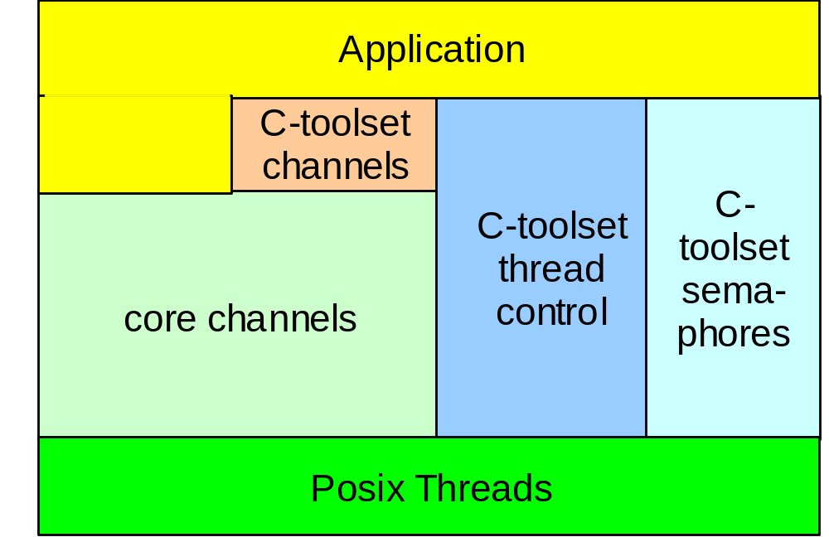
libcsp – where it fits in
Notes:
1
1
This diagram shows how the application sits on libcsp, which in turn depends on Posix Threads.
libcsp provides the glue by which a multithreaded application can be developed along CSP lines. It does so using the Posix Threads API as its basis.
Furthermore, libcsp emulates most of the API of the Inmos C Toolset. This is rather incompletely implemented at present, however, and is unlikely to progress much unless a need for this becomes apparent.
The C Toolset contains an API for forking and joining lightweight ‘processes’ (threads) that suited the old transputer environment. However, this API is a little difficult to work with, outside of the transputer environment. When compared to JCSP, for example, clear expression of process networks is not easy. This leaves some room for improvement.

Slide 3




Posix Threads
Creation and deletion of threads
Mutual exclusion – mutexes
Synchronisation - condition variables
Plus semaphores, signals and
error handling
Notes:
1
1
Here is an overview of Posix Threads.
The Posix Threads library provides three main functions
The creation and deletion of threads. Attributes can be used to control threads, e.g. to emulate the Inmos C Toolset ProcRunHigh and ProcRunLow, a fifo scheduler and a round-robin scheduler are used (respectively).
Access to shared resources, e.g. shared memory locations, is controlled using mutexes. These prevent race conditions if used correctly.
Threads are normally de-synchronised by mutexes. Condition variables allow one thread to wait until another thread signals it.
Semaphores are provided but their use is not encouraged.
Posix signals and error handling is also covered. The error handling differs from that used in the rest of Posix!

Slide 4
libcsp Channels
typedef struct CSP_Channel_t Channel;
typedef enum
{
CSP_ONE2ONE_CHANNEL,
CSP_MANY2ONE_CHANNEL,
CSP_ONE2MANY_CHANNEL,
CSP_MANY2MANY_CHANNEL
} CSP_ChanType_t;
Channel * CSP_chanAlloc (CSP_ChanType_t type, int discriminant);
Notes:
1
1

Slide 5
Copying data across channels
c ! count::data
c ? count::data
void CSP_chanOutCopy
(Channel * c, void * data, int count)
int CSP_chanInCopy
(Channel * c, void * data, int count)
c ! n
INT n:
c ? n
void CSP_chanOutInt (Channel * c, int n)
int CSP_chanInInt (Channel * c)
Notes:
1
1

Slide 6
Moving data across channels
n/a
n/a
void CSP_chanOutMove
(Channel * c, void ** data)
int CSP_chanInMove
(Channel * c, void ** data)
Notes:
1
1

Slide 7
How do libcsp channels work?
struct CSP_Channel_t
{
int waitingToMeet;
int waitingToPart;
pthread_mutex_t meetMx;
pthread_mutex_t rwMx;
pthread_mutex_t readQueue;
pthread_mutex_t writeQueue;
pthread_cond_t meetSync;
pthread_cond_t rwSync;
struct CSP_Alt_t * alt;
int hasReadQueue; /* one2many, many2many */
int hasWriteQueue; /* many2one, many2many */
int discriminant; /* run-time type consistency checking*/
int integer; /* transferred data */
void * buffer; /* ditto */
int guardEnabled; /* alt guard enable/disable */
};
Notes:
1
1
There are 4 mutexes
There are 2 cond. Vars
There are two main booleans
alt used for alternation - described later
Bottom stuff - general

Slide 8
How do libcsp channels work?
Writer
take the meetMx mutex
take the rwMx mutex
(channel is now in writing phase)
if the reading thread is waiting, signal meetSync; otherwise wait (& free meetMx)
free the meetMx lock
copy the data to the channel’s internal structure
wait on rwSync until the reading thread has taken the data
free the rwMx mutex
Reader
take the meetMx mutex
if the writing thread is waiting, signal meetSync; otherwise wait (& free meetMx)
free the meetMx lock
take the rwMx mutex
(channel is now in reading phase)
copy the data from the channel’s internal structure
signal the writing thread on rwSync
free the rwMx mutex
Notes:
1
1

Slide 9
Alternation
int CSP_priAltSelect
(CSP_Alt_t * alt,
Channel ** clist,
int nChans)
Returns index of a channel that is ready to communicate
Notes:
1
1
API is basically simple, but there are wrappers to provided related functionality

Slide 10
Alternation
Check that every channel is one-to-one
In every channel,
Take the meetMx mutex
If boolean guard is enabled and channel is in writing phase
Release all the meetMx mutexes acquired so far
Return index of waiting channel
// none waiting
Take the altMx mutex
Release all the meetMx mutexes
Wait on altCond
// at this point, alting thread has been signalled and
// alt->selectedChannel is now defined
Release the altMx mutex
Return the index of the selected channel
Notes:
1
1

Slide 11

Performance
Sparc/solaris 5.7 Ultra-5
commstime.c 1100 µs/loop 140 µs/context switch
Same machine with Kroc 0.9ß
commstime.occ 2500 ns/loop 300 ns/context switch
Notes:
1
1

Slide 12
Summary
libcsp provides working channels and alternation in a Posix Threads environment.
Channels can be shared (many-to-one etc)
Library is reasonably small and available under LGPL.
Performance is poor and this highlights the cost of using Posix Threads.
Also, channels were tricky to implement using mutexes and condition variables -
complexity ➔ higher runtime overhead.
It would be better to provide channels at the operating system level.
Notes:
1
1

