Slide 1
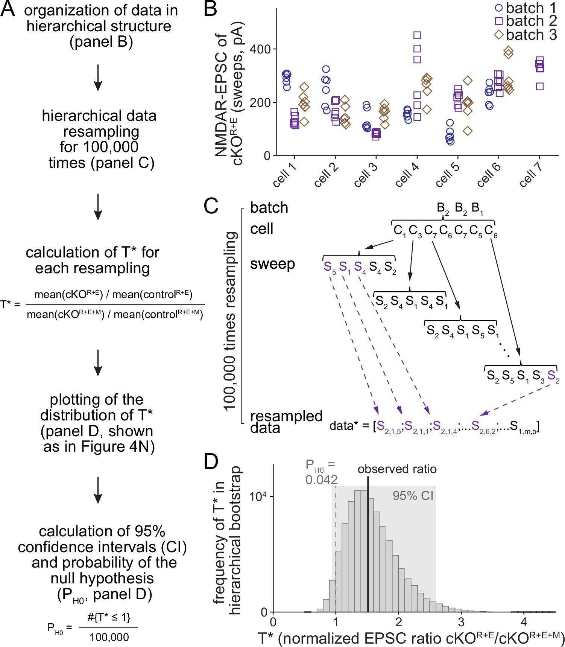
Figure 4—figure supplement 2

Slide 2
Figure 4—figure supplement 2, legend
Workflow of the hierarchical bootstrap analyses.
(A) Analysis pipeline for the hierarchical bootstrap on the example of NMDAR-EPSCs in control^{R+E}, cKO^{R+E}, control^{R+E+M}, and cKO ^{R+E+M} (data from Figure 4). For all cells, we resampled with replacement from the raw data, while preserving its nested, hierarchical structure. By repeating the process 100,000 times, the sampling distribution of the test statistic T was estimated and the distribution of T* values was used to calculate confidence intervals (CI) and the probability of the null hypothesis P_{H0} given the data. (B) Example of the raw data, shown for cKO^{R+E} NMDAR-EPSC values. Each data point represents an individual measurement (sweep) from a specific cell within a specific culture. The tendency for repeated measurements from one cell to be more similar to each other than to measurements from other cells in this example is supported by two-way ANOVA (p<0.001). (C) Example of how resampling with replacement was performed in a hierarchical, nested manner. Starting with the cKO^{R+E} group, we first resampled with replacement from the batches of cells. In all cases, there were three batches of cultures per experiment, and B2, B2, B1 might be drawn for this iteration. Starting with batch 2, the number of cells sampled in this batch is determined, and randomly resampled from the cells in this batch, replicating the same number but containing a different combination of cells. In the first example, the bootstrap cells C₁, C₃, C₇, C₆, C₇, C₅, C₆ were drawn; cells 6 and 7 were included twice and cells 2 and 4 not included at all. Then we proceeded through this list of cells, each time randomly resampling (always with replacement) from the set of technical replicates for that cell and appending these resampled measurements to the bootstrap sample for this group. After doing this for each of the seven cells in the list, the entire process was repeated, first for batch 2 (again), but selecting a different sample of the seven cells, and then for batch 1. At the end, the bootstrap sample for this experimental group was exactly the same size as the original dataset, but containing a different subset of measurements and, importantly, preserving the nested, hierarchical structure of the original data. The above process was then repeated for the remaining three groups (control^{R+E}, cKO^{R+E+M}, control^{R+E+M}), and T* was calculated using the formula T* = [mean(cKO^{R+E})/mean(control^{R+E})]/[mean(cKO^{R+E+M})/mean(control^{R+E+M})]; '*' denotes a bootstrap replicate of the test statistic. The entire procedure was repeated 100,000 times, producing an estimate of the sampling distribution of T. (D) Outcome of the hierarchical bootstrap analysis for NMDAR-EPSCs as shown in Figure 4N following the workflow in (A). The histogram shows the distribution of the 100,000 T* values used to calculate confidence intervals and evaluate the probability of the null hypothesis, P_{H0}.

