Slide 1
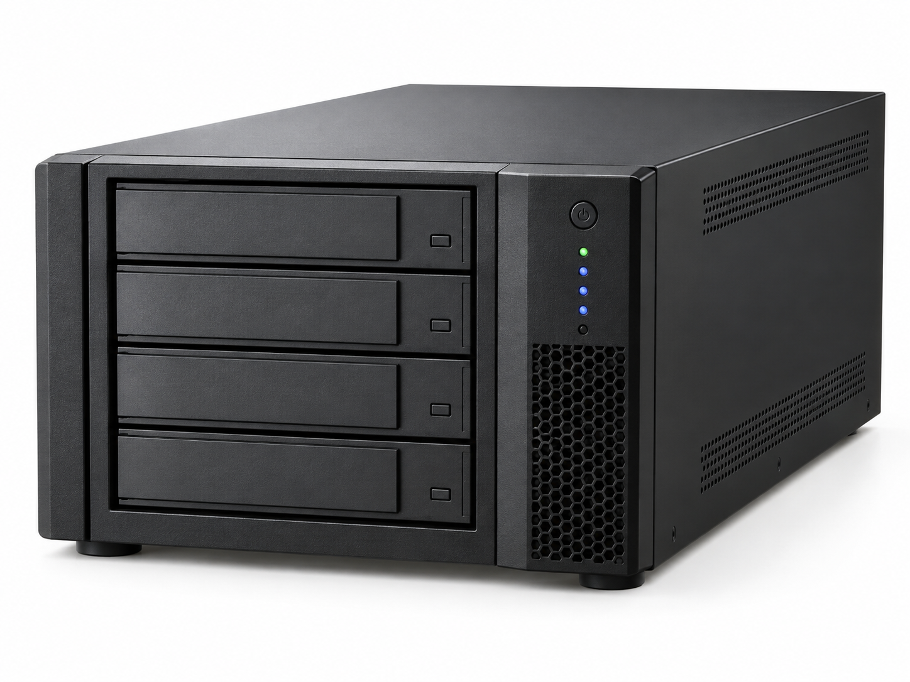
SAVARTUS
Optical Storage Systems
ELS100
Compact Optical Storage Appliance
ELS-100 active archive optical storage for secure long-term retention with fast access through cache, browser, and S3 workflows.
Active archive storage tier
Designed to keep important data accessible while preserving it on optical media for resilient long-term storage and lower operating cost.
Standard S3 interface for object-based application integration
Cache or hot-warm tier supports quick access and restore workflows
Optical media provides durable, tamper-resistant long-term retention
65 TB
100
Up to 4
n/a
160W
Max capacity with 1TB media
Maximum media
Addressable drives
Footprint
Typical energy
What it is built for
Active archive model
Edge, lab, departmental, or branch-office archive
Small evidence, records, imaging, and project repositories
Compact active archive with a cache-first access model
Pilot deployments before scaling to larger ELS systems
Ingest -> Cache -> Write Strategy -> Optical -> Restore
Savartus keeps users working through the cache or hot-warm tier while write strategies move data to optical storage for durable retention.
Capacity profile
16 TB
32 TB
65 TB
200GB media
500GB media
1TB media
Why Savartus ELS
Disk-level access model with optical-grade retention
Standard S3 integration for applications and migration workflows
Lower long-term power and replacement burden than disk-only retention
Manage. Store. Preserve.
ELS-100 | Front
Notes:
Sources: User-provided Savartus/Netzon model specification table in chat. Common platform capabilities summarized from uploaded oRAID 150/288 Compact Units deck, including S3 service, disk plus Blu-ray hybrid architecture, optical RAID, self-healing, energy-management, and service/support content.

Slide 2
SAVARTUS
Optical Storage Systems
ELS100
Compact Optical Storage Appliance
ELS-100 technical summary and deployment notes. Configure with a cache or hot-warm tier for active archive access and optical retention.
Core specifications
Netzon model
HMS2070
Savartus model
ELS-100
Cartridges / media
2 cartridges; 50 media per cartridge; 100 max media
Magazines
n/a
Capacity with 200GB / 500GB / 1TB media
16 TB / 32 TB / 65 TB
Max addressable drives
Up to 4
Power requirements
110-230VAC 50-60Hz
Peak / typical energy consumption
450W / 160W
Dimensions
9.4 x 20.3 x 25.4 in; 240 x 515 x 645 mm
Rack units / max weight
n/a; 79 lb / 36 kg
Integration model
Protection & economics
Standard S3 protocol for ingest and application access
Cache/hot-warm tier supports fast reads and restores
Customer-defined write strategies move data to optical
Browser interface supports discovery and restore workflows
Optical tier preserves original data for long-lived retention
RAID 11+1 optical protection and automatic recovery model
Intelligent sleep/power management reduces ongoing operating cost
Designed to reduce repeated disk refresh cycles
Recommended positioning
ELS-100 is an active archive platform for organizations that need accessible storage today and preservation-grade optical retention for information that must remain trustworthy over time.
Manage. Store. Preserve.
ELS-100 | Back
Notes:
Sources: User-provided Savartus/Netzon model specification table in chat. Common platform capabilities summarized from uploaded oRAID 150/288 Compact Units deck, including S3 service, disk plus Blu-ray hybrid architecture, optical RAID, self-healing, energy-management, and service/support content. Product image is a conceptual rendering unless supplied as a specific product photo.

Slide 3
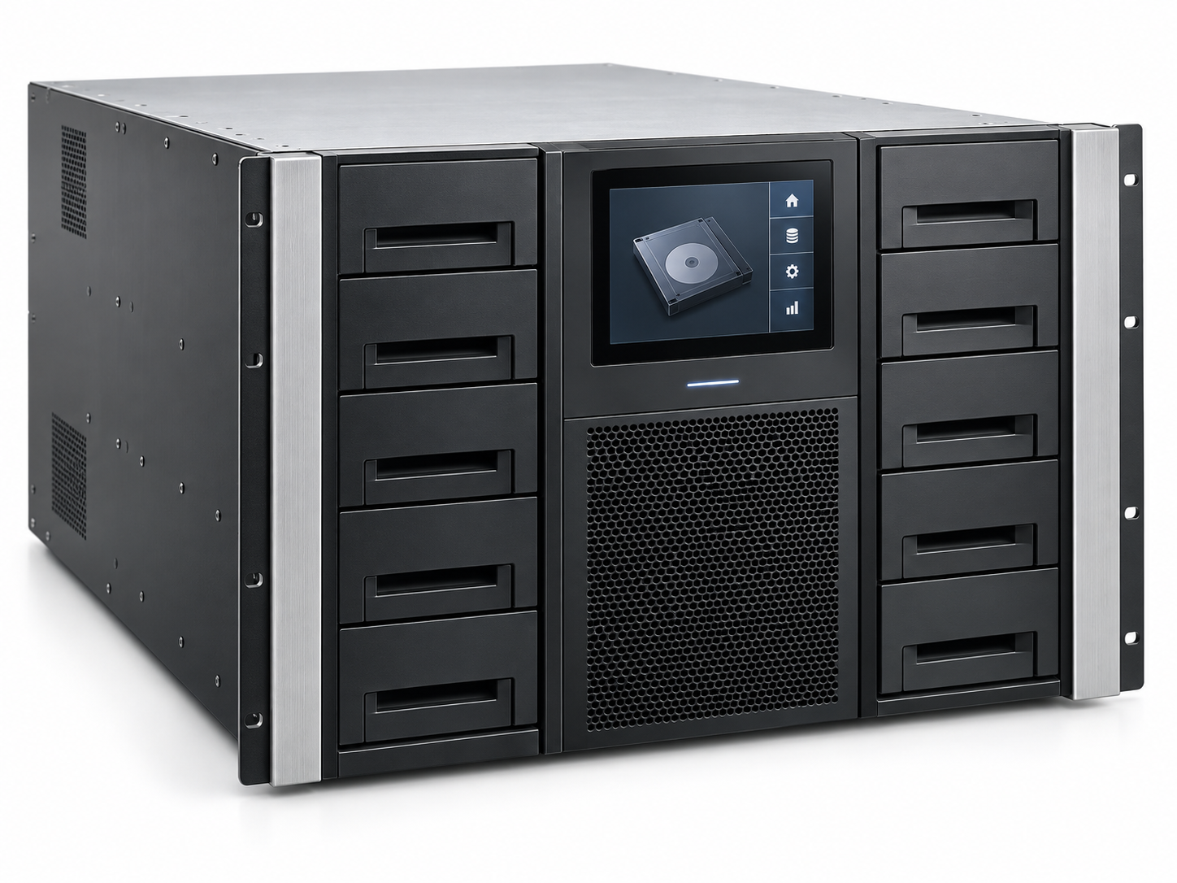
SAVARTUS
Optical Storage Systems
ELS500
Rackmount Optical Library
ELS-500 active archive optical storage for secure long-term retention with fast access through cache, browser, and S3 workflows.
Active archive storage tier
Designed to keep important data accessible while preserving it on optical media for resilient long-term storage and lower operating cost.
Standard S3 interface for object-based application integration
Cache or hot-warm tier supports quick access and restore workflows
Optical media provides durable, tamper-resistant long-term retention
374 TB
576
Up to 6
7U
200W
Max capacity with 1TB media
Maximum media
Addressable drives
Footprint
Typical energy
What it is built for
Active archive model
Departmental active archive and secondary storage
Medical imaging, records, evidence, and content libraries
Data center deployments where rack density matters
Storage tiering behind applications using S3
Ingest -> Cache -> Write Strategy -> Optical -> Restore
Savartus keeps users working through the cache or hot-warm tier while write strategies move data to optical storage for durable retention.
Capacity profile
93 TB
187 TB
374 TB
200GB media
500GB media
1TB media
Why Savartus ELS
Disk-level access model with optical-grade retention
Standard S3 integration for applications and migration workflows
Lower long-term power and replacement burden than disk-only retention
Manage. Store. Preserve.
ELS-500 | Front
Notes:
Sources: User-provided Savartus/Netzon model specification table in chat. Common platform capabilities summarized from uploaded oRAID 150/288 Compact Units deck, including S3 service, disk plus Blu-ray hybrid architecture, optical RAID, self-healing, energy-management, and service/support content.

Slide 4
SAVARTUS
Optical Storage Systems
ELS500
Rackmount Optical Library
ELS-500 technical summary and deployment notes. Configure with a cache or hot-warm tier for active archive access and optical retention.
Core specifications
Netzon model
HDL576
Savartus model
ELS-500
Cartridges / media
48 cartridges; 12 media per cartridge; 576 max media
Magazines
2; 24 cartridges per magazine
Capacity with 200GB / 500GB / 1TB media
93 TB / 187 TB / 374 TB
Max addressable drives
Up to 6
Power requirements
110-230VAC 50-60Hz
Peak / typical energy consumption
450W / 200W
Dimensions
17.7 x 12.2 x 36 in; 448 x 310 x 930 mm
Rack units / max weight
7U; 177 lb / 80 kg
Integration model
Protection & economics
Standard S3 protocol for ingest and application access
Cache/hot-warm tier supports fast reads and restores
Customer-defined write strategies move data to optical
Browser interface supports discovery and restore workflows
Optical tier preserves original data for long-lived retention
RAID 11+1 optical protection and automatic recovery model
Intelligent sleep/power management reduces ongoing operating cost
Designed to reduce repeated disk refresh cycles
Recommended positioning
ELS-500 is an active archive platform for organizations that need accessible storage today and preservation-grade optical retention for information that must remain trustworthy over time.
Manage. Store. Preserve.
ELS-500 | Back
Notes:
Sources: User-provided Savartus/Netzon model specification table in chat. Common platform capabilities summarized from uploaded oRAID 150/288 Compact Units deck, including S3 service, disk plus Blu-ray hybrid architecture, optical RAID, self-healing, energy-management, and service/support content. Product image is a conceptual rendering unless supplied as a specific product photo.

Slide 5
SAVARTUS
Optical Storage Systems
ELS1000
High-Density Rackmount Optical Library
ELS-1000 active archive optical storage for secure long-term retention with fast access through cache, browser, and S3 workflows.
Active archive storage tier
Designed to keep important data accessible while preserving it on optical media for resilient long-term storage and lower operating cost.
Standard S3 interface for object-based application integration
Cache or hot-warm tier supports quick access and restore workflows
Optical media provides durable, tamper-resistant long-term retention
747 TB
1,152
Up to 12
10U
200W
Max capacity with 1TB media
Maximum media
Addressable drives
Footprint
Typical energy
What it is built for
Active archive model
Departmental active archive and secondary storage
Medical imaging, records, evidence, and content libraries
Data center deployments where rack density matters
Storage tiering behind applications using S3
Ingest -> Cache -> Write Strategy -> Optical -> Restore
Savartus keeps users working through the cache or hot-warm tier while write strategies move data to optical storage for durable retention.
Capacity profile
187 TB
374 TB
747 TB
200GB media
500GB media
1TB media
Why Savartus ELS
Disk-level access model with optical-grade retention
Standard S3 integration for applications and migration workflows
Lower long-term power and replacement burden than disk-only retention
Manage. Store. Preserve.
ELS-1000 | Front
Notes:
Sources: User-provided Savartus/Netzon model specification table in chat. Common platform capabilities summarized from uploaded oRAID 150/288 Compact Units deck, including S3 service, disk plus Blu-ray hybrid architecture, optical RAID, self-healing, energy-management, and service/support content.

Slide 6
SAVARTUS
Optical Storage Systems
ELS1000
High-Density Rackmount Optical Library
ELS-1000 technical summary and deployment notes. Configure with a cache or hot-warm tier for active archive access and optical retention.
Core specifications
Netzon model
HDL1152
Savartus model
ELS-1000
Cartridges / media
96 cartridges; 12 media per cartridge; 1,152 max media
Magazines
4; 24 cartridges per magazine
Capacity with 200GB / 500GB / 1TB media
187 TB / 374 TB / 747 TB
Max addressable drives
Up to 12
Power requirements
110-230VAC 50-60Hz
Peak / typical energy consumption
450W / 200W
Dimensions
17.7 x 17.5 x 36 in; 448 x 445 x 930 mm
Rack units / max weight
10U; 352 lb / 160 kg
Integration model
Protection & economics
Standard S3 protocol for ingest and application access
Cache/hot-warm tier supports fast reads and restores
Customer-defined write strategies move data to optical
Browser interface supports discovery and restore workflows
Optical tier preserves original data for long-lived retention
RAID 11+1 optical protection and automatic recovery model
Intelligent sleep/power management reduces ongoing operating cost
Designed to reduce repeated disk refresh cycles
Recommended positioning
ELS-1000 is an active archive platform for organizations that need accessible storage today and preservation-grade optical retention for information that must remain trustworthy over time.
Manage. Store. Preserve.
ELS-1000 | Back
Notes:
Sources: User-provided Savartus/Netzon model specification table in chat. Common platform capabilities summarized from uploaded oRAID 150/288 Compact Units deck, including S3 service, disk plus Blu-ray hybrid architecture, optical RAID, self-healing, energy-management, and service/support content. Product image is a conceptual rendering unless supplied as a specific product photo.

Slide 7
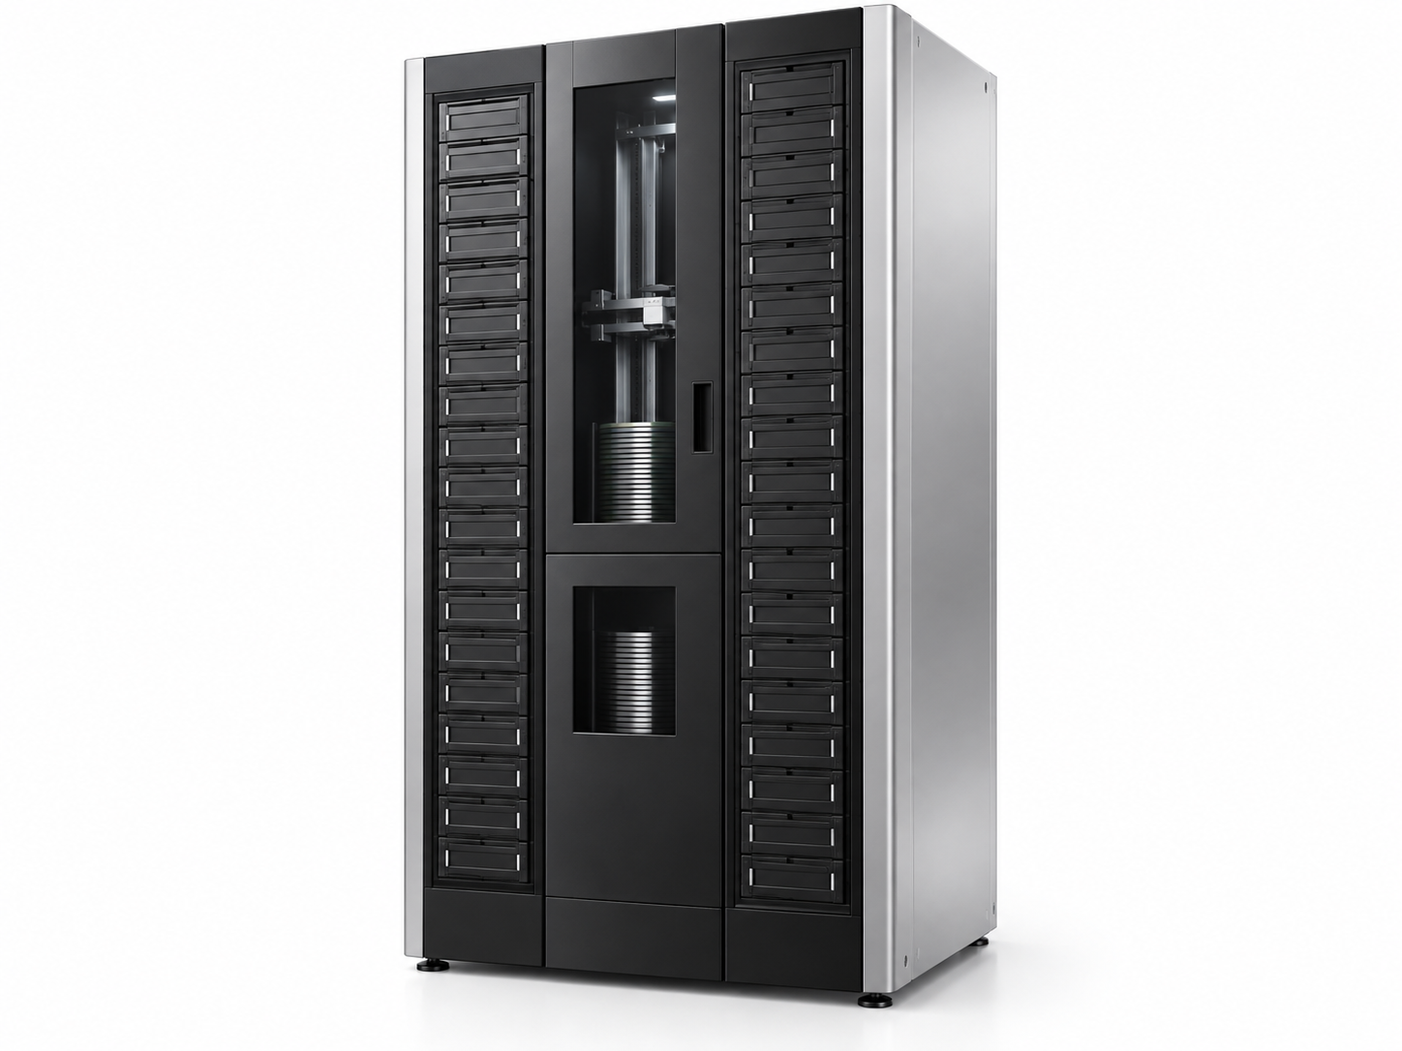
SAVARTUS
Optical Storage Systems
ELS3600
Enterprise Optical Library
ELS-3600 active archive optical storage for secure long-term retention with fast access through cache, browser, and S3 workflows.
Active archive storage tier
Designed to keep important data accessible while preserving it on optical media for resilient long-term storage and lower operating cost.
Standard S3 interface for object-based application integration
Cache or hot-warm tier supports quick access and restore workflows
Optical media provides durable, tamper-resistant long-term retention
2,336 TB
3,600
Up to 24
20U
200W
Max capacity with 1TB media
Maximum media
Addressable drives
Footprint
Typical energy
What it is built for
Active archive model
Enterprise active archive and tiered storage
Large image, video, research, and evidence collections
Cost-controlled long-term retention with fast recall
Compliance repositories needing durable media
Ingest -> Cache -> Write Strategy -> Optical -> Restore
Savartus keeps users working through the cache or hot-warm tier while write strategies move data to optical storage for durable retention.
Capacity profile
584 TB
1,168 TB
2,336 TB
200GB media
500GB media
1TB media
Why Savartus ELS
Disk-level access model with optical-grade retention
Standard S3 integration for applications and migration workflows
Lower long-term power and replacement burden than disk-only retention
Manage. Store. Preserve.
ELS-3600 | Front
Notes:
Sources: User-provided Savartus/Netzon model specification table in chat. Common platform capabilities summarized from uploaded oRAID 150/288 Compact Units deck, including S3 service, disk plus Blu-ray hybrid architecture, optical RAID, self-healing, energy-management, and service/support content.

Slide 8
SAVARTUS
Optical Storage Systems
ELS3600
Enterprise Optical Library
ELS-3600 technical summary and deployment notes. Configure with a cache or hot-warm tier for active archive access and optical retention.
Core specifications
Netzon model
HDL3600
Savartus model
ELS-3600
Cartridges / media
300 cartridges; 12 media per cartridge; 3,600 max media
Magazines
n/a
Capacity with 200GB / 500GB / 1TB media
584 TB / 1,168 TB / 2,336 TB
Max addressable drives
Up to 24
Power requirements
110-230VAC 50-60Hz
Peak / typical energy consumption
670W / 200W
Dimensions
17.7 x 35 x 43 in; 448 x 890 x 1100 mm
Rack units / max weight
20U; 662 lb / 300 kg
Integration model
Protection & economics
Standard S3 protocol for ingest and application access
Cache/hot-warm tier supports fast reads and restores
Customer-defined write strategies move data to optical
Browser interface supports discovery and restore workflows
Optical tier preserves original data for long-lived retention
RAID 11+1 optical protection and automatic recovery model
Intelligent sleep/power management reduces ongoing operating cost
Designed to reduce repeated disk refresh cycles
Recommended positioning
ELS-3600 is an active archive platform for organizations that need accessible storage today and preservation-grade optical retention for information that must remain trustworthy over time.
Manage. Store. Preserve.
ELS-3600 | Back
Notes:
Sources: User-provided Savartus/Netzon model specification table in chat. Common platform capabilities summarized from uploaded oRAID 150/288 Compact Units deck, including S3 service, disk plus Blu-ray hybrid architecture, optical RAID, self-healing, energy-management, and service/support content. Product image is a conceptual rendering unless supplied as a specific product photo.

Slide 9
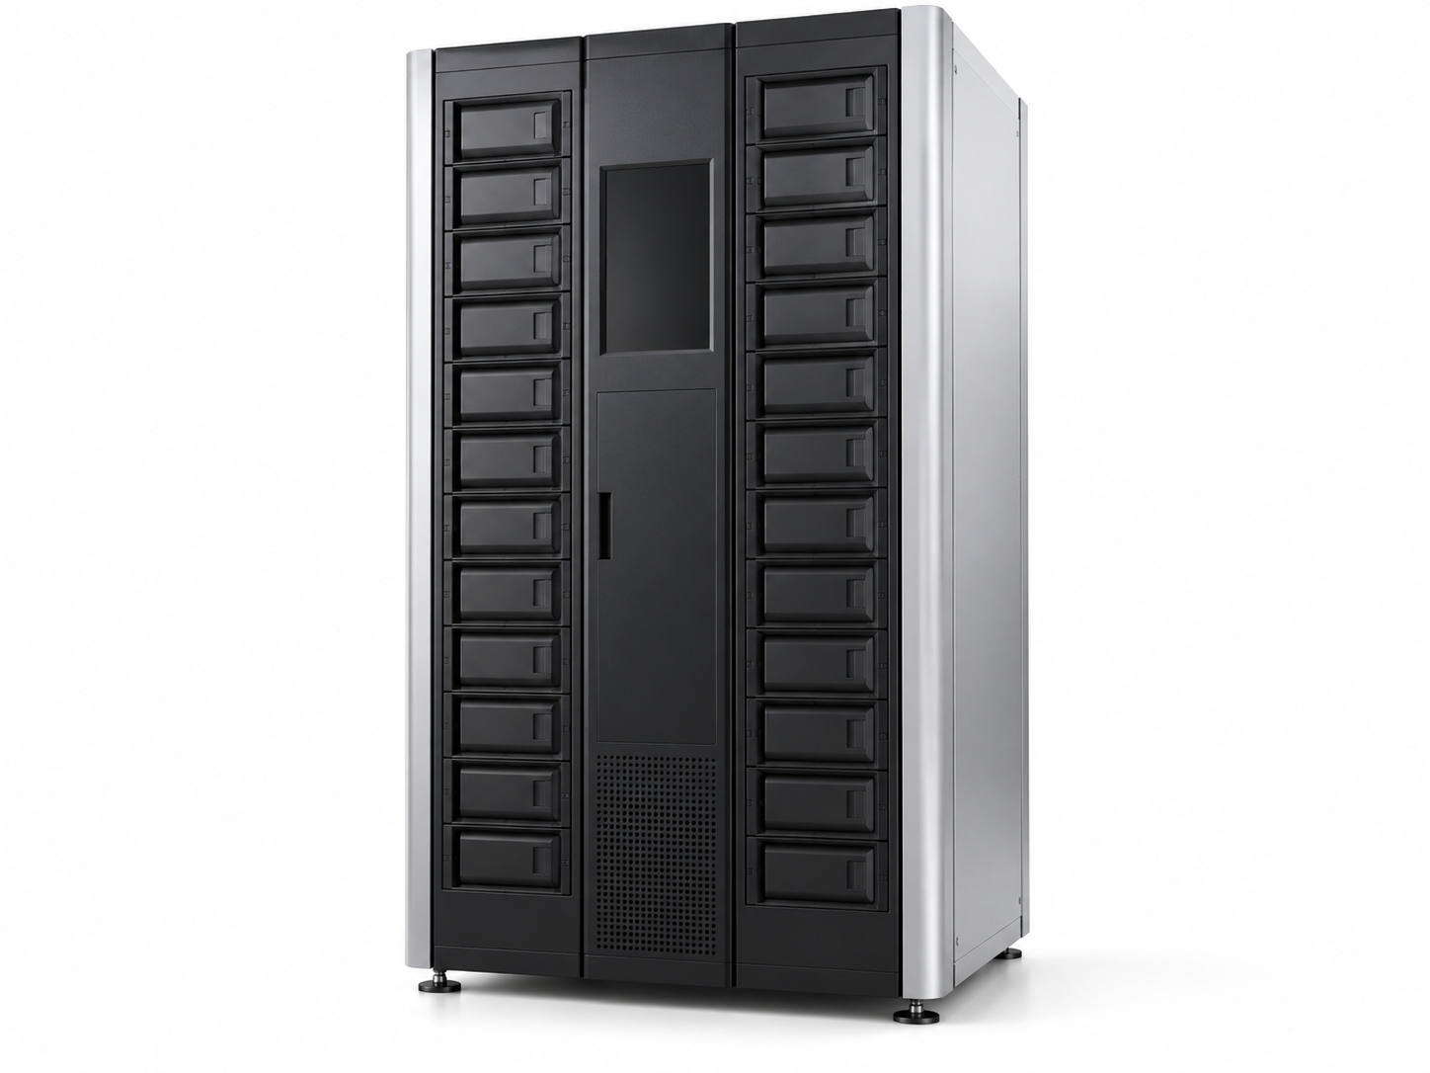
SAVARTUS
Optical Storage Systems
ELS4000
Enterprise Optical Library
ELS-4000 active archive optical storage for secure long-term retention with fast access through cache, browser, and S3 workflows.
Active archive storage tier
Designed to keep important data accessible while preserving it on optical media for resilient long-term storage and lower operating cost.
Standard S3 interface for object-based application integration
Cache or hot-warm tier supports quick access and restore workflows
Optical media provides durable, tamper-resistant long-term retention
2,616 TB
4,032
Up to 12
20U
200W
Max capacity with 1TB media
Maximum media
Addressable drives
Footprint
Typical energy
What it is built for
Active archive model
Enterprise active archive and tiered storage
Large image, video, research, and evidence collections
Cost-controlled long-term retention with fast recall
Compliance repositories needing durable media
Ingest -> Cache -> Write Strategy -> Optical -> Restore
Savartus keeps users working through the cache or hot-warm tier while write strategies move data to optical storage for durable retention.
Capacity profile
654 TB
1,308 TB
2,616 TB
200GB media
500GB media
1TB media
Why Savartus ELS
Disk-level access model with optical-grade retention
Standard S3 integration for applications and migration workflows
Lower long-term power and replacement burden than disk-only retention
Manage. Store. Preserve.
ELS-4000 | Front
Notes:
Sources: User-provided Savartus/Netzon model specification table in chat. Common platform capabilities summarized from uploaded oRAID 150/288 Compact Units deck, including S3 service, disk plus Blu-ray hybrid architecture, optical RAID, self-healing, energy-management, and service/support content.

Slide 10
SAVARTUS
Optical Storage Systems
ELS4000
Enterprise Optical Library
ELS-4000 technical summary and deployment notes. Configure with a cache or hot-warm tier for active archive access and optical retention.
Core specifications
Netzon model
HDL3600A
Savartus model
ELS-4000
Cartridges / media
336 cartridges; 12 media per cartridge; 4,032 max media
Magazines
14; 24 cartridges per magazine
Capacity with 200GB / 500GB / 1TB media
654 TB / 1,308 TB / 2,616 TB
Max addressable drives
Up to 12
Power requirements
110-230VAC 50-60Hz
Peak / typical energy consumption
670W / 200W
Dimensions
17.7 x 35 x 43 in; 448 x 890 x 1100 mm
Rack units / max weight
20U; 662 lb / 300 kg
Integration model
Protection & economics
Standard S3 protocol for ingest and application access
Cache/hot-warm tier supports fast reads and restores
Customer-defined write strategies move data to optical
Browser interface supports discovery and restore workflows
Optical tier preserves original data for long-lived retention
RAID 11+1 optical protection and automatic recovery model
Intelligent sleep/power management reduces ongoing operating cost
Designed to reduce repeated disk refresh cycles
Recommended positioning
ELS-4000 is an active archive platform for organizations that need accessible storage today and preservation-grade optical retention for information that must remain trustworthy over time.
Manage. Store. Preserve.
ELS-4000 | Back
Notes:
Sources: User-provided Savartus/Netzon model specification table in chat. Common platform capabilities summarized from uploaded oRAID 150/288 Compact Units deck, including S3 service, disk plus Blu-ray hybrid architecture, optical RAID, self-healing, energy-management, and service/support content. Product image is a conceptual rendering unless supplied as a specific product photo.

Slide 11
SAVARTUS
Optical Storage Systems
ELS8000
Floor-Standing Optical Library
ELS-8000 active archive optical storage for secure long-term retention with fast access through cache, browser, and S3 workflows.
Active archive storage tier
Designed to keep important data accessible while preserving it on optical media for resilient long-term storage and lower operating cost.
Standard S3 interface for object-based application integration
Cache or hot-warm tier supports quick access and restore workflows
Optical media provides durable, tamper-resistant long-term retention
6,166 TB
9,504
Up to 40
45U
340W
Max capacity with 1TB media
Maximum media
Addressable drives
Footprint
Typical energy
What it is built for
Active archive model
Large-scale active archive repositories
Government, research, healthcare, media, and AI datasets
Petabyte-class optical retention with browser/S3 access
High-density storage for data that must persist for decades
Ingest -> Cache -> Write Strategy -> Optical -> Restore
Savartus keeps users working through the cache or hot-warm tier while write strategies move data to optical storage for durable retention.
Capacity profile
1,542 TB
3,083 TB
6,166 TB
200GB media
500GB media
1TB media
Why Savartus ELS
Disk-level access model with optical-grade retention
Standard S3 integration for applications and migration workflows
Lower long-term power and replacement burden than disk-only retention
Manage. Store. Preserve.
ELS-8000 | Front
Notes:
Sources: User-provided Savartus/Netzon model specification table in chat. Common platform capabilities summarized from uploaded oRAID 150/288 Compact Units deck, including S3 service, disk plus Blu-ray hybrid architecture, optical RAID, self-healing, energy-management, and service/support content.

Slide 12
SAVARTUS
Optical Storage Systems
ELS8000
Floor-Standing Optical Library
ELS-8000 technical summary and deployment notes. Configure with a cache or hot-warm tier for active archive access and optical retention.
Core specifications
Netzon model
HDL8640A
Savartus model
ELS-8000
Cartridges / media
792 cartridges; 12 media per cartridge; 9,504 max media
Magazines
22; 36 cartridges per magazine
Capacity with 200GB / 500GB / 1TB media
1,542 TB / 3,083 TB / 6,166 TB
Max addressable drives
Up to 40
Power requirements
90-300VAC
Peak / typical energy consumption
1500W / 340W
Dimensions
23.6 x 78.74 x 42 in; 600 x 2000 x 1067 mm
Rack units / max weight
45U; 1490 lb / 676 kg
Integration model
Protection & economics
Standard S3 protocol for ingest and application access
Cache/hot-warm tier supports fast reads and restores
Customer-defined write strategies move data to optical
Browser interface supports discovery and restore workflows
Optical tier preserves original data for long-lived retention
RAID 11+1 optical protection and automatic recovery model
Intelligent sleep/power management reduces ongoing operating cost
Designed to reduce repeated disk refresh cycles
Recommended positioning
ELS-8000 is an active archive platform for organizations that need accessible storage today and preservation-grade optical retention for information that must remain trustworthy over time.
Manage. Store. Preserve.
ELS-8000 | Back
Notes:
Sources: User-provided Savartus/Netzon model specification table in chat. Common platform capabilities summarized from uploaded oRAID 150/288 Compact Units deck, including S3 service, disk plus Blu-ray hybrid architecture, optical RAID, self-healing, energy-management, and service/support content. Product image is a conceptual rendering unless supplied as a specific product photo.

Slide 13
SAVARTUS
Optical Storage Systems
ELS10K
Maximum-Capacity Online Optical Library
ELS-10K active archive optical storage for secure long-term retention with fast access through cache, browser, and S3 workflows.
Active archive storage tier
Designed to keep important data accessible while preserving it on optical media for resilient long-term storage and lower operating cost.
Standard S3 interface for object-based application integration
Cache or hot-warm tier supports quick access and restore workflows
Optical media provides durable, tamper-resistant long-term retention
6,727 TB
10,368
Up to 40
50U
340W
Max capacity with 1TB media
Maximum media
Addressable drives
Footprint
Typical energy
What it is built for
Active archive model
Large-scale active archive repositories
Government, research, healthcare, media, and AI datasets
Petabyte-class optical retention with browser/S3 access
High-density storage for data that must persist for decades
Ingest -> Cache -> Write Strategy -> Optical -> Restore
Savartus keeps users working through the cache or hot-warm tier while write strategies move data to optical storage for durable retention.
Capacity profile
1,682 TB
3,363 TB
6,727 TB
200GB media
500GB media
1TB media
Why Savartus ELS
Disk-level access model with optical-grade retention
Standard S3 integration for applications and migration workflows
Lower long-term power and replacement burden than disk-only retention
Manage. Store. Preserve.
ELS-10K | Front
Notes:
Sources: User-provided Savartus/Netzon model specification table in chat. Common platform capabilities summarized from uploaded oRAID 150/288 Compact Units deck, including S3 service, disk plus Blu-ray hybrid architecture, optical RAID, self-healing, energy-management, and service/support content.

Slide 14
SAVARTUS
Optical Storage Systems
ELS10K
Maximum-Capacity Online Optical Library
ELS-10K technical summary and deployment notes. Configure with a cache or hot-warm tier for active archive access and optical retention.
Core specifications
Netzon model
HDL10368
Savartus model
ELS-10K
Cartridges / media
864 cartridges; 12 media per cartridge; 10,368 max media
Magazines
n/a
Capacity with 200GB / 500GB / 1TB media
1,682 TB / 3,363 TB / 6,727 TB
Max addressable drives
Up to 40
Power requirements
110-230VAC 50-60Hz
Peak / typical energy consumption
1500W / 340W
Dimensions
23.6 x 86.6 x 47.2 in; 600 x 2200 x 1200 mm
Rack units / max weight
50U; 1546 lb / 701 kg
Integration model
Protection & economics
Standard S3 protocol for ingest and application access
Cache/hot-warm tier supports fast reads and restores
Customer-defined write strategies move data to optical
Browser interface supports discovery and restore workflows
Optical tier preserves original data for long-lived retention
RAID 11+1 optical protection and automatic recovery model
Intelligent sleep/power management reduces ongoing operating cost
Designed to reduce repeated disk refresh cycles
Recommended positioning
ELS-10K is an active archive platform for organizations that need accessible storage today and preservation-grade optical retention for information that must remain trustworthy over time.
Manage. Store. Preserve.
ELS-10K | Back
Notes:
Sources: User-provided Savartus/Netzon model specification table in chat. Common platform capabilities summarized from uploaded oRAID 150/288 Compact Units deck, including S3 service, disk plus Blu-ray hybrid architecture, optical RAID, self-healing, energy-management, and service/support content. Product image is a conceptual rendering unless supplied as a specific product photo.

Slide 15
SAVARTUS
Optical Storage Systems
ELS8000-OL
Offline Optical Library
ELS-8000-OL active archive optical storage for secure long-term retention with fast access through cache, browser, and S3 workflows.
Air-gapped optical retention tier
Designed as an offline optical library for deep retention, physical isolation, and controlled recall when paired with Savartus cache or online optical systems.
Pairs with cache or online ELS systems for active archive workflows
Supports offline magazines/cartridges for air-gapped retention
Preserves optical media as the long-lived system of record
6,166 TB
9,504
n/a
45U
50W
Max capacity with 1TB media
Maximum media
Addressable drives
Footprint
Typical energy
What it is built for
Active archive model
Offline evidence and records retention
Air-gapped backup copy and cyber recovery
Long-term preservation of regulated information
Media vaulting with indexed recall process
Ingest -> Cache -> Write Strategy -> Optical -> Restore
Savartus uses an online/cache tier for ingest, search, and restore, while the offline library protects optical media in an isolated preservation tier.
Capacity profile
1,542 TB
3,083 TB
6,166 TB
200GB media
500GB media
1TB media
Why Savartus ELS
Air gap reduces exposure to ransomware and accidental deletion
Optical media supports long-term retention and physical isolation
Designed to complement online ELS and cache tiers
Manage. Store. Preserve.
ELS-8000-OL | Front
Notes:
Sources: User-provided Savartus/Netzon model specification table in chat. Common platform capabilities summarized from uploaded oRAID 150/288 Compact Units deck, including S3 service, disk plus Blu-ray hybrid architecture, optical RAID, self-healing, energy-management, and service/support content.

Slide 16
SAVARTUS
Optical Storage Systems
ELS8000-OL
Offline Optical Library
ELS-8000-OL technical summary and deployment notes. Configure with a cache or hot-warm tier for active archive access and optical retention.
Core specifications
Netzon model
HDL8640 OFF
Savartus model
ELS-8000-OL
Cartridges / media
792 cartridges; 12 media per cartridge; 9,504 max media
Magazines
n/a
Capacity with 200GB / 500GB / 1TB media
1,542 TB / 3,083 TB / 6,166 TB
Max addressable drives
n/a
Power requirements
110-230VAC 50-60Hz
Peak / typical energy consumption
50W / 50W
Dimensions
23.6 x 78.74 x 42 in; 600 x 2000 x 1200 mm
Rack units / max weight
45U; 1378 lb / 625 kg
Integration model
Protection & economics
Configured behind or alongside Savartus online/cache tiers
Supports deep retention with offline media management
Retrieval workflow restores required content back to cache
Best used for cold, preserved, or air-gapped copies
Physical isolation helps reduce cyber and operational risk
Optical media supports durable long-term retention
Low typical power profile for offline preservation tiers
Designed for indexed recall rather than continuous online access
Recommended positioning
ELS-8000-OL is the offline preservation tier for organizations that need optical media physically separated from production systems while still participating in a managed active archive workflow.
Manage. Store. Preserve.
ELS-8000-OL | Back
Notes:
Sources: User-provided Savartus/Netzon model specification table in chat. Common platform capabilities summarized from uploaded oRAID 150/288 Compact Units deck, including S3 service, disk plus Blu-ray hybrid architecture, optical RAID, self-healing, energy-management, and service/support content. Product image is a conceptual rendering unless supplied as a specific product photo.

Slide 17
SAVARTUS
Optical Storage Systems
ELS10K-OL
Offline Optical Library
ELS-10K-OL active archive optical storage for secure long-term retention with fast access through cache, browser, and S3 workflows.
Air-gapped optical retention tier
Designed as an offline optical library for deep retention, physical isolation, and controlled recall when paired with Savartus cache or online optical systems.
Pairs with cache or online ELS systems for active archive workflows
Supports offline magazines/cartridges for air-gapped retention
Preserves optical media as the long-lived system of record
ELS-10K-OL details shown as capacity-class draft - confirm final offline specifications.
6,727 TB
10,368
n/a
50U (confirm)
50W (confirm)
Max capacity with 1TB media
Maximum media
Addressable drives
Footprint
Typical energy
What it is built for
Active archive model
Offline evidence and records retention
Air-gapped backup copy and cyber recovery
Long-term preservation of regulated information
Media vaulting with indexed recall process
Ingest -> Cache -> Write Strategy -> Optical -> Restore
Savartus uses an online/cache tier for ingest, search, and restore, while the offline library protects optical media in an isolated preservation tier.
Capacity profile
1,682 TB
3,363 TB
6,727 TB
200GB media
500GB media
1TB media
Why Savartus ELS
Air gap reduces exposure to ransomware and accidental deletion
Optical media supports long-term retention and physical isolation
Designed to complement online ELS and cache tiers
Manage. Store. Preserve.
ELS-10K-OL | Front
Notes:
Sources: User-provided Savartus/Netzon model specification table in chat. Common platform capabilities summarized from uploaded oRAID 150/288 Compact Units deck, including S3 service, disk plus Blu-ray hybrid architecture, optical RAID, self-healing, energy-management, and service/support content.

Slide 18
SAVARTUS
Optical Storage Systems
ELS10K-OL
Offline Optical Library
ELS-10K-OL technical summary and deployment notes. Configure with a cache or hot-warm tier for active archive access and optical retention.
Core specifications
Netzon model
ELS-10K offline variant
Savartus model
ELS-10K-OL
Cartridges / media
864 cartridges; 12 media per cartridge; 10,368 max media
Magazines
24; 36 cartridges per magazine
Capacity with 200GB / 500GB / 1TB media
1,682 TB / 3,363 TB / 6,727 TB
Max addressable drives
n/a
Power requirements
110-230VAC 50-60Hz
Peak / typical energy consumption
50W (confirm) / 50W (confirm)
Dimensions
23.6 x 86.6 x 47.2 in (confirm); 600 x 2200 x 1200 mm (confirm)
Rack units / max weight
50U (confirm); 1546 lb (confirm) / 701 kg (confirm)
ELS-10K-OL details shown as capacity-class draft - confirm final offline specifications.
Integration model
Protection & economics
Configured behind or alongside Savartus online/cache tiers
Supports deep retention with offline media management
Retrieval workflow restores required content back to cache
Best used for cold, preserved, or air-gapped copies
Physical isolation helps reduce cyber and operational risk
Optical media supports durable long-term retention
Low typical power profile for offline preservation tiers
Designed for indexed recall rather than continuous online access
Recommended positioning
ELS-10K-OL is the offline preservation tier for organizations that need optical media physically separated from production systems while still participating in a managed active archive workflow.
Manage. Store. Preserve.
ELS-10K-OL | Back
Notes:
Sources: User-provided Savartus/Netzon model specification table in chat. Common platform capabilities summarized from uploaded oRAID 150/288 Compact Units deck, including S3 service, disk plus Blu-ray hybrid architecture, optical RAID, self-healing, energy-management, and service/support content. Product image is a conceptual rendering unless supplied as a specific product photo.

