Slide 1




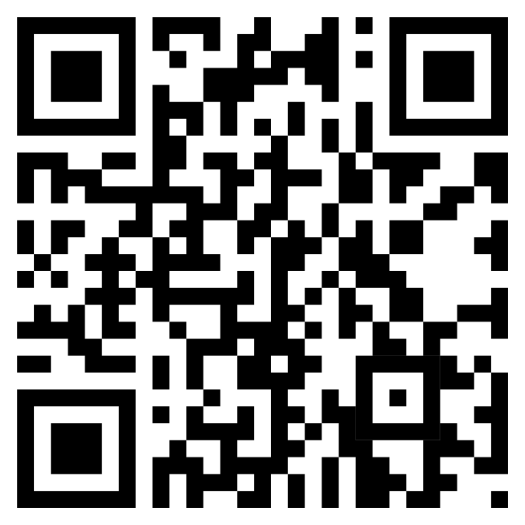
Jupyter Notebooks
Ruud Steltenpool & Rick de Klerk
https://rickdkk.github.io/DCC-workshop/

Slide 2
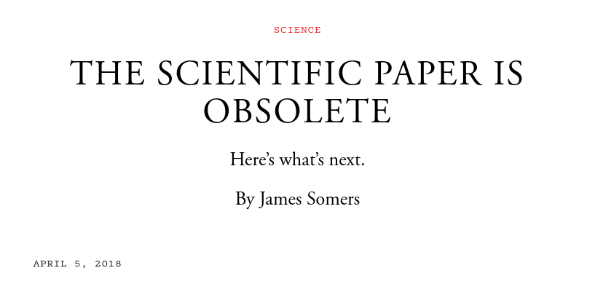
https://www.theatlantic.com/science/archive/2018/04/the-scientific-paper-is-obsolete/556676/

Slide 3
Outline
Notebooks
Waarom notebooks?
Waarom Jupyter?
Hoe werkt het?
Delen
Voorbeeld

Slide 4
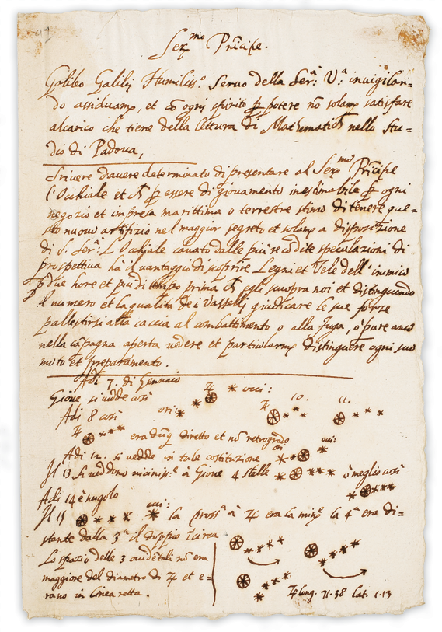
Notebooks
Computational narrative
Een stukje geschiedenis
Reproduceerbaarheid, samenwerken, herbruikbaarheid

Slide 5
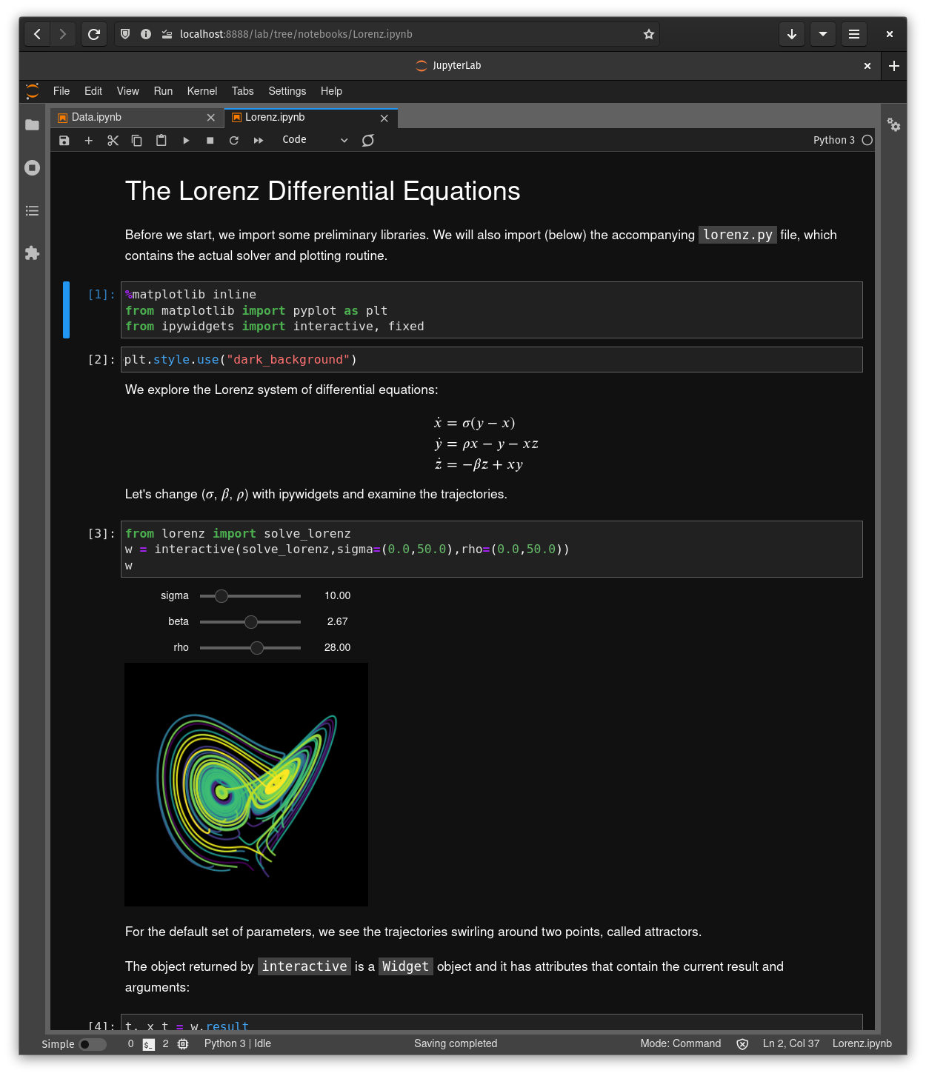
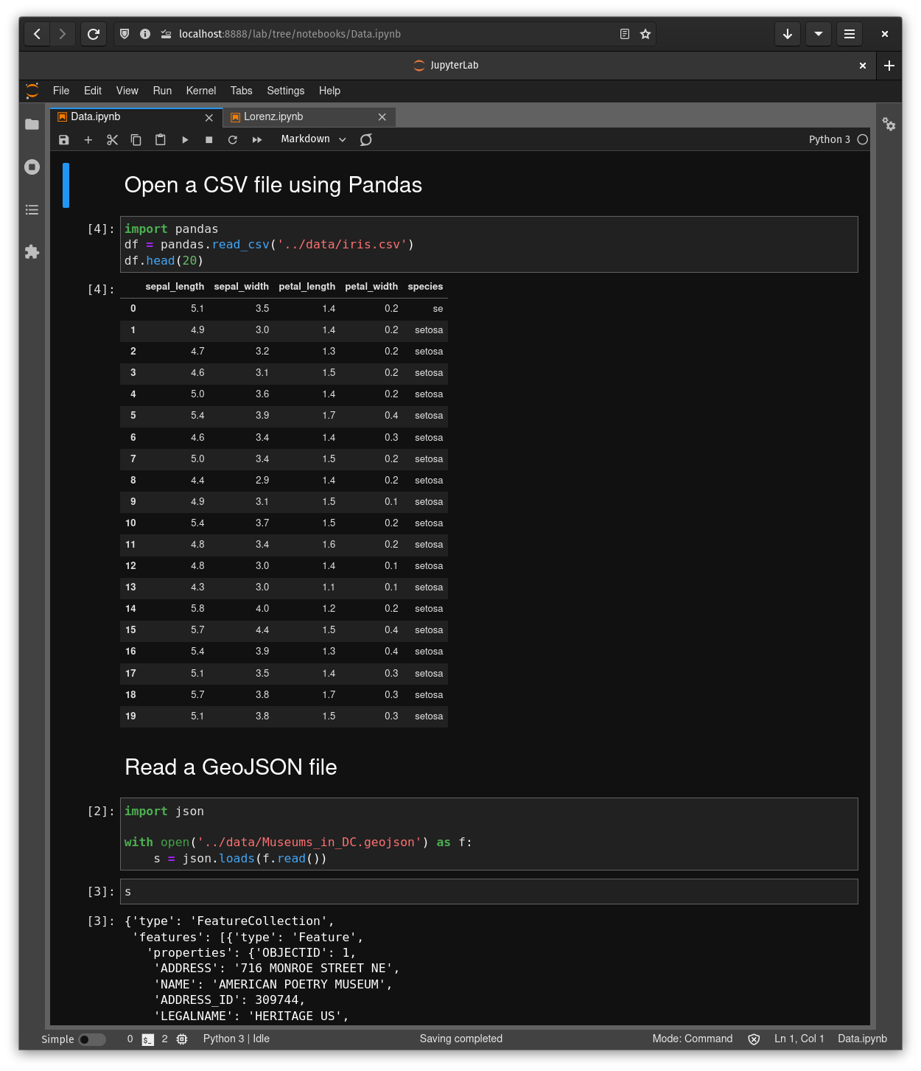

Slide 6
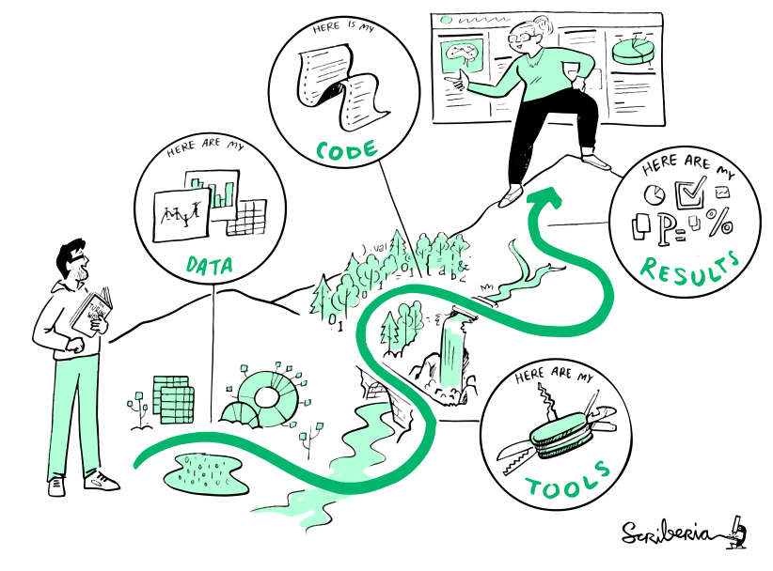
Waarom notebooks?
Transparantie
Experimenteren
Leren
Research Cloud/Drive
Delen
Samenwerken
Documenteren
The Turing Way project illustration by Scriberia.

Slide 7
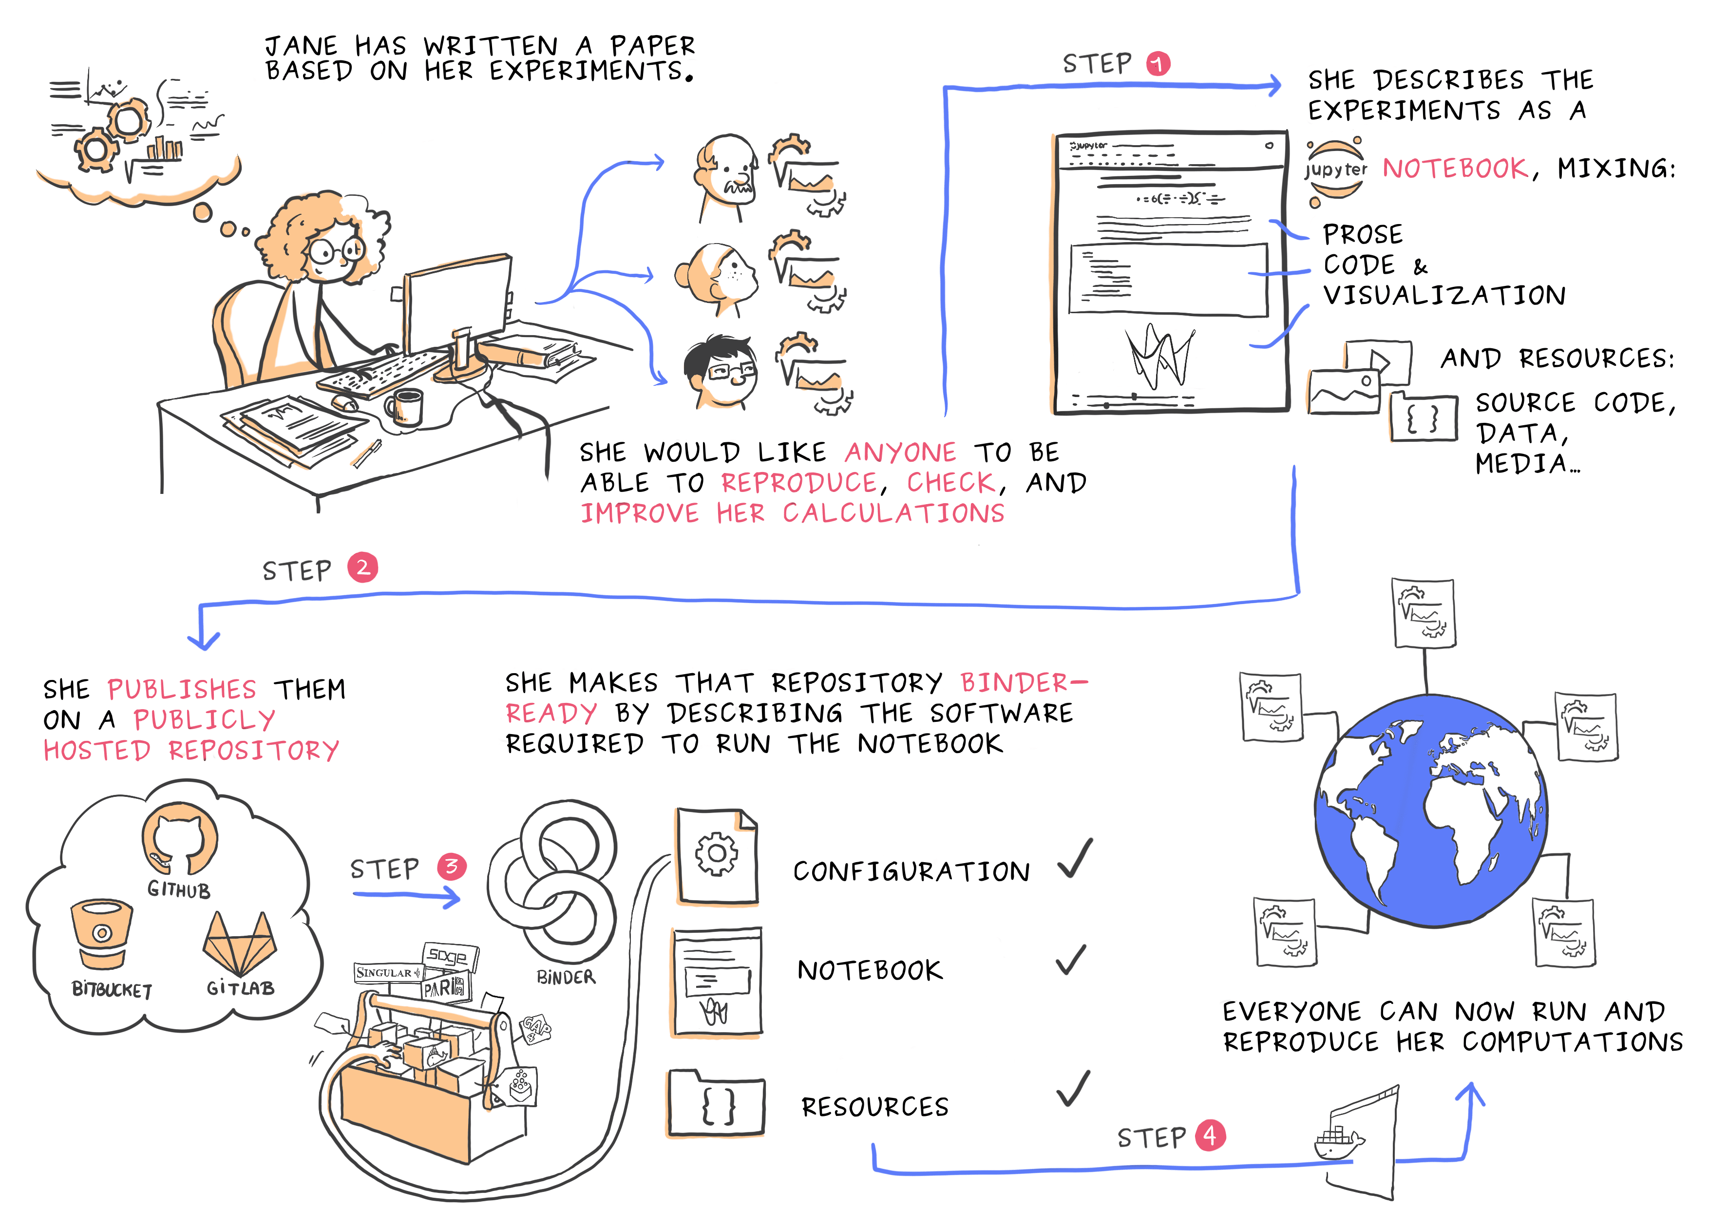
Notebooks & Open Science
Juliette Taka, Logilab and the OpenDreamKit project

Slide 8

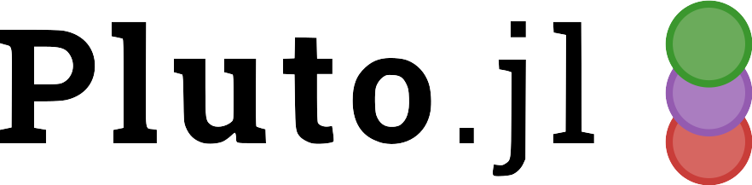

Notebooks
Jupyter
SageMaker, Colab, Azure
Observable
Datalore
Reactor
Pluto
…

Slide 9
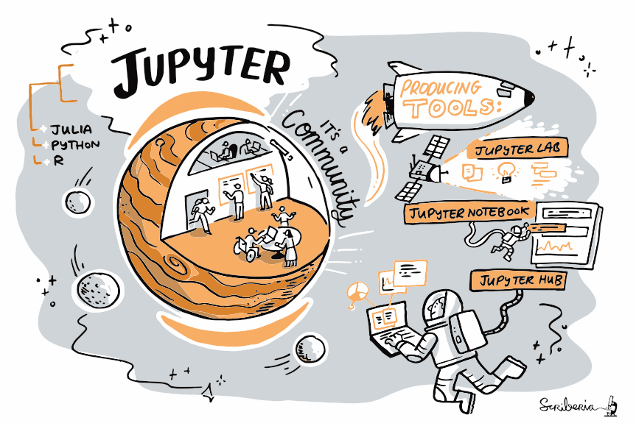
Waarom Jupyter?
Free en open source
Language agnostic
Populair
The Turing Way project illustration by Scriberia.

Slide 10
Jupyter Notebooks
Code
Text (Markdown)
Mathematics (LaTeX)
Plots
Media
Widgets

Slide 11
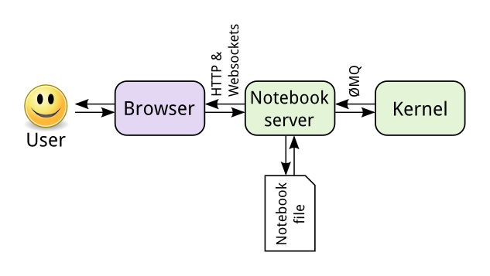
Hoe werkt het?
https://docs.jupyter.org/en/latest/projects/architecture/content-architecture.html

Slide 12
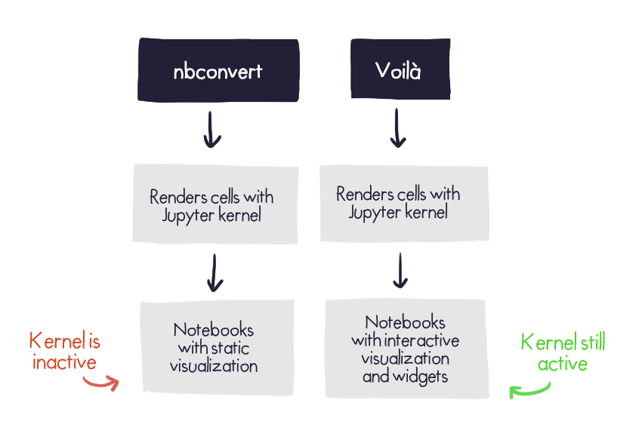
Delen
nbconvert
nbviewer
Voilà (+Déjàvu)
Binder
Slideshows (+RISE)
Jupyterbook
https://blog.jupyter.org/looking-at-notebooks-from-a-new-perspective-bfd06797f188

Slide 13
Voorbeeld

