Slide 1

Game Development for Pythonistas using Godot
Sophie de Klerk
share your talent. move the world.

Slide 2

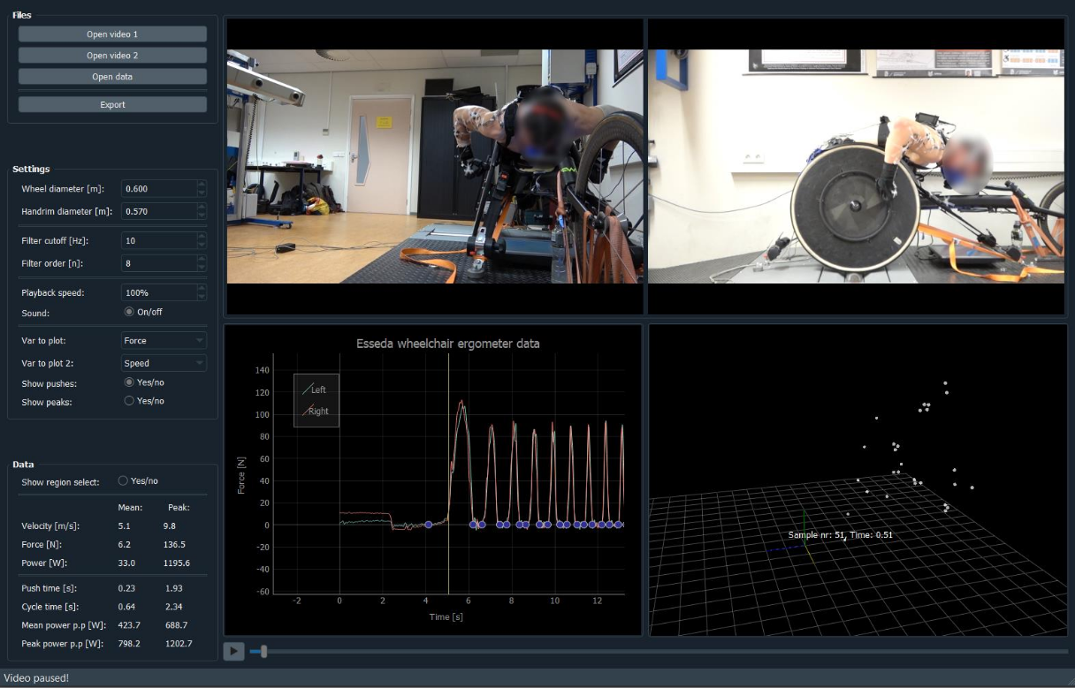
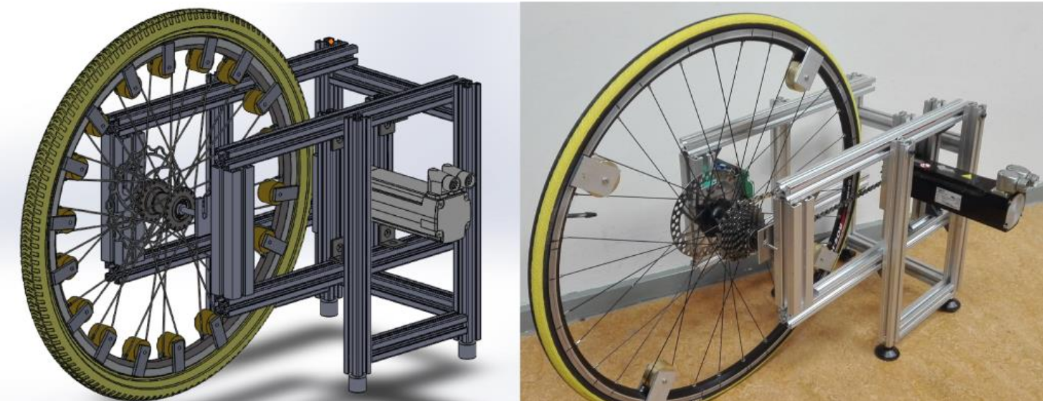
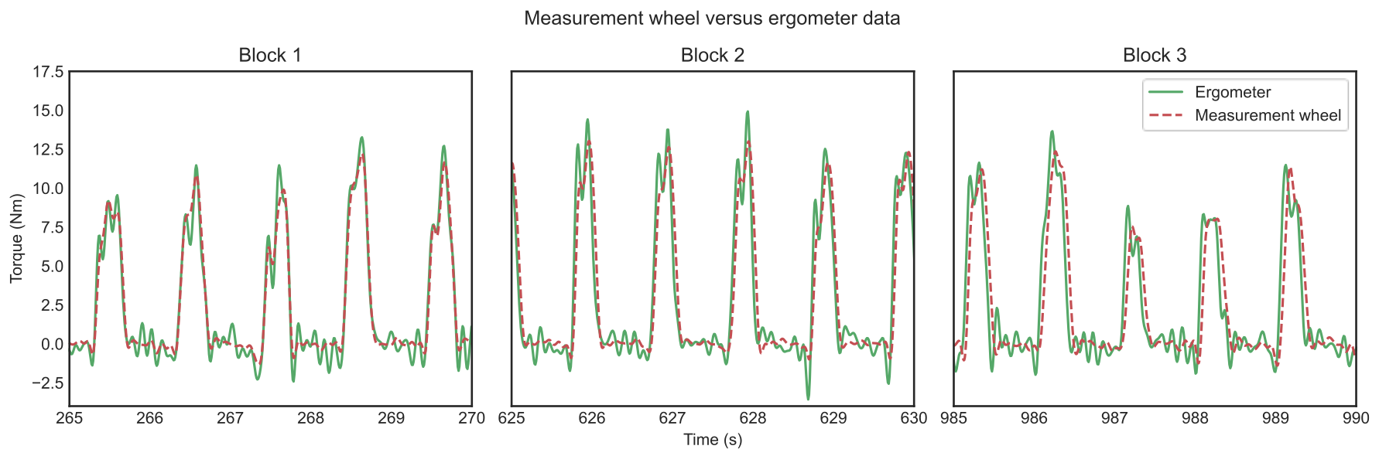
Who this?
Rick Sophie de Klerk
Human Movement Scientist
Python for signal processing / data analysis
Game Programming / Graduation at
Creative Media and Game Technologies

Slide 3
Who this?
Rick Sophie de Klerk
Human Movement Scientist
Python for signal processing / data analysis
Lecturer-researcher at
Creative Media and Game Technologies

Slide 4
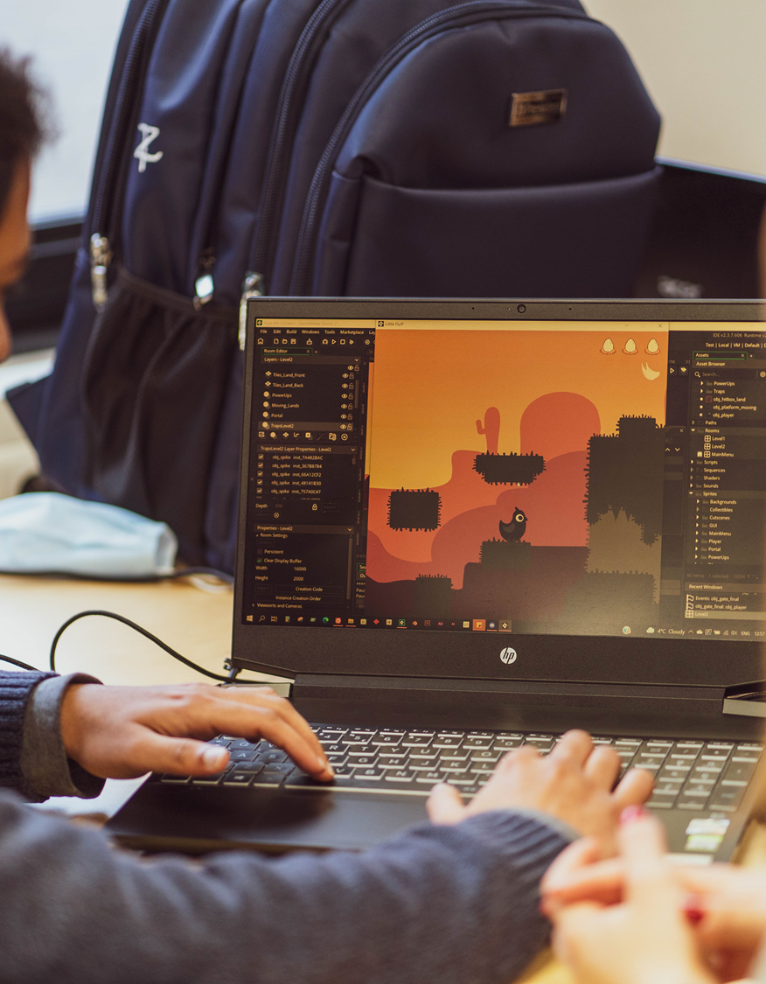
What is CMGT?
Work with Future Tech
Use Game Technologies
Teamwork, Critical thinking
Digital Creator and Innovator
Create for Users
Learn by doing!

Slide 5

What is Godot?
Game engine (duh…)
Editor
Separate 2D and 3D engines
Export to Linux, Mac, Windows, Android/iOS, console
Open source (MIT)

Slide 6
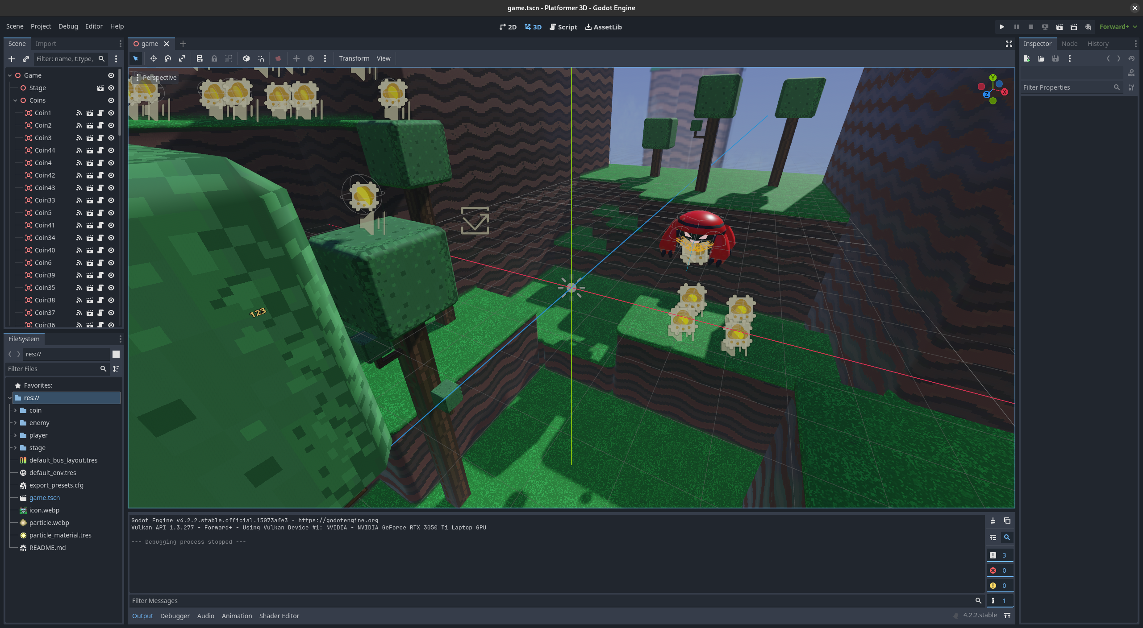
What is Godot?
Game engine (duh…)
Editor
Separate 2D and 3D engines
Export to Linux, Mac, Windows, Android/iOS, console
Open source (MIT)

Slide 7
What is Godot?
Game engine (duh…)
Editor
Separate 2D and 3D engines
Export to Linux, Mac,
Windows, Phones, Console
Open source (MIT)

Slide 8

What is Godot?
Game engine (duh…)
Editor
Separate 2D and 3D engines
Export to Linux, Mac, Web,
Windows, Phones, Console*
Open source (MIT)

Slide 9
What is Godot?
Game engine (duh…)
Editor
Separate 2D and 3D engines
Export to Linux, Mac, Web,
Windows, Phones, Console*
Open source! 🥳

Slide 10
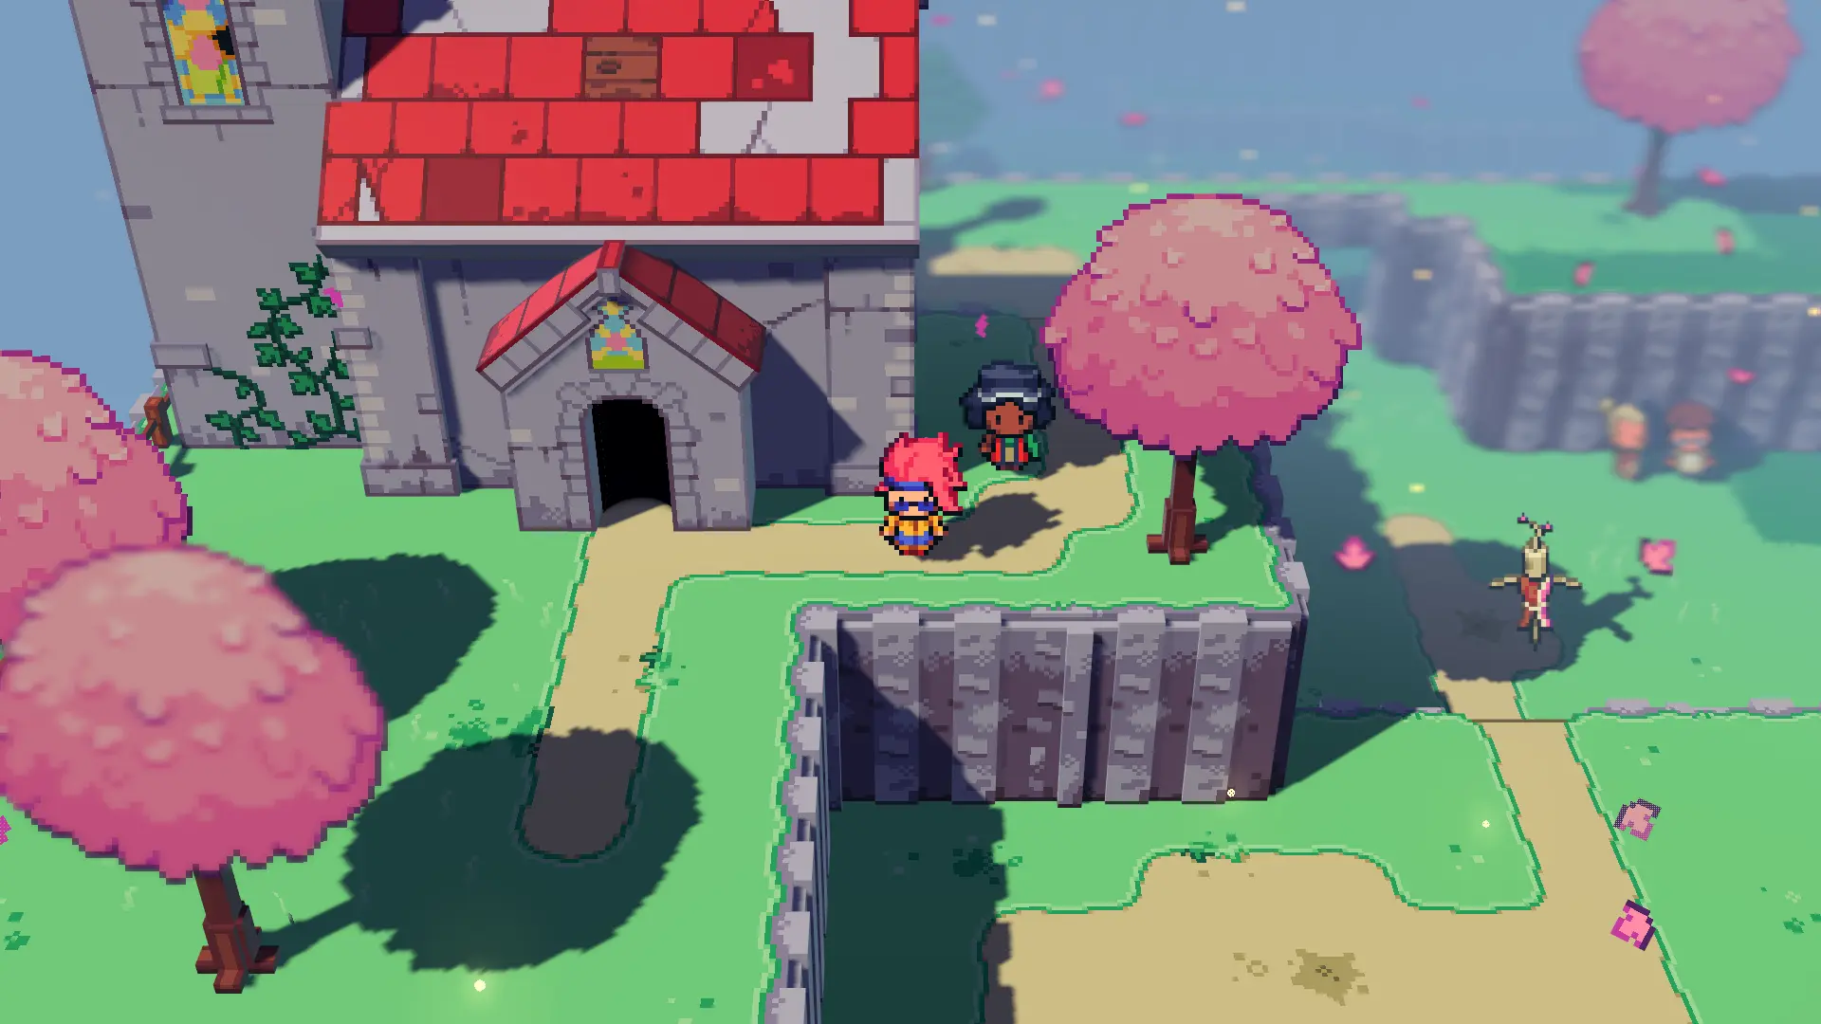
Some examples

Slide 11
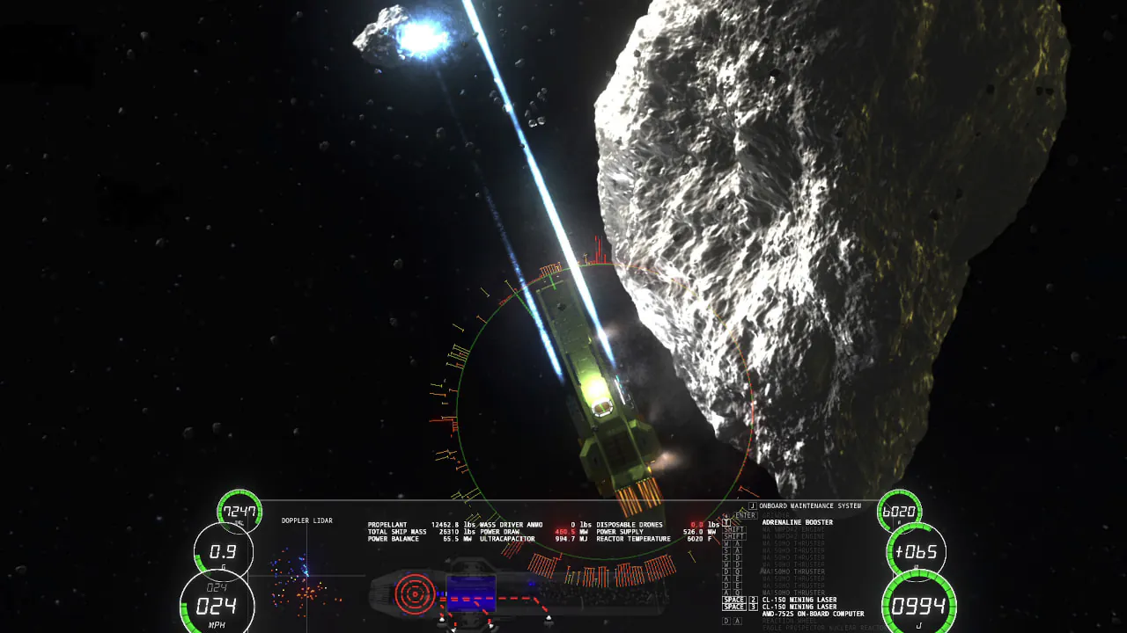
Some examples

Slide 12
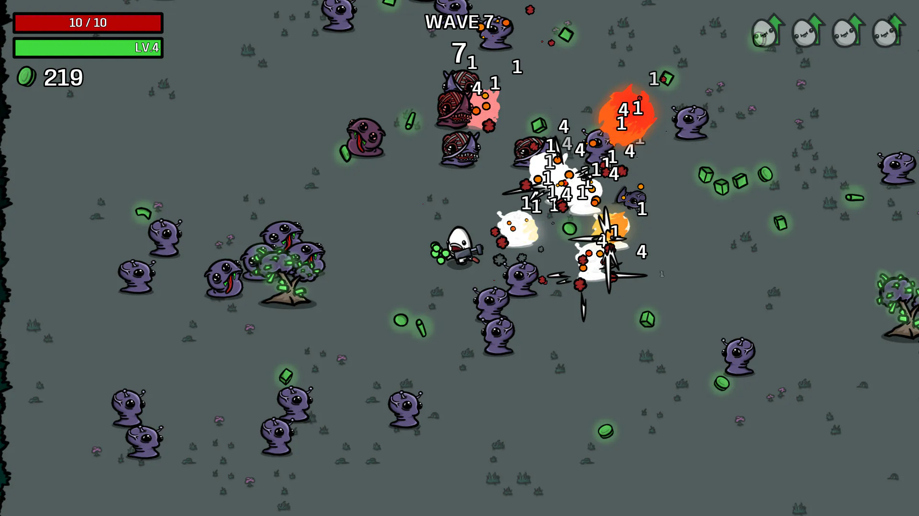
Some examples

Slide 13
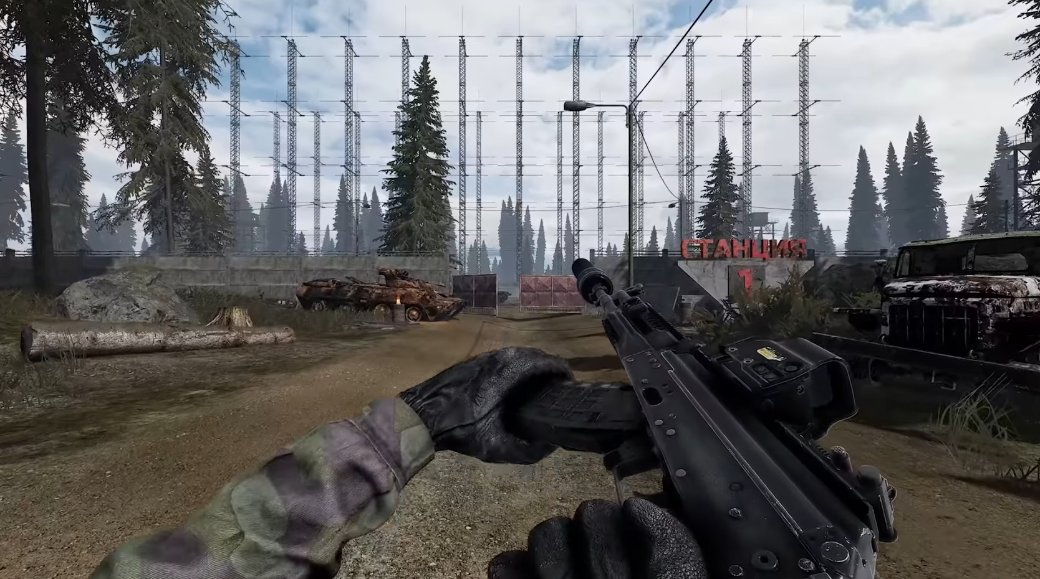
Some examples

Slide 14

Some examples
Notes:
Casette Beasts
ΔV: Rings of Saturn
Brotato
Road to Vostok
Slay the Spire

Slide 15
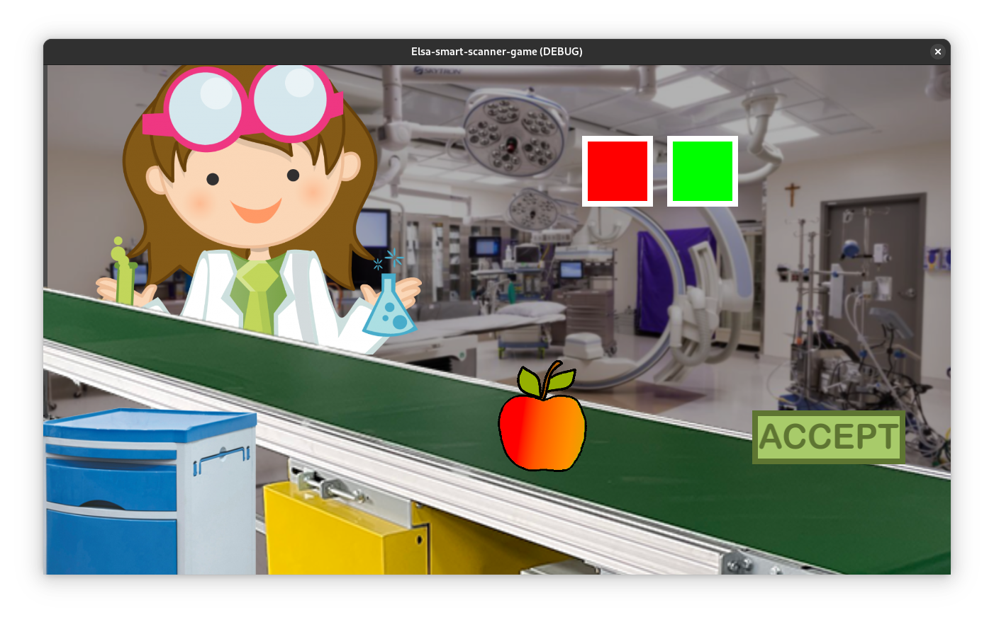
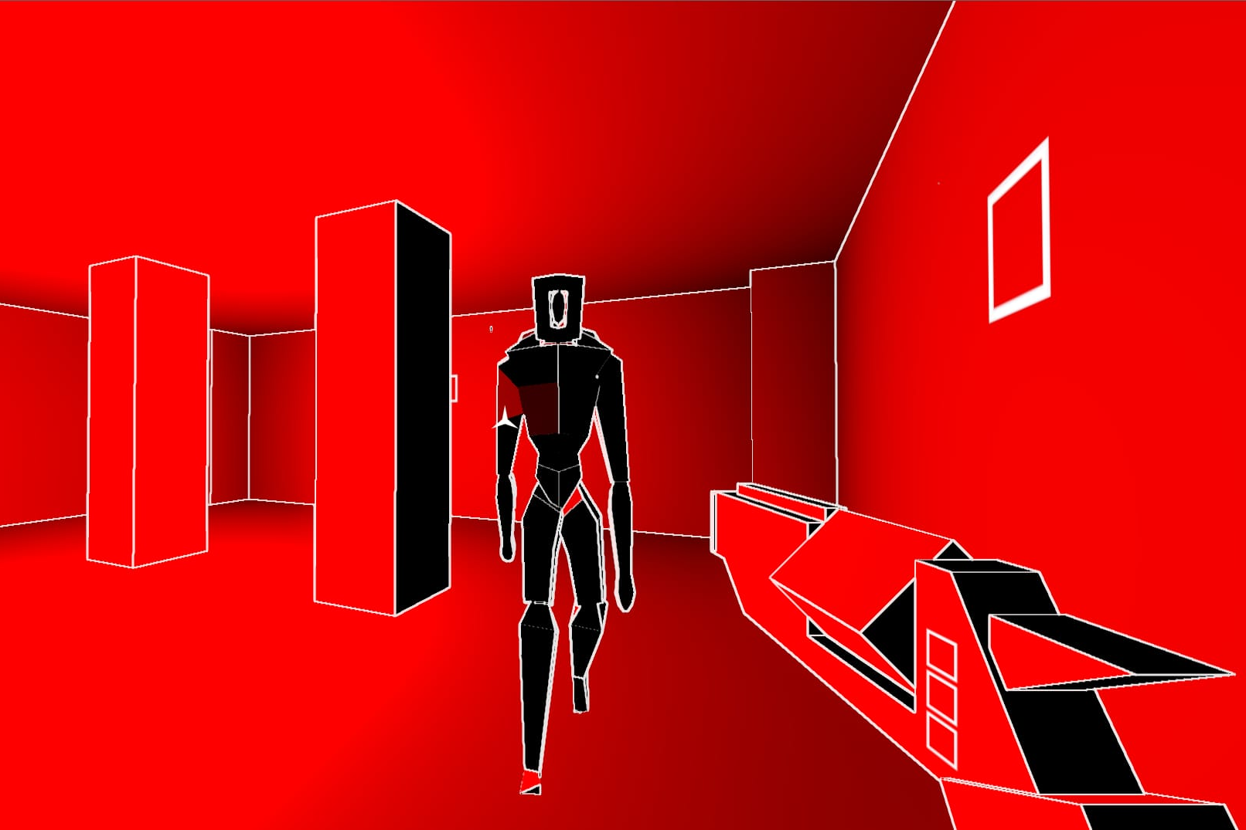
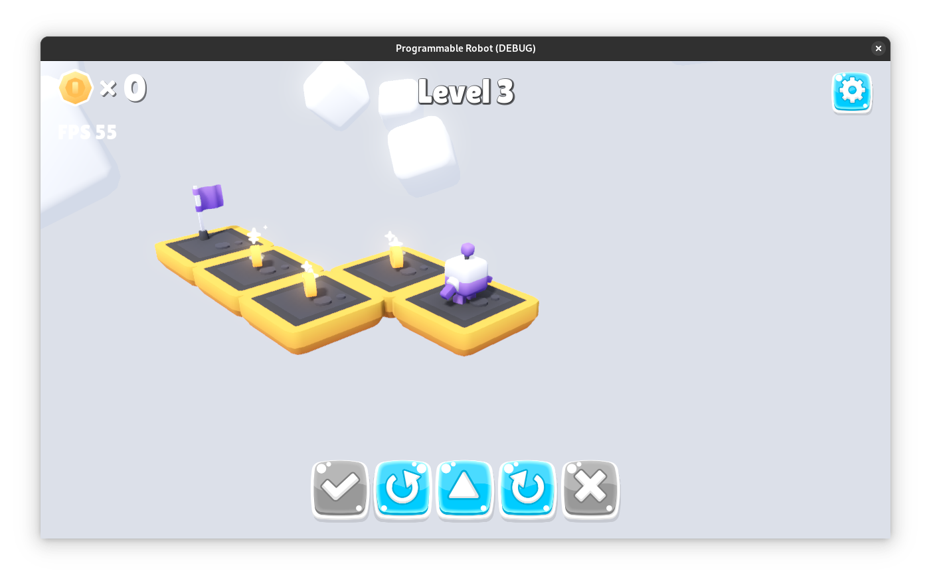
Some of our examples

Slide 16
Building blocks
Nodes
Scenes
Scene tree
Signals
Resources

Slide 17
Building blocks
Nodes
Scenes
Scene tree
Signals
Resources

Slide 18
Building blocks
Nodes
Scenes
Scene tree
Signals
Resources

Slide 19
Building blocks
Nodes
Scenes
Scene tree
Signals
Resources

Slide 20
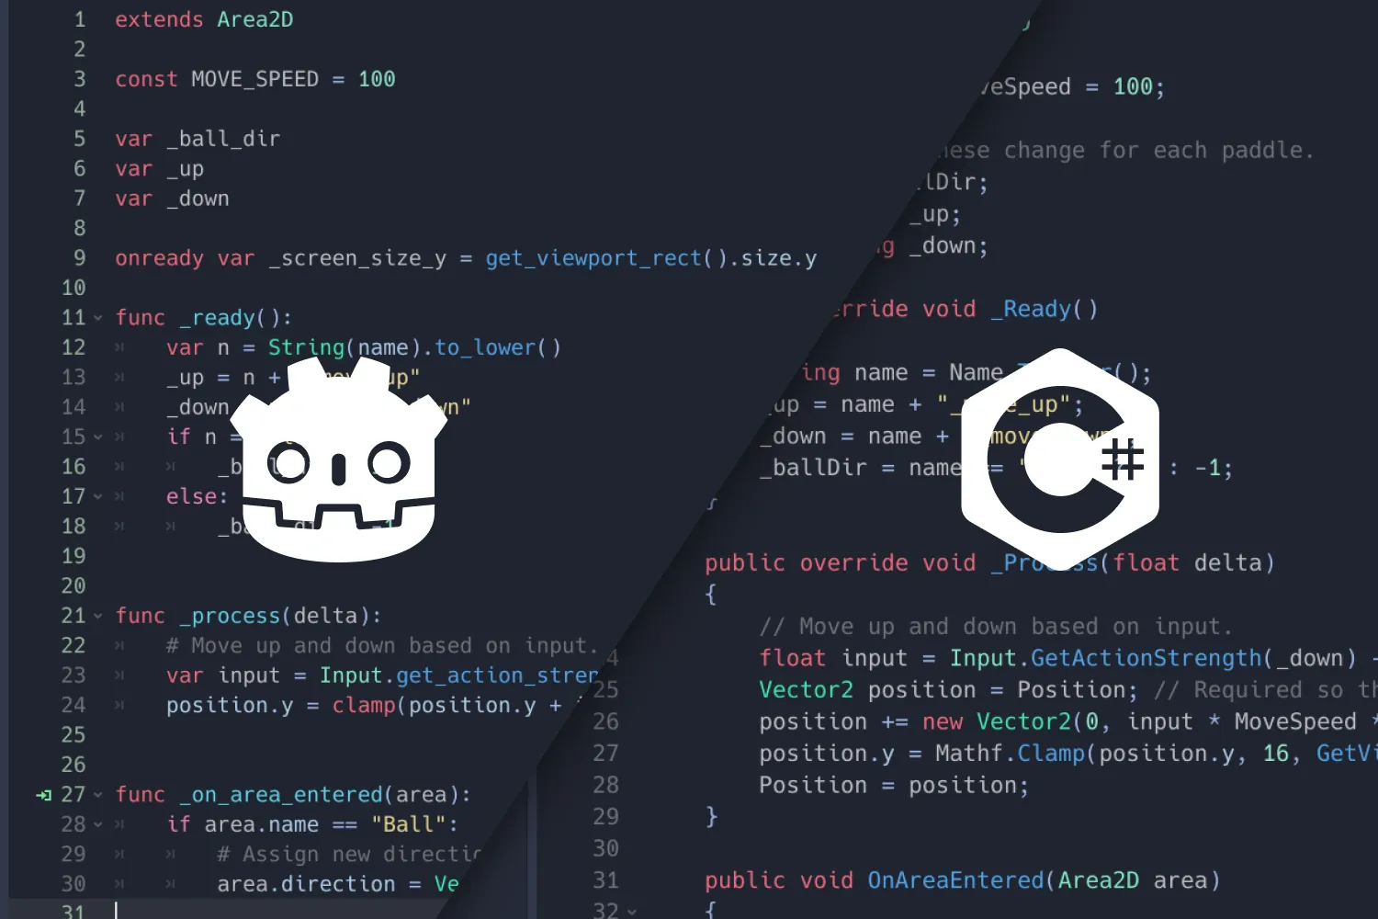
Programming in Godot
GDScript
C#
GDExtension
Other bindings

Slide 21
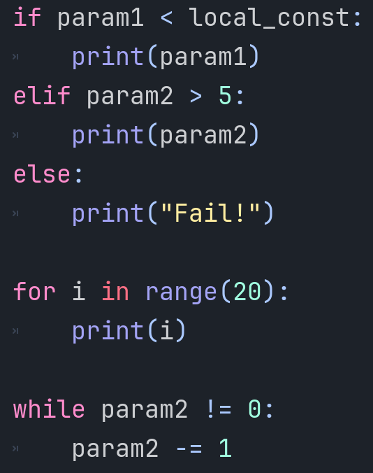
Programming in GDScript
Inspired by Python (but unique!)
Indentation based
Gradual typing: dynamic, optional types
Built-in types for gamedev
Fast compilation
Memory management

Slide 22
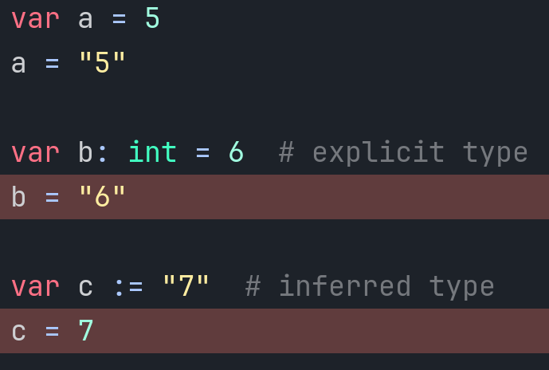
Programming in GDScript
Inspired by Python (but unique!)
Indentation based
Gradual typing
Built-in types for gamedev
Fast compilation
Memory management

Slide 23
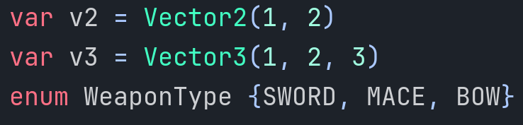
Programming in GDScript
Inspired by Python (but unique!)
Indentation based
Gradual typing
Built-in types for gamedev
Fast compilation
Memory management

Slide 24
Programming in GDScript
Inspired by Python (but unique!)
Indentation based
Gradual typing
Built-in types for gamedev
Fast compilation
Memory management

Slide 25
Enchanting gameplay experience

Slide 26
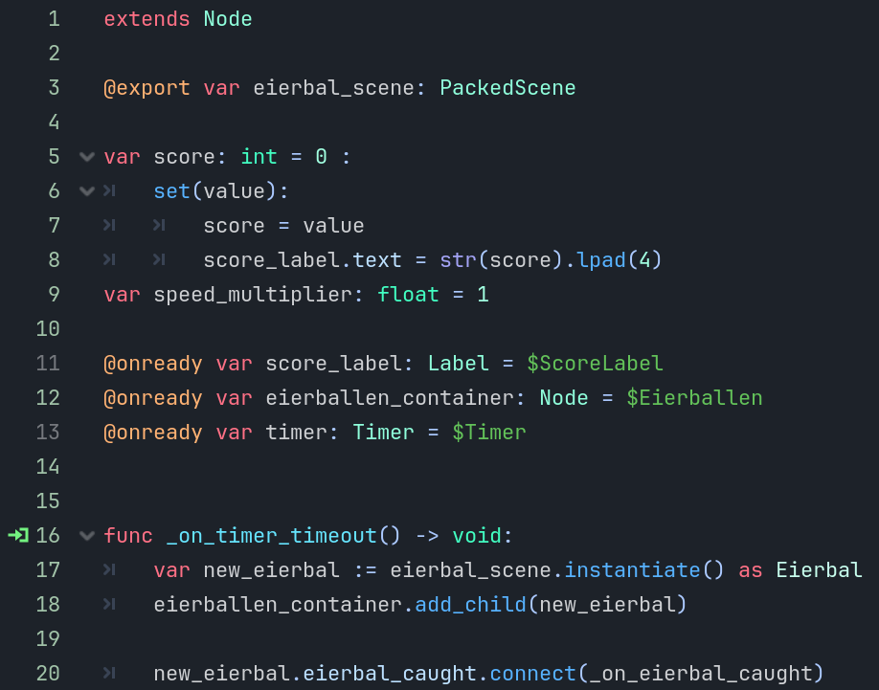
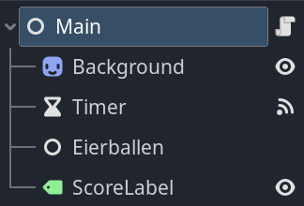
Wrapping up
Nodes, Scenes, Signals, GDScript
Have a look at the documentation!
Have a look at all the free assets on the web!

Slide 27
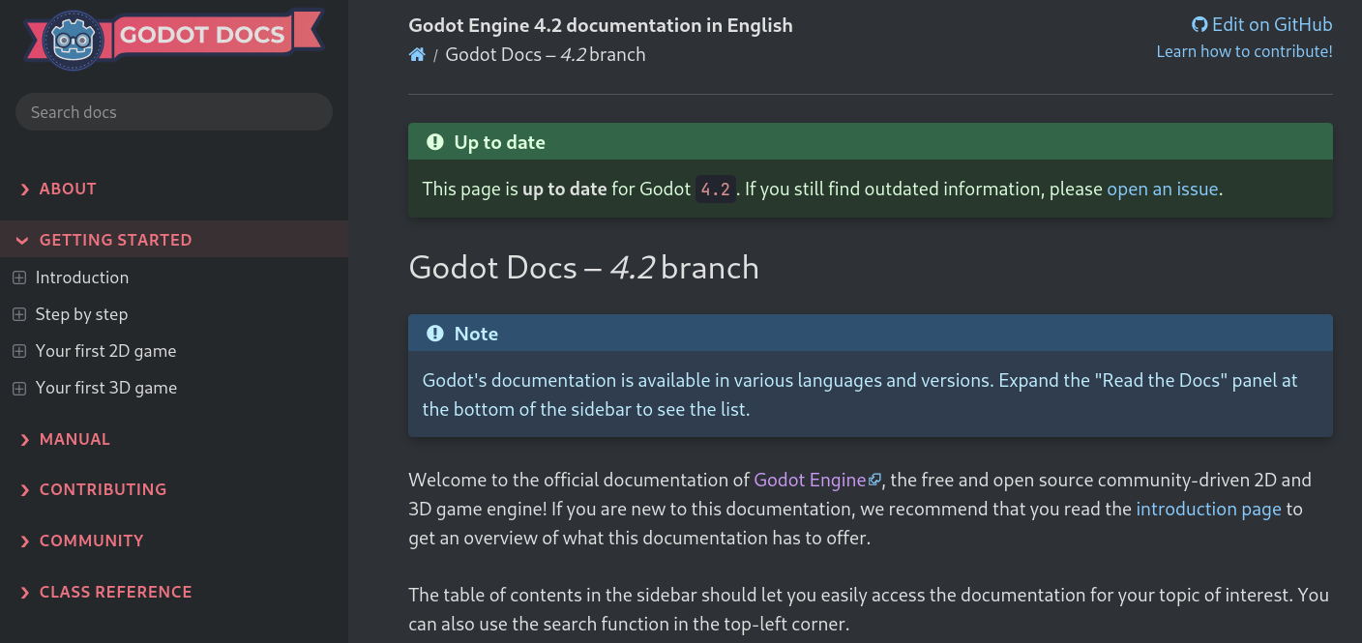
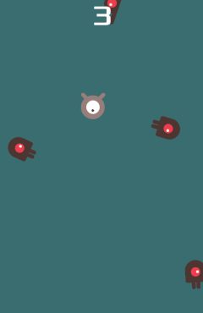
Wrapping up
Nodes, Scenes, Signals, GDScript
Have a look at the documentation!
Have a look at all the free assets on the web!

Slide 28
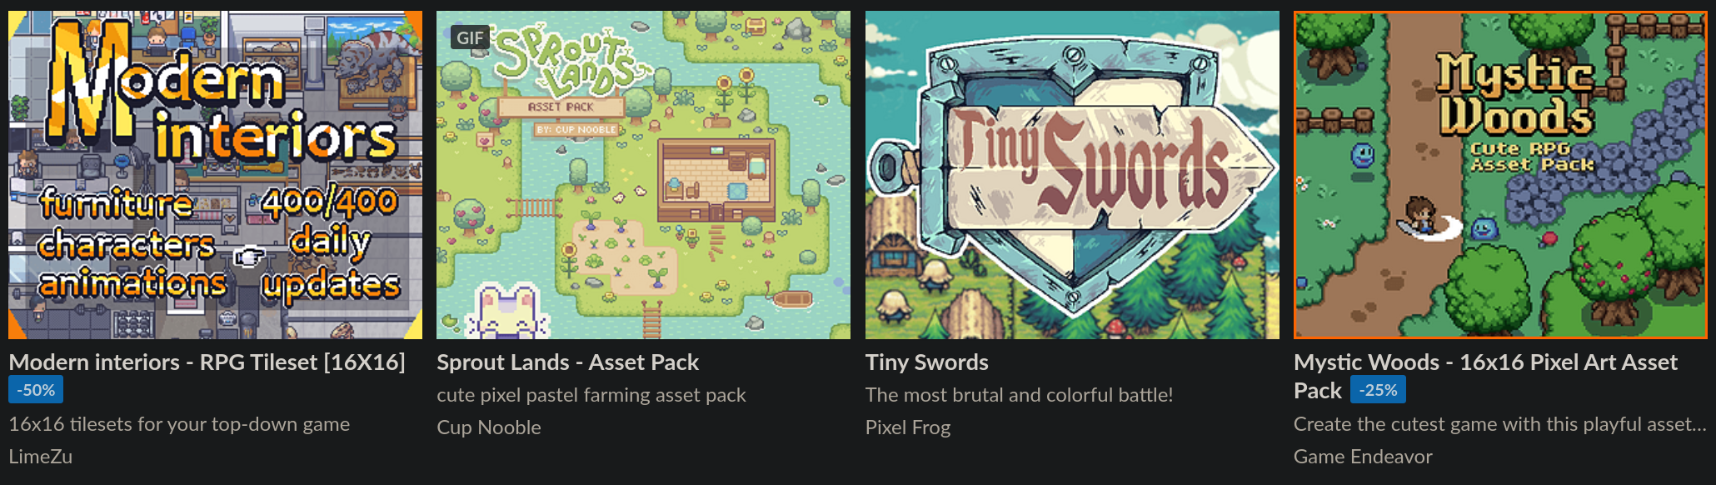
Wrapping up
Nodes, Scenes, Signals, GDScript
Have a look at the documentation!
Have a look at all the free assets on the web!

Slide 29
Credits
Godot Python Logo by Pinswell (CC-BY)
Info, logo, icons from official documentation (CC BY)
Image Groningen by Michiel Verbeek (CC-BY-SA)
Image of Eierbal adapted from Erik009 (CC-BY-SA)

Slide 30
Game Development for Pythonistas using Godot
Sophie de Klerk
share your talent. move the world.

