Slide 1
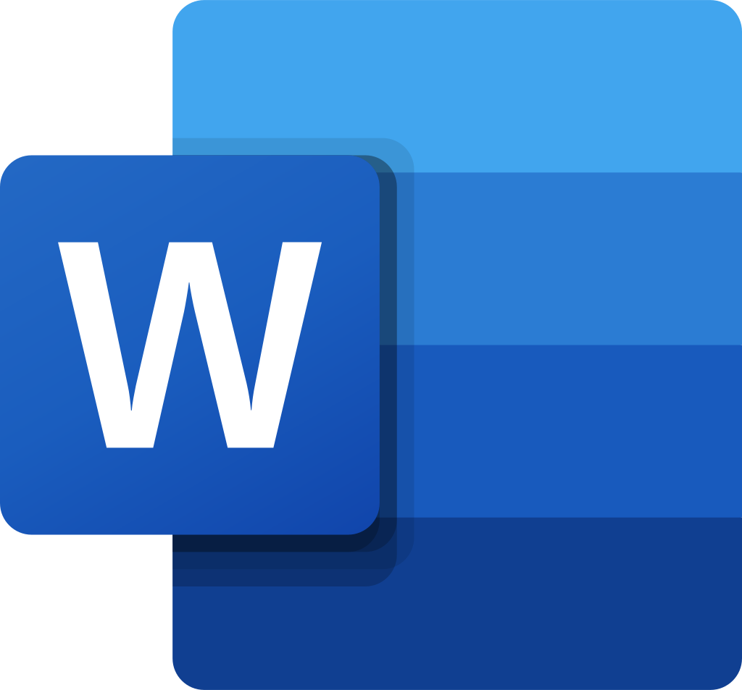
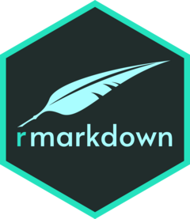
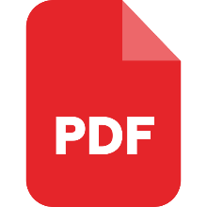
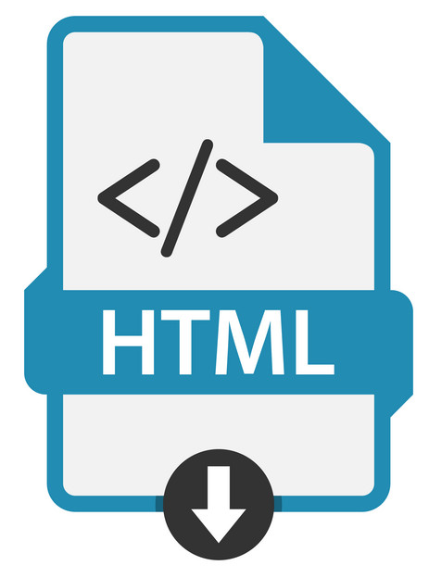


StyleTemplates/
ReportTemplates/
Knit.
Pass styles to YAML via officedown
.Rmd report templates.
Reports/
.docx template with desired styles
Pass report components to YAML via knitr.
Modules/
Apps/
Pass/call modules.
Data/
Shiny modules for generating components of reports (graphs, tables)
Shiny-enabled .Rmd documents for generating report components from data. These are the user-facing documents (the apps).

