Slide 1


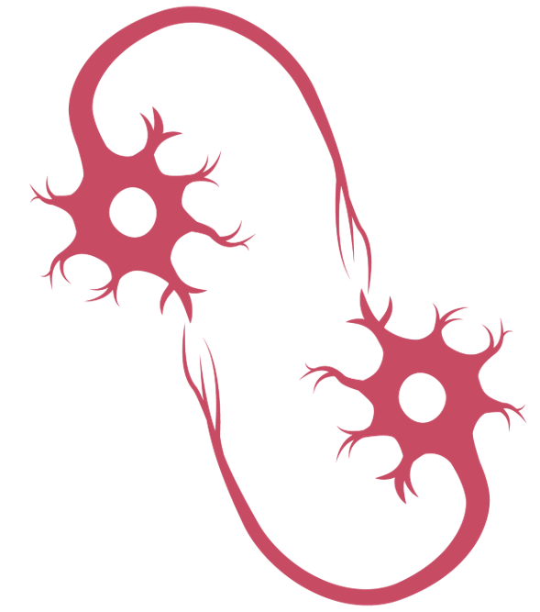

Interaction of the Na⁺/K+ pump and Persistent Na+ currents offers a robust mechanism controlling bursting properties
Ricardo Erazo Toscano1, 2,
Gennady Cymbalyuk1,
Ronald L. Calabrese2
1Neuroscience Institute, Georgia State University, Atlanta GA 30303 USA
2Department of Biology, Emory University, Atlanta GA 30322 USA

Slide 2
Introduction
Neuronal networks, known as Central Pattern Generators (CPGs), control rhythmic motor behaviors such as breathing and walking in vertebrates, and heartbeat in the leech
Membrane and synaptic currents of neurons produce the functional rhythms of CPGs
The Na⁺/K⁺ pump current is activated by intracellular sodium concentration. It is an outward current. The pump current does not have a time constant; in our model, it activates instantaneously In accordance with [Na⁺]_{i}
In addition to its classical role preserving ionic gradients across the membrane, the Na⁺/K⁺ pump contributes to the generation of the rhythmic activity of neurons.
The Na⁺/K⁺ pump is a target of modulation
We hypothesize that persistent sodium current (I_{P}) and the pump current (I_{pump}) interact to create an oscillatory mechanism
I_{P} is a low-threshold activated current and can be active in depolarized and hyperpolarized membrane potentials. I_{pump} is voltage-independent, and it can be active throughout the cycle as well.
Interneurons of the leech heartbeat CPG are endogenously rhythmic. We investigate in single neurons how I_{P} and I_{pump} interact
Cymbalyuk et al.,2002; Tobin & Calabrese, 2005; Kueh at al., 2016

Slide 3
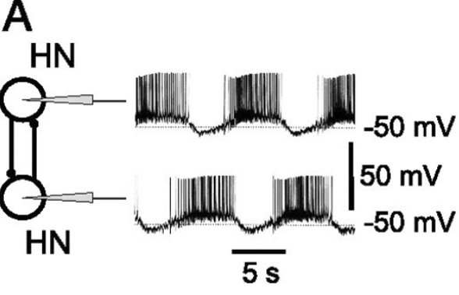
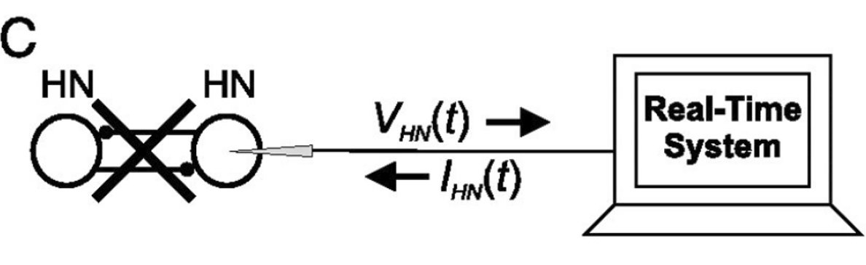
Methods
In the leech heartbeat CPG, rhythmically active interneurons (HN neurons) comprise the network.
Hybrid system: A living neuron interacts in real-time with a computational model via a sharp microelectrode
New-Generation dynamic clamp: The model runs in real-time; it accounts for the contribution of IP and removal of Na+ by the Na/K pump to estimate [Na+]i as a dynamic variable. The model uses the intracellular sodium concentration to compute and inject the pump current into the living HN neuron.
Control parameters of dynamic clamp:
ḡ_{P} : The maximal conductance of I_{P}
I_{pumpmax} : The maximum current produced by the Na⁺/K⁺ pump
(Sorensen et al., 2004; Olypher et al., 2006)

Slide 4
Methods. Experimental protocol
We generally perform two experimental protocols:
Keep IpumpMax constant and systematically vary gP
Keep gP steady and systematically vary IpumpMax
These methods allow us to control each current simultaneously and independently.

Slide 5
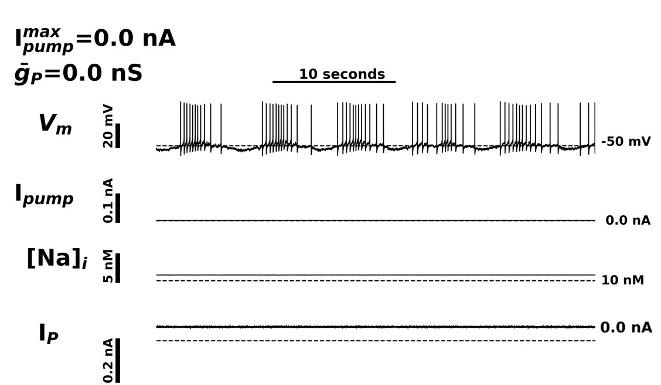
Single HN neuron endogenous rhythm

Slide 6
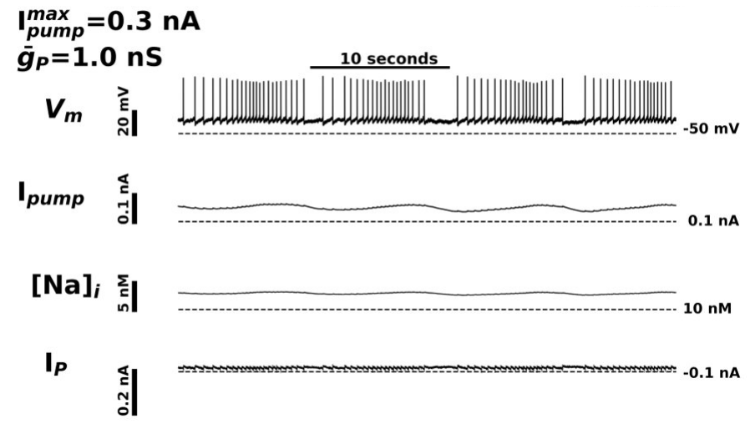
ḡ_{P} ≤ 3 nS: low spike frequency

Slide 7
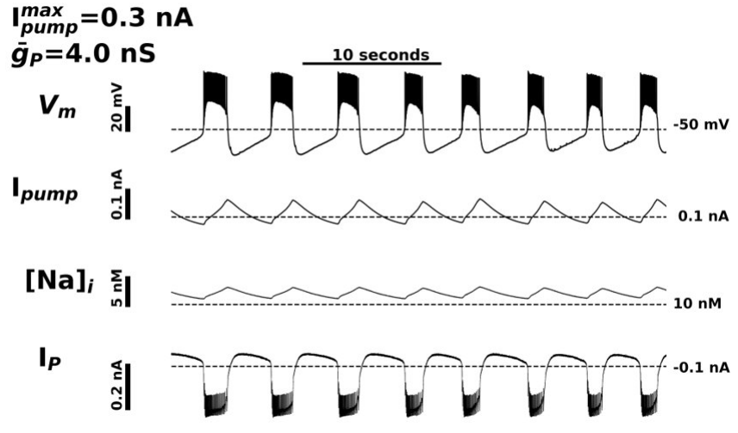
ḡ_{P} > 3 nS: high spike frequency

Slide 8
ḡ_{P} > 3 nS: short burst duration, high spike frequency

Slide 9
ḡ_{P} affects the amplitude of [Na⁺]_{i} oscillations
The amplitude of oscillations in red are shorter than the amplitude of oscillations in blue
Upregulation of IpumpMax does not affect amplitude of the oscillations, but it shifts the baseline [Na⁺]_{i}

Slide 10
Average spiking frequency of bursts
When gP is less or equal than 3 nS, spike frequency is always less than 7 Hz, and when gP is greater than 3 nS, spike frequency is always more than 8 Hz.

Slide 11
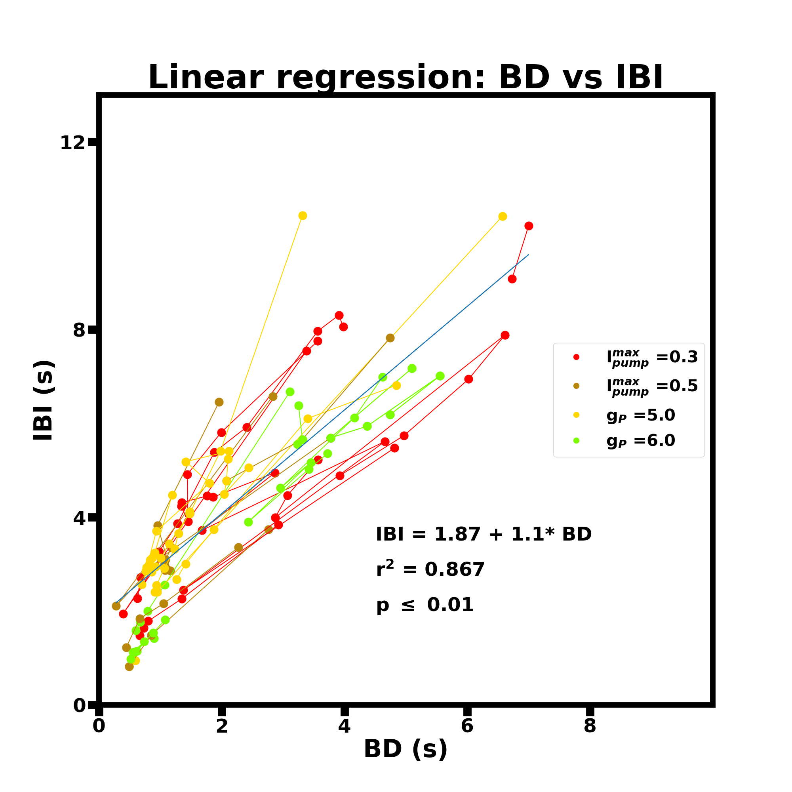
Burst duration and interburst interval are positively, strongly correlated across subjects and experimental conditions.
This graph shows that independent of the experimental manipulation burst duration and interburst interval tend to increase and decrease together. These two dependent variables scale linearly and demonstrate that our experimental manipulations lengthen and shorten both burst duration and interburst interval.

Slide 12
Results summary
HN neurons oscillate robustly with dynamic clamp I_{pump} and I_{P}
I_{P} and I_{pump} interact to control V_{m} excursion, [Na⁺]_{i}, and burst duration
I_{P} controls average burst spike frequency
Burst duration and Interburst interval are strongly, positively correlated, across subjects and experiments

Slide 13
Conclusions
I_{P} and I_{pump} interact to generate a rhythmic mechanism independent of synapses
Burst duration and interburst interval tend to increase and decrease together. IP and Ipump interact loading and emptying intracellular sodium, analogous to a relaxation oscillator
ḡ_{P} marks a qualitative change in V_{m} excursion and average burst spiking frequency

Slide 14
Conclusions
Ipump interacts with IP to create a flexible mechanism to control the neuronal activity of rhythmic neurons. The rhythmic patterns that arise from their interaction range from:
low spike frequency
high spike frequency
These bursting modes and characteristics represent qualitative transitions in neuronal dynamics.

Slide 15
Acknowledgements
We would like to acknowledge the following sources of funding: NIH Grant 1 R21 NS111355 issued to Gennady Cymbalyuk and Ronald Calabrese.

Slide 16
References
Cymbalyuk, G. S., Gaudry, Q., Masino, M. A., & Calabrese, R. L. (2002). Bursting in leech heart interneurons: cell-autonomous and network-based mechanisms. Journal of Neuroscience, 22(24), 10580-10592.
Sorensen, M., DeWeerth, S., Cymbalyuk, G., & Calabrese, R. L. (2004). Using a hybrid neural system to reveal regulation of neuronal network activity by an intrinsic current. Journal of Neuroscience, 24(23), 5427-5438.
Tobin, A. E., & Calabrese, R. L. (2005). Myomodulin increases I h and inhibits the Na/K pump to modulate bursting in leech heart interneurons. Journal of neurophysiology, 94(6), 3938-3950.
Olypher, A., Cymbalyuk, G., & Calabrese, R. L. (2006). Hybrid systems analysis of the control of burst duration by low-voltage-activated calcium current in leech heart interneurons. Journal of neurophysiology, 96(6), 2857-2867.
Kueh, D., Barnett, W. H., Cymbalyuk, G. S., & Calabrese, R. L. (2016). Na+/K+ pump interacts with the h-current to control bursting activity in central pattern generator neurons of leeches. Elife, 5, e19322.

