Slide 1


Android 测试

Slide 2
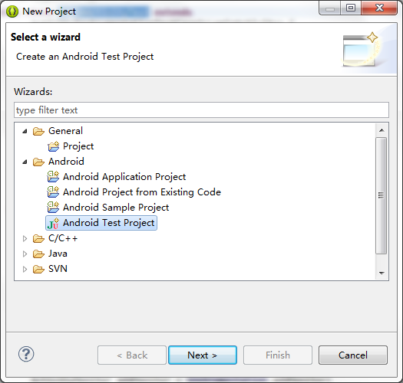

Slide 3
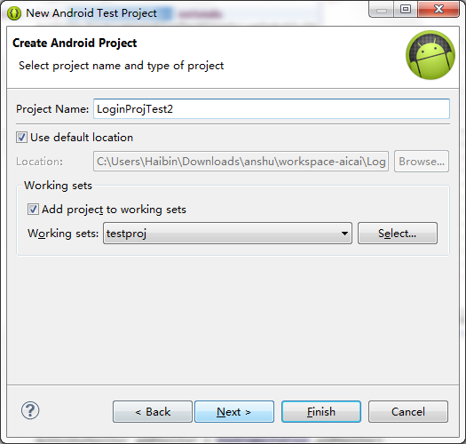

Slide 4
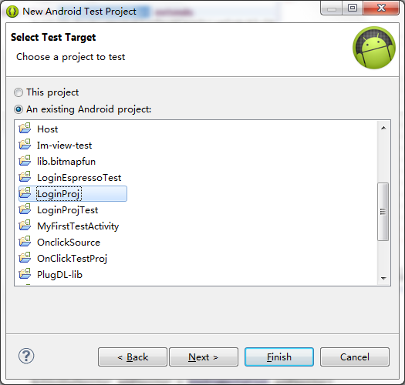

Slide 5
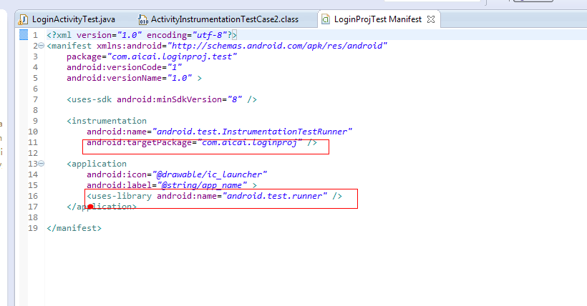

Slide 6
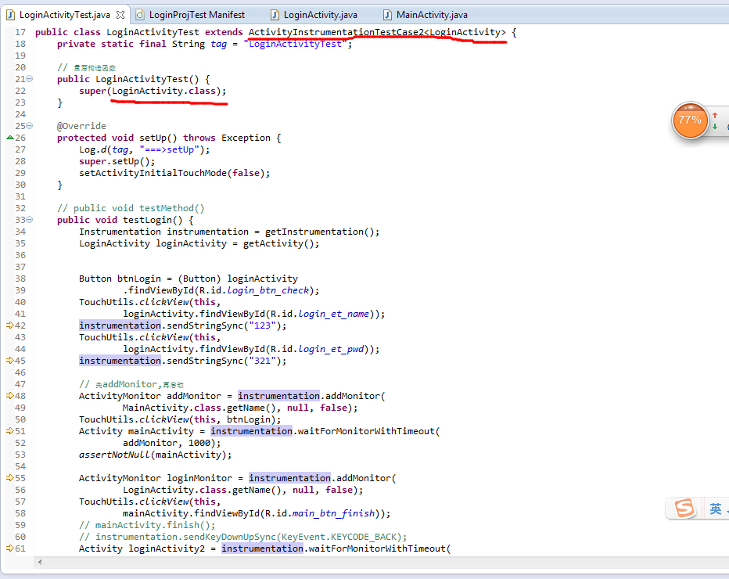

Slide 7
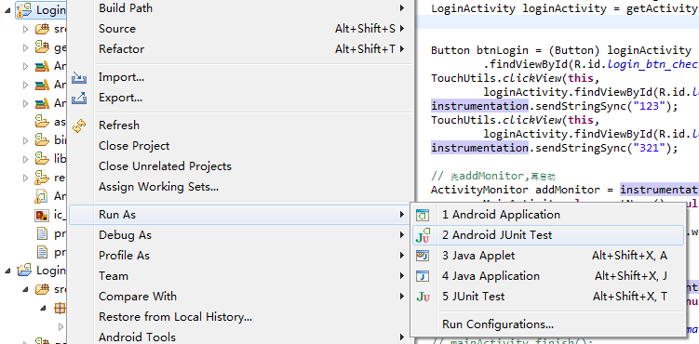

Slide 8
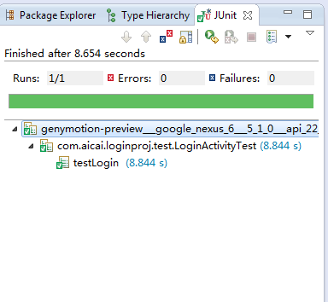

Slide 9


Why not office on your smart phone ?
Kingsoft Office for Android is an efficient mobile office solution made exclusively for cell phones and tablet devices running the Android Honeycomb OS (2.1 or above).
3rd.

Slide 10

THANK YOU!

