Slide 1
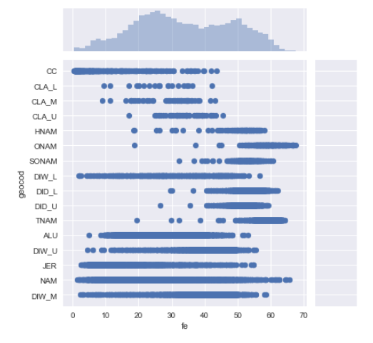
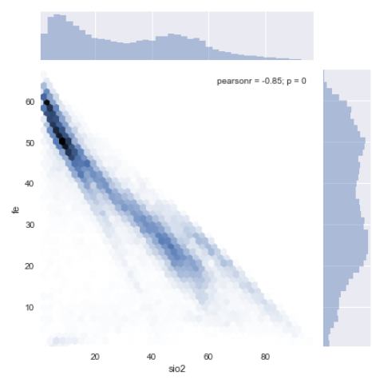
Drill hole data is important as it allows us to evaluate rock/ore type for mine planning purposes
Dataset captures location, geochemistry and geological (logging) data. E.g. fe, sio2, rock domain, co-ordinates

